Slide 1
A Simplified Method for Automatic Verification of Java Programs
Zhi Li¹，Ling Xie¹，Yilong Yang²
1：Guangxi Normal University
2：Beihang University

Slide 2
1
Introduction
2
Method and Implementation
CONTENTS
3
Experiment
4
Conclusion

Slide 3
Introduction
Problem
Many current program verification methods or techniques are only applicable to program fragments or simple programs.
Current Key verification tool for Java programs provides limited capability for verifying Java programs.
Solution
A program simplification method is urgently needed to extend the capability of existing program verifiers so that complex programs can be dealt with constructively.
In this paper, we provide a method for simplifying complex Java programs into a KeY-compatible format, by defining a set of rules based on Abstract Syntax Tree (AST).

Slide 4
Introduction
AST
Abstract syntax tree (AST) is used to parse, traverse, and re-factor Java code.
KeY
The ultimate goal of simplifying complex Java programs is to be verifiable in the KeY tool.
The KeY is a formal verification tool for Java programs, with both fully automated and
interactive verifications.

Slide 5
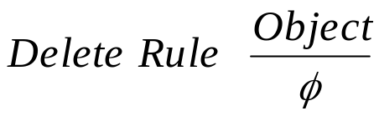
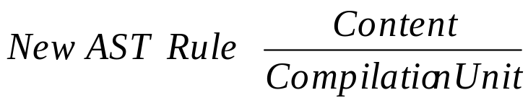
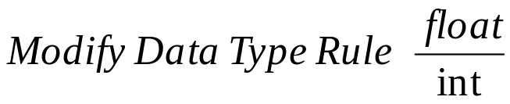
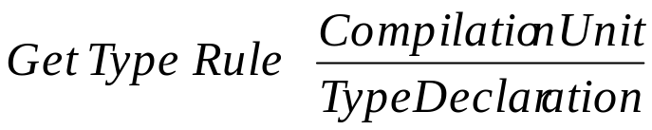
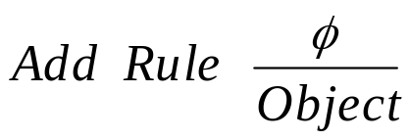
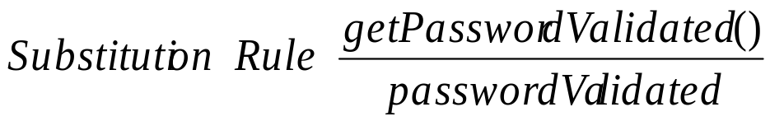
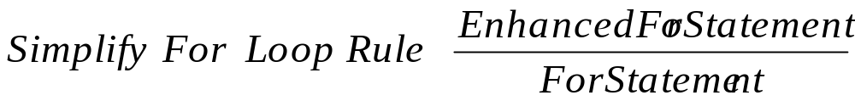
Method and Implementation
Overview of the methods
New AST Rule
Delete Rule
Modify Data Type Rule
Get Type Rule
7 simplified rules
Add Rule
Substitution Rule
Simplify For Loop Rule

Slide 6
Method and Implementation
Method implementation
The implementation is based on the eclipse JDT plug-in, and it consists of the following steps.
Environment preparation
Parsing the AST
Modifying the AST
AST converted into Java program
Install the JDT plug-in in
Eclipse, then download the
corresponding JAR package to use when the configuration
program runs.
Use statements to create a parser, and the parser to create and return the AST context result CompilationUnit as the root node.
According to different simplification requirements, use 7 simplified rules to modify the AST.
The file output stream
parses the modified string, converts the string into a Java file and outputs it to the specified
location.

Slide 7
Experiment
This section presents an example of a bank ATM withdrawal that shows how to simplify the source Java program by using AST and then verify the correctness with the KeY tool.
Substitution Rule
The GetCardIDValidated() method is replaced by the CardIDValidated variable.
Using the inputCard function to show the application of rule:
Delete Rule
It is used to delete comments, variables or statements in the methods.
04
Add Rule
It is applied to add variable C of
BankCard data type to the method.
Simplify For Loop Rule
03
The enhanced For Loop is
simplified into the general For Loop.
02
01

Slide 8
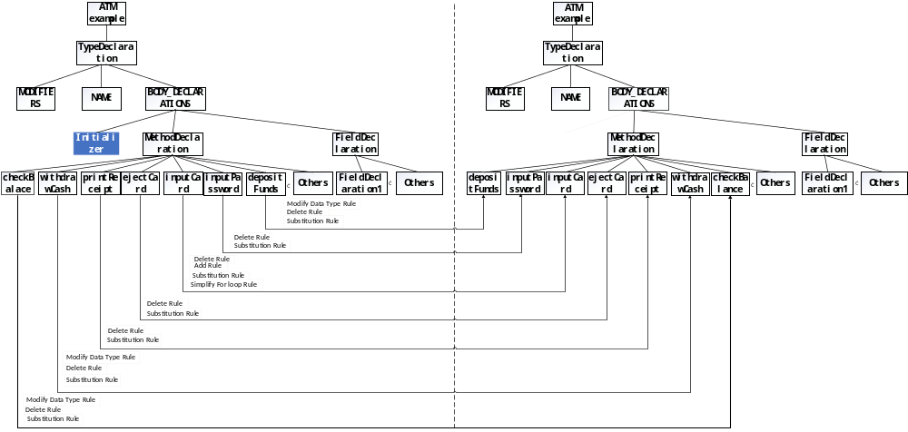
Experiment
indows 10
Simplified process diagram of bank ATM withdrawal example

Slide 9
Conclusion
We present seven rules for simplifying your source Java programs.
The scope of simplification proposed in this paper has yet to be extended.
The simplified Java programs are verified based on the Java program-oriented verification tool KeY.
Future work will improve the simplification work based on AST and try to use empirical methods to evaluate our simplification rules.

Slide 10
Thank you!

