Slide 1


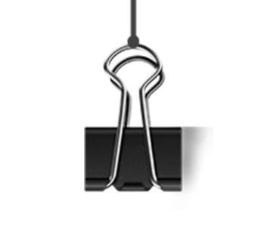

A Node-Merging based Approach for Generating iStar Models from User Stories
Chao Wu¹ , Chunhui Wang^{*1} , Tong Li² ，Ye Zhai¹
1 College of Computer Science and Technology,Inner Mongolia Normal University,Hohhot, China
2 Faculty of Information Technology,Beijing University of Technology, Bejing, China
SEKE 2022，July 5

Slide 2

Outline
1
Background
2
Method
3
Experiments
4
Conclusion
Notes:
这篇论文主要从以下四个部分进行阐述：背景、方法、实验、结论

Slide 3


1. Background
1.1 Motivation
① In agile development, 90 % of practitioners adopt user stories written in natural language to express their requirements^{[1]}.
Example：As an administrator， I want to login ，so that I can use application
×
√
[1] Lucassen G, Dalpiaz F, Werf J M, et al. The Use and Effectiveness of User Stories in Practice. 2016.

Slide 4
1. Background
1.1 Motivation
② In recent years, building model from natural language is an open research area.
×
√

Slide 5
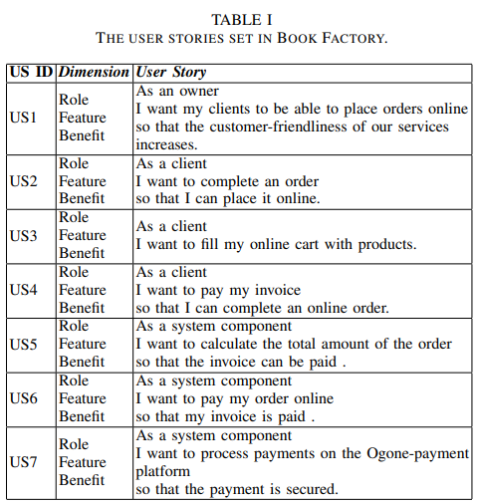
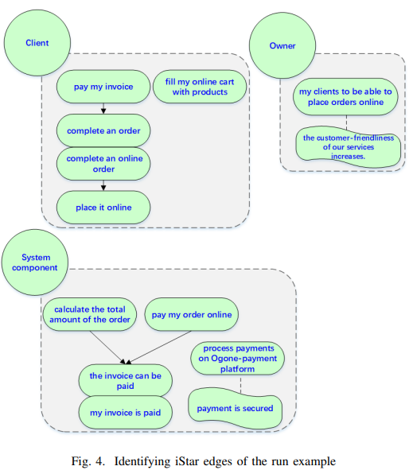
用户故事生成这样的目标模型
1. Background
From user stories to generate iStar models

Slide 6
1. Background
1.2 Related work
Method of building goal model:
A light weight Goal Net based method to build^{[1]}.
A custom rationale diagram on the basis of a US set^{[2]}.
A pipeline of applying NLP techniques and initial heuristics to build^{[3]}.
A set of heuristics to build i* models^{[4]}.
[1] Lin J , Han Y , Shen Z , et al. Using goal net to model user stories in agile software development[C]// 2014.
[2] Wautelet Y , Heng S , Kolp M , et al. Building a Rationale Diagram for Evaluating User Story Sets[C]// 2016.
[3] T Güne, Aydemir F B . Automated Goal Model Extraction from User Stories Using NLP[C]//2020.
[4] Jaqueira A , Lucena M , Aranha E , et al. Using i* models to enrich user stories. 2013.

Slide 7
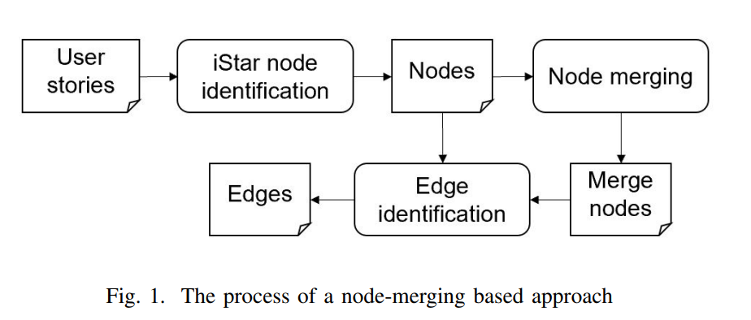
2. Method
This paper proposes a node-merging based approach to generating iStar models from user stories.

Slide 8
2. Method
In this phase, we identify iStar nodes and their types from a set of input user stories.
Input a set of user stories;
Obtain the user stories components;
Identify iStar nodes and types;
Rule1: Each who component maps to role type node;
  Rule2: Each what component maps to intention type node;
  Rule3: Each why component maps to intention type node.
  Discover quality type nodes : based on keywords matching.
2.1 iStar node identification
有非功能需求列表，不用引用

Slide 9

2. Method
2.2 Node merging
In this phase, we identify and merge iStar nodes with high similarity.
Identify iStar nodes similarity：
Generate nodes vector by fine-tune BERT model；
Measure the similarity of each pair of nodes by cosine.
Merge nodes with high similarity：
Extract node pairs with threshold greater than 0.8；
Merge them as a node.

Slide 10

2. Method
2.3 Edge identification
In this phase, we used three rules to automatically identify the edges between nodes based on the identified iStar nodes and the merged nodes.
Rule 1: Add an edge of type means-ends for two intention nodes from the same user story. The source is from what part in the user story. The target is from why part in the user story.
Rule 2: Add edges of type refinement type for a merged node and its components (nodes).
Rule 3: Add an edge of type contribution for a quality node and its corresponding intention node.

Slide 11

3. Experiment
3.1 Dataset
We evaluated our approach on three user story datasets from three different areas of entertainment, education and business.
Dataset | Field | Num
GA | entertainment | 21
BADcamp | education | 70
webCompany | business | 79

Slide 12

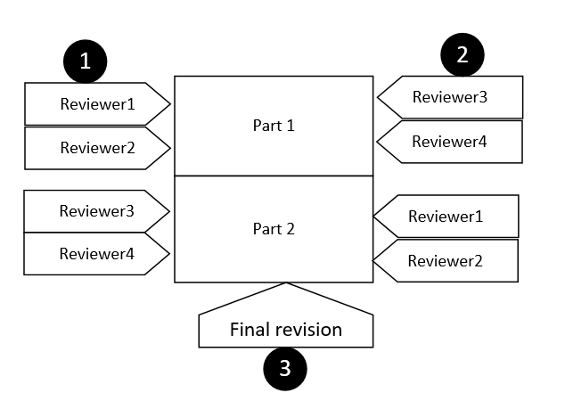
3. Experiment
3.2 Manually labeled datasets
Labeled setup:
One is for quality requirements,
Other is for finding similar pairs of user stories.
Labeled member：4 graduate students with software engineering related knowledge.
Labeled Method：

Slide 13

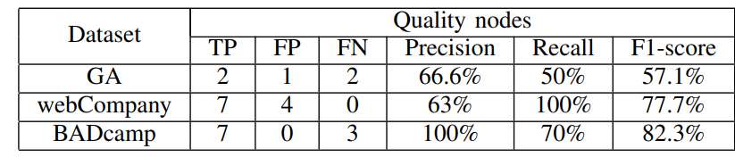
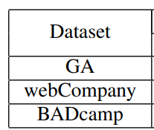
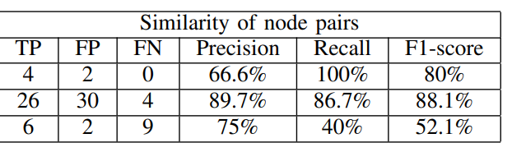
3. Experiment
3.3 Experiment evaluation
RQ1: How effective is the discovery of quality type nodes in iStar node identification processing?
RQ2: How effective is the discovery of similarity nodes in node merging processing?

Slide 14

4. Conclusion
This paper focuses on the refinement and contribution relationships between user stories.
A node-merging based approach is proposed to identify the potential refinement relationships.
A quality word list is built to find the non-function user story and to identify the contribution edges.
Three data sets are used to evaluate the effectiveness of the proposed approach.

Slide 15

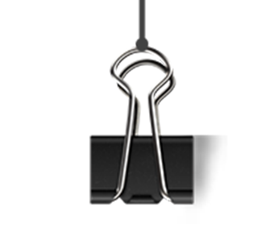
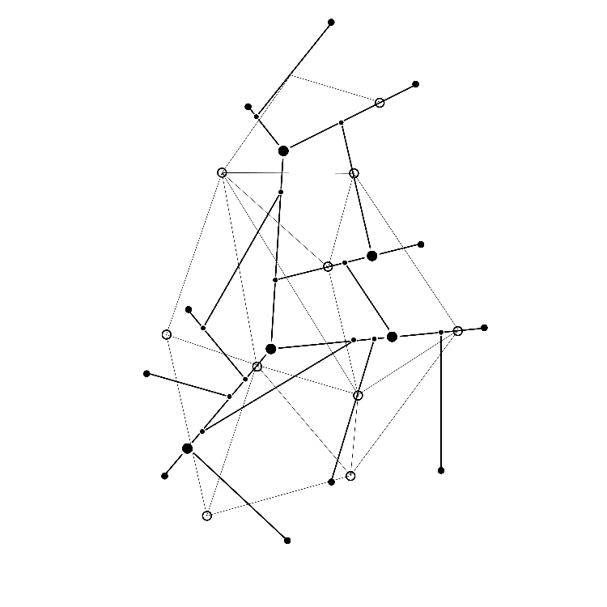

Thank you!

