Slide 1
Data Modeling and Data Analysis in Simulation Credibility Evaluation of Autonomous Underwater Vehicles
A.P. Xiaojun Guo
National University of Defense Technology

Slide 2
1
INTRODUCTION
CONTENTS
2
DATA ANALYTICS METHODS IN CREDIBILITY EVALUATION
3
DATA MODELING AND DATA ANALYSIS METHODS

Slide 3
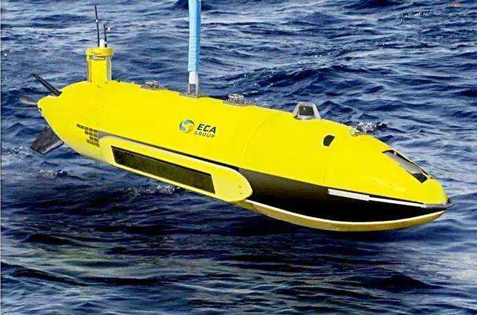



Introduction
For the simulation modeling and reliability evaluation of complex large systems, Bayesian statistics and expert systems have been proposed.
AUV, whose communication, target detection, etc. all involve more complex test environmental conditions.
The uncertainty of the system error and the inaccuracy of the experimental data observation are the main causes of the uncertainty.

Slide 4
1
INTRODUCTION
CONTENTS
2
DATA ANALYTICS METHODS IN CREDIBILITY EVALUATION
3
DATA MODELING AND DATA ANALYSIS METHODS

Slide 5
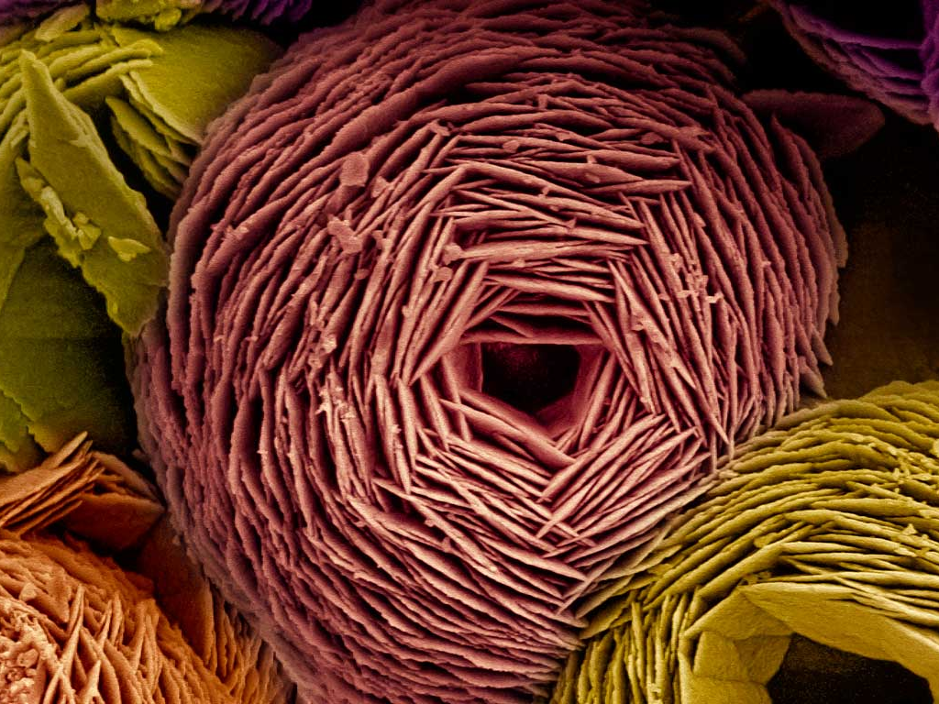
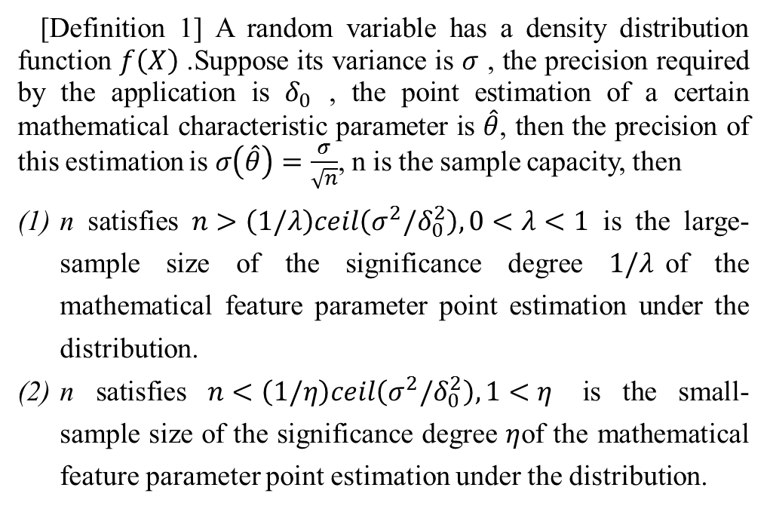
Definition of small sample
[Definition 1] A random variable has a density distribution function $f\left(X\right)$ .Suppose its variance is $σ$ , the precision required by the application is $δ_{0}$ , the point estimation of a certain mathematical characteristic parameter is $\hat{θ}$, then the precision of this estimation is $σ\left(\hat{θ}\right)=\frac{σ}{\sqrt{n}}$, n is the sample capacity, then
n satisfies $n>\left(1/λ\right)ceil\left(σ^{2}/δ_{0}^{2}\right),0<λ<1$ is the large-sample size of the significance degree $1/λ$of the mathematical feature parameter point estimation under the distribution.
n satisfies $n<\left(1/η\right)ceil\left(σ^{2}/δ_{0}^{2}\right),1<η$ is the small-sample size of the significance degree $η$of the mathematical feature parameter point estimation under the distribution.

Slide 6
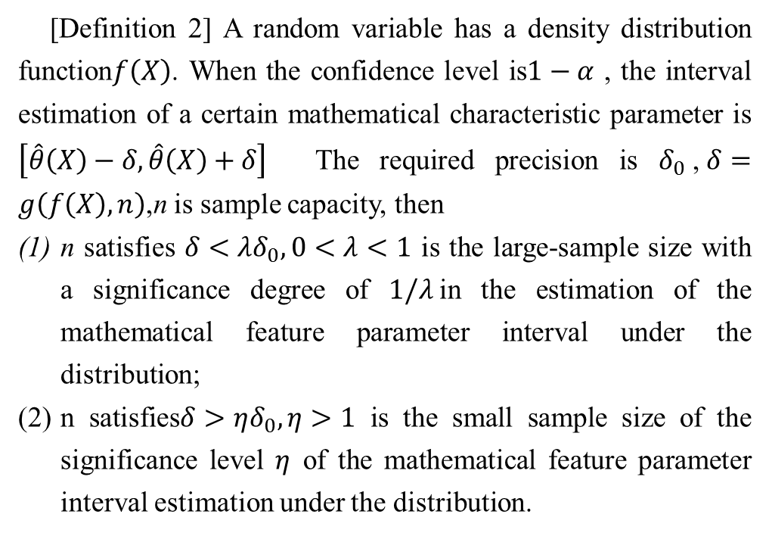
Definition of small sample
[Definition 2] A random variable has a density distribution function$f\left(X\right)$. When the confidence level is$1−α$ , the interval estimation of a certain mathematical characteristic parameter is $\left[\hat{θ}\left(X\right)−δ,\hat{θ}\left(X\right)+δ\right]$ The required precision is $δ_{0}$,$δ=g\left(f\left(X\right),n\right)$,n is sample capacity, then
n satisfies $δ<λδ_{0},0<λ<1$ is the large-sample size with a significance degree of $1/λ$in the estimation of the mathematical feature parameter interval under the distribution;
n satisfies$δ>ηδ_{0},η>1$ is the small sample size of the significance level $η$ of the mathematical feature parameter interval estimation under the distribution.

Slide 7
Bayesian sequential mess test
sequential probability ratio test (SPRT)
sequential posterior odd test (SPOT)
Sequential Mess Test (SMT)
Bayes Sequential Mess Test (BSMT)

Slide 8
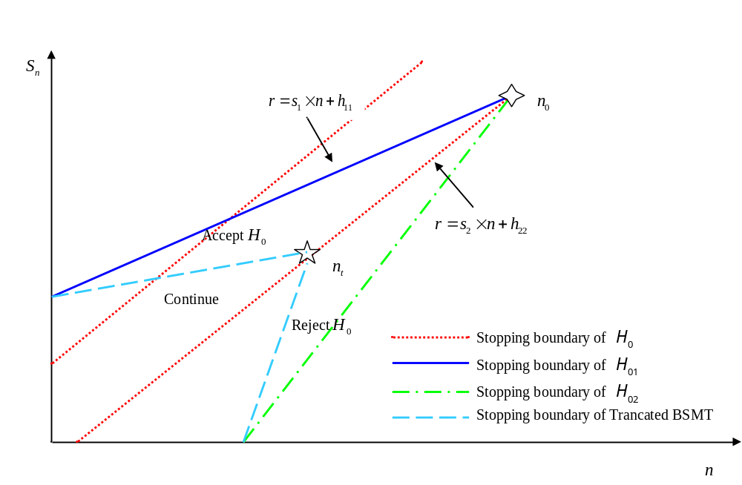
Bayesian sequential mess test
Sequential Mess Test (SMT)

Slide 9
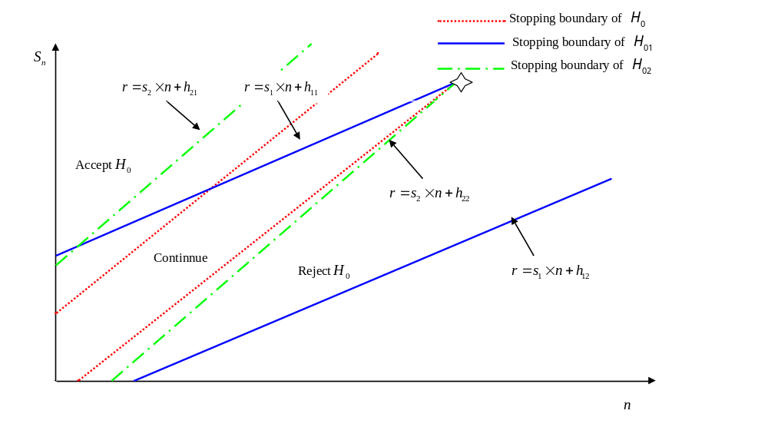
Bayesian sequential mess test
Bayes Sequential Mess Test (BSMT)

Slide 10
1
INTRODUCTION
CONTENTS
2
DATA ANALYTICS METHODS IN CREDIBILITY EVALUATION
3
DATA MODELING AND DATA ANALYSIS METHODS

Slide 11
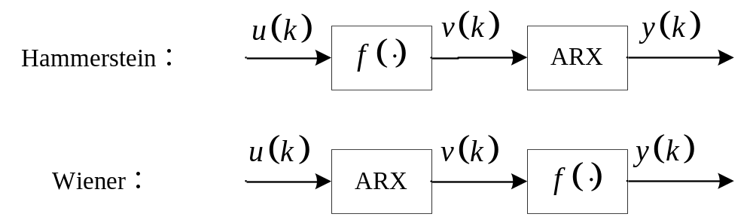
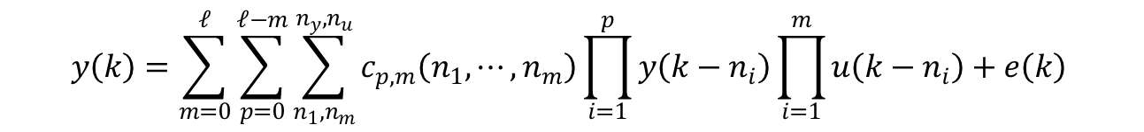
Steady-state response for NARX model
Hammerstein and Wiener models
general NARX model
$$y\left(k\right)=\sum_{m=0}^{𝓁}{\sum_{p=0}^{𝓁−m}{\sum_{n_{1},n_{m}}^{n_{y},n_{u}}{c_{p,m}\left(n_{1},⋯,n_{m}\right)}}}\prod_{i=1}^{p}{y\left(k−n_{i}\right)}\prod_{i=1}^{m}{u\left(k−n_{i}\right)}+e\left(k\right)$$

Slide 12
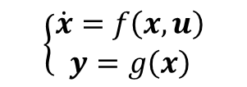
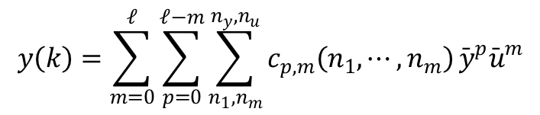
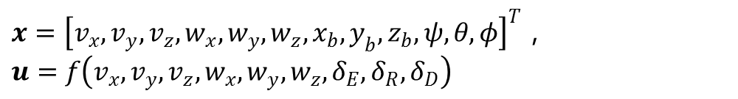
NARX characterization of AUV motion models
model of the 6-DOF AUV
$$\left\{\begin{aligned}\dot{x}=f\left(x,u\right) \\ y=g\left(x\right)\end{aligned}\right.$$
$x={\left[v_{x},v_{y},v_{z},w_{x},w_{y},w_{z},x_{b},y_{b},z_{b},ψ,θ,φ\right]}^{T}$，$u=f\left(v_{x},v_{y},v_{z},w_{x},w_{y},w_{z},δ_{E},δ_{R},δ_{D}\right)$
discretized NARMAX state equation
$$X\left(k+1\right)=F^{𝓁}\left(X\left(k\right),U\left(k\right),C_{0}^{b},Te,Rx,⋯,Mx,⋯\right)$$
$$y\left(k\right)=\sum_{m=0}^{𝓁}{\sum_{p=0}^{𝓁−m}{\sum_{n_{1},n_{m}}^{n_{y},n_{u}}{c_{p,m}\left(n_{1},⋯,n_{m}\right)}}}{\bar{y}}^{p}{\bar{u}}^{m}$$

Slide 13
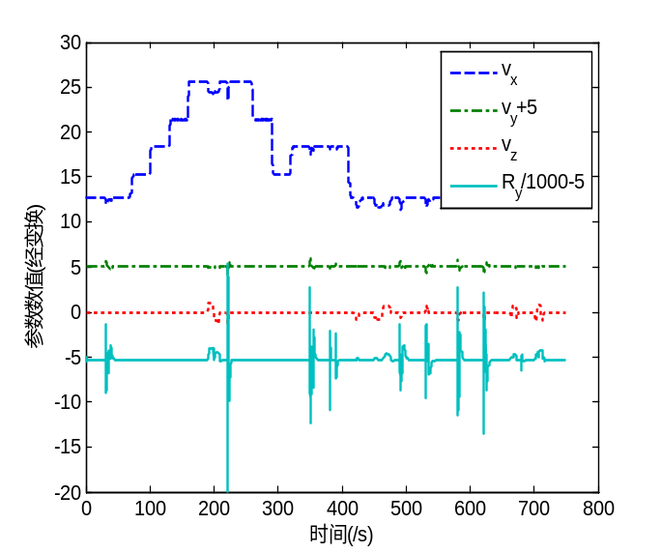
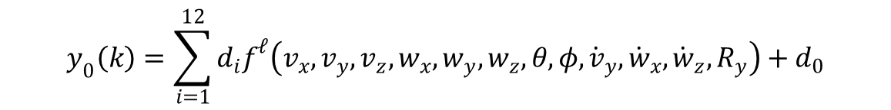
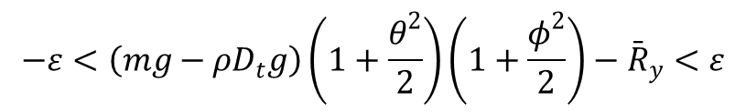
NARX Model Steady-State Response Grey Box Identification
steady-state response process
$$y_{0}\left(k\right)=\sum_{i=1}^{12}{d_{i}f^{𝓁}\left(v_{x},v_{y},v_{z},w_{x},w_{y},w_{z},θ,φ,{\dot{v}}_{y},{\dot{w}}_{x},{\dot{w}}_{z},R_{y}\right)}+d_{0}$$
$$−ε<\left(mg−ρD_{t}g\right)\left(1+\frac{θ^{2}}{2}\right)\left(1+\frac{φ^{2}}{2}\right)−{\bar{R}}_{y}<ε$$
Partial identification data

Slide 14
NARX Model Steady-State Response Grey Box Identification
FITTING ACCURACY OF PARAMETERS
Period | Accumulation of identification errors
 | RFF-LS | RPEA-BP | Steady state response method
0-40s | 6.5254 | 14.5911 | 5.5376
0-200s | 132.851 | 213.284 | 78.265
0-400s | 416.4397 | 520.515 | 222.549
0-750s | 814.675 | 1302.32 | 416.61

Slide 15
Thanks for your attention!

