Slide 1





The 34th International Conference on Software Engineering & Knowledge Engineering (SEKE 2022), July 1-10, 2022, Pittsburgh, USA (Virtual)
Decisions in Continuous Integration and Delivery:
An Exploratory Study
Yajing Luo¹, Peng Liang¹, Mojtaba Shahin², Zengyang Li³, Chen Yang⁴
¹ School of Computer Science, Wuhan University, Wuhan, China
² School of Computing Technologies, RMIT University, Melbourne, Australia
³ School of Computer Science & Hubei Provincial Key Laboratory of Artificial Intelligence and Smart Learning,
Central China Normal University, Wuhan, China
⁴ School of Artificial Intelligence, Shenzhen Polytechnic, Shenzhen, China

Slide 2
Outline
Background & Motivation
Methodology
Study Results
Conclusions & Future Work
2/10

Slide 3
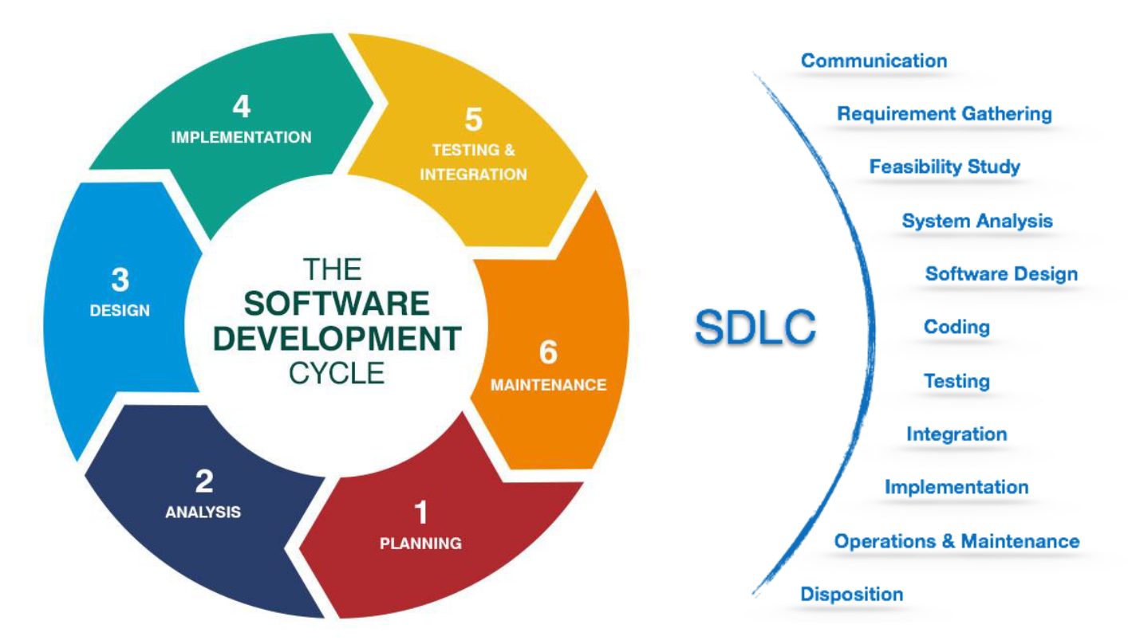
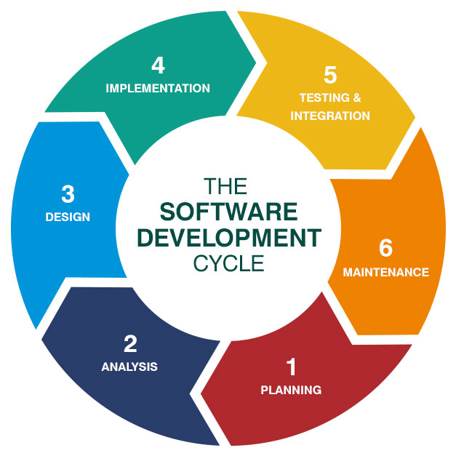
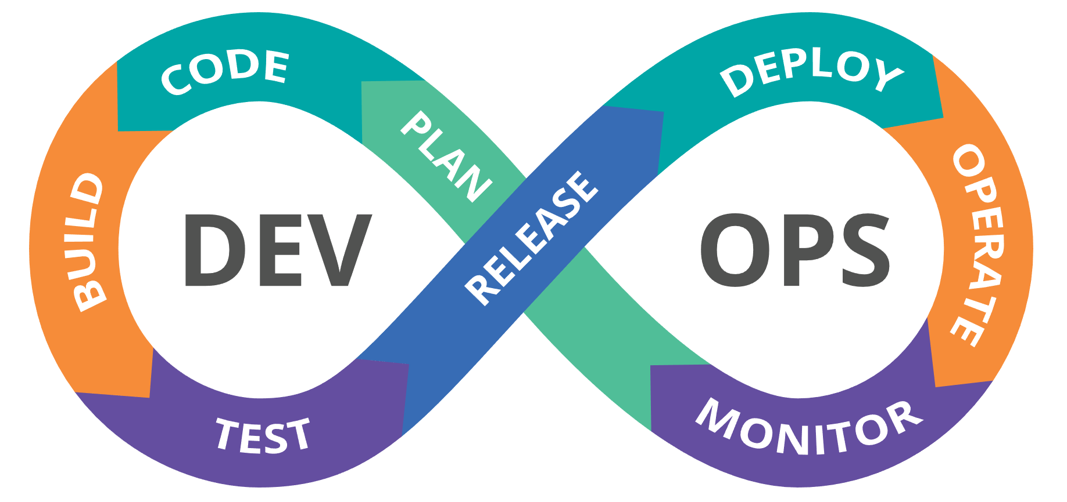
1. Background & Motivation
The Software Development Life Cycle (SDLC) of an information system goes through the steps of planning, creation, testing, and deployment.
In recent years, DevOps, a set of practices (e.g., cloud-based continuous integration, and automated deployment) enables organizations to deliver changes into production as quickly as possible, without compromising quality.
3/10

Slide 4
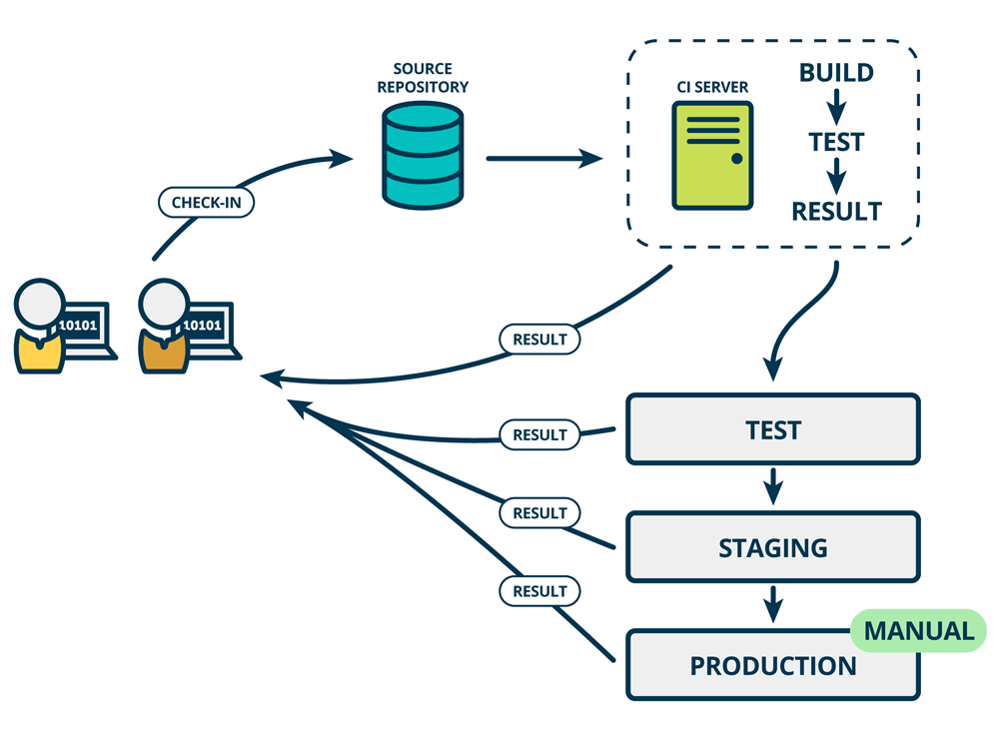
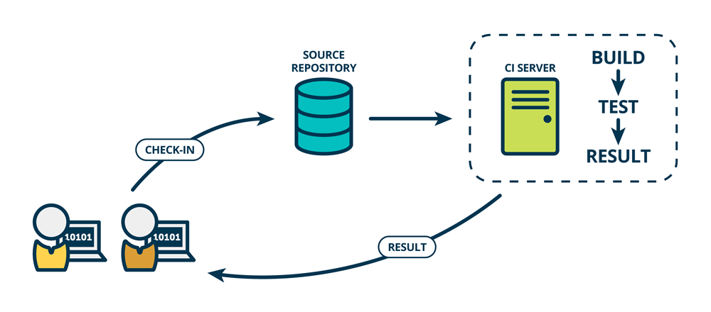
1. Background & Motivation
Continuous Integration (CI) systems automate the compilation, building, and testing of software. It is the practice of merging all developers' working copies to a shared mainline several times a day.
Continuous Delivery (CD) aims at ensuring an application is always at production-ready state after successfully passing automated tests and quality checks.
4/10

Slide 5
1. Background & Motivation
Motivation: although many studies have been conducted in a CI/CD context, very few of them have explored:
  Decisions made in CI/CD
  How the decisions made in CI/CD differ from those made in traditional software development
  What types of decisions are made in CI/CD
Research Goal: provide insights on the types of decisions made in CI/CD from practitioners’ perspective
RQ
  What types of decisions are made in CI/CD?
5/10

Slide 6
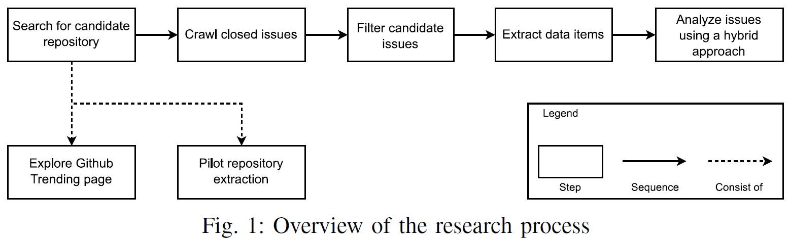
2. Methodology
After excluding the irrelevant issues, we finally got 370 issues out of the 1,168 closed issues from Budibase.
We searched for the candidate GitHub project based on the following criteria:
A repository running a GitHub Actions workflow
A hot topic in GitHub in the last three months
An active repository
The number of closed issues exceeds 1000
We refer to this combination of the pre-defined classification and the Constant Comparison method as a hybrid approach.
6/10

Slide 7
3. Study Results
RQ: What types of decisions are made in CI/CD?
Type |  | Percentage
Requirement Decision | Functional Requirement Decision | 67.6%
 | Non-functional Requirement Decision | 5.4%
Architecture Decision |  | 11.1%
Management Decision | Version Control Decision | 1.6%
 | Documentation Decision | 3.2%
Build Decision | Source Code Decision | 2.2%
 | Continuous Integration Decision | 0.3%
Testing Decision | Bug Fixing Decision | 4.6%
 | Traditional Testing Decision | 4.3%
 | Continuous Integration Testing Decision | 0.3%
Deployment Decision | Traditional Deployment Decision | 4.3%
 | Continues Deployment Decision | 1.4%
  We got 6 main categories and 11 subcategories of decisions made in CI/CD, in which Requirement Decision has the highest percentage (67.6%), with only a small amount of decisions (e.g., Continuous Deployment Decision) related to CI/CD.
7/10

Slide 8
4. Conclusions & Future Work
Conclusions
  The types of decisions made in CI/CD we obtained in this study have certain common points with the types of decisions made in traditional software development, while Deployment Decision only exists in CI/CD.
  Practitioners are encouraged to put more effort on the issues and making decisions related to CI/CD, and researchers can extend the dataset and decision types got from this study by exploring projects employing other CI/CD tools and diverse data resources.
8/10

Slide 9
4. Conclusions & Future Work
Future Work
  Extend this work with a larger dataset from more repositories and diverse sources, and using complementary research methods (e.g., questionnaire, interview, and focus group)
  Take a deeper look at various aspects of decisions in CI/CD, including:
  software artifacts involved in CI/CD-related decisions
  the rationale behind CI/CD decision-making
  the impact of CI/CD-related decisions in development
9/10

Slide 10
Q & A
Thank You!
Yajing Luo
luoyajing@whu.edu.cn

