Slide 1



“Risk unidentified is risk unaddressed”
Identifying Risks for Collaborative Systems during
Requirements Engineering:
An Ontology-Based Approach
${Kirthy Kolluri}^{1}$, ${Robert Ahn}^{1}$, ${Julie Rauer}^{1}$, ${Tom Hill}^{2}$, ${Lawrence Chung}^{1}$
1
2
The University of Texas at Dallas
Fellows Consulting Group

Slide 2


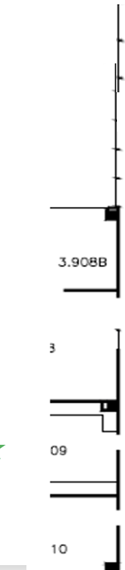

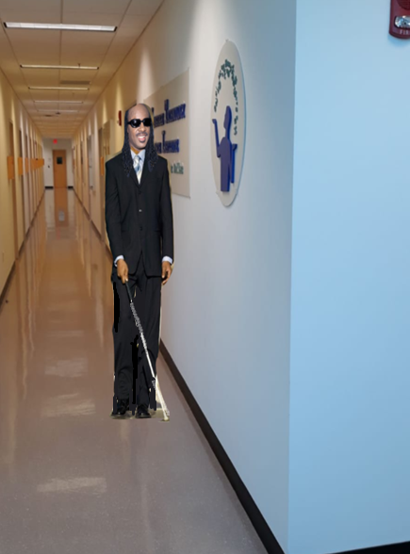
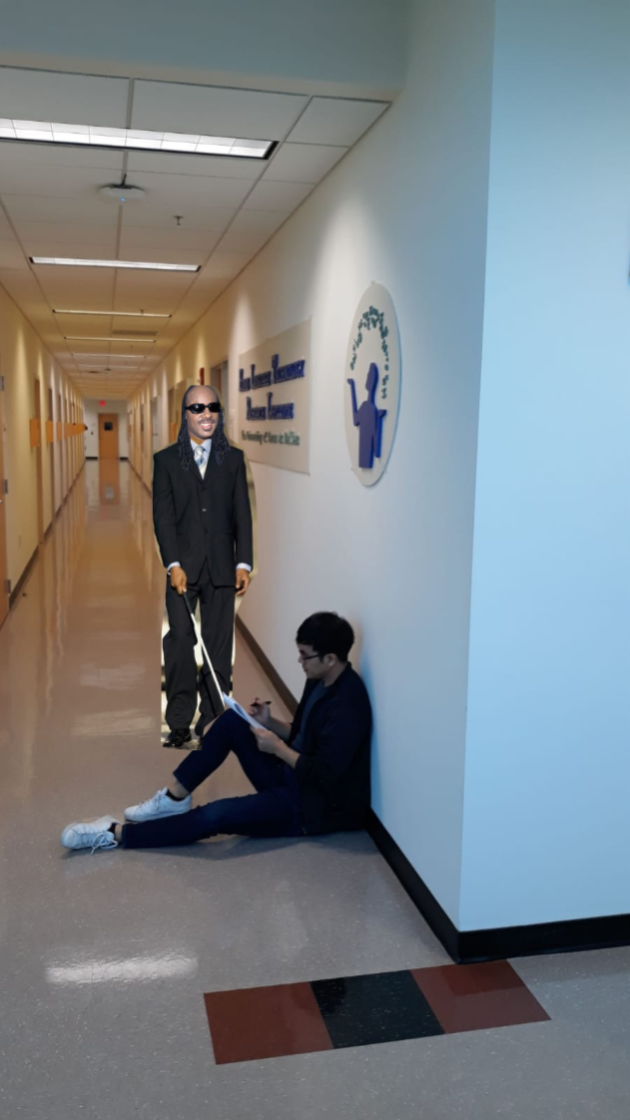
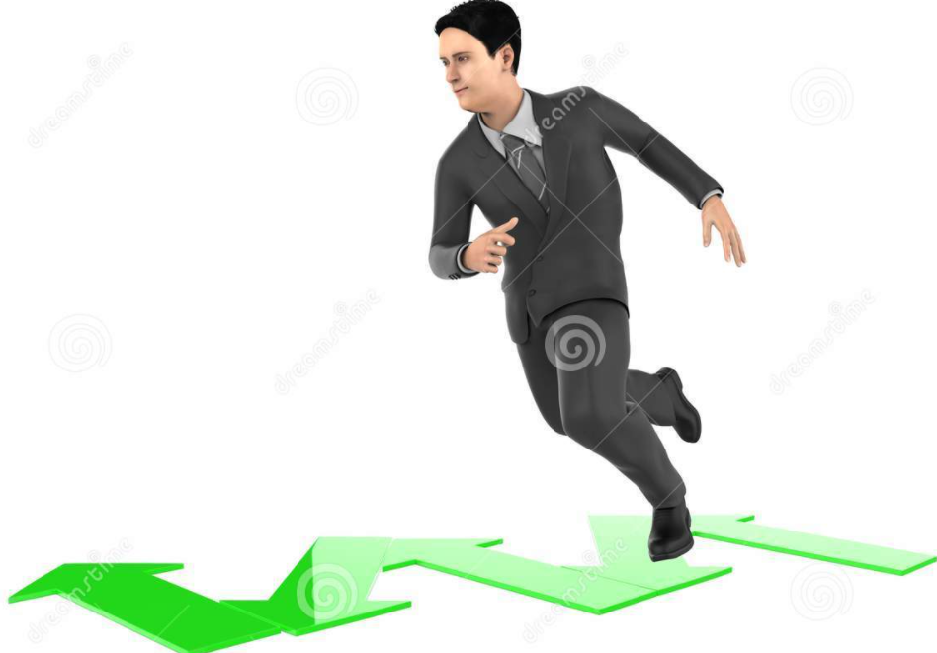
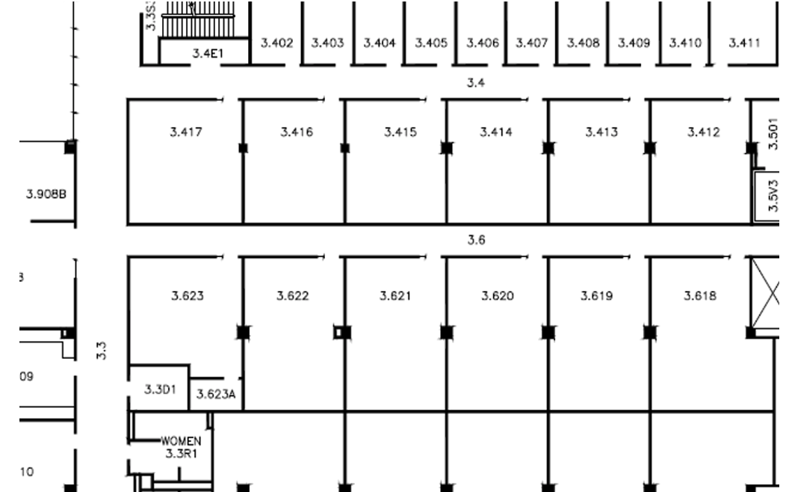


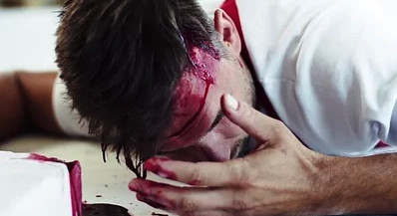


Consider, Indoor navigation for a blind person involves ……
Stevie is a blind person, and he wants to go from room 3.3D1 to room 3.413
He needs to perform a set of activities to reach his destination
  Walk
  Turn
  Stop
  Sit
  Speak
Every activity that Stevie performs is associated with a risk [1]
Turning in the
wrong direction
Banana peel present
in the hallway
Person sitting with legs stretched
Walking in a zig-zag pattern
Turn right
walk 18-20 steps
Destination
Fall down
Colliding against the wall
Water present
in the hallway
walk 11-13 steps
Current Location
What is a risk?

Slide 3
Outline
Research Problem
Related Work
Research Approach
  - Activity-oriented Ontology
  - Risk-aware Collaborative Approach
  - Augmented Reference Model
  Risk Analysis Graph (RAG)
Experimentation
Future Work

Slide 4
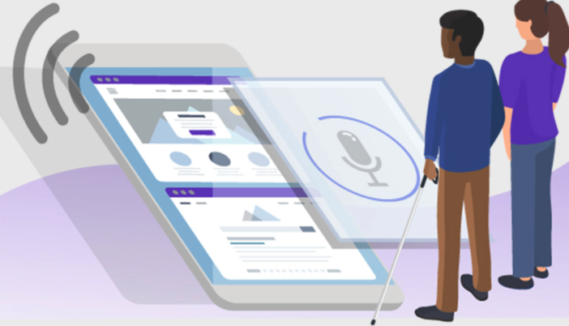
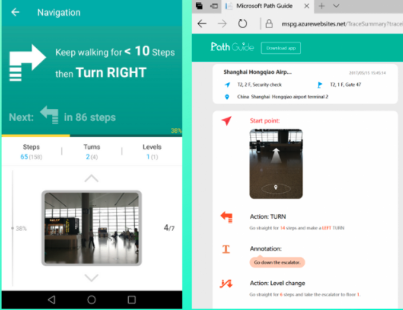
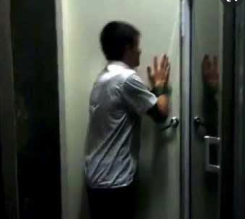

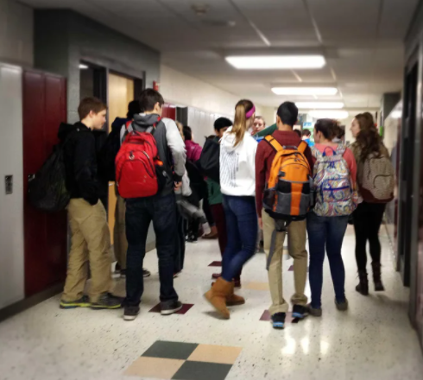

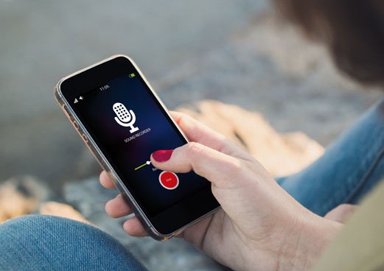

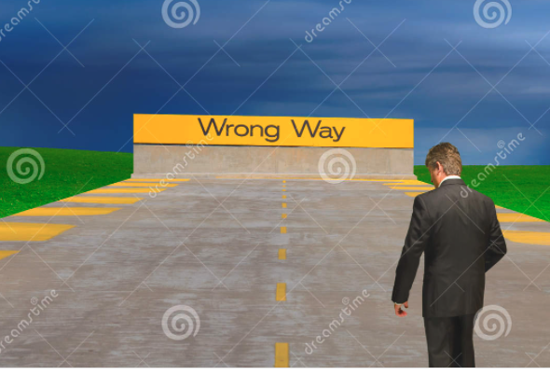

Can smartphone apps hurt people? Any need for identifying risks…??
Blind person indicates a destination using voice instruction
Smartphone app provides instructions to destination
Blind person starts his navigation based on the instructions
Blind person may or may not reach his destination
Risk
Risk
Risk
Risk
The background noise
may be too high
Incorrect instructions
provided
Walking in a haphazard
fashion
How do we identify all these risks?
The microphone does
not work
Speaker does not work
Unexpected obstacle
on the way
Blind person getting hurt
?? Missing
Incomplete instructions
are given
Missing route or taking
a wrong direction
Indicate wrong destination
Bumping into a person
4

Slide 5
Research problem
Goal is to identify important risks
Technical problem is lack of systematic approaches to identify risks associated with the requirements in developing a software system
How do we identify relevant risks in a comprehensive manner?
  How do we identify risks which are not related to the domain?
How do we identify risks for systems that involve collaboration between the user and the software system?
How do we identify risks in a logical sense and beyond?

Slide 6
Related Work
Requirements Engineering
  Ontology
  Reference Model (WRSPM Model)
Collaborative Systems
  Indoor Navigation Apps
  Autonomous Vehicles
Qualitative and Quantitative Risk Analysis
  Fishbone diagram
  Problem Frames
  NFR Framework (Problem-Interdependency Graph)
  Obstacle Analysis
  Goal-Risk Model
  Fault Tree Diagram
  Failure mode and effect analysis (FMEA)
Requirements Engineering
Collaborative Systems
Activity oriented ontology for Collaborative Systems
Risk-driven Ontology,
Reference Model
Indoor navigation apps,
Autonomous Vehicles
Perform Risk
Analysis
for Collaborative
Systems using
Augmented
Reference
Model, RAG
Risk
identification and generation of Risk
Analysis
graphs and using ontology
Identifying and analyzing
risks
for Collaborative
systems
Qualitative and Quantitative
Risk Analysis
Risk Analysis

Slide 7
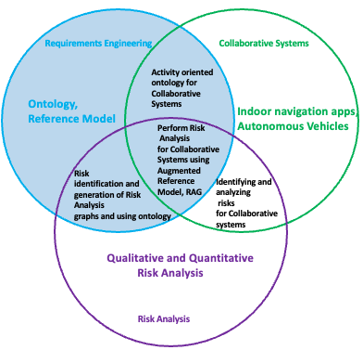
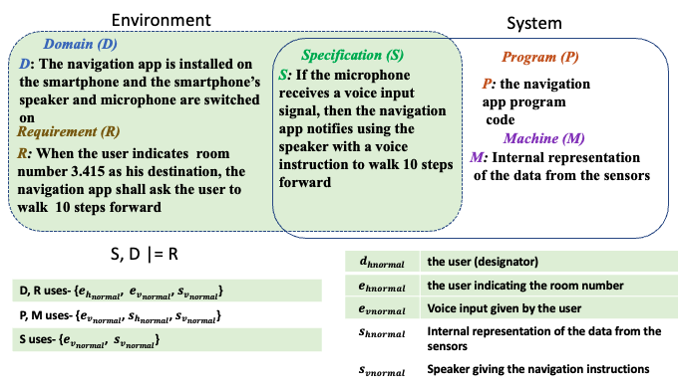
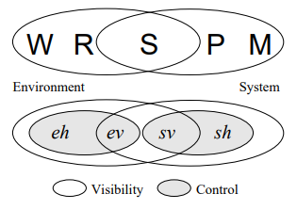
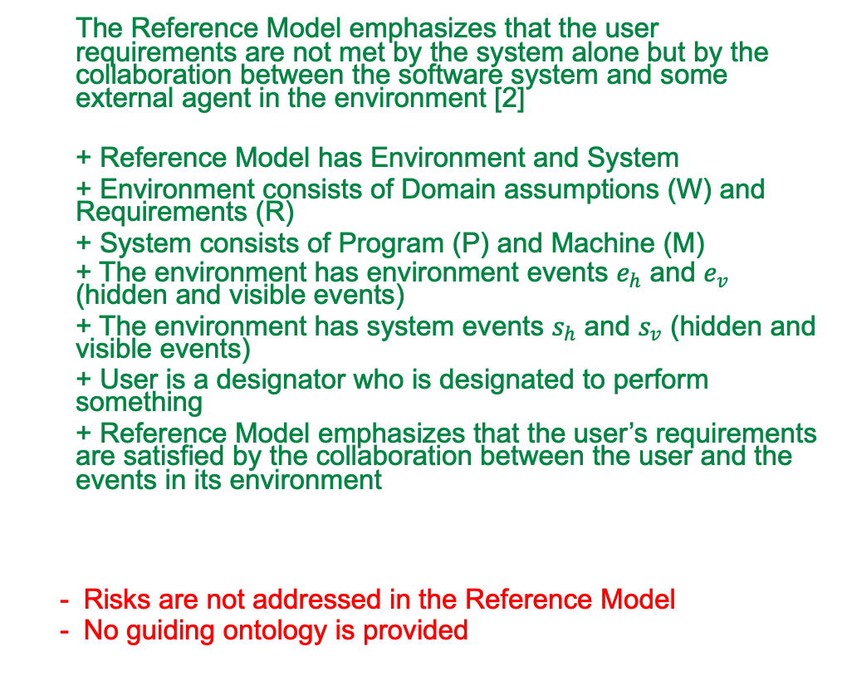
Reference Model in Requirements Engineering
  The Reference Model emphasizes that the user requirements are not met by the system alone but by the collaboration between the software system and some external agent in the environment [2]
  + Reference Model has Environment and System
  + Environment consists of Domain assumptions (W) and Requirements (R)
  + System consists of Program (P) and Machine (M)
  + The environment has environment events $e_{h}$ and $e_{v}$ (hidden and visible events)
  + The environment has system events $s_{h}$ and $s_{v}$ (hidden and visible events)
  + User is a designator who is designated to perform something
  + Reference Model emphasizes that the user’s requirements are satisfied by the collaboration between the user and the events in its environment
  Risks are not addressed in the Reference Model
  No guiding ontology is provided
S, D l= R

Slide 8
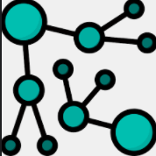




Our Approach/Solution
To help requirements engineers/developers identify and analyze risks during requirements engineering before developing the application and devise risk mitigation strategies to help avoid the risks identified
To build an activity-oriented ontology
To make a process for risk identification
To devise Risk-aware Collaborative Approach via Augmented Reference Model
Obtain Risk Analysis Graph for systematic risk identification
To build a prototype tool as a proof of concept

Slide 9
Our Research Approach
While identifying risks, there are infinitely many possible risks associated with each action of an agent, and it is hard to capture all the risks. There can be omissions and commissions of risks. Avoiding omissions and commissions as much as we can, helps in achieving completeness.
For e.g., When the user indicates the destination as room 3.415 using a voice instruction, the smartphone app shall indicate to walk 10 steps forward and turn right
There can be many omissions and commissions of risks associated with this simple scenario. Omission of risks is leaving out (omitting) the important risks while commission of risks is identifying irrelevant or incorrect risks.
Omissions
  The user not tapping the screen to give the voice instruction
  The user stops walking in the mid-way
  The user taps the screen to give voice instruction, but his tap is not recognized
  The user walks 10 steps but they are not 10 steps as the stride size is small
  The user does not turn in the correct angle
  The user does not hold the phone straight
  The user walking in a zig-zag pattern
  The user walking in the opposite direction
  The user does not always follow the instruction
  The user microphone/speaker may not work
Commissions
  The user of the smartphone app usually fly while going to class
  The user always runs while using the smartphone app
  The user always reduces volume while giving a voice instruction
  The user indicates the smartphone to provide route to White House
  The smartphone instructs the user to play music while walking
  The smartphone instructs the user to open the camera and click a picture
  The user usually walks 5 steps forward and 2 steps backward until he/she reaches the destination

Slide 10
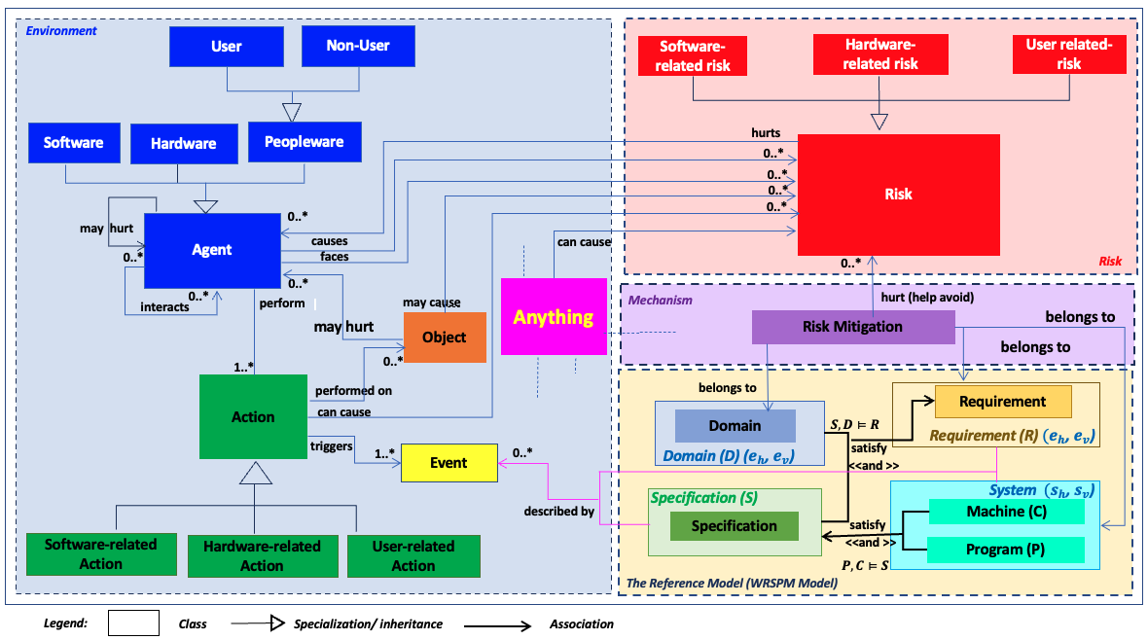
Murphy Framework: Ontology
Categories of essential:
  Concepts
  Relationships between the concepts
  Constraints on the concepts and the relationships
Key Concepts
  Risk
  Agent
  Action
  Anything
  Requirement
  Domain
  Specification
  System
  Mitigation mechanism

Slide 11
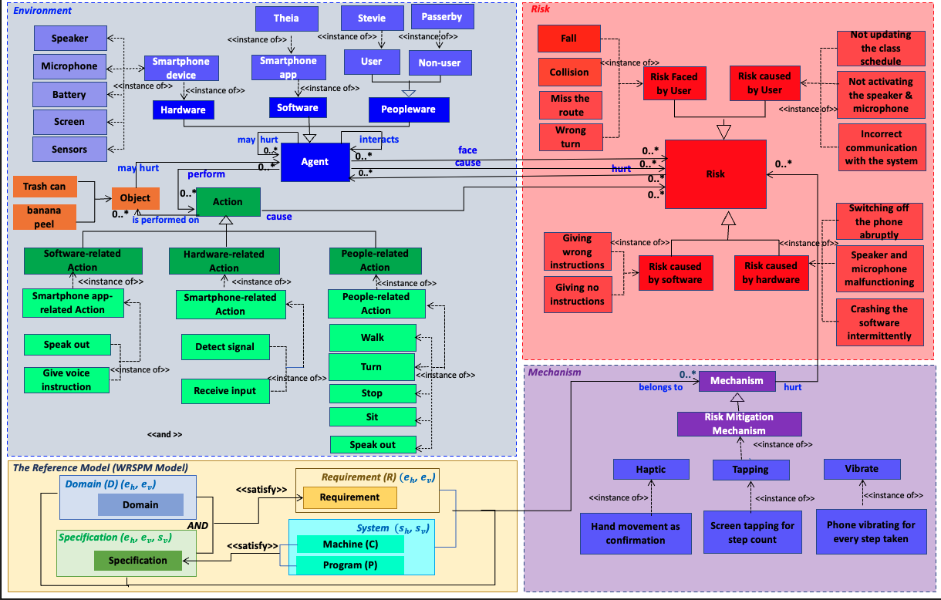
Murphy Framework: Domain-Specific Ontology for Theia

Slide 12
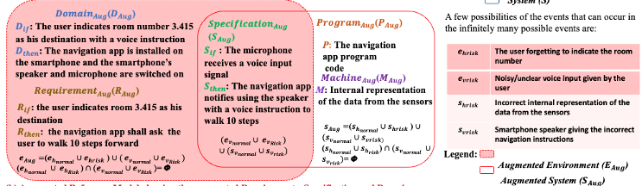


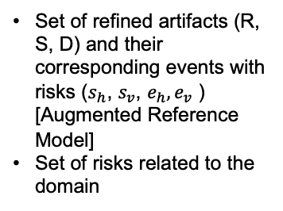
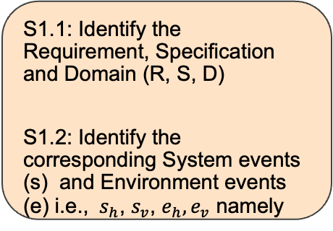
Murphy Process
(Iterative, Incremental, and Interleaving process)
Set of refined artifacts (R, S, D) and their corresponding events with risks ($s_{h}$, $s_{v}$, $e_{h},e_{v}$ ) [Augmented Reference Model]
Set of risks related to the domain
Set of prioritized risks along with corresponding set of Risk mitigation strategies
Stakeholders’ Requirements, System Specification, Domain Assumptions (Reference Model)
…..
Step 1: Gather the artifacts and the corresponding events
Step 2: Perform Risk Discovery and Analysis
Step 3: Prioritize risks and Devise Risk Mitigation mechanism
S1.1: Identify the Requirement, Specification and Domain (R, S, D)
S1.2: Identify the corresponding System events (s) and Environment events (e) i.e., $s_{h}$, $s_{v}$, $e_{h},e_{v}$ namely
S2.1: Refine R, S, or D using AND/OR refinements
S2.2: Identify a set of risks associated with the events using ontology
S2.3: Generate risks by applying the rules for risk generation
S3.1: Identified set of risks are examined and prioritized using the ontology
S 3.2: Corresponding risk mitigation strategies are devised

Slide 13
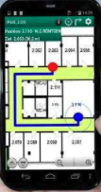


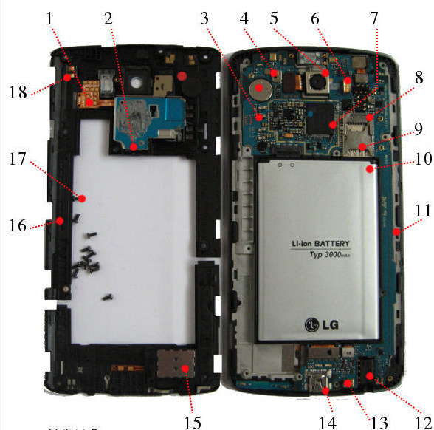


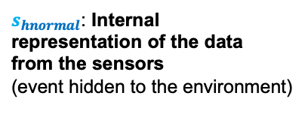

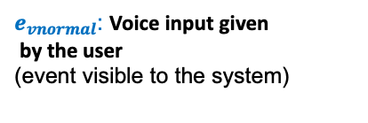
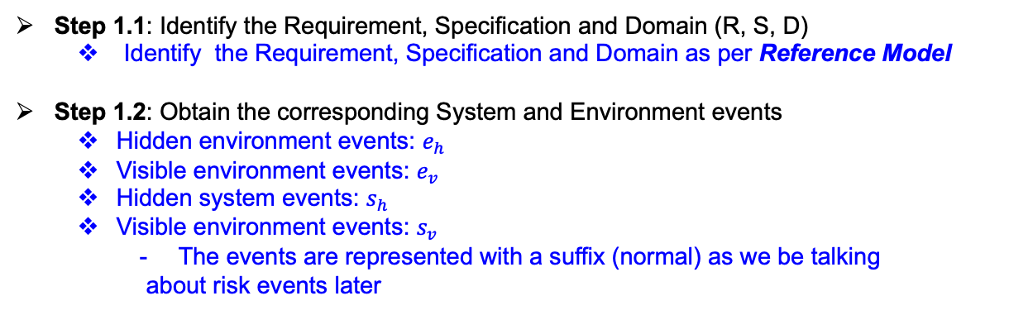

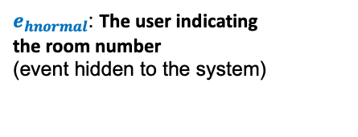


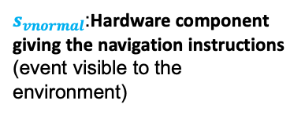
Step 1: Gather the artifacts (R, S, D) and the corresponding events
There are 2 sub-steps that are performed under step 1
perform an action
Step 1.1: Identify the Requirement, Specification and Domain (R, S, D)
  Identify the Requirement, Specification and Domain as per Reference Model
Step 1.2: Obtain the corresponding System and Environment events
  Hidden environment events: $e_{h}$
  Visible environment events: $e_{v}$
  Hidden system events: $s_{h}$
  Visible environment events: $s_{v}$
    The events are represented with a suffix (normal) as we be talking
    about risk events later
indicate a destination
$$→$$
R: When the user indicates the destination as room number, the navigation app shall ask the user to perform some action
1
receive voice
input signal
perform an action
Speaker
$$→$$
$s_{vnormal}$:Hardware component giving the navigation instructions
(event visible to the environment)
Step 1.1
Step 1.2
Identify
Identify
S: When the hardware component receives a voice input signal, the software notifies using the hardware component with a voice instruction to perform an action
2
Requirement (R)
System events
($s_{h}$, $s_{v}$, )
giving instructions
Specification (S)
Environment events ($e_{h},e_{v}$)
$s_{hnormal}$: Internal
representation of the data
from the sensors
(event hidden to the environment)
Domain (D)
receive voice
input signal
$$→$$
Hardware component is enabled
$e_{hnormal}$: The user indicating
the room number
(event hidden to the system)
$e_{vnormal}$: Voice input given
by the user
(event visible to the system)
Stevie
Stevie
D: When a hardware component receives a voice input, another hardware component gets enabled to give an instruction
indicates a room
number as destination
3

Slide 14



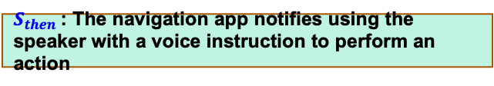





Step 2: Perform Risk Discovery and Analysis
In this example, the requirement R, Specification S and Domain D are of
the form $i→t$
Perform an action
indicate desti-
nation
$$→$$
Step 2.1
R1: When the user indicates the destination as room number, the navigation app shall ask the user to perform some action
R: When the user indicates the destination as room number, the navigation app shall ask the user to perform some action
$R_{if}$ : The user indicates a room number as the destination
$R_{then}$: The navigation app shall ask the user to perform an action
receive voice
input signal
Perform an action
S: When the hardware component receives a voice input signal, the software notifies using the hardware component with a voice instruction to perform an action
$$→$$
S: When the hardware component receives a voice input signal, the software notifies using the hardware component with a voice instruction to perform an action
$S_{if}$ : The microphone receives a voice input signal
$S_{then}$: The navigation app notifies using the speaker with a voice instruction to perform an action
D: When the microphone receives a voice input, the speaker gets enabled to give an instruction
receive voice
input signal
$$→$$
Hardware component is enabled
$D_{if}$ : The microphone receives a voice input signal
$D_{then}$ : The speaker gets enabled to give an instruction
Step 2.1: Decompose/ Refine R, S, or D using AND/OR refinements
Different kinds of refinements are possible
  AND decomposition, OR decomposition
  Decompose when there is a , or (.)
D: When a hardware component receives a voice input, another hardware component gets enabled to give an instruction
14

Slide 15
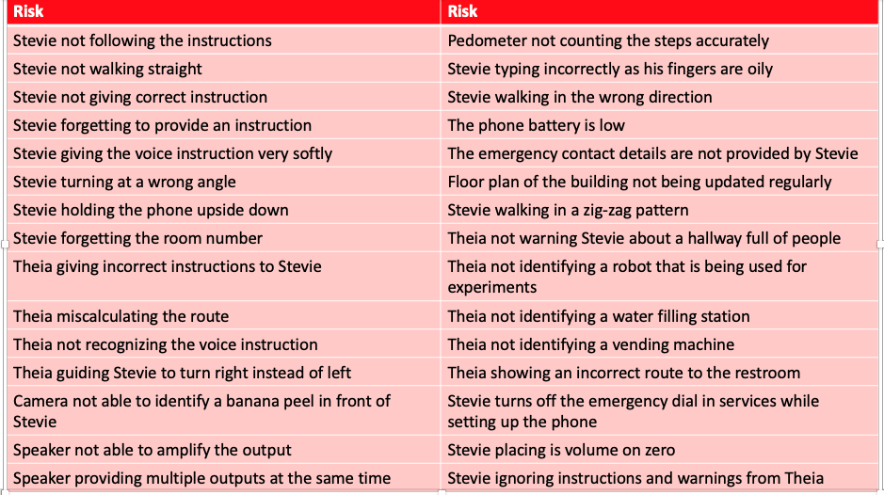
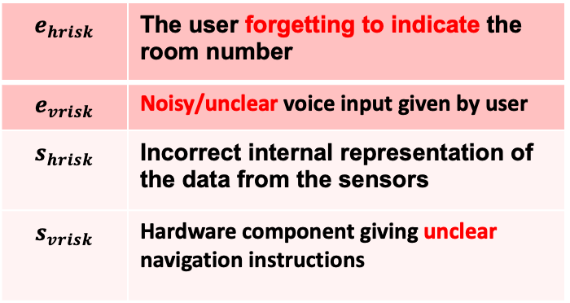
We use the system and environment events obtained from Step 1 and obtain risk
Step 2.2: Obtain risks associated with the events
Risks from environment and system events can be identified by:
  Fault in user actions, software actions or hardware actions
    e.g., user indicating wrong destination, system giving incorrect instructions, etc.
  Using the what-if-not question, why not question
    - e.g., what-if the user does not hear the instruction clearly from the speaker?, etc.
$$e_{hrisk}$$ | The user forgetting to indicate the room number
$$e_{vrisk}$$ | Noisy/unclear voice input given by user
$$s_{hrisk}$$ | Incorrect internal representation of the data from the sensors
$$s_{vrisk}$$ | Hardware component giving unclear navigation instructions
Step 2.3: Obtain a set of risks and identify critical risks using ontology
Risks obtained are mapped to the instances(Ontology)
  Instances related to every key concept in the ontology are captured
    e.g.; User (Stevie) giving the voice instruction softly– which is an instance of user-related risk, Speaker providing multiple outputs at the same time – which is an instance of hardware-related risk, etc.
    Risks which are mapped are identified as the most important and are prioritized
    Risks which are not found in the instances are left behind as they may be unimportant/irrelevant risks

Slide 16
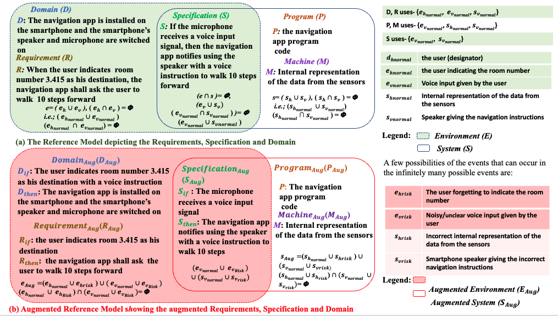
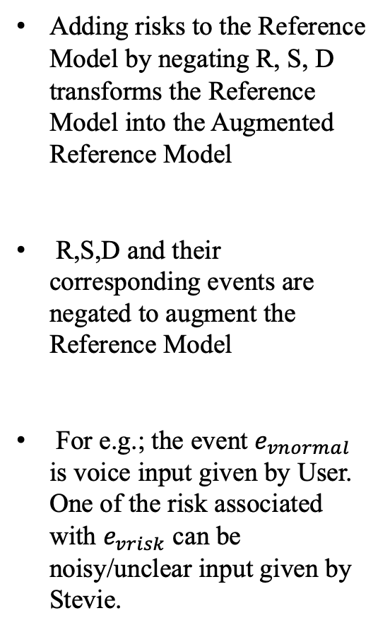
Augmented Reference Model
Adding risks to the Reference Model by negating R, S, D transforms the Reference Model into the Augmented Reference Model
R,S,D and their corresponding events are negated to augment the Reference Model
For e.g.; the event $e_{vnormal}$ is voice input given by User. One of the risk associated with $e_{vrisk}$ can be noisy/unclear input given by Stevie.

Slide 17
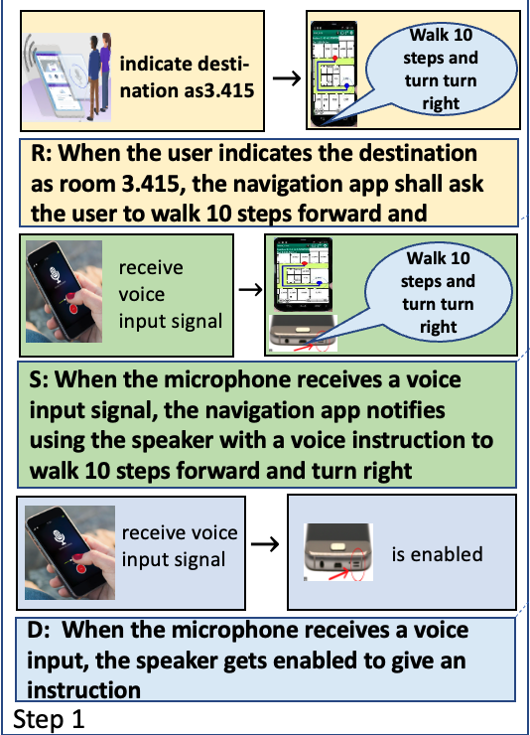
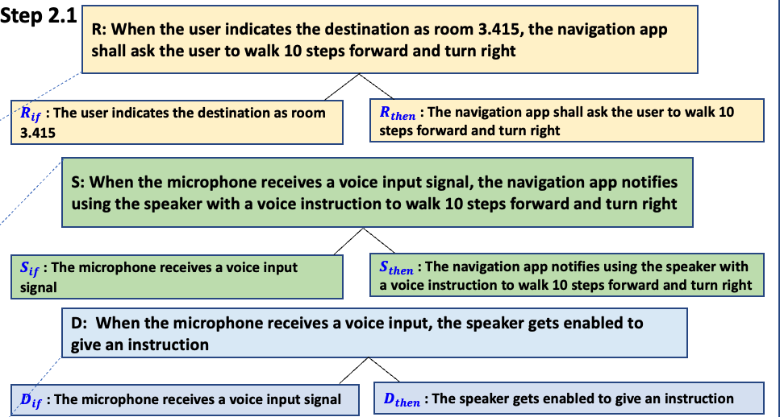
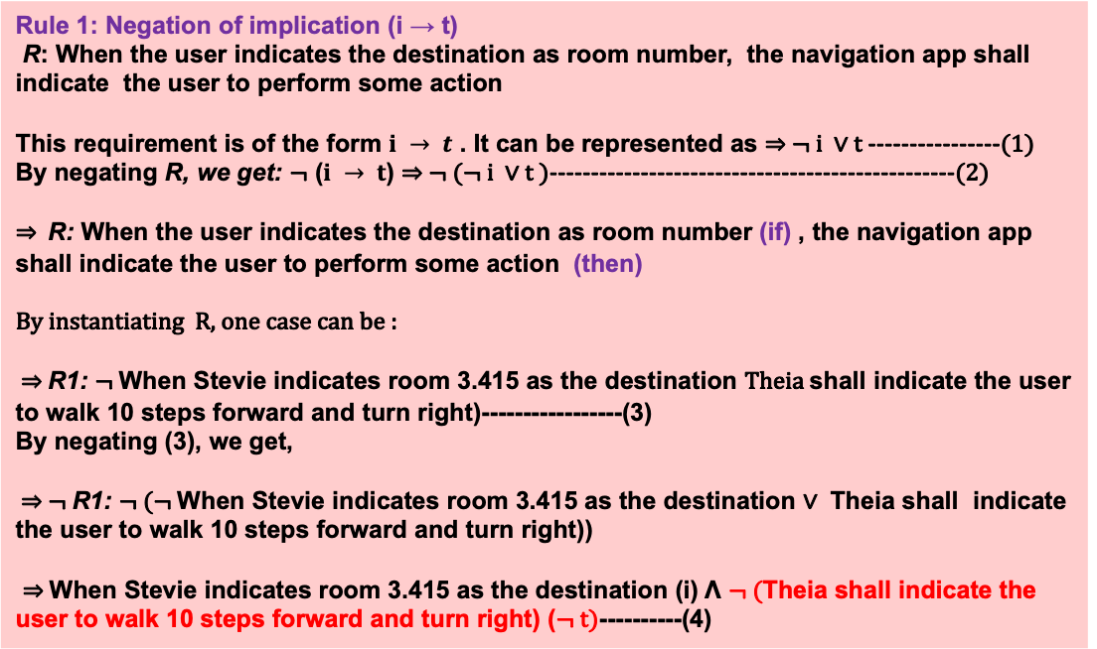
Step 2.3: Generate risks by applying the rules for risk generation
Rule 1: ￢( i → t ): negation of i implies t
Step 1: Gather the artifacts
(R, S, D) and the corresponding
events(previous step)
Rule 1: Negation of implication (i → t)
R: When the user indicates the destination as room number, the navigation app shall indicate the user to perform some action
This requirement is of the form $i → t$ . It can be represented as ⇒ ¬ i ∨ t ----------------(1)
By negating R, we get: ¬ ($i → t$) ⇒ ¬ (¬ i ∨ t )-------------------------------------------------(2)
⇒ R: When the user indicates the destination as room number (if) , the navigation app shall indicate the user to perform some action (then)
By instantiating R, one case can be :
⇒ R1: ¬ When Stevie indicates room 3.415 as the destination Theia shall indicate the user to walk 10 steps forward and turn right)-----------------(3)
By negating (3), we get,
⇒ ¬ R1: ¬ (¬ When Stevie indicates room 3.415 as the destination ∨ Theia shall indicate the user to walk 10 steps forward and turn right))
⇒ When Stevie indicates room 3.415 as the destination (i) Λ ¬ (Theia shall indicate the user to walk 10 steps forward and turn right) (¬ t)----------(4)
Step 2: Perform Risk Discovery and Analysis
Step 2.3: Generate risks by applying the rules for risk generation to identify risk cases
Rules are applied based on the structure of the R, S or D or negation of ontological concepts
  Rule 1: Negation of implication
  Rule 2: i ∧ ￢t: Consider the antecedent and the negation of the consequent joined by logical AND
  Rule 3: ￢ i ∧ t: Consider the negation of the antecedent and the consequent joined by a logical AND
  Rule 4: ￢(￢ t→￢ i): Negation of Contrapositive and so on
Risks Identified
The risk cases associated with t is:
Theia does not indicate Stevie to walk 10 steps forward but Stevie walks 14 steps
or
Theia indicates Stevie to walk >10 steps forward and turn right
or
Theia indicates Stevie to walk < 10 steps forward and turn left ….
17

Slide 18
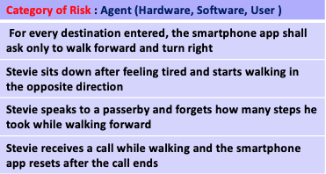
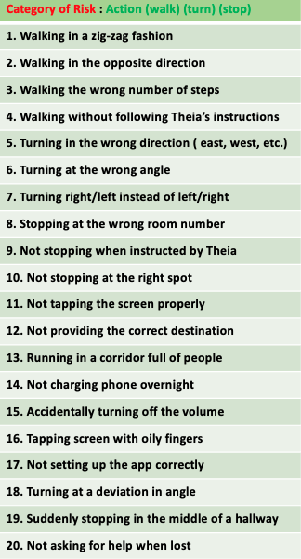
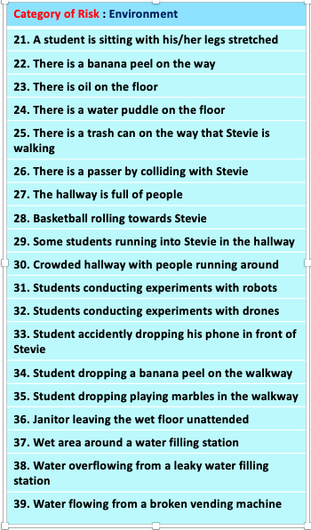
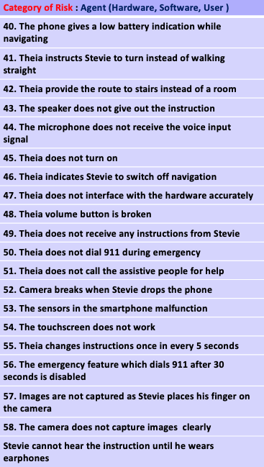
Step 3: Prioritize risks and devise Risk Mitigation mechanism
The set of risks identified are compared with the risks that were captured using the ontology and are prioritized
Risks Identified
The risk cases associated with t are:
Theia does not indicate Stevie to walk 10 steps forward but Stevie walks 14 steps
or
Theia indicates Stevie to walk >10 steps forward and turn right
or
Theia indicates Stevie to walk < 10 steps forward and turn left ….
The risks identified from the
list are prioritized and risk mitigation
mechanisms are derived

Slide 19
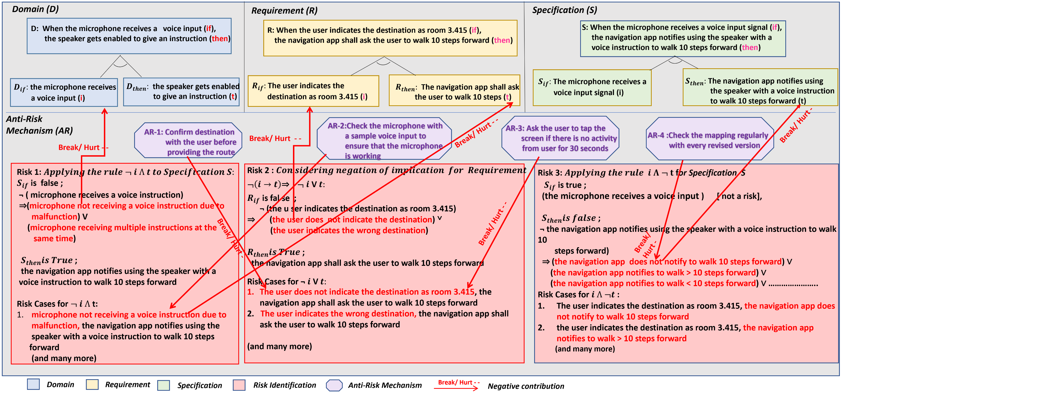
Generation of RAG
Risk Mitigation Mechanism: For e.g., for Stevie walking 14 steps instead of 10 steps,
we devised a screen tapping mechanism for keeping a tab on the number of steps taken, etc.
By using the 3 steps in the Murphy process we can generate an RAG
RAG shows the bigger picture of all the possible risks and the corresponding risk mitigation strategies that can be devised

Slide 20
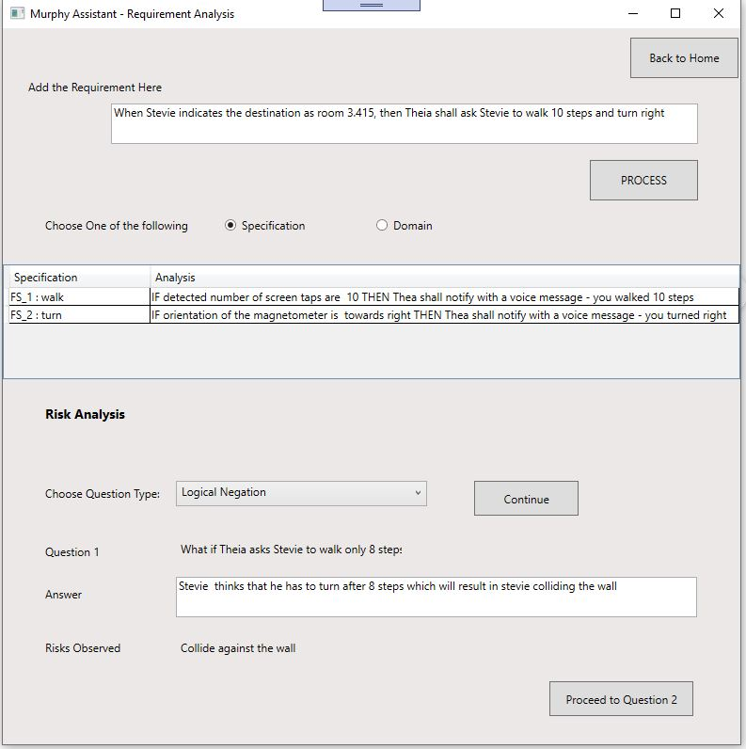
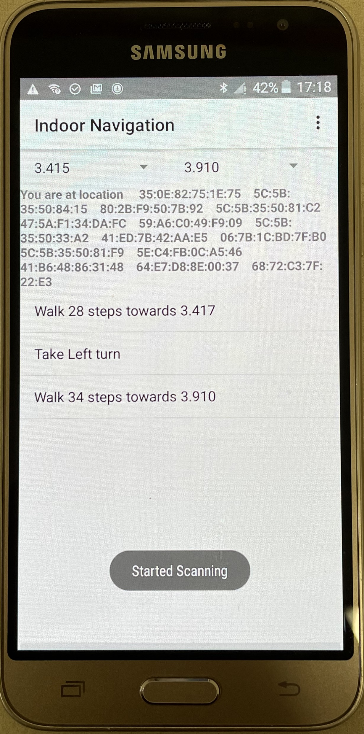
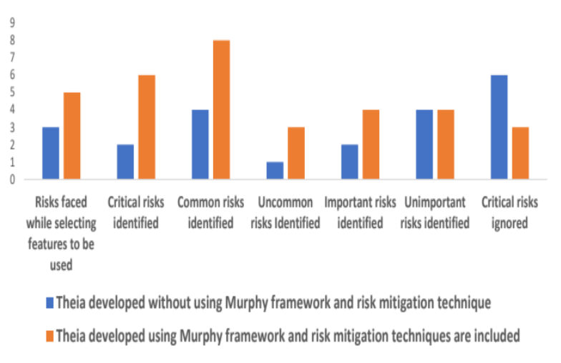
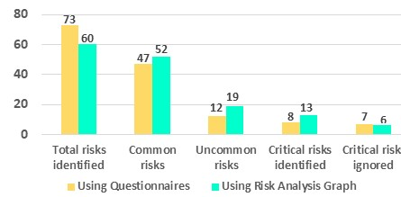
Experimentation
Developed Murphy assistant tool for risk discovery and analysis
Developed two versions of Theia- one by using the Murphy framework and the other without using Murphy framework
Tested both the versions of Theia by 25 students each and compared the results of both the experiments
Murphy Assistant tool
Theia

Slide 21

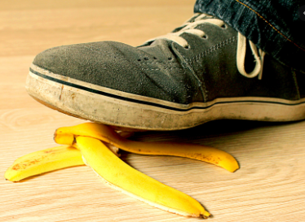
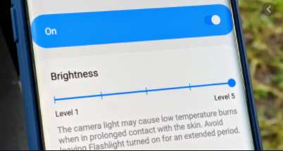
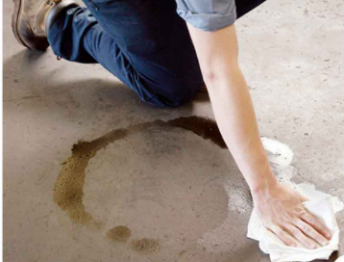
Observation and Discussion
Students who used Theia developed using the Murphy Framework were able to find:
  Common risks: missing route, walking in the wrong direction, etc.,
  Unimportant risks: warnings to increase the volume, increase screen brightness, etc.,
  Critical risks: falling down, bumping into people, colliding against walls etc.
  Uncommon risks: walking in a zig-zag pattern, banana peel on the floor, cleaning items left by janitor, etc.

Slide 22
Future Work
Going beyond logic (e.g., negation) for discovering risks
Extend our work to the Autonomous Vehicles domain
Increase the number of subjects for experimentation
Our evaluation is based on human knowledge, and the decision to generate the RAG using the semi-automated tool may not be good all the time. Hence, improving the efficiency of the assistive tool is also underway
Build sufficient guiding ontology for customizing models for other domains including the Autonomous Vehicles domain

Slide 23
References
[1] 1] Rosa, E., “Metatheoretical foundations for post-normal risk." Journal of Risk Research 1 (1998): 15-44.
[2] Gunter, C. A., Gunter, E. L., Jackson, M. Zave, P., "A reference model for requirements and specifications," in IEEE Software, vol. 17, no. 3, pp. 37-43, May-June 2000, doi:10.1109/52.896248

