Slide 1


WasmFuzzer: A Fuzzer for WebAssembly Virtual Machines
Speaker: Bo Jiang*
Co-authors: Zichao Li*, Yuhe Huang*, W.K. Chan†
*Beihang University
†City University of Hong Kong

Slide 2
Contents
Background
The design of WasmFuzzer
Experiments and Results Analysis
Related Work
Conclusion & future work

Slide 3


Information on WebAssembly (Wasm)
a portable target for compilation of high-level languages like C/C++/Rust
enabling deployment on the web
C
client
Rust
Rust
Web
server
C++

Slide 4
Information on Wasm
4 basic number types
2 instruction categories
32-bit width
Integers
64-bit width
32-bit width
IEEE 754-2019 numbers
64-bit width
Simple instructions
Perform basic operations on data
Control instructions
Alter control flow

Slide 5
Information on Wasm
A table stores an array of function references
A linear memory structure
Takes the form of a module
Features
Define functions, tables, memories, variables ✔
Define initialization data ✔
Shorter code length
Web or Blockchain platforms
Faster running speed
Easier program migration

Slide 6

Wasm code execution
Wasm virtual machines
  WAVM
  Wasmtime
  Wasmer
Errors in virtual machines
Wrong results ✓
Abnormal exit ✓
$$√$$
Fuzzing test
How to reach the deep logic within the VM?
How to accommodate differences among VMs?

Slide 7
Contents
Background
The design of WasmFuzzer
Experiments and Results Analysis
Related Work
Conclusion & future work

Slide 8
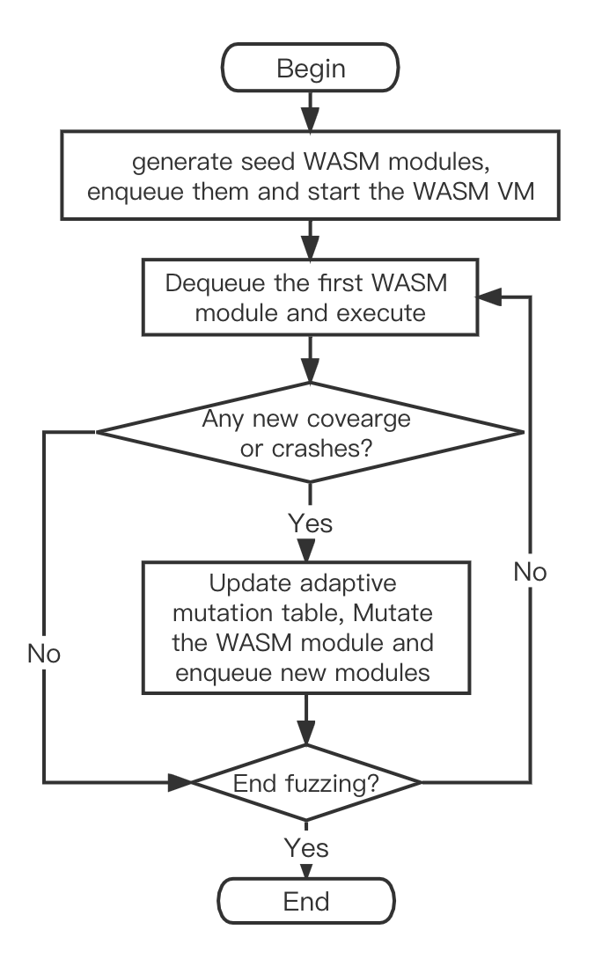

Workflow of WasmFuzzer
Generate seed modules
Dequeue and execute
Mutate and Enqueue
Update adaptive mutation table

Slide 9
Generation of Wasm Bytecode
Input to the Wasm VM : Wasm bytecode
Generate
Valid Wasm bytecode ✓
Binary input and mutation ✗
Selected from the module
Parameters
Generated from data domain
use
Instructions
Wasm binary toolkit

Slide 10
Mutation for Wasm module
Mutation operations
  Mutation operations on Instructions
  Other mutation operations
Classification | Mutation operator | Description
Mutation operations on Instructions | insertInstruction | Insert an instruction
 | eraseInstruction | Delete an instruction
 | moveInstruction | Move an instruction
 | addFunction | Add an empty function
 | eraseFunction | Delete a function
 | swapFunction | Swap the positions of two functions

Slide 11
Mutation for Wasm module
Mutation operations
  Mutation operations on Instructions
  Other mutation operations
Classification | Mutation operator | Description
Other mutation operations | addGlobal | Add a global variable
 | eraseGlobal | Delete a global variable
 | swapGlobal | Swap the positions of two global variables
 | addExport | Add an export entry
 | eraseExport | Delete an export entry
 | swapExport | Swap the positions of two export entries
 | addType | Add a type
 | addMerory | Add a block of storage space
 | setStart | Set the start function
 | eraseStart | Delete start function

Slide 12
Mutation for Wasm module
Adaptive random mutation strategy
  Each mutation operator has a probability to be selected
  Reward the mutation operators leading to new code coverage or crash by dynamically increasing their probabilities
  Define an adaptive mutation table
    an array of function pointers of length 256
    point to different mutation operators
    first 16 positions : read-only areas

Slide 13
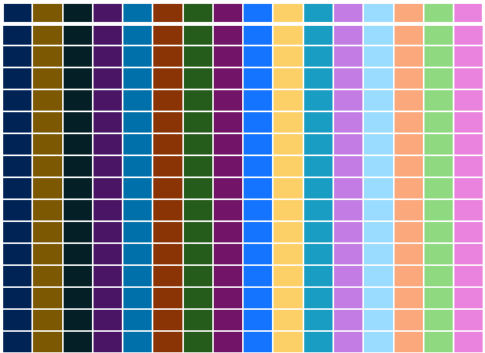
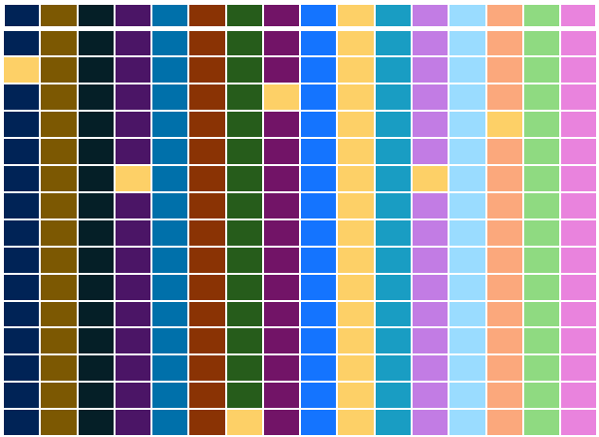
Mutation for Wasm module
Adaptive mutation table
Initialization with equal probability
Increase PR of effective mutation

Slide 14
Mutation for Wasm module
Adaptive mutation table
  Algorithm updating adaptive mutation table
Input | table: adaptive mutation table,
 | func: pointer to the current mutation operator
Output | updated adaptive mutation table
1 | #define NEW_PATH_REWARD 3
2 | #define CRASH_REWARD 6
3 | int increase = 0;
4 | if (new paths found)
5 | increase += NEW_PATH_REWARD;
6 | if (new crash triggered)
7 | increase += CRASH_REWARD;
8 | for (int i = 0; i < increase; ++i) {
9 | int num = randomBetween(16, 255);
10 | table[num] = func;
11 | }
12 | return table;

Slide 15
Contents
Background
The design of WasmFuzzer
Experiments and Results Analysis
Related Work
Conclusion & future work

Slide 16
Research Questions
Focus on: WasmFuzzer’s test capability and test efficiency
Compare: WasmFuzzer and AFL
Performance metrics: code coverage, number of unique crashes that could be found, type of software problem

Slide 17
Experiment Design
Subjects: 3 Wasm virtual machines
  WAVM
  WebAssembly Micro Runtime(WAMR for short)
  EOS-VM
Instrumentation Procedure
  use Gcc compiler with code coverage profiling options enabled
  enabled the address sanitizer during compilation
Experimental process
  fuzzing time: 8 hours
  use the afl-cov tool to analyze the code coverage

Slide 18
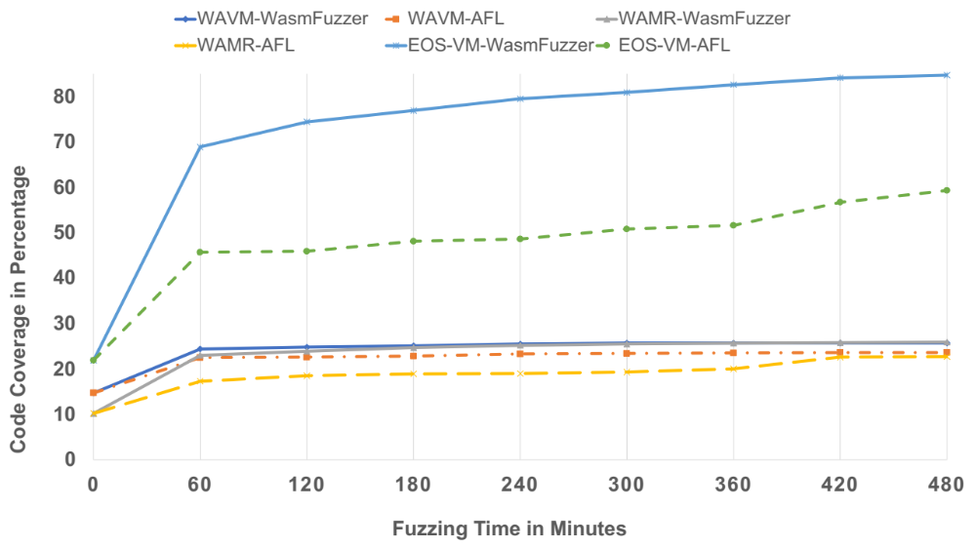
Result & Analysis
Code coverage
Subjects | Code Coverage
/ | WasmFuzzer | AFL
WAVM | 25.7% | 23.6%
WAMR | 25.9% | 22.7%
EOS-VM | 84.7% | 59.3%
WasmFuzzer can indeed achieve more code coverage than AFL
if given the same fuzzing time.

Slide 19
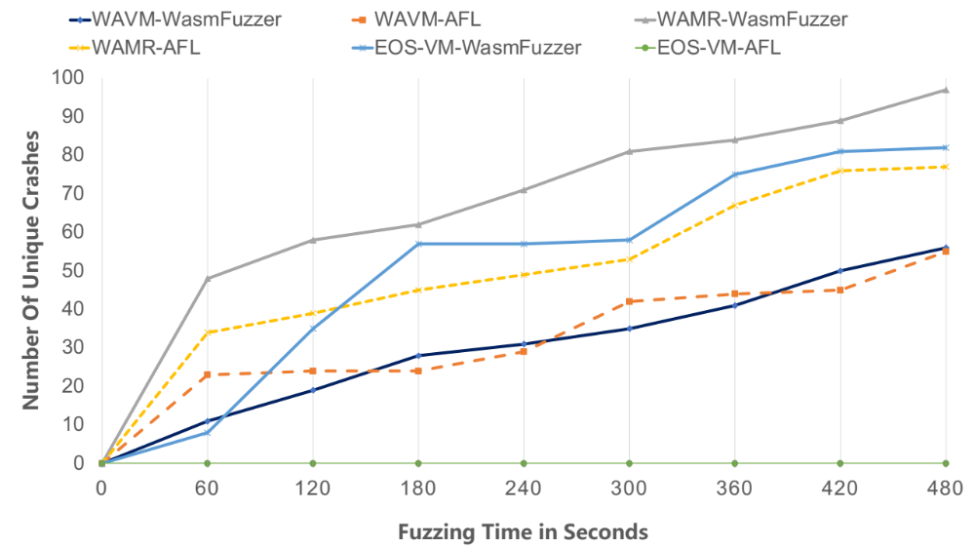
Result & Analysis
Unique crashes
Subjects | Unique crash
/ | WasmFuzzer | AFL
WAVM | 56 | 55
WAMR | 97 | 77
EOS-VM | 82 | 0
WasmFuzzer can perform as good as or better than AFL in terms
of unique crashes.

Slide 20
Contents
Background
The design of WasmFuzzer
Experiments and Results Analysis
Related Work
Conclusion & future work

Slide 21
Related Work
DIE
  Park S., Xu W., Yun I., et al.@ S&P 2020
  a JavaScript fuzzing tool.
  design a new test case mutation technique called aspect-preserving.
Montage
  Lee S., Han H. S., Cha S. K., et al.@ USENIX Security 2020
  a fuzzing tool based on neural network language model.
  train the model with the abstract syntax subtree.
SQUIRREL
  Zhong R., Chen Y., Hu H., et al.@ ACM CCS 2020
  a fuzzing tool for relational databases.
  input data is structured query language.

Slide 22
Related Work
Differential testing of JVM
  Chen Y., Su T., Sun C., et al. @ PLDL 2016
  a fuzzing tool for differentially testing Java virtual machines.
  use the same input to execute multiple Java virtual machines.
WARF
  Patrick Ventuzelo.
  fuzz WebAssembly virtual machines and test them with binary data.
  integrates three mainstream fuzzing tools, AFL++, Honggfuzz and libFuzzer.

Slide 23
Contents
Background
The design of WasmFuzzer
Experiments and Results Analysis
Related Work
Conclusion & future work

Slide 24
Conclusion
In this work, we propose WasmFuzzer, a bytecode level fuzzing tool for WASM VMs.
WasmFuzzer proposes to generate initial seeds for Fuzzing at the Wasm bytecode level and it also proposes a systematic set of mutation operators for Wasm bytecode.
Furthermore, WasmFuzzer proposes an adaptive mutation strategy to search for the best mutation operators for different fuzzing targets.
Our evaluation on 3 real-life Wasm VMs shows that WasmFuzzer can significantly outperform AFL in terms of both code coverage and unique crash.

Slide 25
Future Work
For future work, we plan to explore new seed generation scheme and fuzzing input scheduling scheme to improve the effectiveness of the fuzzing tool.
We will also perform fuzzing on other popular Wasm VMs to further evaluate the effectiveness of WasmFuzzer.

Slide 26
Thank you!

