Slide 1
Designing Microservice-Oriented Application Frameworks
Yunhyeok Lee (Presenter) and Yi Liu
Department of Computer and Information Science
University Of Massachusetts Dartmouth
Notes:
Hello My name is Yunhyeok Lee.
I would like to present our paper titled ”Designing microservice-oriented application frameworks by generalization”.

Slide 2
Agenda
Introduction
Background
Methodology & Case Study
Discussion
Conclusion
Notes:
The contents start from Introduction, background, Methodology and Case-study, Evaluation, Conclusion and Future Work”

Slide 3
Introduction
An application framework is a reusable “skeleton” application that can be specialized to develop custom applications.
As microservices become more popular in the software industry, the importance of methodologies for designing microservices-oriented frameworks is increasing.
The existing methodologies for designing application frameworks, which were developed for the monolithic environment, do not fit the microservice architecture well.
This study proposes a methodology that extends Schmid's systematic generalization approach to enable the design of microservice-oriented application frameworks.
Notes:
An application framework is a reusable “skeleton” application that can be specialized to develop custom applications.
Our proposed methodology is built based on Schmid's systematic generalization methodology and extends it to fit into the microservices environment.

Slide 4
Background
Software application framework:
Schmid defines an application framework is ”a generic application that allows different applications to be created from a family of applications.” [Schmid97].
An application framework enables developers to write clean and easily adaptable code, achieve scalability, and focus on writing code that is specific to their application
An application framework is designed in the form of incomplete summaries that include predefined hot spots, which can later be redesigned for reusability, and frozen spots for commonality of the application framework.
Notes:
Schmid defines an application framework is ”a generic application that allows different applications to be created from a family of applications.” [Schmid97].
An application framework enables developers to write clean and easily adaptable code, achieve scalability, and focus on writing code that is specific to their application.
Specifically, an application framework is designed in the form of incomplete summaries that include predefined hot spots, which can later be redesigned for reusability, and frozen spots for commonality of the application framework.

Slide 5
Background
Schmid's systematic framework design approach [Schmid1996] :
Step 1: Creation of a fixed application model
Step 2: Hot spot analysis and specification
Step 3: Hot spot high-level design
Step 4: Generalization transformation
Notes:
In Schmid’s research paper, the designing methodology for an application framework is described.
In his paper, He suggested four steps to design methodology for an application framework.
First step is “Creation of a fixed application model”.
Second Step is “Hot spot analysis and specification”
Third Step is “Hot spot high-level design”
The last step is “Generalization transformation”
The approach seeks to generalize the design around these hot spots by applying systematic transformations of the design that are driven by the analysis of the hot spot.
The transformation process will be generated for each hot spot based on their rules.

Slide 6
Background
Microservices:
A microservice architectural style is an approach to developing a single application as a set of small services [Fowler2014].
Independent Deployment: The independent deployment improves the flexibility of the development and enhances the comprehensibility of the microservice-oriented application.
Communication Mechanism: Microservices utilize HTTP request-response with service APIs and lightweight messaging.
  Synchronous Protocol: The client sends a request and waits for a response from a server.
  Asynchronous Protocol: The client code or message sender does not wait for a response from a server.
Language-Independence: The developers have the option to select the most appropriate programming languages for developing particular microservices.
Notes:
A microservice architectural style is an approach to developing a single application as a set of small services.
Each service performs its own process, serves a specific function, and interacts with other services through well-defined APIs.
In microservice, there are three characteristics such as Independent Deployment, Communication Mechanism, Language-Independence.

Slide 7
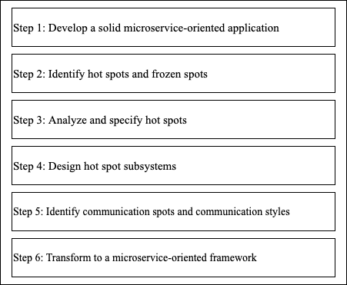
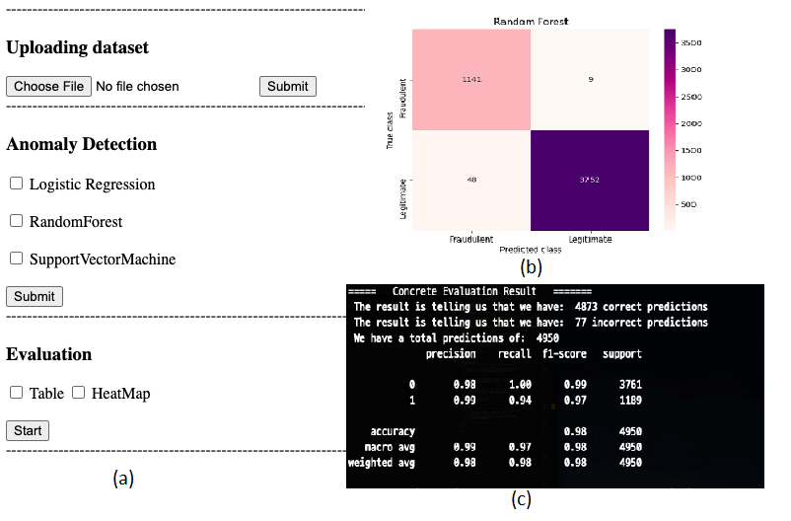
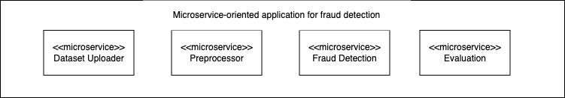
Methodology
Schmid’s approach uses object-oriented paradigms. Our methodology uses Schmid’s approach as a basis and extends it to fit into the microservice environment.
Case study: A fraud detection application which consists of four independent services.
Framework design Activities
Microservice-oriented application for fraud detection
Notes:
In this slide, I would like to describe my designing methodology.
Our methodology uses Schmid’s approach as a basis and extends it to fit into the microservice environment. The communication between independent services in a microservice environment requires specific techniques, such as HTTP Request-Response APIs (such as REST) or lightweight messaging APIs (such as Protocol Buffer).
Thus, the communication spot and communication style are proposed to define communication methods among independent services as well as the execution order between two services. The proposed methodology consists of a total of six steps.
Our Case-study has four difference services such as Dataset Uploading, Preprocessing, Fraud Detection and Evaluation Service.

Slide 8
Methodology & Case-Study
Step 1: Develop a solid microservice-oriented application
To build a web-based microservice-oriented framework, we use a web-based application that reconstructs the fraud detection system based on microservices.
Step 2: Identify the hot spot and frozen spot
The aspects that vary among application family members are hot spots [Schmid1997].
We define hot spots and frozen spots to assort the flexibility and commonality of the microservice-oriented framework for fraud detection. The hot spots in the microservice-oriented application for fraud detection.
  Hotspots can allow developers to plug in an application-specific class or set of classes while customizing a framework to build an application.
  The aspects that are common to all application family members are called frozen spots [Schmid1997].
Notes:
Step 1: Develop a solid microservice-oriented application
Just like Schmid's approach, the proposed methodology starts with the construction of a representative application in the framework family. This application should be microservice-oriented instead of monolithic and object-oriented as seen in Schmid's approach. To build a web-based microservice-oriented framework, we use a web-based application that reconstructs the fraud detection system based on microservices.
Step 2: Identify the hot spot and frozen spot
The aspects that vary among application family members are hot spots. The different implementations to these hot spots result in different applications within the family.
A framework is customized to an application with specific implementations of hot spots. We define hot spots and frozen spots to assort the flexibility and commonality of the microservice-oriented framework for fraud detection. In our case-study, we have five hot spots and three frozen spot.

Slide 9
Methodology & Case Study
Step 2: Identify the hot spots and frozen spots
Hot spots
Frozen spots
  Variability in the file formats of datasets uploaded by users in Dataset Uploading service.
  Variability in the data normalization techniques in the Preprocessing service.
  Variability in the feature selection techniques in the Preprocessing service.
  Variability in the machine learning algorithms applied to analyze a dataset in Fraud Detection service.
  Variability in the result presentation in the Evaluation service.
  The data input and analysis order is fixed, that is, dataset upload, data preprocessing, fraud analysis and detection, and result presentation.
  Each dataset is uploaded one at a time and then converted to CSV format.
  Machine learning algorithms are used in the Fraud Detection service.
  Users should be able to upload a dataset, choose machine learning algorithms and view the results.
Notes:
In our case-study, we have five hot spots and four frozen spots.

Slide 10
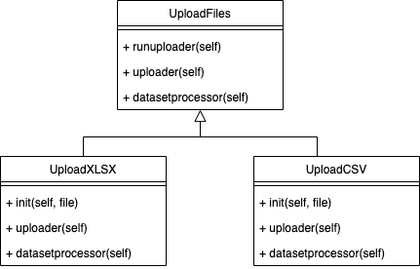
Methodology & Case-Study
Step 3: Hot spot detail specification and design
Building the framework is to collect and describe the domain's variable aspects during the hot spot analysis [Schmid1996]. This has been defined as an extension of the requirements analysis phase from the application development.
Step 4: Design hot spot subsystems
A hot spot is implemented by a hot-spot subsystem [Schmid1996], which typically consists of an abstract base class, concrete derived classes, as well as possibly additional classes and relationships. We can choose a specific design pattern depending on additional classes and relationships.
Dataset Uploading service
Notes:
Step 3: Hot spot detail specification and design
The framework domain's variable aspects have been collected and described in the previous step as hot spots. The hot spot detail specification and design are performed individually in the case of each hot spot.
Step 4: Design hot spot subsystems
A hot spot is implemented by a hot-spot subsystem, which typically consists of an abstract base class, concrete derived classes, as well as possibly additional classes and relationships. Among these, the abstract base class specifies the common responsibilities for all hotspot alternatives.

Slide 11
Methodology & Case-Study
Step 5: Identify communication spots and communication styles
  Communication spot: Consists of a list of the execution orders of each pair of services.
  Communication style: To specify how microservices communicate within a system. Communication styles are categorized as synchronous and asynchronous.
  - Synchronous method: The client-side sends a request to a server- side service and waits for its response.
  - Asynchronous method: The client-side continues sending requests to the server-side service without waiting for the acknowledgment of the previous response.
Communication spot 1: Dataset Uploading service is executed first, followed by the preprocessing service.
Communication spot 2: Preprocessing service is executed first, followed by the Fraud Detection service.
Communication spot 3: The Fraud Detection service is executed first, followed by the Evaluation service.
Communication Style 1: S(client, Dataset Uploading): A client sends a synchronous request to the Dataset Uploading service. Only a single file can be uploaded at a time
Communication Style 2: S(client, Preprocessing): A client sends a synchronous request to the Preprocessing service. One a single dataset is preprocessed at a time
Notes:
Step 5: Identify communication spots and communication styles
In a monolithic, object-oriented application, communications among the components are typically conducted through procedure calls through inheritance, polymorphism, or composition. Such communication is applicable for the components within a microservice, but would not work between microservices. We use communication spots and communication styles to specify how microservices communicate within a systemstyle.
Commmuncation Spots in case study are First Communication Spot is Dataset Uploading service is executed first, followed by the preprocessing service.
Second Communication Spot that Preprocessing service is executed first, followed by the Fraud Detection service.
Last Communication spot that The Fraud Detection service is executed first, followed by the Evaluation service.

Slide 12
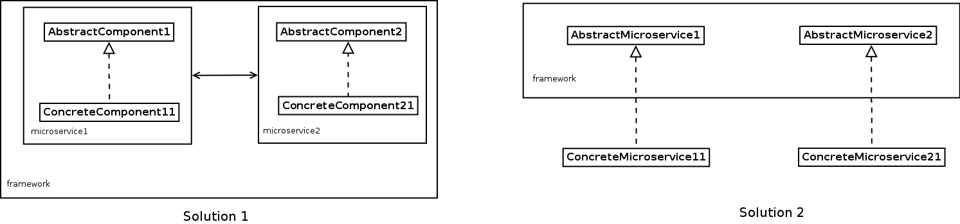
Methodology & Case-Study
Step 6: Transform into a microservice-oriented framework
Schmid's generalization transformation strategy is applicable within each microservice. Beyond the structure of each service, a microservice-oriented framework also needs to reflect the microservice generalization and service communications.
  Solution 1 is to place the abstract (class or classes) and its concrete implementations (classes) into a microservice.
  Solution 2 is to make the abstract into an "abstract" microservice and put the concrete implementations in the form of separate microservices that "extend" the abstract microservices.
Notes:
Step 6: Transform into a microservice-oriented framework
To generalize the microservice, we propose two solutions. We adopt the first microservice solution to plug the hot spot subsystems into the framework

Slide 13
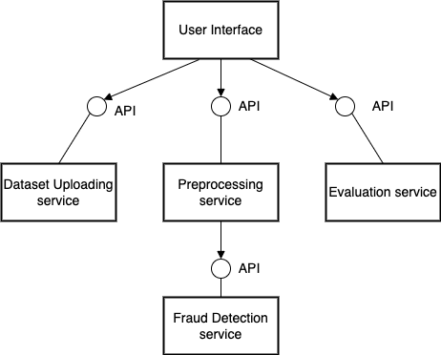
Methodology & Case-Study
Step 6: Transform into a microservice-oriented framework
he Hybrid Messaging Pattern is applied to integrate the services for fraud detection framework.
Applying a hybrid messaging pattern to integrate services in the fraud detection framework
Notes:
Last step is Transforming into a microservice-oriented framework
The identified communication styles indicate that the uploading dataset service and evaluation service use synchronous communication, while the preprocessing service and fraud detection service use asynchronous communication.
Thus, the Hybrid Messaging Pattern is best applied to integrate the services. With the help of the identified communication spots for the communication orders of the services, the high-level integration structure of the Fraud Detection framework is designed.

Slide 14
Contribution
Schmid’s approach is object-oriented, generalizing the class structure of an application when designing application frameworks. There are also alternative systematic approaches that are not constrained to the object-oriented paradigm.
The proposed methodology of designing microservices-oriented frameworks addressed these limitations of Schmid’s approach by introducing the concept of communication spots and communication styles, which allowed Schmid’s approach to be adjusted into a microservice environment.
A case study is used to demonstrate the usage of the proposed methodology in designing a microservice-oriented fraud detection framework
Each pattern serves as a solution for a fine-grained integration problem. To construct a system with microservices, it is necessary to utilize most of these patterns simultaneously
Notes:
Schmid’s approach is object-oriented, generalizing the class structure of an application when designing application frameworks. There are also alternative systematic approaches that are not constrained to the object-oriented paradigm.
This study uses three integration patterns in the case study. There are also other alternative integration patterns that can be used in the transformation step. For example, Microsoft Azure proposed nine patterns [20] for integrating microservices in applications.

Slide 15
Conclusion
Microservice-oriented application frameworks will be beneficial for the development of microservice-oriented applications in the particular business domains that the frameworks are constructed for.
The future work will be focused in two directions.
  We can explore to find any possibilities to enhance the fraud detection framework by introducing the support for time series, unsupervised learning algorithms, and the usage of quantum computing.
  Second direction is to investigate the impact of the different computing environments (classical vs. quantum) to the framework design in order to improve our methodology.
Notes:
Microservice-oriented application frameworks will be beneficial for the development of microservice-oriented applications in the particular business domains that the frameworks are constructed for.
Future work will be focused on two directions. One direction is to enhance the fraud detection framework by introducing the support for time series, unsupervised learning algorithms, and the usage of quantum computing. The other direction is to examine the impact of the different computing environments (classical vs. quantum) on the framework design thus enhance the methodology

Slide 16

Thank you
Presenter: Yunhyeok Lee
Notes:
Source code appendix.

