Slide 1
Visualization of automated program repair focusing on suspiciousness values
(SEKE-2022)
Naoki Tane
Computer science and engineering
Waseda University
Tokyo, Japan
n.tane0228@fuji.waseda.jp
Yusaku Ito
Computer science and engineering
Waseda University
Tokyo, Japan
yusaku66els01@suou.waseda.jp
Hironori Washizaki
Computer science and engineering
Waseda University
Tokyo, Japan
washizaki@waseda.jp
Toshiaki Fukazawa
Computer science and engineering
Waseda University
Tokyo, Japan
Fukazawa@waseda.jp
Notes:
It is a great honor to have the opportunity to share our research at SEKE2022. My name is Naoki Tane.
Today I will introduce our research, “Visualization of automated program repair focusing on suspiciousness values”.

Slide 2
Background & Related Work
Fault Localization (Spectral-based methods)
Methods that identify faulty program lines based on information obtained from the success or failure of test cases.
APR (Automated Program Repair)
APR removes bugs from buggy programs without human intervention.
  Input: buggy program & test cases
  Output: bug-free program
Notes:
First, I will introduce the background and related work.
First, fault localization means a method that examines lines of the program that are likely to have bugs based on the pass rate of the test cases.
Next, Automated program repair removes bugs from buggy programs without human intervention.
If the developper gives a buggy program and test cases, Automated program repair outputs a program with the bug fixed.

Slide 3
Background & Related Work
kGenProg
An APR tool based on source code reuse written in Java.
kGenProg automatically repairs bugs using GAs.
kGenProg works as follows…
Notes:
Finally, kGenProg is an APR tool based on source code reuse written in Java.
It automatically repairs bugs using Genetic Algorithms and works as follows.
First, it generates multiple variants by modifying the lines that contain bugs.
Second, kGenProg runs unit tests on the generated variants.
kGenProg outputs a repaired program if a variant passes all the tests.
If not, kGenProg selects some of the generated variants considering the pass rate of the test cases and creates new variants based on them.

Slide 4
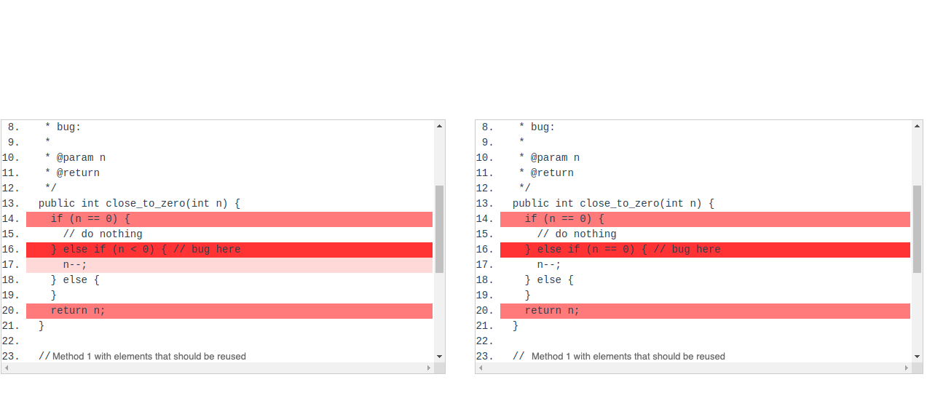
Primary genetic operation of kGenProg: Mutation
Determined that there is a high possibility of a bug in line 16
-> Set suspicious value to high
Replace line 16
Generation 3
Generation 4
Notes:
Next, I will describe the mutation, which is the primary genetic operation in kGenProg.
First, kGenProg performs fault localization to determine which lines in a buggy program have a higher probability of being buggy.
Fault localization sets a higher suspiciousness value for lines that are considered more likely to have bugs.
Then, kGenProg performs mutation operations on the lines for which the suspiciousness value is set.
It performs mutation operations with higher probability on rows with higher Suspiciousness Values.
Mutation operations add, delete, or change rows.
In this example, kGenPog
applies the Replace operation
to line 16,
which has
a high suspiciousness value.

Slide 5
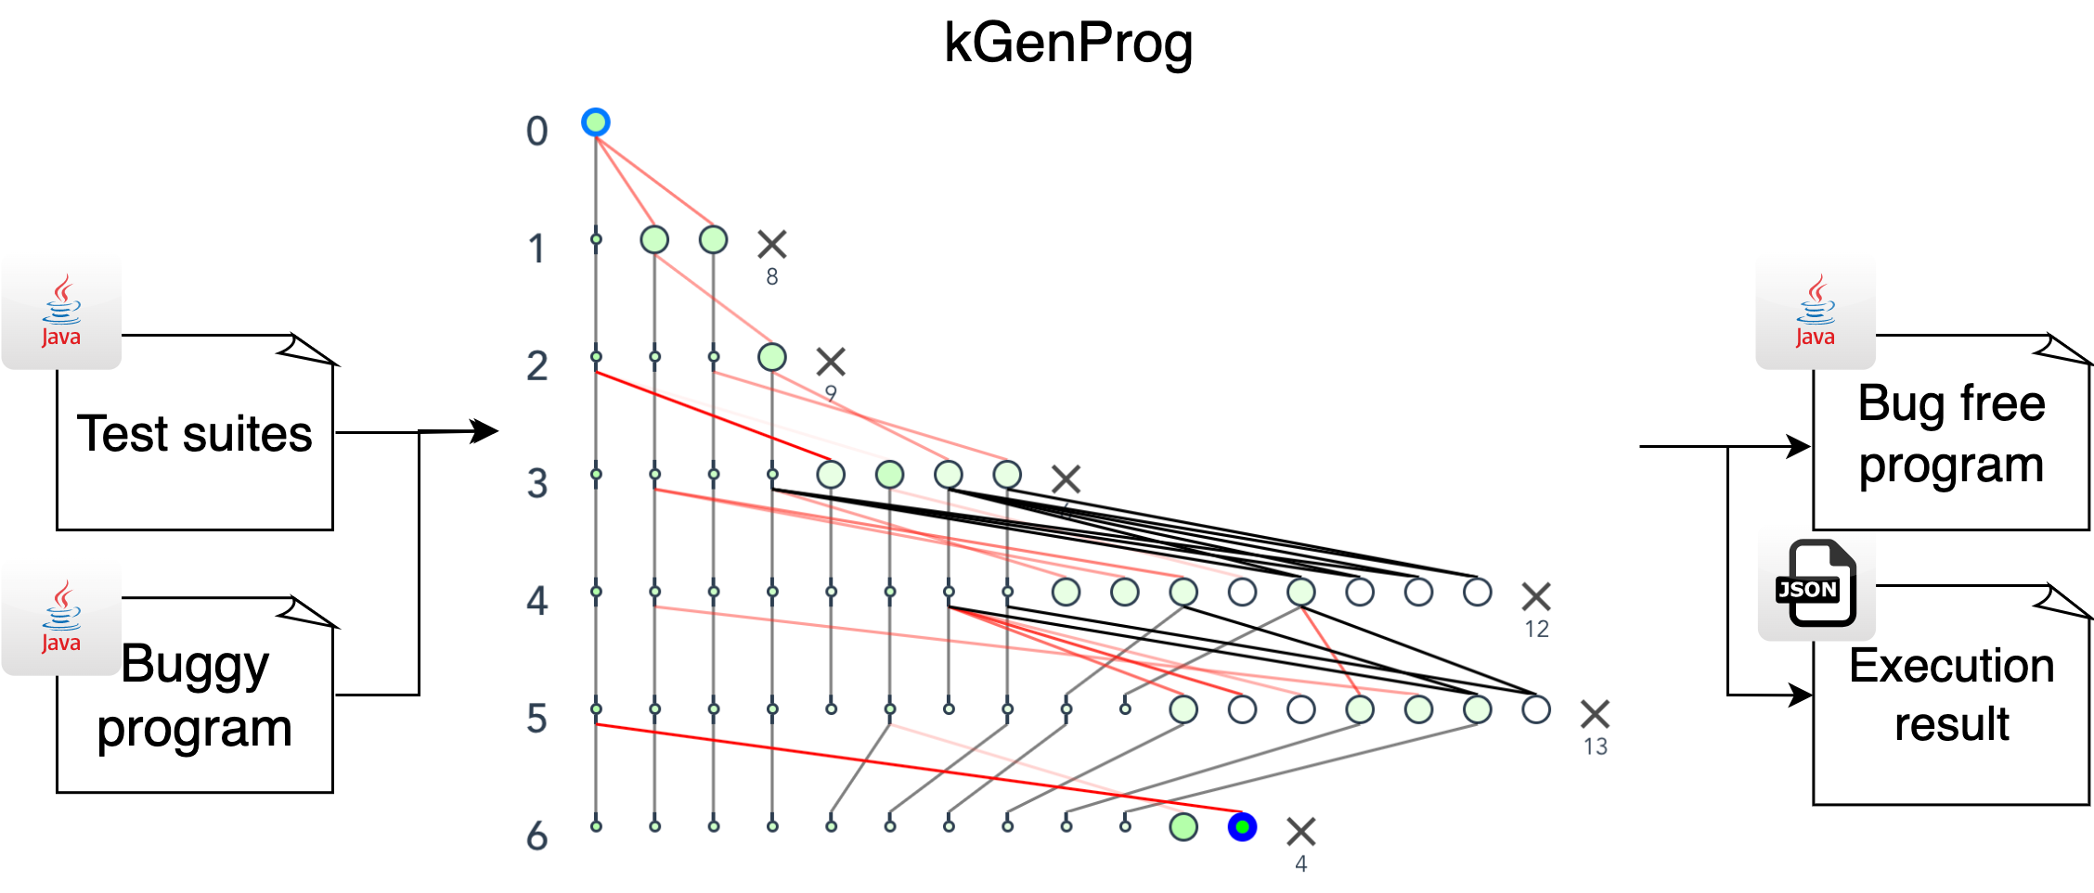
Motivation
  Difficult to intuitively understand the impact of fault localization in APR with genetic algorithms.
  We propose a new method to visualize the impact of fault localization on program evolution in kGenProg.
？
Notes:
And then, I will talk about the motivation of our research.
APR using genetic algorithms produces bug-free programs from buggy programs and test cases, but it is difficult to understand the modification process.
It's especially Difficult to intuitively understand the impact of fault localization in APR with genetic algorithms because kGenProg generates multiple programs.
So we propose a new method to visualize the impact of fault localization on program evolution in kGenProg.
3:40

Slide 6
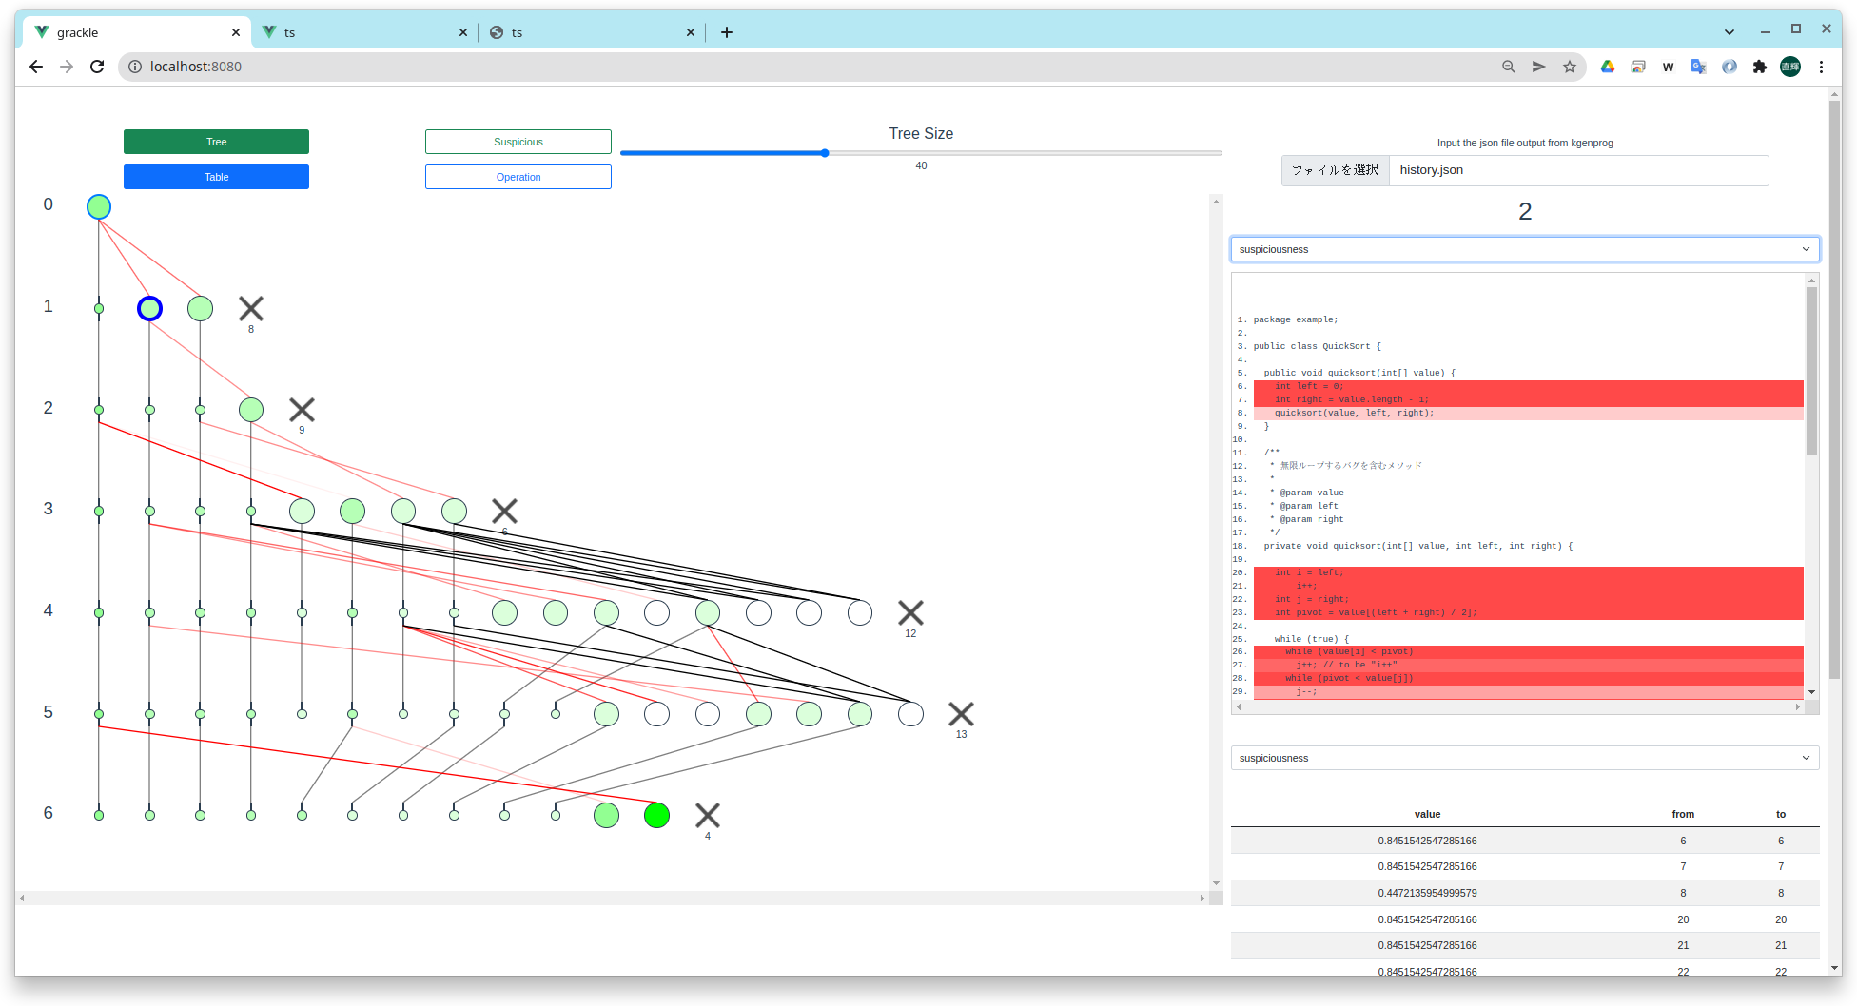
Our Approach: An overview
  How to visualize the impact of fault localization on program evolution in kGenProg
    Visualization of suspicious values output by fault localization
  How to visualize suspicious values output by fault localization
    Code genealogy as a bird’s eye view tree structure
    Detailed variant information
    Detailed variant information
Code genealogy
Notes:
After that, I will explain our approach.
Our approach is to visualize suspicious values output by fault localization to visualize the impact of fault localization on program evolution in kGenProg.
Our approach visualizes these by displaying the following two.
One is Code genealogy as a bird’s eye view tree structure,
and the other is Detailed variant information.

Slide 7
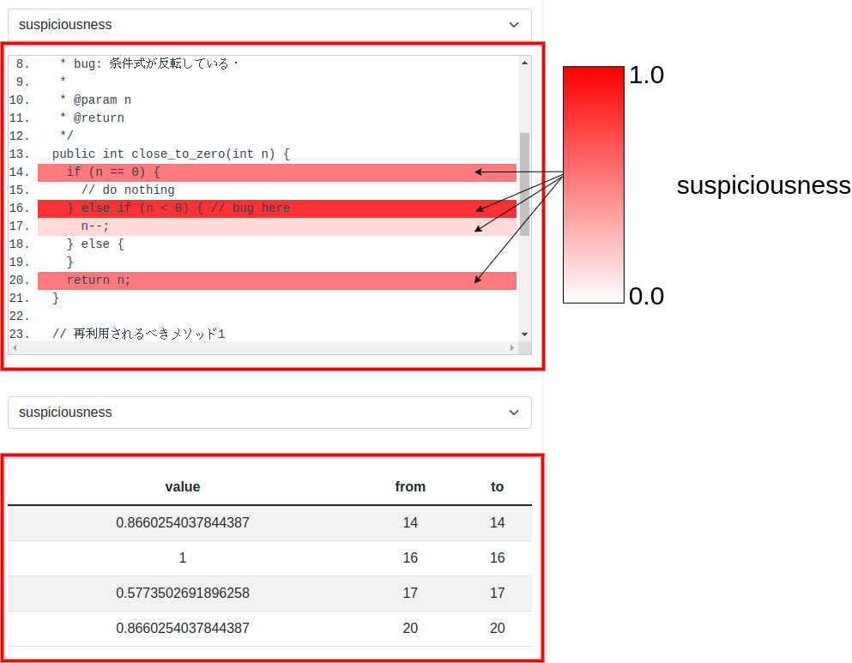
Visualizing suspiciousness values (Detailed variant information)
    The color intensity represents suspiciousness values set for the row that operated to generate each variant.
    Table of suspiciousness values set for the row that operated to generate each variant.
Notes:
First, Detailed variant information provides visualization for the alleged value of each row in each variant.
The color intensity represents suspiciousness values set for the row that operated to generate each variant.
And it also shows the table of suspiciousness values.

Slide 8
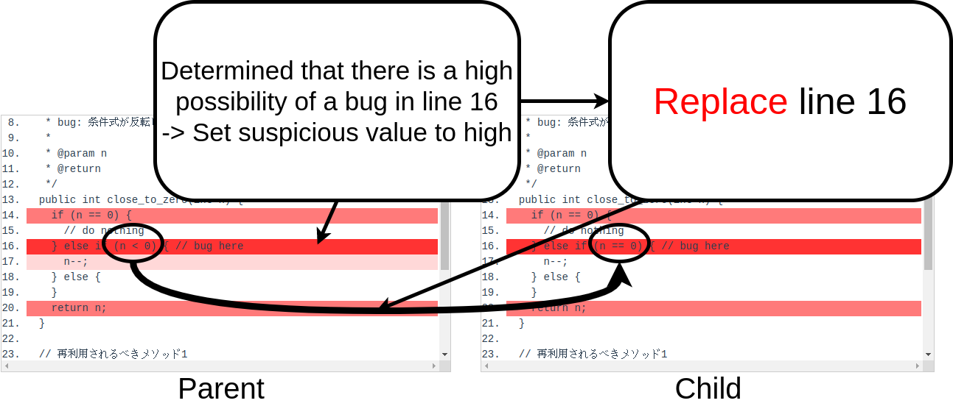
Visualizing suspiciousness values (Code genealogy)
Method 1 with elements that should be reused
Method 1 with elements that should be reused
Generation 3
Generation 4
Notes:
Next, I will explain how to visualize the suspiciousness values using Code genealogy.
In mutation, it performs operations such as inserting, deleting, or replacing lines suspected of having bugs in fault localization.

Slide 9
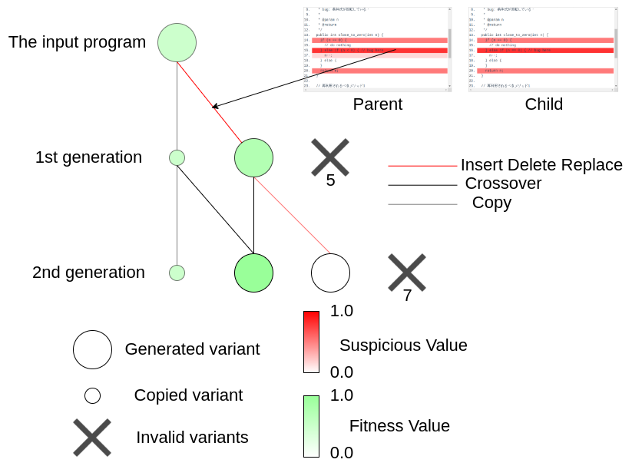
Visualizing suspiciousness values (Code genealogy)
    The red intensity of the edge
    → suspiciousness value set at the line where kGenProg operated. (mutation)
    Areas with high suspiciousness values are easily visualized.
    The influence of fault localization on APR
    can be understood intuitively.
Notes:
Then, the red intensity of the edge of the Code genealogy visualizes suspiciousness values that were calculated for such a changed location by mutation.
And areas with high suspiciousness values are easily visualized.
Developpers can understand the influence of fault localization on APR intuitively.

Slide 10
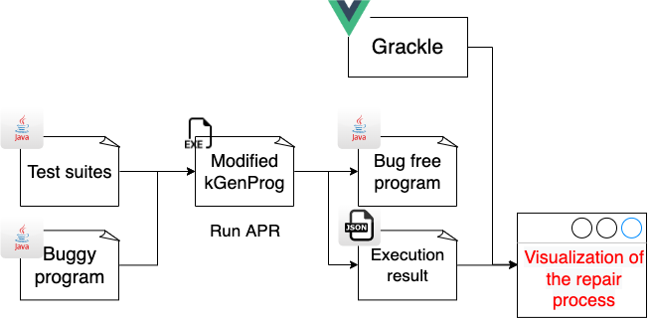
Example of visualization with our tool: Grackle
Grackle
    A tool to implement our method.
    Run in modern web browsers
    ( Google Chrome, Firefox, Safari,
    Microsoft Edge etc ).
Notes:
Next, I will introduce one visualization example with our tool: Grackle.
First, Grackle is a tool to implement our method and run in modern web browsers like Google Chrome, Firefox, Safari, Microsoft Edge, and so on.
Grackle uses the log file of the APR with modified kGenProg as input for visualization in the browser.
デモンストレーション
Now I will demonstrate our tool, Grackle.
This is the grackle screen.
First, the program is automatically modified with kGenProg, which is modified to output the Suspiciousness Value and other information as a log.
Then, the log file of the modification process output by kGenProg is entered into Grackle.
<ファイルを入力、suspiciousness value 表示 ３０にする>
In this case, I am using kGenProg to repair the QuickSort bug program, and I am inputting the output log file into grackle for visualization.
<0番目のvariant選択、26行目表示>
In fact, you can see that the bug originally found here
<最後のvariant選択、26行目表示>
on line 26 has been fixed.
After that, the modification process is represented by code genealogy and detailed variant information.
Here variant means programs modified by genetic manipulation.
At first, I will explain the representation in the code genealogy.
<ノードを指す>
Each node represents a single variant,
＜番号を指す＞
and nodes on the same y-axis mean that they are from the same generation of kGenProg.
<大円をクリック>
Circle nodes represent newly generated variants,
<小円をクリック>
and small circle nodes denote variants copied from all ages.
<大円を指す>
The adaptive value is an indicator of the pass rate. In our method, the darker the green color, the higher the adaptive value.
<赤線を指す>
The red intensity of the edge of the tree structure of our method represents the suspiciousness value set at the point where kGenProg performed mutation operations. The darker the color, the higher the suspiciousness value of the changed part.
<Gen3の一番左のノードをクリック>
This visualization of the Suspiciousness Value allows us to know which variants were generated by adapting the operation to the rows that kGenProg identified as likely to have bugs in the fault localization.
Then, by looking at those variants, you can check to see if fault localization works correctly in automated program repair.
<怪しさ値、差分、単体テスト結果,差分>
You can also select a variant of code genealogy to see the suspiciousness value for each row of that variant, differences, and unit test results.

Slide 11
Conclusion and Future Work
Conclusion
Related Work: Macaw doesn’t give intuitive information about fault localization but…
The proposed method facilitate the understanding of fault localization.
The effect of fault localization in GA-based APR is easily understood.
Future Work
Evaluate our method and tool quantitatively.
Devise use cases for the proposed method and verify the practicality of our method and tool.
Notes:
Finally, I will provide a conclusion to this research.
In fact, there is a tool, Macaw, that has similarly implemented the kGenProg visualization method in a related work.
However, it does not give intuitive information on fault localization.
But, the proposed method facilitates the understanding of fault localization.
Also, developpers can easily understand the effect of fault localization in GA-based APR.
In the future, we plan to evaluate our method and tool quantitatively. We also plan to devise use cases for the proposed method and verify the practicality of our method and tool.
Thank you for listening.

