Slide 1
Quantum Software Models:
Software Density Matrix is a
Perfect Direct Sum of Module Matrices
Iaakov Exman and Alexey Nechaev
Software Engineering Department
The Jerusalem College of Engineering – JCE - Azrieli
Jerusalem, Israel
iaakov@jce.ac.il, alosha82@gmail.com
DOI: 10.18293/SEKE2022-158

Slide 2
The Message
Software System Density Matrix:
a Direct Sum of Modules’
density matrices
Bidirectional:
Top-down or bottom-up
Design Whole system
from verified correct modules
July 2022
Copyright by Iaakov Exman
2 of 12

Slide 3
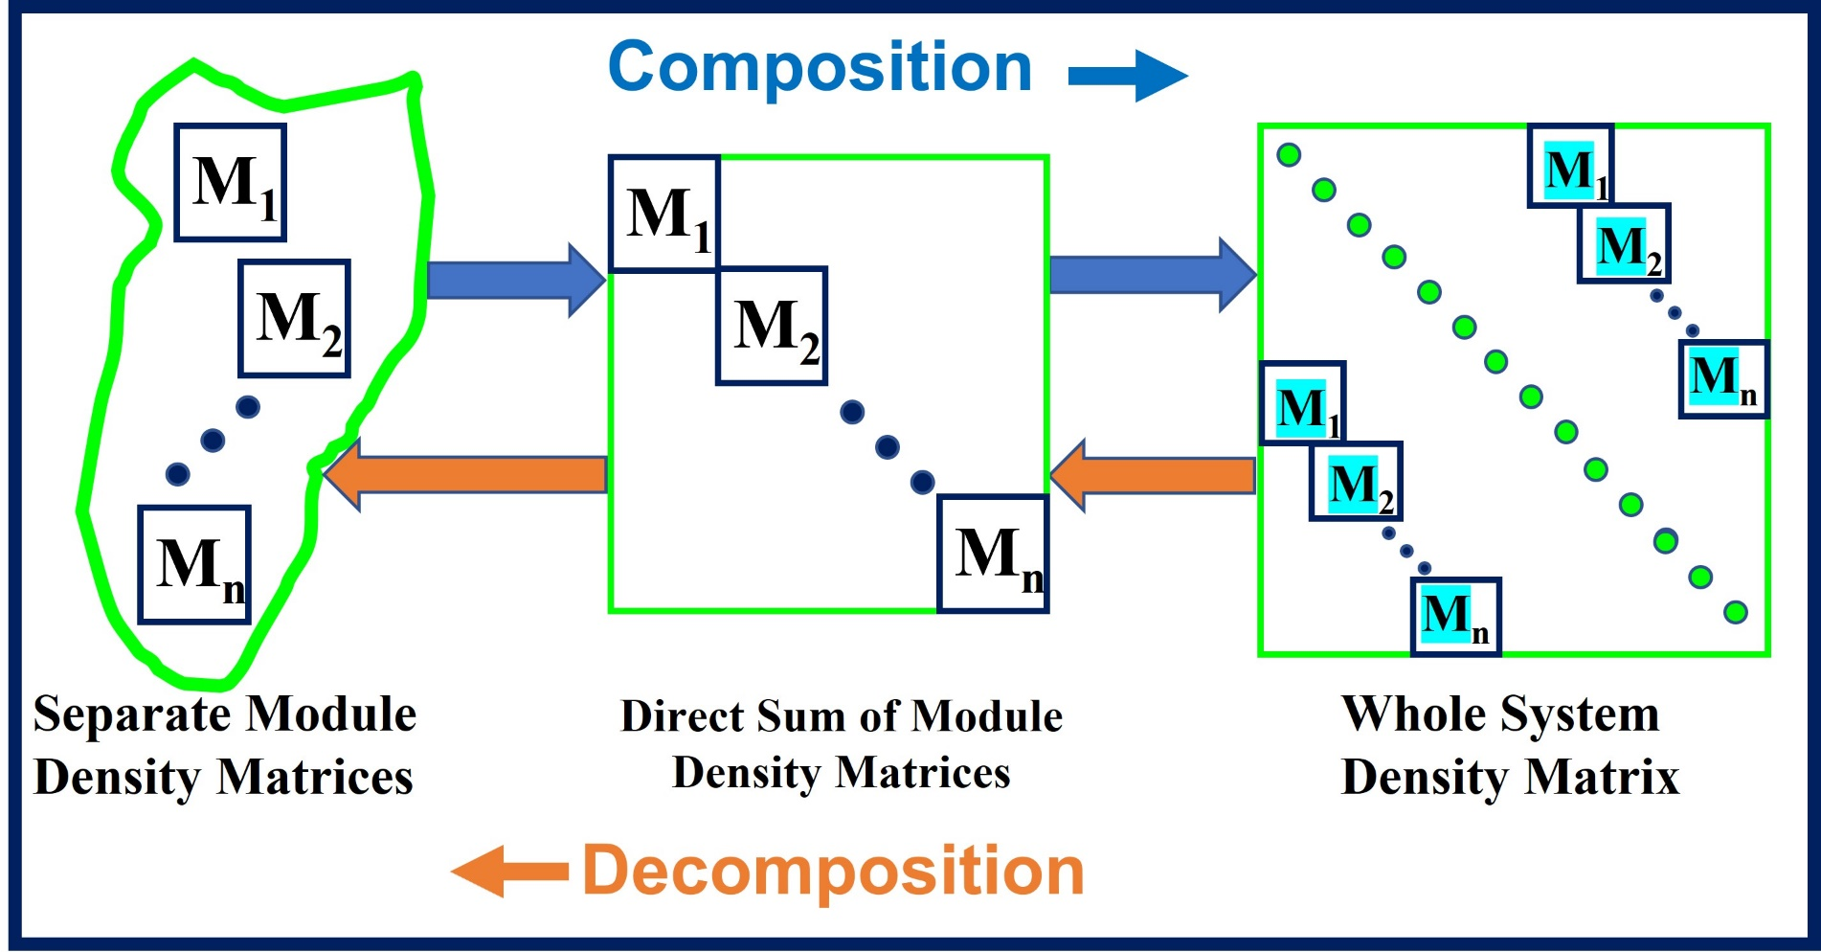
The Message
⨁_{j} M_{j} = diag(M₁, M₂,…,M_{n})
July 2022
Copyright by Iaakov Exman
3 of 12

Slide 4
Agenda
Basics: Bipartite Graph to Density Matrix
Classical: Command Design Pattern
Quantum: Grover Search
Some Theory: Well-designed Software
Discussion: Important Features
July 2022
Copyright by Iaakov Exman
4 of 12

Slide 5
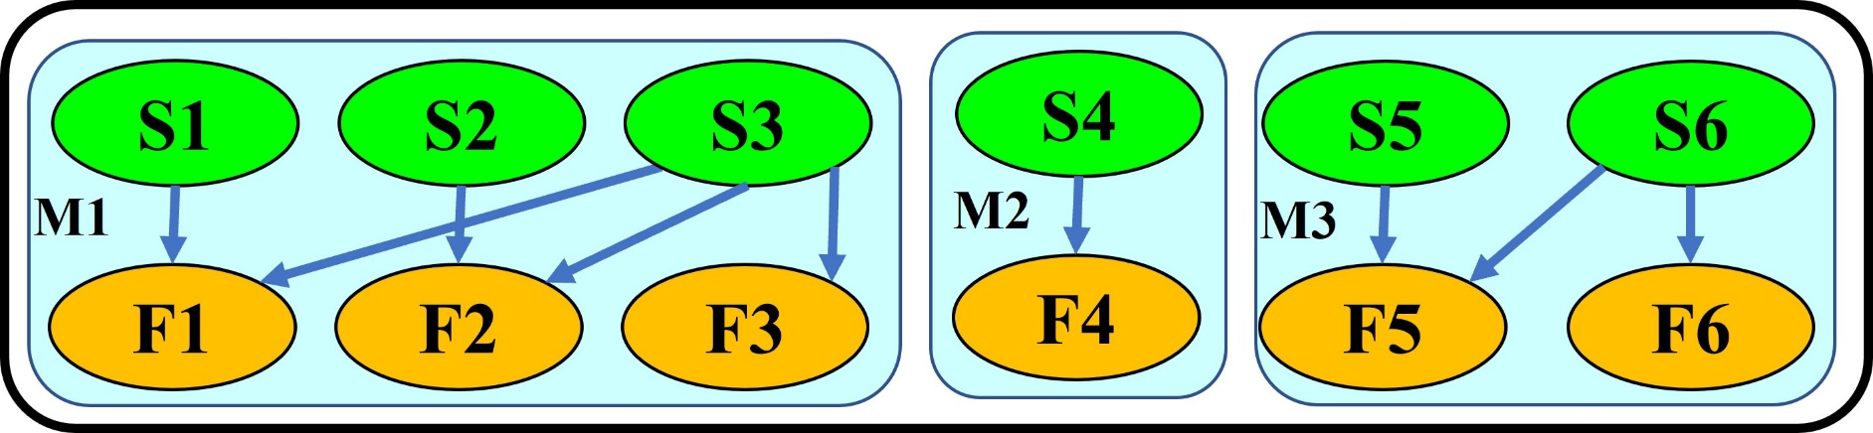
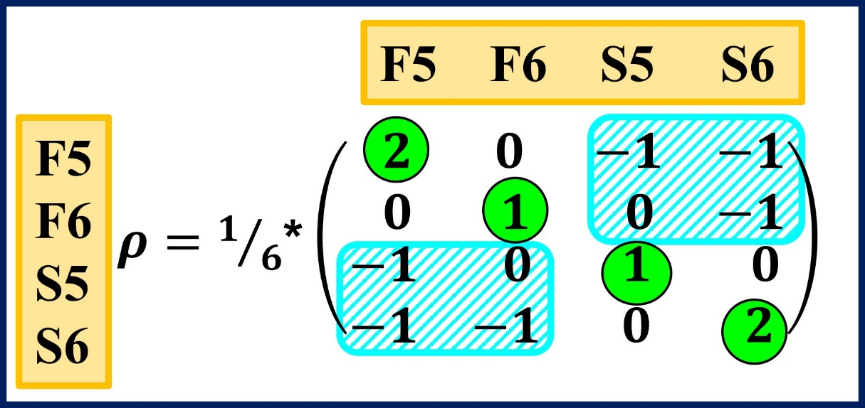
1. Basics:
Module M3
Bipartite Graph
System Bipartite Graph
Module M3
Density Matrix
July 2022
Copyright by Iaakov Exman
5 of 12

Slide 6
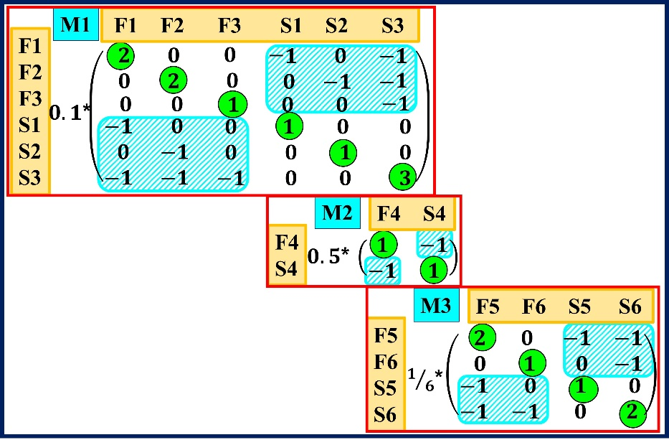
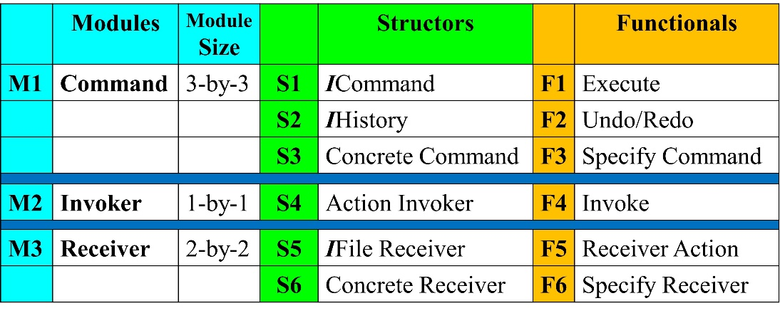
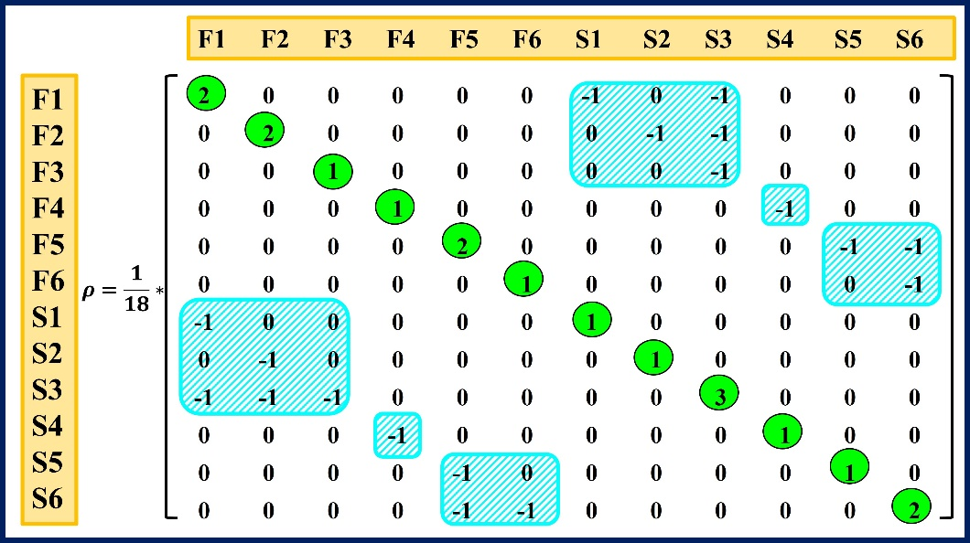
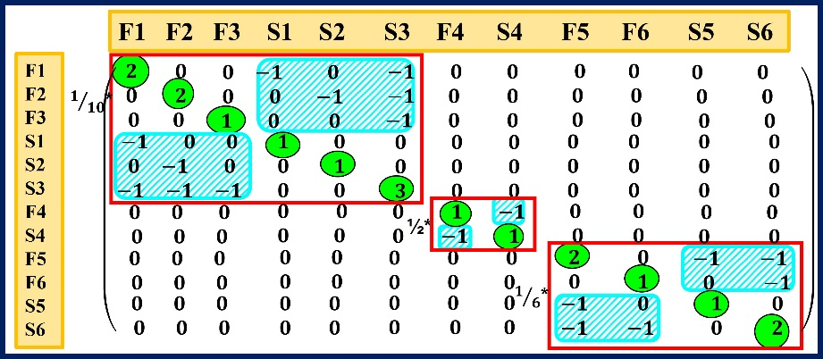
2. Classical: Command Design Pattern
Separate
Modules
Whole System
Direct Sum
July 2022
Copyright by Iaakov Exman
6 of 12

Slide 7
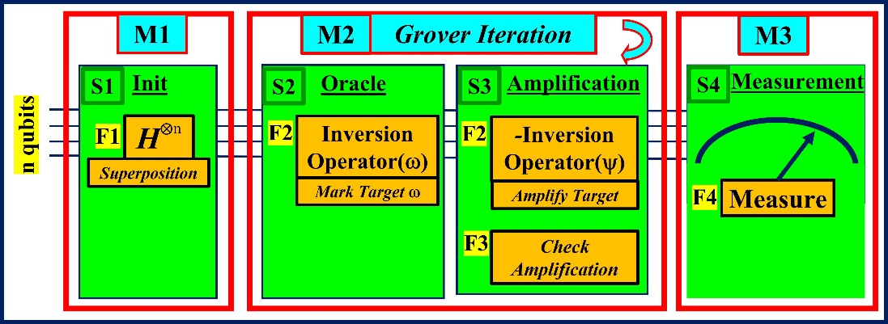
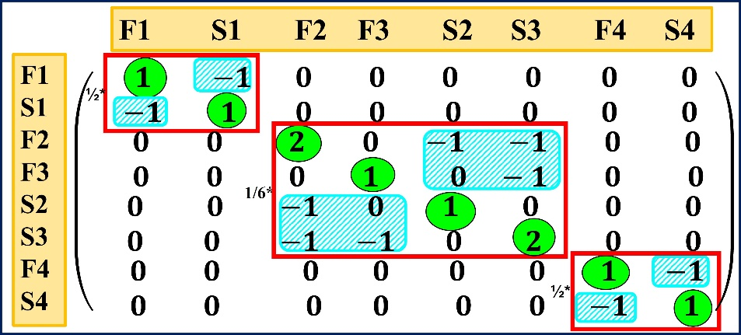
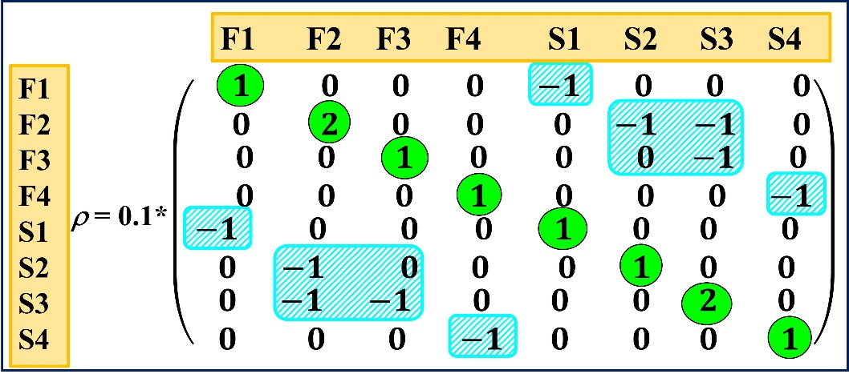
3. Quantum: Grover Search
Quantum
Circuit
Direct Sum
Whole System
July 2022
Copyright by Iaakov Exman
7 of 12

Slide 8
4. Some Theory: Formulas
Laplacian L generated from
Bipartite Graph,
by equation
L = D – A
D = diagonal Degree matrix
A = Adjacency Matrix
Density Matrix ρ obtained from
Laplacian L,
by equation
ρ = L / Tr(L)
Tr(L) = Laplacian Trace
= Sum of diagonal elements
July 2022
Copyright by Iaakov Exman
8 of 12

Slide 9
4. Some Theory: Well-Designed Software
Definition 1 – Well-designed Software System
A Density Matrix software system, well-designed in algebraic
Conceptual Integrity terms, obeys the following Adjacency Matrix conditions, within the Density Matrix:
Linear Independences – all its Structors are mutually
linearly independent and all its Functionals are mutually
linearly independent;
Square Adjacency Matrix – each quadrant of the Adjacency
Matrix, within the Density Matrix is square, a linear algebra
consequence of the Linear Independences’ condition;
Orthogonality – all modules in both quadrants of the Adjacency Matrix, are block diagonal.
July 2022
Copyright by Iaakov Exman
9 of 12

Slide 10
4. Some Theory: Perfect Direct Sum
Theorem 1 – Perfect Direct Sum of Modules’
Density Matrix
Assuming:
each module Density Matrix of a chosen set of modules is well-designed,
Then:
the composed whole software system Density Matrix is well-designed.
July 2022
Copyright by Iaakov Exman
10 of 12

Slide 11
5. Discussion: Important Features
Quantum Theory – rigorous, self-consistent, triggers otherwise unthinkable questions;
Agile Design Rules – Brooks’ Conceptual Integrity implemented by a Density Matrix is a theory behind Agile-Design-Rules;
Input modules a priori correctness – assured by algebraic spectral modularization;
Formal uniformity & Software generality – extremely
simple and uniform Density Matrix format.
July 2022
Copyright by Iaakov Exman
11 of 12

Slide 12
The Message
Software System Density Matrix:
a Direct Sum of Modules’
density matrices
July 2022
Copyright by Iaakov Exman
12 of 12

