Slide 1

Improving Mutation-Based
Fault Localization via
Mutant Categorization
Xia Li, Durga Nagarjuna Tadikonda

Slide 2
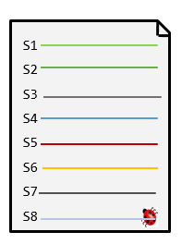
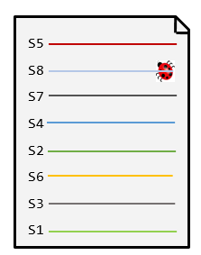


Fault Localization
Fault localization is one of the most important software debugging techniques
It can help localize faulty code elements (e.g., statements, functions, methods or classes) when certain test cases fail in a faulty program
Fault Localization
Faulty Program
Suspicious Ranking List
Manual Checking
Goal: Localizing the faulty element at the top location!

Slide 3
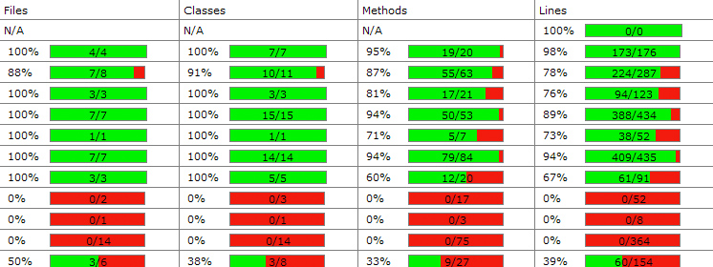



Spectrum-Based Fault Localization (SBFL)
It leverage the coverage information between source code elements and test case
Limitation: faulty elements may also be executed by passed tests
Coverage
Test Failure

Slide 4

Mutation-Based Fault Localization (MBFL)
Generate mutants by mutation testing
Run original test case on each mutant and check the impact of mutant on test outputs, e.g., if test outputs change before and after mutation
If a mutant causes more failed test to pass, the original element which this mutnat occurs in has higher probability to be faulty
S1
S2
S3
S4
S5
S6
S7
S8
S1
S2
S3
S4
S5
S6
S7
S8
S1
S2
S3
S4
S5
S6
S7
S8
C = a + b
C = a - b
C = a + b
a++
a++
a--
Mutant-1
Mutant-2

Slide 5













Mutation-Based Fault Localization (MBFL)
Metallaxis [Papadaki et al.]
 |  | Test-1 | Test-2 | Test-3 | Test-4 | Susp value
Element-1 | Mutant-1
 | Mutant-2
Element-2 | Mutant-3
 | Mutant-4
Element-3 | Mutant-5
Element-4 | Mutant-6
:The output of test case changes before and after mutation
Mutating programs can help check its impact on the test outputs and determine its contribution to test failures
Papadaki et al, Metallaxis-fl: mutation-based fault localization,” Software Testing, Verification and Reliability, 2015.

Slide 6


Mutation-Based Fault Localization (MBFL)
However, following case may occur in the real world
 |  | Test-1 | Test-2 | Test-3 | Test-4 | Susp value
Element-1 | Mutant-1
 | Mutant-2
Element-2 | Mutant-3
 | Mutant-4
Element-3 | Mutant-5
Element-4 | Mutant-6
1
1

Slide 7
MuCatFL (FL via Mutant Categorization)
Definition of Mutant Categorization:
  Positive mutant: causes any failed test pass
  Neutral mutant: causes all test cases unchanged
  Negative mutant: causes all failed tests still fail and any passed tests fail
  Basic idea of MuCatFL:
  For the tied elements (with same suspiciousness values):
  Element with more positive mutants has higher probability to be faulty → rank it higher
  Element with more negative mutants has lower probability to be faulty → rank it lower

Slide 8
MuCatFL
Element-1 and Element-2 have the same suspicious value
  Element-1: two positive mutants
  Element-2: one positive mutant
  Element-1 is more suspicious than Element-2
 |  | Test-1 | Test-2 | Test-3 | Test-4
Element-1 | Mutant-1
 | Mutant-2
Element-2 | Mutant-3
 | Mutant-4
Element-3 | Mutant-5
Element-4 | Mutant-6
positive mutant
negative mutant
positive mutant

Slide 9
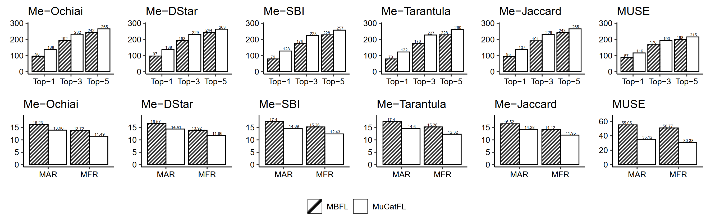
Effectiveness of MuCatFL
Benchmark: Defects4J [Just et al.] including 395 real-world buggy versions
MuCatFL outperforms traditional MBFL techniques in terms of all metrics (Top-N, MAR and MFR)
Just et al, Defects4j: A database of existing faults to enable controlled testing studies for java programs,” ISSTA’14
MUSE: Moon et al, Ask the mutants: Mutating faulty programs for fault localization. ICST’14

Slide 10
Thanks!
Q&A

