Slide 1



Investigating Cognitive Workload during Comprehension and Application Tasks
in Software Testing
Daryl Camilleri
Mark Micallef
Chris Porter

Slide 2
Motivation
Software testers are an integral part of development teams.
They need to understand the project on multiple levels, probably more than developers.
It is desirable to gain insights into the cognitive workload experienced by testers as they comprehend a task, understand what is required and complete it.

Slide 3
Research Questions
RQ1: How are cognitive load and effectiveness in software testers affected when carrying out different types of testing tasks?
RQ2: How are cognitive load and effectiveness affected by an individual’s experience and education?

Slide 4
Methodology

Slide 5
Tasks and Data Collection
2 Practice Tasks
8 Measured Tasks
  3 Test Analysis and Design (increasing difficulty)
  3 Test Automation (increasing difficulty)
  1 Bug Finding
  1 Adequacy Analysis
3 to 5 minutes each task
2-minute fish-tank video in between tasks

Slide 6
Experimental Procedure
Welcome and Consent Form Signing
Carry out Practice Tasks
View Fish Tank Video
Carry out next task
Complete NASA-TLX Assessment for Task
Tasks complete
More tasks remain
Exit Interview and Conclude Experiment

Slide 7
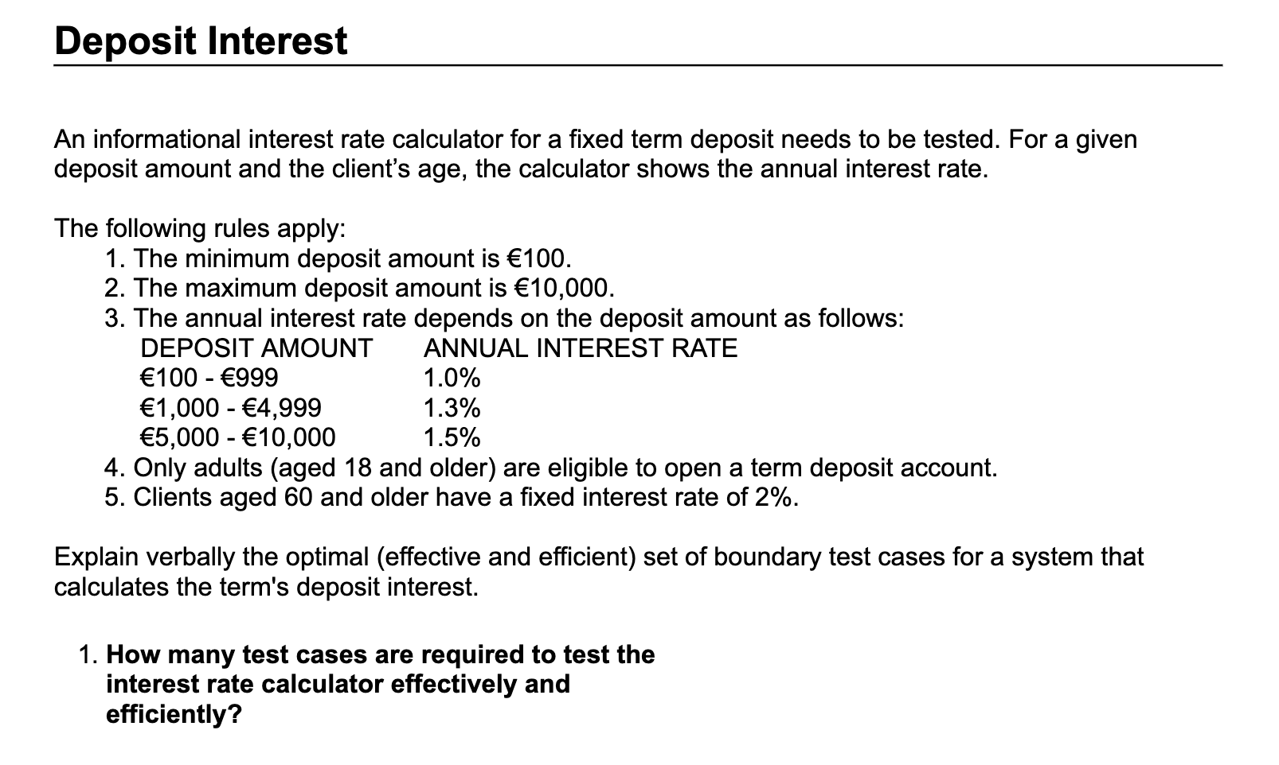
Test Analysis and Design Task

Slide 8
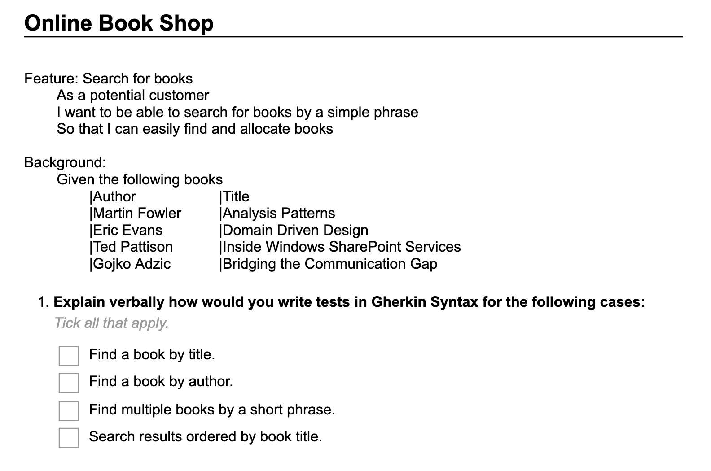
Test Automation Task

Slide 9
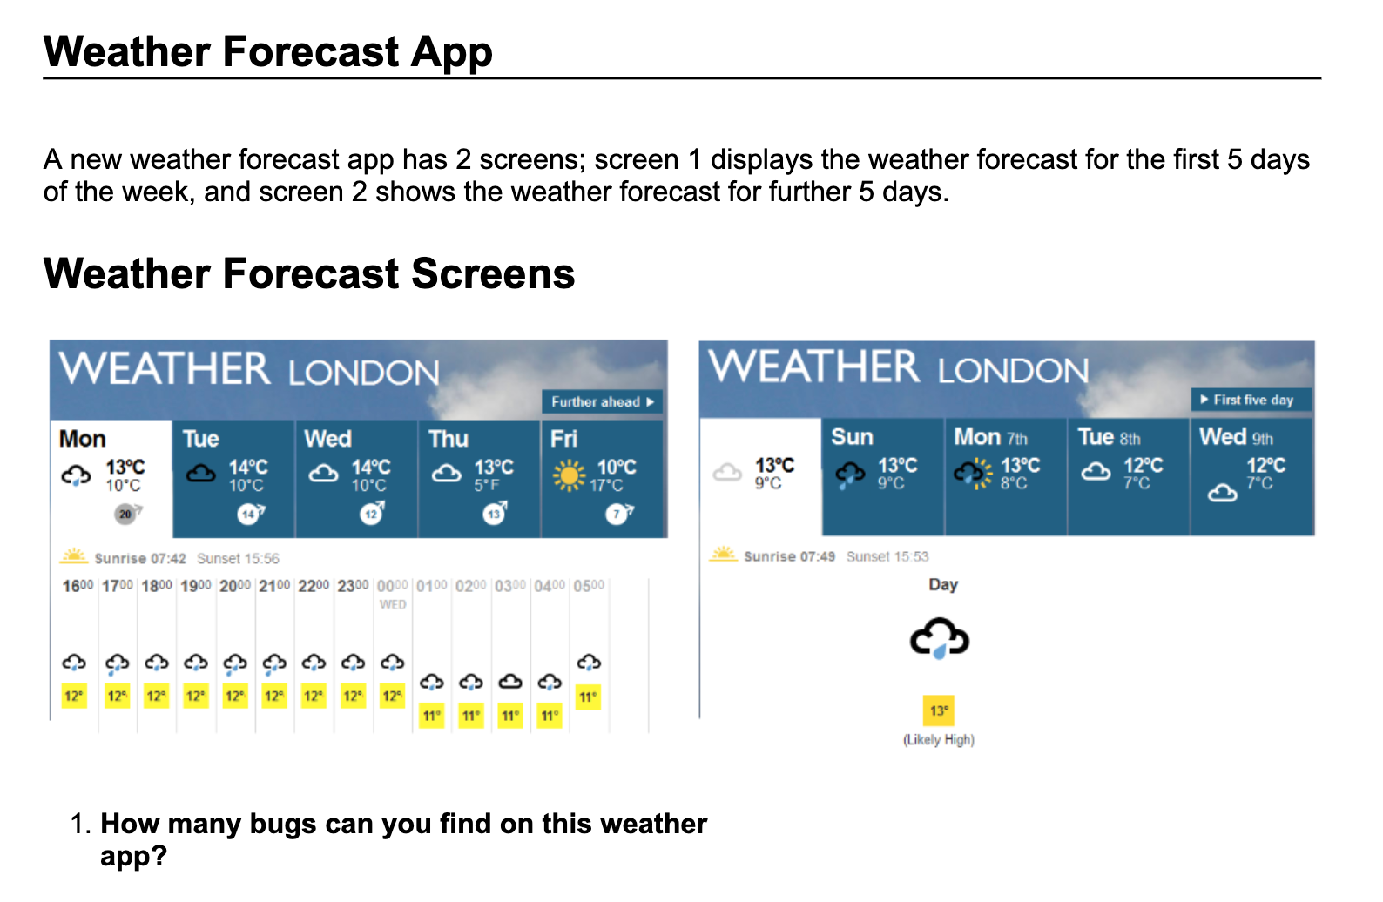
Bug Finding Task

Slide 10
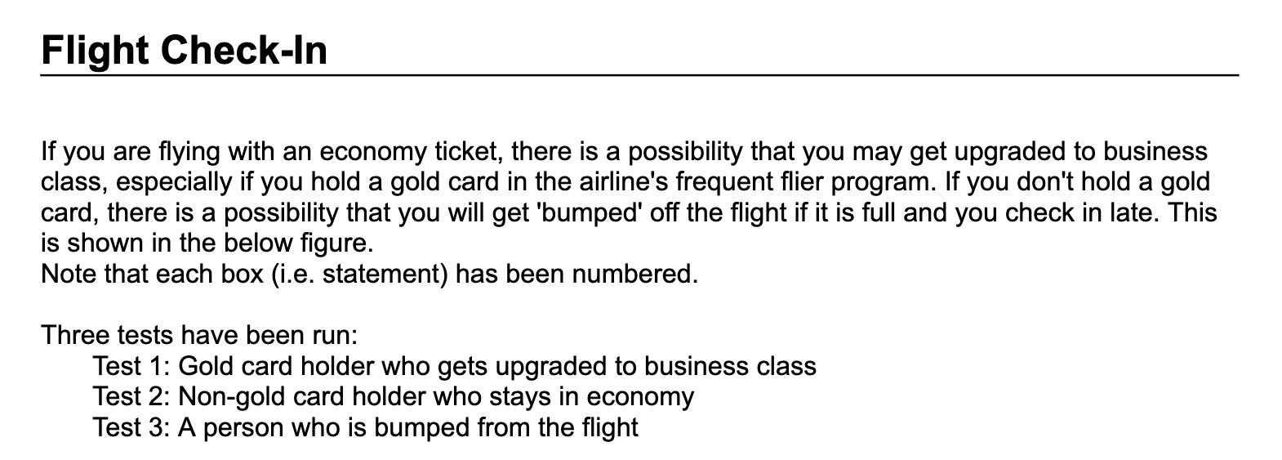
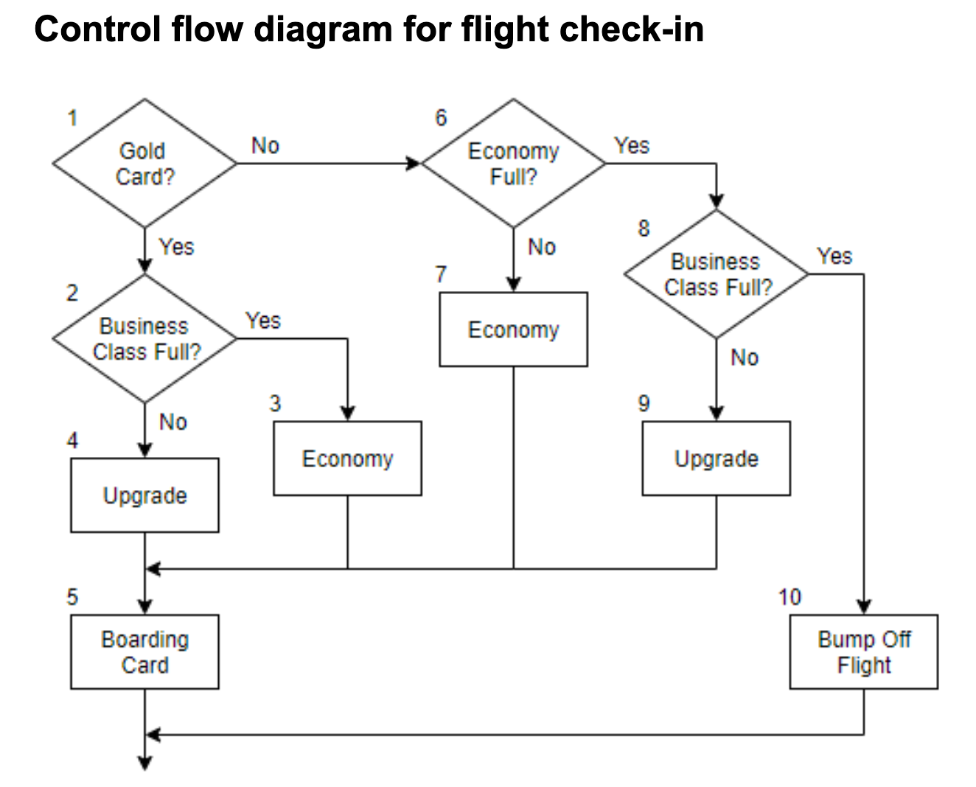
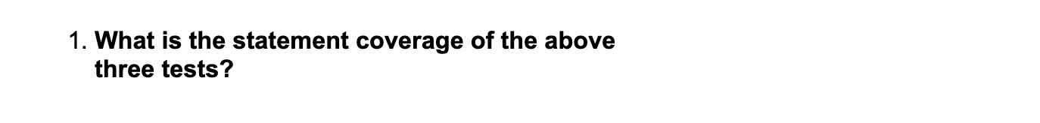
Adequacy Analysis Task

Slide 11
Results

Slide 12
Participant Demographics
Total of 15 participants
Experience
  0-2 years - 3 participants (20%)
  3-5 years - 8 participants (53%)
  6+ years - 4 participants (27%)
Education
  Diploma Level - 2 participants (13%)
  First Degree - 9 participants (60%)
  Postgraduate - 4 participants (27%)
Gender
  Male - 14 participants (93%)
  Female - 1 participant (7%)

Slide 13
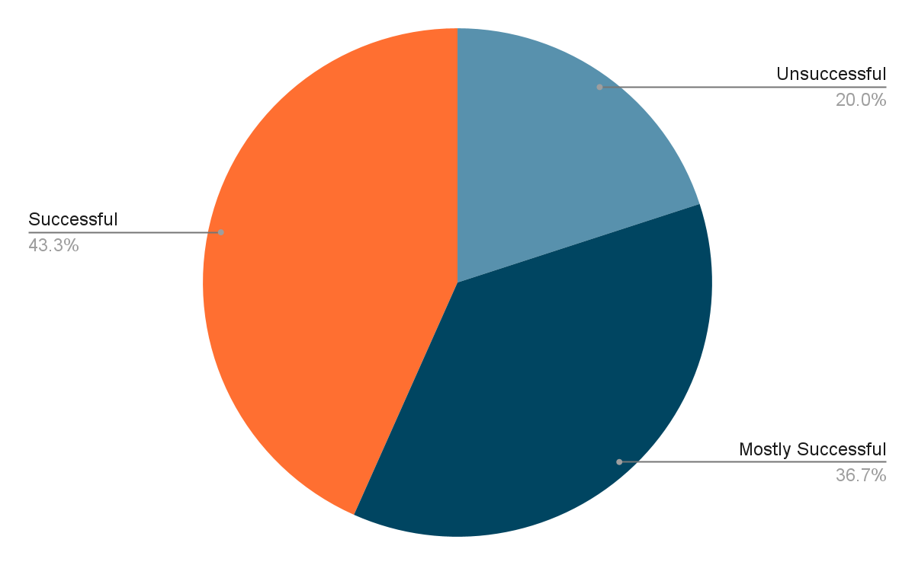
Overall Task Performance

Slide 14
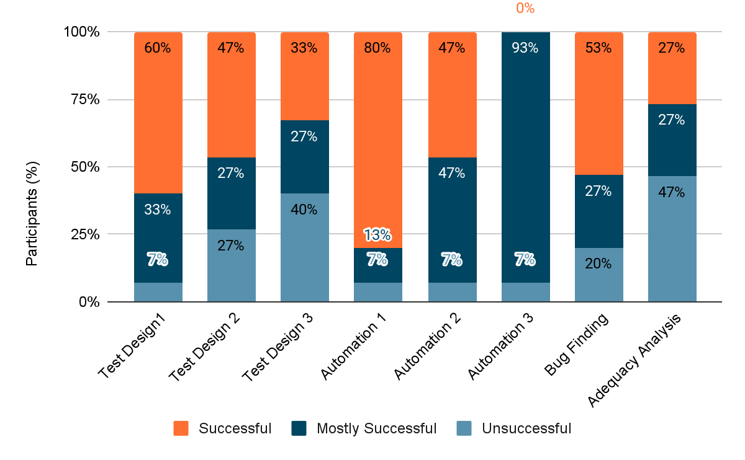
Performance by Task

Slide 15
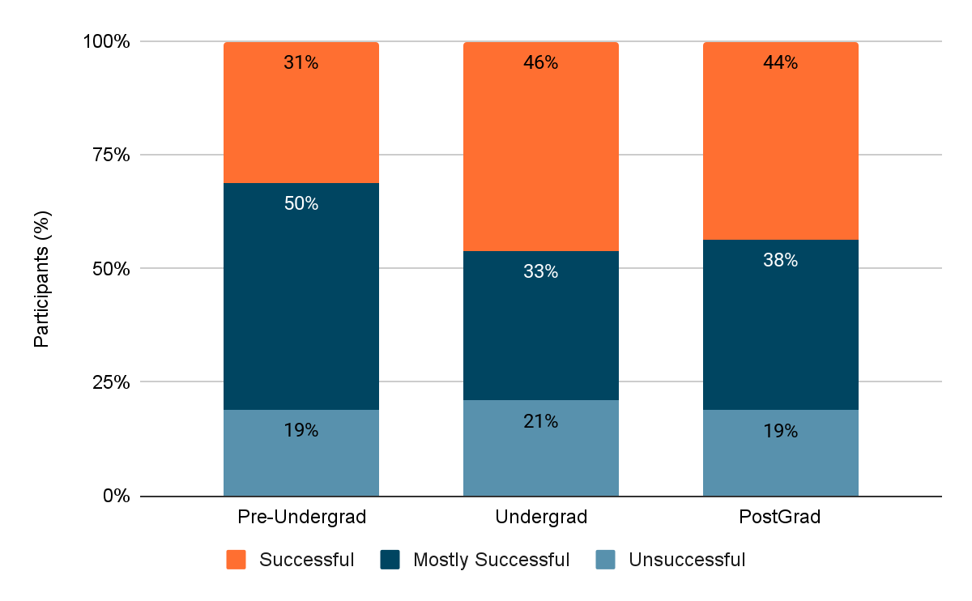
Performance by Level of Education

Slide 16
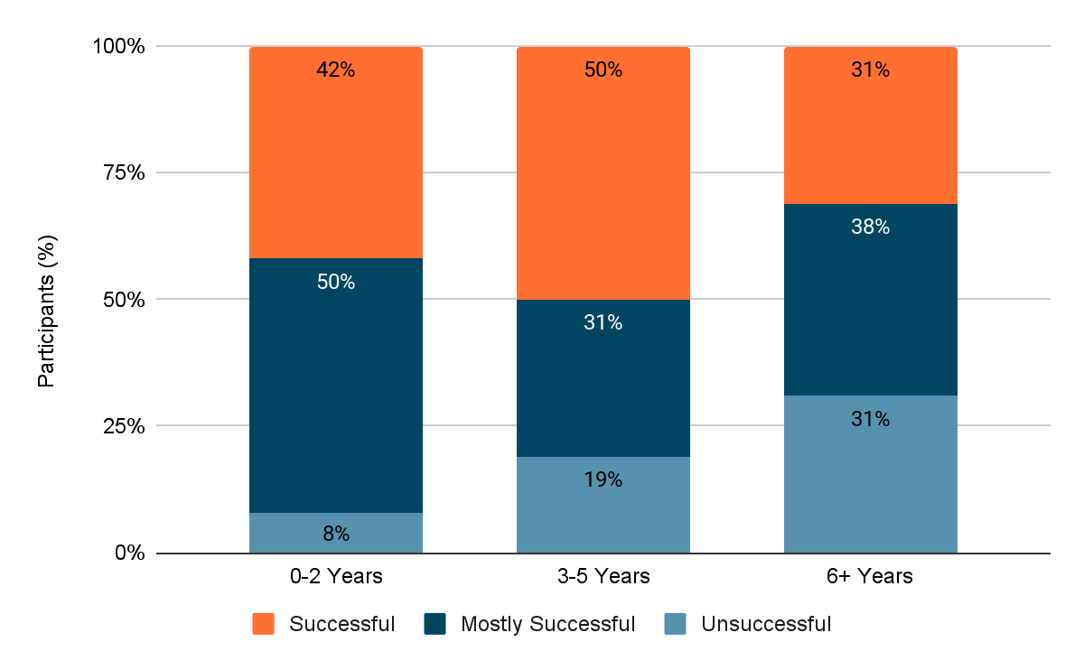
Performance by Experience

Slide 17
Overall Cognitive Workload
Experienced testers experience less cognitive workload in Test Design tasks and Adequacy Analysis.
Inexperienced testers experience less cognitive workload in implementation and bug finding tasks.
Lower levels of education tend to lead to less cognitive workload overall.
The highest workload was experienced by undergraduate participants.

Slide 18
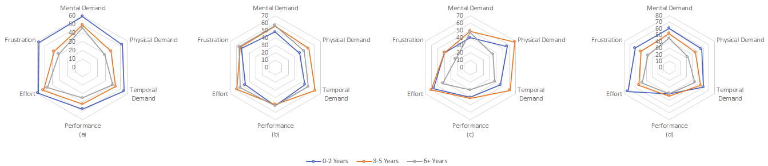
Workload Components by Experience
NASA-TLX scales by experience for (a) test design, (b) test automation, (c) bug finding, and (d) adequacy analysis

Slide 19
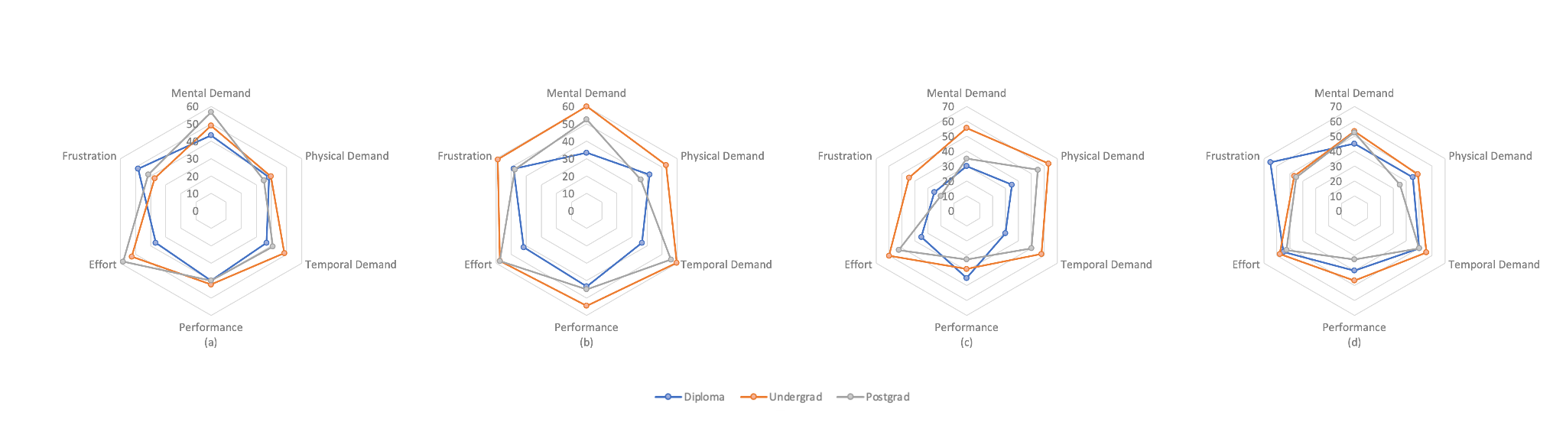
Workload Components by Education
NASA-TLX scales by education for (a) test design, (b) test automation, (c) bug finding, and (d) adequacy analysis

Slide 20
RQ1 - Task Effectiveness and Cognitive Workload
Task effectiveness
  Decreased when we increased task difficulty.
  More “unsuccessful” attempts with test design tasks.
  More “mostly successful” attempts with automation tasks.
  Adequacy analysis was the most challenging task.
Cognitive workload
  Type of task had minimal effect on mean mental demand.

Slide 21
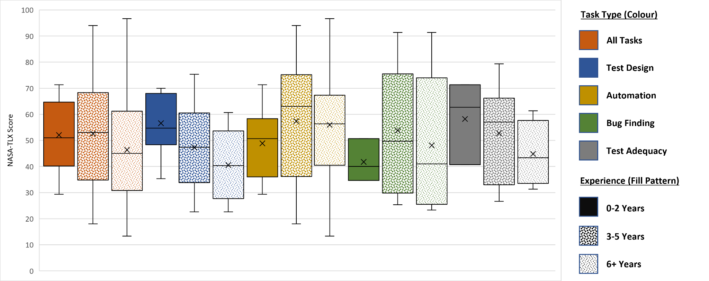
RQ2 - Effect of experience and education

Slide 22
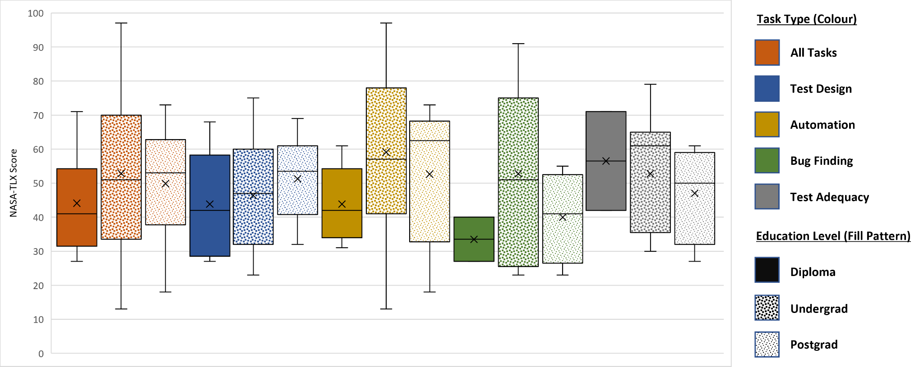
RQ2 - Effect of experience and education

