Slide 1
A Novel Approach to
Maintain Traceability between
Safety Requirements and Model Design
Qian Wang†, Jing Liu†∗, John Zhang‡∗, Hui Dou‡, Haiying Sun†, HongTao Chen‡, Xiaohong Chen†, Jifeng He†
†Shanghai Key Laboratory of Trustworthy Computing, East China Normal University, Shanghai, China
‡Huawei Technology, Shanghai, China
DOI: 10.18293/SEKE2022-140

Slide 2
Introduction – SysML & Ontology
System Modeling Language(SysML): a general-purpose architecture modeling language for Systems Engineering applications and has been used in many safety-critical systems.
SysML-as-Pretty-Pictures: the most common SysML usage mode which lacks complete formalization and rigorousness, and users pay relatively little attention to the well-formedness of SysML and its underlying simulatable and executable semantics.
Dynamic behavior simulations: to confirm that the system behavior satisfies the safety requirements.
Traceability: links from risk to overall safety requirements, to safety-critical system component design.
contribute to

Slide 3
Introduction – SysML & Ontology
Ontology is extended based on description logic which has formal standards; therefore, ontology reasoners can find errors or entailments in ontology rules and facts while drawing inferences.
Traceability Information Model(TIM): a model with traceability.
If a TIM is transformed into an ontology with the same semantics, we can conduct inferences to verify the design of this TIM.

Slide 4
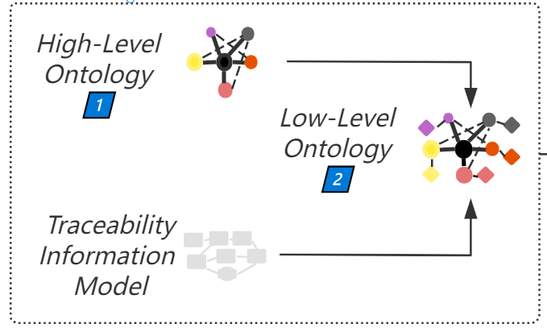
Transformation Approach

Slide 5
Transformation Approach - forewords
Transformation concentrates on SysML’s four semantic dimensions:
(1) requirements, (2) structure, (3) behavior, and (4) state.
The approach refers to and extends the existing ontology building work and is divided into two stages, including six small steps.
We have expanded and defined the use of traceability links in SysML to better express traceability.
High-level ontology(written O for ease of understanding), low-level ontology(written o), a specific model m.

Slide 6
First stage - building high-level ontology
Step 1. Determine the domain and scope of the ontology.
  What is the domain? SysML’s four semantic dimensions.
  For what we are going to use? Complete and correct expression of the domain’s semantics, and then the users can query and infer about m from o.
  What types of information can the ontology provides? m’ basic and traceability information.
  Who are the ontology’s users? Software engineers.
Step 2. Enumerate important terms.
  SysML diagram
  Nodes in diagram
  Edges in diagram
  Other items of SysML component(Such as parameter, function)
  Mapping(horizontal semantics between diagrams)

Slide 7
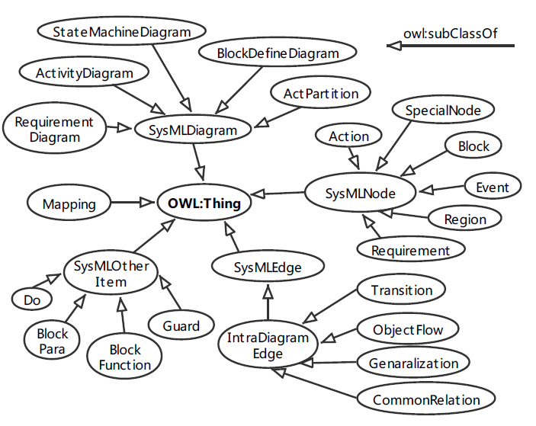
First stage - building high-level ontology
Step 3. Define the classes and their hierarchy.

Slide 8
First stage - building high-level ontology
Step 4. Define the properties of classes.
  The classes alone can’t provide enough information to answer the competency questions in Step 1.
  Object Property and Datatype Property are required to describe the internal structure of concepts.

Slide 9
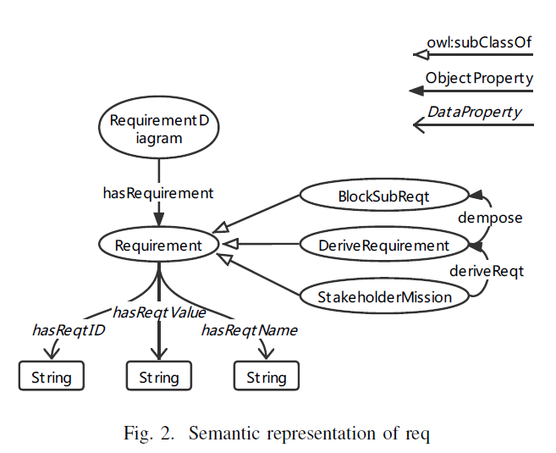
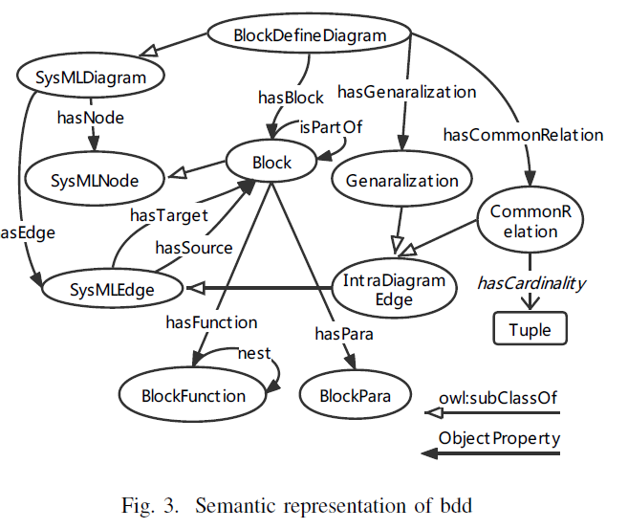
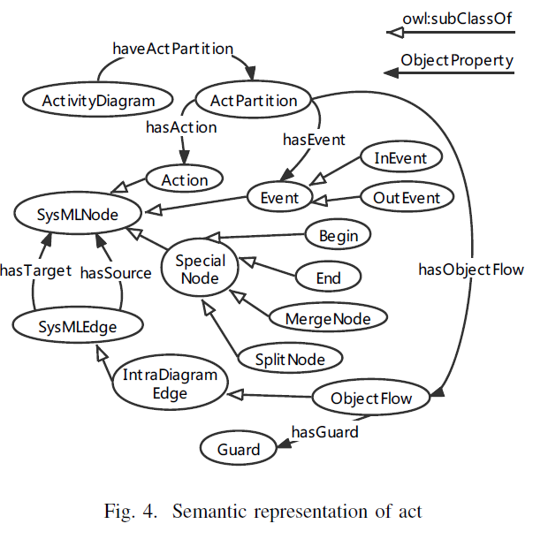
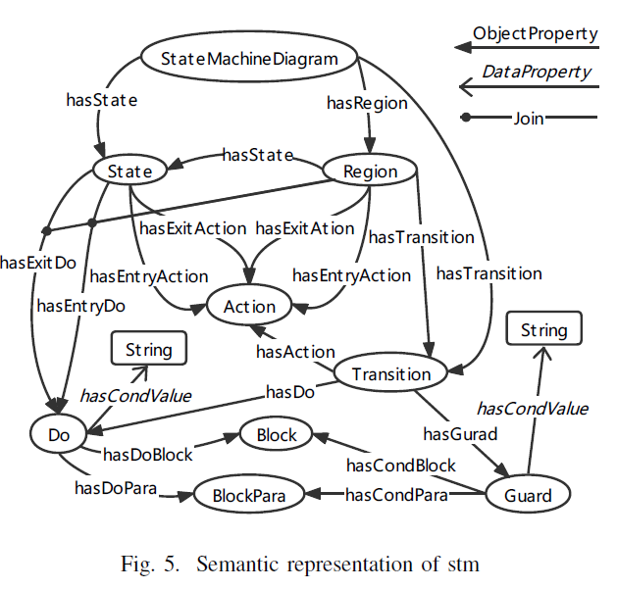

Slide 10
Second stage - building low-level ontology
Step 5. Enrich the class and class hierarchy.
  In a system, each block will have several particular instances; consequently, all blocks are modeled as children of Block.
Step 6. Create individuals.
  The final step is to create individuals for the remaining instances in m. Creating an individual of a class requires (1) selecting a class, (2) creating an individual of that class, and (3) adding property values to that individual.

Slide 11
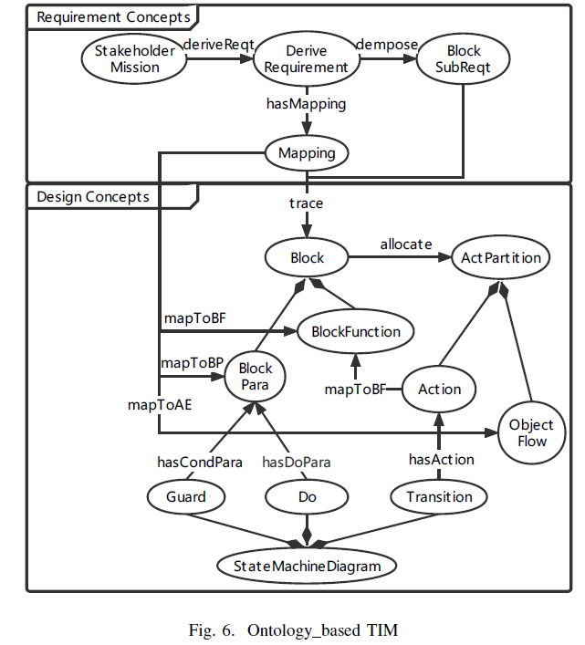
Ontology-based TIM
If there exists a block b that satisfies the following axioms, then b is said to be a system component that satisfies the functional requirement q.
Block(?b) ∧ Mapping(?map) ∧ DeriveRequirement(?q)∧ hasMapping(?q, ?map) ∧ trace(?map, ?b)

Slide 12
Evaluation – Experiment Design
Production Cell System (PCS): a well-known paradigm for embedded systems and was previously used as a baseline to evaluate the capabilities of various specification methods for safety analysis and verification. PCS consists of 23 safety-related requirements and 6 main blocks, each with corresponding activity partitions and state machine diagrams.

Slide 13

Evaluation – Experiment Design
Quantitative ontology evaluation method
  8 sub-characteristics RROnto, ANOnto, LCOMOnto, INROnto, CROnto, NOMOnto, and CBOnto which count the proportion of classes, properties, and individuals from different perspectives to measure the rationality of ontology design. Each sub-characteristic has a calculated value and a score out of five, based on each value.
  Based on the eight sub-characteristics, 4 metrics are summarized to measure overall quality: structural metric SEv, functional adequacy metric FAEv, maintainability metric MEv, and global metric Glov.

Slide 14
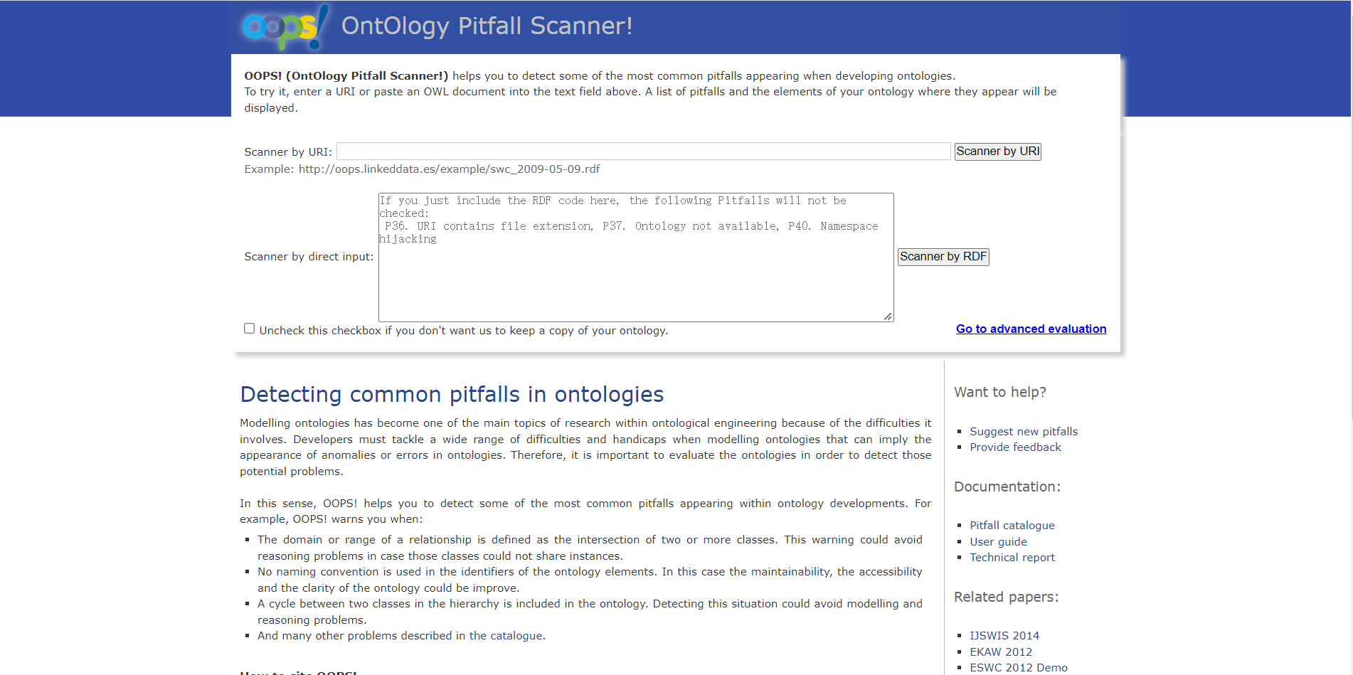
Evaluation – Experiment Design
Qualitative evaluation tool
  Detecting common pitfalls with importance levels(critical, important, or minor).
  Critical: affect ontology consistency, reasoning and applicability.
  Important: does not affect the functionality, but it is important to correct this type of pitfall.
  Minor: does not represent a problem, correcting it makes the ontology better organized and user friendly

Slide 15
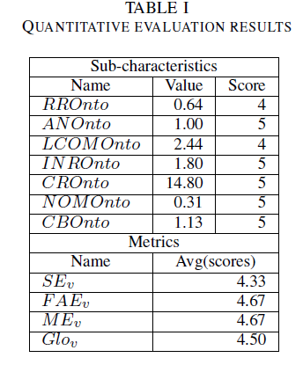
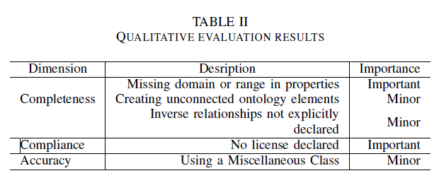
Evaluation – Results

Slide 16
Conclusion
(1)an innovative approach to maintaining traceability using a phased transformation, (2)a normative process of ontology building in support of an automated implementation, (3)an experimental evaluation of a real-world safety-critical system.
In future work
  implement an automated tool to derive ontology model from SysML model
  explore the universality of our transformation method
  In addition, we can use semantic inference tools of ontology to perform verification

Slide 17
Thank You!
Any Questions?

