Slide 1

An Information Flow Security Logic for Permission-Based Declassification Strategy
Zhenheng Dong¹, Yongxin Zhao^{1*} and Qiang Wang²
1 Shanghai Key Laboratory of Trustworthy Computing, East China Normal University, Shanghai, China
2 Chinese Academy of Military Science, Beijing, China

Slide 2
OutLine
01 / 18
Outline
Introduction
Running Examples
The Formal Language
Operational Semantics
The Logic
Verification
Conclusion and Future Work
References

Slide 3
Introduction
02 / 18
Information Flow Security
system components can be classified into different security levels
confidential information (e.g., private data resource) is marked as high security level
public information (e.g., public program variable) is marked as low security level
the basic idea of information flow security is to ensure confidential information with high security level can not be obtained by analyzing the observable information with lower security levels.

Slide 4
Introduction
03 / 18
Contribution
Permission-based formal language for information flow security：
abstract application programs into functions.
use function calls to represent information interactions among applications.
Permissions are the basis for whether messages can be obtained in information interaction.
Logic rules supporting declassification strategy
add the content of permission into the traditional information flow logic.
add a declassification strategy to make the reasoning more precise.

Slide 5
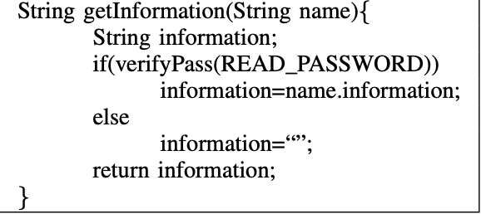
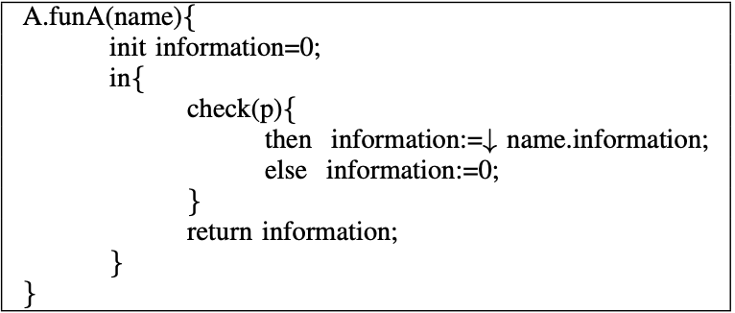
Running Examples
04 / 18
Permission check
Declassification strategy

Slide 6

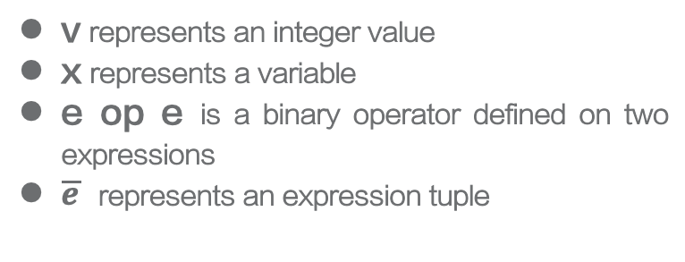
The Formal Language
05/ 18
The syntax of expressions
v represents an integer value
x represents a variable
e op e is a binary operator defined on two expressions
$\overline{e}$ represents an expression tuple

Slide 7
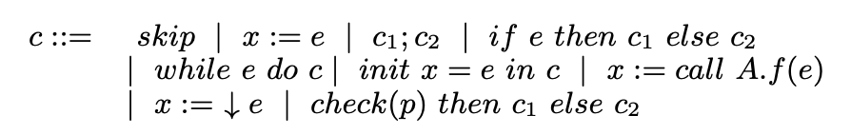
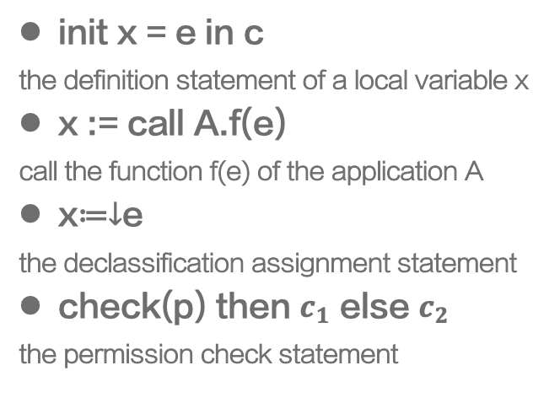
The Formal Language
06/ 18
The syntax of the command statement
init x = e in c
the definition statement of a local variable x
x := call A.f(e)
call the function f(e) of the application A
x≔$↓$e
the declassification assignment statement
check(p) then $c_{1}$ else $c_{2}$
the permission check statement

Slide 8

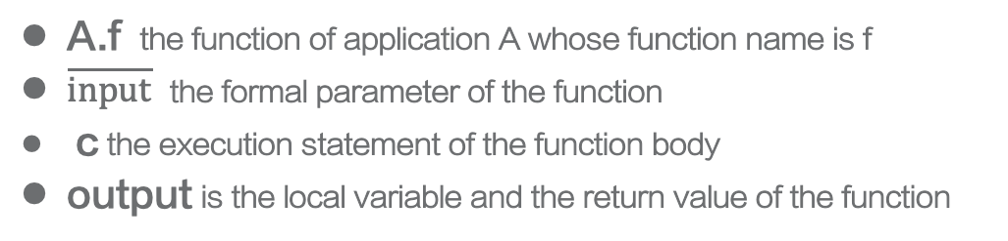
The Formal Language
07 / 18
The definition of function
A.f the function of application A whose function name is f
$\overline{input}$ the formal parameter of the function
c the execution statement of the function body
output is the local variable and the return value of the function

Slide 9
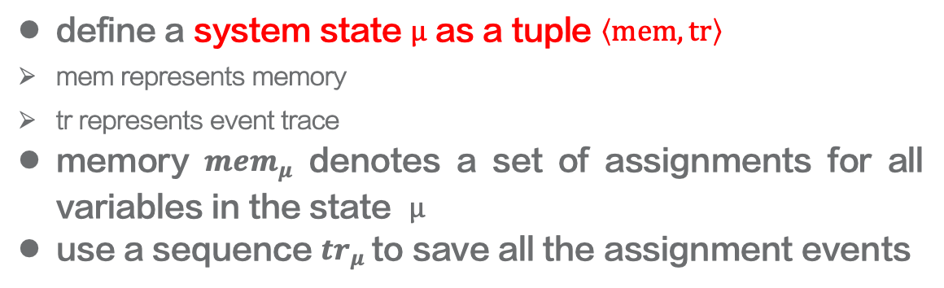
Operational Semantics
08 / 18
Semantics Model
define a system state $μ$ as a tuple $\left\langle mem,tr\right\rangle$
mem represents memory
tr represents event trace
memory ${mem}_{μ}$ denotes a set of assignments for all variables in the state $μ$
use a sequence ${tr}_{μ}$to save all the assignment events

Slide 10
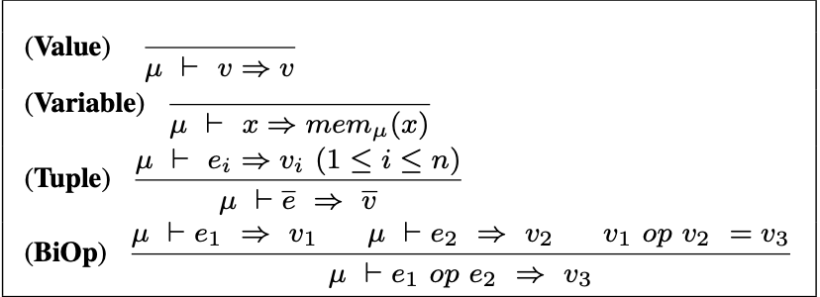
Operational Semantics
09 / 18
Evaluation of Expressions
The semantic judgment of the expression has the form of $μ⊢e⇒v$

Slide 11
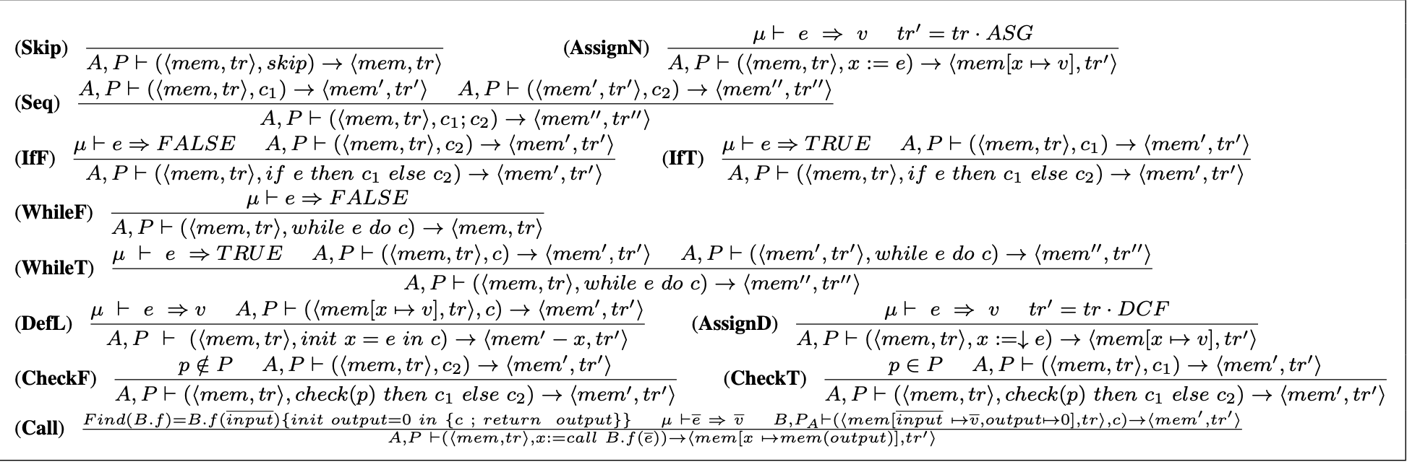

Operational Semantics
10 / 18
Operational Semantics of Statements
The operational semantic judgment of the command statement has the form of $A,P⊢\left(\left\langle mem,tr\right\rangle ,c\right)→⟨ mem^{′},tr^{′}⟩$

Slide 12
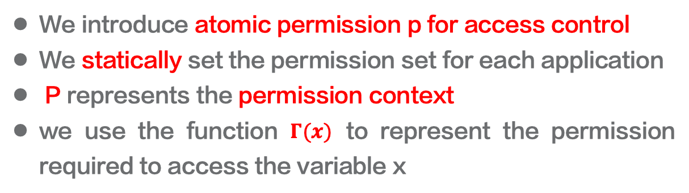
The Logic
11 / 18
Access Control Model
We introduce atomic permission p for access control
We statically set the permission set for each application
P represents the permission context
we use the function $Γ(x)$ to represent the permission required to access the variable x

Slide 13
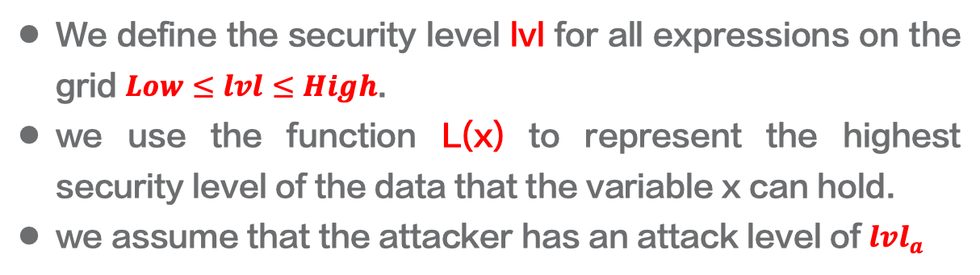
The Logic
12 / 18
Information Flow Model
We define the security level lvl for all expressions on the grid $Low≤lvl≤High$.
we use the function L(x) to represent the highest security level of the data that the variable x can hold.
we assume that the attacker has an attack level of ${lvl}_{a}$

Slide 14

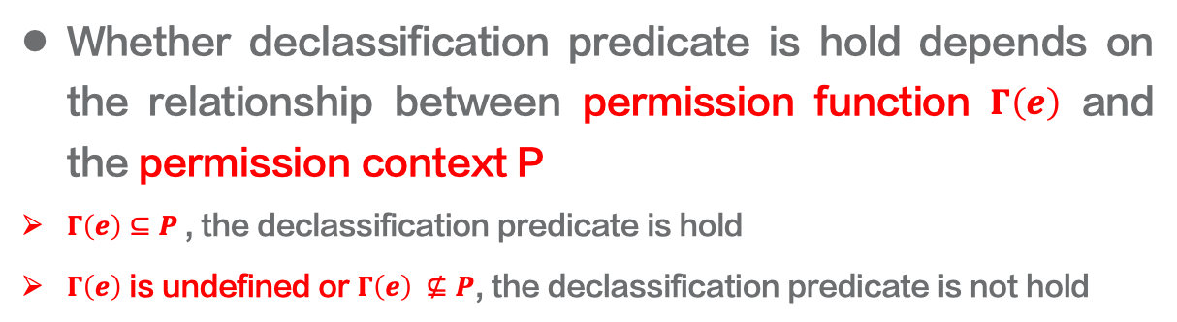
The Logic
13 / 18
Declassification Model
Whether declassification predicate is hold depends on the relationship between permission function $Γ\left(e\right)$ and the permission context P
$Γ\left(e\right)⊆P$, the declassification predicate is hold
$Γ\left(e\right)$ is undefined or $Γ\left(e\right) ⊈P$, the declassification predicate is not hold

Slide 15
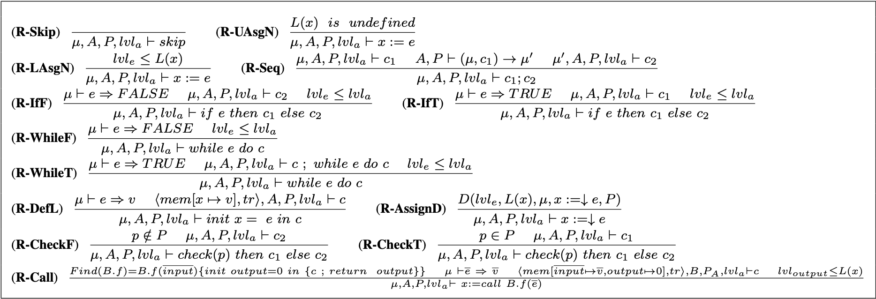
The Logic
14/ 18
Rules
Our logic has judgements of the form $μ,A,P,{lvl}_{a}⊢c$

Slide 16
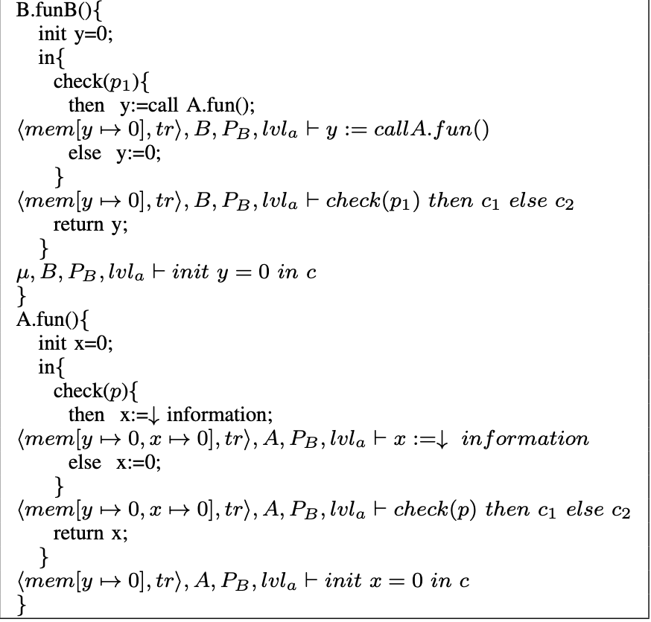
Verification
15 / 18
An application example

Slide 17
Conclution and Future Work
16 / 18
Conclusion
We present a formal language and the corresponding logical rules for proving the information flow security of mobile applications.
Our approach has well defined semantics and makes use of a permission based declassification strategy, which makes the reasoning more accurate.

Slide 18
Conclution and Future Work
17 / 18
Future Work
extend the access control policy to consider solutions to the branching problem that relies on secrets.
extend the semantics and the logic to handle the problem of non-monotonic of permissions.

Slide 19
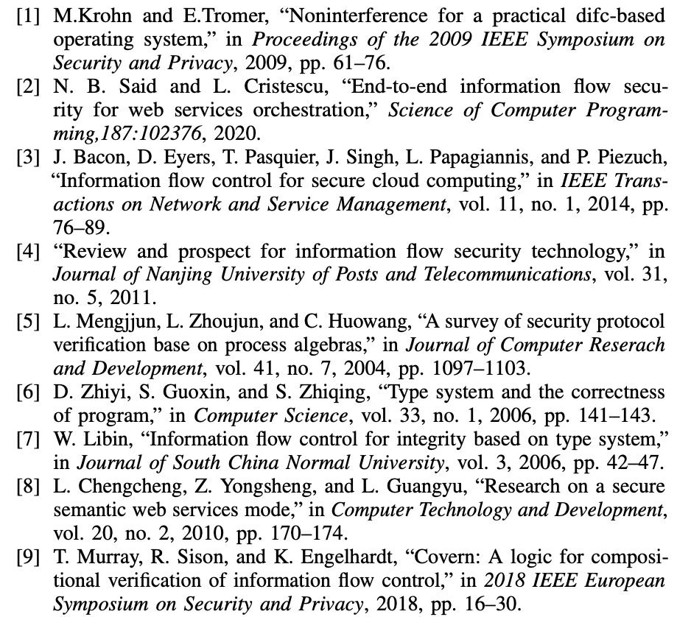
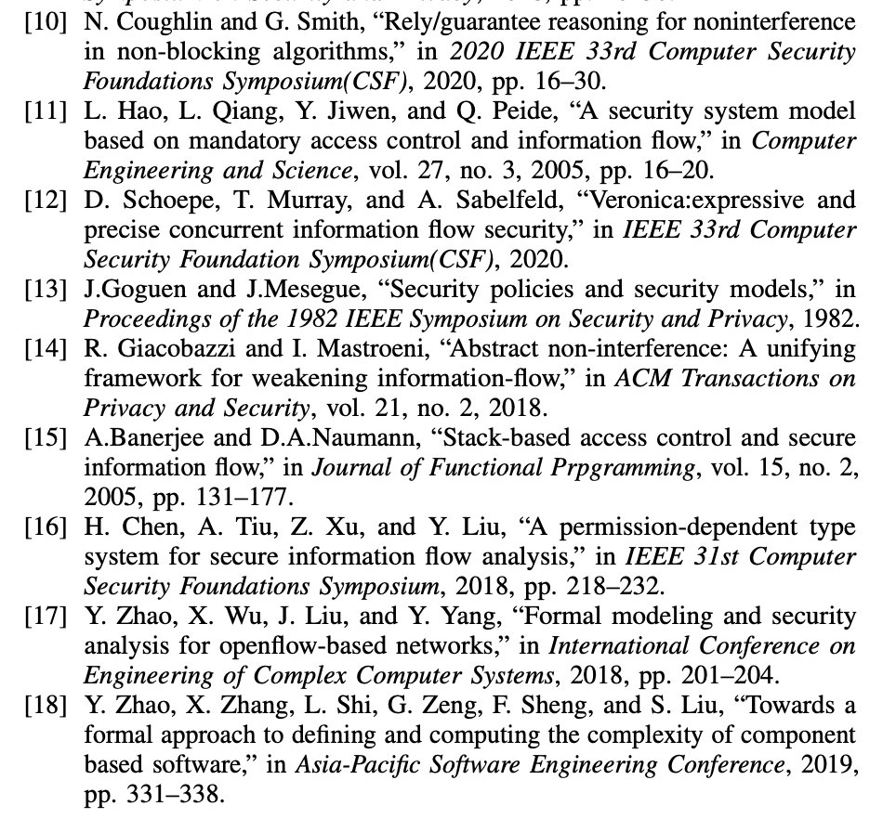
References
18 / 18

Slide 20
THANKS

