Slide 1

An Enhanced Data Augmentation Approach
to Support
Multi-Class Code Readability Classification
Qing Mi , Yiqun Hao, Maran Wu, Liwei Ou
Beijing University of Technology, Beijing, China

Slide 2

1
Introduction
2
Proposed Approach
3
Experiments
Outline
4
Discussion
5
Conclusion

Slide 3
Introduction
Introduction

Slide 4


Introduction
Source code readability, defined as the ease of understanding the source code, is growing crucial in modern software development because of a higher demand for rapid deliveries.
A code readability classifier embedded in IDE is desired by programmers according to a Microsoft research. However, current code readability classifiers are not effective enough to be used in practice.

Slide 5



Introduction
ML vs. DL
Uses hand-crafted features that require massive work and time
Automatically extracts features that require little work and time
Not comprehensive enough because only surface-level features are captured
Could capture more features
Might be affected by bias
Could be more generalized

Slide 6
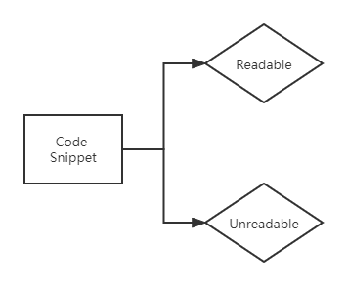
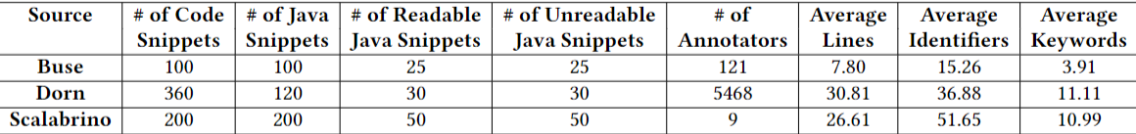
Introduction
Problem 1
Binary Classification
Problem 2
Very Limited Dataset Size

Slide 7
Introduction
We propose a multi-class classifier.
We propose a code readability data augmentation approach including domain-specific data transformation and GAN-based data augmentation to enlarge the small dataset.

Slide 8
Proposed Approach
Proposed Approach

Slide 9
Proposed Approach
Dataset Construction
We partition dataset into three
readability categories based on the readability score assigned
to support multi-class classification.
R eadable
N eutral
U nreadable

Slide 10
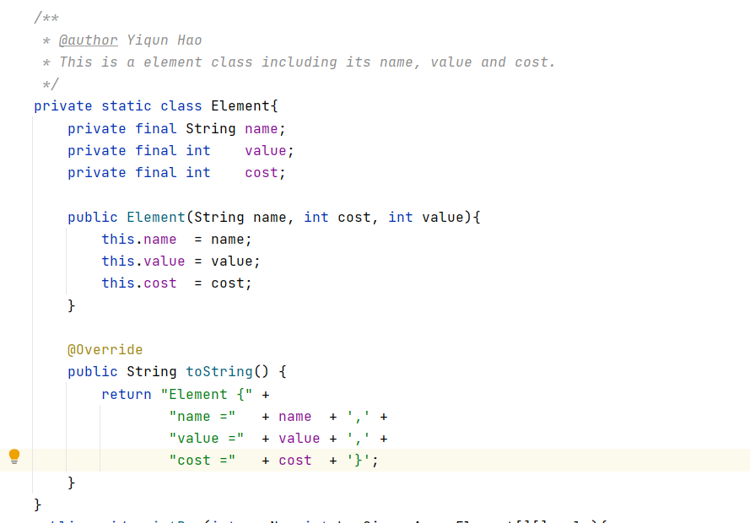
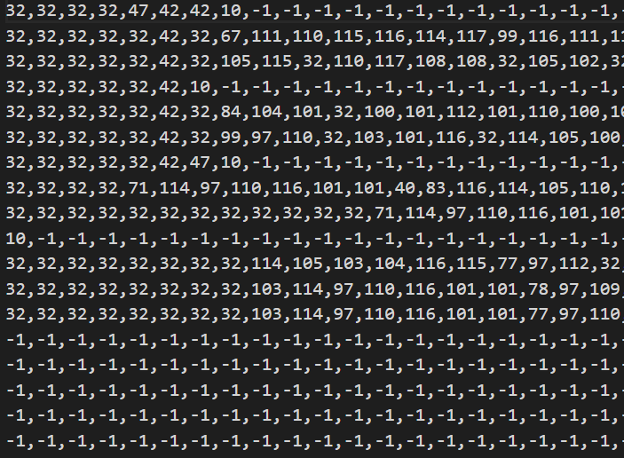
Proposed Approach
Code Representation
We adopt character-level representation in this paper.
Source code
Two-dimension character matrices

Slide 11
Proposed Approach
Data Augmentation
Domain-Specific Data
Transformation Method
GAN-Based Data
Augmentation Method
Parallel
Augmentation Method
Sequential
Augmentation Method

Slide 12
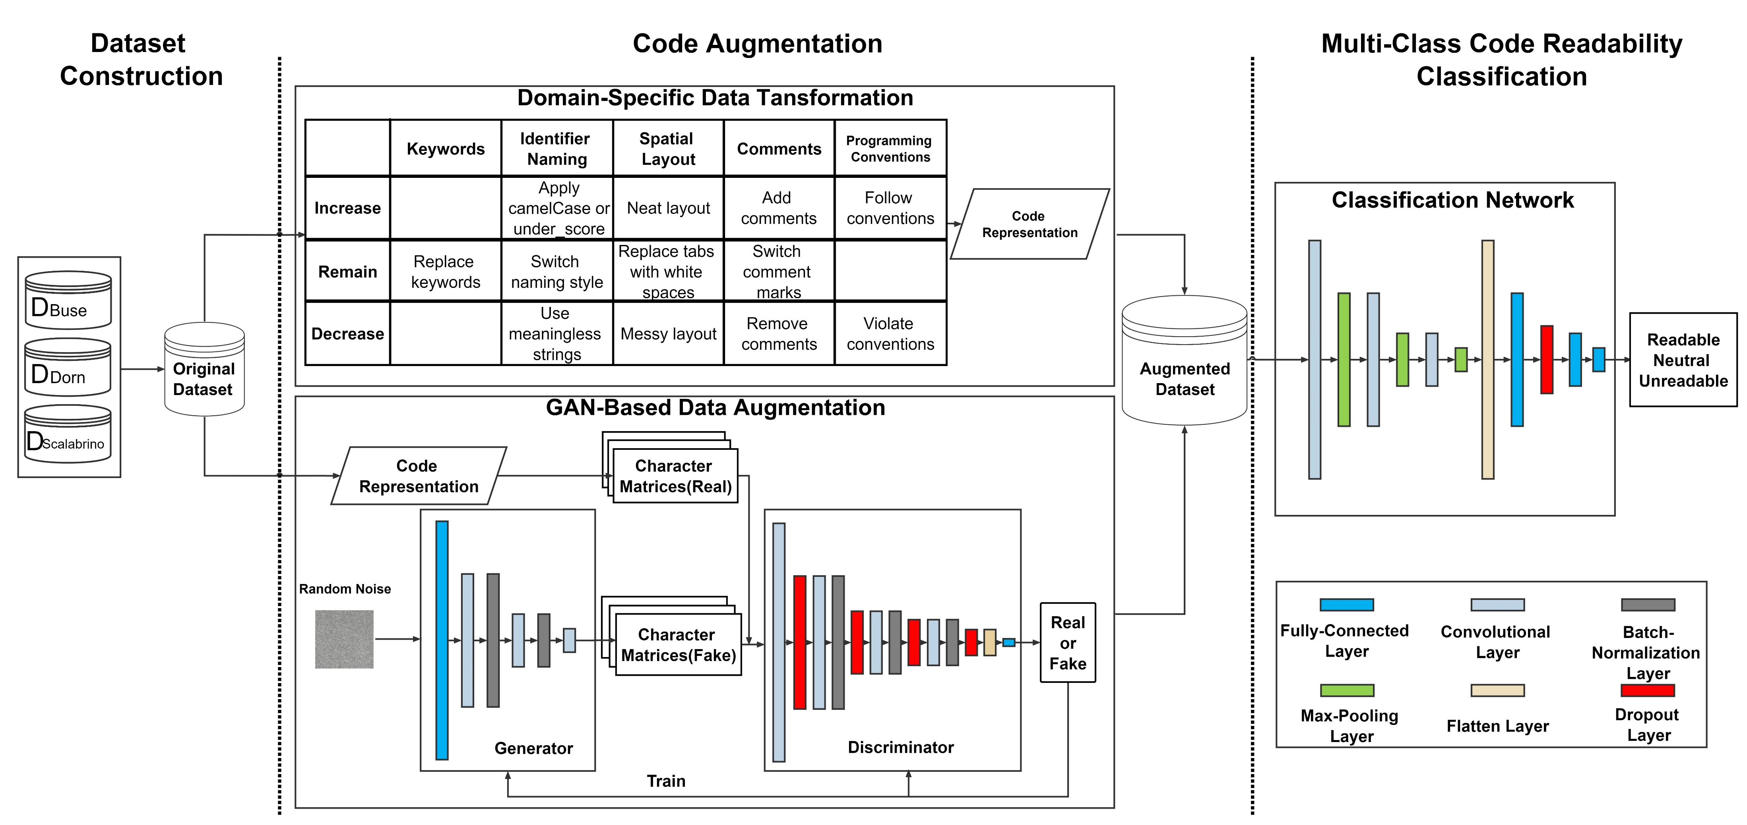
Proposed Approach

Slide 13

Experiments
Experiments

Slide 14
Experiments
RQ1: Which code augmentation method is the most effective for multi-class code readability classification?
Research
Question
RQ2: Which augmentation level is the best for multi-class code readability classification?
RQ3: To what extent does data augmentation improve multi-class code readability classification?

Slide 15
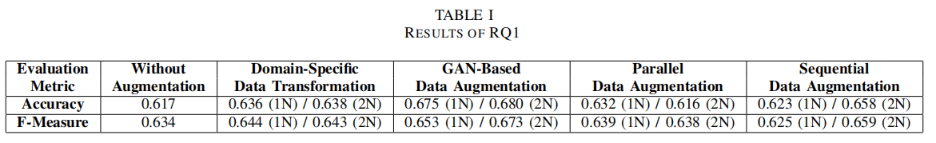

Experiments
RQ1: Which code augmentation method is the most effective for multi-class code readability classification?
It can be seen that the GAN-based data augmentation method
outperforms the other three on both accuracy and f-measure.

Slide 16
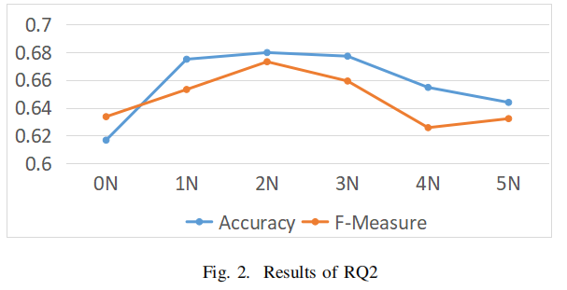
Experiments
RQ2: Which augmentation level is the best for multi-class code readability classification?
In this RQ, we evaluate the effect of different augmentation levels from 0N (i.e., only original data) to 5N.

Slide 17
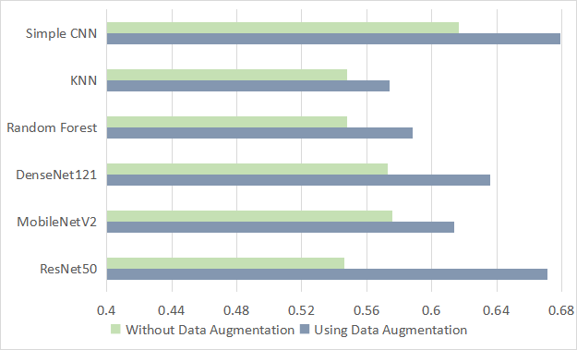
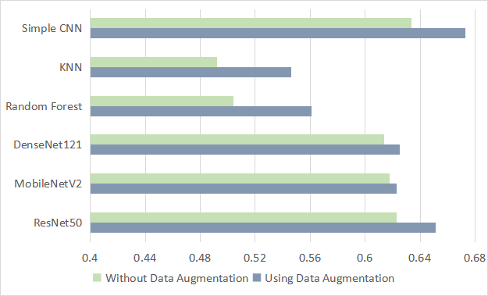
Experiments
RQ3: To what extent does data augmentation improve multi-class code readability classification?
Accuracy
F-Measure

Slide 18
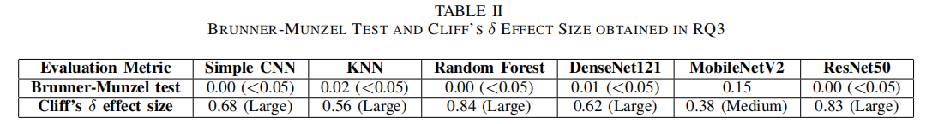
Experiments
RQ3: To what extent does data augmentation improve multi-class code readability classification?
BM Test and Cliff δ Effect Size
Both of them imply statistically significant improvements in classification performance.

Slide 19

Discussion
Discussion

Slide 20

Discussion
Augmentation Effort
By adopting the data augmentation approach, the cost is largely reduced.
Readability and Understandability
It is noticeable that the domain-specific data transformation does not perform well because of the subjectivity code readability owns. Besides, manual manipulations
might affect code understandability as well.
Readability Data
The original dataset sourced from different prior researches might be prone to errors and weaken our conclusions to a certain extent because three datasets are labeled by different groups of human annotators and differ remarkably in terms of code length, code completeness.

Slide 21

Conclusion
Conclusion

Slide 22
Conclusion
To enable multi-class code readability classification, we propose a data augmentation approach that could be used to effectively enlarge the dataset and well train a multi-class classifier.
The results reveal that adopting the data augmentation approach could improve
the classification performance to a considerable extent with the accuracy improved by 1.8% to 10.7%.
The classifier produced by our proposed method could reach a state-of-the-art multi
class code readability classification accuracy of 68.0%, as well as 67.3% f-measure.

Slide 23

THANKS

