Slide 1



The 34th International Conference on Software Engineering & Knowledge Engineering (SEKE 2022), July 1-10, 2022, Pittsburgh, USA (Virtual)
DeepController: Feedback-Directed Fuzzing for Deep Learning Systems
Hepeng Dai ¹, Chang-ai Sun ¹, Huai Liu ²
¹ School of Computer and Communication Engineering，University of Science and Technology Beijing，Beijing，China
﻿² Department of Computing Technologies，Swinburne University of Technology，Melbourne，Australia
Notes:
Hi! My name is Dai Hepeng, from University of Science and Technology, Beijing, Today I will talk about our research on Feedback-directed fuzzing for deep learning systems.

Slide 2
Outline
Introduction & Background
DL systems and their quality assurance issues
Fuzzing for DL systems
Software cybernetics and AT
Approach
Overview of DeepController, AS2, and AMS2
Empirical Study
Conclusion
1/15

Slide 3


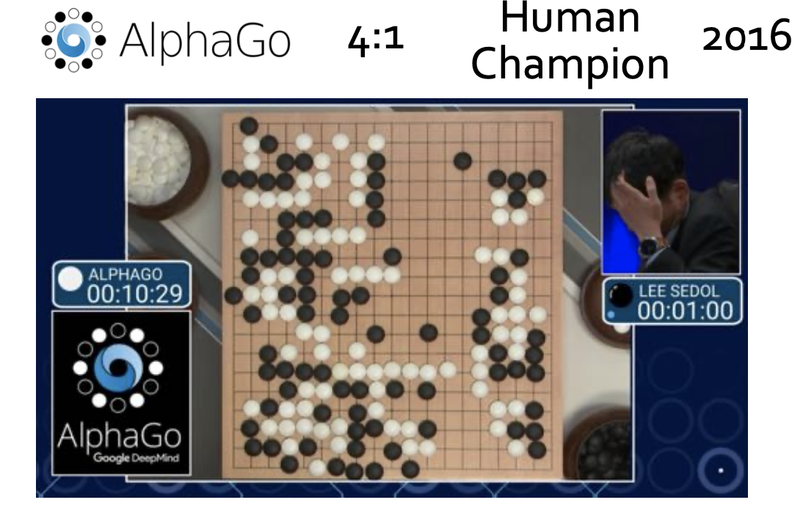
Introduction:
Rushing for developing deep learning (DL) systems
2/15

Slide 4
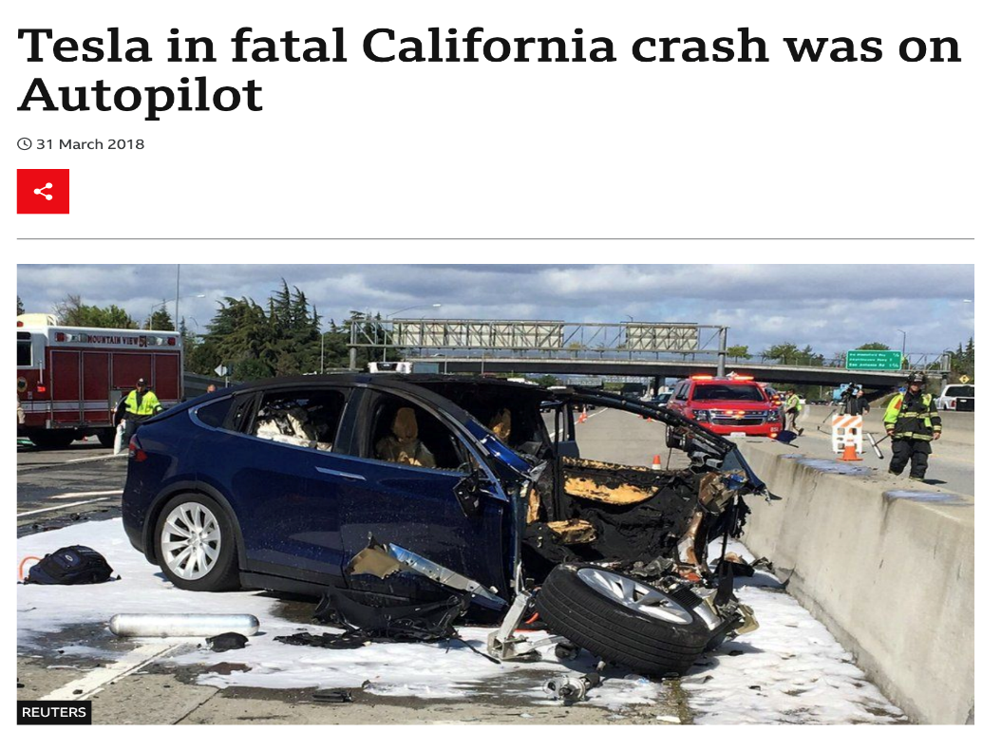
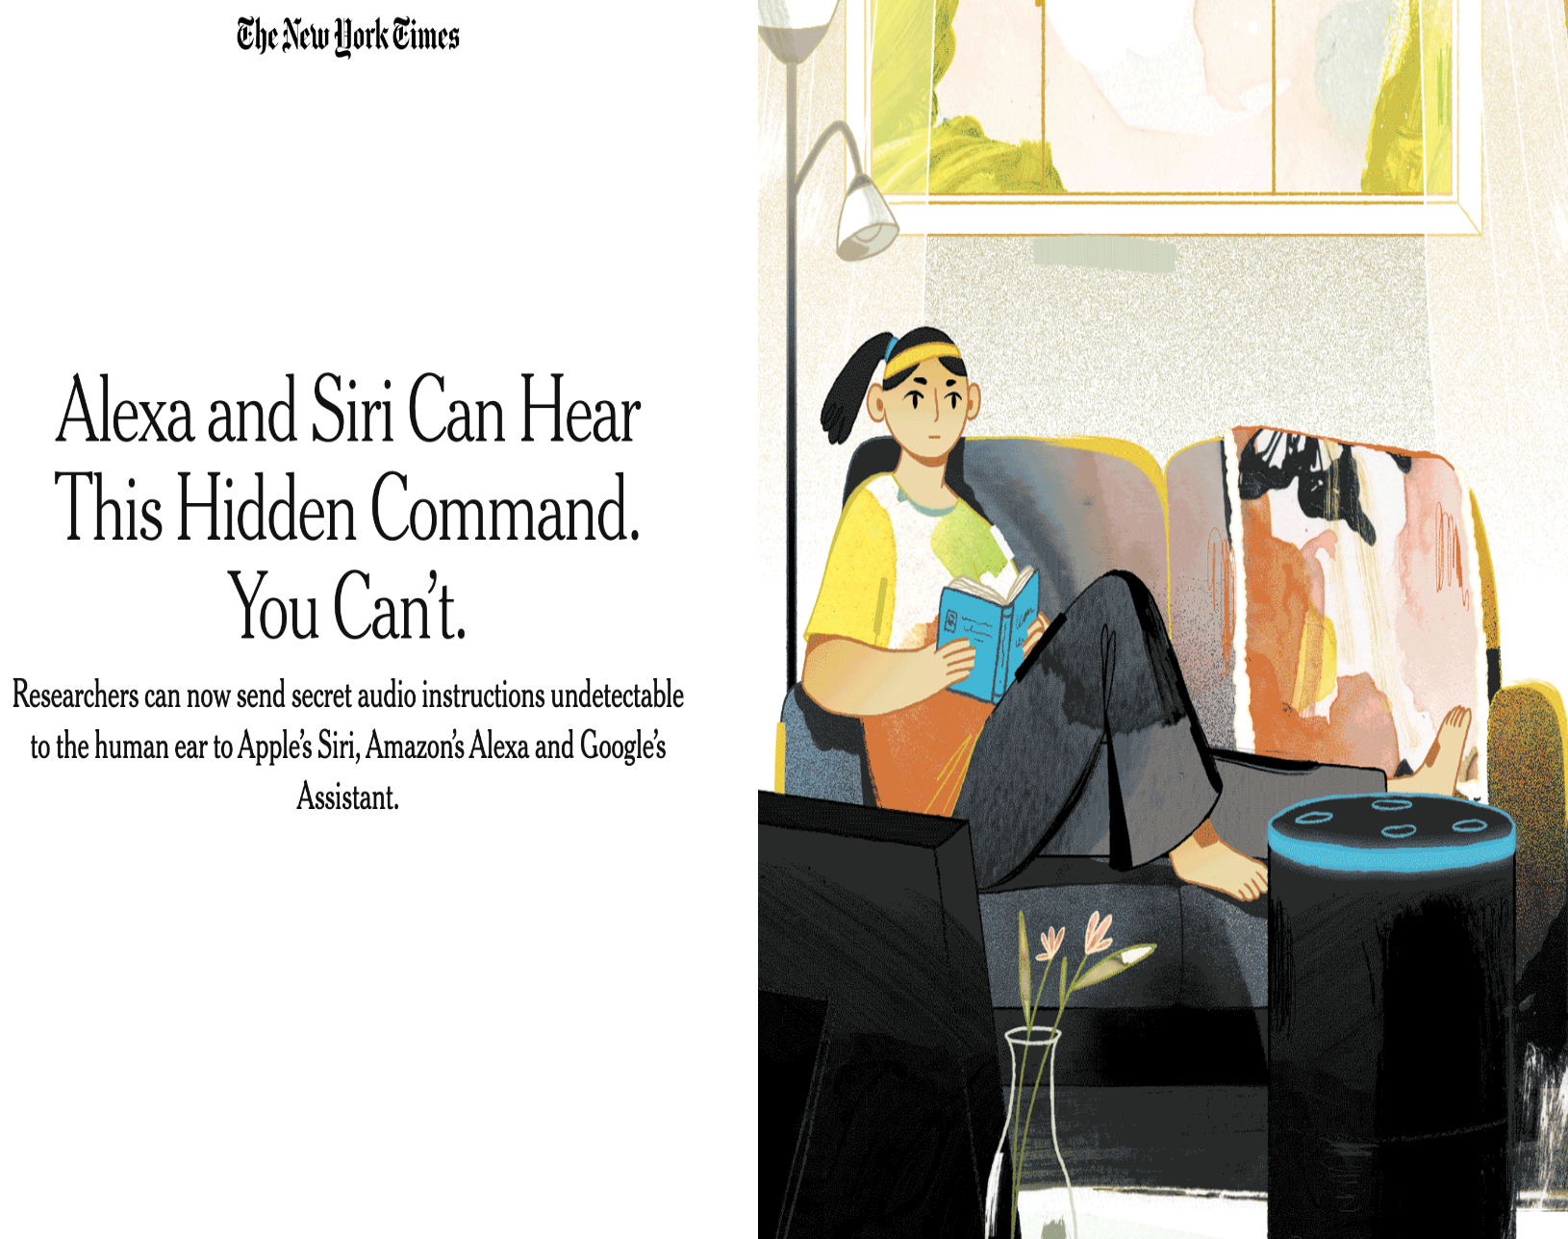
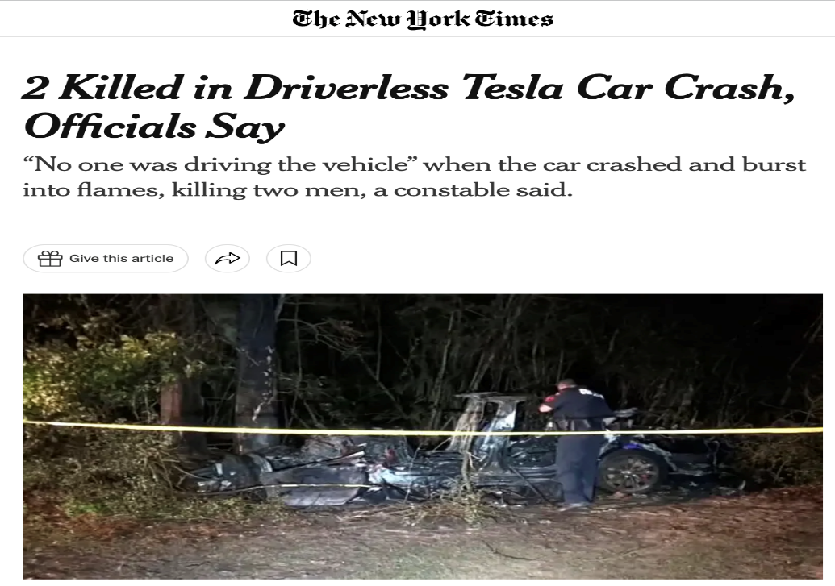
Introduction: DL is vulnerable
3/15

Slide 5


Introduction: Quality assurance for DL is challenging
The logic of a DL system is learned from data
Traditional
Software Developer
DL
Software Developer
Coding
Coding
Coding
Source Code
Data Processing
…
Train Program
Compilation
Transformation
Training
Executable
Program
Input
Output
DL Model
Input
Output
Commonly used testing techniques for DL: Symbolic Execution, Metamorphic testing, ﻿gradient-based methods, and Fuzzing
4/15

Slide 6

Background: Fuzzing for DL systems
Fuzzing refers to a process of repeatedly running a program with generated inputs that maybe syntactically or semantically malformed (Valentin et al., TSE, 2019)
Test Case Generation
Test Cases
Random
Random
Seed
Queue
…
…
Frequency Aware
Greedy Method
Seed Selection
Mutation Selection
Coverage Analysis
Test Case Execution
Code Coverage
CNN
Analysis
…
Neuron Coverage
…
Testing Criterion
RNN
The framework of coverage-based fuzzing
5/15

Slide 7

Background: Fuzzing for DL systems
Seed selection strategy
Random selection
﻿recency-aware strategy selects a seed based on the time of adding to the seed queue
﻿frequency-aware strategy ﻿selects a seed based on the number of times it has been fuzzed
In theory, ﻿considering a variety of test information comprehensively would maximize the efficiency of fuzzing
Mutation strategy selection strategy
Random selection
﻿Greedy selection strategy selects mutation strategies that trigger new coverage
﻿Search-based strategies and reinforcement learning
Test information was not fully utilized and ﻿existing strategies did not individually consider specific seeds
How to make full use of test information to improve the efficiency of fuzzing?
6/15

Slide 8
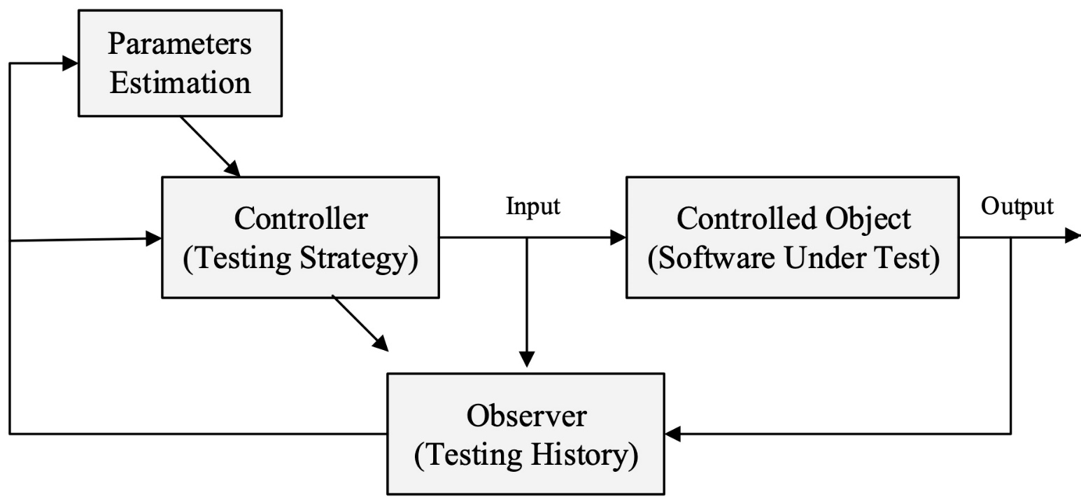
Background: Software cybernetics and adaptive testing (AT)
Software cybernetics explores the interplay between software and control theory (Cai, IST, 2002)
AT results from the application of feedback and adaptive control principles in software testing (Lv et al., TSE, 2014)
7/15

Slide 9
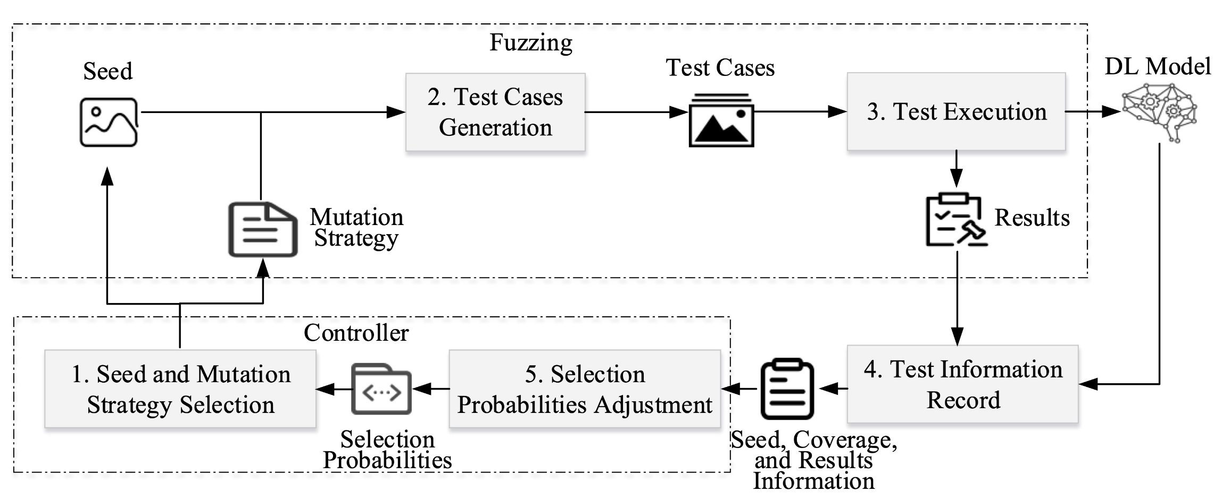
Approach: Overview of DeepController
DeepController makes use of the feedback information to select best seeds and mutation strategies
8/15

Slide 10
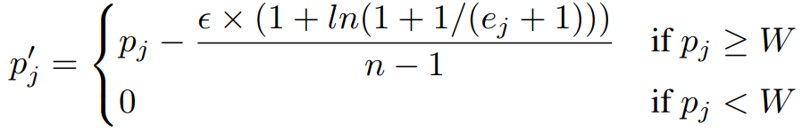
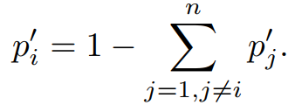
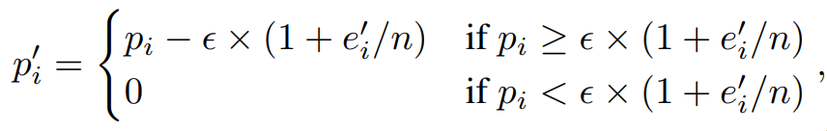
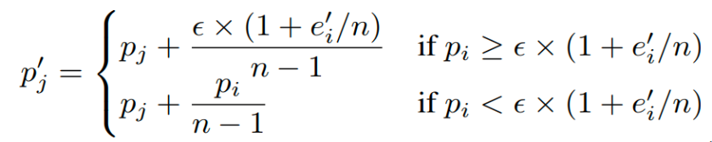
Approach: Adaptive seed selection strategy (AS2)
AS2 ﻿makes the seeds with higher chances of triggering new coverage and being used less times have higher selection probabilities
3. If the selected seed s* triggers
new coverage: ﻿
1. Initialize the selection probabilities of seeds{<s₁,p₁>…< s_{n},p_{n} >}
DL Models
4. If the selected seed s* cannot
trigger new coverage: ﻿
2. ﻿Coverage, ﻿testing results, ﻿the number of seed mutations, ﻿and
the times of seeds added to the seed queue are collected
9/15

Slide 11
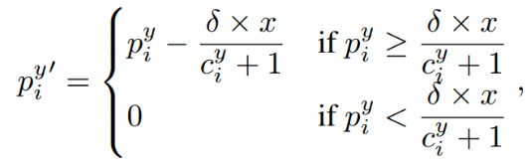

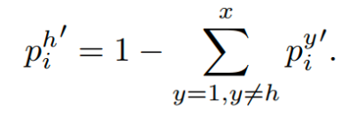
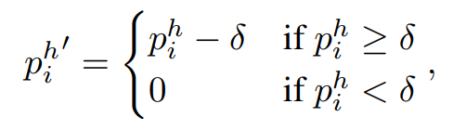
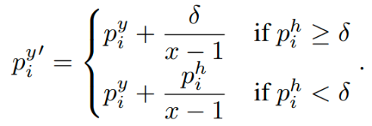
Approach: Adaptive mutation strategy selection strategy (AMS2)
AMS2 ﻿makes ﻿the mutation strategies with a higher probabilities of triggering new coverage and detecting faults for the selected seeds have higher selection probabilities
3. If the seed s* (mutated m_{y})
triggers new coverage: ﻿
Initialize the selection probabilities of mutation strategy
{<m₁,p₁>…< m_{x},p_{x} >}
DL Models
4. If the seed s* (mutated m_{y})
Cannot trigger new coverage: ﻿
2. ﻿Coverage, ﻿testing results, and ﻿the number of mutation
strategy used are collected
10/15

Slide 12
Empirical Study
Technique | Dataset | Model | # Parameters | # Acc. (%)
DeepXplore DeepTest DeepHunter FGSM DeepController | ImageNet | VGG-16 | ﻿138,357,544 | ﻿92.60
DeepTest |  | VGG-19 | ﻿143,667,240 | ﻿92.70
DeepHunter | MNIST | LeNet-1 | ﻿7,206 | ﻿98.25
FGSM |  | LeNet-4 | ﻿69,362 | ﻿98.75
DeepController |  | LeNet-5 | ﻿107,786 | ﻿98.63
 | CIFAR10 | VGG-16 | ﻿138,357,544 | ﻿86.84
 |  | VGG-19 | ﻿143,667,240 | ﻿77.26
 |  | CNN-20 | ﻿952,234 | ﻿77.68
4 baselines, 3 datasets, and 8 models
400 testing scenarios = 5 techniques ✖️ 8 models ✖️ 10 repetition
11/15

Slide 13
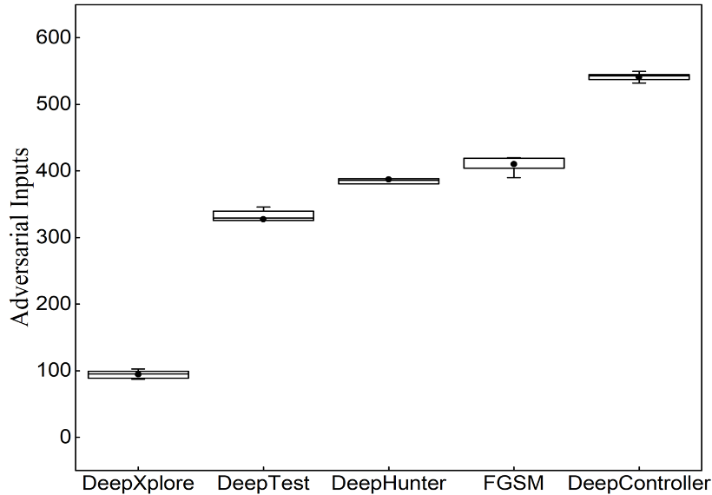
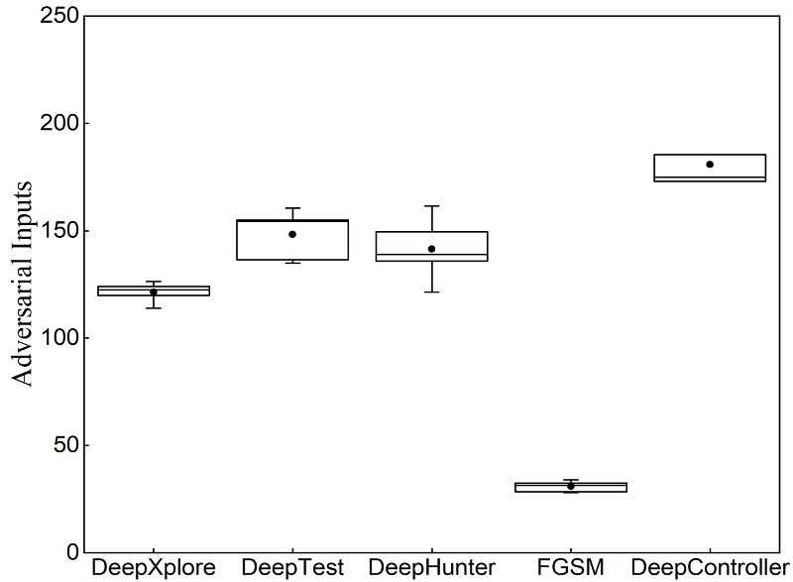
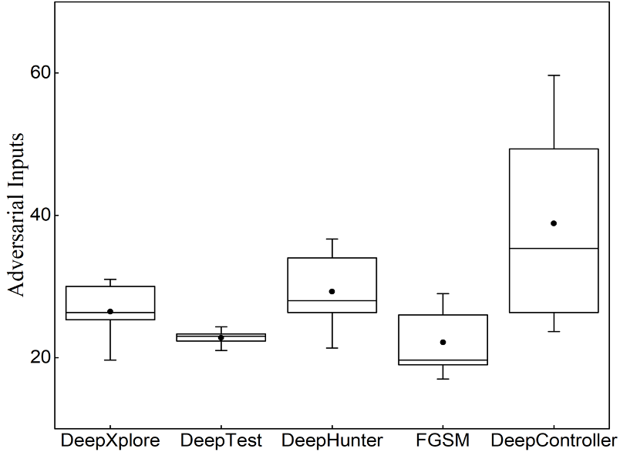
Results of adversarial inputs glimpse
MNIST
ImageNet
CIFAR10
DeepController ﻿generated more adversarial inputs than the four baseline techniques
The performances of DeepXplore, DeepTest, DeepHunter and FGSM varied on different datasets
12/15

Slide 14
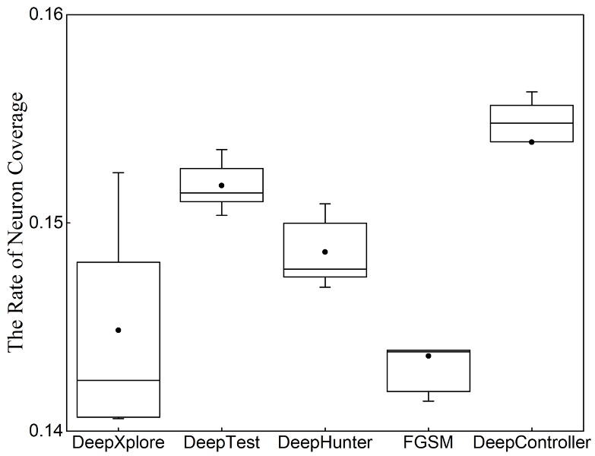
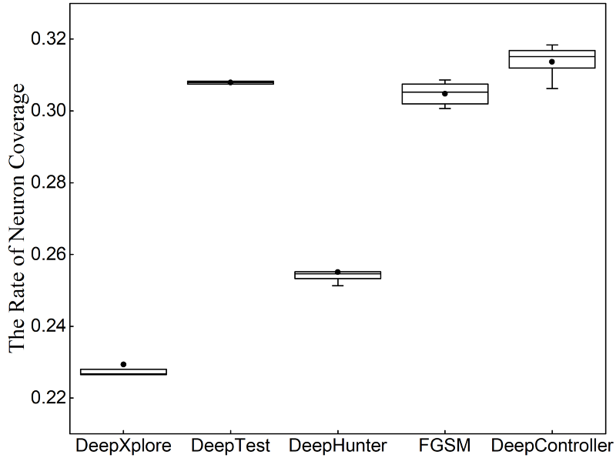
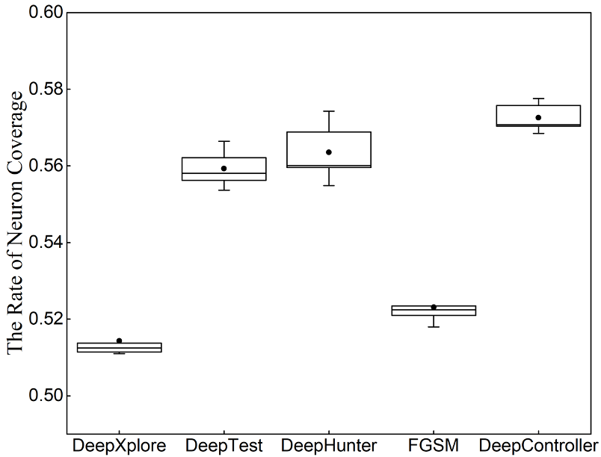
Results of neuron coverage glimpse
MNIST
ImageNet
CIFAR10
DeepController ﻿ ﻿covered more neurons than the four baseline techniques
The performances of DeepXplore, DeepTest, DeepHunter and FGSM varied on different
13/15

Slide 15
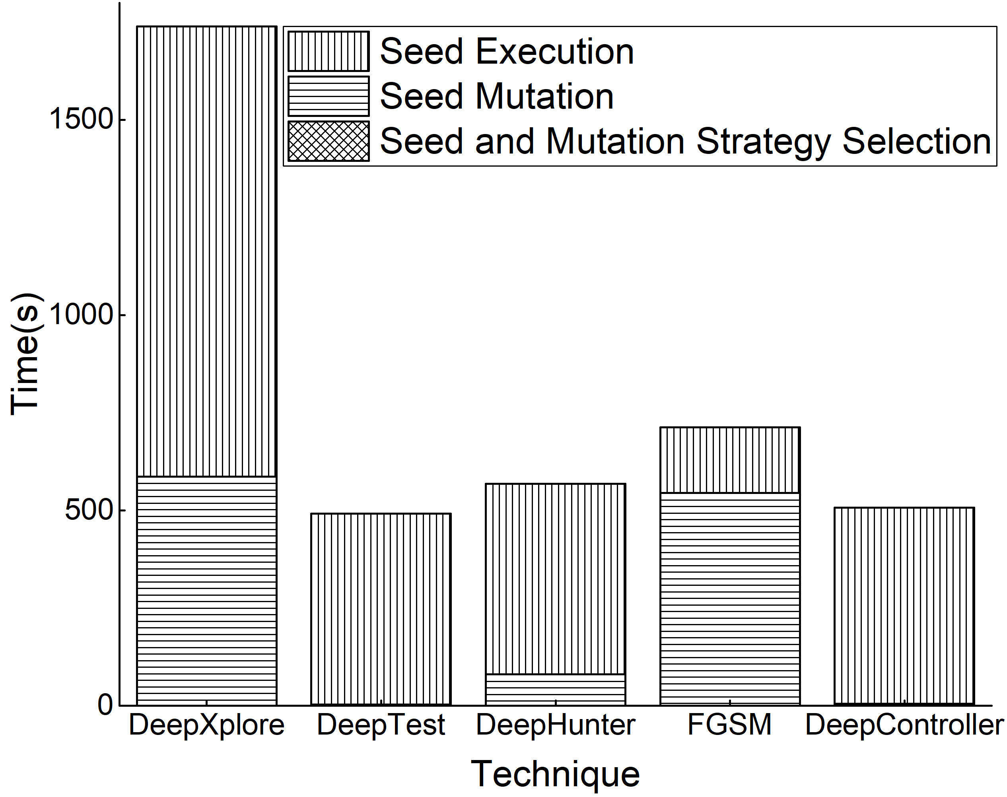
Results of time overhead glimpse
Technique | Seed and mutation selection time (s) | Seed mutation time (s) | Seed execution time (s) | Total (s)
DeepXplore | 0.1/0.1/0.1 | 170.4/994.9/596.0 | 4.6/3223.1/230.1 | 175.1/4218.1/826.2
DeepTest | 0.1/0.1/0.1 | 0.3/7.6/0.4 | 1.8/1443.3/21.8 | 2.2/1451.1/22.3
DeepHunter | 0.9/0.2/0.2 | 157.6/31.3/51.0 | ﻿1.6/1440.1/21.1 | 160.1/1471.7/72.2
FGSM | 0.1/0.1/0.1 | 4.0/1497.7/131.8 | 1.6/441.8/60.6 | ﻿5.7/1939.5/192.5
DeepController | 0.8/0.1/0.2 | 2.2/11.1/1.6 | ﻿1.7/1483.1/22.3 | 4.7/1494.2/24.1
x/y/z ﻿denotes the average time overheads of studied techniques on MNIST, ImageNet, and CIFAR10, respectively
Seed execution and seed mutation are ﻿an expensive process
Seed selection and mutation strategy selection are ﻿an inexpensive process (﻿only 1.2% of the whole testing time)
﻿For executing the same number of test cases, DeepController generally had shorter testing time than DeepXplore, FGSM, and DeepHunter﻿, but had marginally higher time overhead than DeepTest
14/15

Slide 16
Conclusion and Future Work
Conclusion:
We proposed DeepController, an efficient fuzzer for DL systems,
Framework: selecting seeds and mutation strategies that both have high potentials of fault detection, adaptive to the feedback information from test executions.
Two algorithms: AS2 and AMS2 for the selections of seeds and mutation strategies, respectively.
Empirical studies on three datasets, and eight DL models: DeepController could generate more adversarial inputs, and explore more internal states of DL models than the state-of-the-art DL testing techniques.
Future work:
Application of DeepController to other types of inputs, such as audios and text.
Influence of hyper-parameters on the performance of DeepController.
15/15

Slide 17

THANK YOU!
Notes:
Thanks for your attention.
I’m ready to take questions

