Slide 1


Anomaly Detection in Spot Welding Machines in the Automotive Industry for Maintenance Prioritization
Laislla C. P. Brandão | Aldonso Martins-Jr
Gabriel A. Kopte | Edson Filho
Alexandre M. A. Maciel

Slide 2
Summary
Introduction
Materials and Methods
Evaluation and Results
Conclusions and Future Work

Slide 3
Introduction

Slide 4

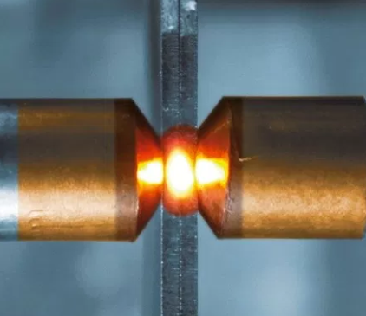
Contextualization
In the automotive industry, a globally common process to assemble an automobile is the joining of metal sheets using a technique known as Spot Welding, made by an equipment called Welding Gun.
The welding gun uses two metallic copper electrodes to apply a force of union between metallic plates creating welding spots by passing high level electrical current through them and the metal worksheets in between [3]. The heat generated by the passage of high electric current through the small section of the electrodes melts the metals of the two plates, providing the union of the parts when the material solidifies again.

Slide 5
Challenges
Limited resources
Targeted maintenance
Rework prevention
Low availability of machines to carry out maintenance, limited amount of spare material and labor.
In many cases, traditional maintenance policies can be satisfactory, but when maintenance and failure costs are high [2], targeted maintenance through data analysis becomes a better choice.
There are reworks to correct defects caused by imperfections in the process, such as splashes (leaking of weld residue during the Spot Welding process), and those must be avoided.

Slide 6
Objective
By analyzing the data generated by the welding machines that use BOSCH technology, this study plans to develop methodologies that assist in the detection of anomalous behavior patterns, to support the reduction of unscheduled stops, maintenance time and repair costs and provide a rise in the efficiency and quality of the welding process, with the same available resources.

Slide 7
Materials and Methods

Slide 8
Data Collection
Data is automatically logged by Weld Controllers (1 per robot) in a Local SQL Server Database;
The data refer to the Spot Welding process of a manufacturing unit in the automotive sector that uses BOSCH technology. The dataset refers to the process alarms (warnings and errors) of a single production line that contains 34 welding machines. The work developed in one line is considered valid and sufficient for the reproducibility of the project in other lines, since all lines are similar.
The data considered is the gathering of a month of production.

Slide 9
Dataset Description
COLUMN | DESCRIPTION
data | Event registration date
line | Record of the production line where the robot is located
protRecord_ID | Single consecutive number (automatic value)
dateTime | Timestamp record of the moment of occurrence of the event
timerName | Unique identification of the registered event source welding machine
errorCode1 | Warning or Error code event source
errorCode1_txt | Warning or Error event source - Text in selected language
errorCode2 | Secondary error code
errorCode2_txt | Secondary error code - Text in selected language
isError | Flag to identify if the event is a Warning or Error
isError_txt | Literal text Warning or Error
servodynDVState | Servo status code
servodynDVState_txt | Servo Status - Text in selected language
tablename | Address of the folder on the computer where the ExtError tables are located
The ExtError_RDS_V dataset contains records of warnings and errors events with their respective Timestamps;
Total of 13 columns.
This database is overwritten in a rolling 4-day window, so the data is extracted daily to a local csv and the files transferred to an unstructured environment - Google Cloud Storage;
Python code as ETL for reading each file and adding the records to Google Cloud Platform's BigQuery structured database;

Slide 10

Data Preprocessing
Data loaded into a NOSQL database on Google Cloud Computing (GCP) called BigQuery → scalable, elastic and serverless → no worries about space, latency, speed, integrity and availability.
Using the OLAP approach, it was possible to transform data from categorical columns into non-categorical columns while reading the data -> primary keys with date and machine codes are stored separately in dimension tables.

Slide 11
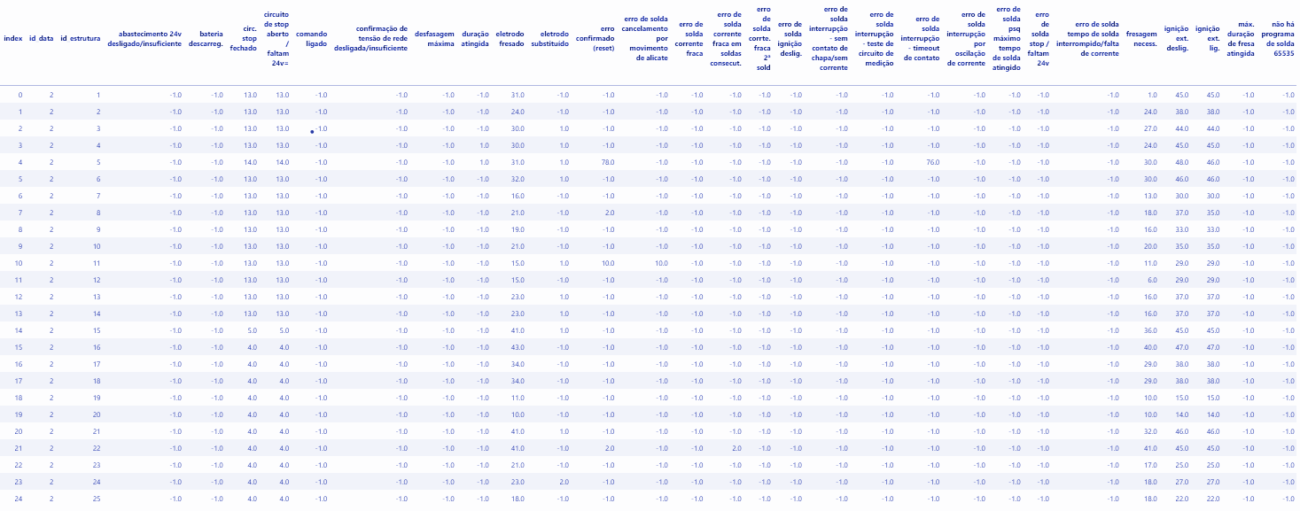

Data Preprocessing
The columns errorCode1_txt and errorCode2_txt were concatenated creating a new column, errorCode_txt. This brings a second level of detail for each error.
New dataset ExtError_group, pivoting the various errors into features for the Machine Learning model and the event counts grouped by machines ID and dates ID.

Slide 12
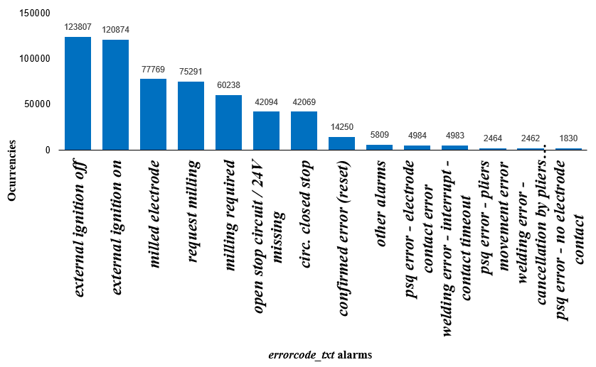
Exploratory Data Analysis
Original dataset ExtError_RDS_V
CÓDIGO | DESCRIÇÃO | TIPO DE ALARME
31 | reached duration | WARNING
32 | reached pre-ewarning | WARNING
33 | request milling | WARNING
34 | milling required | WARNING
35 | pre-warning mill | WARNING
36 | max. milling duration reached | WARNING
41 | maximum lag | WARNING
80 | Stop circuit open / 24V missing | ERROR
84 | Battery discharged | WARNING
87 | There is no welding program | ERROR
99 | welding error | ERROR
101 | command on | WARNING
102 | external ignition off | WARNING
104 | external ignition on | WARNING
115 | psq error | ERROR
131 | replaced electrode | WARNING
132 | milled electrode | WARNING
140 | circ. stop closed | ERROR
162 | main voltage off / insufficient | ERROR
166 | 24V supply off / insufficient | ERROR
169 | interrupted welding time / out of current | ERROR
180 | confirmed error (reset) | WARNING/ ERROR
217 | confirmation of main voltage off / insufficient | ERROR
1008 | program started | WARNING
1013 | user exchange: | WARNING
1009 | program finished | WARNING

Slide 13
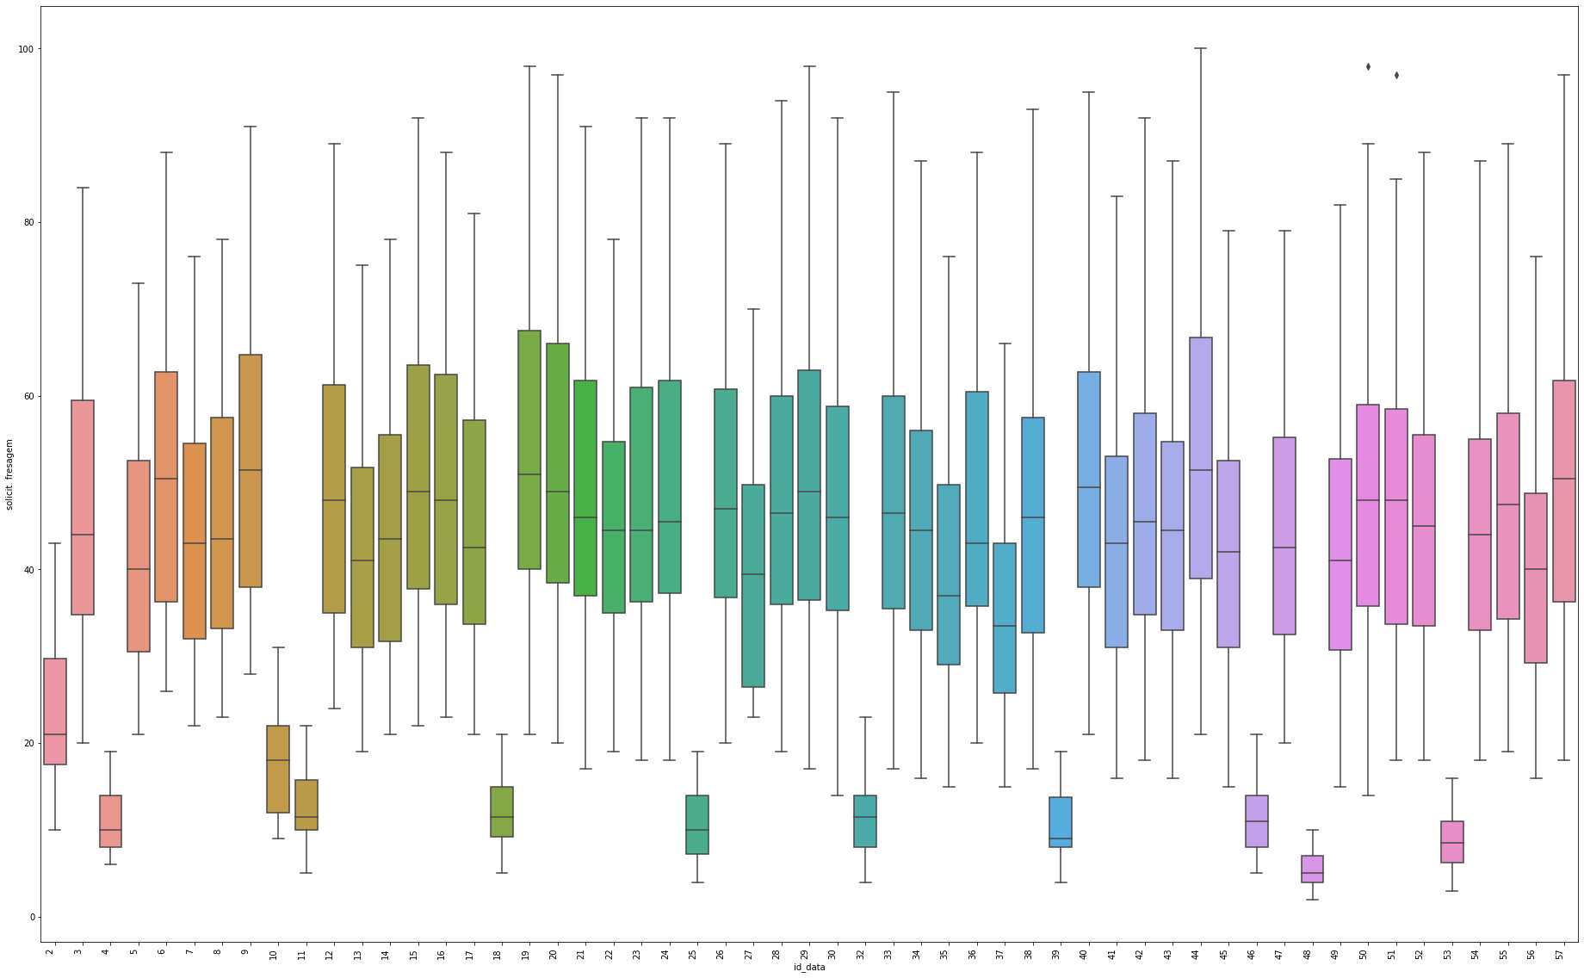
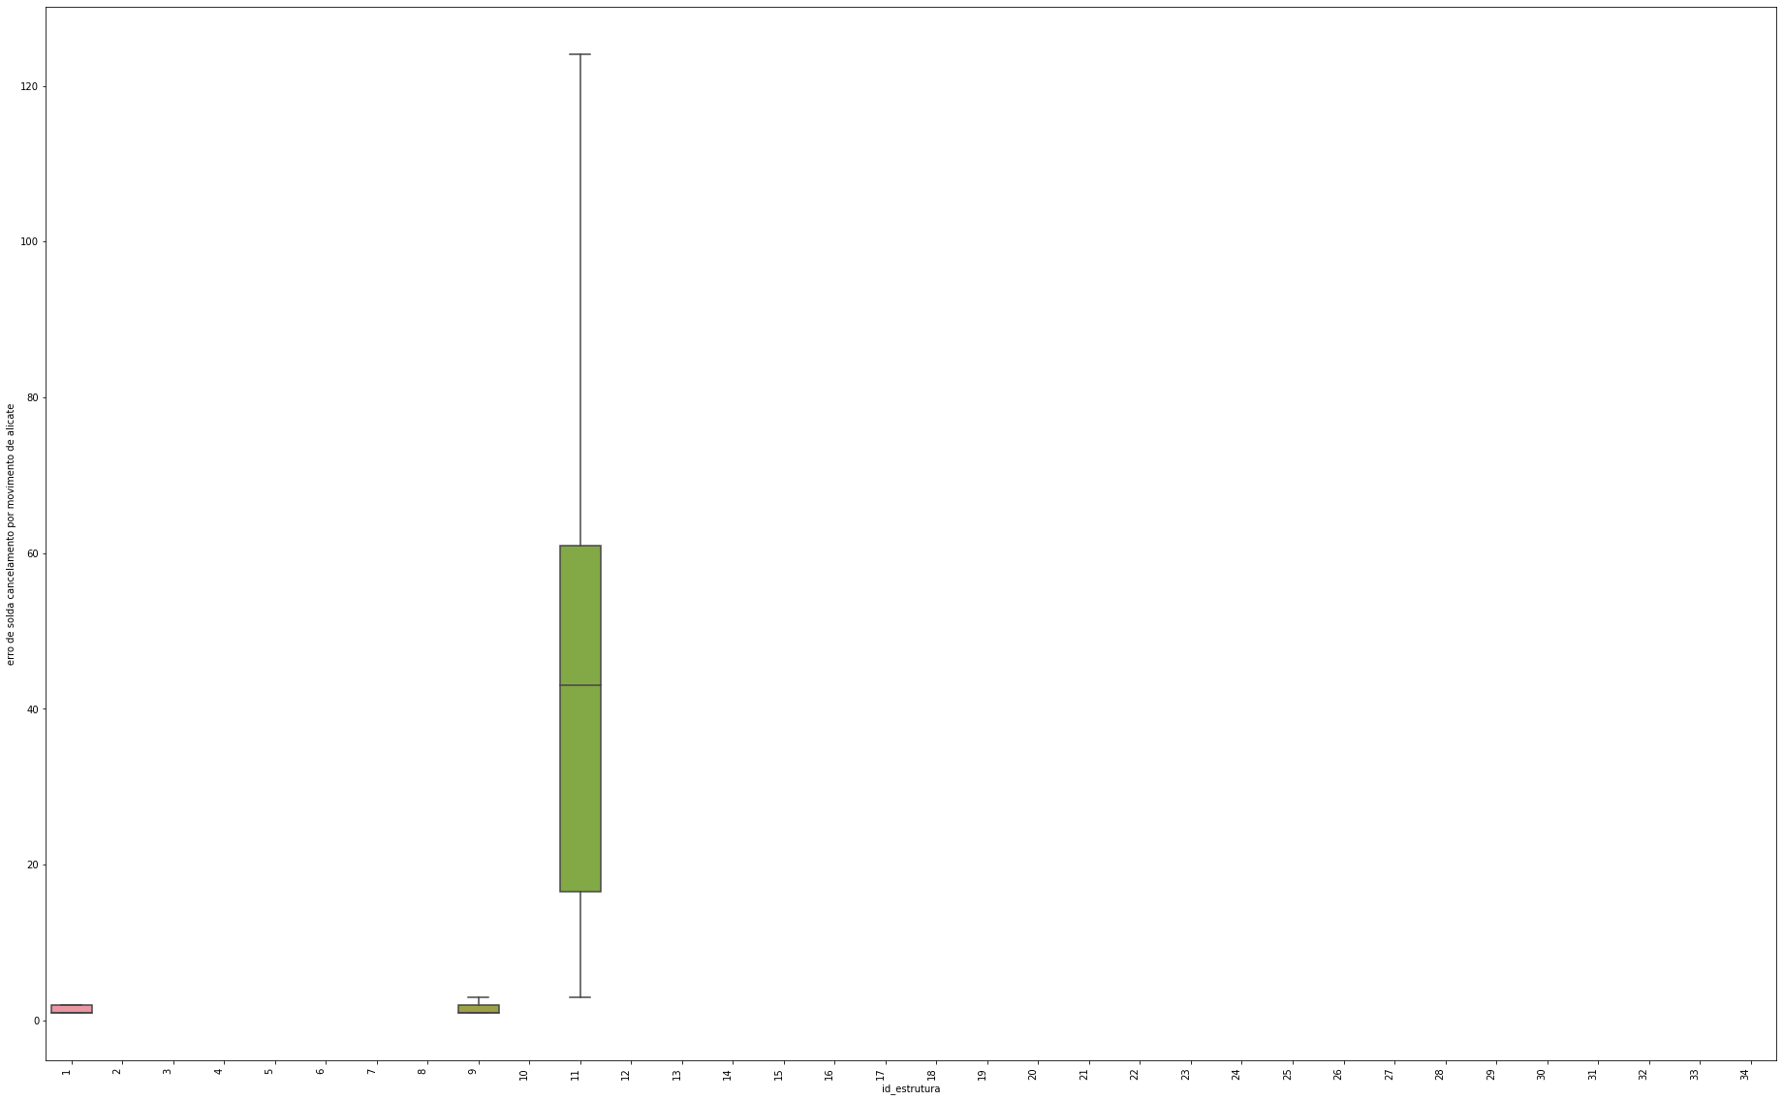
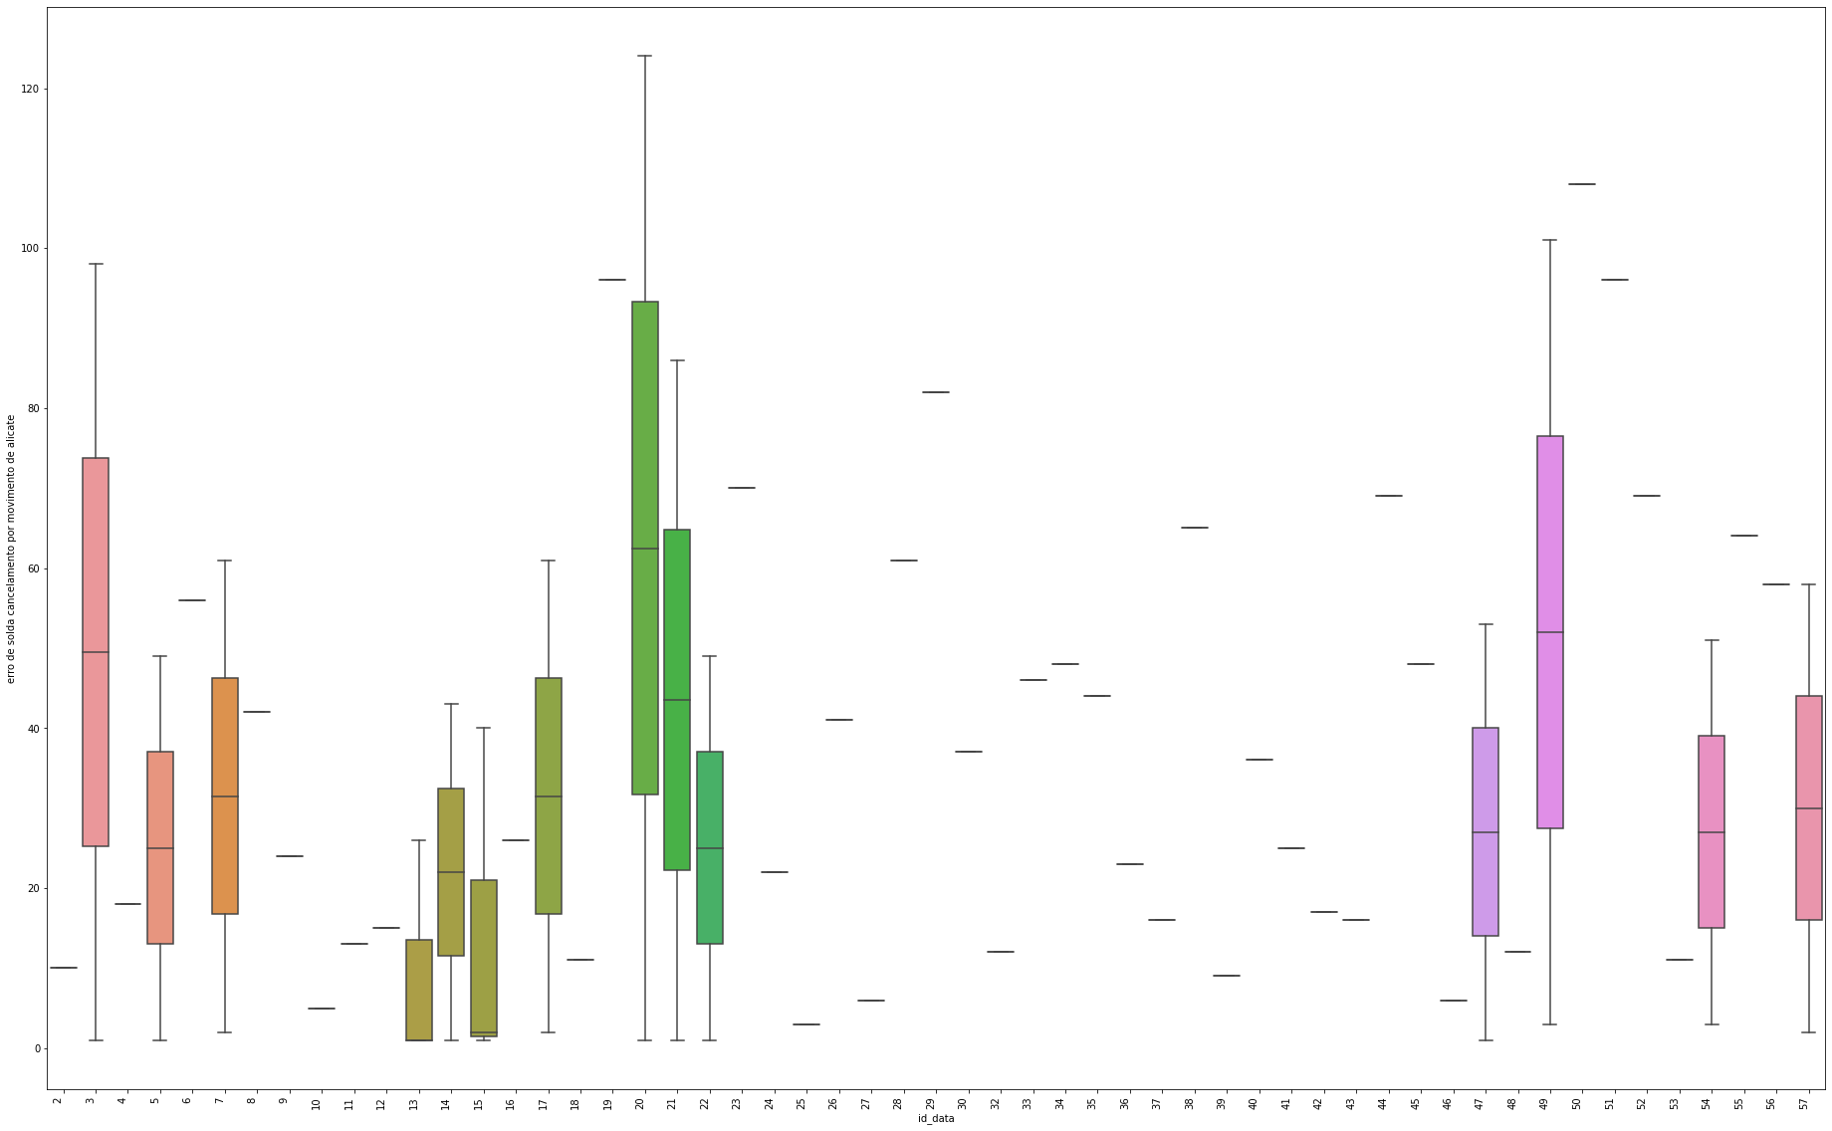
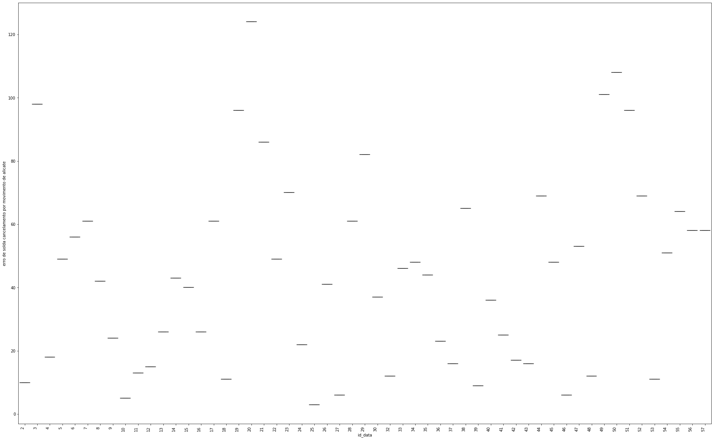
Exploratory Data Analysis
New grouped dataset ExtError_group
Distribution of occurrences of the error “Welding error - Cancellation by pliers movement” for each machine.
Variation of the warning “Request. milling” for each date.
Distribution of occurrences of the error “Welding error - Cancellation by movement of pliers” on the machine (id=11) for the dates in the dataset.
Variation of the error “Welding Error - Cancellation by Pliers Movement” for each date.

Slide 14
Modeling
Bayesian
Networks
ASSOCIATION
K-Means
DBSCAN
Fuzzy C-Means
Non-Standard data:
original data from the ExtError_group dataset
Two approaches for data preparation
CLUSTERIZATION
Standard data:
data standardized by the StandScaler method

Slide 15
Modeling
DBSCAN
Maximum Silhouette
Elbow Curve (Inertia)
Approaches to parameter selection
K-Means
Fuzzy C-Means

Slide 16
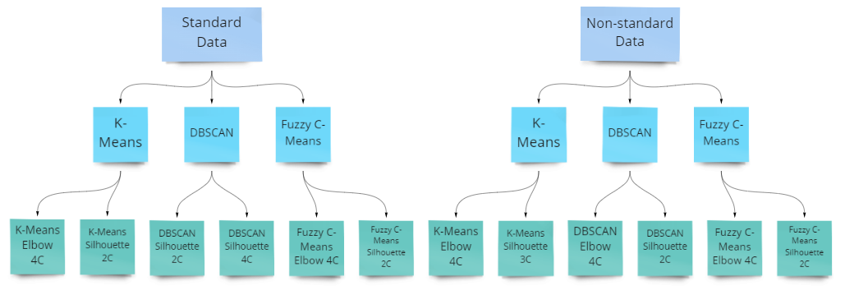
Modeling

Slide 17
Evaluation and Results

Slide 18
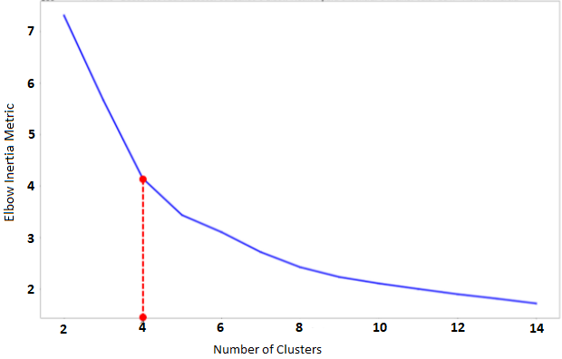
Results
Clusterization (K-Means) - Model 1
Elbow Method (Inertia) - Non-standard data
Number of clusters → 4

Slide 19
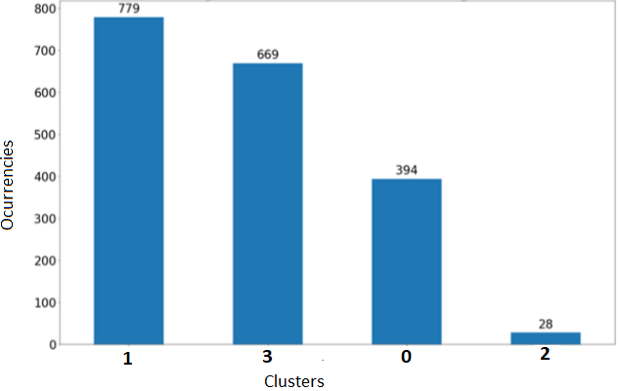
Results
Clusterization (K-Means) - Model 1
Distribution of the 4 groups

Slide 20
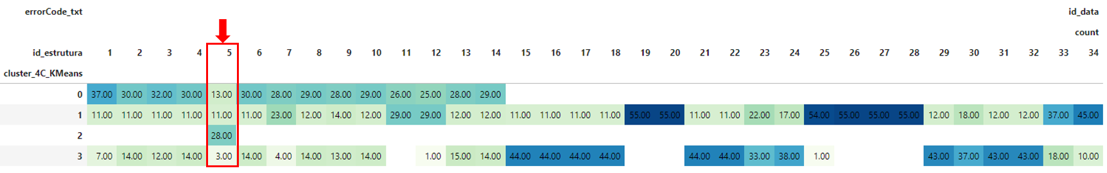
Results
Clusterization (K-Means) - Model 1
Distribution of the K-Means for the 4 groups with non-standard data
Machine of interest:
  id=5
Silhouette Score:
  0,38
Euclidean distance mean:
  48,9

Slide 21
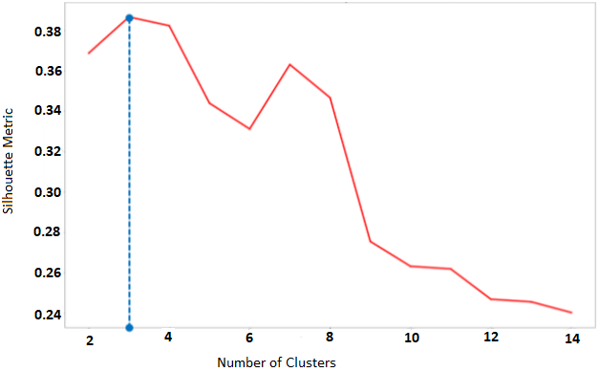
Results
Clusterization (K-Means) - Model 2
Silhouette Score - Non-standard data
Number of clusters → 3

Slide 22
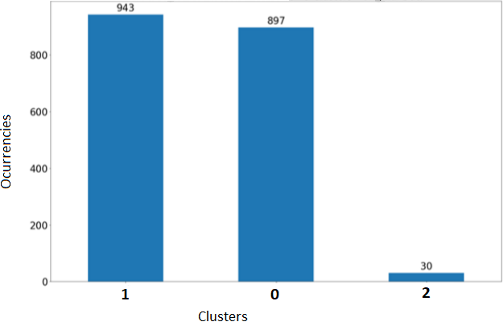
Results
Clusterization (K-Means) - Model 2
Distribution of the 3 groups

Slide 23
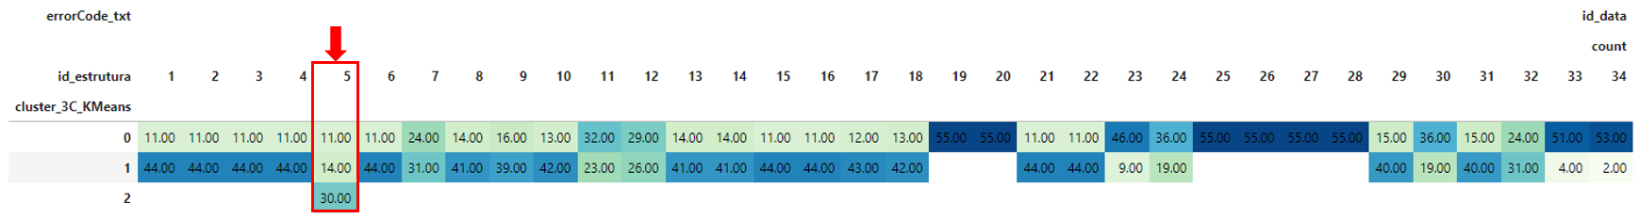
Results
Clusterization (K-Means) - Model 2
Distribution of the K-Means for the 3 groups with non-standard data
Machine of interest:
  id=5
Silhouette Score:
  0,38
Euclidean distance mean:
  41,4

Slide 24
Results
Clusterization
Algorithm | Number of groups | Standard Data | Method selection of number of groups | Silhouette Score | Distance | ID Machines of interest (possible anomalies)
K-Means | 3 | No | Máx Silhouette score | 0.38 | 48.9 | 5
K-Means | 2 | Yes | Máx Silhouette score | 0.43 | 13.0 | Not identified
K-Means | 4 | No | Elbow Method (Inertia) | 0.38 | 41.4 | 5
K-Means | 4 | Yes | Elbow Method (Inertia) | 0.32 | 10.1 | 17, 18
DBSCAN | 2* *Result of eps=19 e min_samp=10 | No | Máx Silhouette score | 0.47 | none | 2, 4, 17
DBSCAN | 2* *Result of eps=18 e min_samp=7 | Yes | Máx Silhouette score | 0.15 | none | 2, 3, 4, 13, 17, 18
DBSCAN | 4* *Result of eps=19 e min_samp=10 | No | Elbow Method (Silhouette) | 0.33 | none | 5, 7, 17, 18, 26,
DBSCAN | 4* *Result of eps=10 e min_samp=3 | Yes | Elbow Method (Silhouette) | 0.16 | none | 2, 4, 13, 17, 33
Fc-means | 2 | No | Máx Silhouette score | 0.37 | 51.6 | 23, 33, 34
Fc-means | 2 | Yes | Máx Silhouette score | 0.43 | 13.0 | Not identified
Fc-means | 4 | No | Elbow Method (Inertia) | 0.31 | 39.2 | Not identified
Fc-means | 4 | Yes | Elbow Method (Inertia) | 0.32 | 10.1 | 17, 18

Slide 25
Results
Machines of Interest
ID MACHINES | OCCURRENCES
17 | 6
18 | 4
2 | 3
4 | 3
5 | 3
33 | 2
13 | 2
7 | 1
3 | 1
34 | 1
23 | 1
26 | 1
This table summarizes the “machines of interest” highlighted by each of the applied models.

Slide 26
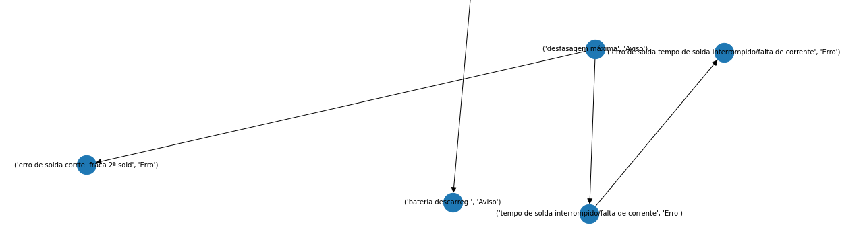
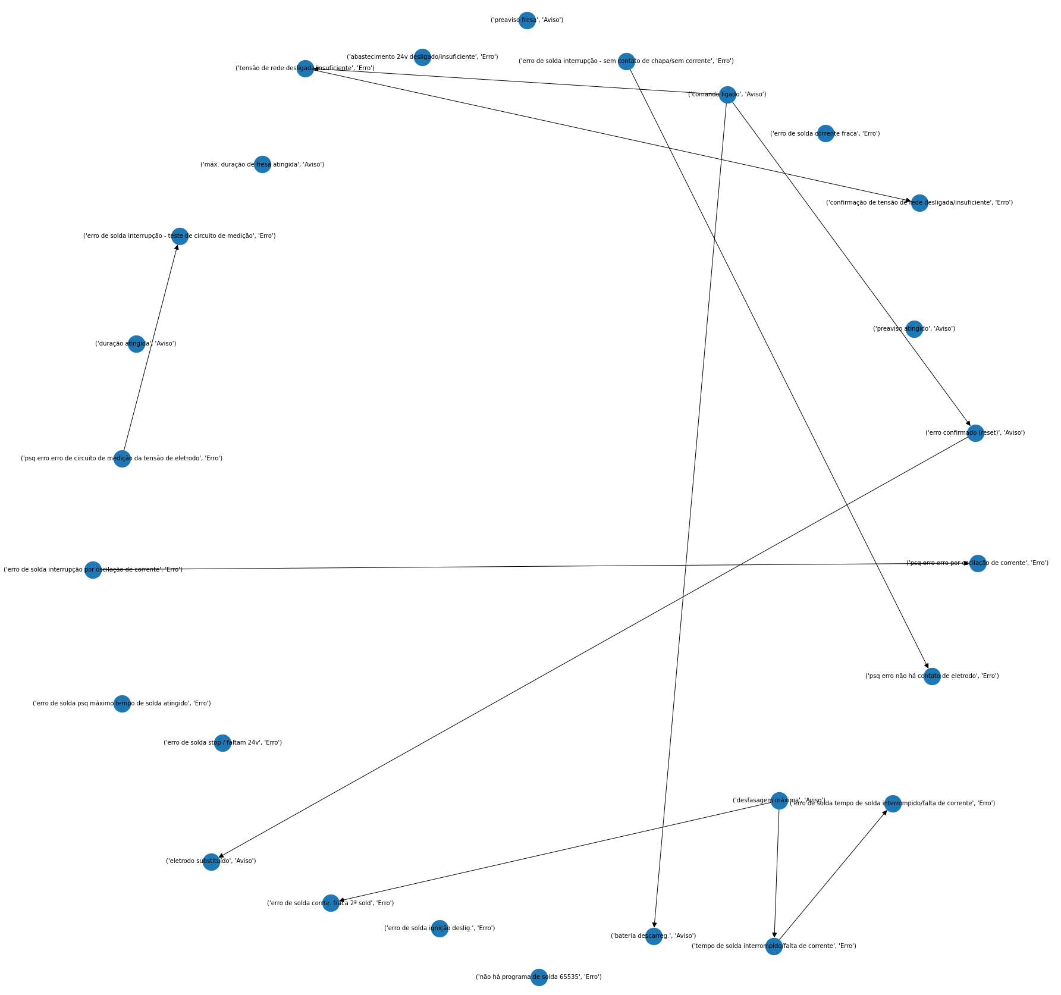
Results
Bayesian Networks
1. (‘maximum lag', Warning) -> (‘welding error - weak current 2nd weld, ’Error’)
Causality in error and warning logs, trying to relate apparently non-relevant errors and warnings with errors related to critical failures, for the machines of interest (belonging to minority clusters).
2. (‘maximum lag', Warning) -> (‘welding error - interrupted welding time / lack of current’,’Error’) -> (‘interrupted welding time / lack of current’,’Error’)
It indicates a lack of current error related to a maximum current lag warning.
Possible causes:
  Deterioration of the welding electrode;
  Deterioration of the measurement circuit or auxiliary cables;
  Welding transformer problems (insufficient capacity);
  Failure in the electrode milling process.

Slide 27
Results
Bayesian Networks
('welding error - interruption by current oscillation',’Error’)->(‘psq error - error by current oscillation’,’Error’)
It indicates a current oscillation problem;
Possible causes:
  Mechanical alignment conditions;
  Defects in electronic components.

Slide 28
Discussions
Generically, it is possible to divide the results of each clustering model between majority classes and minority classes.
Majority clusters tend to bring together sets of machines that operate similarly to each other in a larger set of days, which should characterize the common production process, without major behavioral surprises.
Minority clusters tend to isolate machines that behaved anomalously on a certain set of days.
Both cases need to be evaluated together with the stakeholders and maintenance team to find insights in the data for the business.
A greater emphasis should be given to machines id=17 and id=18, as they appear in several different models as “machines of interest”, which may give rise to greater chances of opportunity for preventive maintenance interventions.
The Bayesian network analysis of the machine id=5 indicates a possible electromechanical failure (looseness, lack of contact or orthogonality) or failure in a power electronic component (causes) for the occurrence of multiple recorded errors (effect).

Slide 29
Conclusions

Slide 30
ETL - Data Ingestion
OLAP Modeling
Data Cleaning and Preparation
Machine Selection Methodology 1
Machine Selection Methodology 2
Causal analysis of failures
From data in files to the cloud
Data extraction per production day from local SQL databases and export to csv.
File ingestion into an unstructured environment.
Python code for reading each file and adding the records to Google Cloud Platform's BigQuery structured database.
Dimensions Modeling
Reduction of categorical columns by nesting in combined dimensions.
Categorical columns transformed into non-categorical columns while reading the data, primary keys with date and machine codes stored separately in dimension tables.
Data cleaning, preparation and standardization
The base is quite unbalanced, having warning events that occur commonly in production.
Grouping of events by day and machine, transformation of different error codes into columns, creating a new dataset. The values are the counts of occurrence of each alarm.
Replacement of NaN by -1.
Generation of a standardized base using StandScaler.
Data Exploration
Filter and analyze each error, using occurrence groupings by machine and day.
Selection of cases where errors are concentrated on a single machine and evaluating the distribution in time.
Highlight of known failure cases and association with errors already recorded to enhance the identification of opportunities.
Clustering models
Application of different Unsupervised Machine Learning approaches to divide data into clusters.
Minority clusters tend to isolate machines that behaved anomalously on a certain set of days.
Select the machines that most often fall into minority clusters from different clustering approaches.
Bayesian networks
Analysis of causal relationships between the different errors existing for the selected machines on the indicated dates.
Possible creation of base of known associations that support methodology 1 of machine selection.

Slide 31
Future Work
Other datasets, such as the Spot Welding process parameters and measurements ExtMeasuresProt_V, are likely to be used in the future to improve the findings produced with this work, to improve analysis and associate failure modes in more detail.
The use of this dataset might help to identify new priorities that also benefit quality control, not exclusively the maintainability of the welding process.
Also, the new studies will feature a review of the literature in search of the state-of-the-art regarding anomaly detection techniques.

Slide 32
References
[1] R. Y. Zhong, X. Xu, E. Klotz, and S. T. Newman, “Intelligent manufacturing in the context of industry 4.0: A review,” Engineering, vol. 3, no. 5, pp. 616–630, 2017. [Online]. Available: https://www.sciencedirect.com/science/article/pii/S2095809917307130
[2] A. Parida and U. Kumar, “Maintenance productivity and performance measurement,” in Handbook of maintenance management and engineering. Springer, 2009, pp. 17–41.
[3] B. Zhou, Y. Svetashova, S. Byeon, T. Pychynski, R. Mikut, and E. Kharlamov, “Predicting quality of automated welding with machine learning and semantics: a bosch case study,” in Proceedings of the 29th ACM International Conference on Information & Knowledge Management, 2020, pp. 2933–2940.
[4] H. Zou, “Clustering algorithm and its application in data mining,” Wireless Personal Communications, vol. 110, no. 1, pp. 21–30, 2020.
[5] K. Khan, S. U. Rehman, K. Aziz, S. Fong, and S. Sarasvady, “Dbscan: Past, present and future,” in The fifth international conference on the applications of digital information and web technologies (ICADIWT 2014). IEEE, 2014, pp. 232–238.
[6] J. Nayak, B. Naik, and H. Behera, “Fuzzy c-means (fcm) clustering algorithm: a decade review from 2000 to 2014,” Computational intelligence in data mining-volume 2, pp. 133–149, 2015.
[7] K. B. Korb and A. E. Nicholson, Bayesian artificial intelligence. CRC press, 2010.
[8] J. Pearl, “Bayesian networks,” 2011.
[9] M. Subramaniyan, A. Skoogh, A. S. Muhammad, J. Bokrantz, B. Johansson, and C. Roser, “A data-driven approach to diagnosing throughput bottlenecks from a maintenance perspective,” Computers & Industrial Engineering, vol. 150, p. 106851, 2020.
[10] C. Roser, M. Nakano, and M. Tanaka, “Comparison of bottleneck detection methods for agv systems,” in Winter Simulation Conference, vol. 2, 2003, pp. 1192–1198.
[11] C. Yu and A. Matta, “A statistical framework of data-driven bottleneck identification in manufacturing systems,” International Journal of Production Research, vol. 54, no. 21, pp. 6317–6332, 2016.
[12] E. Lima, E. Gorski, E. F. Loures, E. A. P. Santos, and F. Deschamps, “Applying machine learning to ahp multicriteria decision making method to assets prioritization in the context of industrial maintenance 4.0,” IFAC-PapersOnLine, vol. 52, no. 13, pp. 2152–2157, 2019.
[13] Y. Svetashova, B. Zhou, T. Pychynski, S. Schmidt, Y. Sure-Vetter, R. Mikut, and E. Kharlamov, “Ontology-enhanced machine learning: a bosch use case of welding quality monitoring,” in International Semantic Web Conference. Springer, 2020, pp. 531–550.

Slide 33
Anomaly Detection in Spot Welding Machines in the Automotive Industry for Maintenance Prioritization
Laislla C. P. Brandão | Aldonso Martins-Jr
Gabriel A. Kopte | Edson Filho
Alexandre M. A. Maciel

