Slide 1


Revealing Agile Mindset Using LEGO® SERIOUS PLAY®: Experience from an Online Agile Training Project
Ilenia Fronza and Xiaofeng Wang
Free University of Bozen-Bolzano, Italy

Slide 2

Introduction
LEGO bricks are usually associated with constructing concrete structures such as buildings or cars
The dynamic nature of LEGO also allows it to represent more abstract concepts
LSP is a facilitated workshop where participants build 3D models using a special mix of LEGO bricks designed to inspire the use of metaphors and story-making
Unsplash Photo by Philip Myrtorp on Unsplash

Slide 3
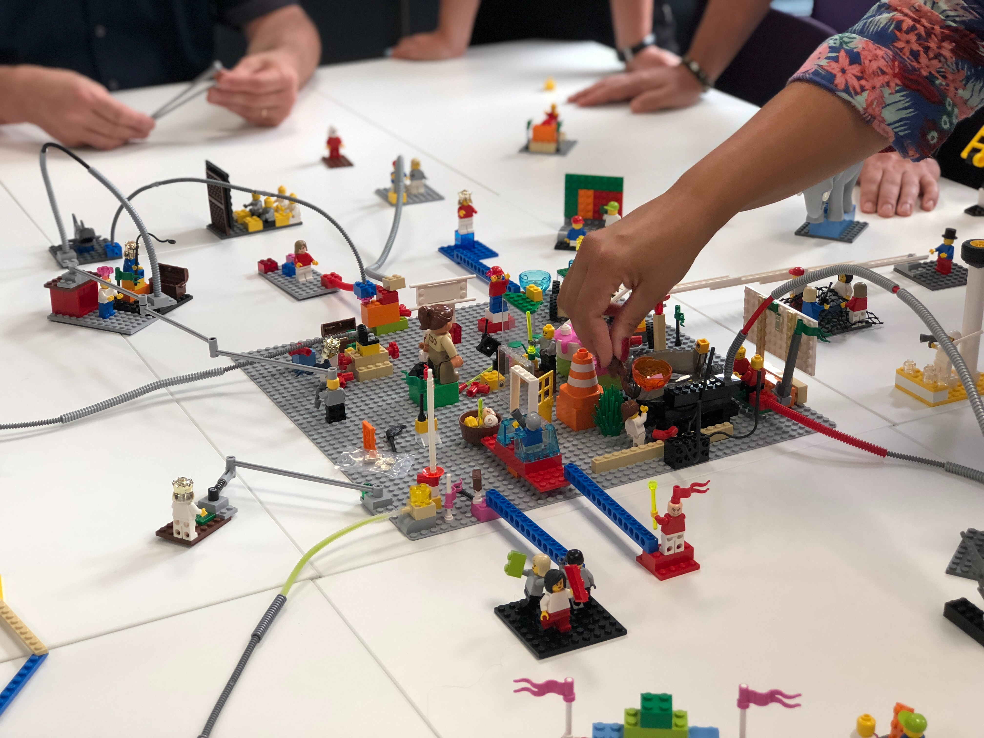
Introduction
LEGO bricks are usually associated with constructing concrete structures such as buildings or cars
The dynamic nature of LEGO also allows it to represent more abstract concepts
LSP is a facilitated workshop where participants build 3D models using a special mix of LEGO bricks designed to inspire the use of metaphors and story-making
Photo by Amélie Mourichon on Unsplash

Slide 4
Introduction
Due to the abstract nature of the agile mindset [1], there are limited studies on explicit training for it
  AM1: Trust
  AM2: Responsibility and ownership
  AM3: Continuous improvement
  AM4: Willingness to learn
  AM5: Openness and willingness to continually adapt and grow
  AM6: Specific personal attributes, including intent, integrity, honesty, transparency, courage, authenticity, empathy, proactivity, creativity and problem- orientation
  AM7: Enabling environment
  AM8: Autonomy of people and teams
  AM9: Managing uncertainty
  AM10: Focus on customer value
[1] M.Mordi, Azuka; Schoop, “Making It Tangible-Creating a Definition of Agile Mindset,” 28th European Conference on Information Systems (ECIS2020), 2020.
Photo by Amélie Mourichon on Unsplash

Slide 5

Objective
The objective of this experience report is to demonstrate how to utilize the LSP methodology in agile training that has the agile mindset as a core element, especially how it helps to reveal the participants’ agile mindset
We describe our experience of utilizing LSP in an agile (online) training project
We adapted the standard LSP methodology for online settings – F2F interactions are key characteristics of the LSP methodology
Thus, we also show a feasible implementation of LSP in online settings
Photo by engin akyurt on Unsplash

Slide 6
Online agile training project
31 participants (28 M, 3 F); 4 software companies
10-15 years of working experience (38.5%); 28.0% never used agile methods; 12.0% used agile methods for less than one year, mainly at the team level (60.9%)
4 groups: project managers (8, 2 F), program and middle managers (6), software engineers (14, 1 F), and other roles (2)
Beginning part: fundamental agile concepts, principles, and practices
Central part: different topics for each group
Final part: scaling agile methods to the whole organization

Slide 7
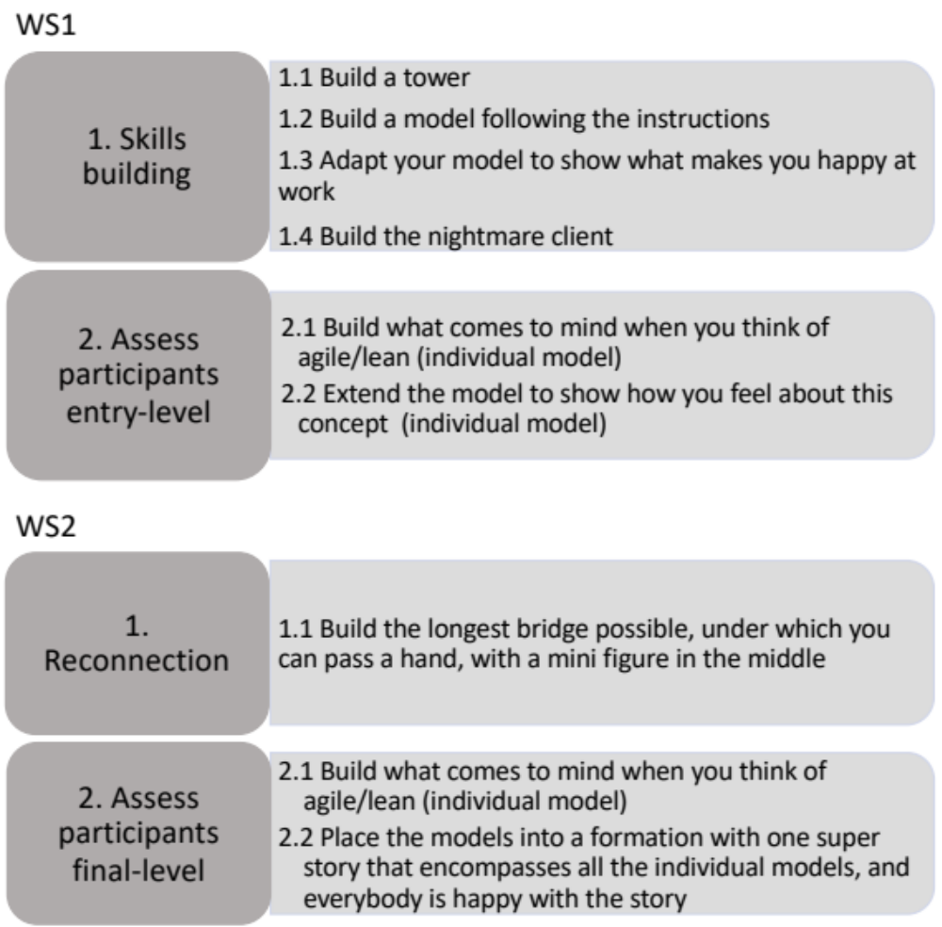
Online LSP workshop
Two 4-hour LSP workshops: WS1 in the first part and WS2 at the end of the training, seven months later
Each workshop was repeated for the four groups (WS1: 25 part. WS2: 22 part.)
Shared models by organizing pictures in a shared document
The facilitator annotated each model in a visual booklet

Slide 8
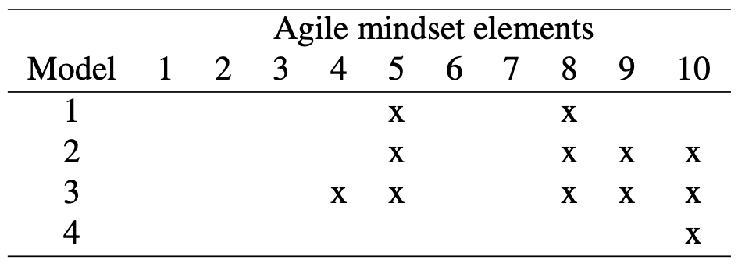
Utilizing LSP Models to Reveal Agile Mindset
AM5 Willingness to adapt
AM8 Autonomy of people and team

Slide 9
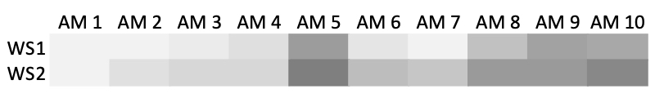
Utilizing LSP Models to Reveal Agile Mindset
Visualization to supervise the learning process of a group of learners
  focus on the critical agile mindset elements (e.g., Responsibility and ownership (AM2))
  understand whether the participants’ AM was enhanced

Slide 10
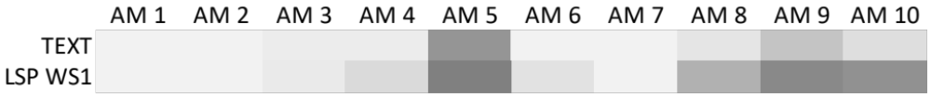
Effectiveness of LSP to Review Agile Mindset
During the project kick-off meeting, participants wrote down their answer to the question “what agile means to you?”
We compared the expressiveness of text versus LSP models (WS1) in terms of revealing the participants’ AM
LSP models reveal stronger presence of most AM elements (except AM1, AM2 and AM7), especially for AM8, AM9 and AM10 where sharper contrasts can be observed

Slide 11
Lessons Learned and Recommendations
Running LSP workshops (online)
LSP workshops require considerably more time than traditional text-based surveys – but they can better surface participants’ invisible agile mindset
We recommend collecting the necessary information about the participants (e.g., colour-blindness) to plan the workshops
Online: keep cameras and mics on
Online: Have backup activities ready to keep the fastest builders engaged – they disengage quickly (e.g., read emails)

Slide 12
Lessons Learned and Recommendations
LSP workshops when training for AM
To enable more personalized training, we recommend to keep the mapping between participants and the LSP models they build in different workshop sessions in order to compare their initial and final mindset

Slide 13
Conclusion
Through our experience, we demonstrated the effectiveness of LSP models to reveal the agile mindset of people
To establish the effectiveness of the LSP methodology in training for agile mindset, more rigorously designed studies are needed
Potential interesting aspects to explore:
  how LSP works for different backgrounds (disciplinary, gender, etc.)
  whether/how LSP could be used in training for other types of mindsets or abstract concepts as well as concrete skills or knowledge

Slide 14


Thank you
Free University of Bozen-Bolzano, Italy
{ilenia.fronza, xiaofeng.wang}@unibz.it
inf.unibz.it/swse/

