Slide 1

COAT: A Music Recommendation Model based on
Chord Progression and Attention Mechanisms
Weite Feng¹, Tong Li^{1,2}, Zhen Yang^{1,2}
¹Faculty of Information Technology, Beijing University of Technology, Beijing, China
²Engineering Research Center of Intelligent Perception and Autonomous Control, Ministry of Education, Beijing, China
SEKE 2022
July 1 - July 10, 2022

Slide 2

Introduction
Would P₁ like S₄?
P₁ listen to [S₁, S₂, S₃, S₄]
P₂ listen to [S₁, S₂, S₃]
CF method
Common music recommendation algorithms can be broadly classified into Collaborative Filtering (CF) and Content-Based Filtering (CBF)^{[1]}
CBF method
P₁ listen to [S₁, S₂]
tag1: Coldplay
tag2: Rock
Would P₁ like S₃?
S₃
[1] M. Schedl, H. Zamani, C. Chen, Y. Deldjoo, and M. Elahi, “Current challenges and visions in music recommender systems research,” International Journal of Multimedia Information Retrieval, vol. 7, no. 2, pp. 95–116, 2018.

Slide 3
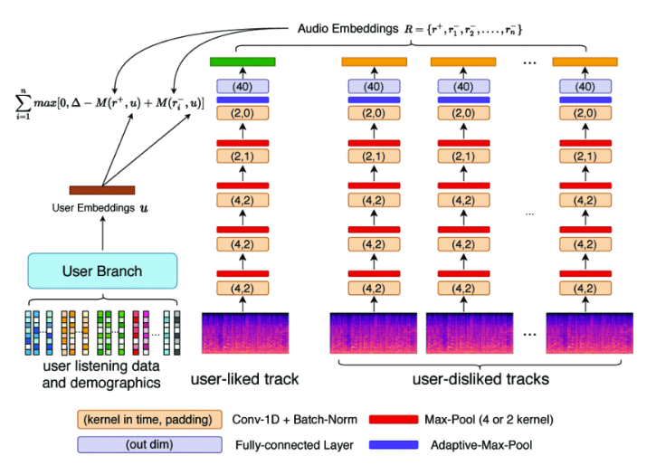
Introduction
Existing work often represents music content by using low-order audio features^{[2]}
Recent studies have shown that this approach may not be optimal for music-related audio processing tasks due to the lack of musical semantics^{[3]}
[2] Chen K, Liang B, Ma X, et al. Learning Audio Embeddings with User Listening Data for Content-Based Music Recommendation[C]//ICASSP 2021-2021 IEEE International Conference on Acoustics, Speech and Signal Processing (ICASSP). IEEE, 2021: 3015-3019.
[3] P. Knees and M. Schedl, Music similarity and retrieval: an introduction to audio-and web-based strategies. Springer, 2016, vol. 9

Slide 4
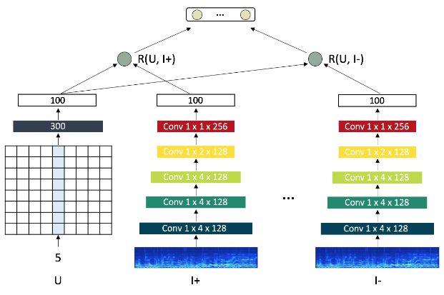
Introduction
Existing work usually uses CNNs or RNNs to learn the representation of music content^{[4]}
Lack of mining of the user's fine-grained preference
May not be the optimal solution
[4] Lee J, Lee K, Park J, et al. Deep content-user embedding model for music recommendation[EB/OL]. https://arxiv.org/abs/1807.06786

Slide 5
Introduction
Challenges :
1. How to appropriately represent music content and integrate it into recommendation algorithms？
2. How to tap into users' fine-grained personality preferences for music content and form recommendations accordingly
Solutions:
1. Use high-order music features (chord sequences) instead of low-order audio features as a representation of music content
2. Using attention mechanisms to mine users' fine-grained personality preferences for music content as an alternative to CNNs or RNNs

Slide 6
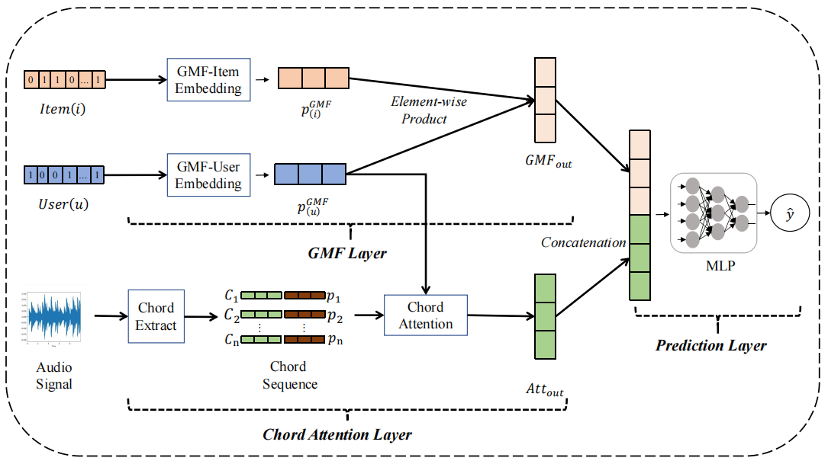
The overall framework of COAT
The COAT model contains the following three components:
the Generalized Matrix Factorization (GMF) layer
the Chord Attention layer
the Prediction layer

Slide 7




The GMF layer
This layer includes two calculation processes :
  User, Song embedding
  Element-wise product
0 | 1 | 1 | 0 | … | 1
Item Embedding
0.1 | 0.8 | 0.4
0.7
0.8
0.5
$$Item\left(i\right)$$
$$E_{i}$$
  Element-wise
  product
1 | 0 | 0 | 1 | … | 1
User
Embedding
0.4 | 0.5 | 0.1
$$User\left(u\right)$$
$$E_{u}$$
$$GMF_{out}$$

Slide 8
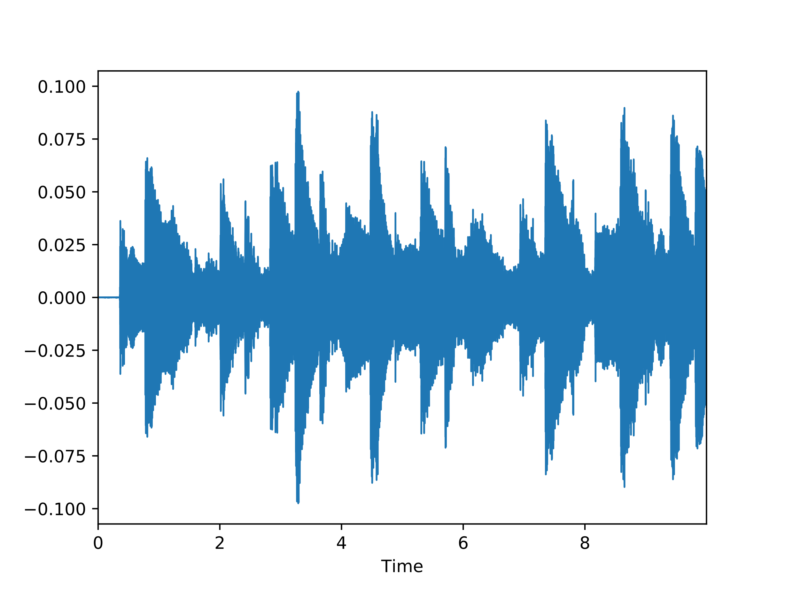








The Chord Attention Layer
This layer includes two calculation processes :
  Chord extract
  Attention calculation
$$p_{\left(u\right)}^{GMF}$$
Chord Extract
$$C_{1}$$
$$p_{1}$$
Chord
Attention
$$C_{2}$$
$$p_{2}$$
...
...
$$p_{n}$$
$$C_{n}$$
Audio
Signal
$${Att}_{out}$$

Slide 9

The Prediction Layer
Integrating the output of the last two layers, this layer uses a multilayer neural network to learn the mapping relationships from various types of features to listening probabilities.
0.1
0.2
0.7
$$GMF_{out}$$
$$\hat{y}$$
0.1
0.5
0.4
$${Att}_{out}$$
MLP

Slide 10
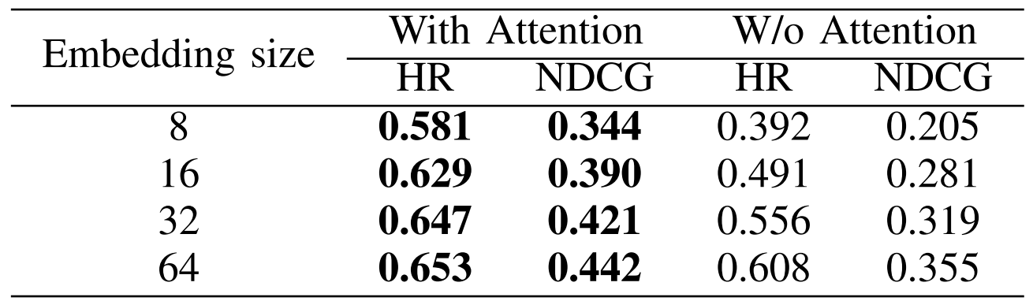
Findings
The model's performance is always better when the attention mechanism is used
indicating that mining users' fine-grained personality preferences can help achieve more accurate recommendations.

Slide 11
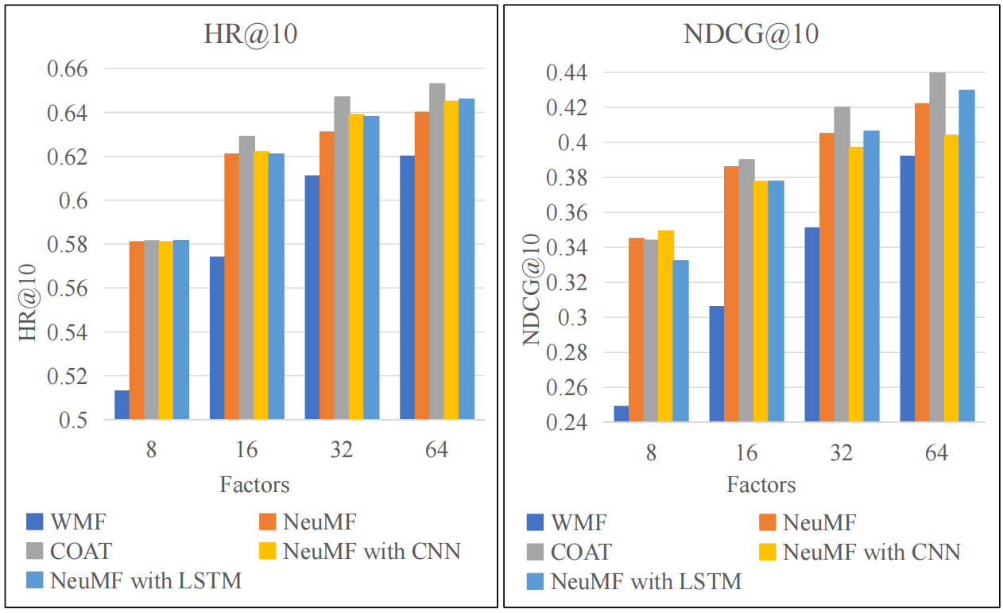
Findings
Compared to related methods that employ audio features as representations of music content, COAT models always perform better
It shows that adopting high-order music features as the representation of music content can help achieve a better recommendation effect

Slide 12
Conclusion
In this paper, we draw out two challenges in the field of music recommendation:
  The representation of music content
  The mining of fine-grained music preferences
We propose the following solutions to address these issue:
  Use high-order music features (chord sequences) instead of low-order audio features as a representation of music content
  Using attention mechanisms to mine users' fine-grained personality preferences for music content as an alternative to CNNs or RNNs
Finally, we propose a music recommendation model based on chord sequence and attention mechanism called COAT.

Slide 13
Thanks for listening!

