Slide 1
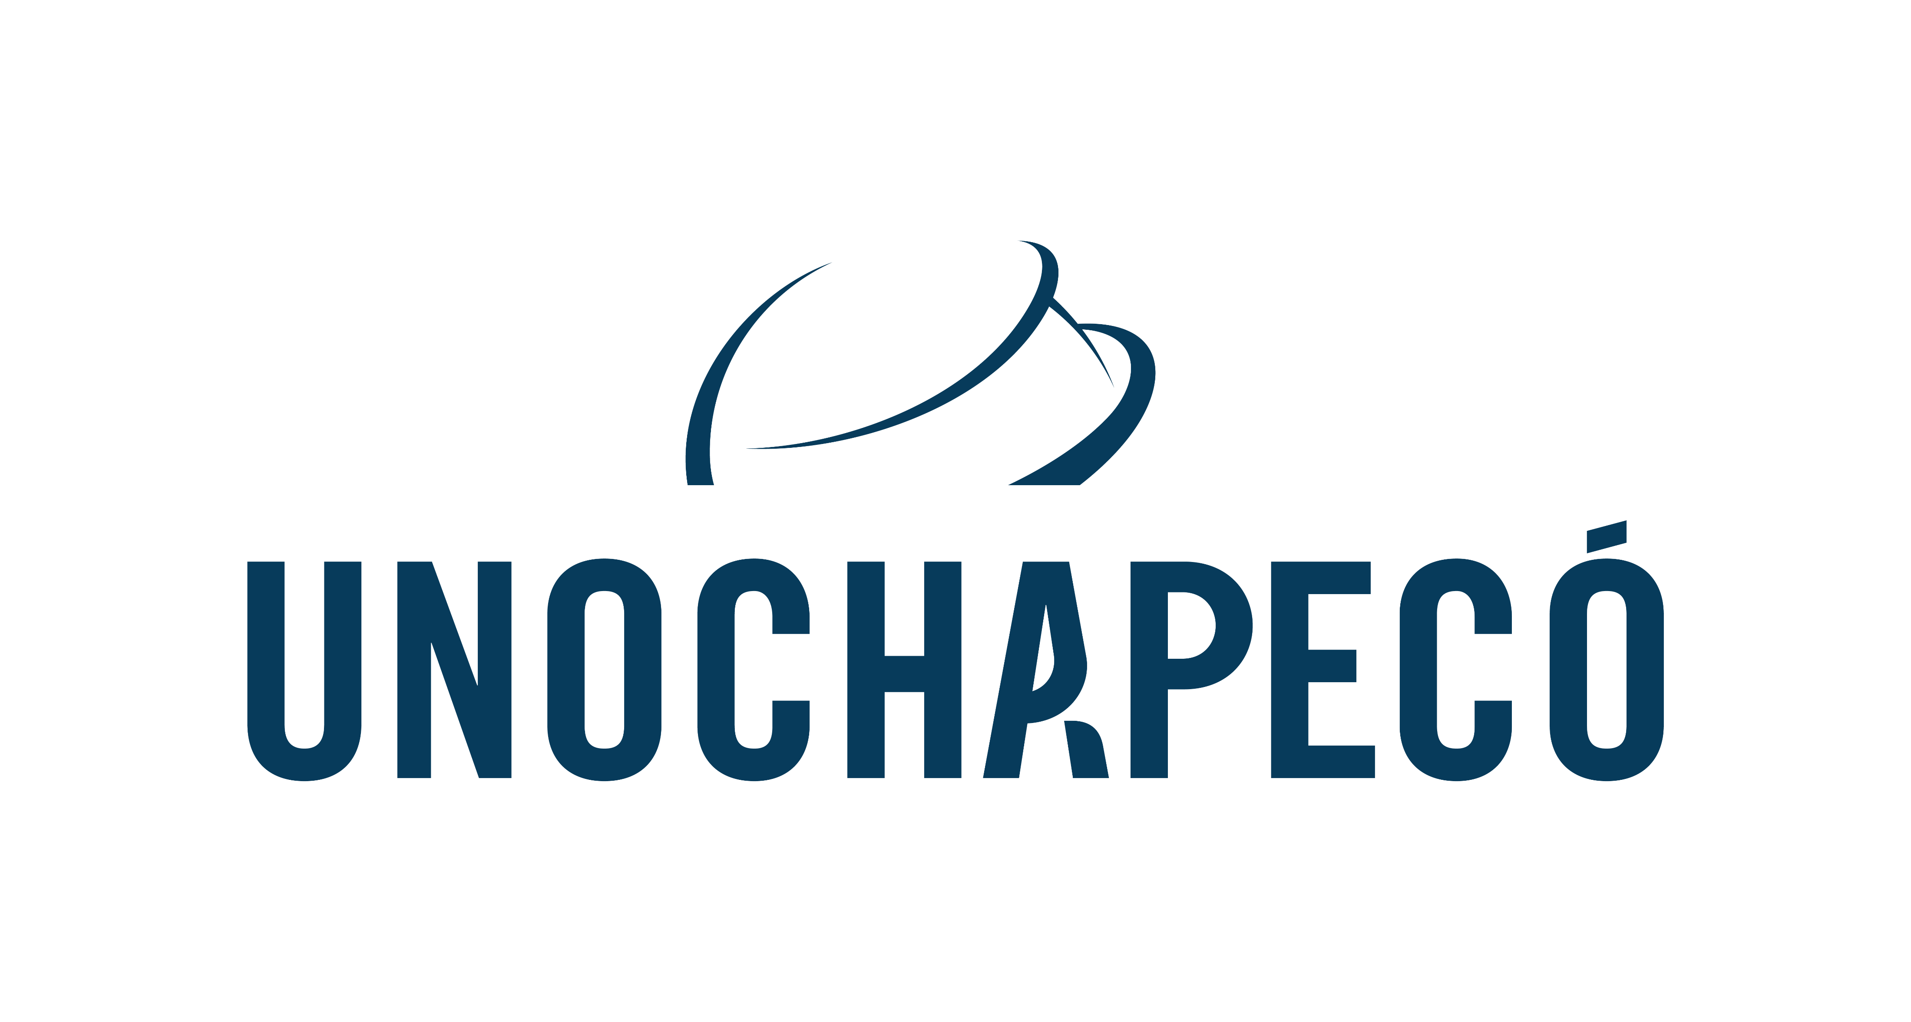

Requirements debt: causes, consequences, and mitigating practices
Viviane Duarte Bonfim¹ and Fabiane Barreto Vavassori Benitti²
July 1, 2022
¹ Escola Politécnica; Department of Informatics and Statistics (INE)
Community University from Chapecó Region (Unochapecó); Federal University of Santa Catarina (UFSC)
viviane.duarte@posgrad.ufsc.br
² Department of Informatics and Statistics (INE)
Federal University of Santa Catarina (UFSC)
fabiane.benitti@ufsc.br

Slide 2
Script
Introduction
Method
Results:Theoretical Model
Conclusions and Future Work
References

Slide 3
INTRODUCTION
In Agile Requirement Engineering the requirements are defined gradually during the interaction between stakeholders and the development team, without the same formalization and, therefore, they are not always properly documented [1] in contrast to what RE recommends [2].
The absence of a good requirements process may cause the RE conduction steps to fail, generating consequences such as misunderstood, omitted, ill-defined, and poorly specified requirements, including technical debts.
When developing requirement engineering activities inadequately, they motivate the emergence of problems that directly affect the development, which can incur requirements debt.
These debts are still poorly understood by organizations, thus hindering the perception of their causes and their consequences complex to prevent and treat them [3].

Slide 4
INTRODUCTION
The requirements debt corresponds to failures in the requirements specification, characterizing the distance between the desired specification of requirements and the actual implementation of these requirements in the system [4].
The aim of the research is to investigate the causes of the generated requirements debt, their consequences, and their mitigation actions.

Slide 5
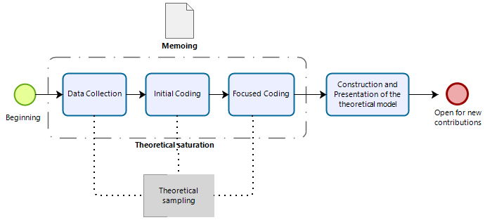
METHOD
Development of this research using a qualitative approach guided by the Grounded Theory (GT) data analysis techniques supported by Charmaz's perspective [5]:
Figure 1. The process carried out during the research

Slide 6
METHOD
Data Collection
  The analyzed data comes from the reports of 19 professionals in 13 agile organizations from 5 different countries (Brazil, France, Portugal, United Arab Emirates, and Belgium).
  The two instruments used for data collection:
    Online interviews semi-structured performed remotely.
    Questionnaire adapted from the interview.
  Data collection and analysis reached theoretical saturation when no new data emerged to add to the study [5].

Slide 7
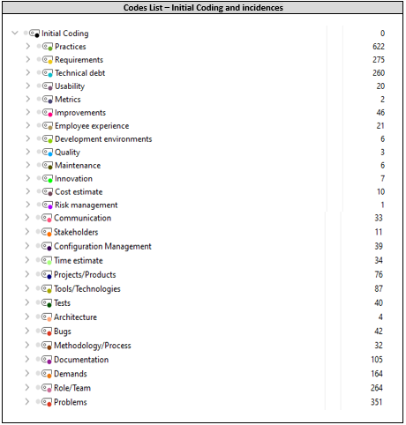
METHOD
Data Analysis: Initial Coding
  Initial coding is the first step of data analysis following the constructivist approach [6].
    Data are carefully examined, with line-by-line or segmental analysis of all transcribed material resulting from data collection [5].
Table 1. Codes list

Slide 8
METHOD
Data Analysis: Focused Coding
  Result the researchers identified the main category of the research, represented by “Factors that impact Requirements Engineering” and its three final categories:
    “Causes that Generate Requirements Debt”;
    “Consequences that Characterize Requirements Debt”;
    “Practices that can reduce and/or prevent requirements debt.”

Slide 9
METHOD
RQ 1. What are the causes of requirements debt found in agile organizations?
Table I1. Causes that generate requirements debt
Category | Subcategories | Evidences
Causes that generate requirements debts | Failure to receive requirements - Requirements debts Elicitation | - Failing to clarify the demand initially received from the customer
 | Failed to refine requirements requisitos_TD_Requirements Analysis | - Requirements absence
 |  | - Delaying the development of some demands or requirements
 | Inconsistency in requirements specification | - Developing without specifying the requirements (generates rework)
 |  | - Requirements specification failure
 | Not validating before development_TD_Validation | - Not validating before developing (it was not as expected)
 | Absence of requirements monitoring TD_Requirements Management | - Having backlog too extensive that are difficult to manage (implicates time)
 |  | - Lack of requirements monitoring/traceability

Slide 10
METHOD
RQ 1.1 What are the consequences of requirements debt?
Table I1I. Consequences that characterize requirements debt
Category | Subcategories | Evidences
Consequences that characterize requirements debts | FR/NF Inconsistency Requirements Analysis_TD | - Requirements inconsistency or absence (FR/NFR)
 | FR/NFR Not met due to a bad specification _TD_RE | - Lack of requirements due to a bad specification
 |  | - Missing features and only realized customer´s feedback post-delivery
 | Requirements not met realized in the delivery_TD_Validation | - Requirements not met and realized post- delivery
 | Not everything that was requested was delivered _TD_Requirements Management | - Not everything is developed due to backlog accumulation/excess over time
 |  | - Not everything that was requested was delivered (lack of requirements traceability)
 |  | - Requirements/demands are dropped due to scope change

Slide 11
METHOD
RQ 2. What practices do agile organizations employ that can minimize requirements debt? (continued in the next slide)
Table IV. Practices that can reduce and/or prevent requirements debt
Category | Subcategories | Evidences
Practices that help reducing and/or prevent requirements debts | Reducing requirements debts | - Assessing impact of TD - usually pays debt in the next sprint
 | Meeting requirements elicitation | - Recording all requirements, demands, and stories in the backlog
 |  | - Building process flow or BDD to understand the demand
 |  | -Performing requirements gathering through multidisciplinary workshops
 | Helping requirements analysis | - Performing the requirements or demands refinement (sprint release)
 |  | - Defining and validating what will be prioritized
 |  | - Performing ceremonies (initials, sprint planning, sprint review)
 |  | - Registering and classifying FR and NFR – using checklist for NFR
 |  | - Following a requirements process

Slide 12
METHOD
RQ 2. What practices do agile organizations employ that can minimize requirements debt?
Table IV. Practices that can reduce and/or prevent requirements debt
Category | Subcategories | Evidences
Practices that help reducing and/or prevent requirements debts | Supporting the implementation of requirements specification | - Keeping and describing the requirements specification document clearly
 |  | - Developing prototypes as part of the requirements specification document
 |  | - Drawing up sequence and use case diagram and database model
 | Implementing requirements validation | -Validating prototypes after requirements specification with customer
 |  | -Performing experimentation, prototypes, MVP or customer’s research
 | Assisting in requirements management | - Managing the requirements, deliveries, backlog delays in progress
 |  | - Performing requirements traceability

Slide 13
RESULTS: Theoretical Model
The results obtained can help companies understand the causes of requirements debt, their effects, and what actions they can take to mitigate such debts.
Theoretical Model
Seven consequences that characterize the emergence of debts
Eight leading causes that generate requirements debt
Sixteen possible practices requirements debt

Slide 14
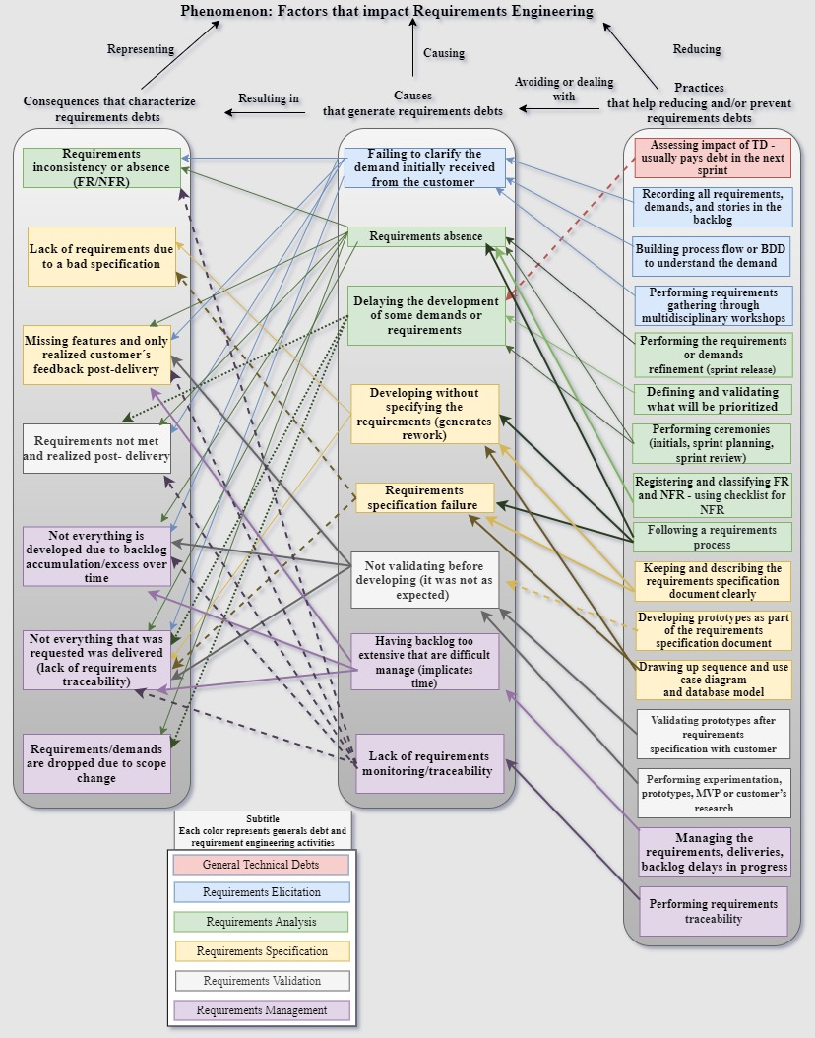
RESULTS: Theoretical Model
Figure 2. Proposed Theoretical Model

Slide 15
CONCLUSIONS AND FUTURE WORK
This study made possible to observe that organizations do not have mechanisms to identify and recognize their requirements debt, and as a consequence.
  The organizations still do not manage such debts, making their mitigation difficult.
The theoretical model demonstrated the relationship between the identified categories and evidence.
  Allowing agile organizations to recognize which causes generate requirements debt and their incurred debts for a better understanding and ways to minimize them by adopting the recommended practices.
Future work:
  Library of practices through a platform suggesting a set of practices that help agile organizations to minimize or mitigate requirements debt, regardless of the adopted process.
  We also mean to provide ways for companies to recognize the causes of requirements debt and their already existing debts to facilitate the implementation of practices.

Slide 16
REFERENCES
[1] E. Bjarnason, K. Wnuk and B. Regnell. “A case study on benefits and side-effects of agile practices in large-scale requirements engineering”. AREW '11: Proceedings of the 1st Workshop on Agile Requirements Engineering, pp. 1-5, July 2011. DOI: https://doi.org/10.1145/2068783.2068786
[2] R. Kasauli, E. Knauss, J. Horkoff, G. Liebel and F. G. O. Neto. “Requirements engineering challenges in large-scale agile system development”. Journal of Systems and Software, vol. 172, February 2021. DOI: https://doi.org/10.1016/j.jss.2020.110851.
[3] W. N. Behutiye, P. Rodríguez, M. Oivo and A. Tosun. “Analyzing the concept of technical debt in the context of agile software development: A systematic literature review”. Information and Software Technology, vol. 82, pp. 139-158, February 2017. DOI: https://doi.org/10.1016/j.infsof.2016.10.004
[4] Y. Guo, R. O. Spínola and C. Seaman. “Exploring the costs of technical debt management – a case study”. Empirical Software Engineering, vol. 21. ed. 1. pp. 159-182, 2016. DOI: 10.1007/s10664-014-9351-7.
[5] K. Charmaz. “Constructing Grounded Theory: A Practical Guide through Qualitative Analysis”. Sage Publications, 2006.
[6] Charmaz. “Constructing Grounded Theory. 2nd., 2014.

Slide 17
Thank you for your attention!
Viviane Duarte Bonfim
viviane.duarte@posgrad.ufsc.br

