Slide 1
Towards Accurate Knowledge Transfer between Transformer-based Models for
Code Summarization
Chaochen Shi ¹, Yong Xiang ², Jiangshan Yu ³, and Longxiang Gao ⁴
^{1, 2} School of Information Technology, Deakin University, Australia
³ Faculty of Information Technology, Monash University, Australia
4 Qilu University of Technology (Shandong Academy of Sciences), China
Email: {shicha, yong.xiang}@deakin.edu.au, j.yu.research@gmail.com, longx.gao@gmail.com

Slide 2
    Transformer-based Code summarization models:
    Wasi Uddin Ahmad, Saikat Chakraborty, Baishakhi Ray, and Kai-Wei Chang. A transformer-based approach for source code summarization. arXiv preprint arXiv:2005.00653, 2020.
    Colin B Clement, Dawn Drain, Jonathan Timcheck, Alexey Svyatkovskiy, and Neel Sundaresan. Pymt5: multi-mode translation of natural language and python code with transformers. arXiv preprint arXiv:2010.03150, 2020.
    Xin Liu and Liutong Xu. A combined model for extractive and abstractive summarization based on transformer model. In SEKE, pages 396–399, 2020.
    Ruyun Wang, Hanwen Zhang, Guoliang Lu, Lei Lyu, and Chen Lyu. Fret: Functional reinforced transformer with bert for code summarization. IEEE Access, 8:135591–135604, 2020.
    …

Slide 3
    Data Shortage:
    For Java and Python, there are already large public datasets such as SIT and CodeSearchNet with millions of records.
    For Solidity, Scala, Rust… THERE ARE NO SUCH CORPUS FOR TRAINING
    Solution:
    Transferring specific knowledge from well-trained code summarization models to less-trained models.

Slide 4
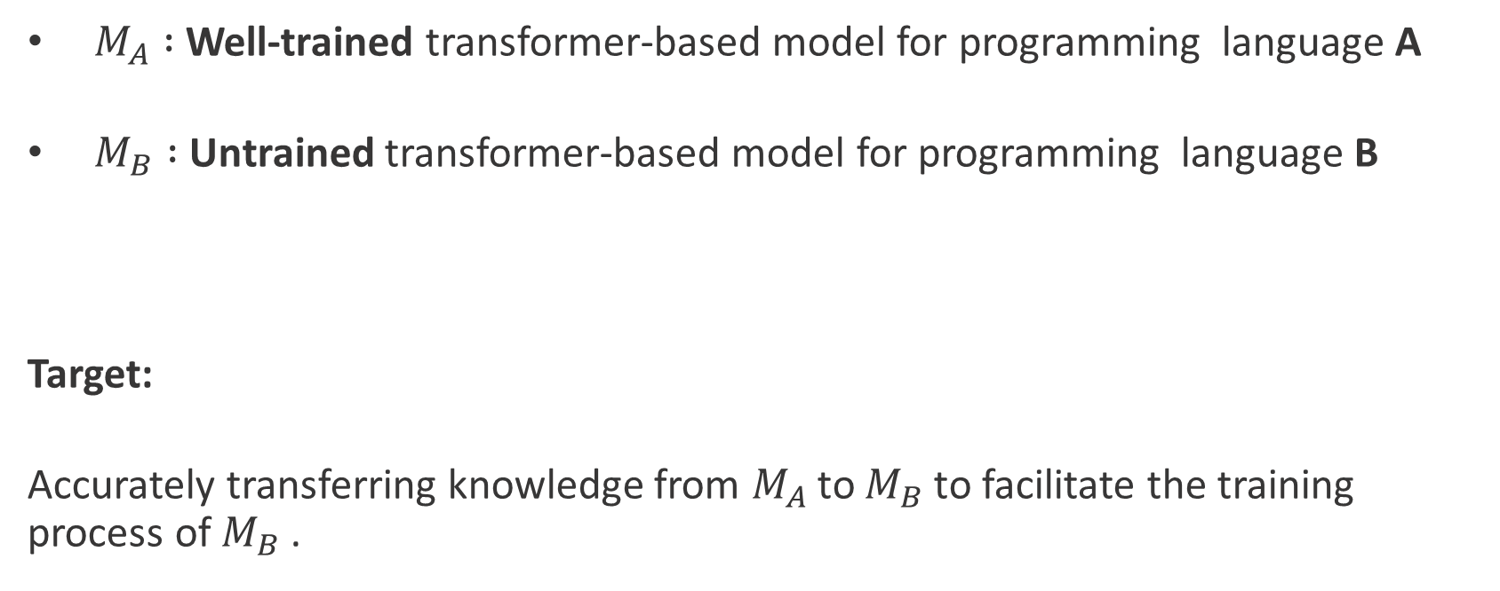
$M_{A} :$Well-trained transformer-based model for programming language A
$M_{B} :$Untrained transformer-based model for programming language B
Target:
Accurately transferring knowledge from $M_{A}$to $M_{B}$to facilitate the training process of $M_{B}$.

Slide 5
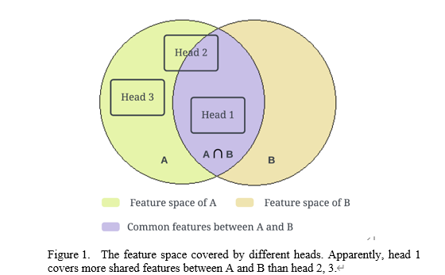
Shared features exist in different programming languages.
Each parallel head pays attention to an individual subspace.

Slide 6
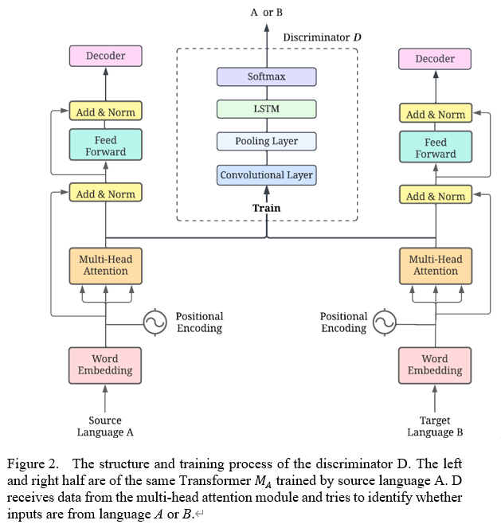
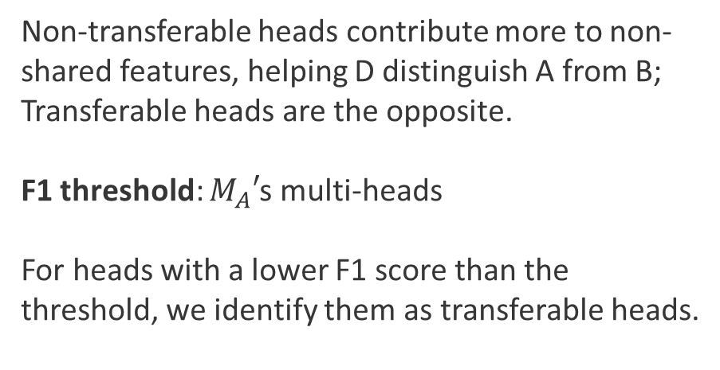
RQ1: How to identify the transferrable heads?
Non-transferable heads contribute more to non-shared features, helping D distinguish A from B; Transferable heads are the opposite.
F1 threshold: $M_{A}′$s multi-heads
For heads with a lower F1 score than the threshold, we identify them as transferable heads.

Slide 7
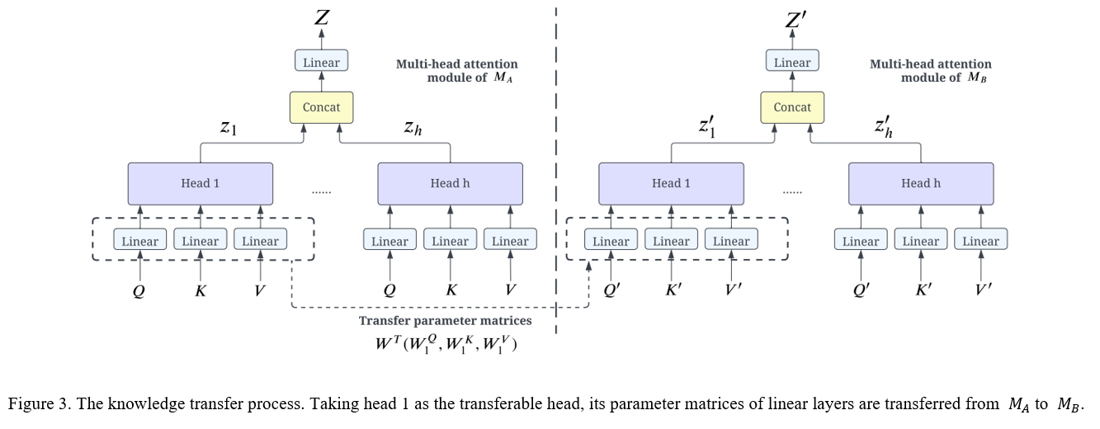
RQ2: How to transfer the selected knowledge between Transformer-based models?

Slide 8
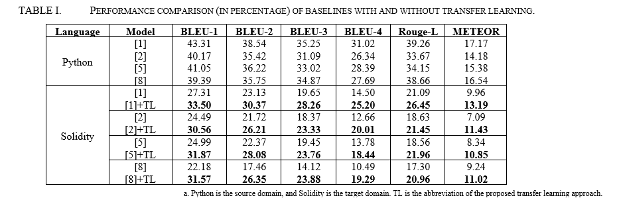
Dataset: 450K Python, 45K Solidity <code, comment> pairs

Slide 9
Thanks!

