Slide 1


Inter- and Intra-Series Embeddings Fusion Network for Epidemiological Forecasting.
The 34th International Conference on Software Engineering & Knowledge Engineering
Feng Xie, Zhong Zhang, Xuechen Zhao, Bin Zhou*, Yusong Tan
National University of Defense Technology, Hunan, China
Department of Computer Science and Technology
xiefeng@nudt.edu.cn

Slide 2
Outline
Background & Motivations
Problem Formulation
Methodology
Experiements
Future Work and Conclusions

Slide 3






Background & Motivations
administrative decision-making
statistic
government
...
epidemic statistic
(e.g., comfirmed case)
allocating health-care resources
virus
human-to-human interaction
hospital
Epidemics spread through human-to-human interaction and circulate worldwide, seriously endangering public health.
The World Health Organization (WHO) estimates that seasonal influenza annually causes approximately 3-5 million severe cases and 290,000-650,000 deaths [1].
In recent years, the COVID-19 pandemic has spread to more than 200 countries and territories around the world [2].
Accurate Epidemiological Forecasting:
  provides opportunities for driving administrative decision-making and timely allocating healthcare resources.
  helps with drug research (i.e., vaccines) which leads to reduce financial burdens and deaths.

Slide 4
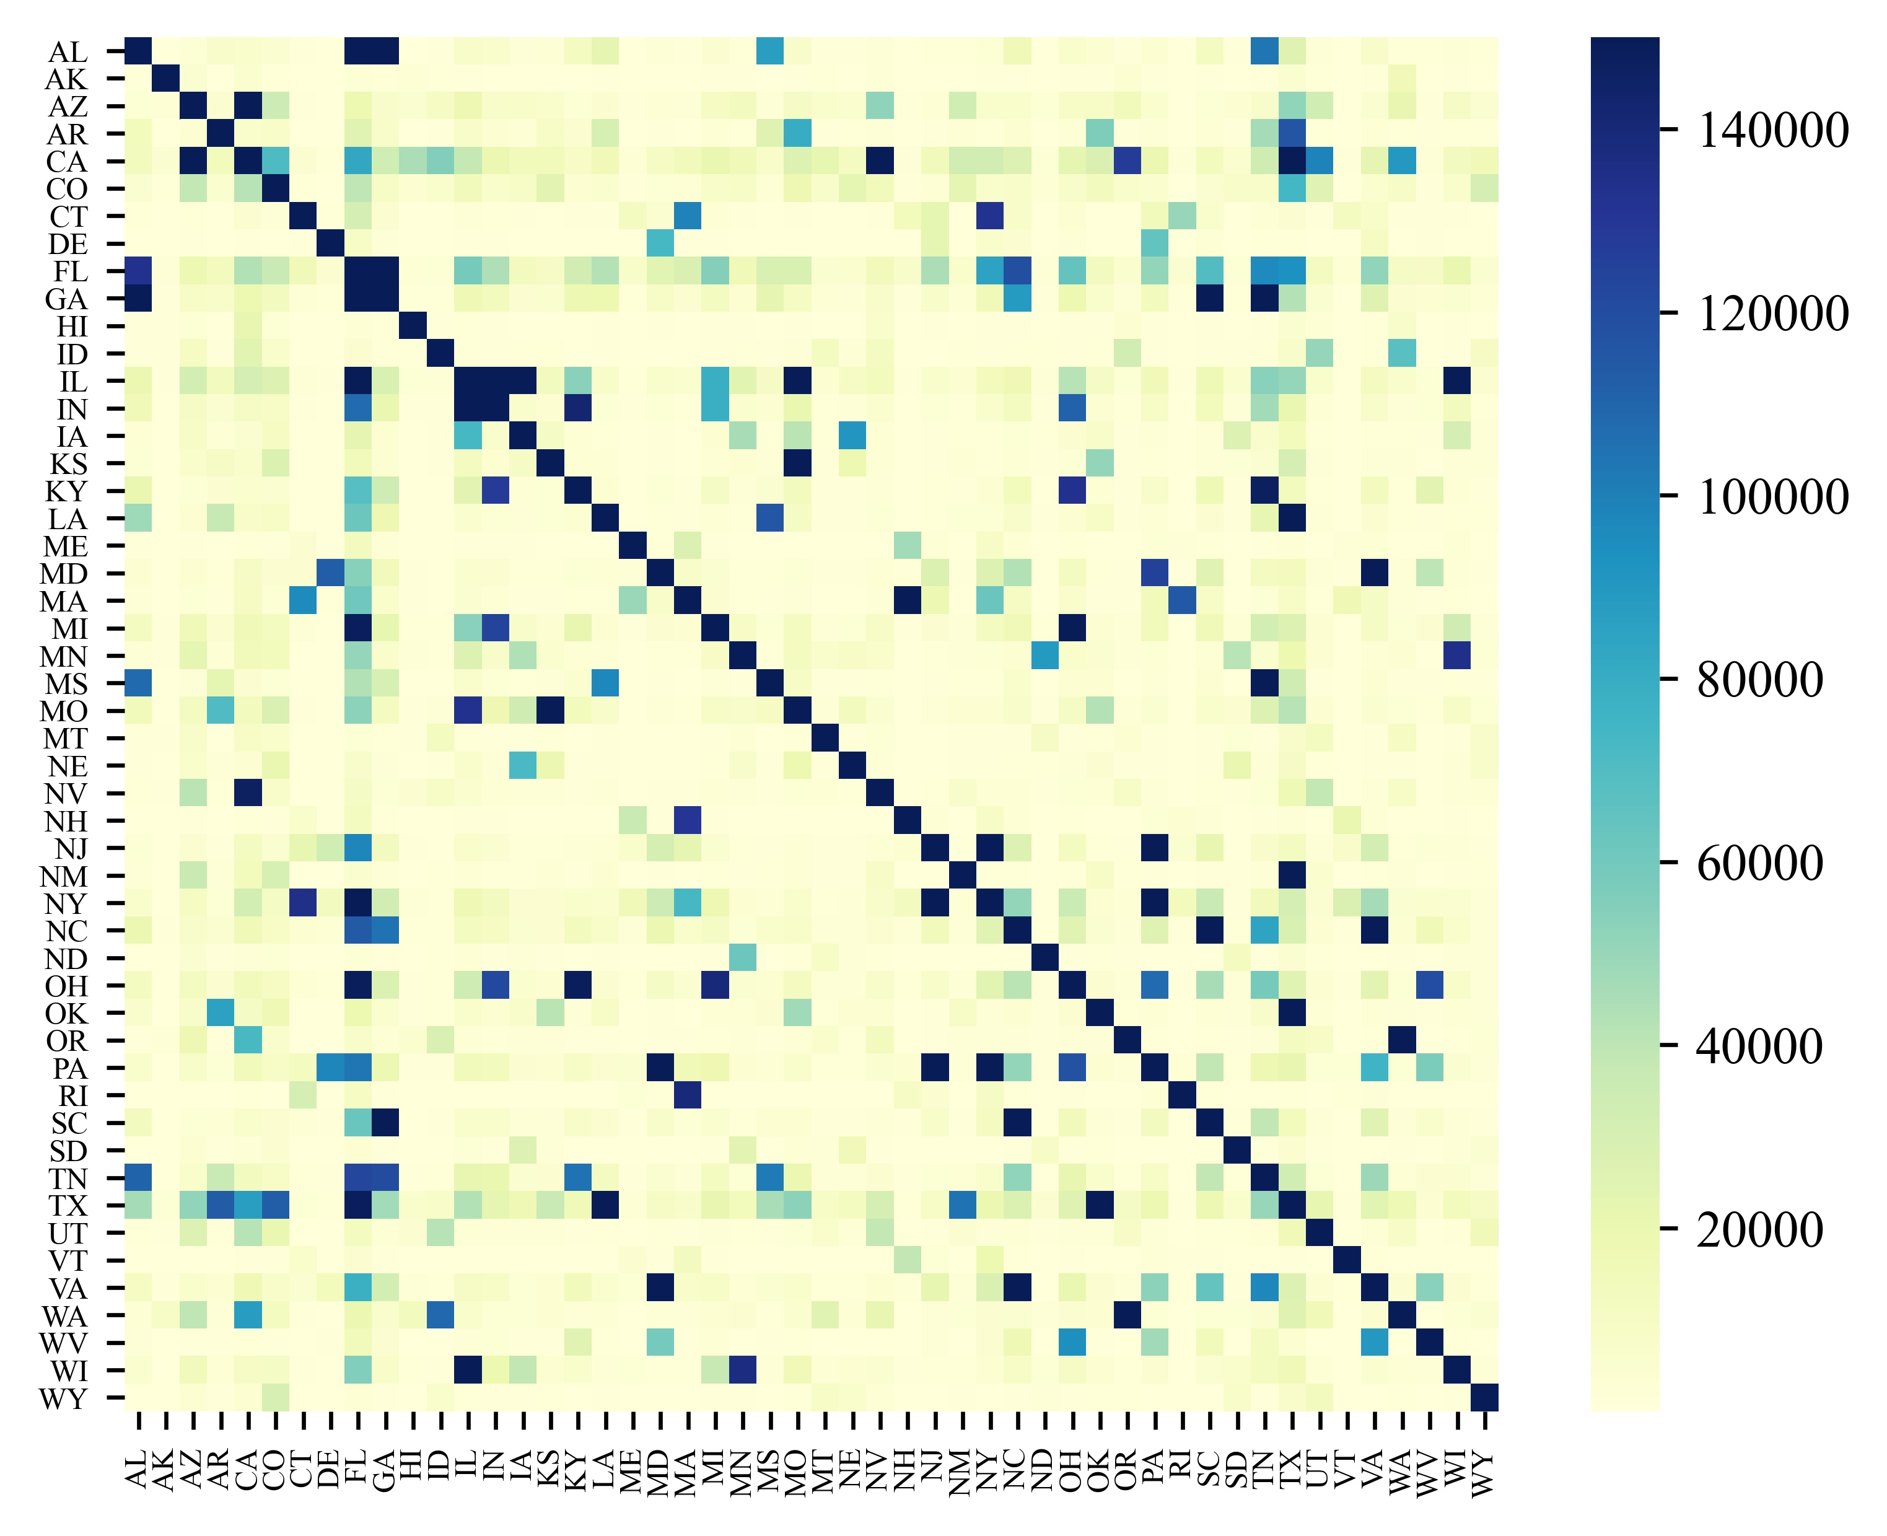
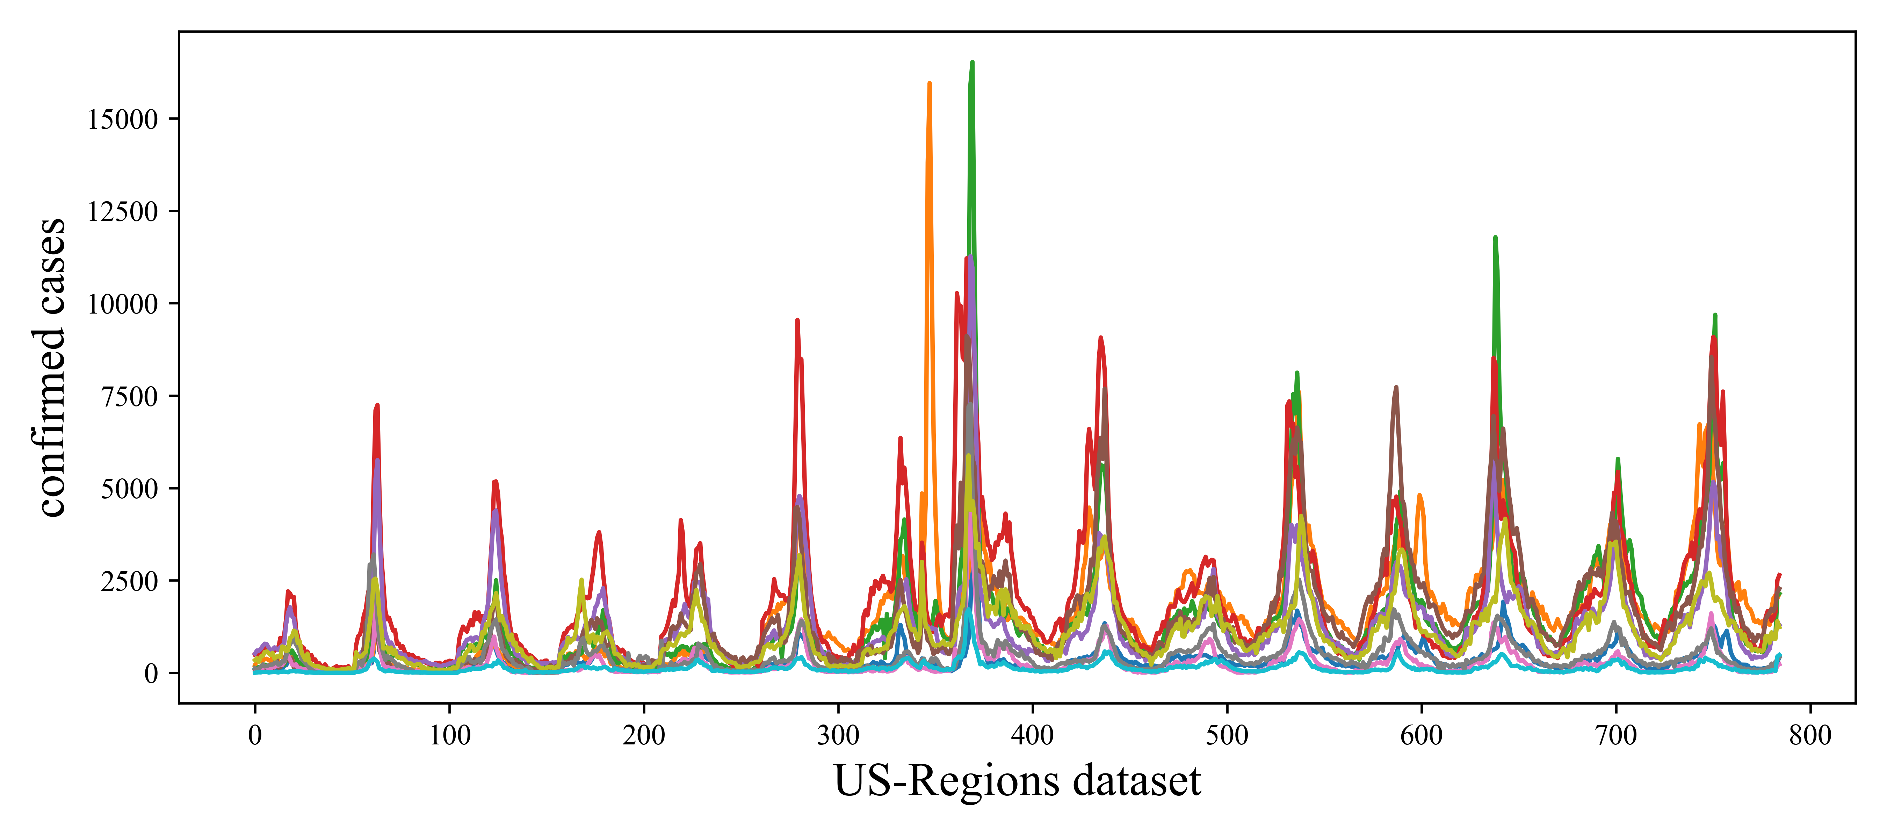
Background & Motivations
Main challenges
The inherent difficulty of long-term forecasting.
Nonlinear temporal dependencies (e.g., seasonal influenza), as shown in Figure 1.
dynamic inter-dependencies between regions (e.g., human mobility in Figure 2).
Exsiting Methods
Statistic Methods: AR, ARIMA, SARIMA.
Compartment Methods: SIR, SEIR, SEUIR.
Deep Learning-based Methods [3,4,5,6,7].
Figure 2. The overall of human mobility flow between different states within Covid-19 period in US.
Figure 1. The overall of the flu statistic of US HHS regions.

Slide 5
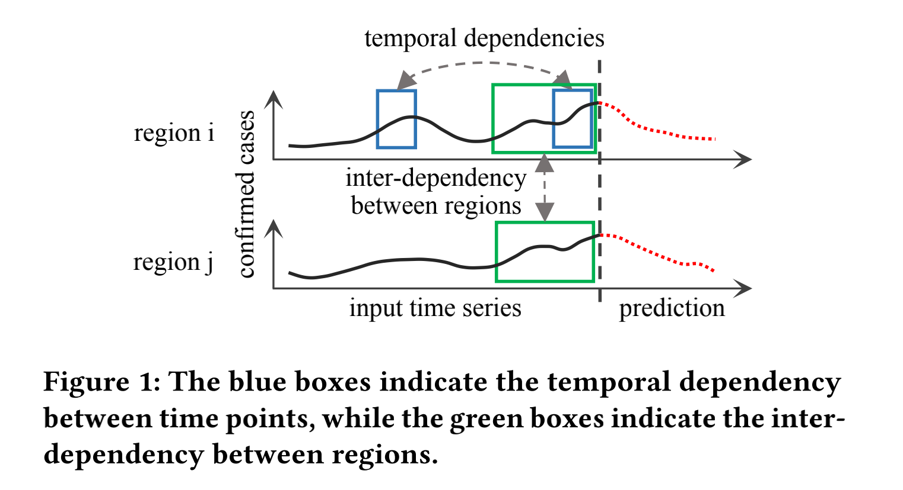
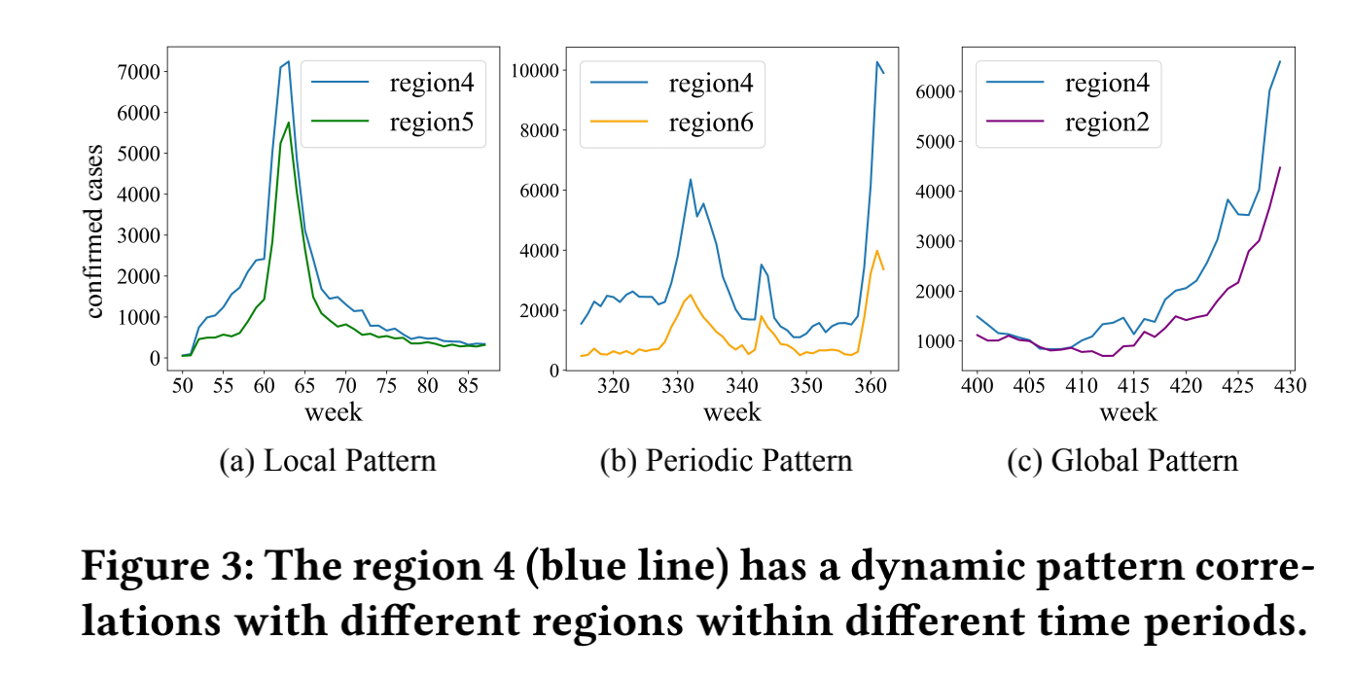
Background & Motivations
The epidemic situation of a region at a certain time step is correlated with both its previous values and other regions' epidemic situation. (Figure 1)
Intra-Series Embedding: Nonlinear temporal dependencies
Inter-Series Embedding: Dynamic inter-dependencies between regions
inconsistent scale (data distribution)
&
different importance on prediction
Epidemics have the characteristics of suddenness, periodicity, and persistence.
Local
pattern
Figure 3(a)
Peridoic
pattern
Figure 3(b)
Global
pattern
Figure 3(c)

Slide 6
Background & Motivations
The epidemic situation of a region at a certain time step is correlated with both its previous values and other regions' epidemic situation. (Figure 1)
Intra-Series Embedding: Nonlinear temporal dependencies
Inter-Series Embedding: Dynamic inter-dependencies between regions
Core Insights:
Inconsistent scale and different importance of Inter- and Intra-Series information.
Dynamic inter-dependencies between regions.

Slide 7
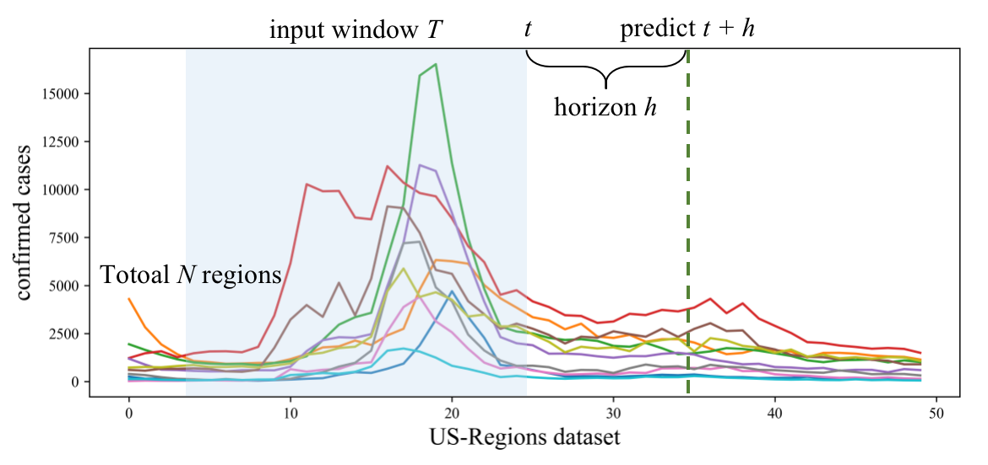
Problem Formulation (Fig.1)
N regions. We have a total of N regions (i.e., states or cities). Each region is associated with a time series for a window T.
Input. Epidemic statistic with a look-back window T at time point t.
Goal. The goal of this task is to predict the epidemic statistic of the future time point t + h.
Figure 1. The illustration of problem formulation.

Slide 8
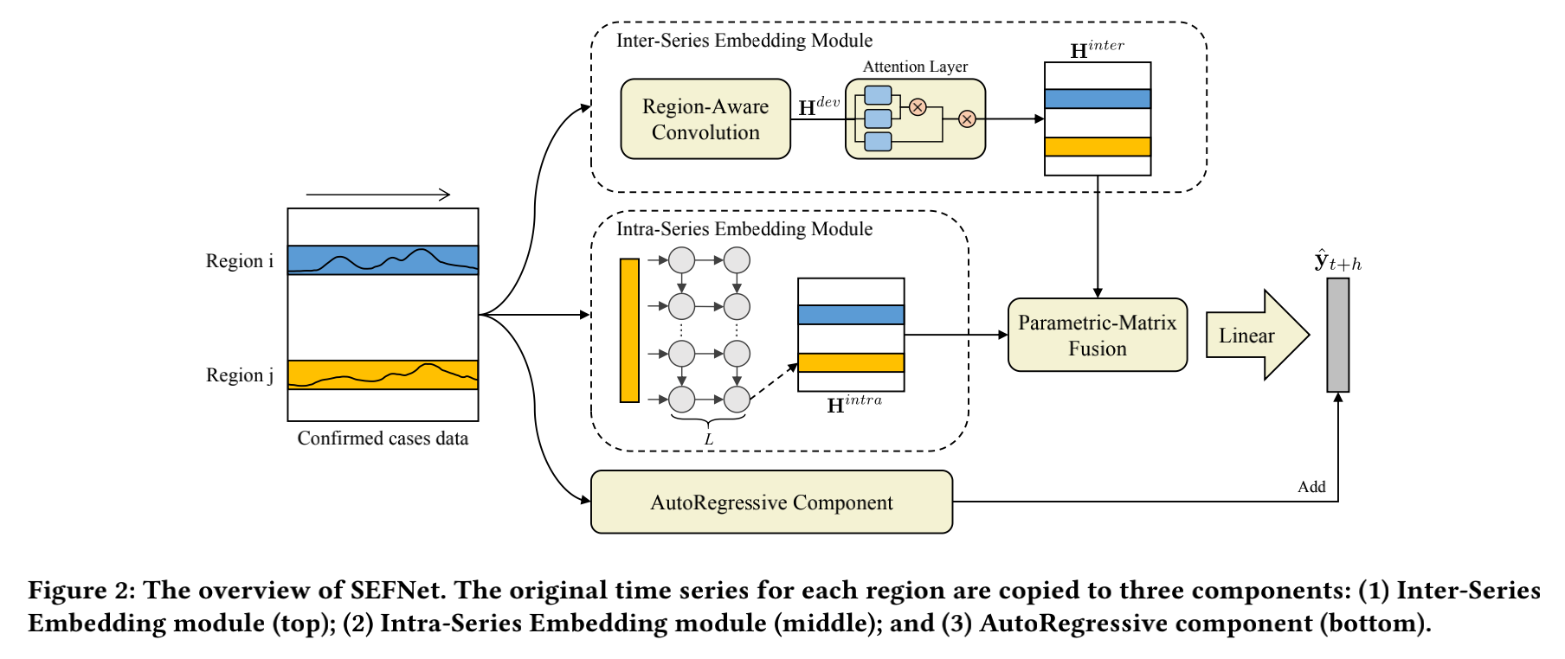
Methodology
Overall
We propose a new model called SEFNet that extracts inter-series correlations and intra-series temporal dependencies through two separate neural networks and uses parametric-matrix fusion to emphasize the importance of each information for epidemic prediction. => deal with the Core Insights 1.
We propose a multi-scale unified convolution component called Region-Aware Convolution that is capable of extracting local, periodic, and global patterns to better obtain feature representation and capture potential dependencies between regions. => deal with the Core Insights 2.

Slide 9
Methodology
Inter-Series Embedding Module
We capture the dynamic inter-dependencies between different regions based on their multi-scale temporal features. In this module, we proposed a multi-scale unified Region-Aware Convolution (RAConv) which cooperates with self-attention to encode the multi-scale features.

Slide 10
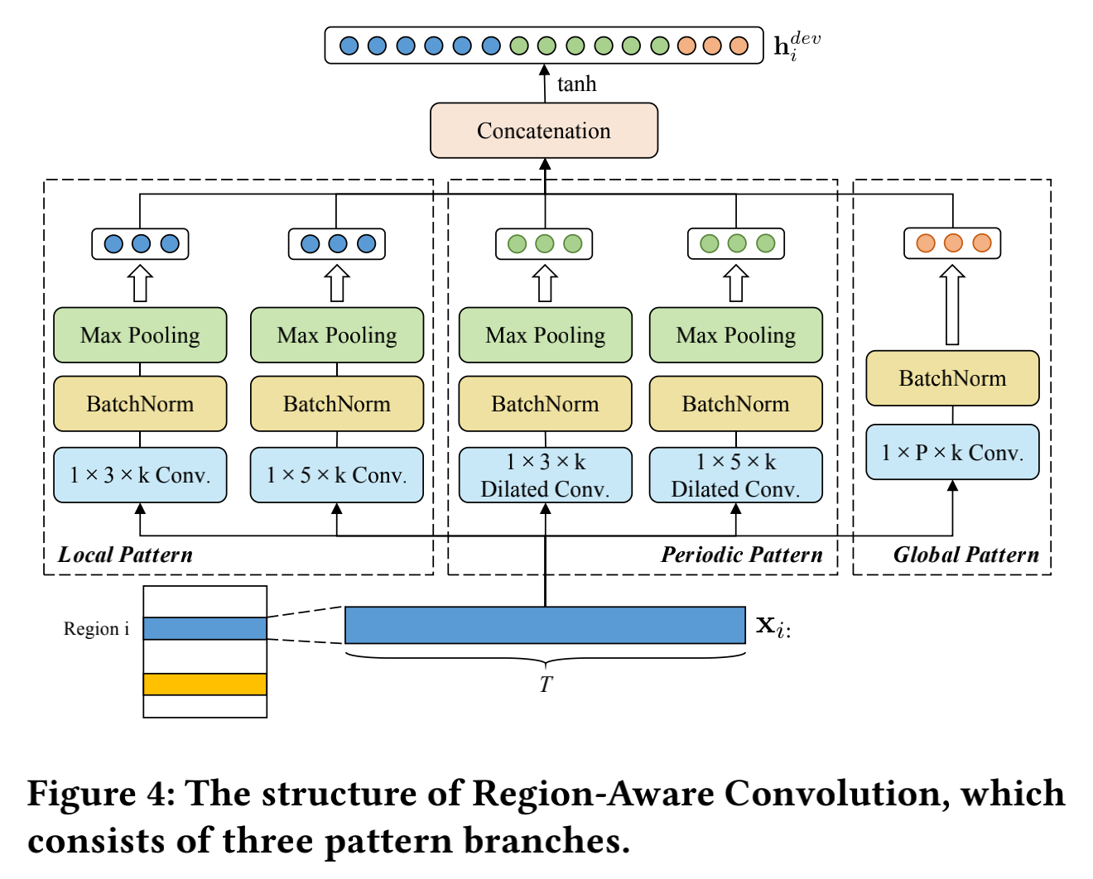




Methodology
Inter-Series Embedding Module
Epidemics have the characteristics of suddenness, periodicity, and persistence.
It is highly likely that similar progression patterns are shared among multiple regions owing to various factors (such as local patterns, periodic, patterns, and global patterns, as shown in Figure 3).
step 1: apply multi-scale convolution to extract multiple patterns.
Inception [12]
step 2: concatenate multiple features and adopt an activation function.
step 3: adopt self-attention to capture dynamic correlations.

Slide 11
Methodology
Intra-Series Embedding Module
We focus on extracting the nonlinear temporal dependencies of a single time series. In this module, we directly use the Long Short-Term Memory network [8]:

Slide 12
Methodology
Fusion
Directly concatenating or summing inter-series embedding and intra-series embedding will have the following problems:
Inconsistent scale.
Different importance.
Therefore, we adopt the Parametric-matrix Fusion [9] to adaptively control the flow of two information.

Slide 13

Methodology
Prediction
Linear Part. Some works have incorporated a linear part to deal with the sensitivity to input and purely nonlinear modeling [10,11].
Nonlinear Part. Neural networks are dedicated to handling the nonlinear characteristics of raw time series.
The final prediction of SEFNet is obtained by summing the nonlinear part and the linear part got by an AutoRegressive component.

Slide 14
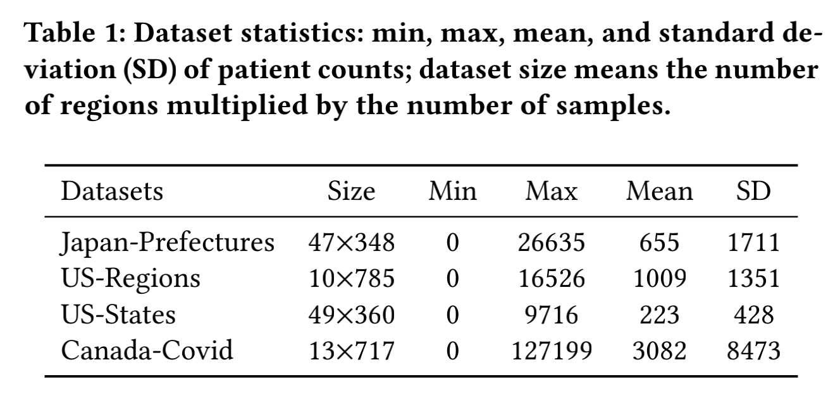
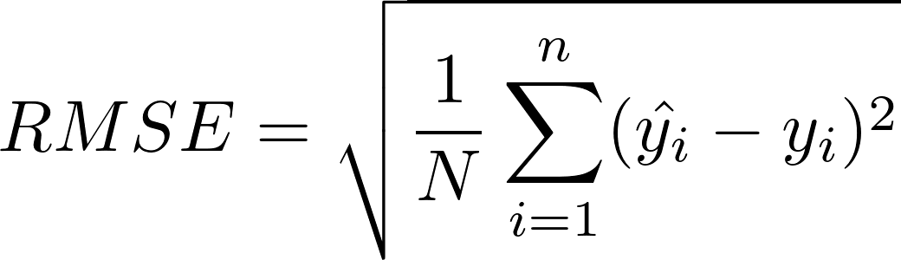
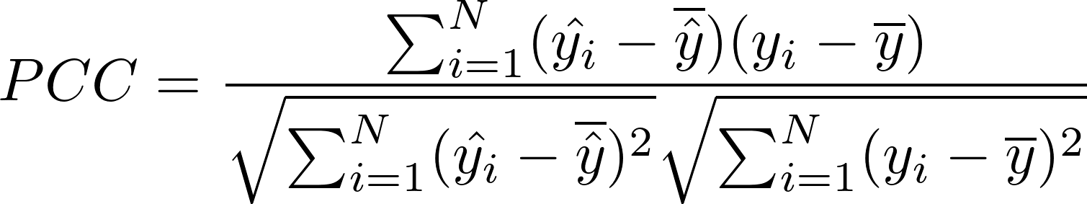
Experimental Settings
01
02
Datasets
Baselines
We prepare four real-world epidemic-related datasets as follows, and their data statistics are shown in Table 1.
Japan-Prefectures
US-Regions
US-States
Canada-Covid
We compared the proposed model with the following methods.
Statistic models: AR, LRidge.
Deep Learning-based models:
  LSTNet [SIGIR2018] [10]
  TPA-LSTM [ECMLPKDD2019] [11]
  CNNRNN-Res [SIGIR2018] [5]
  SAIFlu-Net [JBHI2021] [6]
  Cola-GNN [CIKM2020] [7]
03
Metrics
RMSE
PCC

Slide 15
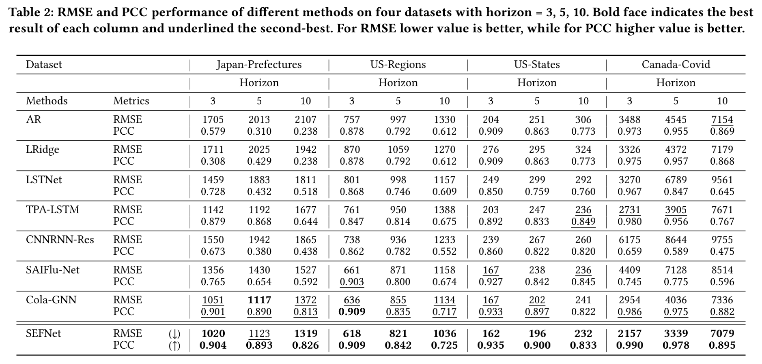
Experimental Results
We evaluate our model in short-term (horizon = 3) and long term (ho-rizon = 5,10) settings.
Our method (SEFNet) achieves the most stable and optimal perform-ance on all datasets.

Slide 16
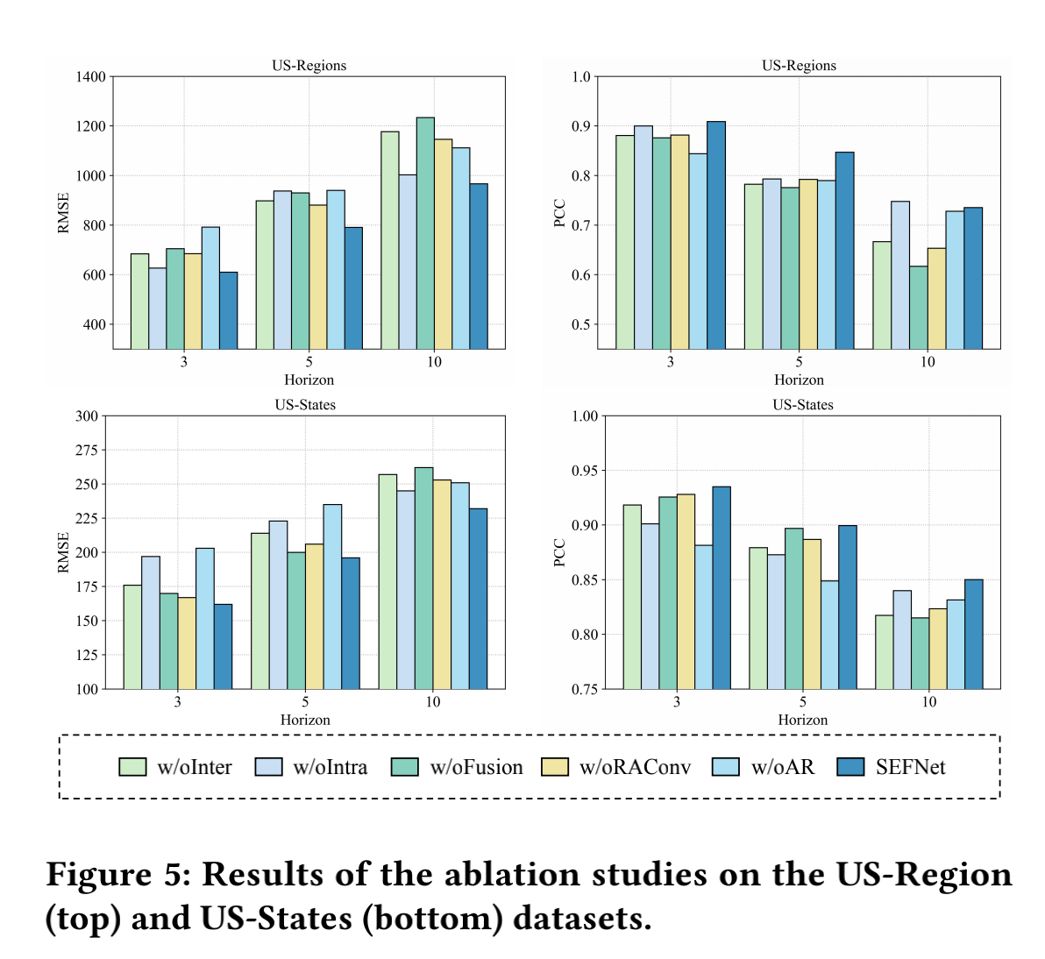
Experimental Results
We highlight several observations:
The full SEFNet model achieves almost the best results.
Both Inter-Series information and Intra-Series information contribute to the final prediction.
Compared with w/oRAConv which applies only single-scale convolutions, RAConv will bring performance gain.
The AutoRegressive part will improve the robustness to the prediction stage.

Slide 17
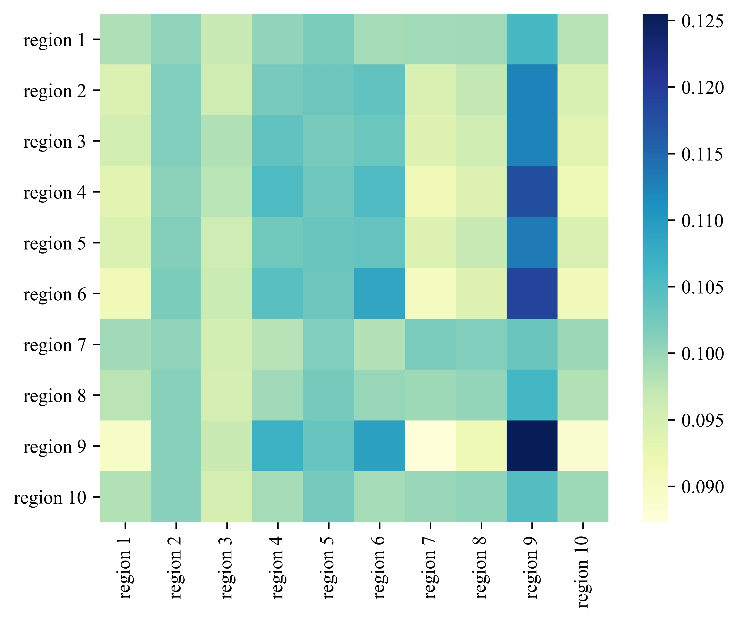
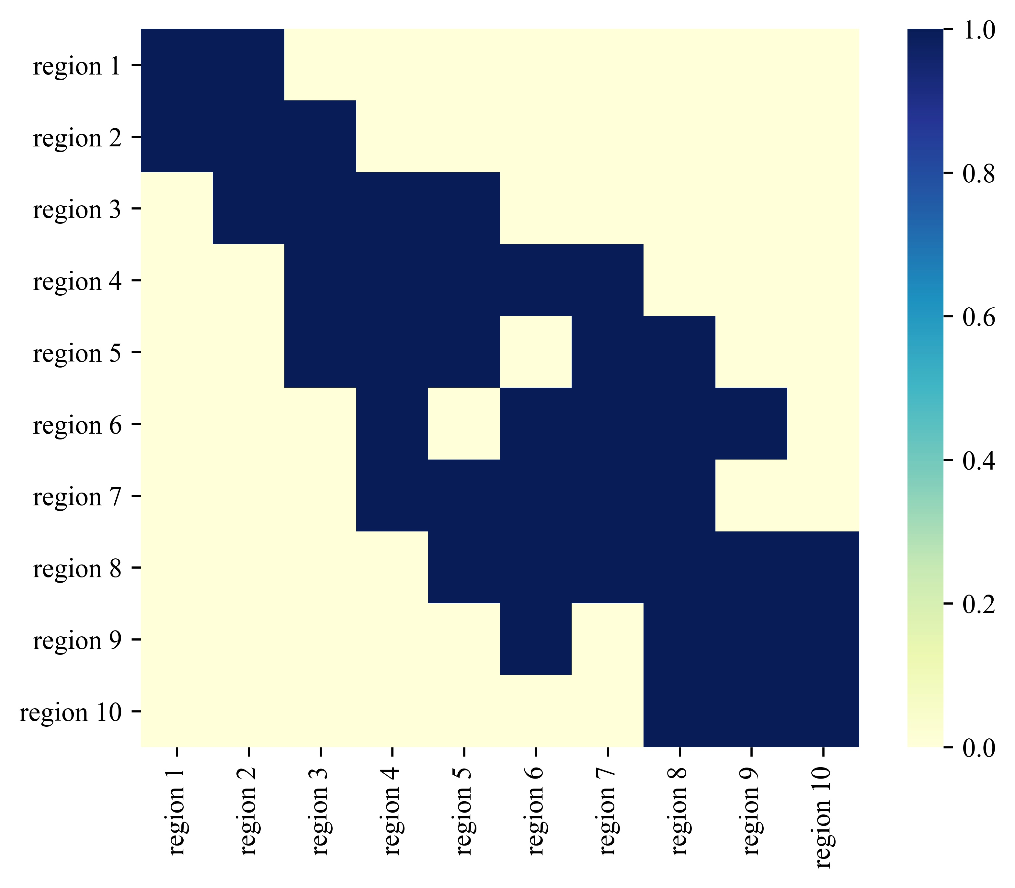
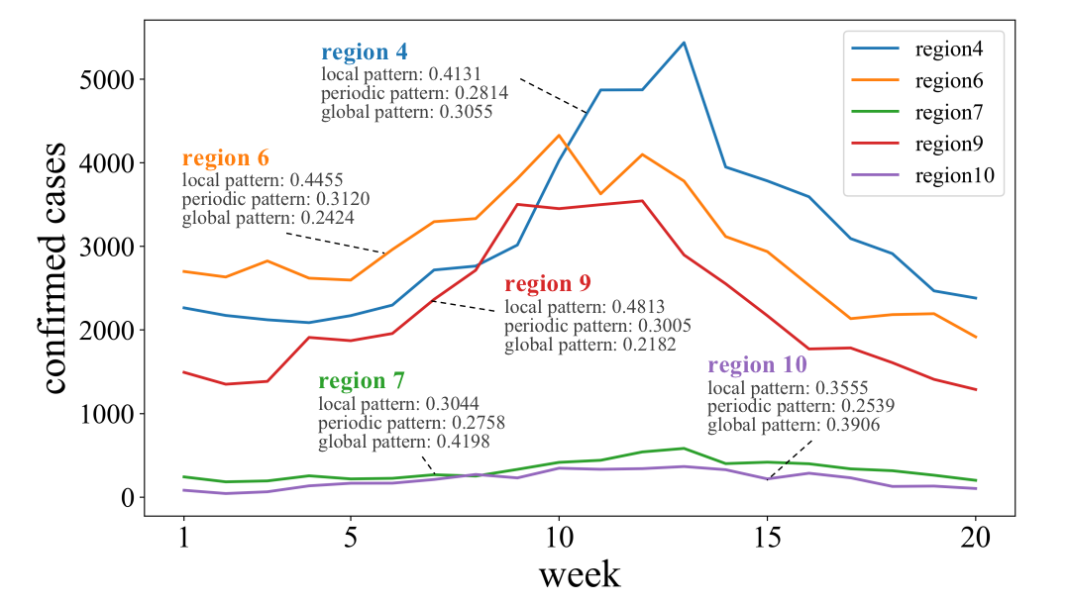
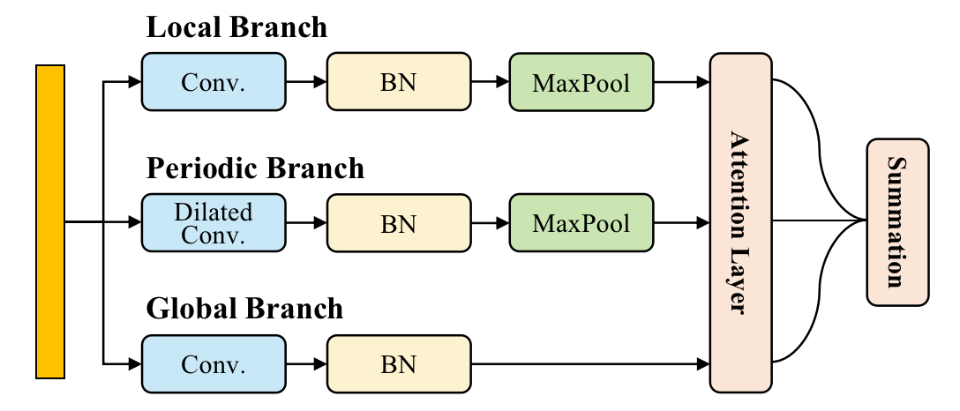
Futher Designing
The original RAConv has some further considerations and improvements:
Efficiency.
Interpretability.
We design an improved RAConv (Fig.1) which applies the attentive mechanism to capture the major temporal patterns behind time series.
Figure 2. Obtained attention matrix
Figure 3. Adjacent matrix
Figure 1. The improved RAConv
Figure 4. The visualization of attentive mechanism

Slide 18
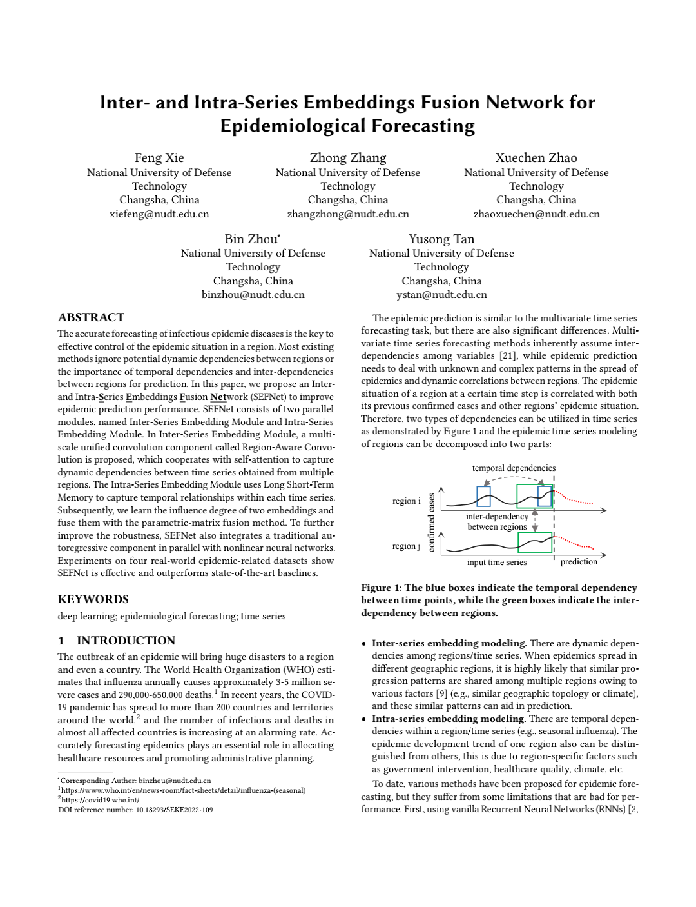
Conclusions
In this paper, we propose an Inter- and Intra-Series Embeddings Fusion Network (SEFNet) for epidemic forecasting.
Experiments on four real-world epidemic-related datasets show the proposed model outperforms the state-of-the-art baselines in terms of performance and stability.
In future work, we plan to delve into the dynamic dependencies and mutual influences among regions.
paper: http://ksiresearch.org/seke/seke22paper/paper109.pdf

Slide 19
References
[1] https://www.who.int/en/news-room/fact-sheets/detail/influenza-(seasonal)
[2] https://covid19.who.int/
[3] Yue Cui, Chen Zhu, Guanyu Ye, Ziwei Wang, and Kai Zheng. 2021. Into the Unob_x0002_servables: A Multi-range Encoder-decoder Framework for COVID-19 Prediction. In Proc. of CIKM.
[4] Xiaoyong Jin, Yu-Xiang Wang, and Xifeng Yan. 2021. Inter-series attention model for covid-19 forecasting. In Proc. of SDM.
[5] Yuexin Wu, Yiming Yang, Hiroshi Nishiura, and Masaya Saitoh. 2018. Deep learning for epidemiological predictions. In Proc. of SIGIR.
[6] Songgaojun Deng, Shusen Wang, Huzefa Rangwala, Lijing Wang, and Yue Ning. 2020. Cola-gnn: Cross-location attention based graph neural networks for long_x0002_term ili prediction. In Proc. of CIKM.
[7] Seungwon Jung, Jaeuk Moon, Sungwoo Park, and Eenjun Hwang. 2021. Self_x0002_attention-based Deep Learning Network for Regional Influenza Forecasting. IEEE Journal of Biomedical and Health Informatics (2021).
[8] Sepp Hochreiter and Jürgen Schmidhuber. 1997. Long short-term memory. Neural computation (1997).
[9] Junbo Zhang, Yu Zheng, and Dekang Qi. 2017. Deep spatio-temporal residual networks for citywide crowd flows prediction. In Proc. of AAAI.
[10] Guokun Lai, Wei-Cheng Chang, Yiming Yang, and Hanxiao Liu. 2018. Modeling long-and short-term temporal patterns with deep neural networks. In Proc. of SIGIR.
[11] Shun-Yao Shih, Fan-Keng Sun, and Hung-yi Lee. 2019. Temporal pattern attention for multivariate time series forecasting. Machine Learning (2019).
[12] Christian Szegedy, Wei Liu, Yangqing Jia, Pierre Sermanet, Scott Reed, Dragomir Anguelov, Dumitru Erhan, Vincent Vanhoucke, and Andrew Rabinovich. 2015. Going deeper with convolutions. In Proc. of CVPR.

Slide 20
Thanks for your attention!
For more information, please refer to our paper or source codes:
paper: http://ksiresearch.org/seke/seke22paper/paper109.pdf
source codes: https://github.com/Xiefeng69/SEFNet
homepage: https://xiefeng69.github.io/
ACKNOWLEDGMENTS: This work is supported by the Key R&D Program of Guangdong Province No.2019B010136003 and the National Natural Science Foundation of China No. 62172428, 61732004, 61732022.

