Slide 1


Deep Correlation based Concept Recommendation for MOOCs
Shengyu Mao

Slide 2

Motivation & Background
MOOC has been widely popular among students，but the completion rate of the courses is less than 5%;
Traditional course recommendation may result in offering the course learners are not interested in;
Need to locate learners’ interests in a more fine-grained way : concept recommendation
Computer Vision Course
Related to Graphics
Related to Deep learning

Slide 3
Motivation & Background
Collaborative Filtering based Methods
Meta-path based Methods
Existing common recommending problems like cold start
Data in MOOCs can be more sparse
Cannot process the multi-entity data in MOOCs
Obtain the multi-entity information in MOOCs
The pre-defined meta-paths are independent
Lack of the useful information between different meta-path
Need to deeply extract the correlation among meta-paths

Slide 4
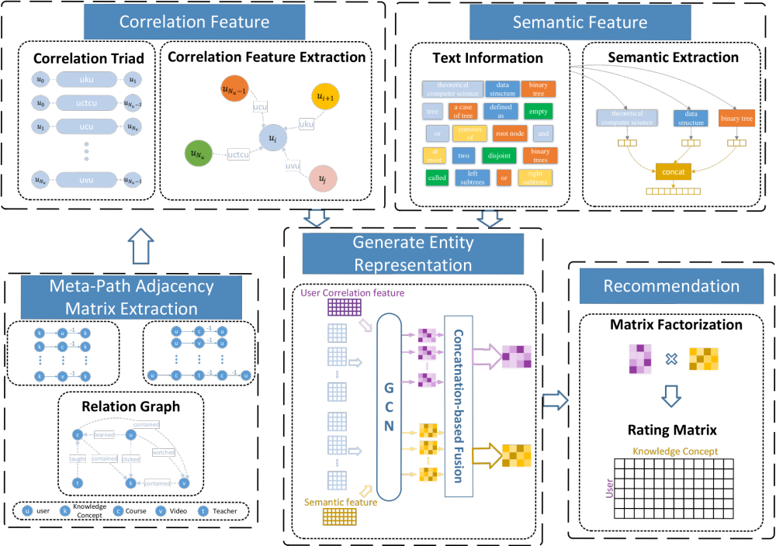
Proposed method-DCCR
Utilizing the interact history in moocs like watching videos, learning courses to generate a correlation feature of users.
Extracting the text context of concepts, like definition, description, classification to generate a semantic feature of concepts.
Generating the final representation of users and concepts by considering the two features above, and generating the final recommendation list by an extended matrix factorization methods
PPT下载 http://www.1ppt.com/xiazai/

Slide 5
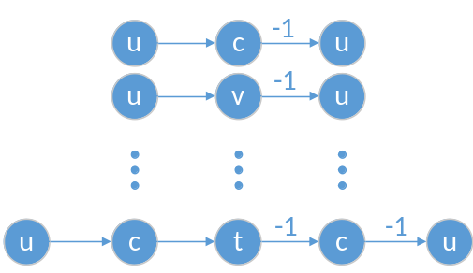
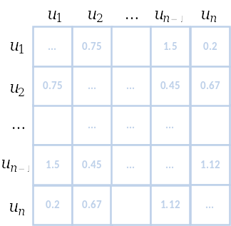
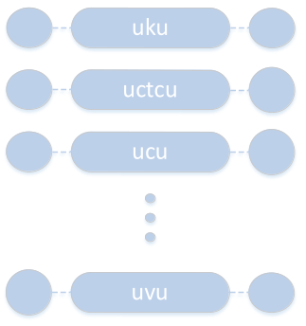
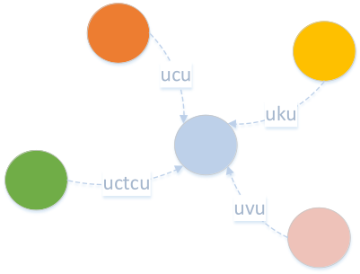
Correlation Feature Extraction
A meta-path like u-c-u, means two users have learnt a same course
Through meta-path, we can generate the adjacency matrices. The specific value means how strongly the two users are related
Set a threshold z, we collect the items whose values are over z, and construct a triple set
Then we applied a multi-graph embedding method to generate user’s correlation feature

Slide 6
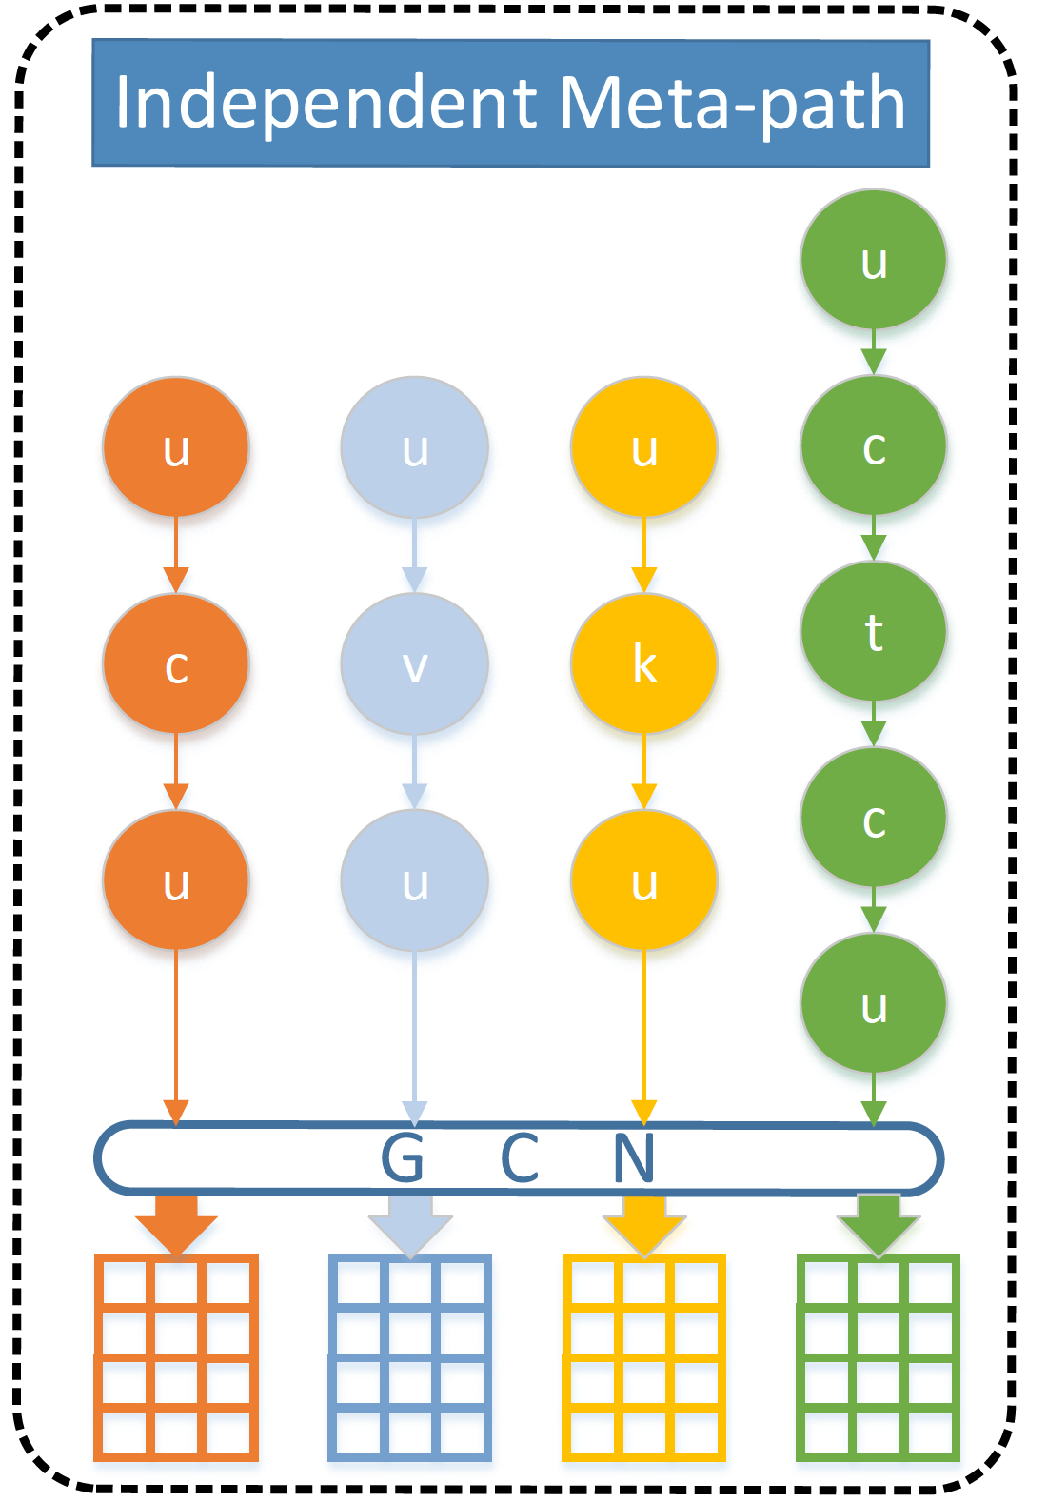
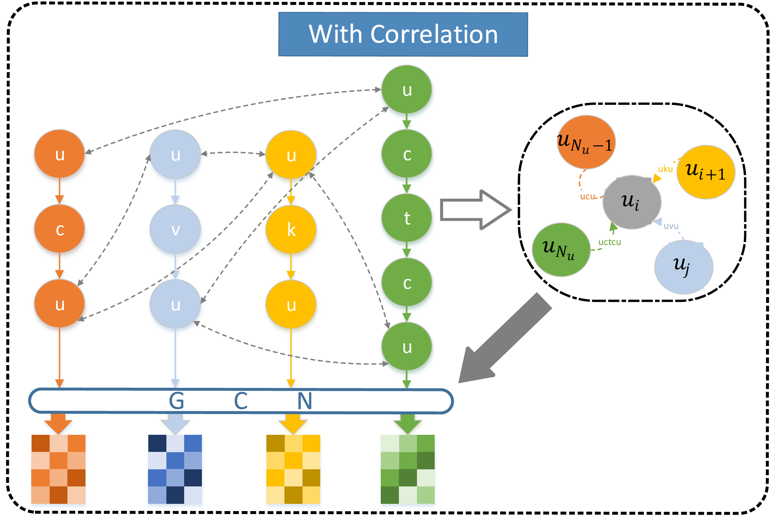
Correlation Feature Extraction
Common Method
Proposed Method
Meta-path are independent
Lack of correlation
Obtain the abundant correlation between different meta-paths

Slide 7
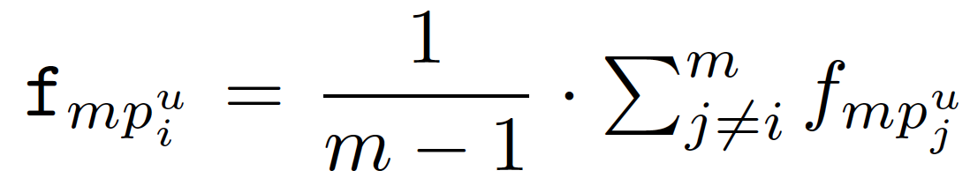
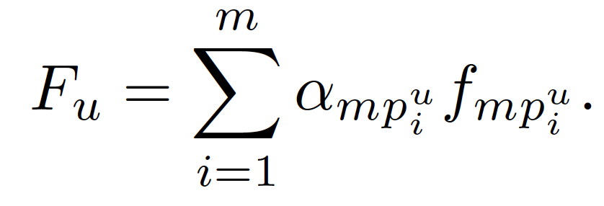
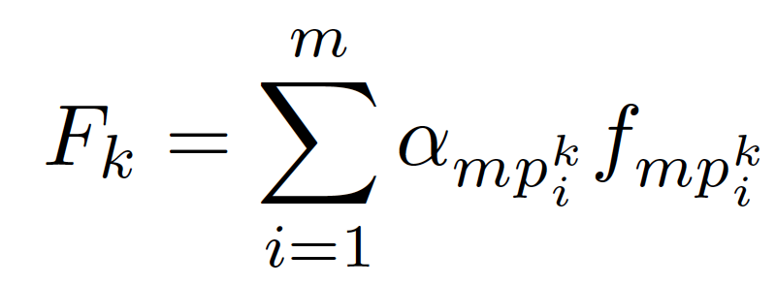
Concatenation-based Fusion
Common Fusion Method
Proposed Concatenation-based Fusion
Average Fusion
Location-based, only considering the item itself when computing the fusion weights
Considering both the current meta-path and the others when computing the fusion weight
Concentrating the second item by fusion with a scale parameter p
Get the more reasonable users and concepts final representation

Slide 8
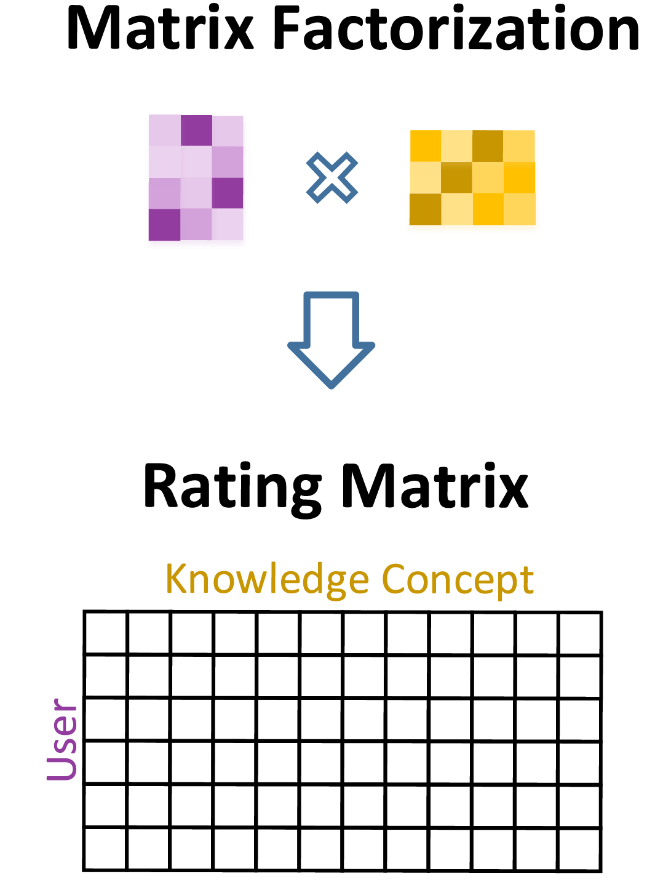
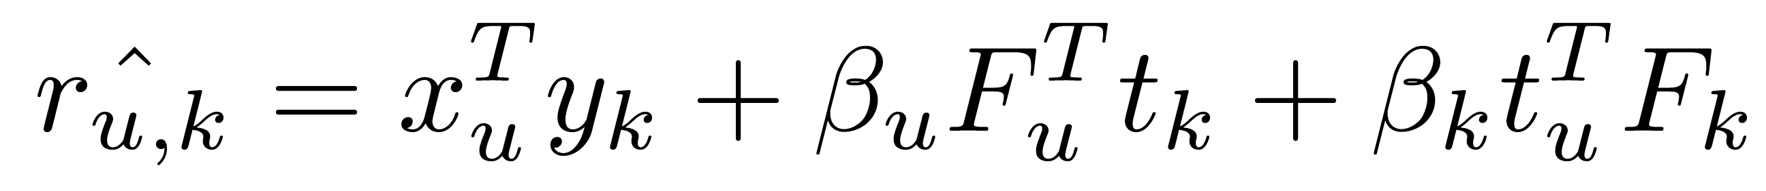
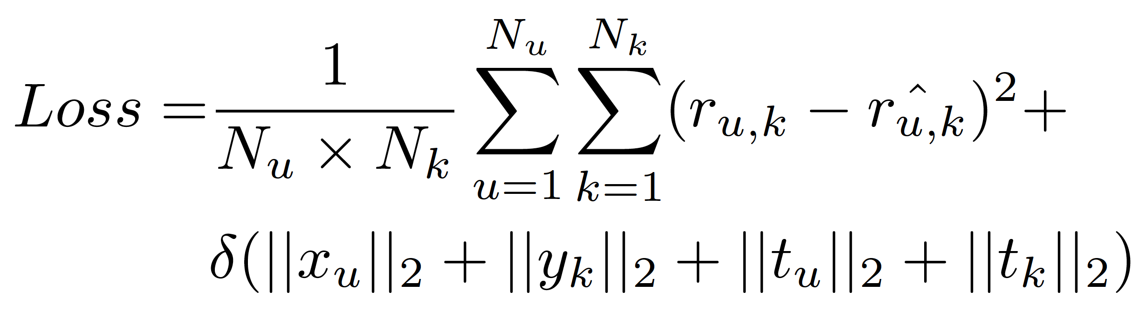
Rating Matrix Generation
  Utilized an extended matrix factorization
  Optimized the following loss function
PPT下载 http://www.1ppt.com/xiazai/

Slide 9
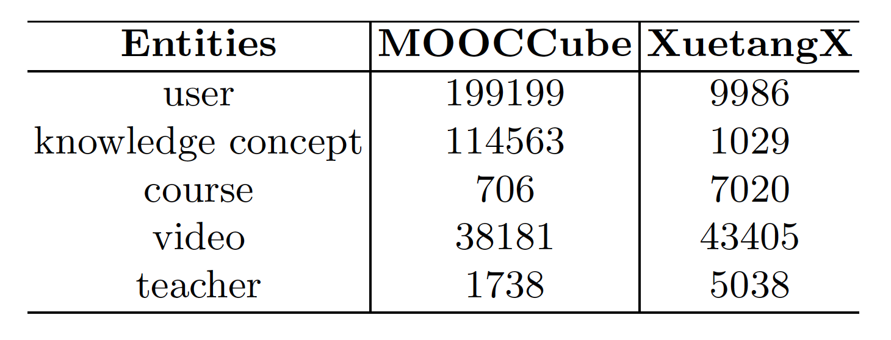
Dataset & Metrics
Dataset
Metrics
  Two real dataset from MOOC platform
  MOOCCube^{[1]} & XuetangX^{[2]}
HR
NDCG
MRR
AUC
[1] Mooccube: A large-scale data repository for nlp applications in moocs
[2] Attentional graph convolutional networks for knowledge concept recommendation in moocs in a heterogeneous view
PPT下载 http://www.1ppt.com/xiazai/

Slide 10
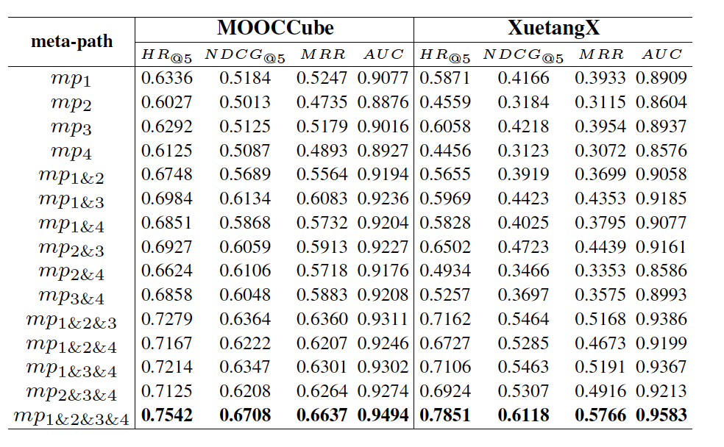
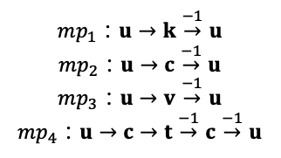
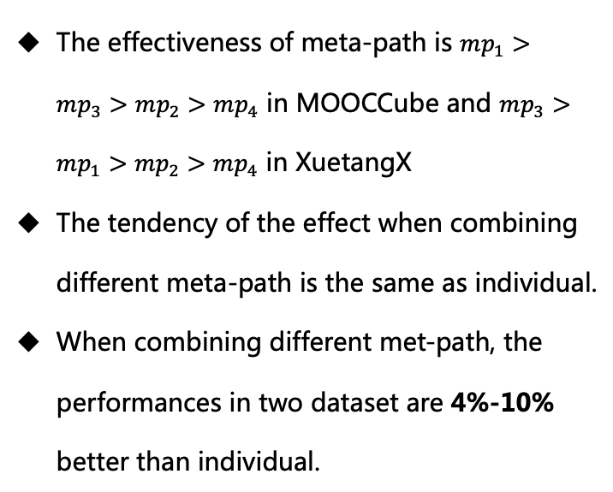
Combination of different meta-paths
The effectiveness of meta-path is $mp_{1}>mp_{3}>mp_{2}>mp_{4}$ in MOOCCube and $mp_{3}>mp_{1}>mp_{2}>mp_{4}$ in XuetangX
The tendency of the effect when combining different meta-path is the same as individual.
When combining different met-path, the performances in two dataset are 4%-10% better than individual.
$mp_{1}$：$u→k\overset{−1}{→}u$
$mp_{2}$：$u→c\overset{−1}{→}u$
$mp_{3}$：$u→v\overset{−1}{→}u$
$mp_{4}$：$u→c→t\overset{−1}{→}c\overset{−1}{→}u$

Slide 11
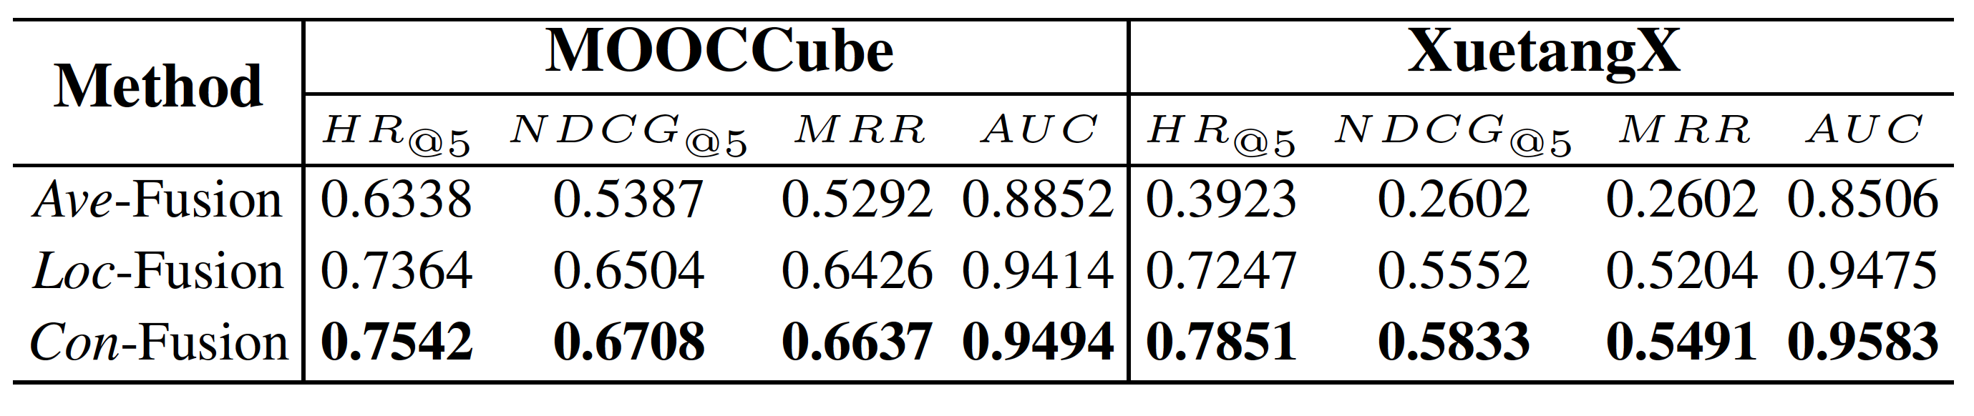
Fusion Method Analysis
The proposed method performs 6.5% better than Ave-Fusion, and 0.8% better than Loc-Fusion in MOOCCube, 10.8% better than Ave-Fusion and 1.1% better than Loc-Fusion in XuetangX.

Slide 12
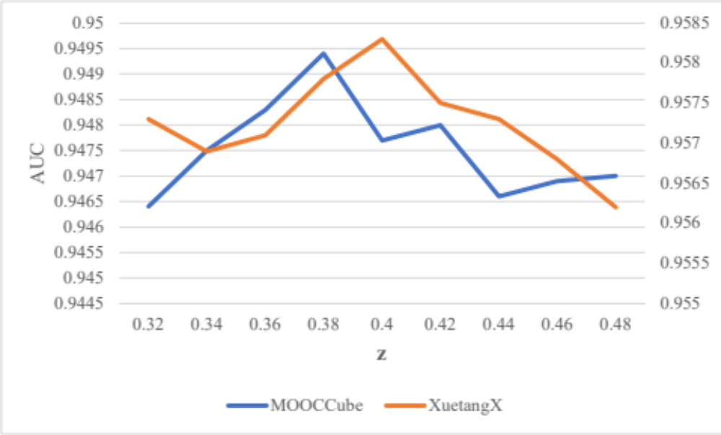
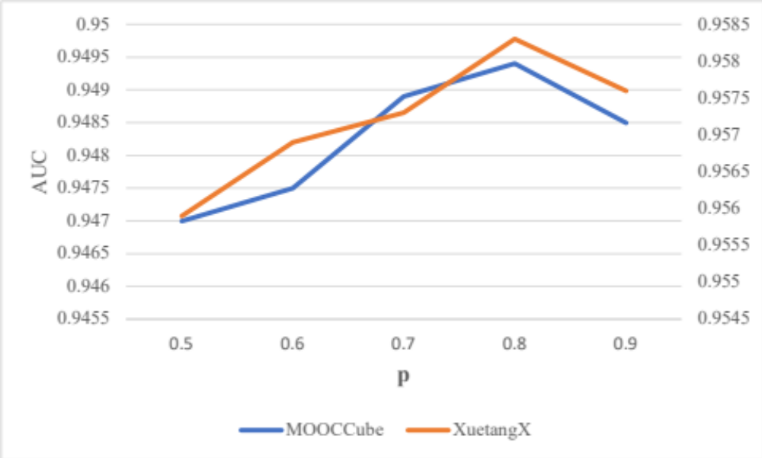
Parameter analysis
Threshold z
  Performs best when the value are 0.38 and 0.44 in MOOCCube and XuetangX, respectively.
  When the value is too low, too much noise data is collected.
  When the value is too high, too little information is introduced in.
Scale parameter p
  Performs best when the values are 0.8 in both dataset;
  When the value was too low, the method would concentrate too much about the others.
  When the value was too high, the method would degenerate into Loc-Fusion.

Slide 13
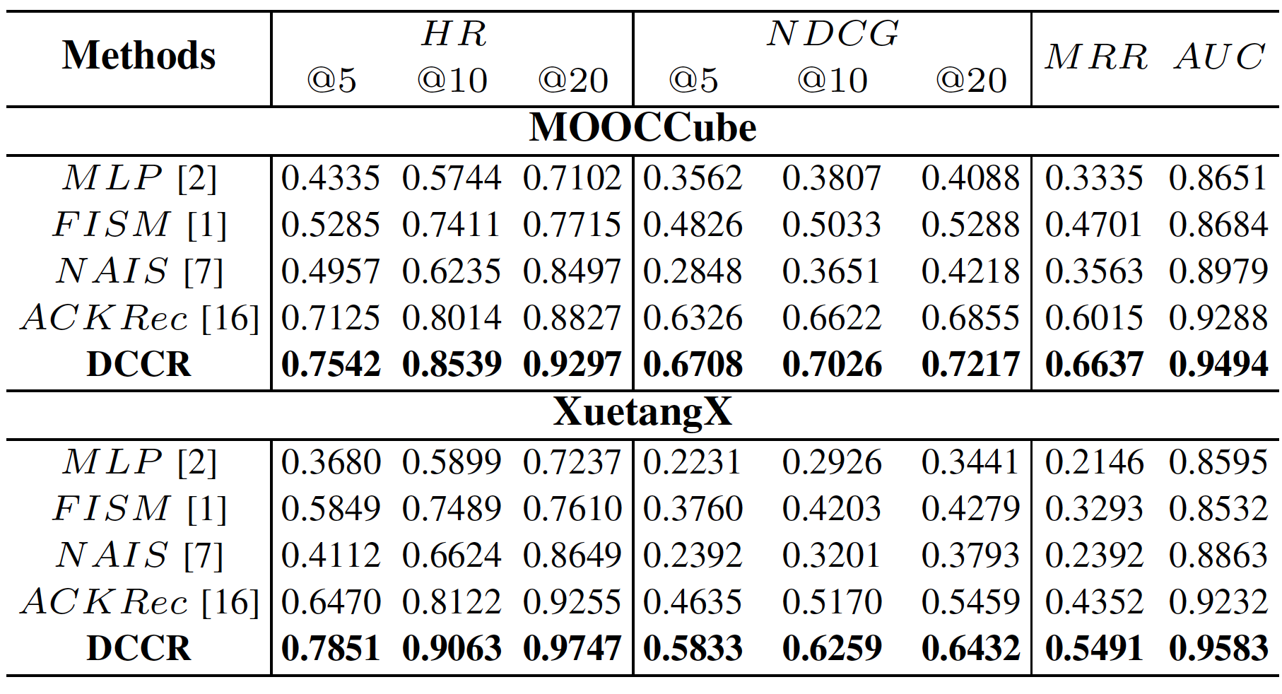
Compared with other methods
In MOOCCube, our methods performed 2%-8% better than the baselines
In XuetangX, our methods performed 3.5%-10% better than the baselines
XuetangX has a larger number of entities except user to gain a more abundant correlation feature. So the method reached a better improvement compared with MOOCCube.

Slide 14
Conclusion & Future work
Conclusion
Future work
We proposed a deep correlation based concept recommendation method to deeply extract the correlation between different meta-paths in moocs, and gained a better performance when utilizing the data in moocs to recommend knowledge concepts.
By now, our method only extract the correlation in users between different meta-paths, in the future, we’re looking forward to considering more kinds of entities
Notes:
排版

Slide 15
Thanks / Q&A

