Slide 1

Supporting Data Selection for Decision Support Systems: Towards a Decision-Making Data Value Taxonomy
Speaker: Mathieu Lega (mathieu.lega@unamur.be)
Co-authors: PhD Christian Colot, Prof. Corentin Burnay, Prof. Isabelle Linden

Slide 2
Context
2010: 2 zettabytes (a thousand billions of gigabytes) of data produced all over the world [Statista]
  2020: 47 zettabytes
  Expectations for 2035: 2000 zettabytes
Organizations -> produce data -> Data-Driven Decision Support Systems
Self-Service Business Intelligence -> help end-users produce dashboards by themselves

Slide 3
Problem statement
Risks with SSBI:
  (i) dashboards may be overloading due to the presence of too much data
  (ii) sub-optimal selection criteria may be applied to data by users -> omission of useful pieces of data or inclusion of irrelevant ones
  (iii) bad quality data may be incorporated in the dashboard, resulting in reduced insights.
  => Resources and time for unsupportive dashboards
=> Need to find a criterion to select the most important pieces of data, in order to facilitate the process of designing SSBI dashboards and more globally DSS

Slide 4
Research questions
What is Decision-Making Data Value (DMDV) in the context of data-driven Decision Support Systems and SSBI?
What are the different dimensions that compose our DMDV criterion?

Slide 5
Methodology
Step 1: gather the dimensions of data value already identified in the literature
  Structured query on Scopus
Step 2: create a taxonomy of all the retrieved data value dimensions applicable to the context of databases
  Open card sorting approach performed by the 4 authors of the paper [Wood2008]
Step 3: select the dimensions to include in our DMDV taxonomy
  Criteria: relevance, distinctiveness, measurability and comprehensiveness
Step 4: validation of the taxonomy with data experts
  Semi-structured interviews

Slide 6
DMDV introduction and definition
Use value of a commodity: “its fitness to supply the necessities, or serve the conveniencies of human life” (Karl Marx, 1875)
Commodity: “an object outside us, a thing that by its properties satisfies human wants of some sort or another” (Karl Marx, 1875) -> data is a commodity
DMDV is a use value: the fitness of data to help decision making
A data item is valuable if its use allows the decision maker to improve its decision making

Slide 7
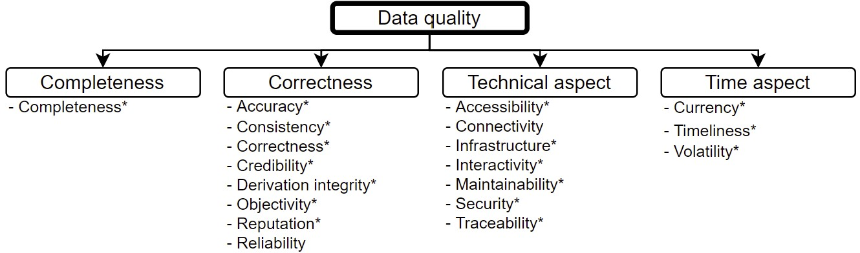
Data quality part of data value taxonomy

Slide 8
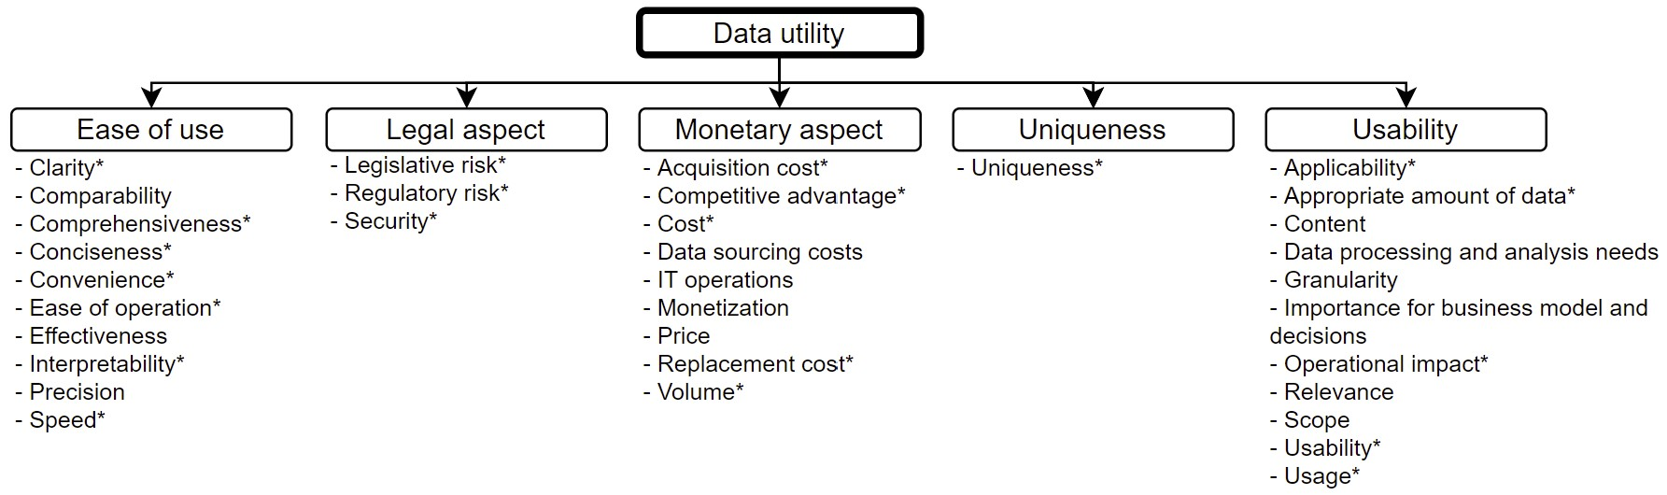
Data utility part of data value taxonomy

Slide 9
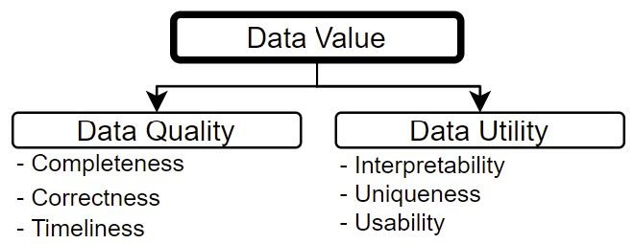
DMDV taxonomy

Slide 10
Future works
Create a DMDV assessment framework based on our taxonomy
  Develop metric for each dimension of our taxonomy
  Aggregate these metrics in a DMDV indicator
Test the proposed framework in real-world situations
  Test and adjust the metrics
Integrate our DMDV concept into a data-driven DSS design process
  Develop an integrated DSS design process guiding the user in the data selection

Slide 11
conclusion
Organizations have so much data that it becomes nearly impossible for decision makers to intuitively select the most important ones
We thus suggest to use the decision-making value of data (DMDV) as data selection criterion
We define the concept of DMDV and develop a taxonomy of the dimensions having an impact on this concept

Slide 12
Thank you for your attention!
Contact: mathieu.lega@unamur.be

