Slide 1
An Exploratory Study of Bug Prioritization and Severity Prediction based on Source Code Features
ChunYing Zhou, Cheng Zeng, Peng He

Slide 2
Outline
1
Background
2
Method
3
Experiments
4
Conclusion

Slide 3
Capturing features from source code files is widely used in software engineering.
There have been studies on the use of bug reports in combination with source code files (e.g. bug localization).
What is the correlation between source code files and bug reports?
Are the source code feature sets feasible for bug priority and severity prediction?

Slide 4
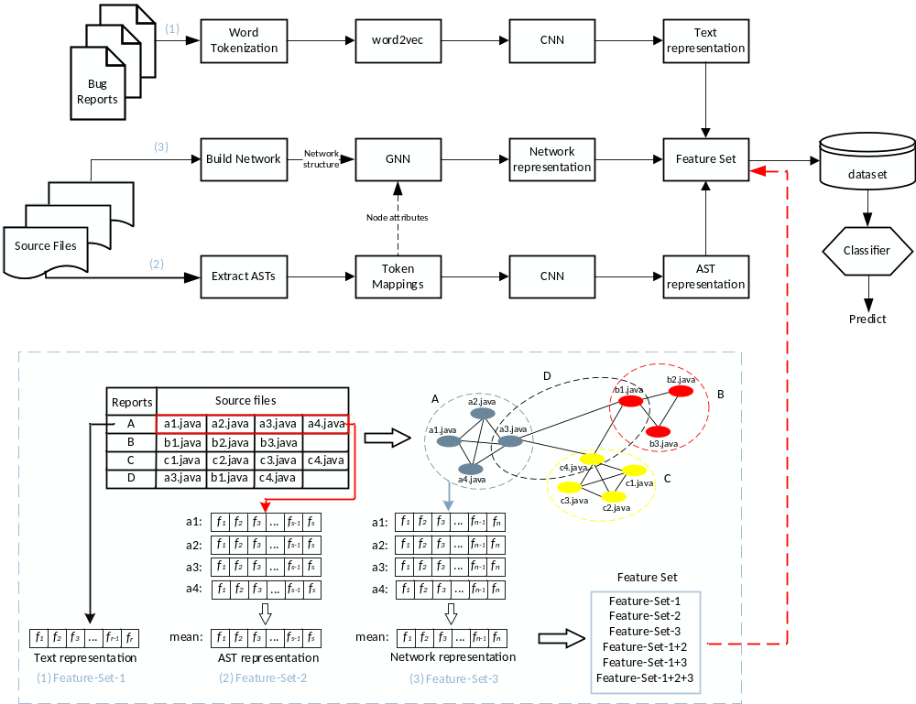

Slide 5
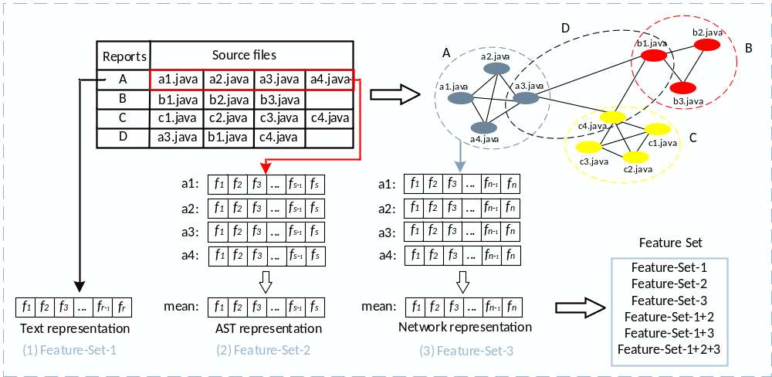

Slide 6
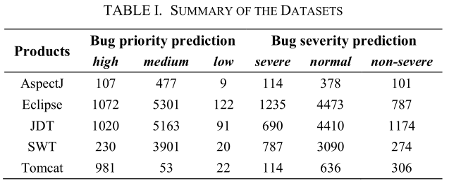
Evaluation metrics: F score, AUC
Data split: randomly select 80% data for training set, and 20% data for testing set, repeat 25 times.

Slide 7
RQ1: Which type of feature set performs better?
RQ2: Is it helpful to consider the importance of source code files?
RQ3: Do the combined feature sets achieve better results?
RQ4: Is the impact of sampling methods obvious?

Slide 8
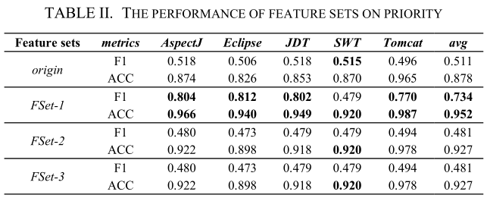
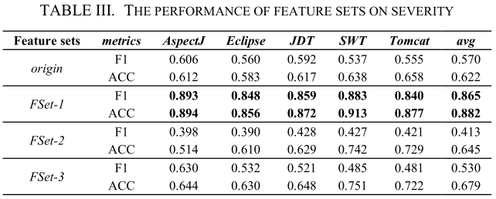
RQ1: Which type of feature set performs better?
origin: original textual features without CNN learning
FSet-1: textual features for bug reports
FSet-2: semantic features from source code files
FSet-3: relational features from co-occurrence network
FSet-1 > origin > FSet-2, FSet-3.

Slide 9
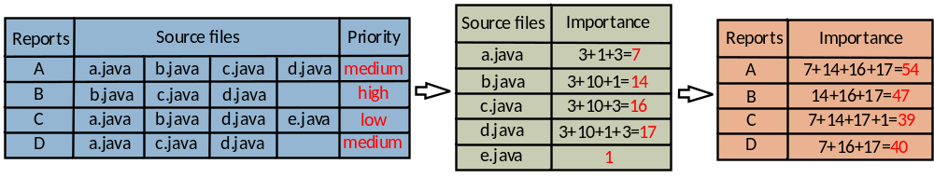
RQ2: Is it helpful to consider the importance of source code files?

Slide 10
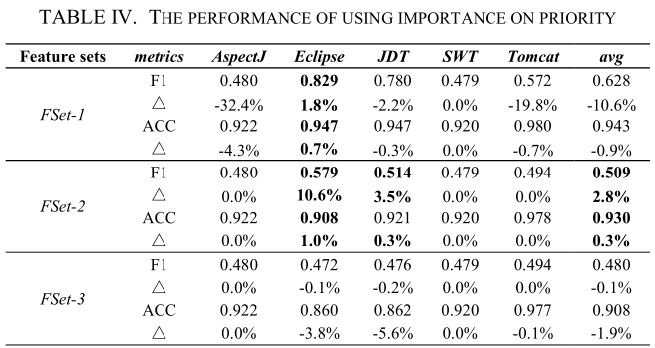
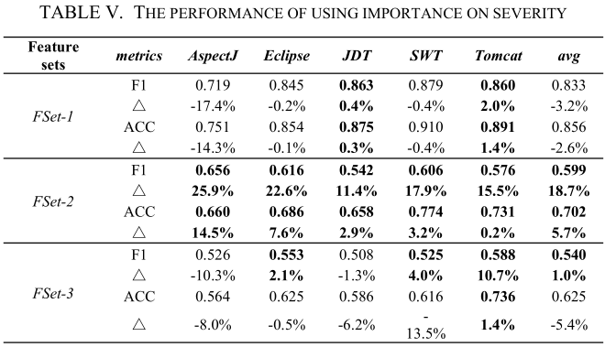
RQ2: Is it helpful to consider the importance of source code files?
FSet-1 > FSet-2 > FSet-3.

Slide 11
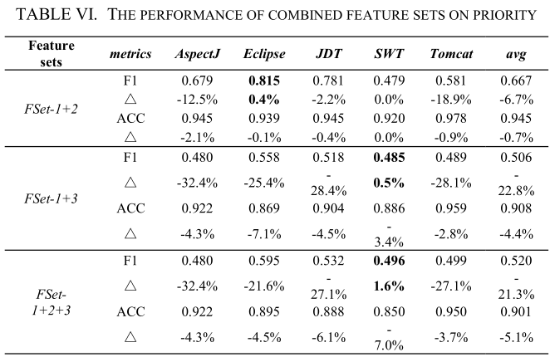
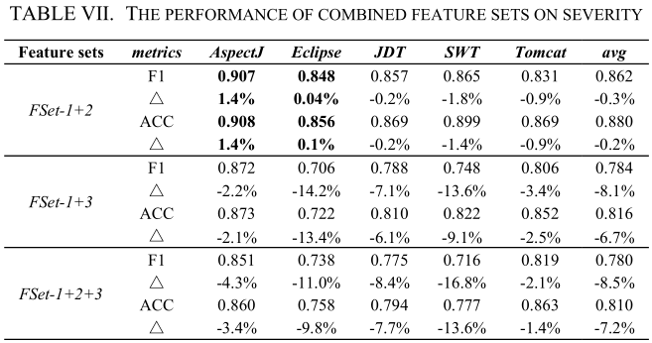
RQ3: Do the combined feature sets achieve better results?
FSet-1+2: FSet-1+FSet-2
FSet-1+3: FSet-1+FSet-3
FSet-1+2+3: FSet-1+FSet-2+FSet-3
FSet-1 > FSet-1+2 > FSet-1+3, FSet-1+2+3.

Slide 12
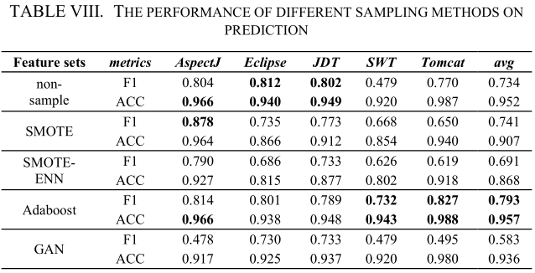
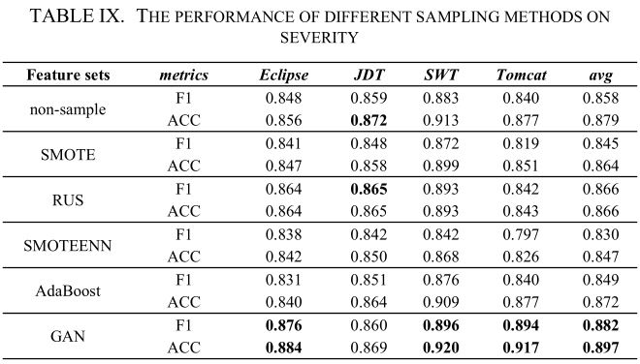
RQ4: Is the impact of sampling methods obvious?
Priority: Adaboost > non-sample > SMOTE > SMOTEENN > GAN.
Severity: GAN > non-sample > Adaboost > SMOTE > SMOTEENN.

Slide 13
The impact of learning the source code files feature sets is not as expected.
GAN performs best with sufficient training data.
In future work, in order to further validate the work of this paper accurately, we need to construct a dataset suitable for the method of this paper.

