Slide 1

A Federated Model Personalisation Method Based
on Sparsity Representation and Clustering
Hailin Yang, Yanhong Huang*, Jianqi Shi and Fangda Ca
Notes:
Good Afternoon everyone, today our team will introduction a software toolkit for the formal design and analysis of artificial intelligence-based system, VERIFAI.

Slide 2


CONTENT
1
Introduction
2
The method : FedPerC
3
Experiments and results
4
Conclusion

Slide 3
Introduction

Slide 4
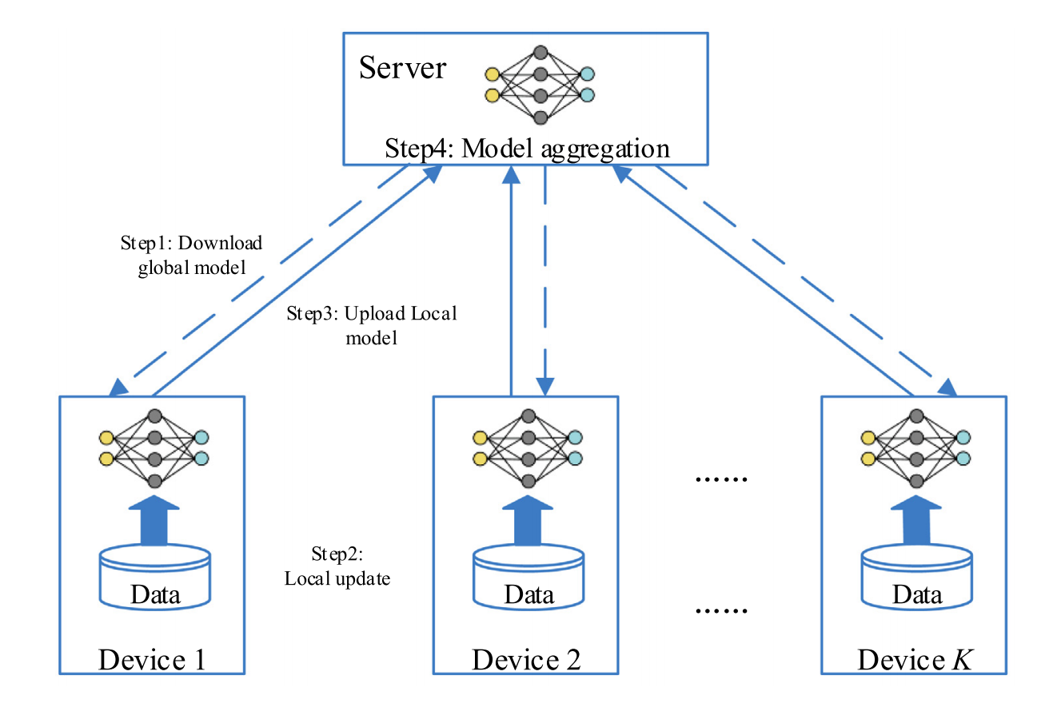
Background
Federated Learning
When the data distribution on different devices is heterogeneous, the performance of the global model obtained by federated learning is often poor.
Personalizing the federated global model to improve its performance for individual devices is a common solution.
Notes:
Currently, the increasing use of artificial intelligence (AI) and machine learning (ML) in systems, including safety-critical systems, has brought with it a pressing need for formal methods and tools for their design and verification. However, AI/ML-based systems, such as autonomous vehicles, have certain characteristics that make the application of formal methods very challenging.

Slide 5
Background
Many personalization methods have been proposed, but most of them limit personalization to a single device, which is easily affected by over-fitting.
We propose an approach to personalization based on device clustering. Instead of personalizing the global model on a single device, we personalize it on a set of customers with similar data distribution.
Notes:
First, several uses of AI/ML are for perception, the use of computational systems to mimic human perceptual tasks such as object recognition and classification, conversing in natural language, etc. For such perception components, writing a formal specification is extremely difficult, if not impossible. Additionally, the signals processed by such components can be very high-dimensional, such as streams of images or LiDAR data.

Slide 6
The method : FedPerC

Slide 7
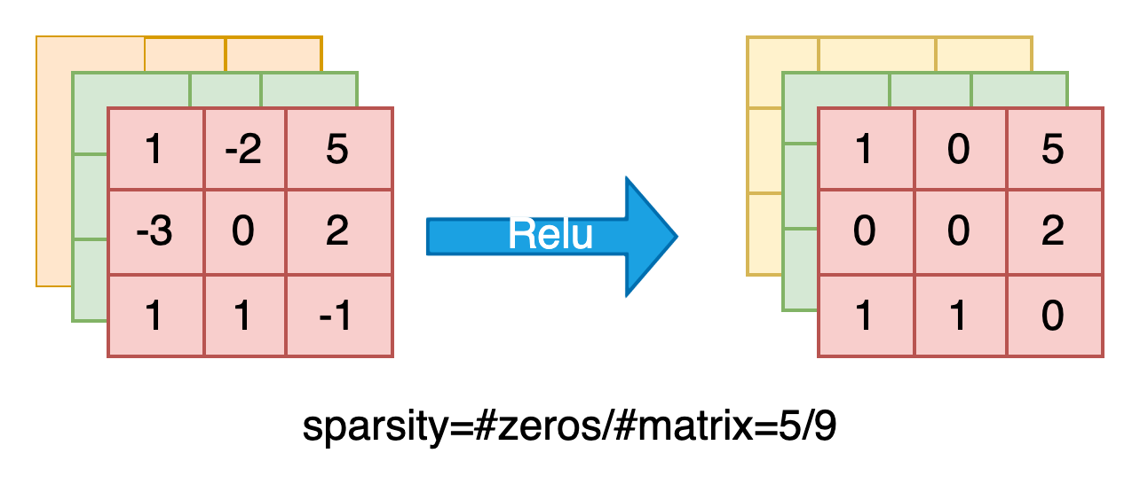
Overview
The definition of sparsity
feature map
feature map
Channel-wise sparsity: sparsity is calculated on each channel to obtain a vector, for example, the above feature map's channel-wise sparsity can be (0.5,0.3,0.56)
Notes:
Second, machine learning being a dominant paradigm in AI, formal tools must be compatible with the data-driven design flow for ML and also be able to handle the complex, high-dimensional structures in ML components such as deep neural networks.

Slide 8
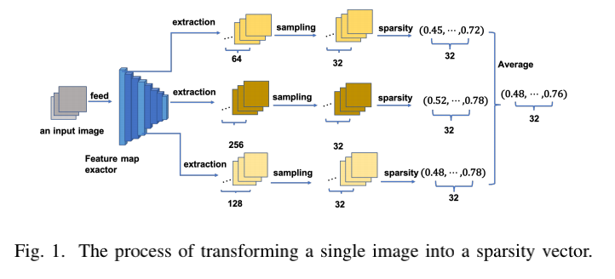
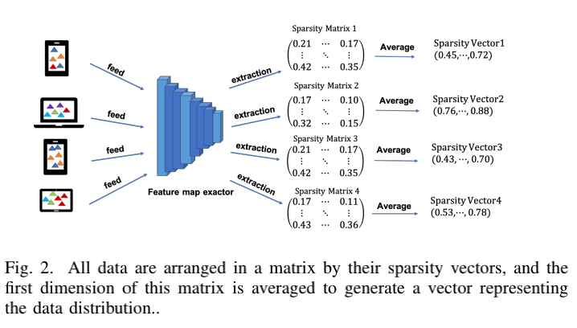
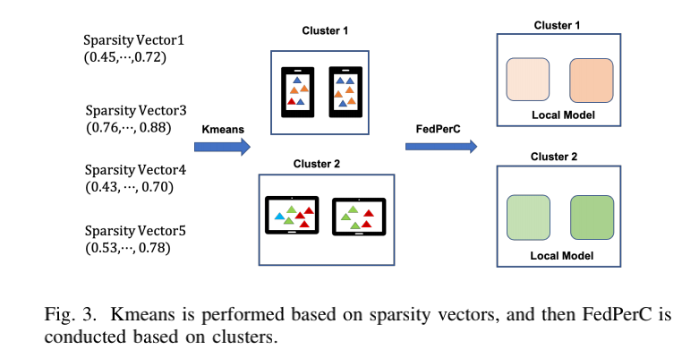
Overview
The transformation process from original data to sparsity vector, and the clustering process based on sparsity vector.
Notes:
Second, machine learning being a dominant paradigm in AI, formal tools must be compatible with the data-driven design flow for ML and also be able to handle the complex, high-dimensional structures in ML components such as deep neural networks.

Slide 9
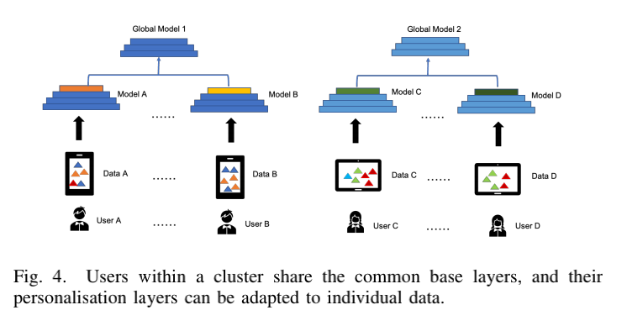
Overview
FedPerC personalization process : Only the weights of base layers required to be uploaded to the parameter server throughout the personalization process, the weights of personalization layers remain local.
Notes:
Second, machine learning being a dominant paradigm in AI, formal tools must be compatible with the data-driven design flow for ML and also be able to handle the complex, high-dimensional structures in ML components such as deep neural networks.

Slide 10
Experiments and results

Slide 11
Experiments and results
On two widely used network architectures, ResNet and MobileNet and we conducted experiments to validate our technique.
We simulate a federated environment: 20 clients and 5 clients roughly belonging to a type of distribution for each dataset.
We employed ResNet34 and MobileNetV1 on the CIFAR-10 and CIFAR-100
datasets, respectively. They are both image classification datasets, with 10 and 100 categories, respectively.
Furthermore, to mimic the finite nature of client data, we limit the quantity of data available to each client to no more than 1000.
Notes:
Third, the environments in which AI/ML-based systems operate can be very complex, with considerable uncertainty even about how many (which) agents are in the environment (both human and robotic), let alone about their intentions and behaviors. As an example, consider the difficulty in modeling urban traffic environments in which an autonomous car must operate.

Slide 12
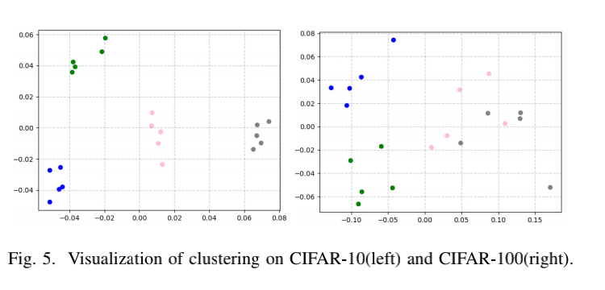
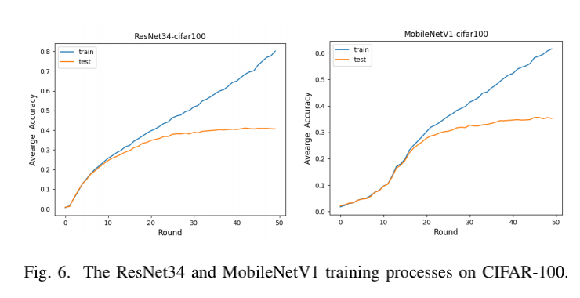
Experiments and results
Principal component analysis (PCA), a dimension reduction technique, was used to visualize the clustering. In Figure 5, we plot these reduced two-dimensional points to visualize the clustering, with different colors signifying different clusters.
Figure 6 depicts the process of federally training a global model on the CIFAR-100 dataset using ResNet34 and MobileNetV1. As can be observed, the heterogeneous distribution of the data causes the global model to over-fit, necessitating personalisation.
Notes:
Third, the environments in which AI/ML-based systems operate can be very complex, with considerable uncertainty even about how many (which) agents are in the environment (both human and robotic), let alone about their intentions and behaviors. As an example, consider the difficulty in modeling urban traffic environments in which an autonomous car must operate.

Slide 13
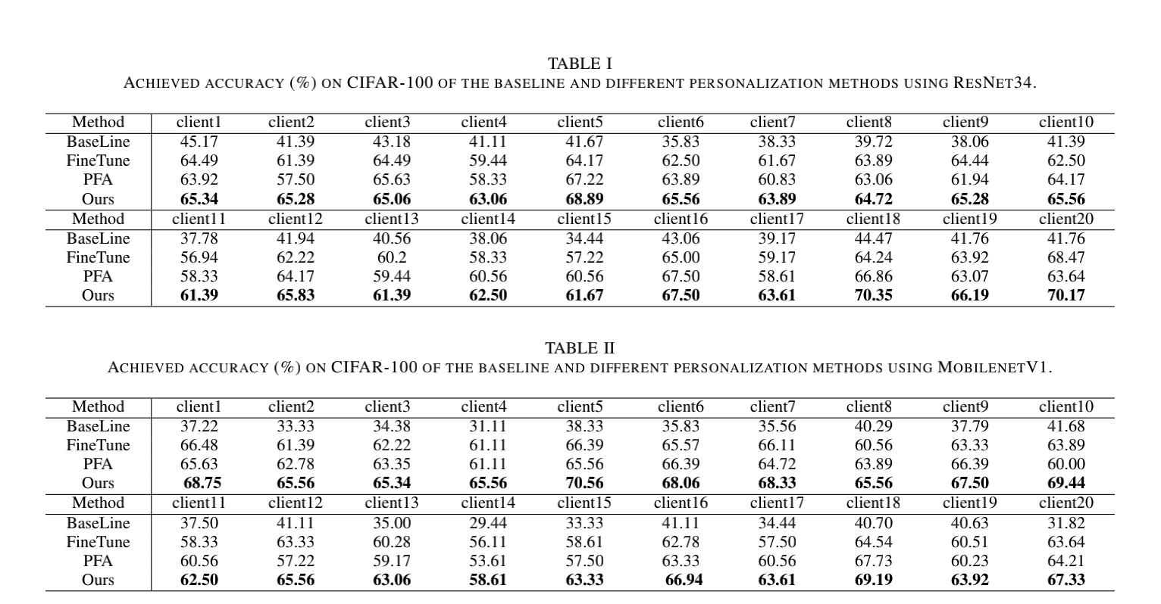
Experiments and results
Baseline refers the global model’s test accuracy for each client.
Fine-tuning refers a migrating learning strategy that retrains the parameters.
PFA is a framework that clusters clients first and then personalizes within groups with the FedAvg algorithm.
Notes:
Learning: VERIFAI aims to not only analyze the behavior of ML components but also use formal methods for their (re-)design. To this end, it provides features to (i) design the data set for training and testing [9], (ii) analyze counterexamples to gain insight into mistakes by the ML model, as well as (iii) synthesize parameters, including hyper-parameters for training algorithms and ML model parameters.

Slide 14
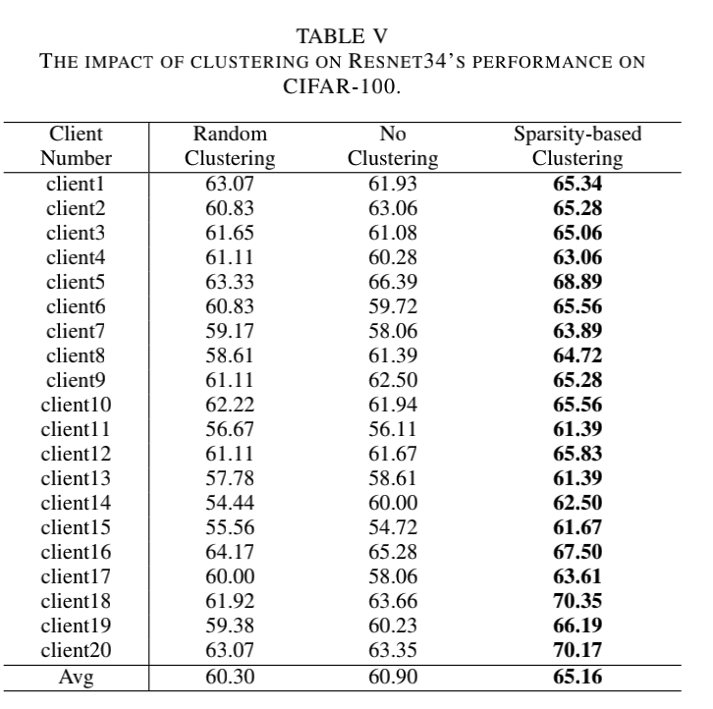
Experiments and results
To see whether clustering affects the impact of personalisation, we examined the experimental findings of ResNet34 on CIFAR-100 under three conditions: clustering,no clustering, random clustering.
Table V displays detailed experimental data.
The experimental investigations indicate that random clustering has a comparable or perhaps slightly lower personalising impact than no clustering. When employing our clustering approach, both models increase their accuracy on CIFAR-100 by 5% roughly.
Notes:
Perception: A perception component maps a concrete feature space (e.g. pixels) to an output such as a classification, prediction, or state estimate. To deal with the lack of specification for perception components, VERIFAI analyzes them in the context of a closed-loop system using a system-level specification. Moreover, to scale to complex high-dimensional feature spaces, VERIFAI operates on an abstract feature space (or semantic feature space) [10] that describes semantic aspects of the environment being perceived, not the raw features such as pixels.

Slide 15
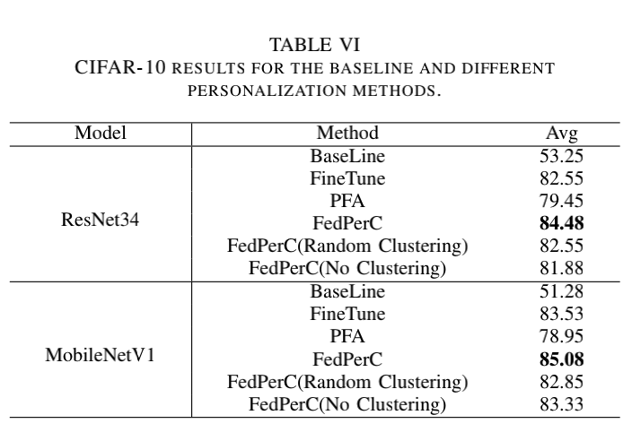
Experiments and results
Table VI presents the average accuracy of all previously mentioned personalisation techniques on CIFAR-10.
The accuracy boost on CIFAR-10 is not as significant as on CIFAR-100, most likely because CIFAR-100 has a higher numberof classes and the variances across clients within a cluster are greater.
Notes:
Perception: A perception component maps a concrete feature space (e.g. pixels) to an output such as a classification, prediction, or state estimate. To deal with the lack of specification for perception components, VERIFAI analyzes them in the context of a closed-loop system using a system-level specification. Moreover, to scale to complex high-dimensional feature spaces, VERIFAI operates on an abstract feature space (or semantic feature space) [10] that describes semantic aspects of the environment being perceived, not the raw features such as pixels.

Slide 16
Conclusion

Slide 17
Conclusion
we propose an algorithm that implements personalisation by clustering users based on a privacy-protected representation of their original data.
This is an exploratory way to addressing the non-IID dilemma of FL, although it has certain downsides:
  though the sparsity patterns of various inputs are often distinct, there may be exceptions that result in incorrect clustering conclusion
  the sparsity representation’s capacity to protect privacy has not been formally demonstrated.
incorporating established privacy-protection mechanisms such as DP is a point of improvement.
On the other hand, our method is limited to CNNs, leaving the possibility of extending it to other network architectures for future implementation.

Slide 18

Thank You

