Slide 1

A Systematic Mapping Study of Information Retrieval Approaches Applied to Requirements Trace Recovery
Bangchao Wang, Heng Wang, Ruiqi Luo, Sen Zhang, Qiang Zhu
Wuhan Textile University, Wuhan, China
2022-07-01

Slide 2
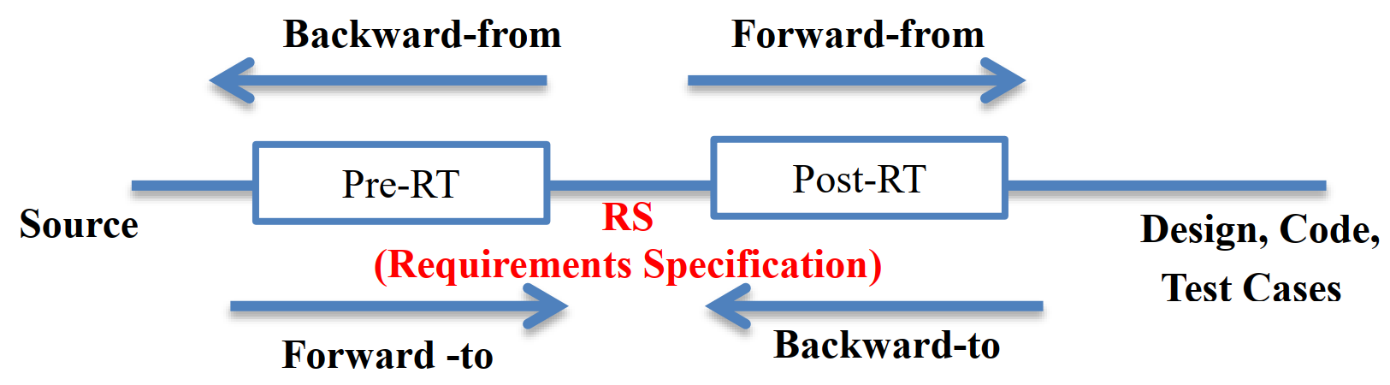
Definition

Slide 3



Background
Trouble
time-consuming
tedious
fallible
We need automated approaches!

Slide 4
Background
Requirements traceability technology
(1)Scenario based approach
(2)Framework based approach
(3)Feature model based approach | (8)Feature-oriented based approach
(4)Aspect weaving based approach | (9)Rule based approach
(5)Design patterns based approach | (10)Keywords and ontology based approach
(6)Information retrieval based approach
(7)Machine learning based approach
.........

Slide 5
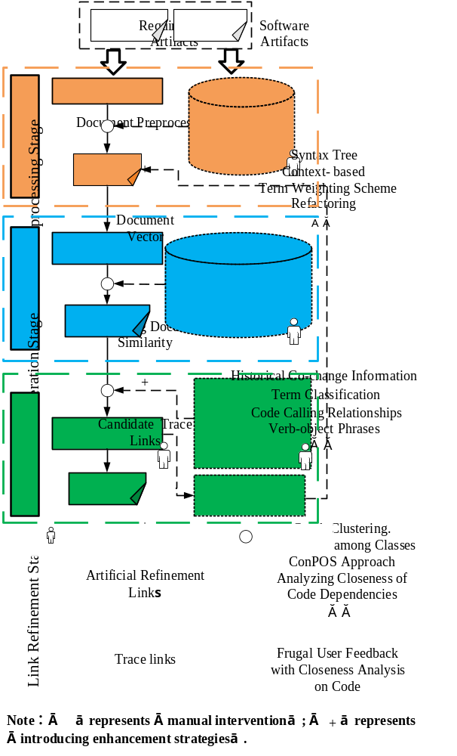
IR models
IR Models | Algebraic Models | VSM | [7] [8] [10] [11] [13] [14] [15] [18] [19] [20] [21] [22] [23] [24] [25] [27] [28][29] [32] [34] [35] [36] [37] [38] [39] [40]
 |  | LSI | [9] [11] [12] [14] [15] [16] [17] [23] [30] [32] [35] [36] [38] [40]
 | Probabilistic Models | JS | [11][22][24] [39][40]
 |  | TM | [21][29]
 | Other | [26] [31] [33]
Note: VSM: Vector Space Model, LSI: Latent Semantic Index, JS: Jensen-Shannon Model, TM: Topic Model.
IR models used in requirements trace recovery
The general process of IR-based trace recovery

Slide 6
Strategies
How to evaluate the quality and usability of RT techniques is vital to propose new automatic RT techniques. Hayes’ paper proposed an acceptable and practical one according to a large number of industrial practices, as shown following Table.
Measure | Acceptable | Good | Excellent
Recall Precision Lag | 60% — 69% 20% – 29% 3 – 4 | 70% — 79% 30 — 49% 2 — 3 | 80% – 100% 50% —100% 0 — 2

Slide 7
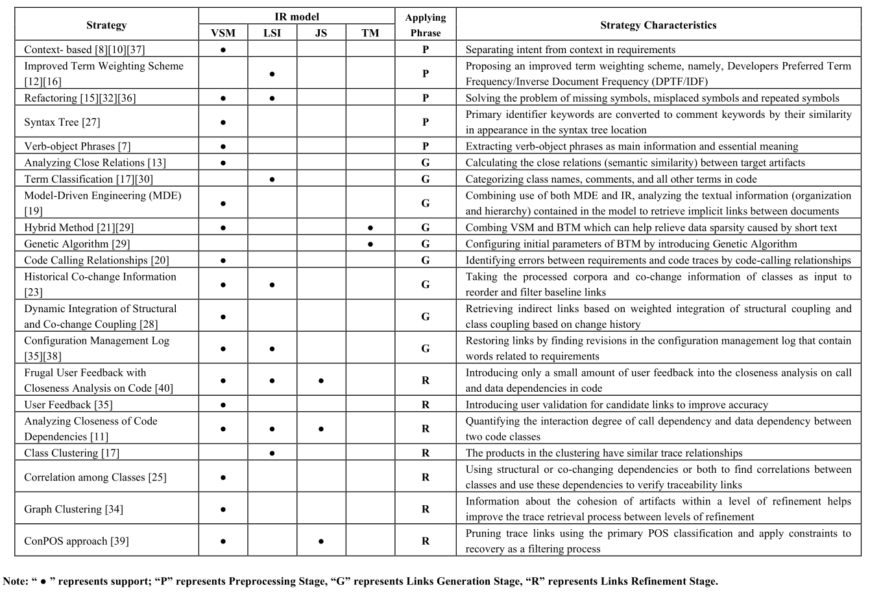

Slide 8
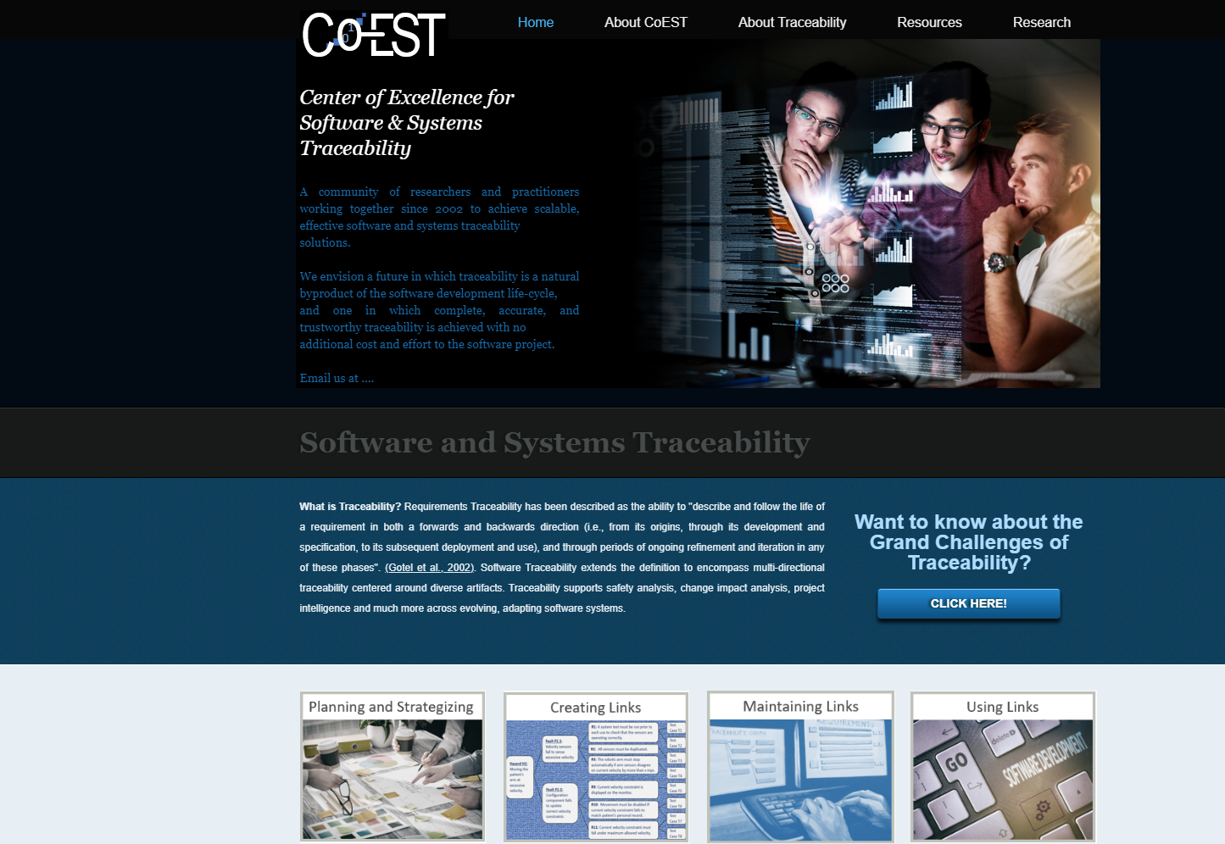
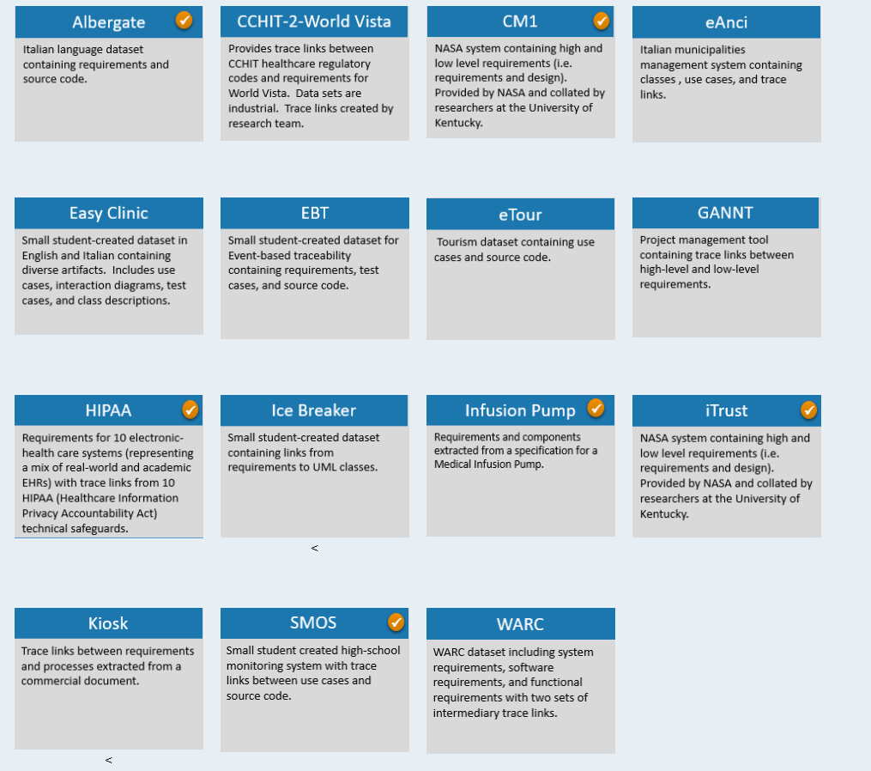
Datasets
CoEST datasets resoure link : http://www.coest.org/

Slide 9
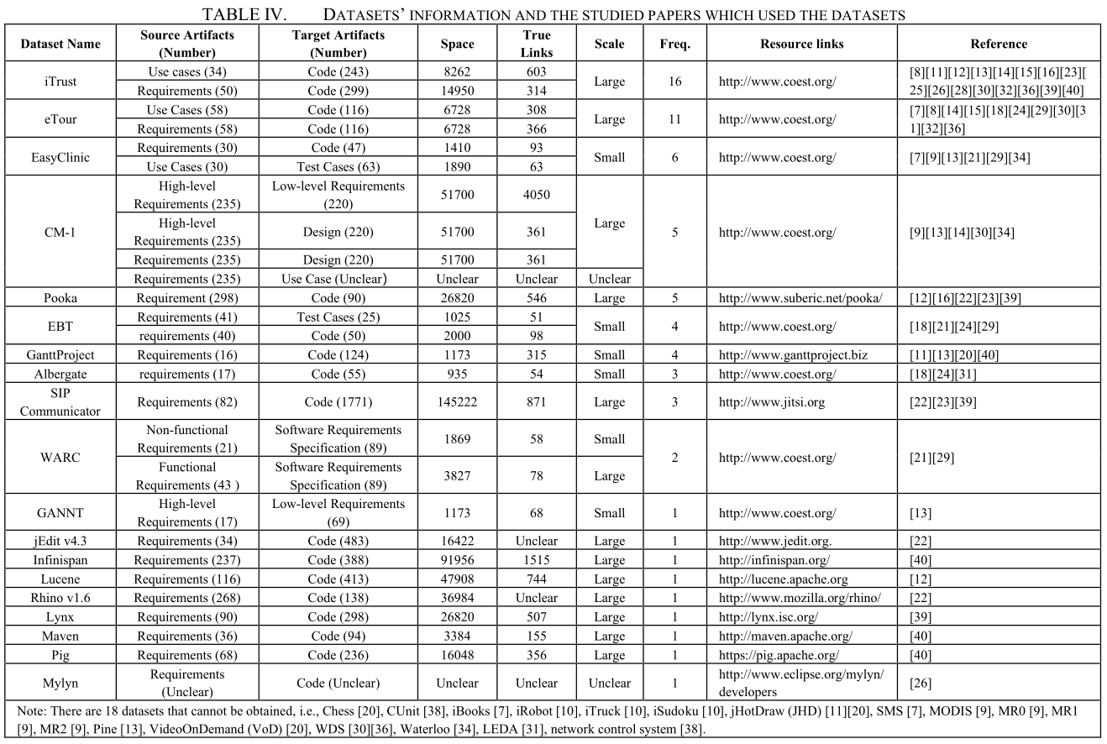

Slide 10
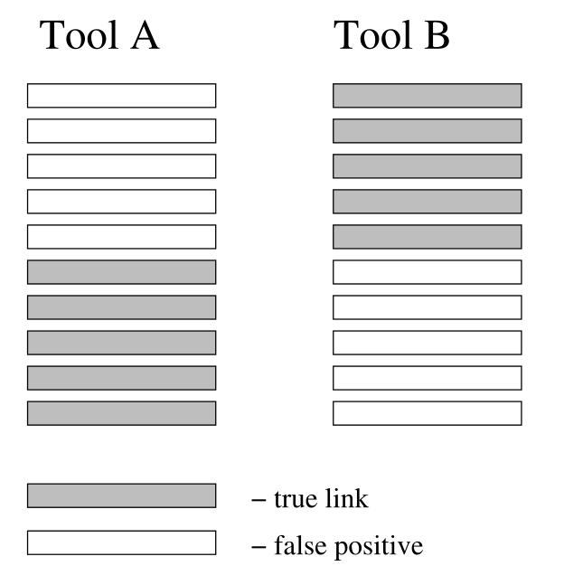
Metrics
8 performance measures
Primary Measure
Secondary Measure
Recall, Precision, F-Measure
MAP, AP, DiffAR, Lag, Selectivity

Slide 11

Conclusion
4 IR models
37 datasets
IR-based Requirements Trace Recovery
21 enhancement strategies
8 measures

Slide 12
Take away
Measure | Acceptable | Good | Excellent
Recall Precision Lag | 60% — 69% 20% – 29% 3 – 4 | 70% — 79% 30 — 49% 2 — 3 | 80% – 100% 50% —100% 0 — 2
IR Models | Algebraic Models | VSM | [7] [8] [10] [11] [13] [14] [15] [18] [19] [20] [21] [22] [23] [24] [25] [27] [28][29] [32] [34] [35] [36] [37] [38] [39] [40]
 |  | LSI | [9] [11] [12] [14] [15] [16] [17] [23] [30] [32] [35] [36] [38] [40]
 | Probabilistic Models | JS | [11][22][24] [39][40]
 |  | TM | [21][29]
 | Other | [26] [31] [33]
A. Standards from Hayes
B. IR models
Categories | Measures | Primary Studies
Primary Measure | Recall | [7][10][11][12][13][16][17][18][20][21][22][23][24][25][26][27][28][29][30][31][32][34][35][36][37][38][39][40]
 | Precision
 | F-Measure | [7][11][12][13][22][24][25][27][28][29][35][38][40]
Secondary Measure | MAP | [8][9][10][11][13][14][30][32][33][34][36][39][40]
 | AP | [11][13][33][34][39][40]
 | DiffAR | [14][32][36]
 | Lag | [14]
 | Selectivity | [29]
C. Datasets
D. Measures

Slide 13
Thank you ！
Q&A

