Slide 1
Formal specification and model checking of
Saber lattice-based key encapsulation mechanisms in Maude
Duong Dinh Tran,
Kazuhiro Ogata
Santiago Escobar
Sedat Akleylek
Ayoub Otmani
Universitat Politecnica de Valencia, Spain
Ondokuz Mayis University, Turkey
University of Rouen Normandie, France
JAIST, Japan
34th International Conference on
Software Engineering & Knowledge Engineering
July 1-10, 2022

Slide 2
Overview
Motivation
Key Encapsulation Mechanism (KEM) and Saber
Modeling Saber in Maude
The property and the counterexample
Summary

Slide 3
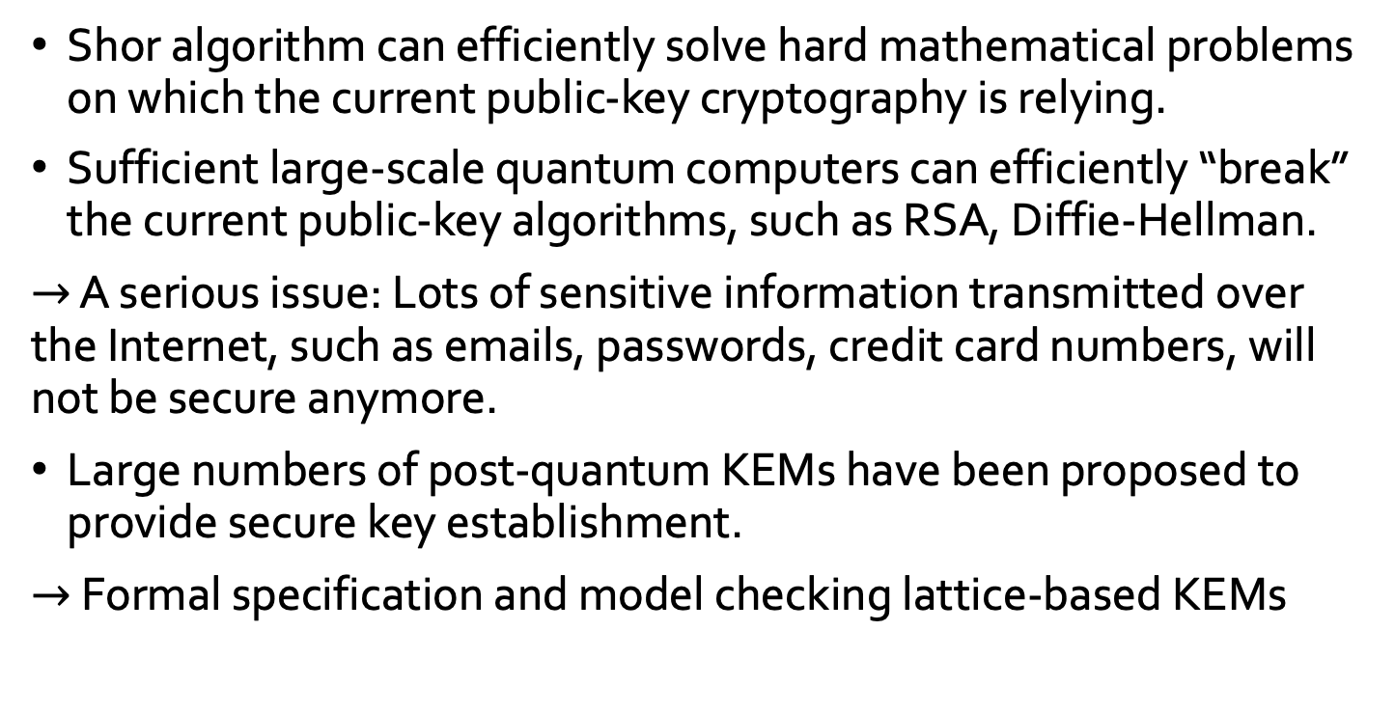
Motivation
Shor algorithm can efficiently solve hard mathematical problems on which the current public-key cryptography is relying.
Sufficient large-scale quantum computers can efficiently “break” the current public-key algorithms, such as RSA, Diffie-Hellman.
$→$ A serious issue: Lots of sensitive information transmitted over the Internet, such as emails, passwords, credit card numbers, will not be secure anymore.
Large numbers of post-quantum KEMs have been proposed to provide secure key establishment.
$→$ Formal specification and model checking lattice-based KEMs

Slide 4
Key Encapsulation Mechanism (KEM)
A KEM is a tuple of algorithms (keygen, encaps, decaps):
(sk, pk) ← keygen(): outputs a public key pk and a secret key sk.
(K, C) ← encaps(pk): takes the public key pk, and outputs a ciphertext C and a shared secret key K.
K ← decaps(sk, C): takes the secret key sk, a ciphertext C and outputs the shared secret key K.
Alice
Bob
(sk, pk) ← keygen()
pk
(K, C) ← encaps(pk)
K ← decaps(sk, C)
C

Slide 5
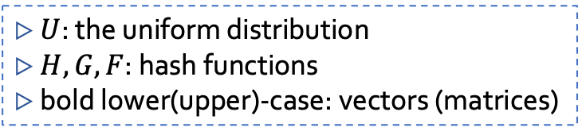
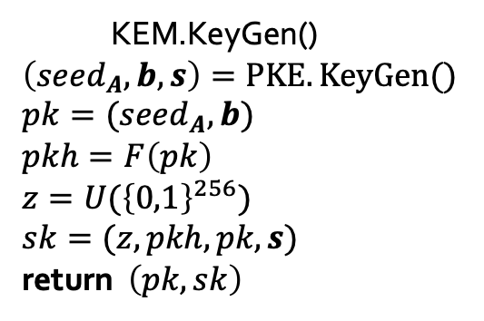


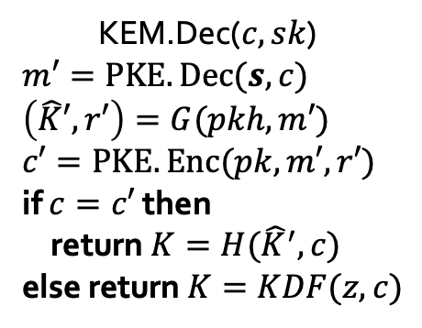
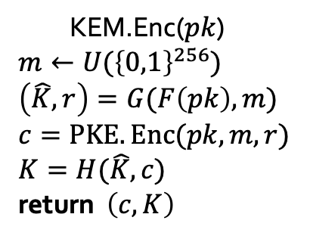
Saber
KEM.KeyGen()
$$\left(seed_{A},b,s\right)=PKE.KeyGen()$$
$$pk=(seed_{A},b)$$
$$pkh=F\left(pk\right)$$
$$z=U({\left\{0,1\right\}}^{256})$$
$$sk=(z,pkh,pk,s)$$
return $\left(pk,sk\right)$
$$pk$$
KEM.Enc($pk$)
$$m←U({\left\{0,1\right\}}^{256})$$
$$\left(\hat{K},r\right)=G(F\left(pk\right),m)$$
$$c=PKE.Enc(pk,m,r)$$
$$K=H(\hat{K},c)$$
return $\left(c,K\right)$
KEM.Dec($c,sk$)
$$m′=PKE.Dec(s,c)$$
$$\left(\hat{K}′,r′\right)=G(pkh,m′)$$
$$c′=PKE.Enc(pk,m′,r′)$$
if $c=c′$ then
return $K=H({\hat{K}}^{′},c)$
else return $K=KDF(z, c)$
$$c$$
▷ $U$: the uniform distribution
▷ $H,G,F$: hash functions
▷ bold lower(upper)-case: vectors (matrices)

Slide 6
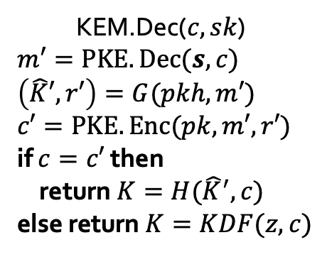

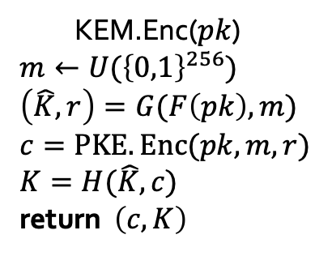

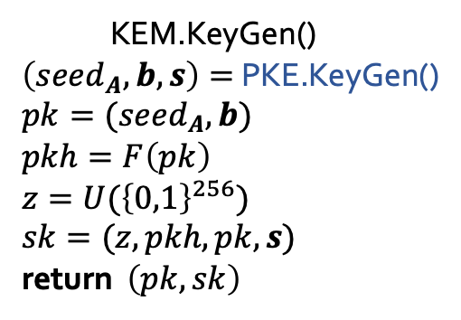
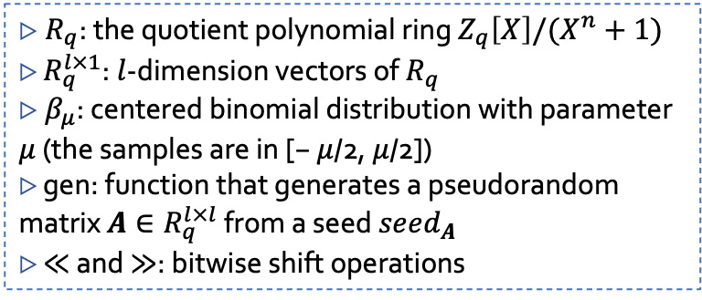
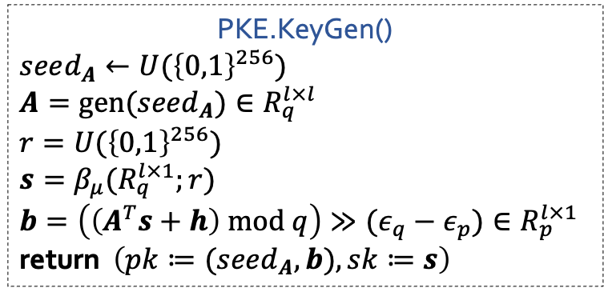
Saber
PKE.KeyGen()
$$seed_{A}←U({\left\{0,1\right\}}^{256})$$
$$A=gen(seed_{A})∈R_{q}^{l×l}$$
$$r=U({\left\{0,1\right\}}^{256})$$
$$s=β_{μ}(R_{q}^{l×1};r)$$
$$b=\left(\left(A^{T}s+h\right) mod q\right)≫(ε_{q}−ε_{p})∈R_{p}^{l×1}$$
return $\left(pk≔(seed_{A},b),sk≔s\right)$
KEM.KeyGen()
$\left(seed_{A},b,s\right)=$ PKE.KeyGen()
$$pk=(seed_{A},b)$$
$$pkh=F\left(pk\right)$$
$$z=U({\left\{0,1\right\}}^{256})$$
$$sk=(z,pkh,pk,s)$$
return $\left(pk,sk\right)$
KEM.Enc($pk$)
$$m←U({\left\{0,1\right\}}^{256})$$
$$\left(\hat{K},r\right)=G(F\left(pk\right),m)$$
$$c=PKE.Enc(pk,m,r)$$
$$K=H(\hat{K},c)$$
return $\left(c,K\right)$
$$pk$$
KEM.Dec($c,sk$)
$$m′=PKE.Dec(s,c)$$
$$\left(\hat{K}′,r′\right)=G(pkh,m′)$$
$$c′=PKE.Enc(pk,m′,r′)$$
if $c=c′$ then
return $K=H({\hat{K}}^{′},c)$
else return $K=KDF(z, c)$
$$c$$
▷ $R_{q}$: the quotient polynomial ring $Z_{q}\left[X\right]/(X^{n}+1)$
▷ $R_{q}^{l×1}$: $l$-dimension vectors of $R_{q}$
▷ $β_{μ}$: centered binomial distribution with parameter $μ$ (the samples are in [− $μ$/2, $μ$/2])
▷ gen: function that generates a pseudorandom matrix $A∈R_{q}^{l×l}$ from a seed $seed_{A}$
▷ ≪ and ≫: bitwise shift operations

Slide 7

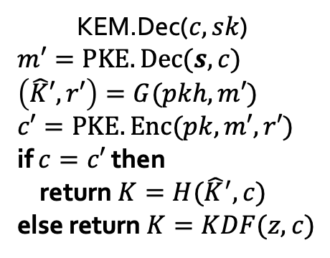

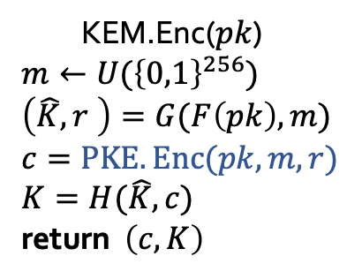
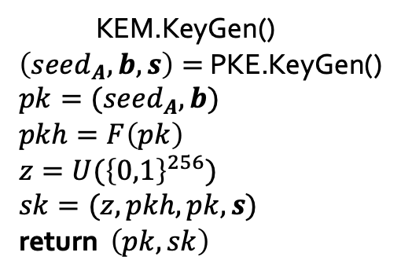
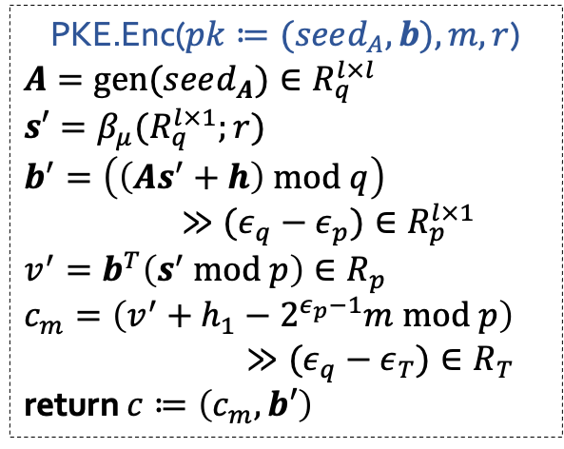
Saber
KEM.KeyGen()
$\left(seed_{A},b,s\right)=$ PKE.KeyGen()
$$pk=(seed_{A},b)$$
$$pkh=F\left(pk\right)$$
$$z=U({\left\{0,1\right\}}^{256})$$
$$sk=(z,pkh,pk,s)$$
return $\left(pk,sk\right)$
KEM.Enc($pk$)
$$m←U({\left\{0,1\right\}}^{256})$$
$$\left(\hat{K},r \right)=G(F\left(pk\right),m)$$
$$c=PKE.Enc(pk,m,r)$$
$$K=H(\hat{K},c)$$
return $\left(c,K\right)$
$$pk$$
$$c$$
KEM.Dec($c,sk$)
$$m′=PKE.Dec(s,c)$$
$$\left(\hat{K}′,r′\right)=G(pkh,m′)$$
$$c′=PKE.Enc(pk,m′,r′)$$
if $c=c′$ then
return $K=H({\hat{K}}^{′},c)$
else return $K=KDF(z, c)$
PKE.Enc($pk≔(seed_{A},b),m,r$)
$$A=gen(seed_{A})∈R_{q}^{l×l}$$
$$s′=β_{μ}(R_{q}^{l×1};r)$$
$$b^{′}=\left(\left(As^{′}+h\right) mod q\right)$$
$≫(ε_{q}−ε_{p})∈R_{p}^{l×1}$
$$v^{′}=b^{T}\left(s^{′} mod p\right)∈R_{p}$$
$$c_{m}=\left(v^{′}+h_{1}−2^{ε_{p}−1}m mod p\right)$$
$≫(ε_{q}−ε_{T})∈R_{T}$
return $c≔\left(c_{m},b′\right)$

Slide 8
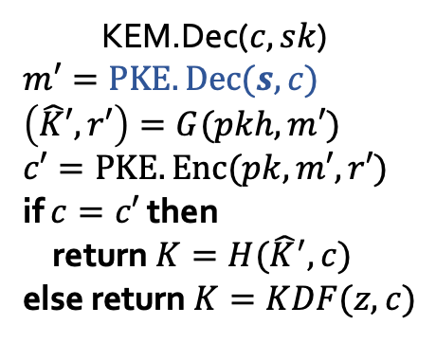

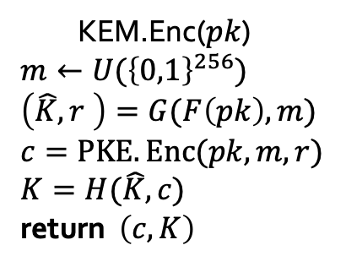
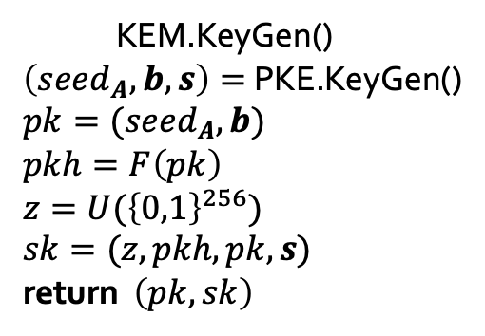
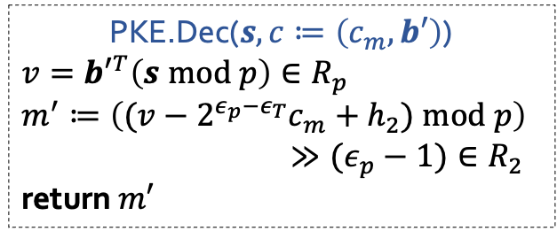
Saber
KEM.KeyGen()
$\left(seed_{A},b,s\right)=$ PKE.KeyGen()
$$pk=(seed_{A},b)$$
$$pkh=F\left(pk\right)$$
$$z=U({\left\{0,1\right\}}^{256})$$
$$sk=(z,pkh,pk,s)$$
return $\left(pk,sk\right)$
$$pk$$
KEM.Enc($pk$)
$$m←U({\left\{0,1\right\}}^{256})$$
$$\left(\hat{K},r \right)=G(F\left(pk\right),m)$$
$$c=PKE.Enc(pk,m,r)$$
$$K=H(\hat{K},c)$$
return $\left(c,K\right)$
KEM.Dec($c,sk$)
$$m′=PKE.Dec(s,c)$$
$$\left(\hat{K}′,r′\right)=G(pkh,m′)$$
$$c′=PKE.Enc(pk,m′,r′)$$
if $c=c′$ then
return $K=H({\hat{K}}^{′},c)$
else return $K=KDF(z, c)$
$$c$$
PKE.Dec($s,c≔\left(c_{m},b′\right)$)
$$v={b′}^{T}\left(s mod p\right)∈R_{p}$$
$$m^{′}≔\left((v−2^{ε_{p}−ε_{T}}c_{m}+h_{2}) mod p\right)$$
$$≫(ε_{p}−1)∈R_{2}$$
return $m′$

Slide 9
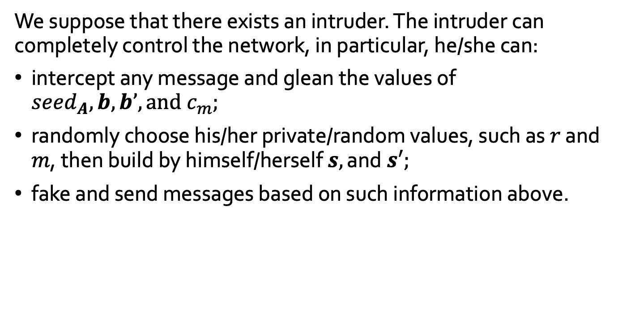
Threat model
We suppose that there exists an intruder. The intruder can completely control the network, in particular, he/she can:
intercept any message and glean the values of $seed_{A},b,b’,\text{and} c_{m};$
randomly choose his/her private/random values, such as $r$ and $m$, then build by himself/herself $s,\text{and} s′;$
﻿fake and send messages based on such information above.

Slide 10
Modeling polynomials
fmod POLYNOMIAL is
pr INT . sort Poly . subsort Int < Poly .
op _p+_ : Poly Poly -> Poly [ctor assoc comm prec 33] . --- addition
op _p*_ : Poly Poly -> Poly [ctor assoc comm prec 31] . --- multiplication
op _p-_ : Poly Poly -> Poly [prec 33] . --- subtraction
op neg_ : Poly -> Poly [ctor] . --- negation
op _md_ : Poly Nat -> Poly [ctor prec 32] . --- mod
op shiftR : Poly Int -> Poly . --- bitwise shift (to right)
vars P0 P1 P2 P3 : Poly .
eq P1 p+ 0 = P1 . eq P1 p* 0 = 0 . eq P1 p* 1 = P1 .
eq P1 p* (P2 p+ P3) = (P1 p* P2) p+ (P1 p* P3) .
eq P1 p- P2 = P1 p+ neg(P2) .
eq P1 p+ neg(P1) = 0 .
eq neg(neg(P1)) = P1 .
eq neg(P1 p+ P2) = neg(P1) p+ neg(P2) .
endfm

Slide 11
Modeling vectors and matrices
op _v+_ : Vector Vector -> Vector [assoc comm prec 33] . --- addition
op _dot_ : Vector Vector -> Poly [prec 31] . --- inner product
op _m*_ : Matrix Vector -> Vector [prec 31] . --- matrix * vector
eq (V1 v+ V2) dot V3 = (V1 dot V3) p+ (V2 dot V3) .
eq V3 dot (V1 v+ V2) = (V3 dot V1) p+ (V3 dot V2) .

Slide 12
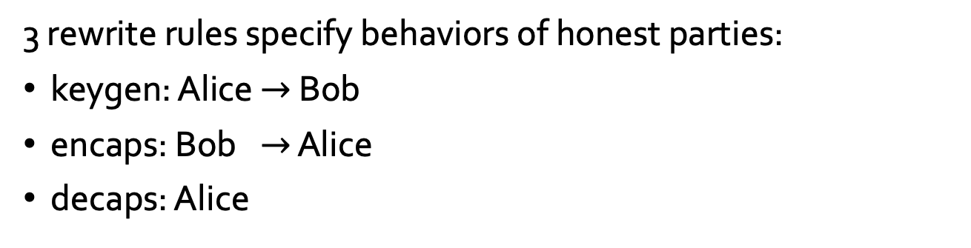
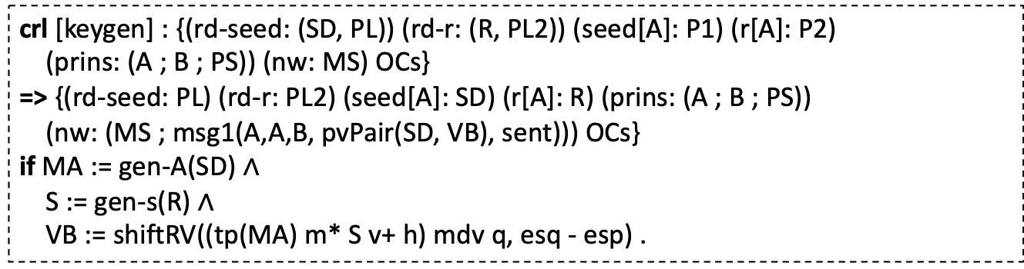
Modeling honest parties
3 rewrite rules specify behaviors of honest parties:
keygen: Alice $→$ Bob
encaps: Bob $→$ Alice
decaps: Alice
crl [keygen] : {(rd-seed: (SD, PL)) (rd-r: (R, PL2)) (seed[A]: P1) (r[A]: P2)
(prins: (A ; B ; PS)) (nw: MS) OCs}
=> {(rd-seed: PL) (rd-r: PL2) (seed[A]: SD) (r[A]: R) (prins: (A ; B ; PS))
(nw: (MS ; msg1(A,A,B, pvPair(SD, VB), sent))) OCs}
if MA := gen-A(SD) $∧$
S := gen-s(R) $∧$
VB := shiftRV((tp(MA) m* S v+ h) mdv q, esq - esp) .

Slide 13
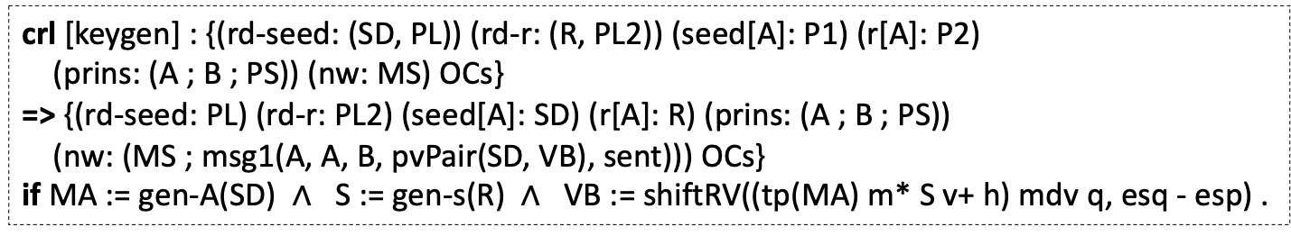
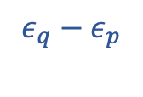


Modeling honest parties
crl [keygen] : {(rd-seed: (SD, PL)) (rd-r: (R, PL2)) (seed[A]: P1) (r[A]: P2)
(prins: (A ; B ; PS)) (nw: MS) OCs}
=> {(rd-seed: PL) (rd-r: PL2) (seed[A]: SD) (r[A]: R) (prins: (A ; B ; PS))
(nw: (MS ; msg1(A, A, B, pvPair(SD, VB), sent))) OCs}
if MA := gen-A(SD) $∧$ S := gen-s(R) $∧$ VB := shiftRV((tp(MA) m* S v+ h) mdv q, esq - esp) .
$$seed_{A}$$
$$r$$
$$ε_{q}−ε_{p}$$
msg1( A, A, B, pvPair(SD, VB), sent)
actual
creator
seeming
sender
receiver
- sent: message was sent
- replied: message was sent, and the receiver replied with another message
- intercepted: message was intercepted by the intruder

Slide 14
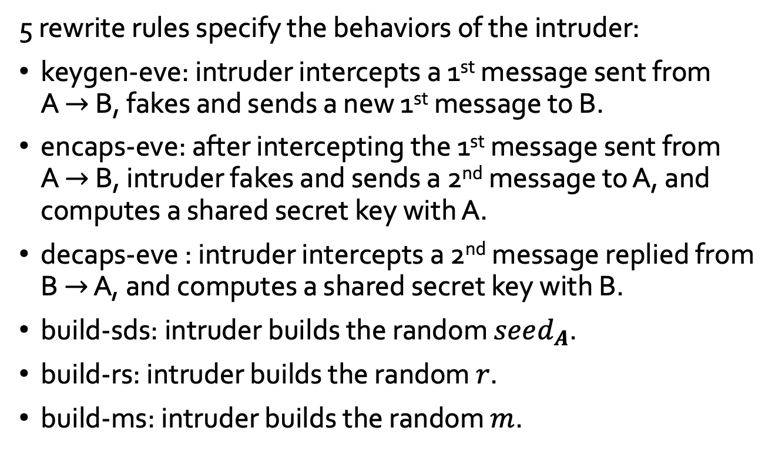
Modeling the intruder
5 rewrite rules specify the behaviors of the intruder:
keygen-eve: intruder intercepts a 1st message sent from
A $→$ B, fakes and sends a new 1st message to B.
encaps-eve: after intercepting the 1st message sent from
A $→$ B, intruder fakes and sends a 2nd message to A, and computes a shared secret key with A.
decaps-eve : intruder intercepts a 2nd message replied from B $→$ A, and computes a shared secret key with B.
build-sds: intruder builds the random $seed_{A}$.
build-rs: intruder builds the random $r$.
build-ms: intruder builds the random $m$.

Slide 15
Kyber – MITM attack
search [1] in SABER :
init =>* {(keys[alice]: key(K1,bob)) (keys[bob]: key(K2,alice))
(glean-keys: (key(K1,alice) ; key(K2,bob) ; KS))
OCs} .
(keys[alice]: key(K1,bob)) : key that Alice obtained after she communicated (in her belief) with Bob,
(keys[bob]: key(K2,alice)) : key that Bob obtained after he communicated (in his belief) with Alice,
(glean-keys: (key(K1,alice) ; key(K2,bob) ; KS)) : collection of keys gleaned by the intruder.

Slide 16

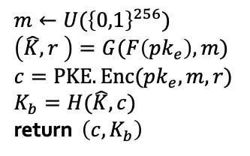
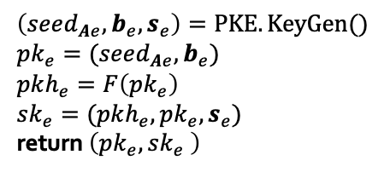
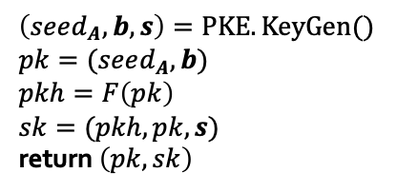

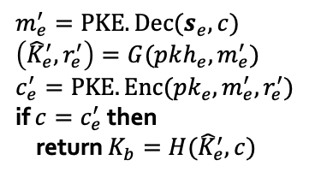

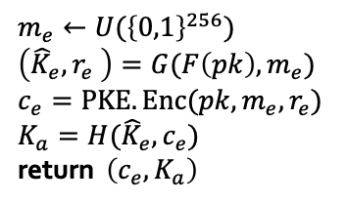
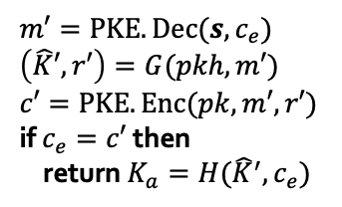

Saber – MITM attack
Alice
Eve
Bob
$$\left(seed_{A},b,s\right)=PKE.KeyGen()$$
$$pk=(seed_{A},b)$$
$$pkh=F\left(pk\right)$$
$$sk=(pkh,pk,s)$$
return $\left(pk,sk\right)$
$$pk$$
$$\left(seed_{Ae},b_{e},s_{e}\right)=PKE.KeyGen()$$
$$pk_{e}=(seed_{Ae},b_{e})$$
$$pkh_{e}=F\left(pk_{e}\right)$$
$$sk_{e}=(pkh_{e},pk_{e},s_{e})$$
return $\left(pk_{e},sk_{e} \right)$
$$pk_{e}$$
$$m←U({\left\{0,1\right\}}^{256})$$
$$\left(\hat{K},r \right)=G(F\left(pk_{e}\right),m)$$
$$c=PKE.Enc(pk_{e},m,r)$$
$$K_{b}=H(\hat{K},c)$$
return $\left(c,K_{b}\right)$
$$m_{e}←U({\left\{0,1\right\}}^{256})$$
$$\left({\hat{K}}_{e},r_{e} \right)=G(F\left(pk\right),m_{e})$$
$$c_{e}=PKE.Enc(pk,m_{e},r_{e})$$
$$K_{a}=H({\hat{K}}_{e},c_{e})$$
return $\left(c_{e},K_{a}\right)$
$$c$$
$$m_{e}^{′}=PKE.Dec(s_{e},c)$$
$$\left({\hat{K}}_{e}^{′},r_{e}^{′}\right)=G(pkh_{e},m_{e}^{′})$$
$$c_{e}^{′}=PKE.Enc(pk_{e},m_{e}^{′},r_{e}^{′})$$
if $c=c_{e}^{′}$ then
return $K_{b}=H({\hat{K}}_{e}^{′},c)$
$$m′=PKE.Dec(s,c_{e})$$
$$\left(\hat{K}′,r′\right)=G(pkh,m′)$$
$$c′=PKE.Enc(pk,m′,r′)$$
if $c_{e}=c′$ then
return $K_{a}=H({\hat{K}}^{′},c_{e})$
$$c_{e}$$

Slide 17
Summary
This is not a novel attack because a KEM does not go along with any solution for authentication.
The paper illustrates one symbolic approach for reasoning PQ KEMs rather than focusing on this kind of attack.
We also conducted model checking: Kyber, MLWR.
The same kind of attack was found.

Slide 18
Thank you for your attention!

