Slide 1
AESPrompt: Pre-trained Language Models for Automated Essay Scoring with Prompt-Tuning
Presenter：Qiuyu Tao
SEKE 2022
KSIR Virtual Conference Center, Pittsburgh, USA
July 1 - July 10, 2022
Notes:
Good afternoon ladies and gentlemen. I am honored to speak at this conference. I am Qiuyu Tao, a master student from Chongqing university. Today my topic is AESPrompt Pre-trained Language Models for Automated Essay Scoring with Prompt-Tuning.

Slide 2
Outline
1
Introduction
2
Method
3
Experiments
4
Conclusion
Notes:
The content of this presentation is divided into 4 parts: In section 1. I will introduce the research status quo of some existing methods for automated essay scoring. In section 2 I will introduce the method we proposed . The experiment will be showd in section. Finally I will make a conclusion.

Slide 3

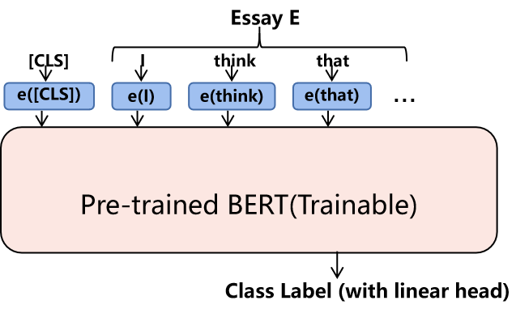
Introduction
Automated essay scoring(AES) aims to automatically assign scores to student essays based on the quality of writing, which is a necessary task in educational applications.
Previous approaches have made many attempts with pre-trained BERT for essay scoring and achieved the state-of-the-art. However, these approaches mainly rely on the high storage and computation consumption.
Fig 1(a). BERT fine tuning for automated essay scoring
Notes:
Automated essay scoring (AES) is the use of specialized computer programs to assign grades to essays written in an educational setting. It is a form of educational assessment and an application of natural language processing.

Slide 4
AESPrompt
In this section, we introduce our AESPrompt framework, which contains two parts:
Prompt Encoder
Self-supervised constraints for essay scoring
self-supervised constraints
Essay E
Prompt Encoder
[CLS]
I
think
that
DIS
PRD
e([CLS])
e(I)
e(think)
e(that)
...
...
Trainable
Pre-trained BERT(Frozen)
Pre-trained BERT(Frozen)
...
...
...
...
...
Class Label (with linear head)
Fig 2. Model architecture of AESPrompt. We design two self-supervised constraints for Prompt Tuning.
Notes:
In this section, we describe the proposed lightweight aes framework,named AESPrompt, which contains two parts:
Prompt Encoder
Self-supervised constraints

Slide 5
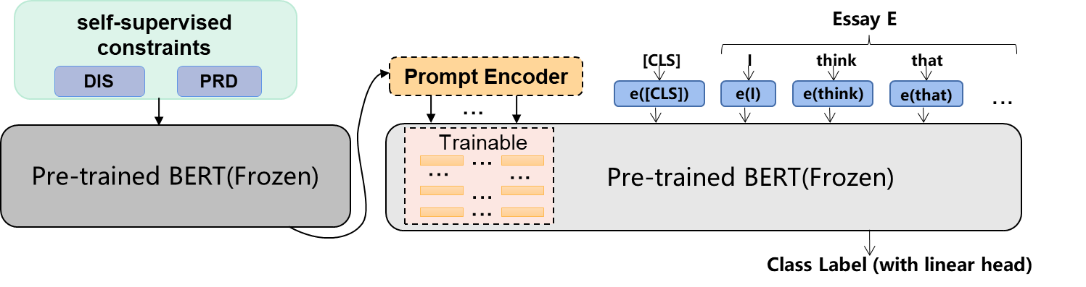
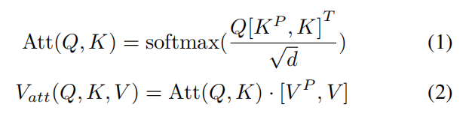
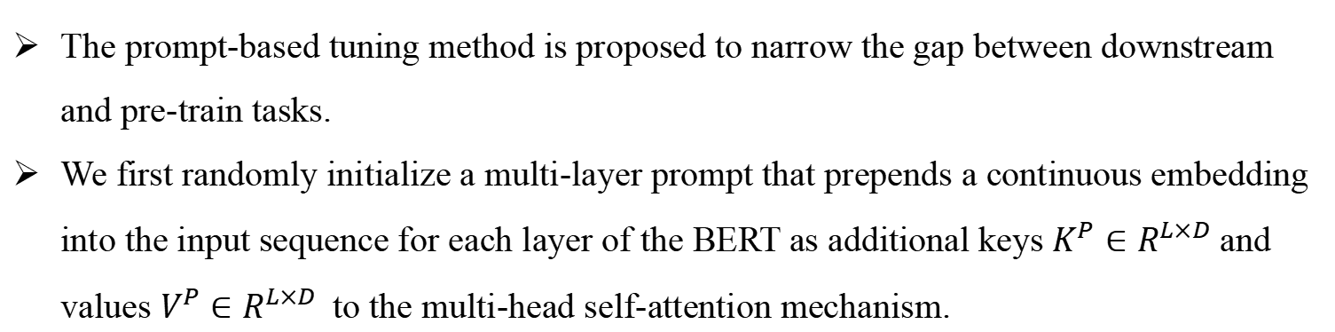
Prompt Encoder
The prompt-based tuning method is proposed to narrow the gap between downstream and pre-train tasks.
We first randomly initialize a multi-layer prompt that prepends a continuous embedding into the input sequence for each layer of the BERT as additional keys $K^{P}∈R^{L×D}$and values $V^{P}∈R^{L×D}$to the multi-head self-attention mechanism.
Notes:
for each training set， our method only need to fine-tune and store the parameters of the prompts, which can reduce the storage and computation consumption dramatically.

Slide 6

Prompt Tuning with self-supervised constraints
To further enhance the prompt’s generalization and document structure awareness. we design self-supervised learning with discourse indicator shuffle and paragraph reordering to pre-train our prompts.
Notes:
The discourse indicator refers to the conjunction indicating the relationship between sentences (e.g. “however”, ”else” and ”while” )
To simplify, for one DI token is chosen, 1) we replace the token with other DI randomly 60% with the time. 2) delete the DI 20% with the time, 3) unchanged the token 20% of the time.

Slide 7
Prompt Tuning with self-supervised constraints
Paragraph Reordering Detection
We divide the document into three parts and each part consists of one or more complete sentences. And then permute them into three possible permutations:
P = {(1, 2, 3),(2, 3, 1),(3, 1, 2)}
Discourse Indicator Shuffle
The discourse indicator refers to the conjunction indicating the relationship between sentences.
To simplify, for one DI token is chosen, 1) we randomly replace the token with other DI 60% of the time. 2) delete the DI 20% of the time, 3) unchanged the token 20% of the time.
Label=1: original essay
Label=0: corrupted essay
Computers benefit ... however ...
Some people ..., but most people...
Instead of going to ..., you can ...
We also learn about their ...
Computers benefit ... also allow ...
Some people ..., most people...
But going to ..., you can ...
We instead of learn about their ...
Computers benefit ... also allow ...
Some people ..., and most people...
But going to ..., you can ...
We instead of learn about their ...
DI shuffled, incohesive
①Computers benefit ... and allow ...
②Some people ..., but most people...
③Instead of going to ..., you can ...
We also learn about their ...
③Instead of going to ..., you can ...
We also learn about their ...
①Computers benefit ... and allow ...
②Some people ..., but most people...
Paragraph Reordering, incoherent
Fig 3. Proposed self-supervised constraints which utilizing coherent/cohesive and incoherent/incohesive texts for Prompt Tuning
Notes:
The discourse indicator refers to the conjunction indicating the relationship between sentences (e.g. “however”, ”else” and ”while” )
To simplify, for one DI token is chosen, 1) we replace the token with other DI randomly 60% with the time. 2) delete the DI 20% with the time, 3) unchanged the token 20% of the time.

Slide 8
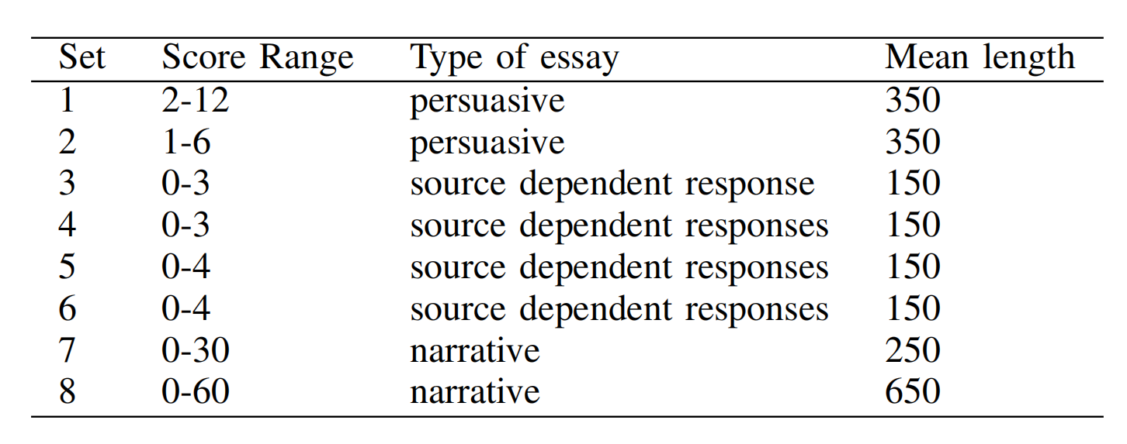
Dataset
ASAP (Automated Student Assessment Prize) dataset is provided by a Kaggle competition which contains eight different essay sets written by students from grade 7 to grade 10.
Table 1. Details of ASAP Dataset
¹https://www.kaggle.com/c/asap-aes/data
Notes:
We use the ASAP dataset as it has been widely used to evaluate the performance of AES systems. There are 13 thousand essays written by students with 8 prompts of different generes.

Slide 9
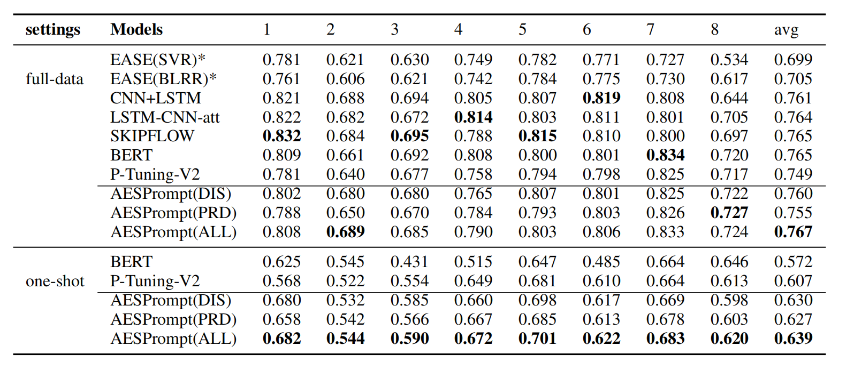
Evaluation
Quadratic Weighted Kappa (QWK) is the official evaluation metric in the ASAP competition, which measures the agreement between ratings assigned by humans and ratings predicted by AES systems.
Table 2.The performance (QWK) of all comparison methods on ASAP dataset. The best measures are in bold. * denotes statistical model
Notes:
As for evaluation Quadratic Weighted Kappa (QWK) is the official evaluation metric in the ASAP competition, which measures the agreement between ratings assigned by humans and ratings predicted by AES systems. From the results in the table, we can see that our model slightly outperforms previous methods.

Slide 10
Conclusion
  • We propose AESPrompt, a prompt-tuning framework for the essay scoring task. To the best of our knowledge, this is the first approach to incorporate a prompt-based method for essay scoring.
  • To better optimize the continuous prompts, we propose AES-related self-supervised constraints, including discourse indicator and paragraph order.
  • We conduct experiments on the ASAP dataset with the BERTbase model. Experimental results not only illustrate the effectiveness of AESPrompt in full data settings but also reinforce the stability in low-resource settings.

Slide 11
Thank you !
SEKE 2022
KSIR Virtual Conference Center, Pittsburgh, USA
July 1 - July 10, 2022

