Slide 1
An Emotion Cause Detection Method Based on XLNet and Contrastive Learning
Hai Feng Zhang, Cheng Zeng, Peng He

Slide 2
Outline
1
Background
2
Method
3
Experiments
4
Conclusion

Slide 3
Emotion cause detection is a new direction in the field of emotion research and is a fine-grained analysis of emotion.
The emotion cause detection research is not only dependent on the algorithms implemented but also limited by the cause-labeled corpus, and the current lack of relevant corpora has affected the depth of research in this area。
This paper proposes an emotion cause detection method incorporating contrastive learning.

Slide 4
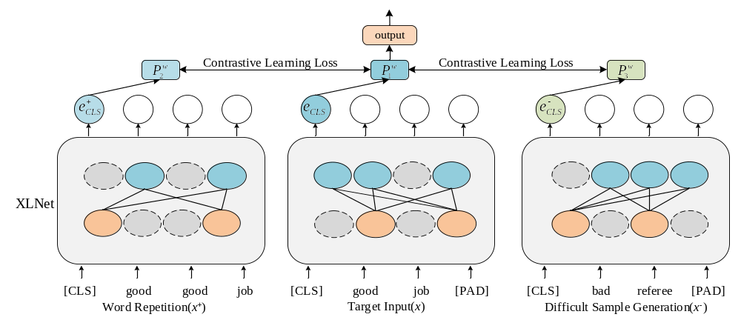

Slide 5
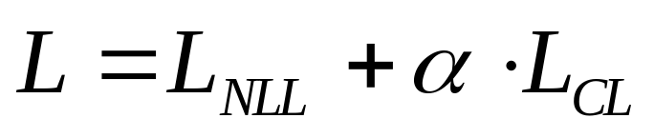
Word repetition strategy
Difficult negative sample generation strategy
The final model fusion loss function:

Slide 6
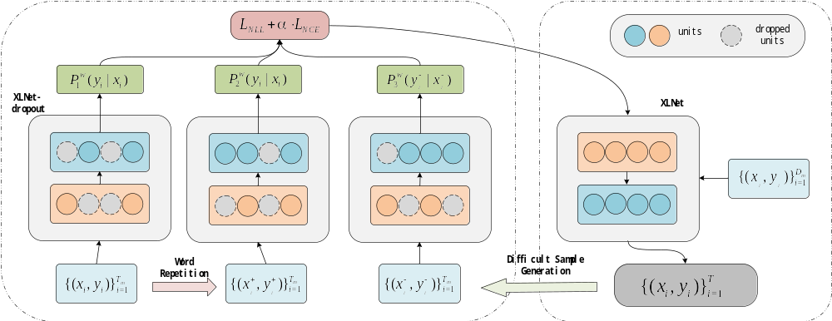

Slide 7
TABLE I. Data Display
Emotional Text | Label
All of you who have watched the whole thing know that your score shouldn't be like this, this judge is really not good, stuck with the score to give the score. | rating criteria
Great, great, superb! | empathy
He is also still our hero! | derivative topics
Evaluation metrics: Acc, MP,MR,F1

Slide 8
TABLE II. Experimental Results
Model | Acc | MP | MR | F1
TextCNN | 0.7550 | 0.5173 | 0.5203 | 0.5174
BiLSTM-Att | 0.7432 | 0.5252 | 0.5160 | 0.5197
BERT | 0.7763 | 0.5766 | 0.5711 | 0.5718
RoBERTa | 0.7822 | 0.6782 | 0.5997 | 0.6196
XLNet | 0.7763 | 0.5745 | 0.5555 | 0.5619
XLNet-RCNN | 0.7893 | 0.6996 | 0.6940 | 0.6890
XLNet-Rdrop | 0.7846 | 0.6977 | 0.6906 | 0.6931
XLNet-SimCSE | 0.7917 | 0.7311 | 0.7164 | 0.7199
XLNet-CL | 0.8036 | 0.7424 | 0.7159 | 0.7266

Slide 9
the difficult negative sample hyperparameter
the fusion factor
the temperature coefficient

Slide 10
In this paper, we propose an emotion cause detection method based on XLNet and contrastive learning, fusing the contrastive learning model on the emotion cause detection task, making full use of the advantages of XLNet and contrastive learning, and introducing a word repetition strategy and a difficult sample generation strategy in the contrastive learning module, so as to improve the emotion cause detection effect.

