Slide 1



Dynamic Heterogeneous Information Network Embedding in Hyperbolic Space
Dingyang Duan, Daren Zha, Xiao Yang, Xiaobo Guo
Seke 2022

Slide 2

Outline
Background & Motivation
Our Approach
Experimental Evaluation
Conclusion

Slide 3

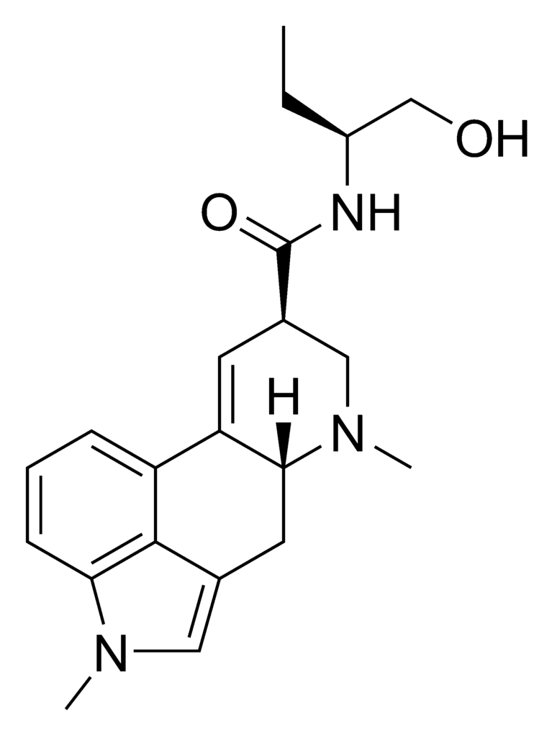
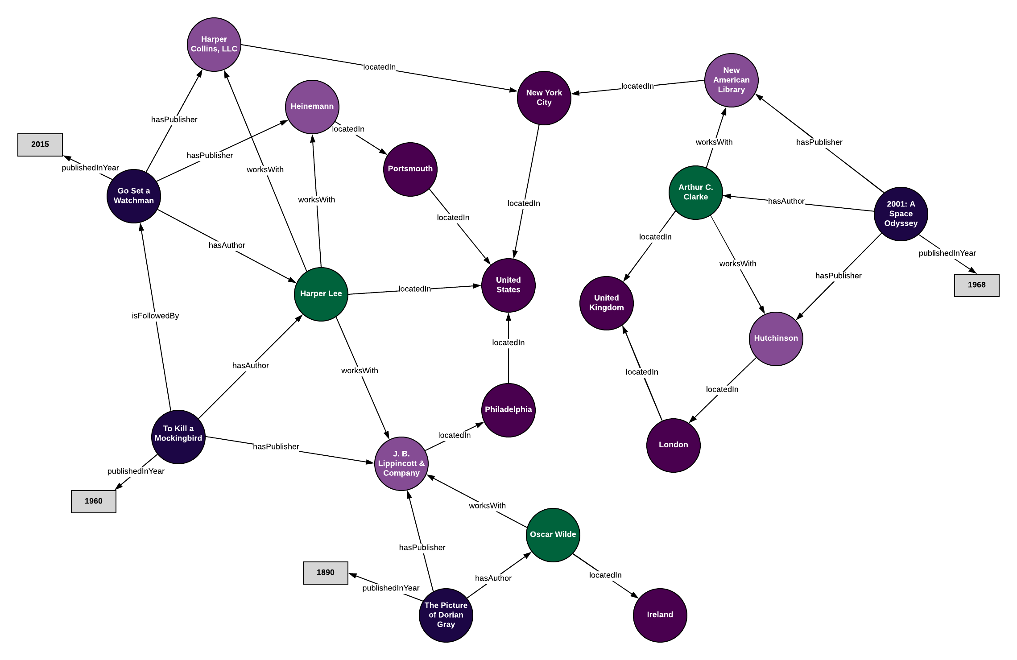
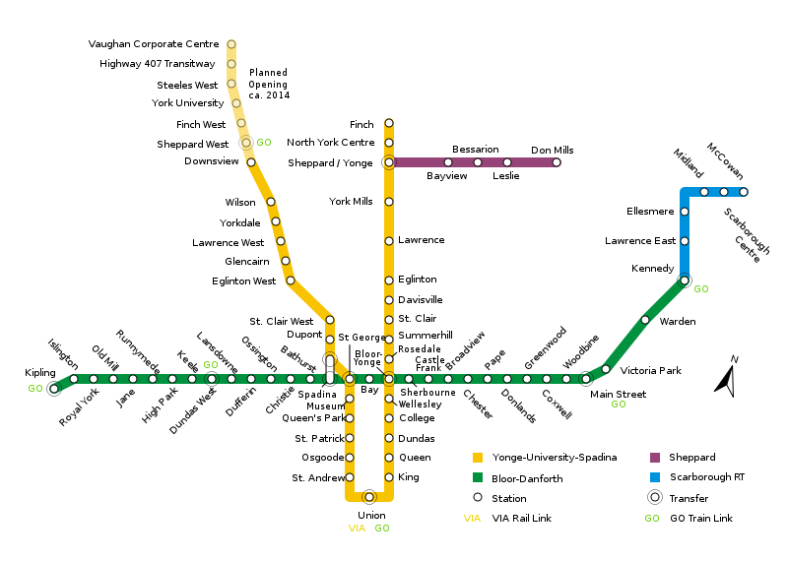
Background & Motivation
Graphs are everywhere

Slide 4
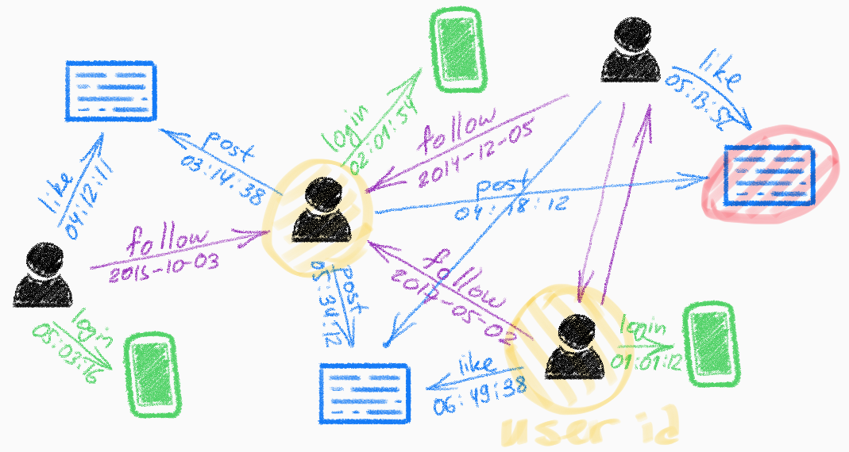
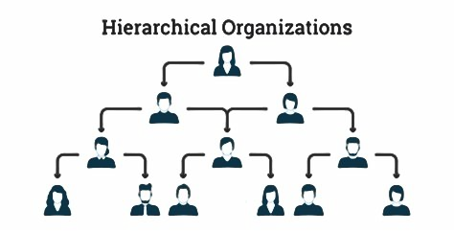
Background & Motivation
Dynamic Heterogeneous Feature
Hierarchical Feature

Slide 5
Background & Motivation
Previous studies:
  Dynamic graph in heterogeneous network. (√)
  Embedding graph in hyperbolic space. (√)
  Embedding dynamic heterogeneous graph in hyperbolic space. (×)
Our study:
  Consideration of both temporal and hierarchical features in heterogeneous network.(√)

Slide 6
Outline
Background & Motivation
Our Approach
Experimental Evaluation
Conclusion

Slide 7
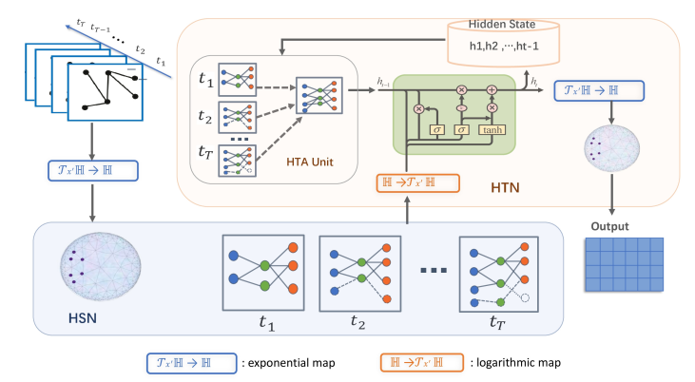
Our Approach-DyHHE

Slide 8
DyHHE-HSN

Slide 9
DyHHE-HTN

Slide 10



Loss function
HSN loss
HTN loss
The Unified Loss

Slide 11
Outline
Background & Motivation
Our Approach
Experimental Evaluation
Conclusion

Slide 12
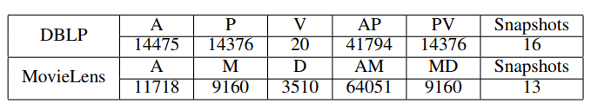
Experimental Evaluation
Datasets

Slide 13
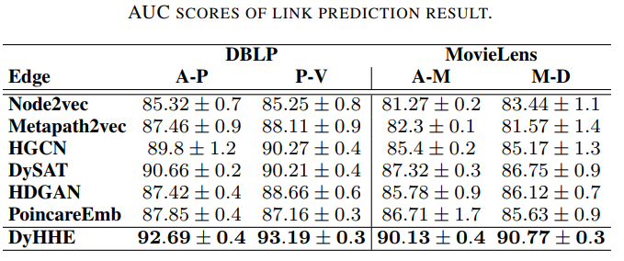
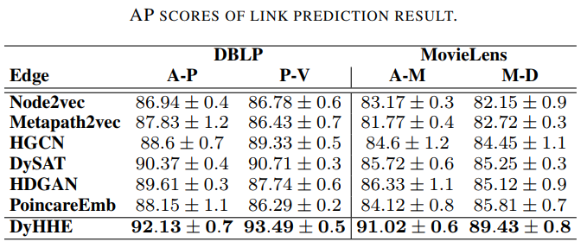
Experimental Evaluation

Slide 14
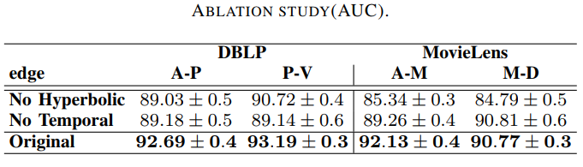
Experimental Evaluation

Slide 15
Outline
Background & Motivation
Our Approach
Experimental Evaluation
Conclusion

Slide 16
Thanks for listening
Contact us
  duandingyang@iie.ac.cn

