Slide 1

Data Selection for Cross-Project Defect Prediction with Local and Global Features of Source Code
AUTHORS:
Xuan deng , Peng He*, Chun Ying Zhou
School of Computer Science and Information Engineering Hubei University
SEKE 2022
July 1 - July 10, 2022

Slide 2
Introduction
Defect prediction (CPDP) is to predict defect-prone files in a project based on the defect data collected from other projects.Nowadays,the growing collection of defect datasets on the Internet make it a more serious challenge to construct an appropriate training data set (TDS) .
Many approaches have been proposed to characterize code files by using traditional hand-crafted features. Unfortunately, they ignore rich semantics hidden in the code’s Abstract Syntax Trees (ASTs) and the globally structural information extracted from the classes in the source code files.
In this paper, we propose a new framework called ALGoF to Automatically learn the Local semantic (ﬁne-grained) and Global structural (coarse-grained) Features of code ﬁles for data selection in CPDP and seek empirical evidence that they can achieve acceptable performance compared with the traditional method.

Slide 3
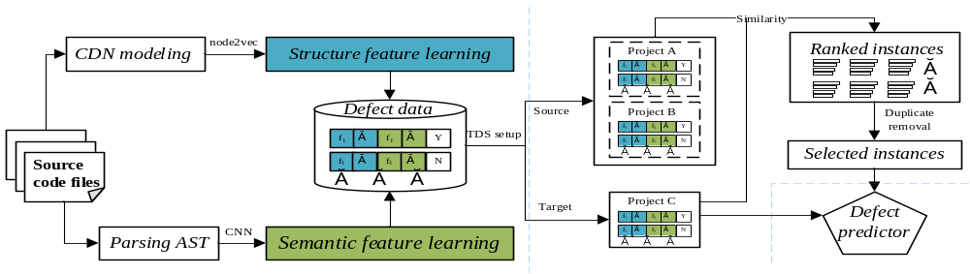
Approach - ALGoF
Extract the dependencies between the classes from the source code files to construct a class dependency network
Perform network embedding learning on the CDN to generate the global structural features of classes
Leverage a Convolutional Neural Network (CNN) to automatically learn semantic features using token vectors extracted from the class files’ abstract syntax trees (AST).
Combine the structural and semantic features and use them as the representation of the class file
Select one project from the Defect data as the target set and all other projects as the training set
Apply cosine similarity index to construct a model for ranking source instances based on the given target instances
Use the resulting source file instances to train the predictor and test on the target instances.

Slide 4
Dataset
Project | Releases | #files | defect rate(%)
Camel | 1.4 | 892 | 17.1
Lucene | 2.0 | 186 | 48.9
Poi | 2.5 | 379 | 65.1
Synapse | 1.1 | 222 | 27.0
Xalan | 2.6 | 875 | 47.0
Xerces | 1.3 | 446 | 15.0
Six defect datasets from the PROMISE repository
#files and defect rate are the number of files and the percentage of defective files, respectively

Slide 5
Experiment Results
RQ1: Does data selection based on ALGoF and its variants of CPDP work well?
Research
Question
RQ2: For CPDP data selection, which is better: automatically learned features or traditional hand-crafted features?

Slide 6
Four Scenarios
(i)THC represents predictor based on the traditional hand-crafted features.
(ii)ALoF represents predictor based only on the local semantic features.
(iii)AGoF represents predictor based only on the global structural features.
(iv)ALGoF represents predictor based on both the local and global features.

Slide 7
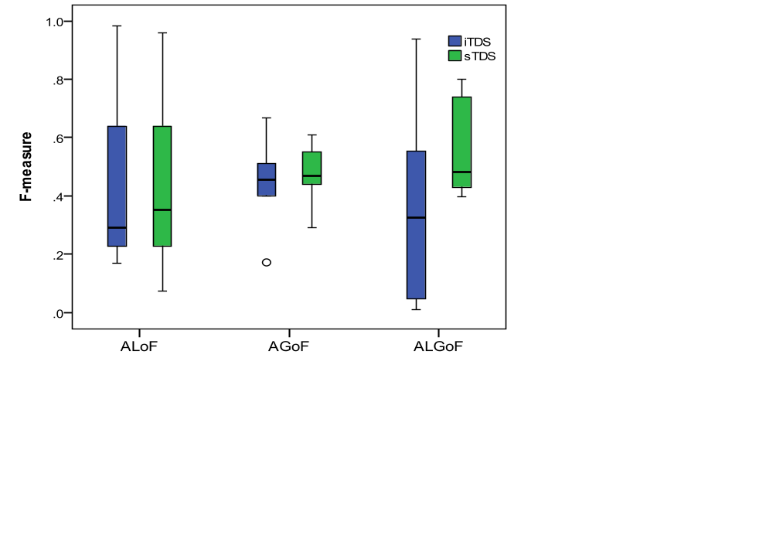
Experiment Results
RQ1: Does data selection based on ALGoF and its variants of CPDP work well?
A comparison on F-measure of CPDP under the case of iTDS and sTDS
Model | iTDS | sTDS | ∆（%）
ALoF | 0.292 | 0.352 | 20.55%
AGoF | 0.456 | 0.470 | 3.07%
ALGoF | 0.325 | 0.482 | 48.31%
the initial source TDS without any selection is considered as a baseline, labeled as iTDS
label the case of TDS selection using the features learned in this paper as sTDS

Slide 8
Experiment Results
RQ1: Does data selection based on ALGoF and its variants of CPDP work well?
The Wilcoxon signed-rank test and Cliff's Delta (0.33≤|δ| <0.474 means the medium effectiveness level, and |δ| ≥0.474 means the large effectiveness level ).
 | Sig. p-value (0.05) | cliff's delta (δ)
ALoF_iTDS-ALoF_sTDS | 0.934 | -0.028
AGoF_iTDS-AGoF_sTDS | 0.745 | 0.000
ALGoF_iTDS-ALGoF_sTDS | 0.116 | -0.484
ALoF_sTD-ALGoF_sTDS | 0.219 | -0.389
AGoF_sTD-ALGoF_sTDS | 0.345 | -0.083

Slide 9
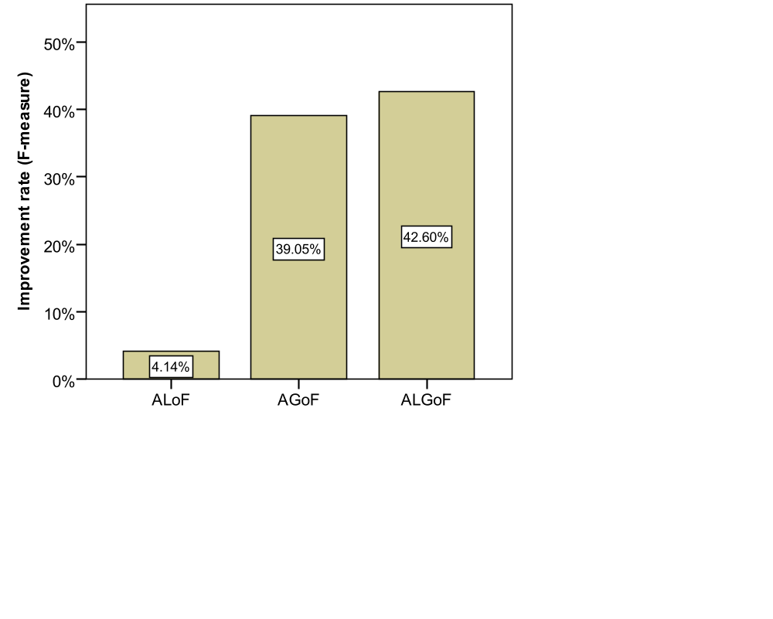
Experiment Results
RQ2 : For CPDP data selection, which is better: automatically learned features or traditional hand-crafted features?
The improvement rate of F-measure values compared with THC scenario (with data selection).

Slide 10
Experiment Results
RQ2 : For CPDP data selection, which is better: automatically learned features or traditional hand-crafted features?
Comparison of Wilcoxon signed-rank test and Cliff's effect size of the automatic extraction features with THC
 | Sig. p-value (0.05) | cliff's(δ)
ALoF_sTDS-THC_sTDS | 0.719 | 0.111
AGoF_sTDS-THC_sTDS | 0.035 | 0.417
ALGoF_sTDS-THC_sTDS | 0.035 | 0.667

Slide 11
Conclusion
The results indicate that features automatically learned from the source code (e.g., local semantic feature and global structural feature) are helpful to guide the training data selection for CPDP, and compared with the case of no data selection processing, the F-measure improvement rate of ALGoF is 48.31%.
The results also show that our method is significant better than the traditional method, especially when using both the local semantic and global structural features as the representation of code files, and about 42.6% actually defective instances can be additionally predicted by our method.

Slide 12
Thank You!
Any Questions?
xuan_deng@qq.com

