Slide 1

Adaptive Prior-Knowledge-Assisted Function
Naming Based on Multi-level Information Explorer
Lancong Liu, Shizhan Chen, Sen Chen, Guodong Fan, Zhiyong Feng, Hongyue Wu ∗
Cognitive and Service Engineering Lab
Tianjin University

Slide 2
Two problems
Comprehensibility of source code is strongly affected by identifier names
Inappropriate names may lead to software defects
Generating a function name that can directly reflect one’s intent is difficult

Slide 3
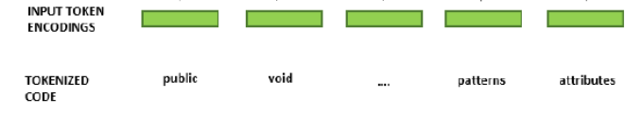
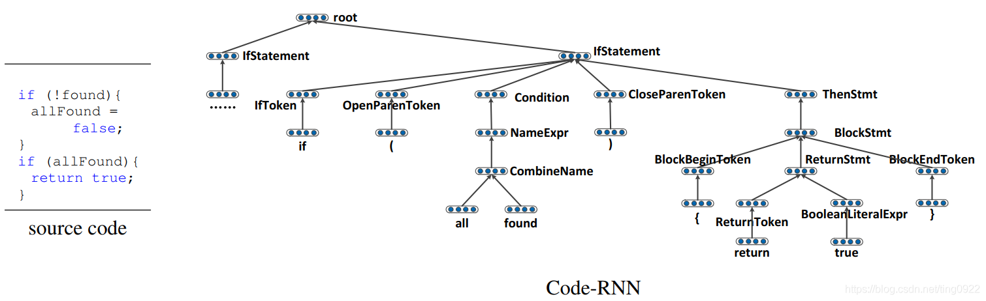
Current deep-learning approaches are based on the granularity of
token or AST nodes
tokens
AST

Slide 4
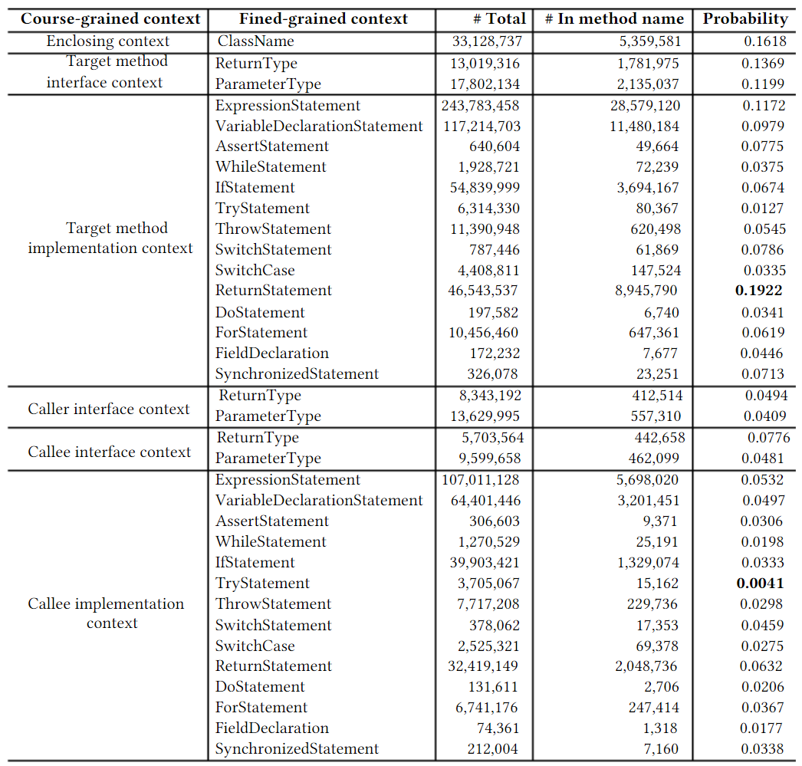
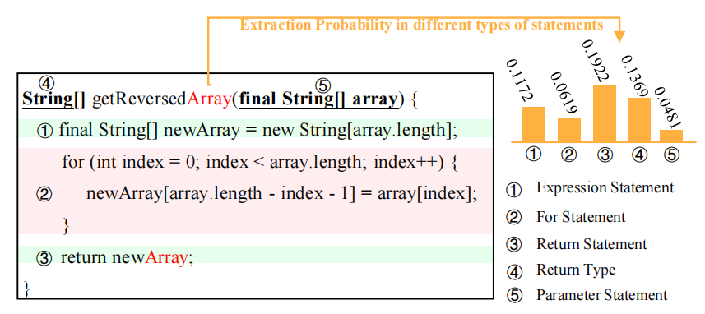
Our approach：capture the function semantics based on statement-level and employ the prior knowledge to assist the model

Slide 5
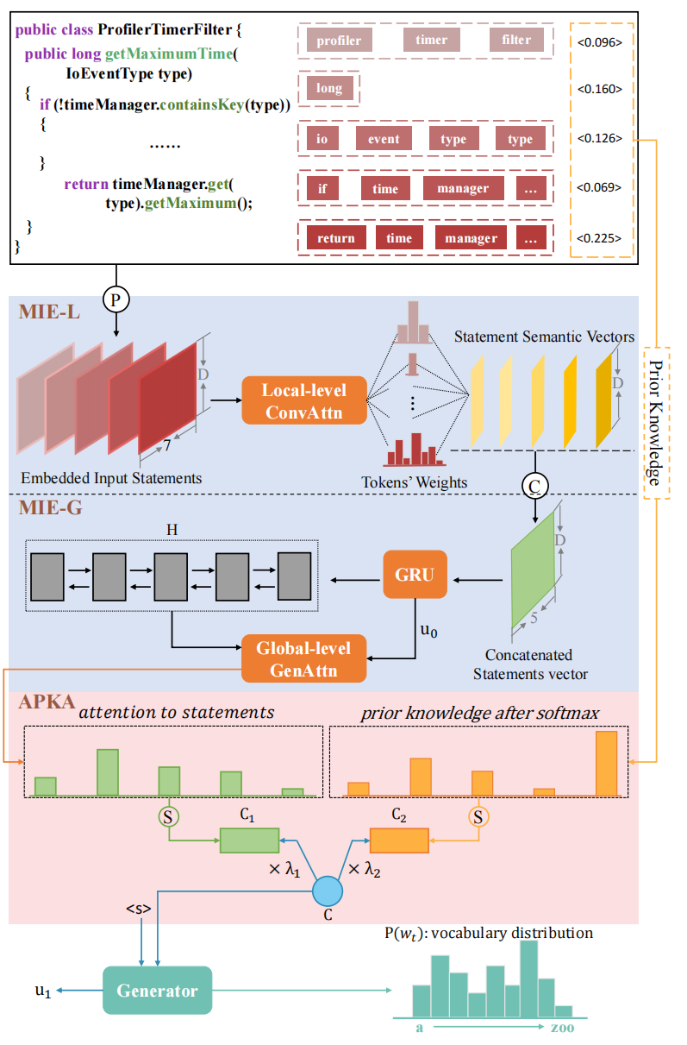
function decomposion
try to understand the meaning of
each statement
comb their logical relations to understand
the whole function
employ the prior knowledge

Slide 6
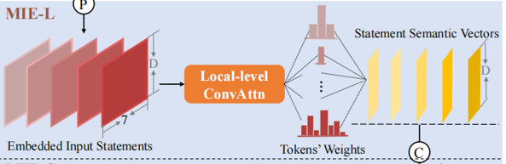
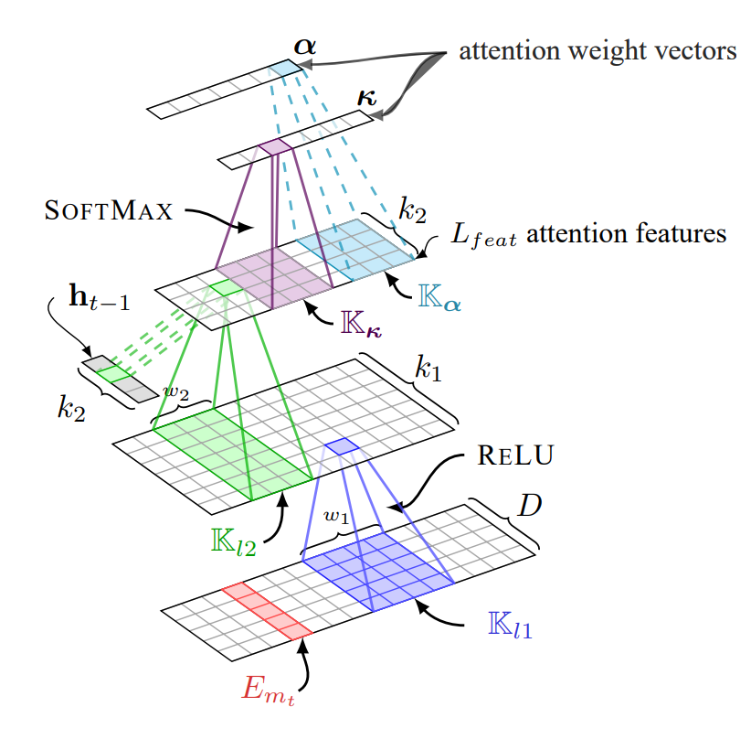
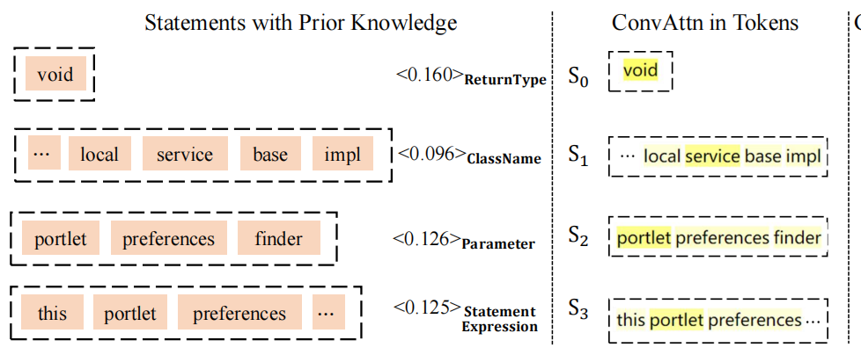
Understand the meaning of each statement

Slide 7
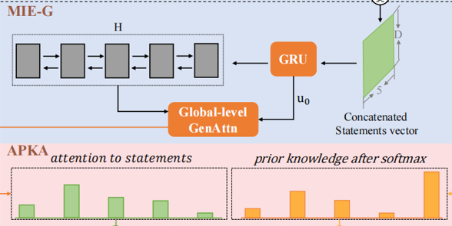
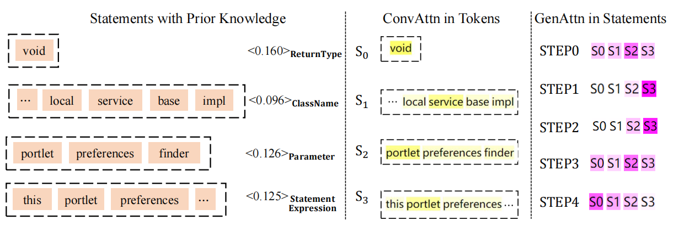
Comb the logical relations to understand the whole function

Slide 8
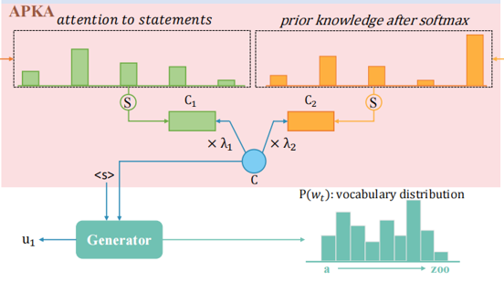
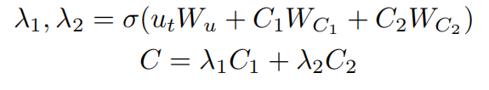
Employ the prior knowledge
why we use the prior knowledge?
Certain name tokens can be extracted directly from certain statements and such probability differs significantly in different types of statements.
why we design in such way?
The model should judge if the name token can be extracted or predicted at each time step.

Slide 9
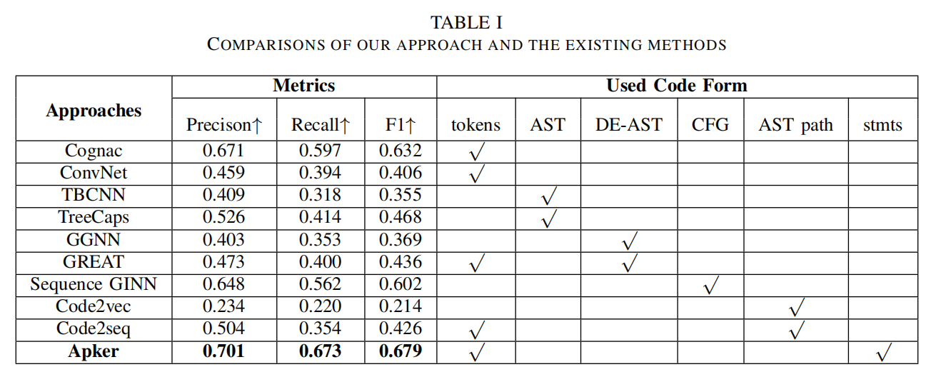
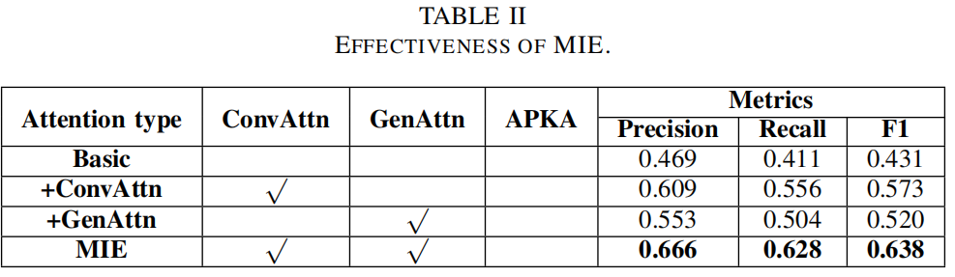
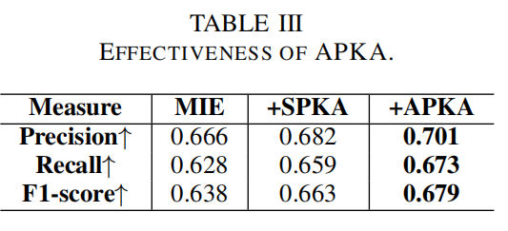
Experimental results

Slide 10
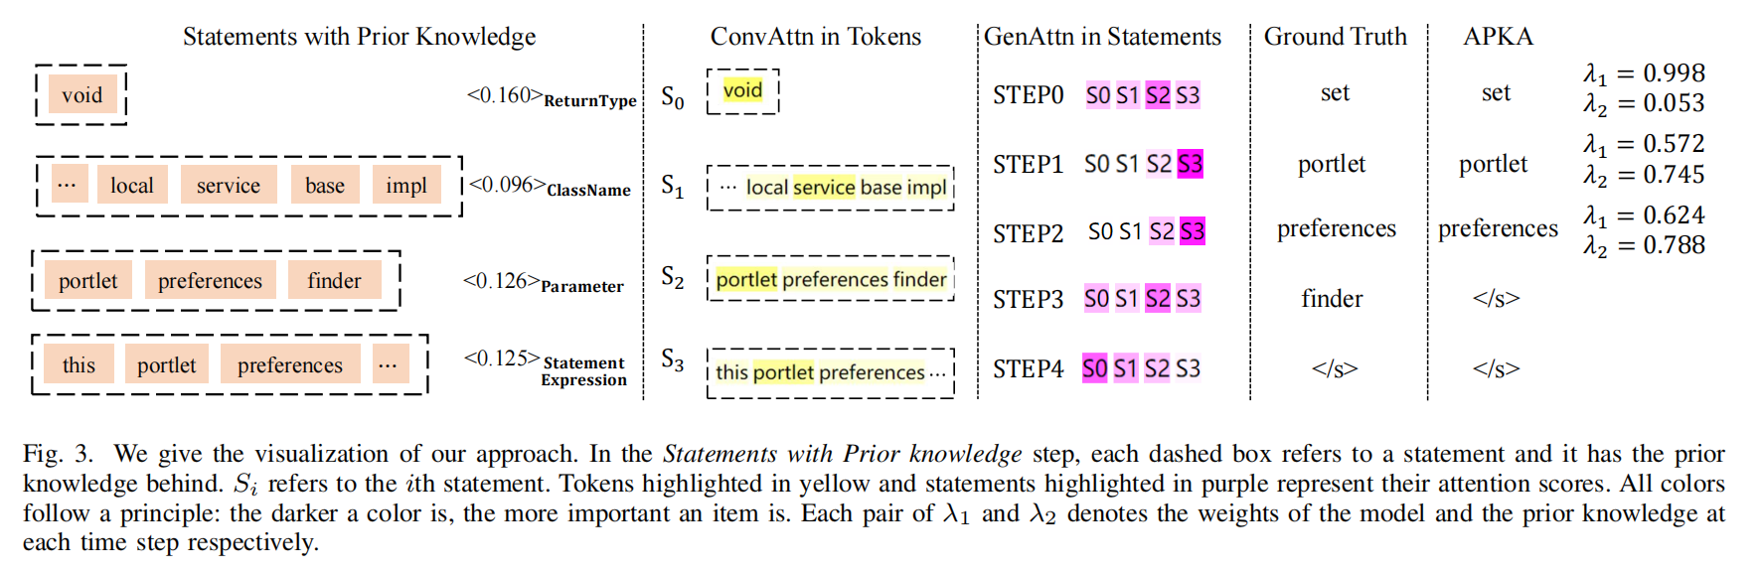
Visual analysis

