Slide 1


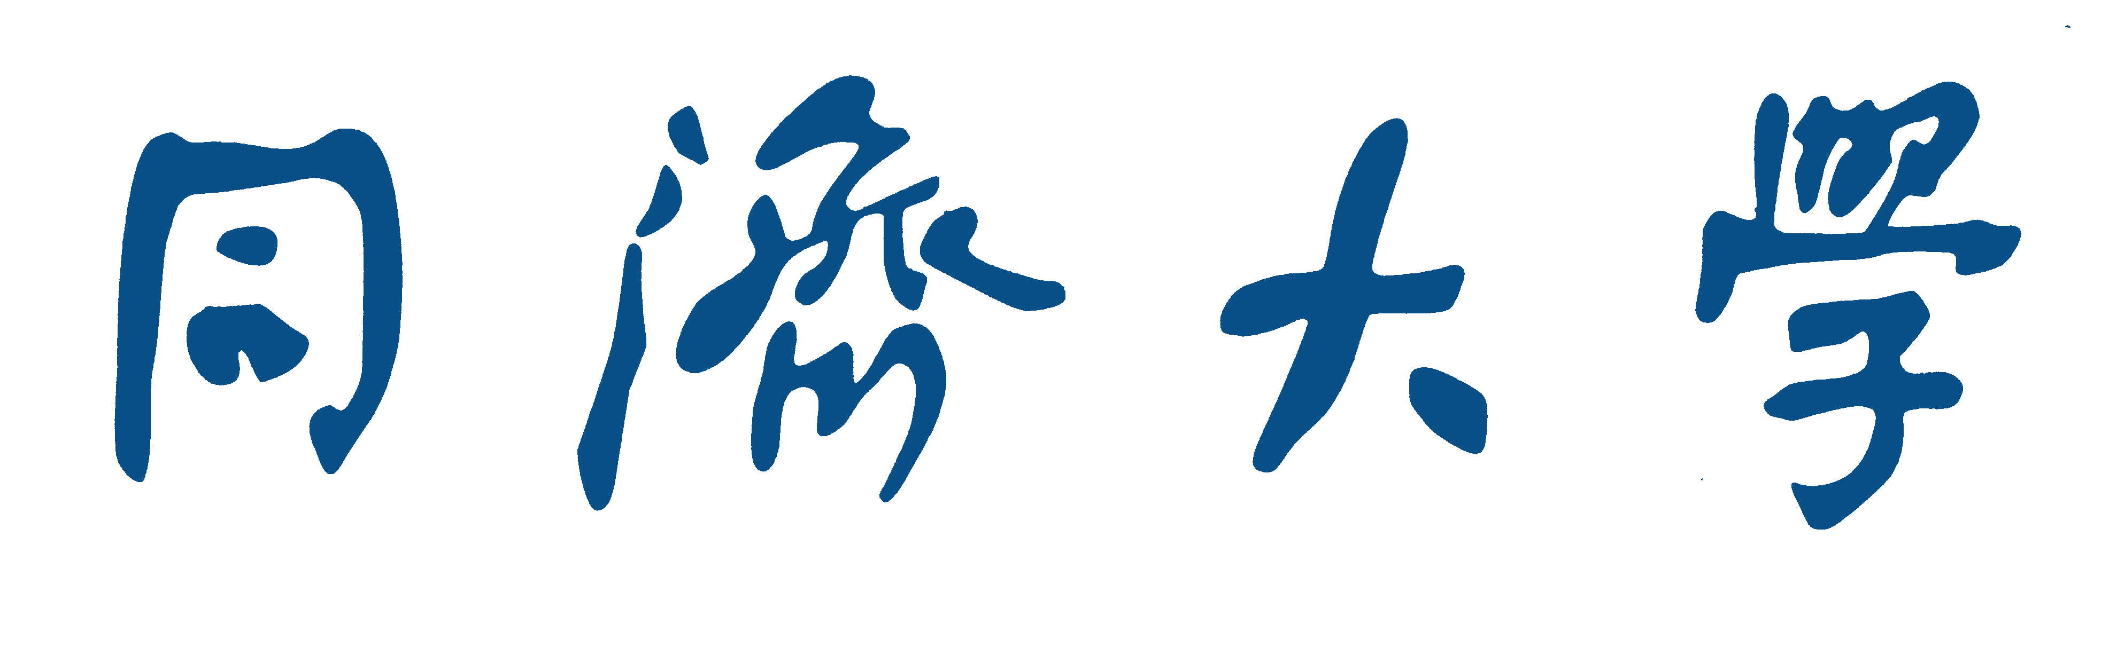
Utilizing Edge Attention in Graph-Based Code Search
Wei Zhao
School of Software Engineering
Tongji University Shanghai, China
2031569@tongji.edu.cn
Yan Liu*
School of Software Engineering
Tongji University Shanghai, China
yanliu.sse@tongji.edu.cn
TONGJI UNIVERSITY
Notes:
Good evening, ladies and gentleman. My name is Zhaowei, and I’m from the school of software engineering, Tongji University. It’s my great honor to be here to address you on this special occasion.
The title of my paper is “Utilizing Edge Attention in Graph-Based Code Search”

Slide 2
01
Introduction
03
Evaluation
02
EAGCS
04
Conclusion
TONGJI UNIVERSITY
Notes:
Now I will introduce my paper from four aspects.

Slide 3
01
Introduction
TONGJI UNIVERSITY
Notes:
The first part is the introduction of my paper.

Slide 4
Introduction
Code Search
Search for code snippets with specific functions in large code bases (such as GitHub, stack overflow) by entering the query description.
It is a common activity in the software development process. According to statistics, developers usually spend 19% of the project time looking for reusable code function fragments.
Accurate search results can be reused with only slight reconstruction and help quickly realize specific project functions to boost developers’ productivity.
Notes:
Code search refers to searching for code snippets with specific functions in large code bases. It is a common activity in the software development process.
According to statistics, developers usually spend 19% of the project time looking for reusable code function fragments.
Accurate search results can be reused with only slight reconstruction and help quickly realize specific project functions to boost developers’ productivity.

Slide 5

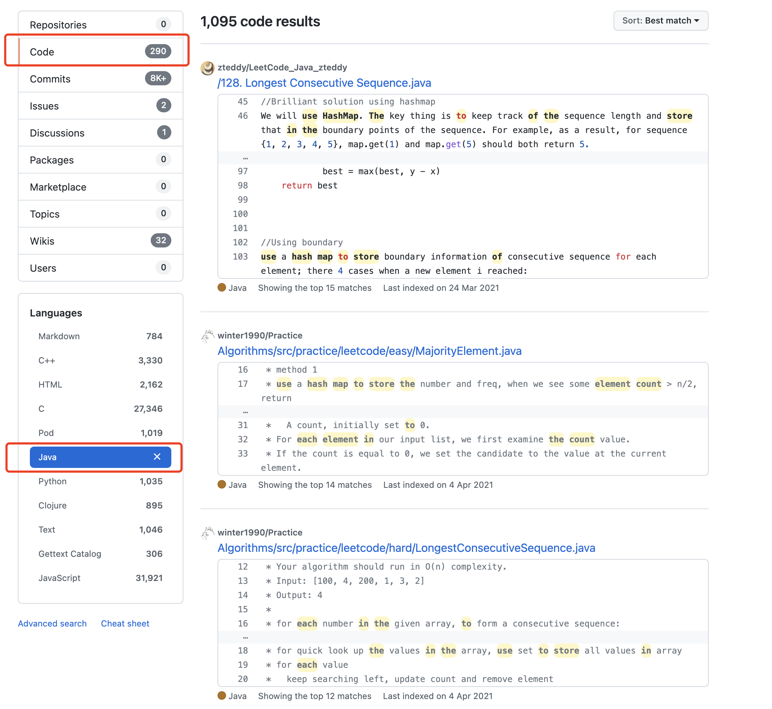
Introduction
Search “use hash map to store the count of each element in nums” in GitHub
Information Retrieve
Mainly based on keyword matching
Lack of semantic understanding of natural language and source code
Multiple attempts are required while the input does not meet the expected results
Users need to have rich experience to give accurate query words
Valid search results rank lower in the returned result list
More accurate results are preferred
Notes:
If you search“ use hash map to store the count of each element in nums”in GitHub， you can get the return results as shown in the left figure.
By observation, most of the first few search results do not meet the expected results.
That’s because the existing code search engines are mainly based on keyword matching, which is unfortunately lack of semantic understanding of natural language and source code.
And multiple attempts are required while the input does not meet the expected results, so users need to have rich experience to give accurate query words
Valid search results rank lower in the returned result list, so more accurate results are preferred

Slide 6
Introduction
Deep Learning
Strength
  bridge the semantic gap between source code and query statements.
  embed code snippets into unified vectors to represent the code, which can reduce the interference of noisy keywords and recognize semantically related words.
Challenge
  how to mine and utilize deep code semantics.
Notes:
To solve above problems, there has been an ample increase in the number of deep learning-based approaches.which can bridge the semantic gap between source code and query statements.
These approaches embed code snippets into unified vectors to represent the code, which can reduce the interference of noisy keywords and recognize semantically related words.
However, how to mine and utilize deep code semantics is still the key challenge, and the basic code representation method has a far-reaching impact on the expression of code semantics, which will further affect search performance.

Slide 7
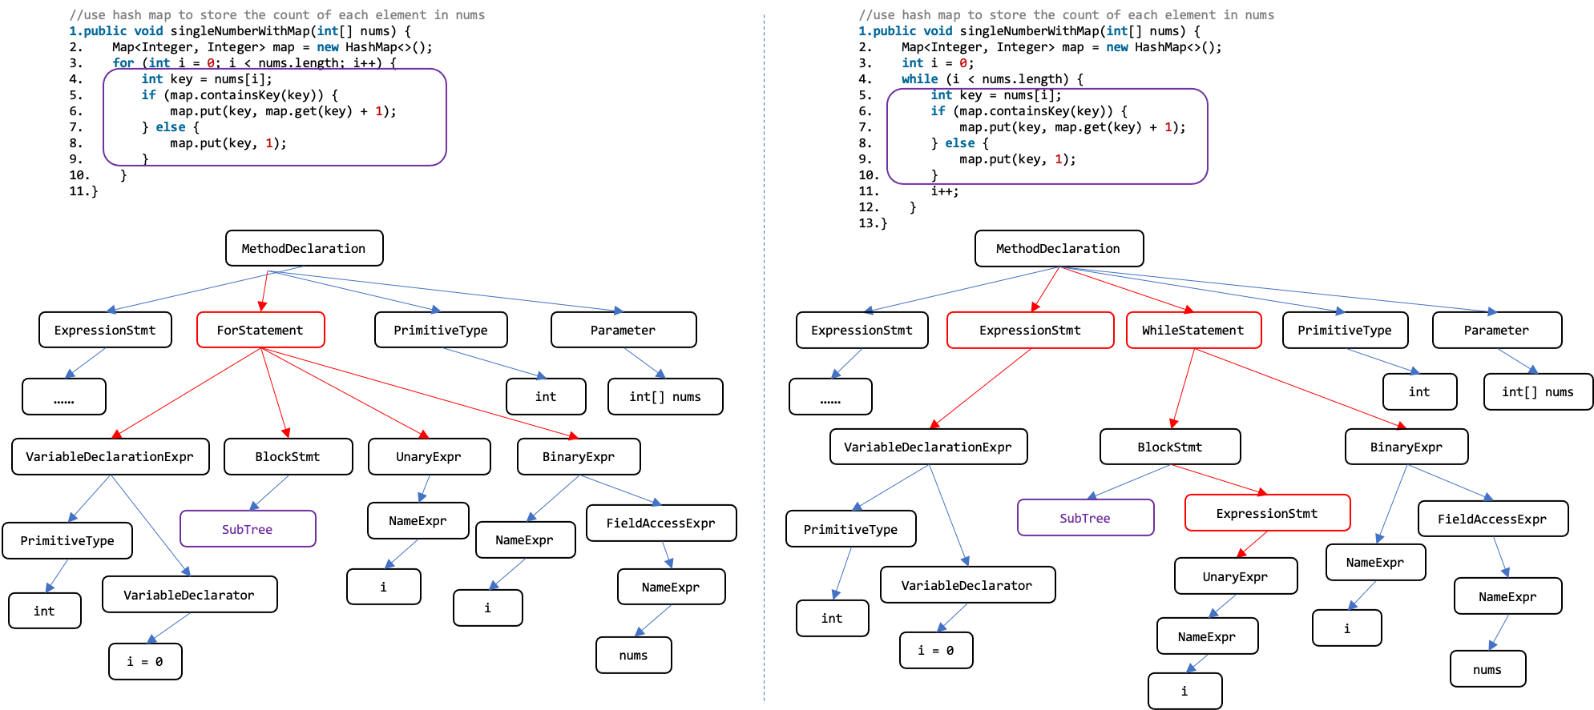
Introduction
Abstract Syntax Tree
Notes:
As code is structural and has unique language-specific semantics, the graph is a natural and effective representation of code.
Taking Java as an example, there are a series of implicit relationships between code elements, such as the order of method calls, variable flow, and these relationships can reveal the potential code semantics.
AST is one of the most common graphical representations of code, however, code with different syntax structures may express the same functionality, as shown in this page, which indicates that simply using AST to represent code is not enough to accurately express the deep code semantics.
So we need to break through the current limitations of sequential data and enhance code semantics via utilizing the rich structural information behind programs.

Slide 8
Introduction
Contributions
We introduce a novel statement-level code representation method called APDG, which optimizes the traditional PDG and strengthens both data and control dependence information to enrich the edge semantics.
We propose EAGCS, a graph-based code search approach that enhances the GGNN via an edge attention mechanism to improve the expression of code semantics in APDG.
We conduct experiments on our model and other start-of- the-art models and the results have shown that our model outperforms the others. Besides, we also explore the impact of different edges on the model performance.
Notes:
Based on the aforementioned background,the main contributions of this paper are as follows:
We introduce a novel statement-level code representation method called APDG, which optimizes the traditional PDG and strengthens both data and control dependence information to enrich the edge semantics.
We propose EAGCS, a graph-based code search approach that enhances the GGNN via an edge attention mechanism to improve the expression of code semantics in APDG.
We conduct experiments on our model and other start-of- the-art models and the results have shown that our model outperforms the others. Besides, we also explore the impact of different edges on the model performance.

Slide 9
02
EAGCS
TONGJI UNIVERSITY
Notes:
Second part I will introduce our proposed method EAGCS

Slide 10
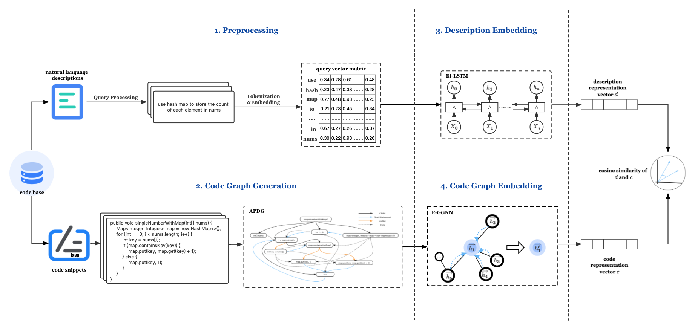
EAGCS
Notes:
This figure shows the overall structure of EAGCS

Slide 11
EAGCS
Segment the comment according to the “.” character
Remove non-English symbols and stop words
Query Processing
Code Processing
Convert the code snippets into class
Code Graph
Generation
Transform the query statements into sequences of numerical tokens.
Tokenization
Tokenization
Transform the node statements into sequences of numerical tokens.
Embed the description into a vector
Description
Embedding
Code Graph Embedding
Notes:
Detail information are shown on this page.
After query processing、tokenization and description embedding，we can get the description vector.
By code processing、code graph generation、tokenization and code graph embedding，we can also get a vector to represent code.
After embedding both descriptions and code snippets into unified vectors, the model can recommend code snippets with higher cosine similarity according to the given user query.
Now we will introduce two important modules in detail

Slide 12
APDG
PDG
APDG
Nodes
  Method Declaration, Parameter, Unary Expression, Variable Declaration Expression, Method Call Expression, Assign Expression, Construction Declaration, Try Statement, Class or Interface Declaration, Condition, Return Statement and Assert Statement
Control Dependence
  defines the constraint relationship of statement execution, which can reflect the syntax, execution order, and control information.
Data Dependence
  defines the constraint relationship of variables between statements.
Definition
  the nodes represent program statements and the edges represent the interdependence between program statements
Weakness
  fails to reflect the order in which statements are executed and the implicit control logic
Notes:
First one is code graph generation.
Program dependence graph (PDG) is one of the most widely used directed code graphs, where the nodes represent program statements and the edges represent the interdependence between program statements,
but it fails to reflect the order in which statements are executed and the implicit control logic.
In our work, we construct a statement-level advanced program dependence graph (APDG)
We first traverse the AST and consider 12 types of node.
And then add control and data edges to improve the awareness of neighbors.
control dependence defines the constraint relationship of statement execution, which can reflect the syntax, execution order, and control information.
data dependence defines the constraint relationship of variables between statements.

Slide 13
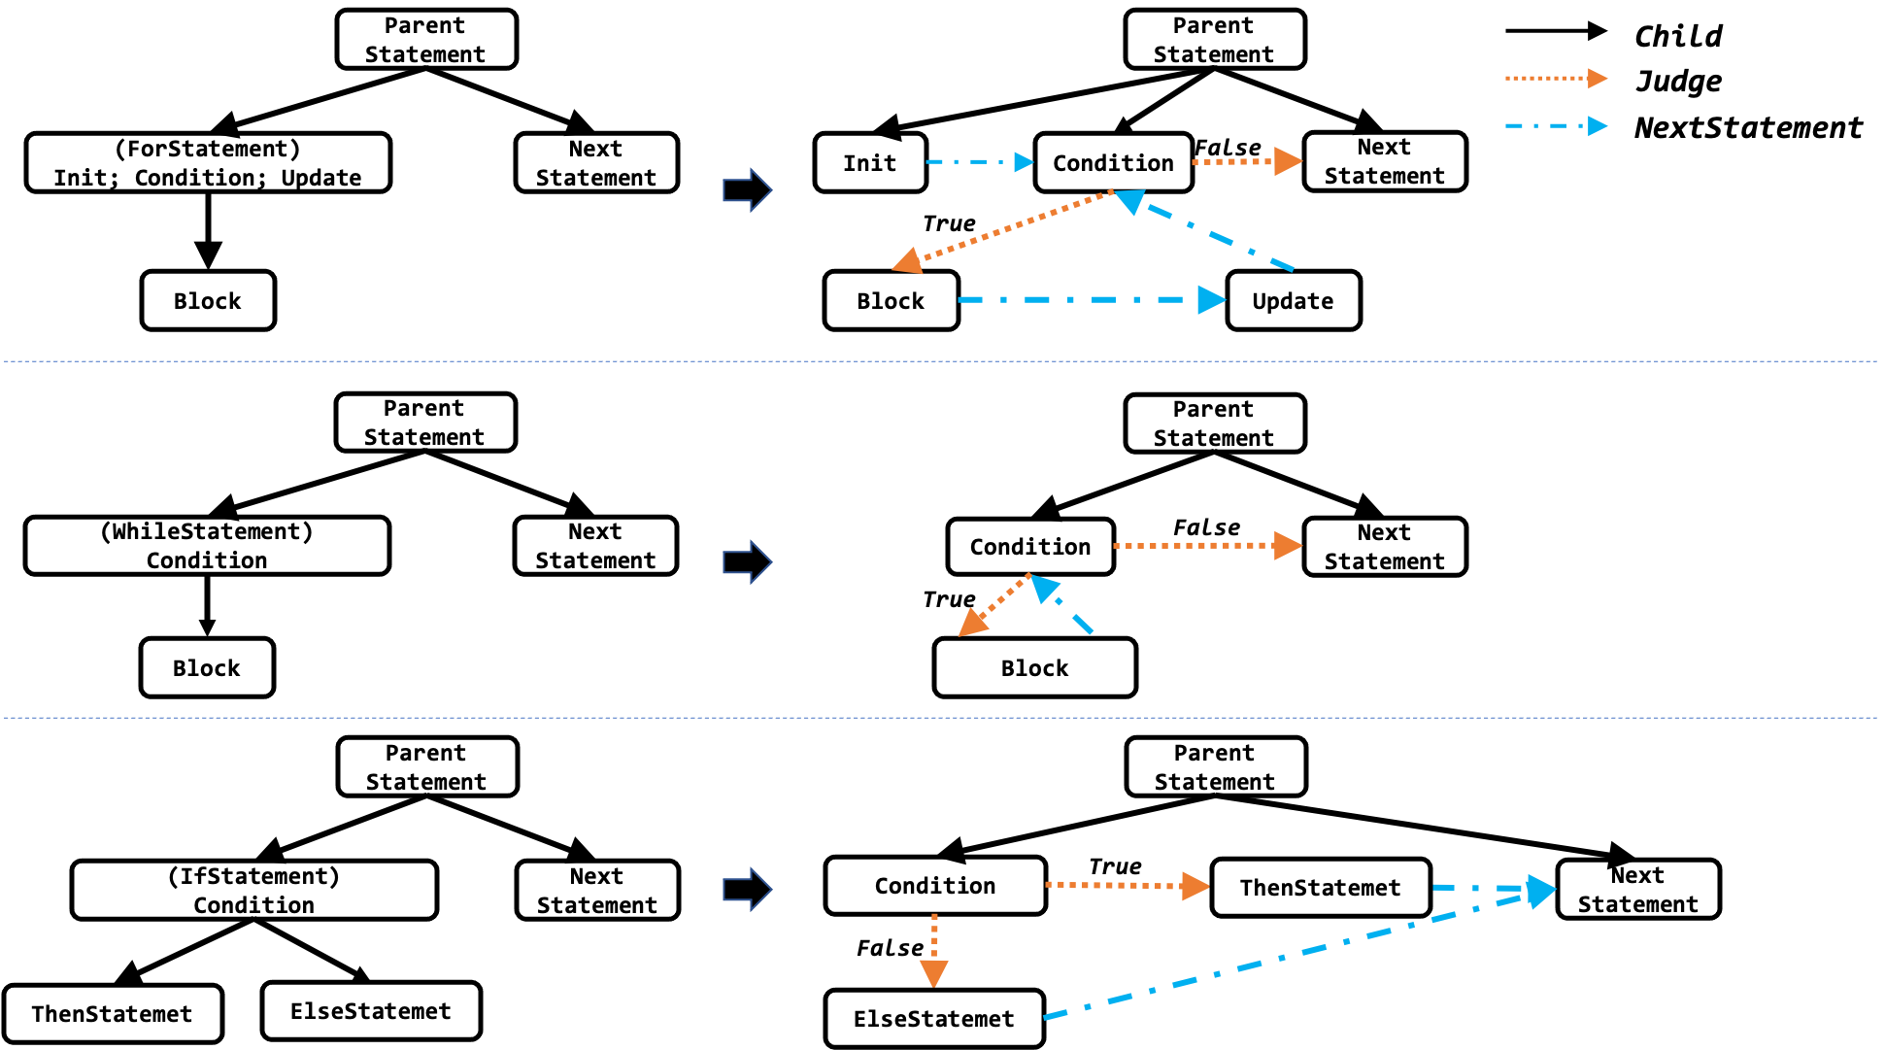
APDG
Control Dependence
  Child Edge: connect parent and child nodes in AST and point from parent node to child node which can reflect the control dependence of statements at the syntactic level
  NextStatement Edge: concatenate statements inside a block according to the context, indicating the order of statement execution.
  Judge Edge: transform three common control statements in AST and add Judge edges to uncover the control logic.
Notes:
There are three edge types which represent code control dependence information
Child Edge: connect parent and child nodes in AST and point from parent node to child node which can reflect the control dependence of statements at the syntactic level
NextStatement Edge: concatenate statements inside a block according to the context, indicating the order of statement execution.
Judge Edge: transform three common control statements in AST and add Judge edges to uncover the control logic.

Slide 14
APDG
Data Dependence
The data dependence rule of variable v from statements s1 to s2 can be described as:
  v is defined or assigned in statement s1.
  v is used in statement s2.
  The scope of s2 is inside the scope of s1.
  If s1 and s2 have the same scope level, a NextStatement path exists from s1 to s2.
Notes:
As for data dependence, We also defined its build rules.

Slide 15
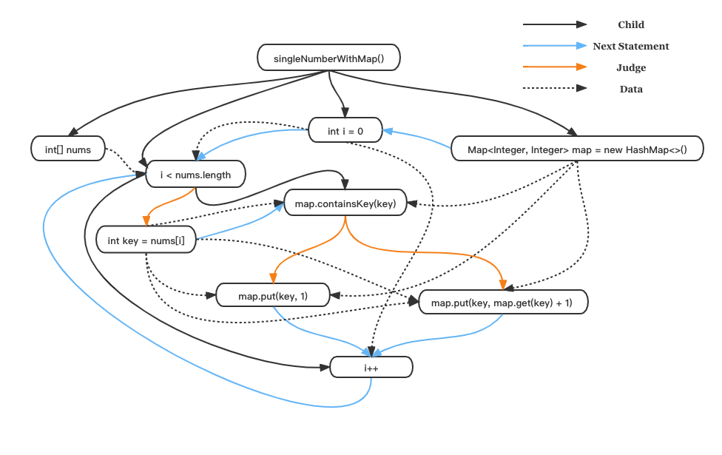
APDG
APDG
//use hash map to store the count of each element in nums
public void singleNumberWithMap(int[] nums) {
Map<Integer, Integer> map = new HashMap<>();
for (int i = 0; i < nums.length; i++) {
int key = nums[i];
if (map.containsKey(key)) {
map.put(key, map.get(key) + 1);
} else {
map.put(key, 1);
}
}
}
Notes:
As shown in this page, we constructed APDG for the left code snippet, and latent code semantics can be expressed through node contents and multiple edges.

Slide 16
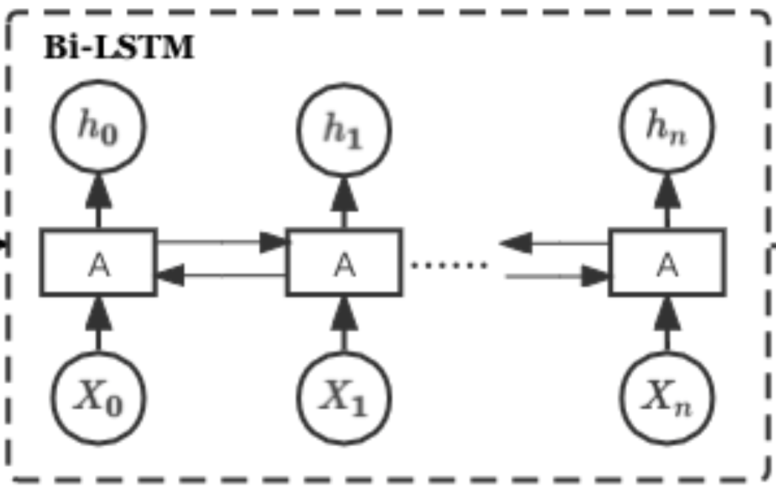
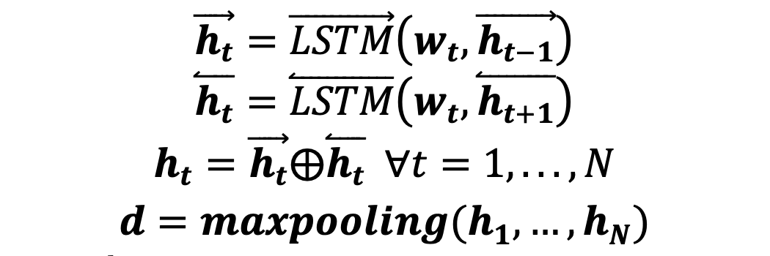
Embedding
Description Embedding
Given a description D as a sequence of token vectors: w1, ..., wN, D = {w1, ..., wN}
𝒘𝒕 ∈ R, ht is the hidden states at step t, t=1,...,N, N is the length of the sequence, ⨁ is the concatenation operation.
Notes:
As for embedding, we use a Bidirectional-LSTM to extract semantic information of query description.

Slide 17
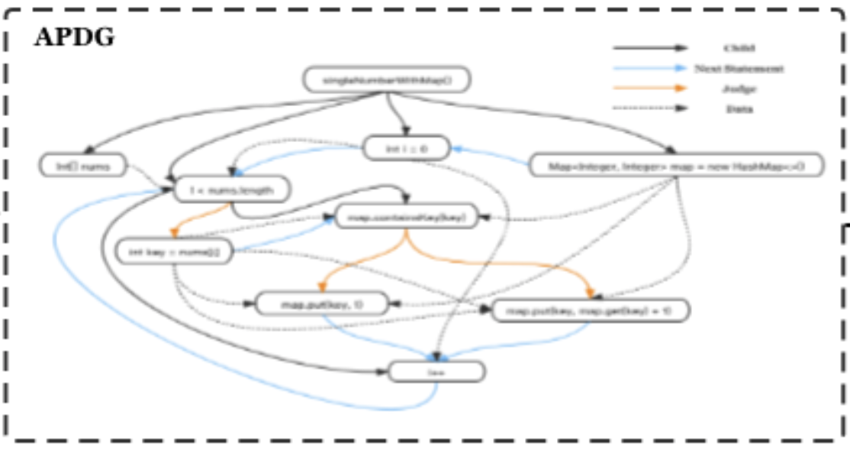
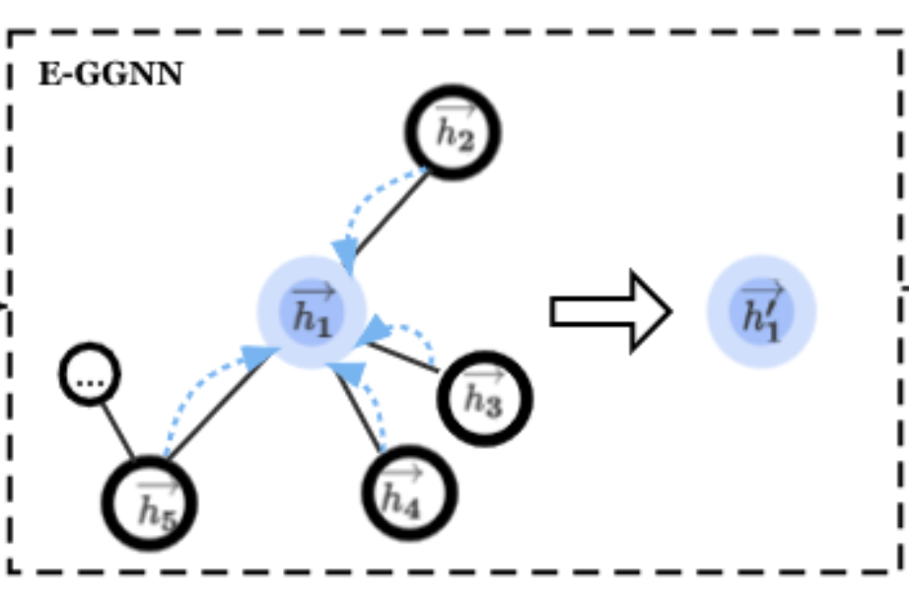
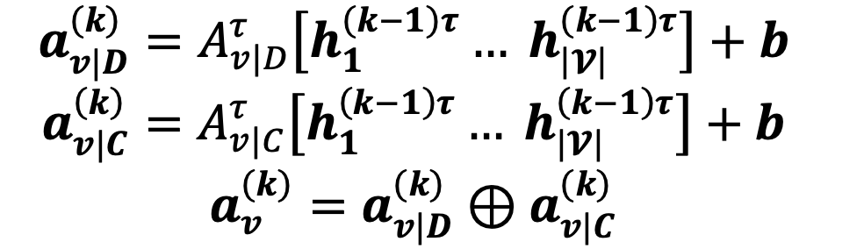
Embedding
Code Graph Embedding
Node
embedding
Edge attention
Notes:
As for code graph embedding
as we have already enriched edge semantics in APDG, we propose EAGGNN which enhances the ordinary GGNN via an edge attention mechanism to deal with different types of edges to focus on both data and control dependence information for each iteration.

Slide 18
03
Evaluation
TONGJI UNIVERSITY
Notes:
Then we designed some experiments to evaluate our code search methods

Slide 19
Evaluation
Processed Dataset
  training set: 454,451 samples
  test set：4,548 samples
Evaluation Method
  Automatic evaluation: we randomly selected 99 other code snippets and combined them with the ground truth as the search base for a query input.
Evaluation Metrics
  SuccessRate@k: the percentage of queries for which the corresponding ground-truth code snippet could exist in the top k ranked results.
  MRR: the average of the reciprocal ranks of results of a query set Q.
Baseline models
  DeepCS：the state-of-the-art neural network to retrieve relevant code snippets given a query description.
  GGNN：the gated neural network without edge attention based on our APDG.
Notes:
As for evaluation method, we took automatic evaluation to avoid the bias caused by manual ranking.
Then we took experiments on baseline models and evaluated the two common evaluation metrics based on the data set we have processed.

Slide 20
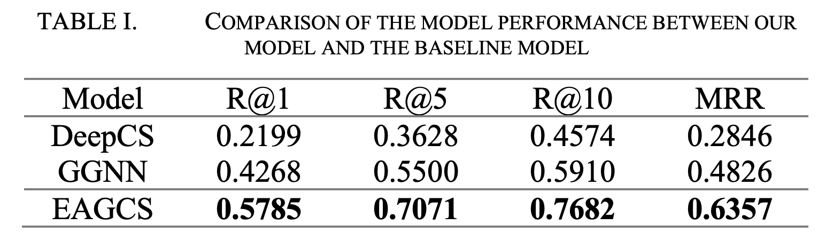
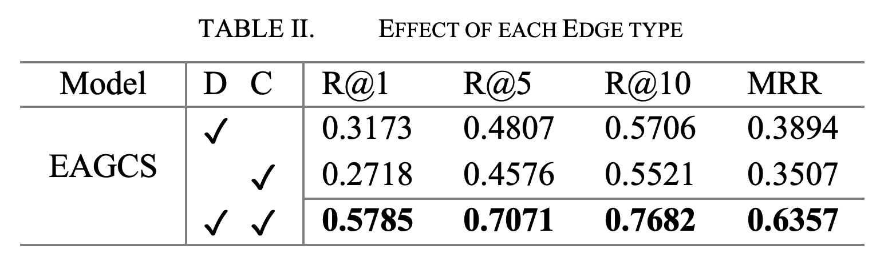
Results
Notes:
The results are shown in this page.
Which indicates the edge attention mechanism can effectively aggregate the edge information.
Results also show that data dependence has a slightly greater weight than control dependence for that all metrics are higher.

Slide 21
04
Conclusion
TONGJI UNIVERSITY
Notes:
Last part is our conclusion

Slide 22
Conclusion
Conclusion
  In this paper, we propose a novel graph-based code search method called EAGCS, which mines latent code semantics by enhancing edge information in APDG and embeds the APDG into graph- level vector via edge attention-based GGNN to boost the semantic expression.
Future work
  optimize the code graph structure and model architecture to improve search performance.
  investigate the influence of the number of nodes in APDG and the length of query statements on the search results.
  excavate potential user search intention and reinforce user query.
Notes:
In this paper, we propose a novel graph-based code search method called EAGCS, which mines latent code semantics by enhancing edge information in APDG and embeds the APDG into graph- level vector via edge attention-based GGNN to boost the semantic expression.
In the furture ,we will optimize the code graph structure and model architecture to improve search performance
We also plan to investigate the influence of the number of nodes in APDG and the length of query statements on the search results.
Query reinforcement is another research field worth studying

Slide 23
THANKS FOR YOUR LISTENING
Wei Zhao
School of Software Engineering
Tongji University Shanghai, China
2031569@tongji.edu.cn
TONGJI UNIVERSITY
Notes:
That’s all. Thank you for your listening.

