Slide 1


Multi-Label Code Smell Detection with Hybrid Model based on Deep Learning
Yichen Li, Xiaofang Zhang*
School of Computer Science and Technology Soochow University
SEKE 2022
SOOCHOW UNIVERSITY

Slide 2
Introduction
Code Smells indicate problems related to aspects of code quality such as understandability and modifiability, and imply the possibility of refactoring.
Many approaches have been proposed to detect code smells but they lose much information which helps recognize each code smell more efficiently and pay little attention to multi-label code smell detection.
In this paper, we propose a hybrid model with multi-level code representation to further optimize the code smell detection. Better results have been achieved on 100 high-quality Java projects from Github.

Slide 3
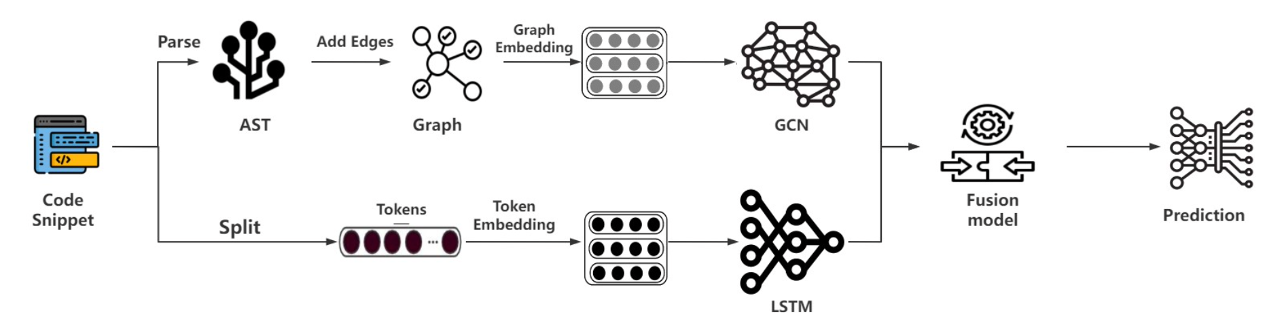
Method-HMML

Slide 4
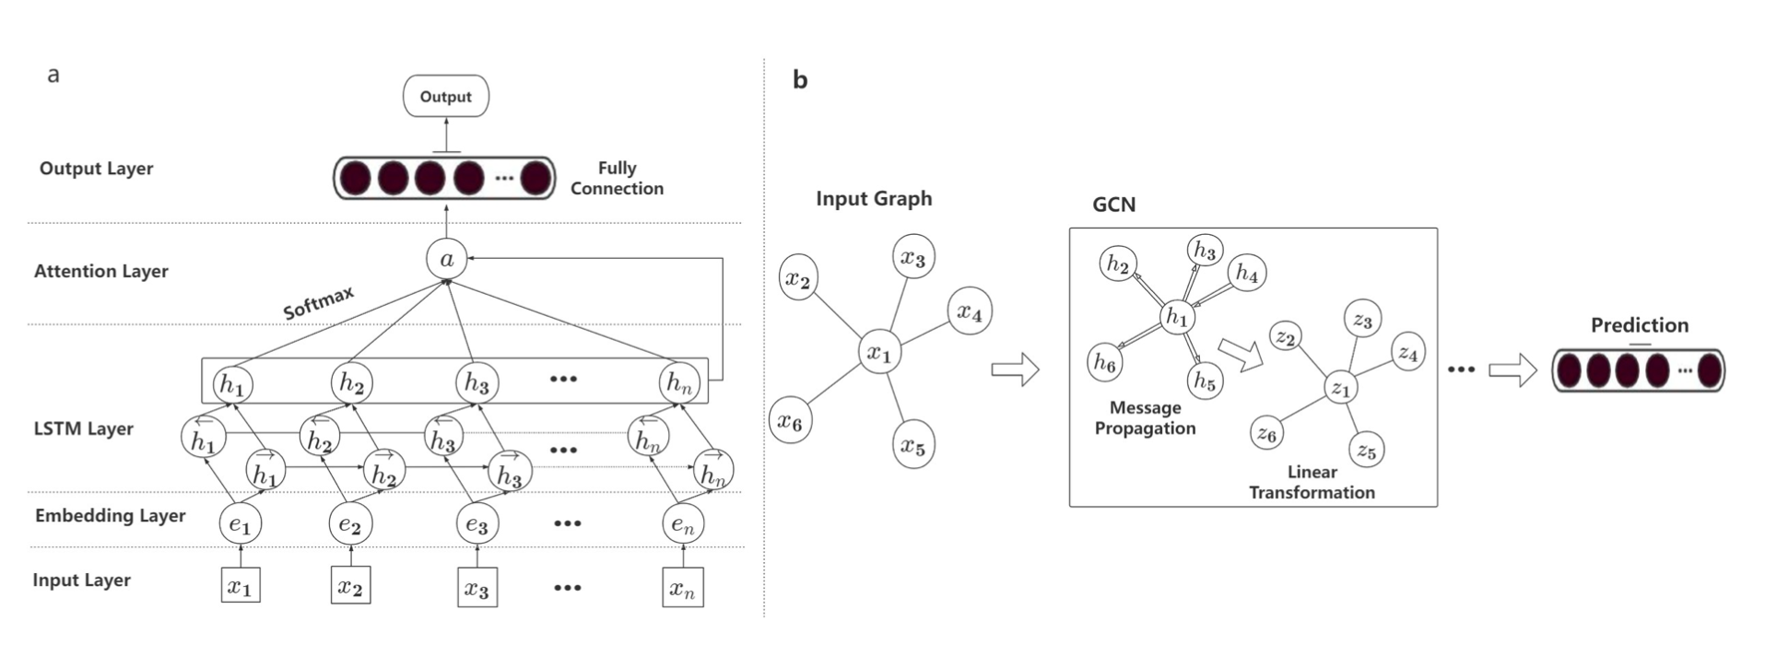
Method-HMML

Slide 5
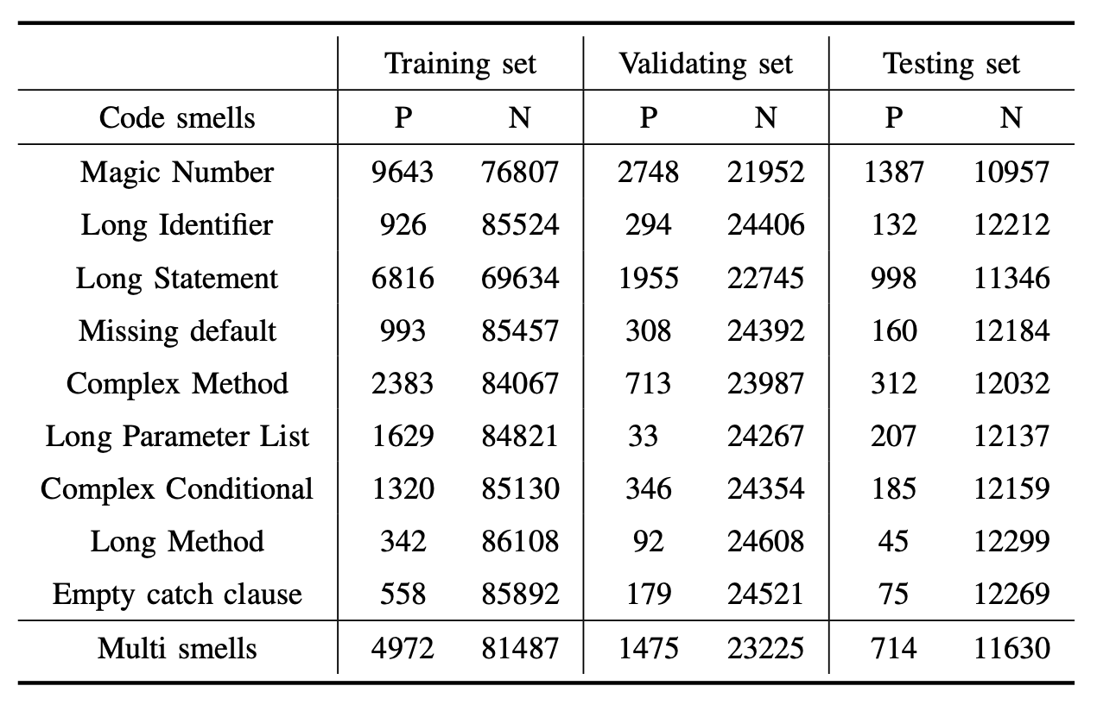
Dataset
We choose nine code smells at the method level for our experiment and combine their labels into a multi- label dataset.

Slide 6
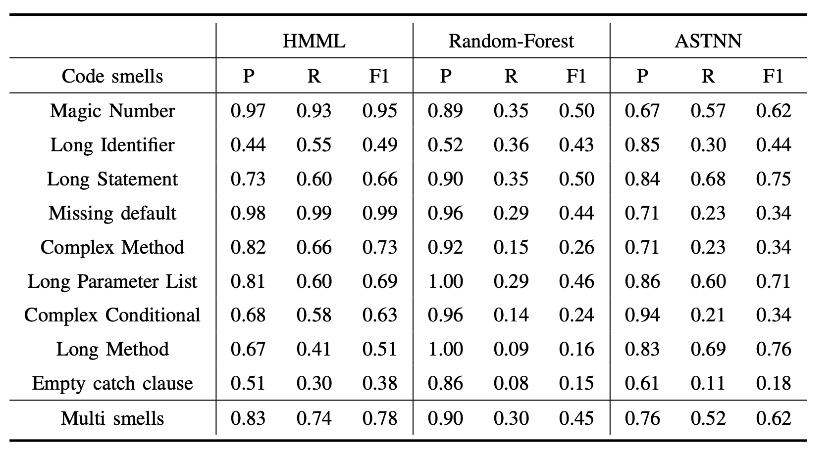
Evaluation - Results
RQ1:How does our HMML method perform compared to other baselines?
We can regard that our HMML method does a good job in the multi-label code smell detection.

Slide 7
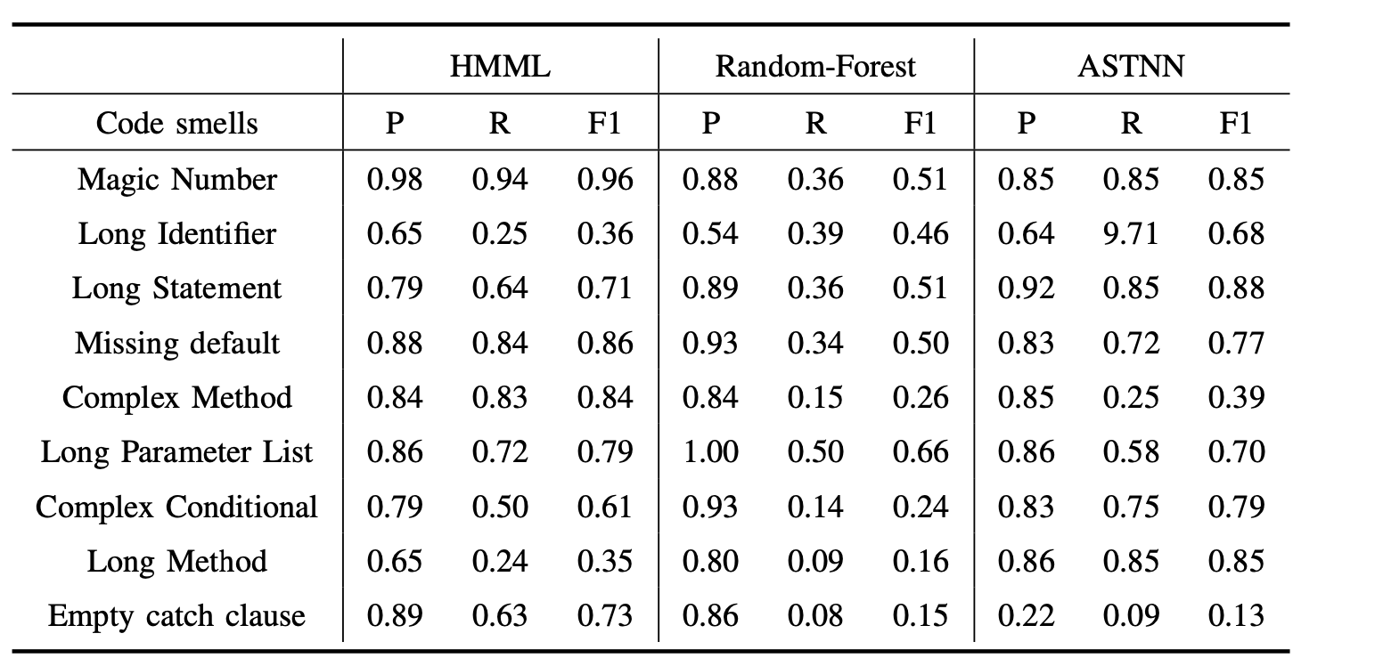
Evaluation - Results
RQ2: How does multi-label code smell detection perform compared with single code smell detection?
our multi-label code smell detection not only performs well in each code smell detection but can find out all code smells by one model at the same time.

Slide 8
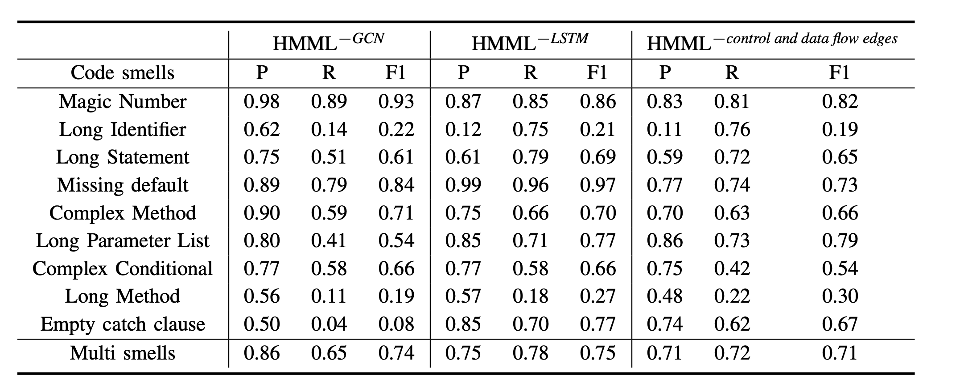
Evaluation - Results
RQ3: What impact does each of our main components have in our model?
Each part of the model plays its own advantages as expected and captures the corresponding code smell features

Slide 9
Conclusion
We propose a hybrid model that extracts the multi-level code representation information and separately applies the appropriate deep learning neural network.
We are the first to carry out the multi-label code smell detection based on the deep learning method and achieve a good result.
We modify many other approaches to fit into multi-label classification tasks and conduct extensive experiments to find the maximum capacity and best configuration.
https://github.com/liyichen1234/HMML

Slide 10
Thanks!
Q&A

