Slide 1

Social Information Popularity Prediction based on Heterogeneous Diffusion Attention Network
(SEKE-2022)
Xueqi Jia
College of Computer Science
Chongqing University
Chongqing, China
jiaxueqi99@126.com
Jiaxing Shang*
College of Computer Science
Chongqing University
Chongqing, China
shangjx@cqu.edu.cn
Linjiang Zheng
College of Computer Science
Chongqing University
Chongqing, China
zlj_cqu@cqu.edu.cn
Dajiang Liu
College of Computer Science
Chongqing University
Chongqing, China
liudj@cqu.edu.cn
Weiwei Cao
Key Laboratory of Flight Techniques and Flight Safety
Civil Aviation Flight University of China
Guanghan, China
ywcao@my.swjtu.edu.cn
Hong Sun
Flight Technology and Flight Safety Research Base
Civil Aviation Flight University of China
Guanghan, China
hanksun@263.net

Slide 2
Outline
Motivation & Background
Related Work
Our Approach
Experimental Evaluation
Conclusion

Slide 3
Motivation & Background
Prosperity of online social media
  Prosperity of various online social media platforms such as Facebook, Twitter and Weibo.
  Competition among different messages for users’ attention.
Applications of popularity prediction
  Viral marketing
  Rumor detection
  Social recommendation
  etc.

Slide 4
Motivation & Background
Motivation of the proposed work
  Previous studies:
    Topology structure of a single diffusion graph(√),
    Social dependencies between active and inactive users(√),
    Correlations among different cascades (×).
  Our study: simultaneous consideration of cascades
    The role of social influence(√),
    Interaction intimacy among users(√),
    User preference to messages(√).

Slide 5
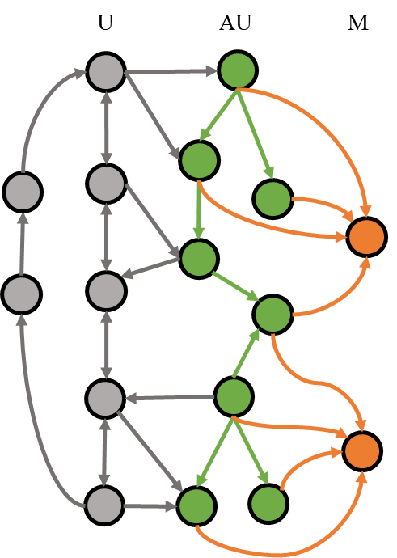
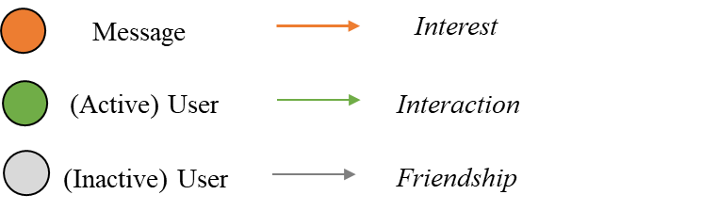
Motivation & Background
Comprehensive consideration of various factors
  Friendship: The role of social influence.
  Interaction: Interaction intimacy among users.
  Interest: User preference to messages.
Heterogeneous Diffusion Graph
Node
Relation
Fig. 1. An example of the heterogeneous diffusion graph.

Slide 6
Outline
Motivation
Related Work
Our Approach
Experimental Evaluation
Conclusion

Slide 7
Related Work
Sequential representation-based methods
  DeepCas [4] utilized random walks to sample the cascade graphs to obtain the sequences of nodes as the input of the bidirectional gated recurrent unit (Bi-GRU).
  DeepHawkes [10] merged three crucial concepts of Hawkes process, i.e., user influence, self-exciting mechanism, and time decay effect, with RNN to make the modeling process more interpretable.
  DeepDiffuse [11] employed embedding technique and attention model to learn from the infection timestamp information.
[4] C. Li, J. Ma, X. Guo, and Q. Mei, “Deepcas: An end-to-end predictor of information cascades,” in Proceedings of the 26th international conference on World Wide Web, 2017, pp. 577–586.
[10] Q. Cao, H. Shen, K. Cen, W. Ouyang, and X. Cheng, “Deephawkes: Bridging the gap between prediction and understanding of information cascades,” in Proceedings of the 2017 ACM on Conference on Information and Knowledge Management, 2017, pp. 1149–1158.
[11] M. R. Islam, S. Muthiah, B. Adhikari, B. A. Prakash, and N. Ramakrishnan, “Deepdiffuse: Predicting the’who’and’when’in cascades,” in 2018 IEEE International Conference on Data Mining (ICDM). IEEE, 2018, pp. 1055–1060.

Slide 8
Related Work
Graph representation-based methods
  CasCN [6] sampled a cascade graph as a series of sequential subcascades and adopted a dynamic multi-directional GCN to learn structural information of cascades.
  DeepCon+Str [14] proposed two higher-order graphs with cascades as nodes based on content and structural proximity, and learned the higher-order graphs by random walks and semi-supervised language models.
  CoupledGNN [8] leveraged two specifically designed GNNs, one for node states and the other for influence spread, to model the cascading effect.
[6] X. Chen, F. Zhou, K. Zhang, G. Trajcevski, T. Zhong, and F. Zhang,“Information diffusion prediction via recurrent cascades convolution,” in 2019 IEEE 35th International Conference on Data Engineering (ICDE).IEEE, 2019, pp. 770–781.
[14] X. Feng, Q. Zhao, and Z. Liu, “Prediction of information cascades via content and structure integrated whole graph embedding.” IJCAI, 2019.
[8] Q. Cao, H. Shen, J. Gao, B. Wei, and X. Cheng, “Popularity prediction on social platforms with coupled graph neural networks,” in Proceedings of the 13th International Conference on Web Search and Data Mining, 2020, pp. 70–78.

Slide 9
Outline
Motivation
Related Work
Our Approach: HeDAN
Experimental Evaluation
Conclusion

Slide 10
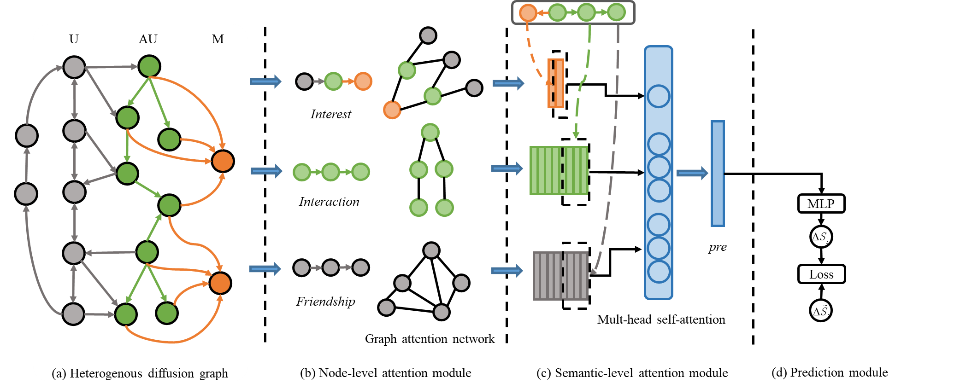
HeDAN: An overview
Fig. 2. Overview of HeDAN:
Heterogeneous diffusion graph construction module;
Node-level attention module;
Semantic-level attention module;
Prediction module.

Slide 11
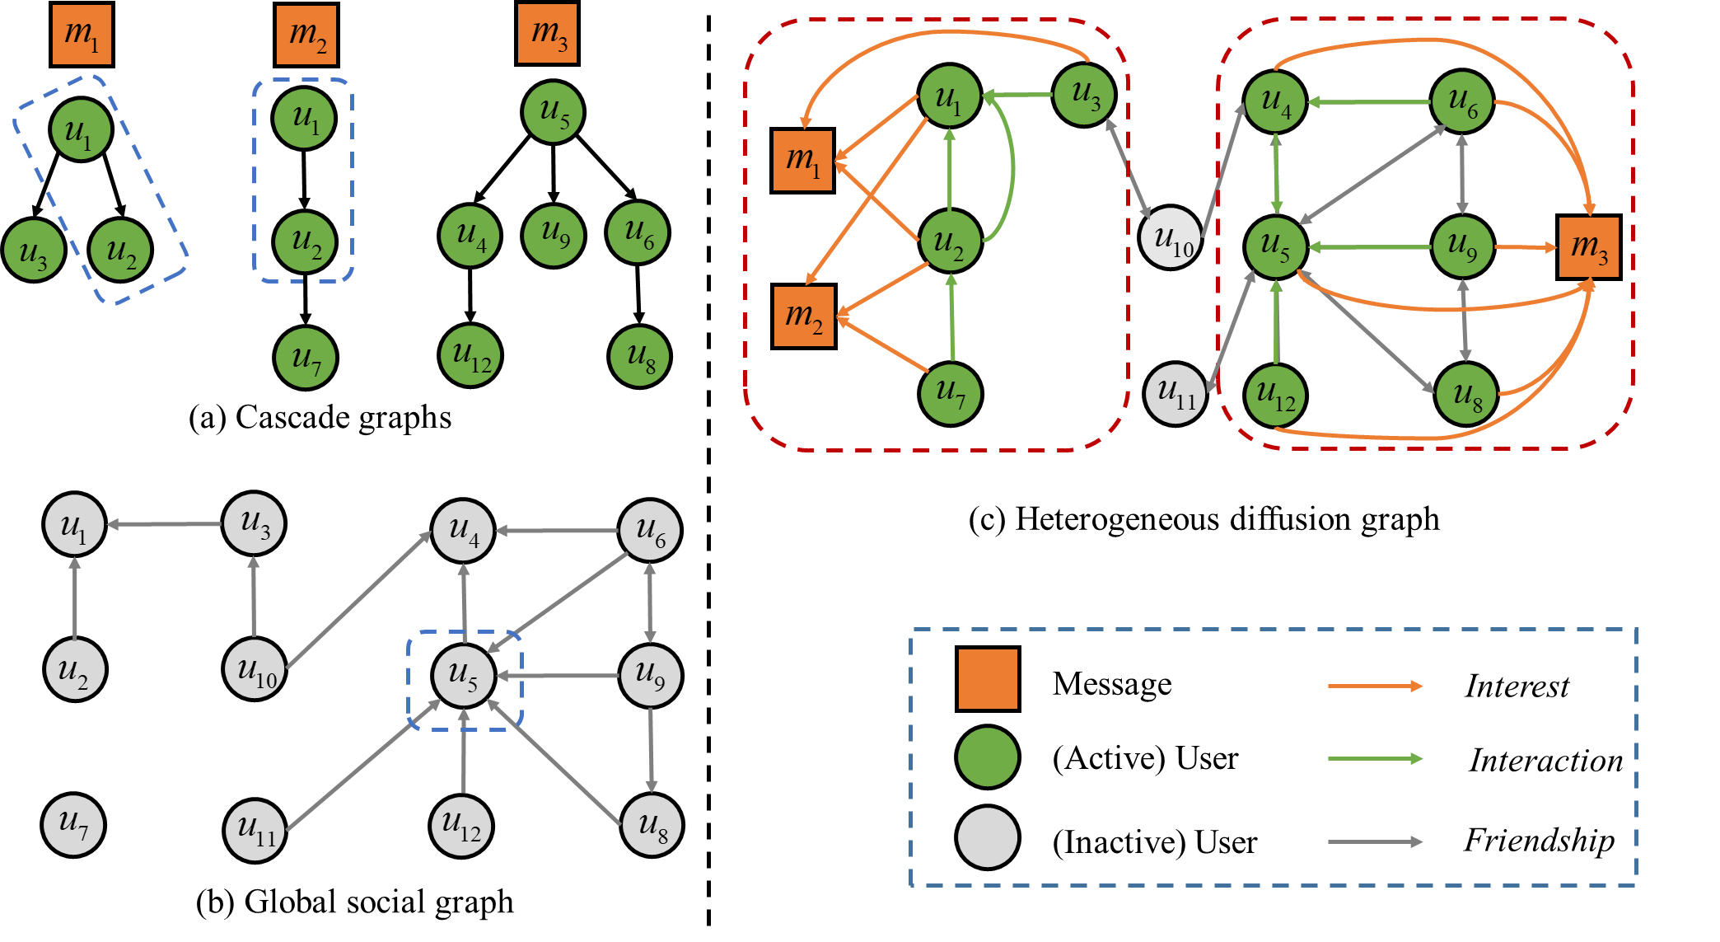
Heterogeneous diffusion graph construction module
Fig. 3. An example of the heterogeneous diffusion graph.
(a) An example of cascade graphs of message m1, m2, m3(marked as orange squares). The edges denote that the user (marked as green circles) reposted a message from another user at a certain timestamp;
(b) The global social graph consisting of follower-followee relationships between users;
(c) The constructed heterogeneous diffusion graph, which includes two types of nodes (user and message) and three types of edges (Friendship, Interaction, and Interest). The green circles represent active user nodes, while the gray circles represent inactive user nodes.

Slide 12
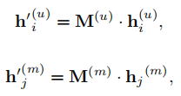

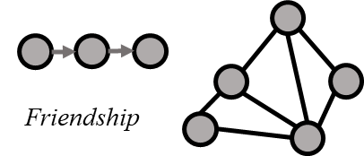
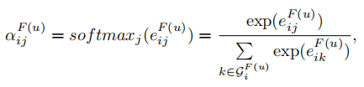

Node-level attention module
  Node feature transformation
  Friendship subgraph attention layer
Fig. 4. Friendship subgraph attention layer.

Slide 13
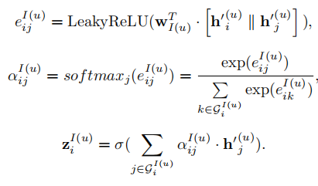
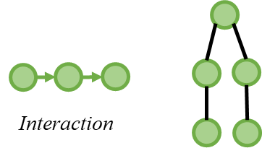
Node-level attention module
  Interaction subgraph attention layer
Fig. 5. Interaction subgraph attention layer.

Slide 14
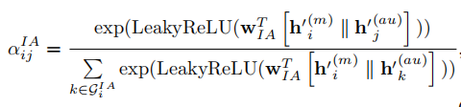
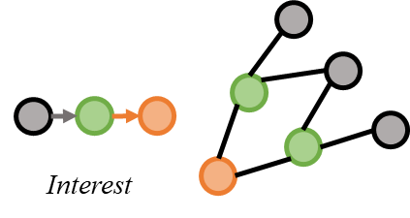
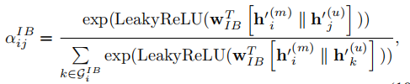

Node-level attention module
  Interest subgraph attention layer
Fig. 6. Interest subgraph attention layer.

Slide 15
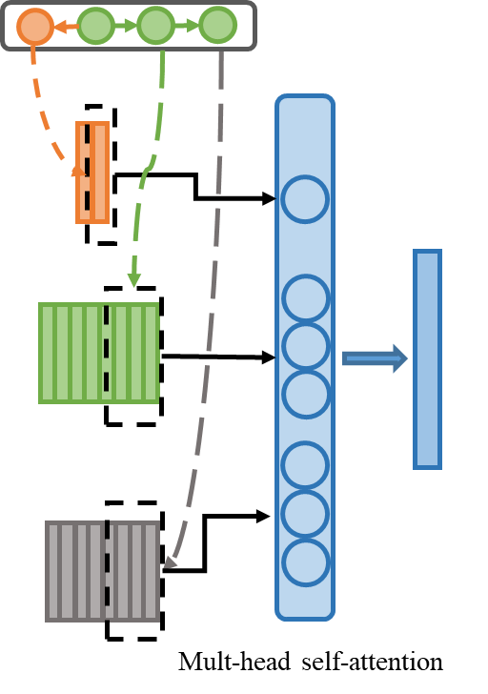
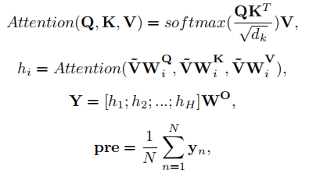
Semantic-level attention module
  We apply the self-attention to distinguish the importance of each relationship and generate the final representation by fusing the above representations.
Fig. 7. Semantic-level attention module.

Slide 16


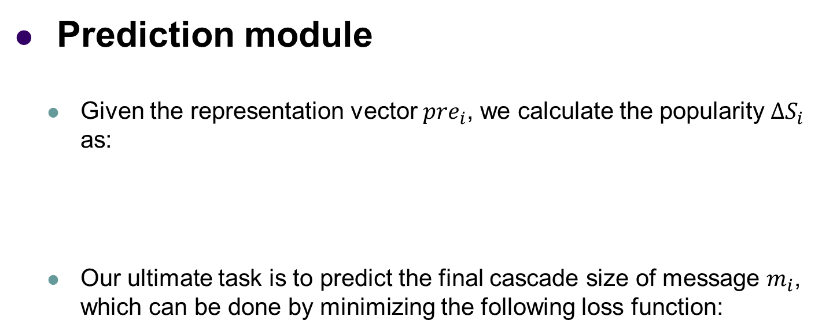
Prediction module
  Given the representation vector ${pre}_{i}$, we calculate the popularity $∆S_{i}$ as:
  Our ultimate task is to predict the final cascade size of message $m_{i}$, which can be done by minimizing the following loss function:

Slide 17
Outline
Motivation
Related Work
Our Approach
Experimental Evaluation
Conclusion

Slide 18
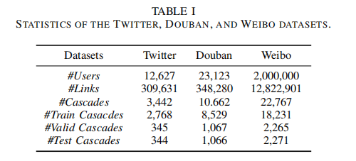


Experimental Evaluation
Dataset
Metric
  MSLE:
  mSLE:

Slide 19
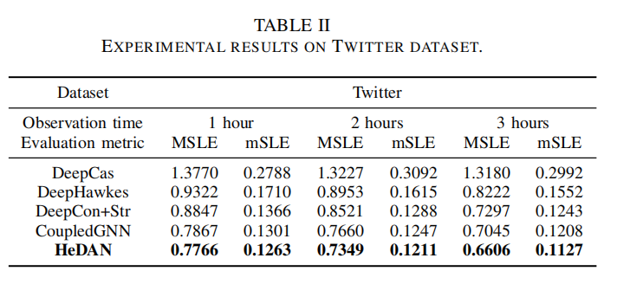
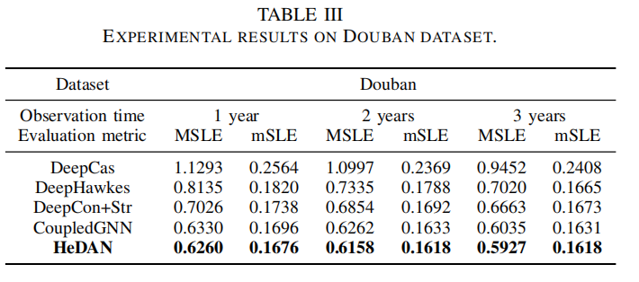
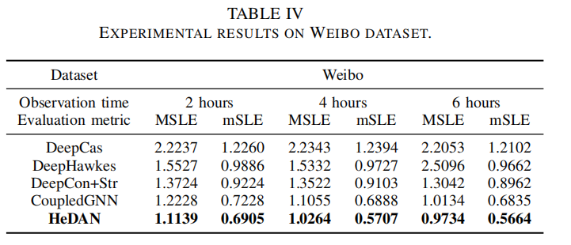
Results

Slide 20
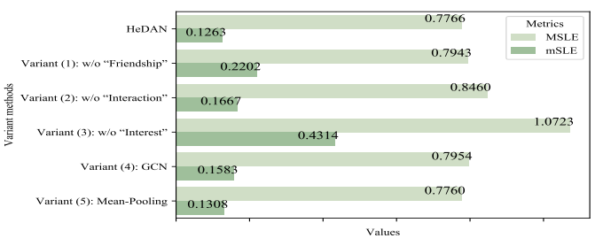
Ablation experiments
Fig. 8 Results of ablation experiments under a 1-hour observation time window on Twitter dataset.

Slide 21
Outline
Motivation
Related Work
Our Approach
Experimental Evaluation
Conclusion

Slide 22
Conclusion
Novelty
  To comprehensively consider various factors that affect information diffusion, we proposed a novel heterogeneous diffusion attention network model to characterize both the user and message representations through hierarchical attention.
  HeDAN can achieve lower prediction error than state-of-the-art baselines.
Future work
  We will extend our model to fine-grained problems such as user-level diffusion behavior prediction.
  We will also consider model interpretability in our future work.

Slide 23
Thank You!
Q&A

