Slide 1



Automated unit testing of hydrologic modeling software with Ci/cd and jenkins
levi Connelly, Melody hammel (presenter), Benjamin eger, lan lin
SEKE 2022
July 1, 2022

Slide 2
overview
The NSF CyberWater project and its testing challenges
Our solution to automated testing of CyberWater modules
Overcoming model-view separation violations with a novel technique
Unit testing frameworks in Python
Test automation with Jenkins and CI/CD
Case studies
PythonCalc
MainGenerator
Conclusion and future work

Slide 3
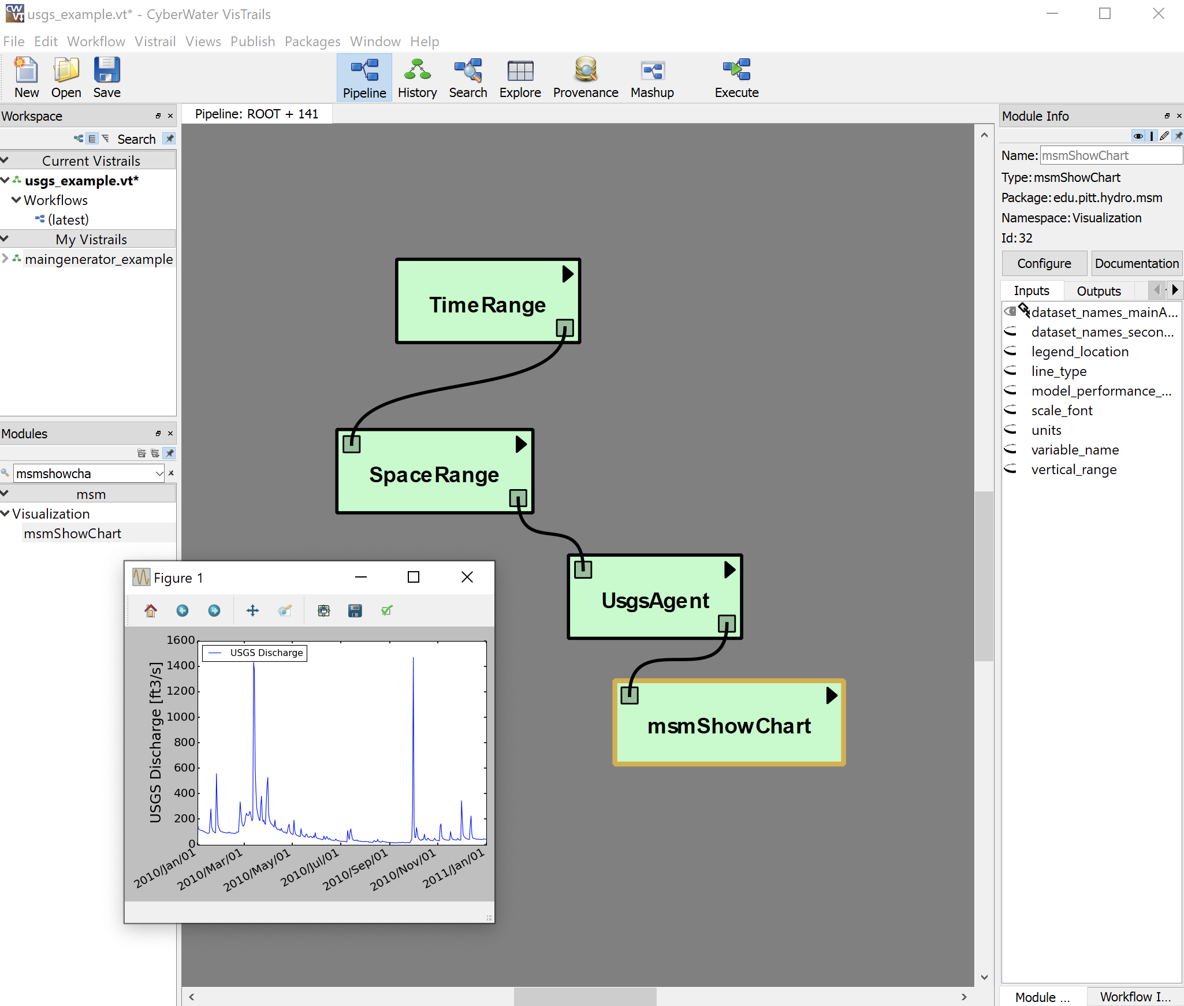
The NSF CyberWater Project
Software designed for water science to reduce user time and effort in modeling

Slide 4
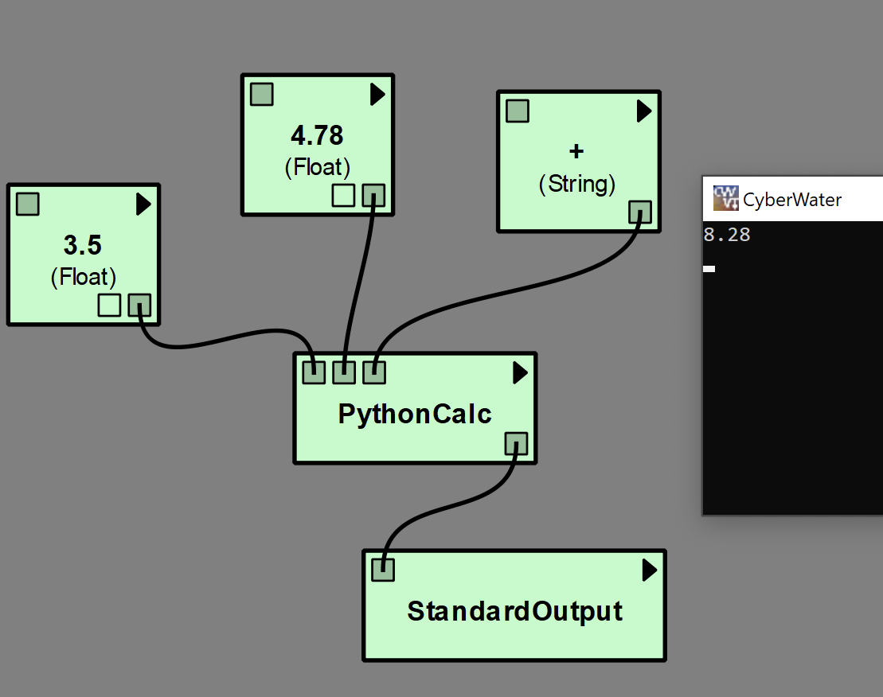
Testing challenge #1
CyberWater is built on VisTrails, which is legacy software with tightly-coupled front- and back-ends
It’s difficult to unit test the software in the back-end without interacting with the front-end

Slide 5
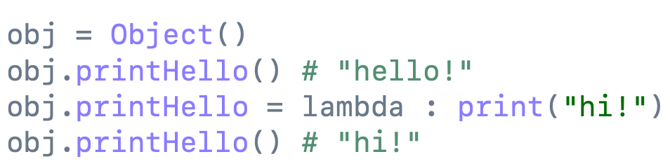
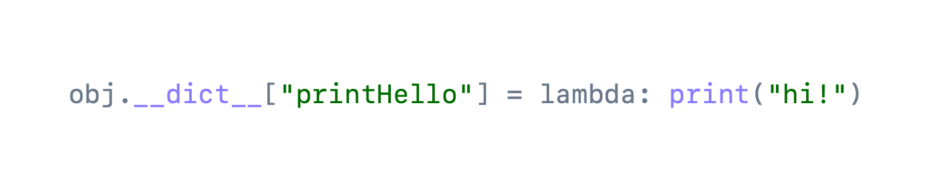
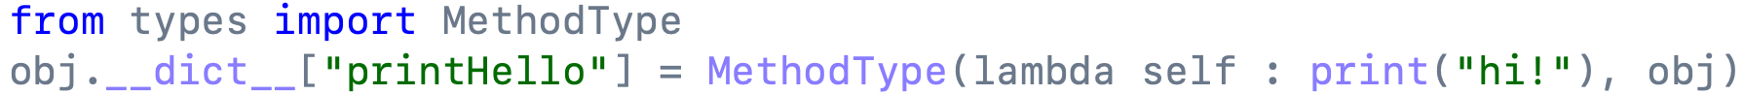
a novel technique: object-method replacement
A novel technique that helps resolve model-view violations to test code in the back-end
Or…
Or…

Slide 6
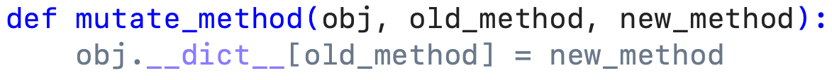
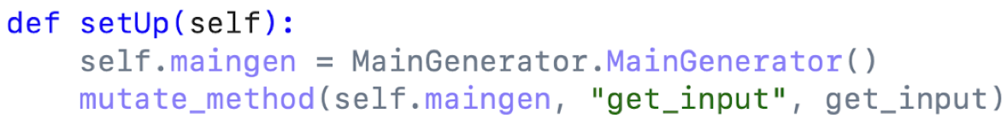
Object-method replacement
Every module contains a get_input method which calls a method accessing the front-end
We define object-method replacement as mutate_method
Replace the GUI-accessing method with our own
Only this instance of the object is changed: the class remains untouched

Slide 7
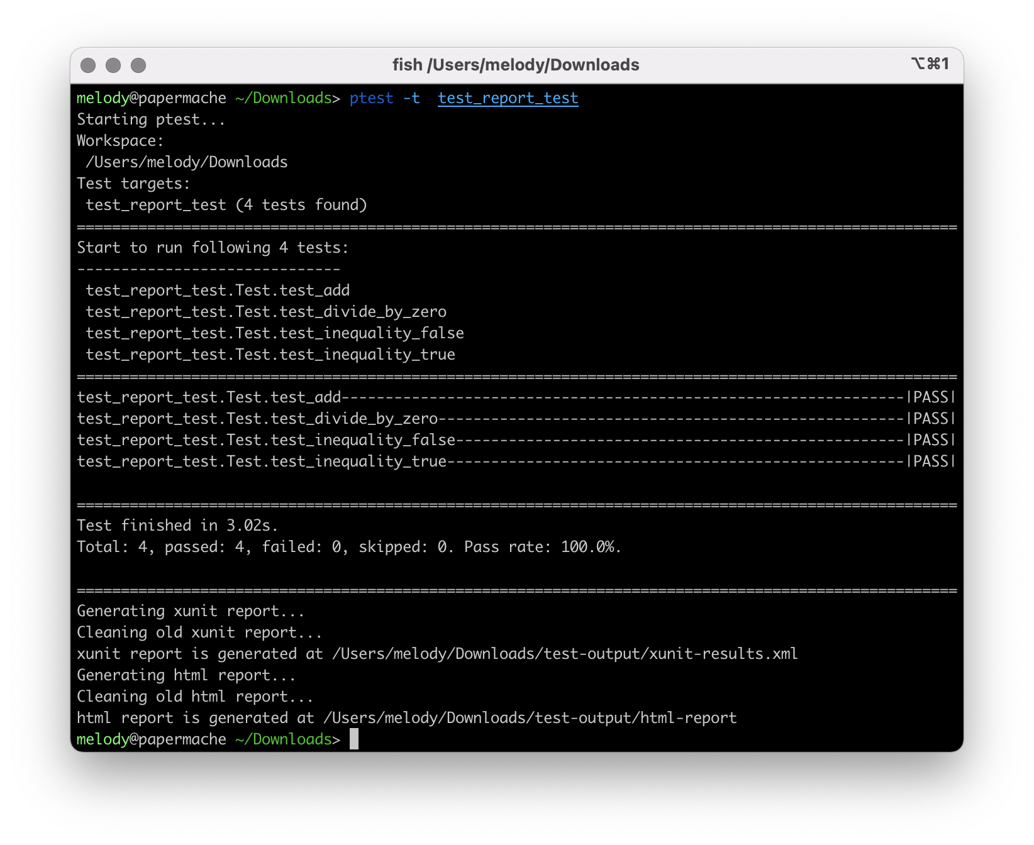
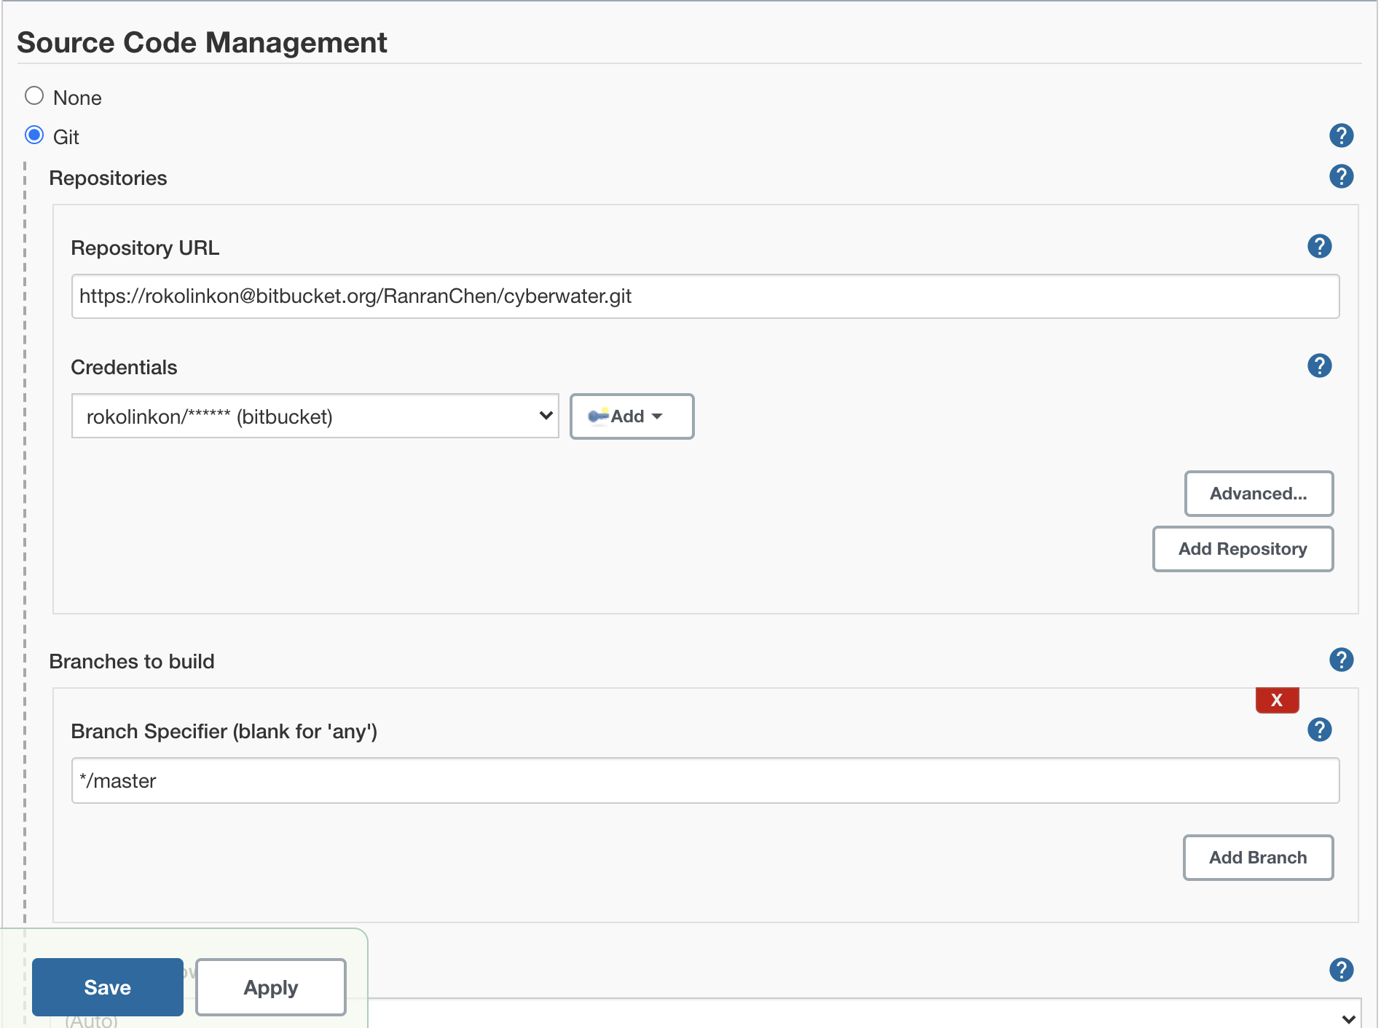
Testing challenge #2
The CyberWater team consists of developers with diverse backgrounds
Code that causes a fault could potentially be pushed to the repository
The master branch of the repository needs to be kept in a production-ready state

Slide 8
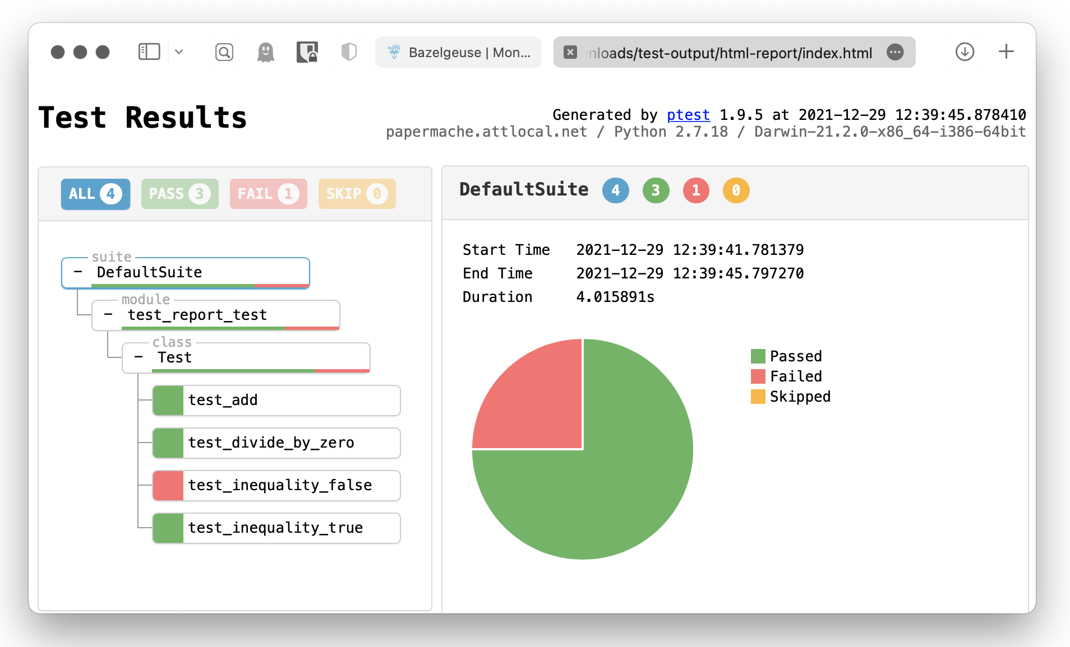
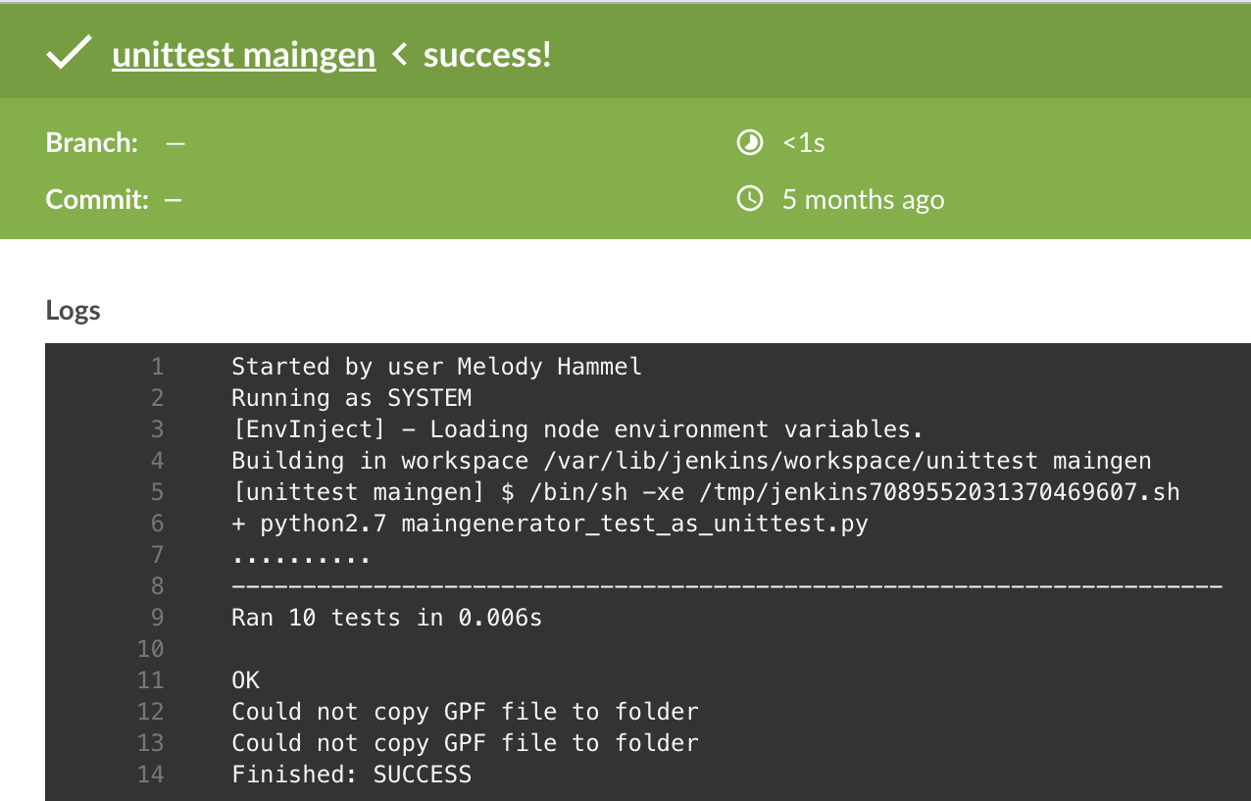
Unit testing frameworks
Ptest
  Graphical test report
  Decorators
  Unique logging system with preporter
Unittest
  Support for Jenkins
  Commonly used
  Built-in to Python

Slide 9

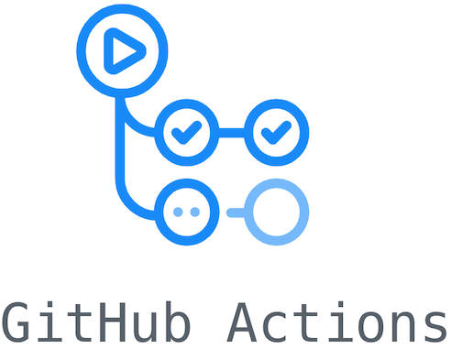

Testing challenge #3
To ensure code quality, we want to automatically run tests upon pushes to the repository
There are many platforms we could use to do this
We chose Jenkins

Slide 10
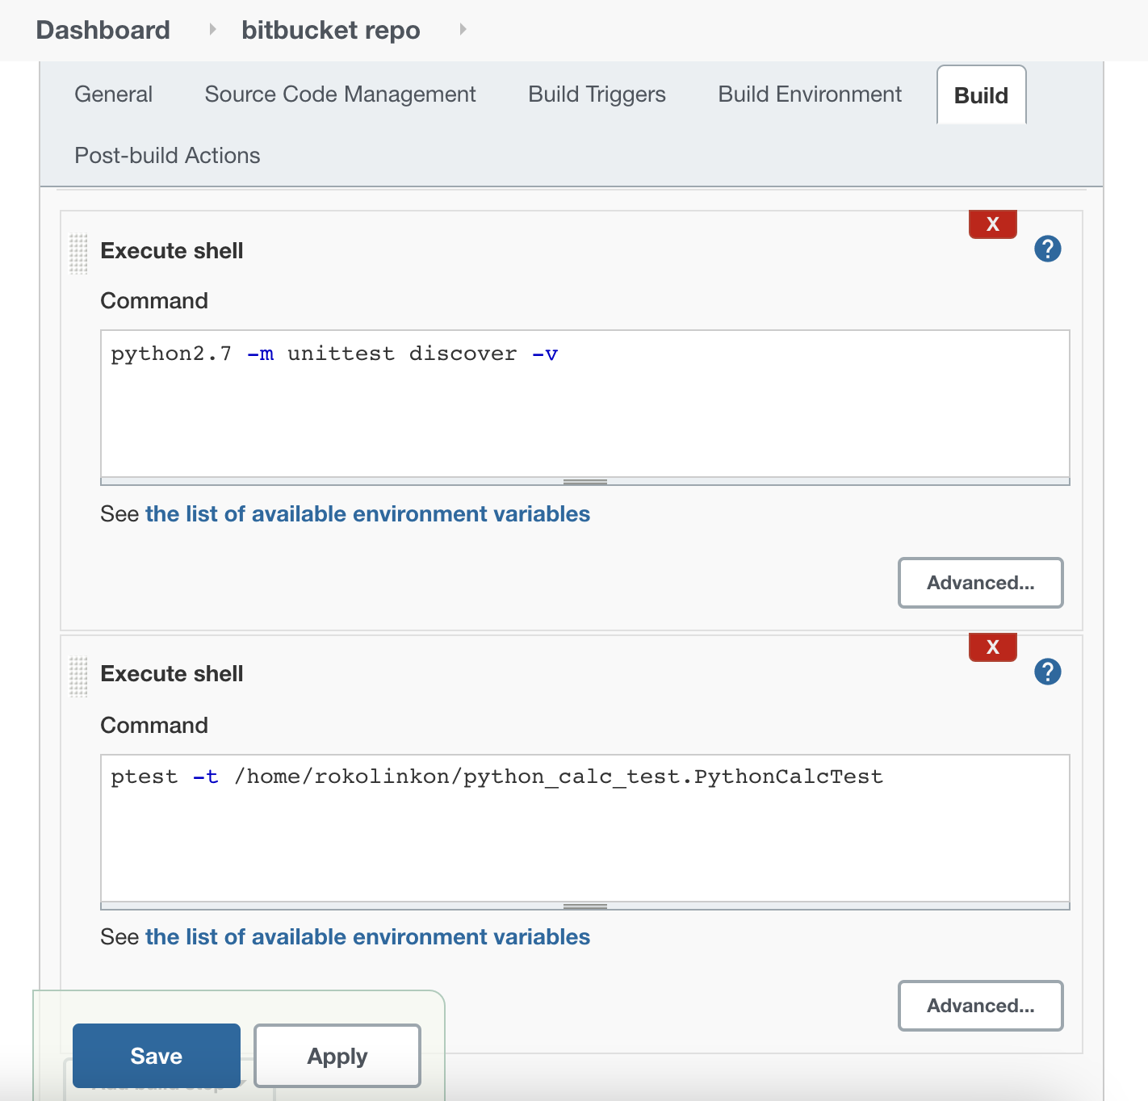
Jenkins for ci/cd
Automated test running upon push to connected repository

Slide 11
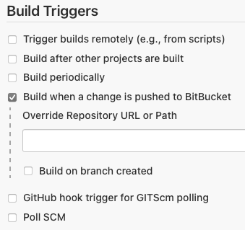
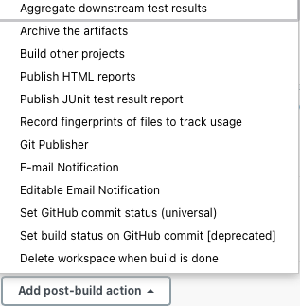
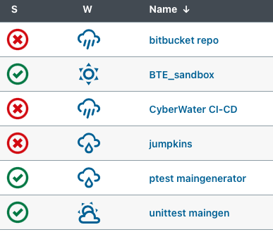
Advantages of jenkins
Jenkins allows us to automate merges from dev to master should all tests pass
It integrates well with BitBucket
Jenkins jobs are efficient to set up

Slide 12
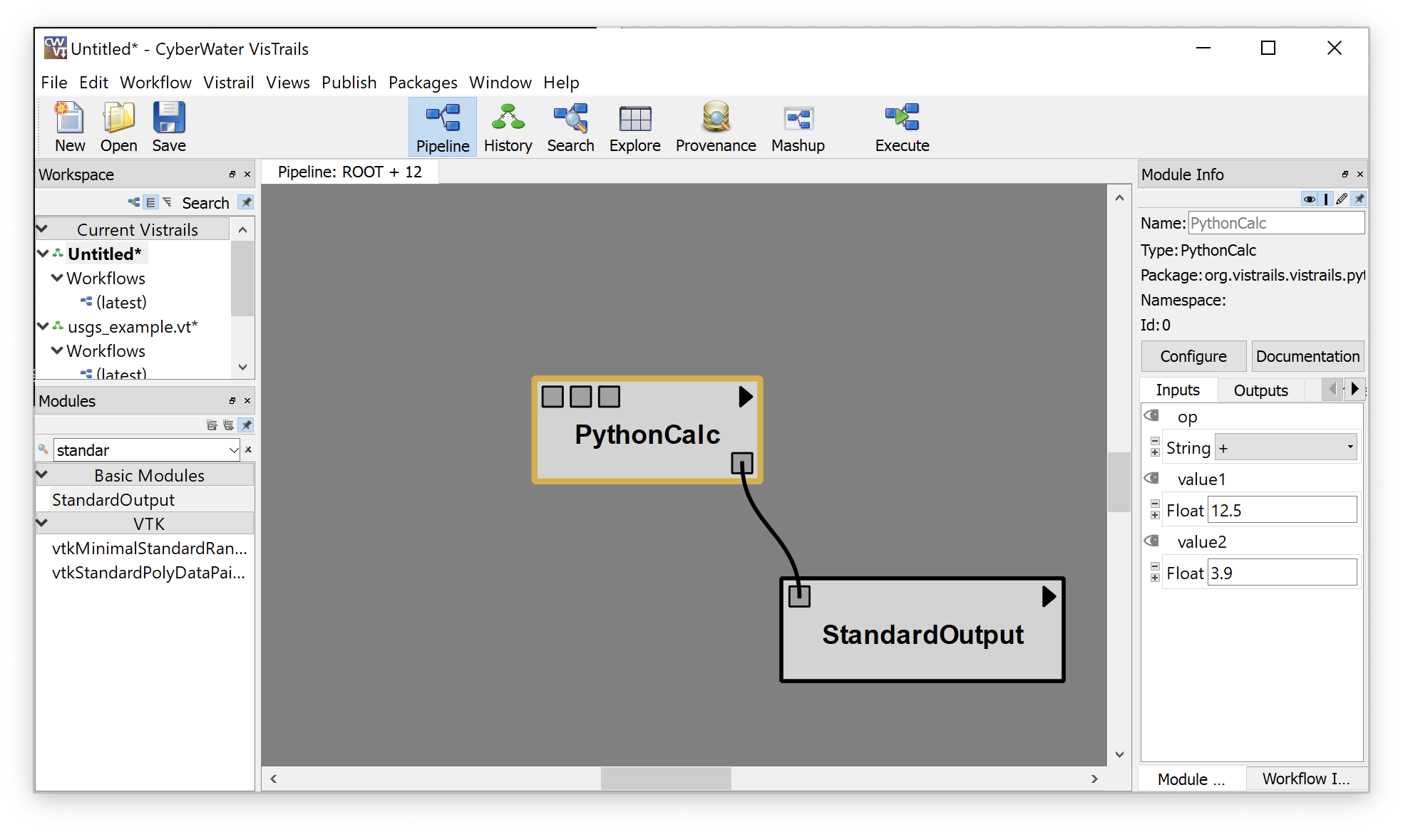
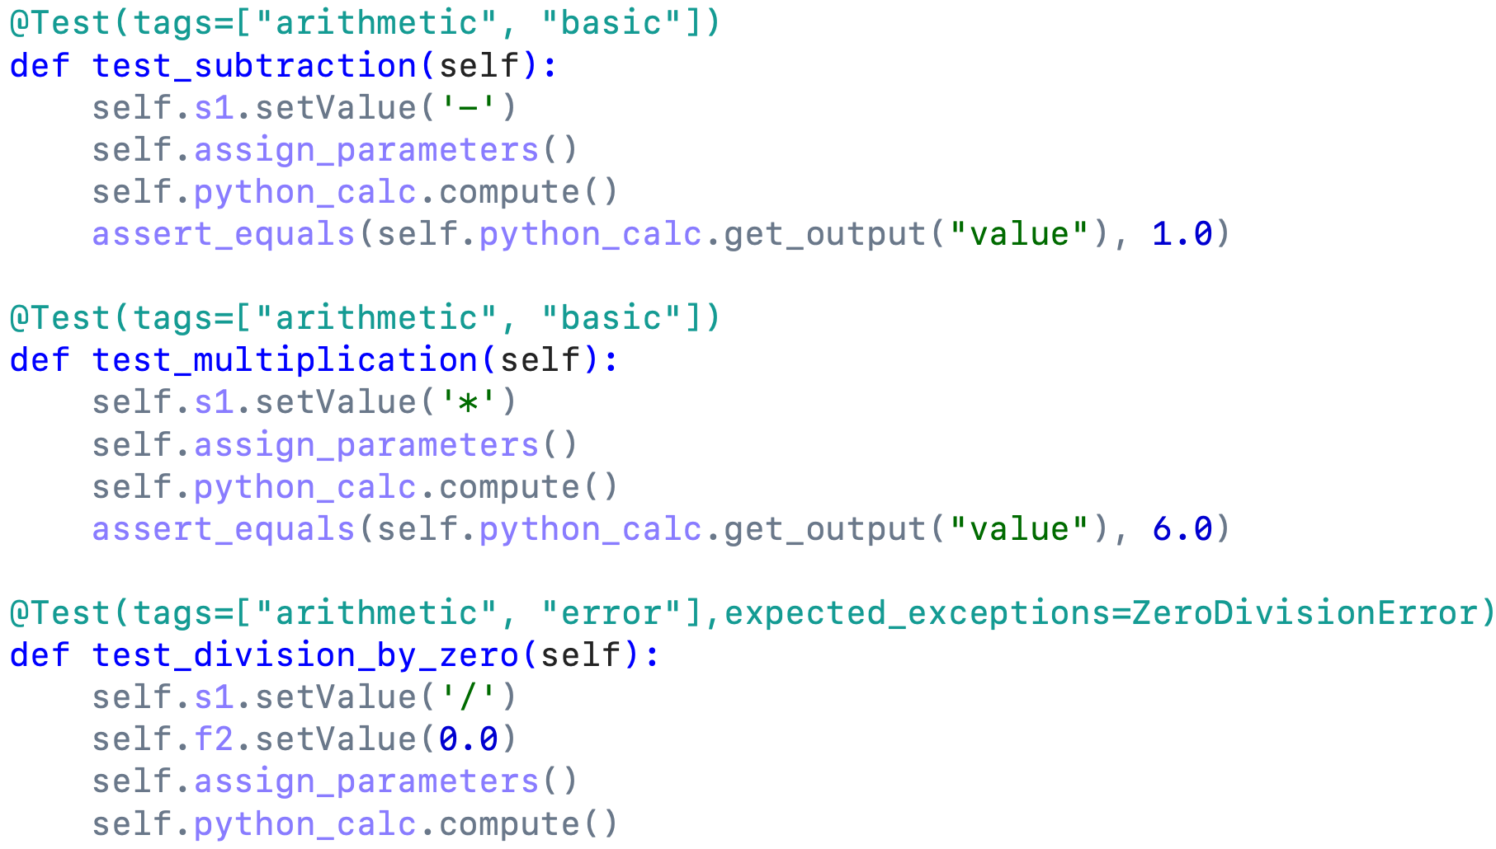
Case study #1: pythoncalc
Proof-of-concept
Simple VisTrails module that acts as a calculator
Allowed us to apply the test design of inputs vs outputs, Ptest, object-method replacement, and CI/CD

Slide 13
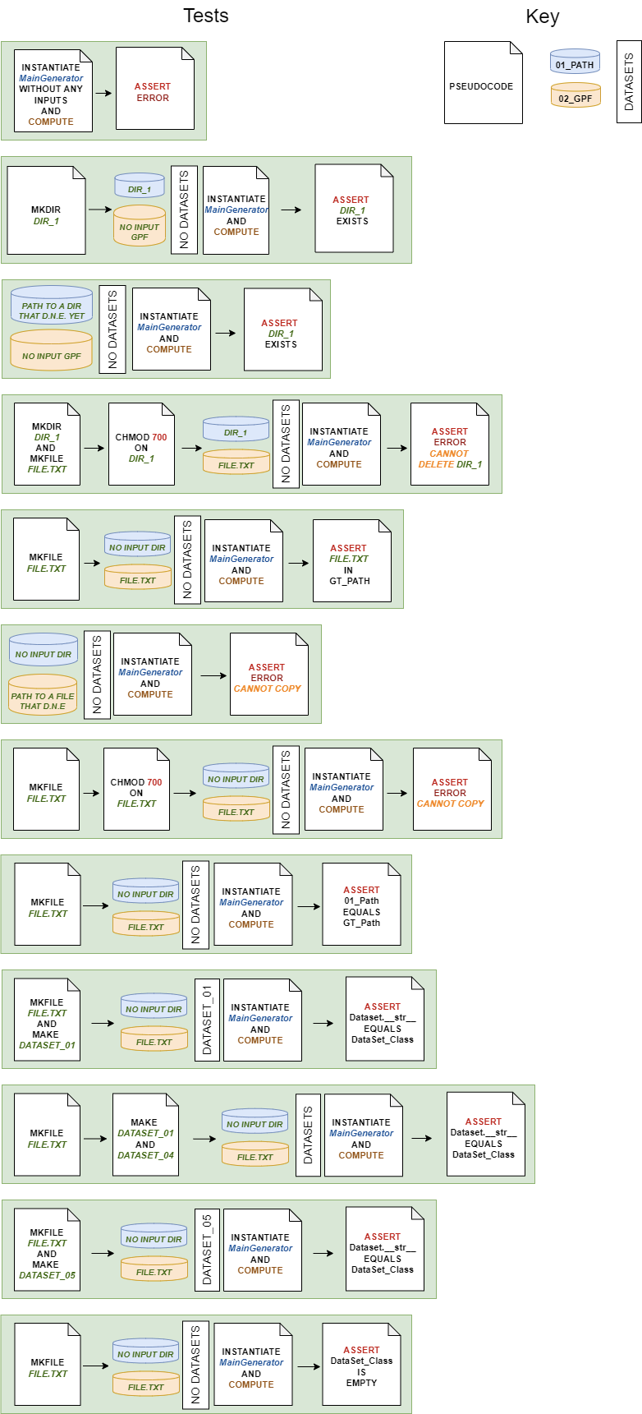
Case study #2: Maingenerator
Test design considers inputs vs outputs
Every input has its associated action

Slide 14
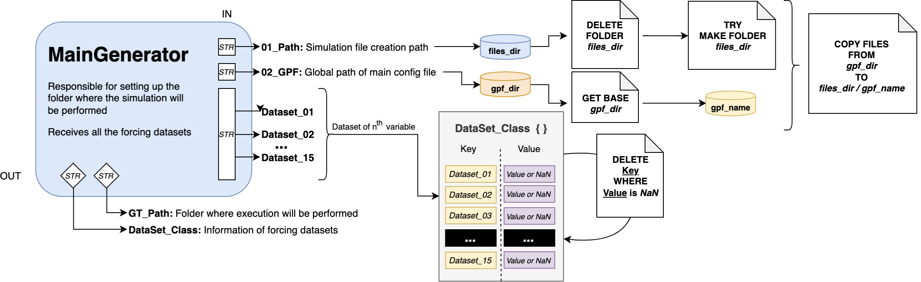
maingenerator
Sets up working directory
Operates on a directory and a file, resulting in verifiable outcomes

Slide 15
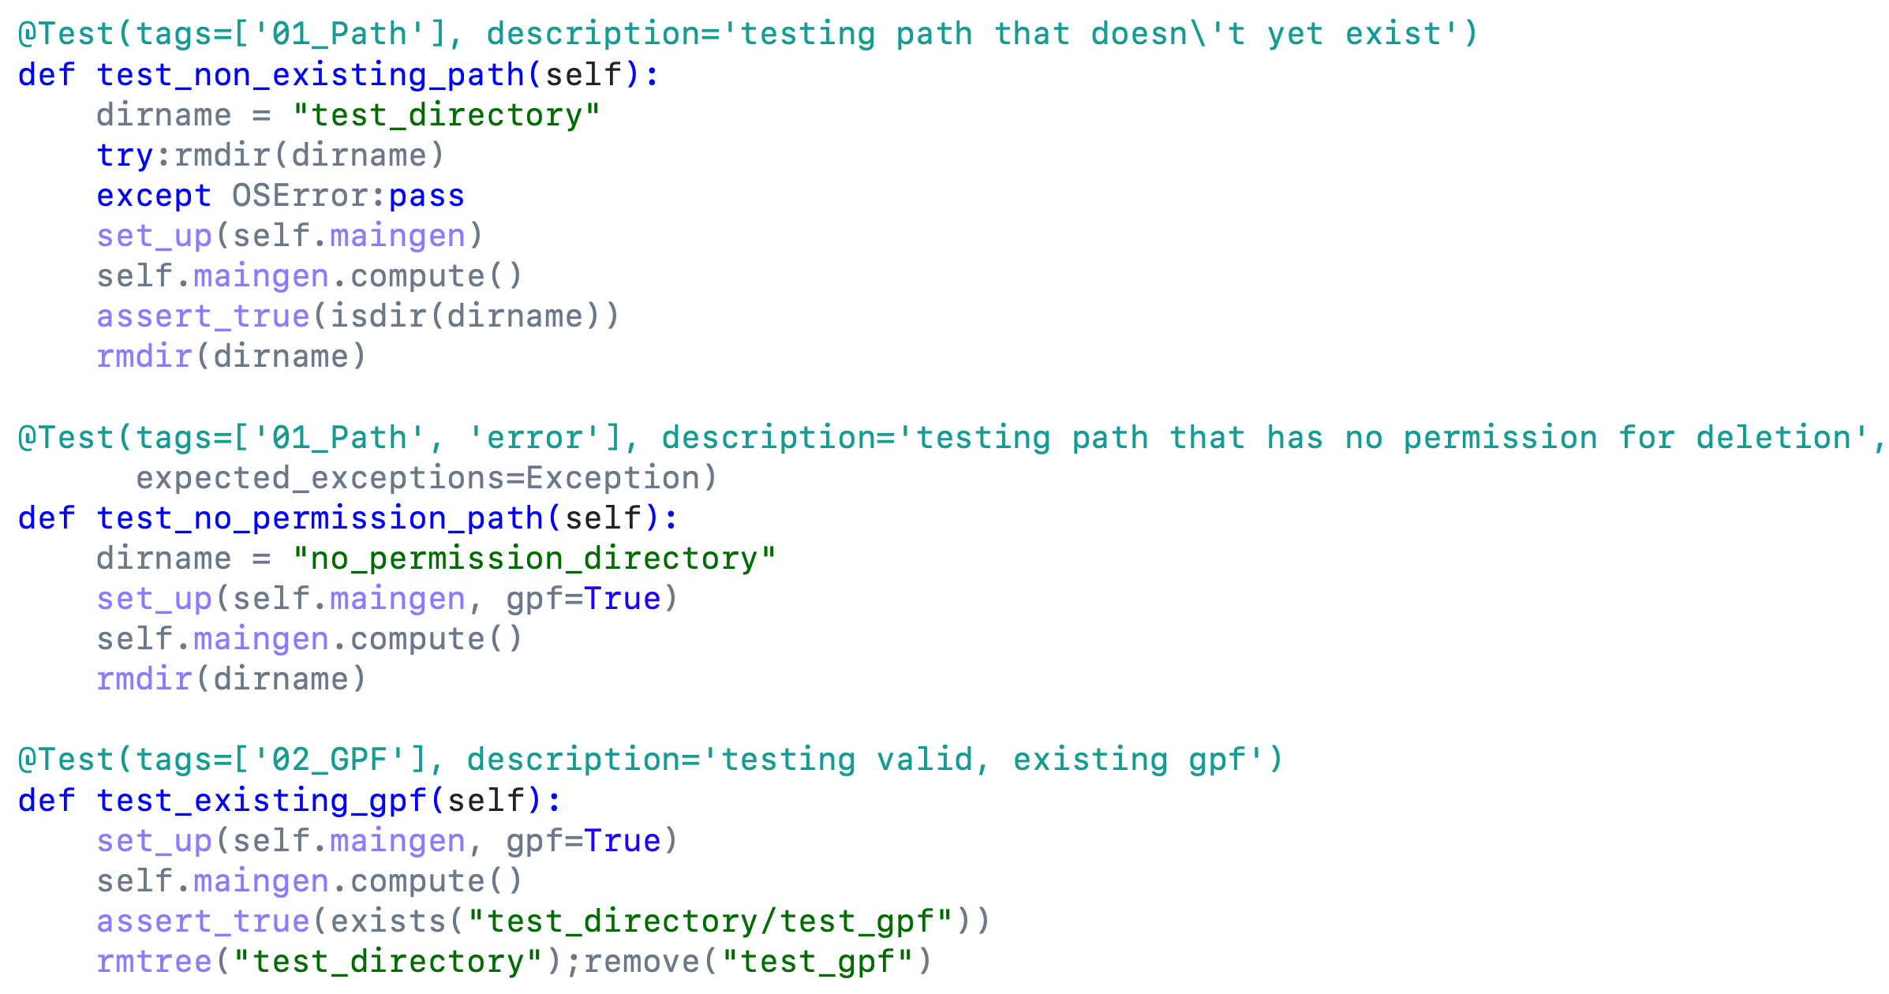
Testing for input and output ports
01_Path – Path of the working directory for the simulation, to be cleared out or created
02_GPF – File detailing parameters for the simulation, to be copied into 01_Path
Dataset_0x – String inputs to be converted to Python dictionary
GT_Path – Working directory (01_Path)
DataSet_Class – Datasets as Python dictionary

Slide 16
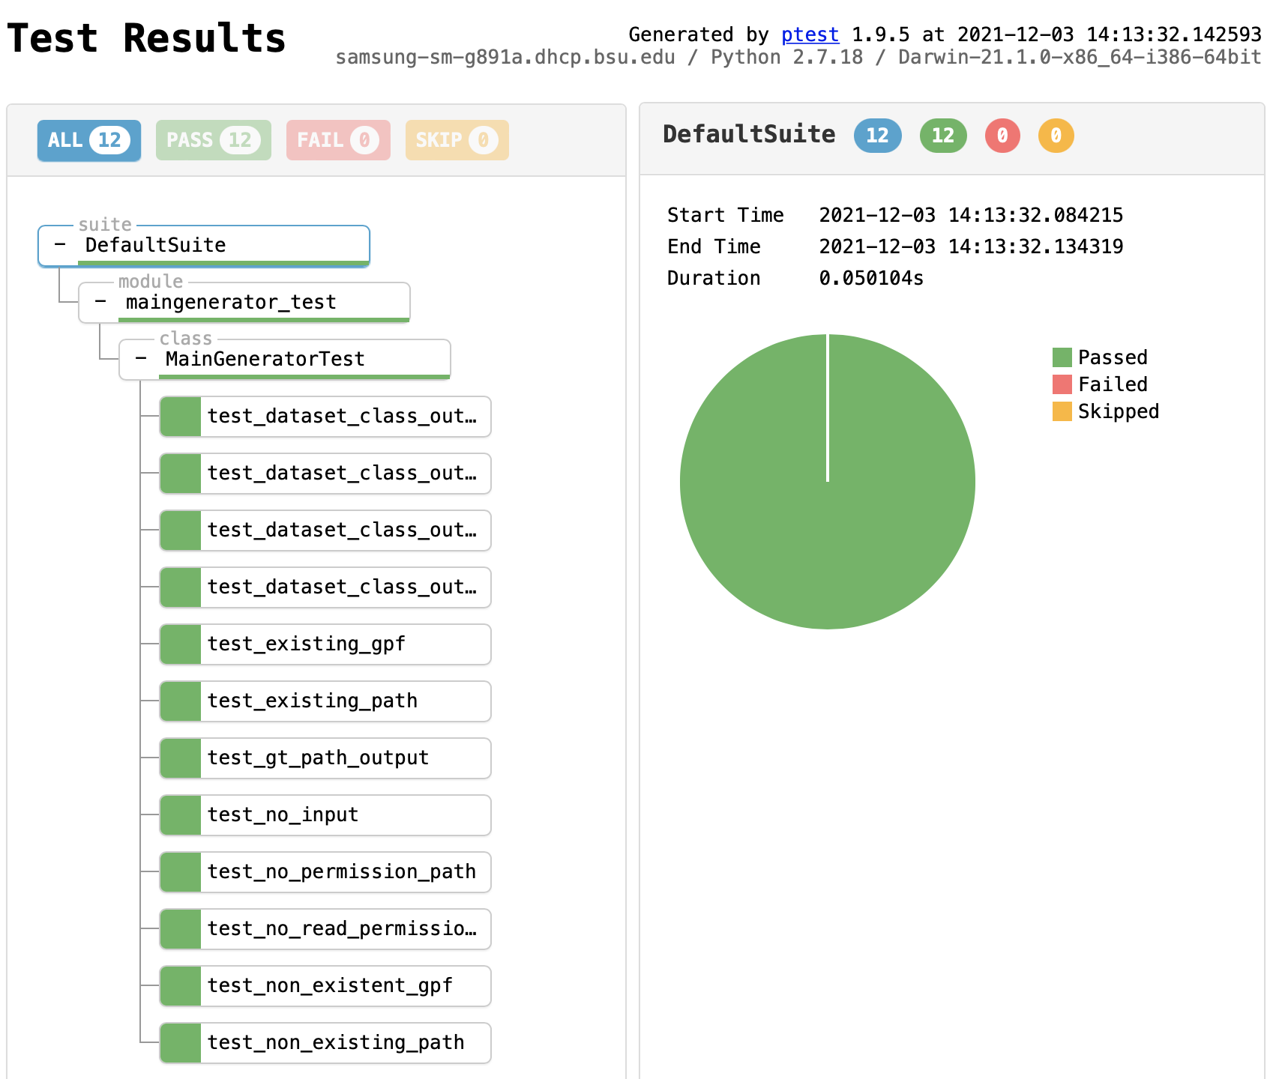
12 Passing tests in ptest

Slide 17
Conclusion & Future work
Object-method replacement: a novel technique for unit testing code with poor model-view separation
Jenkins for CI/CD: automated running of tests to ensure code quality
Ptest and Unittest: two Python unit testing frameworks each with their own advantages
PythonCalc & MainGenerator: case studies and application of techniques
Future work: integration testing with the TimeRange, SpaceRange, and USGSAgent workflow

Slide 18

acknowledgments
This work was generously funded by the National Science Foundation (NSF) under Grant 1835602.
This work was also supported in part by an Undergraduate Honors Fellowship, funded by the Honors College, Ball State University.

