Slide 1
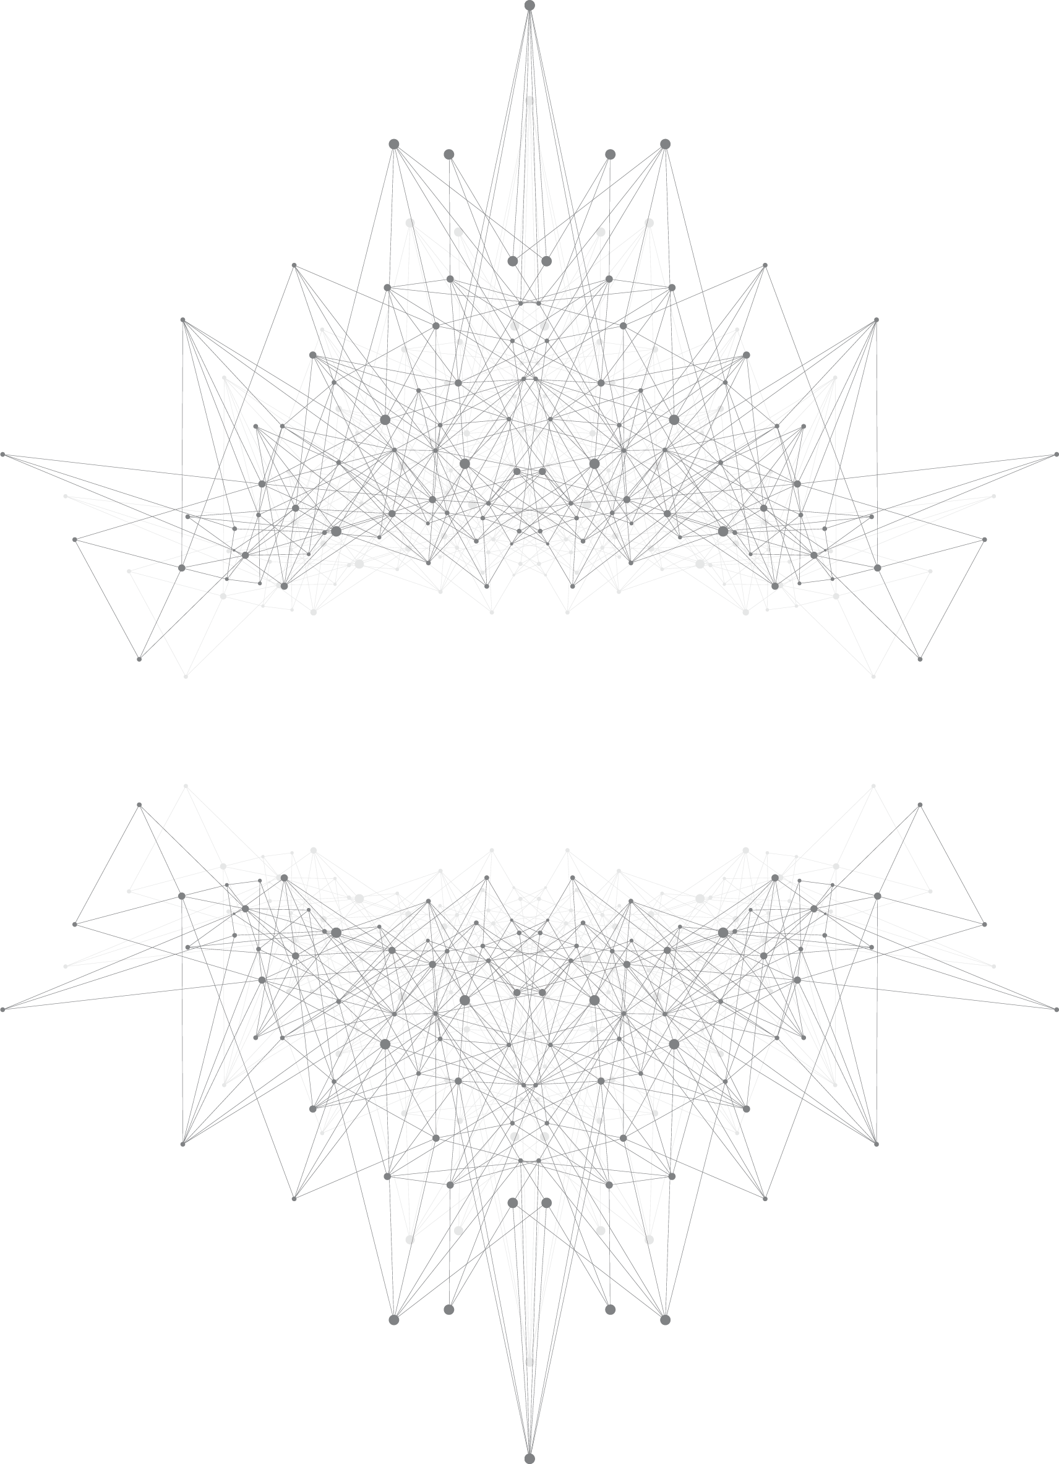

seke2022
Self-Adaptive Task Allocation for Decentralized
Deep Learning in Heterogeneous Environments
Yongyue Chao
Institute of Automation, Chinese Academy of Sciences
2022-6-9
Notes:
Good morning everyone, i will introduce a task allocation method to solve stragglers in distributed deep learning based on synchronous stochastic gradient descent.

Slide 2
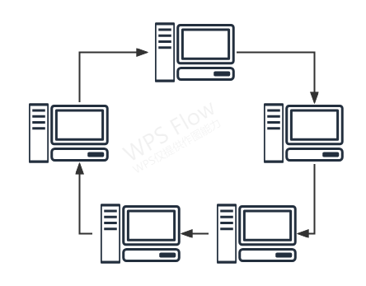
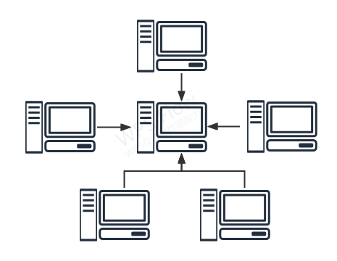
Introduction
Institute of Automation, Chinese Academy of Sciences
Distributed Deep Learning
—— large-scale DNN models
decentralized
centralized

Slide 3
Introduction
Institute of Automation, Chinese Academy of Sciences
1.1 existing problem:
heterogeneous environment
✬ hardware heterogeneity：different GPUs with different computing capacity
straggler
✬ training speed depends on the slowest worker

Slide 4
Related work
Institute of Automation, Chinese Academy of Sciences
2.1. Based on task allocation
⊙Batch Orchestra Algorithm：balances the amount of mini-batch data according to the speed of workers and makes a linear regression on training time and mini-batch size so that allocates tasks for workers based on slope changing.
⊙FlexRR：addresses the straggler problem by integrating flexible consistency bounds with temporary peer-to-peer work reassignment. FlexRR increases the cost of training due to extra communication in worker computing.

Slide 5
Related work
Institute of Automation, Chinese Academy of Sciences
2.2 Based on model average
⊙Partial Random Synchronization: AD-PSGD, Partial All-Reduce and gossip SGP improve global synchronization with partial random synchronization
⊙Backup Worker: abandon gradients from stragglers to allow gradient aggregations without all workers participation
⊙Ajust Learning Rate: dynamically adjust the local learning rate of worker according to the delay of the worker or the state of gradients

Slide 6
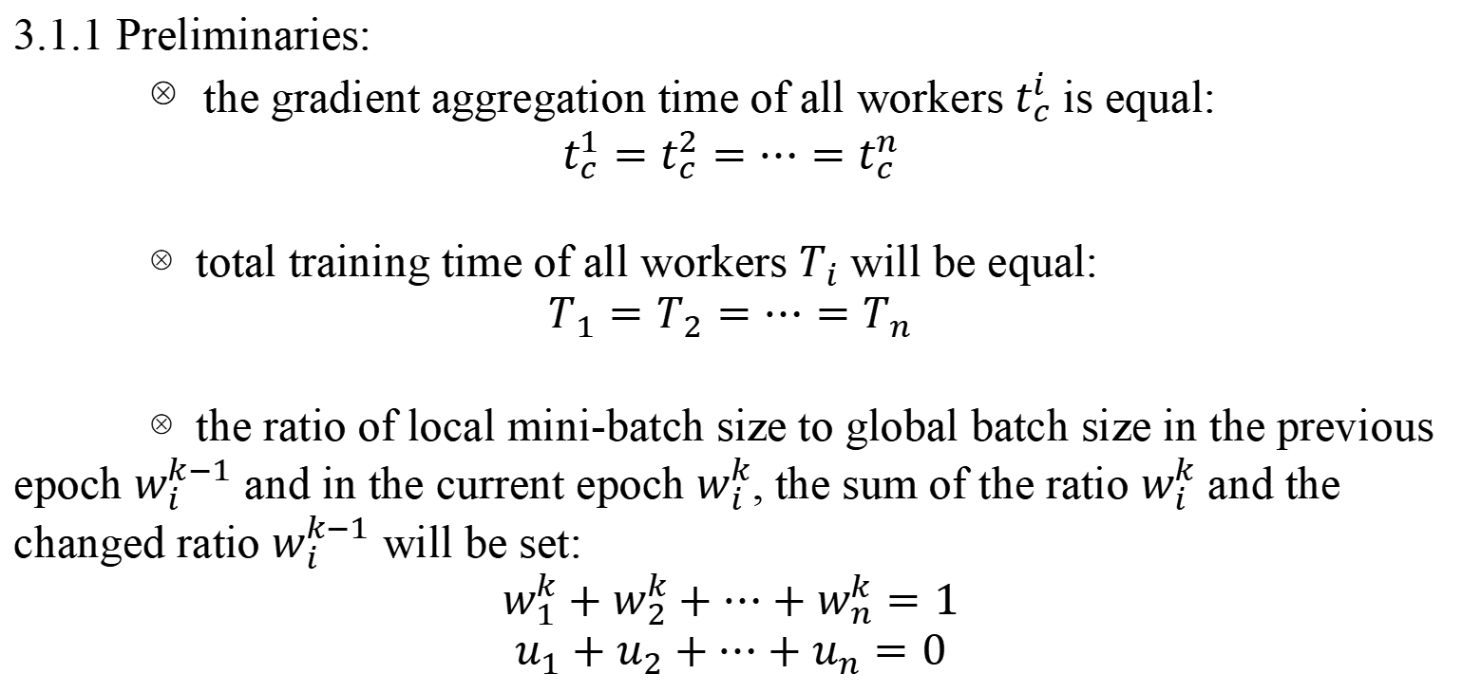
Method --SATA
Institute of Automation, Chinese Academy of Sciences
3.1. task allocation model
3.1.1 Preliminaries:
⊗the gradient aggregation time of all workers $t_{c}^{i}$ is equal:
$$t_{c}^{1}=t_{c}^{2}=⋯=t_{c}^{n}$$
⊗total training time of all workers $T_{i}$ will be equal:
$$T_{1}=T_{2}=⋯=T_{n}$$
⊗the ratio of local mini-batch size to global batch size in the previous epoch $w_{i}^{k−1}$ and in the current epoch $w_{i}^{k}$, the sum of the ratio $w_{i}^{k}$ and the changed ratio $w_{i}^{k−1}$ will be set:
$$w_{1}^{k}+w_{2}^{k}+⋯+w_{n}^{k}=1$$
$$u_{1}+u_{2}+⋯+u_{n}=0$$

Slide 7
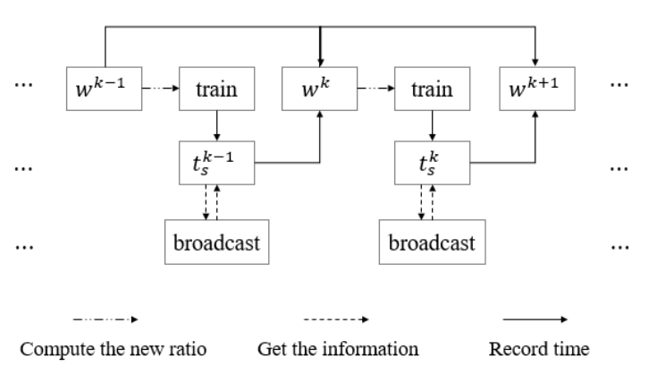
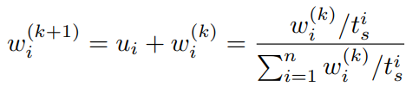
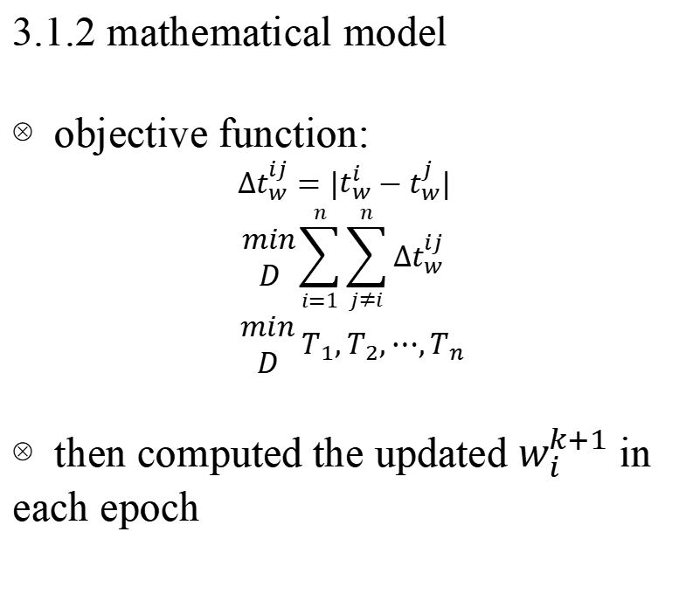
Method --SATA
Institute of Automation, Chinese Academy of Sciences
3.1. task allocation model
3.1.2 mathematical model
⊗objective function:
$∆t_{w}^{ij}=|t_{w}^{i}−t_{w}^{j}|$
$$\begin{matrix}min \\ D\end{matrix}\sum_{i=1}^{n}{\sum_{j≠i}^{n}{∆t_{w}^{ij}}}$$
$\begin{matrix}min \\ D\end{matrix} T_{1},T_{2},⋯,T_{n}$
⊗then computed the updated $w_{i}^{k+1}$ in each epoch

Slide 8
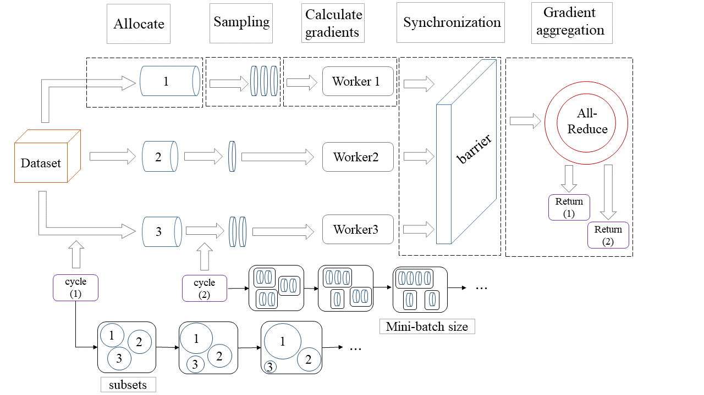
Method --SATA
Institute of Automation, Chinese Academy of Sciences
3.2. self-adaptive task allocation algorithm

Slide 9
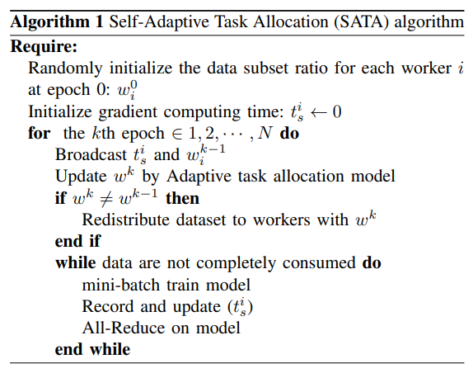
Method --SATA
Institute of Automation, Chinese Academy of Sciences
3.2. self-adaptive task allocation algorithm
⊗Three main parts in the SATA algorithm:
determining the ratio
redistributing the dataset
training
⊗ Under relatively steady environment, w will be steady after several epochs.

Slide 10
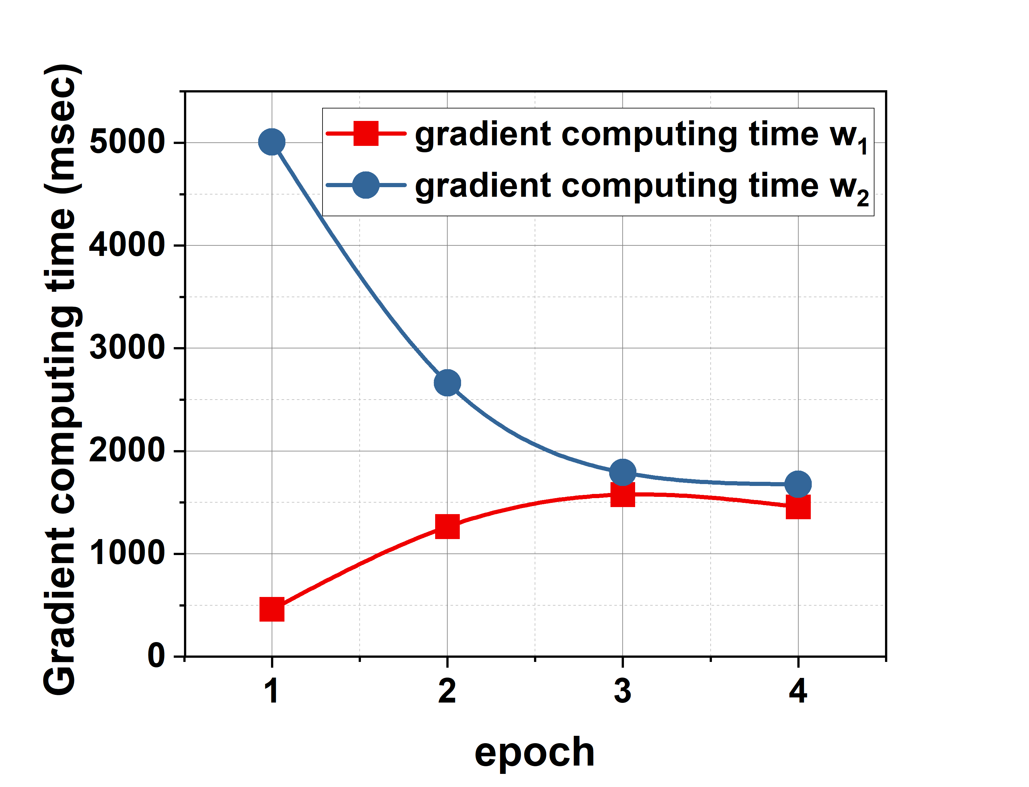
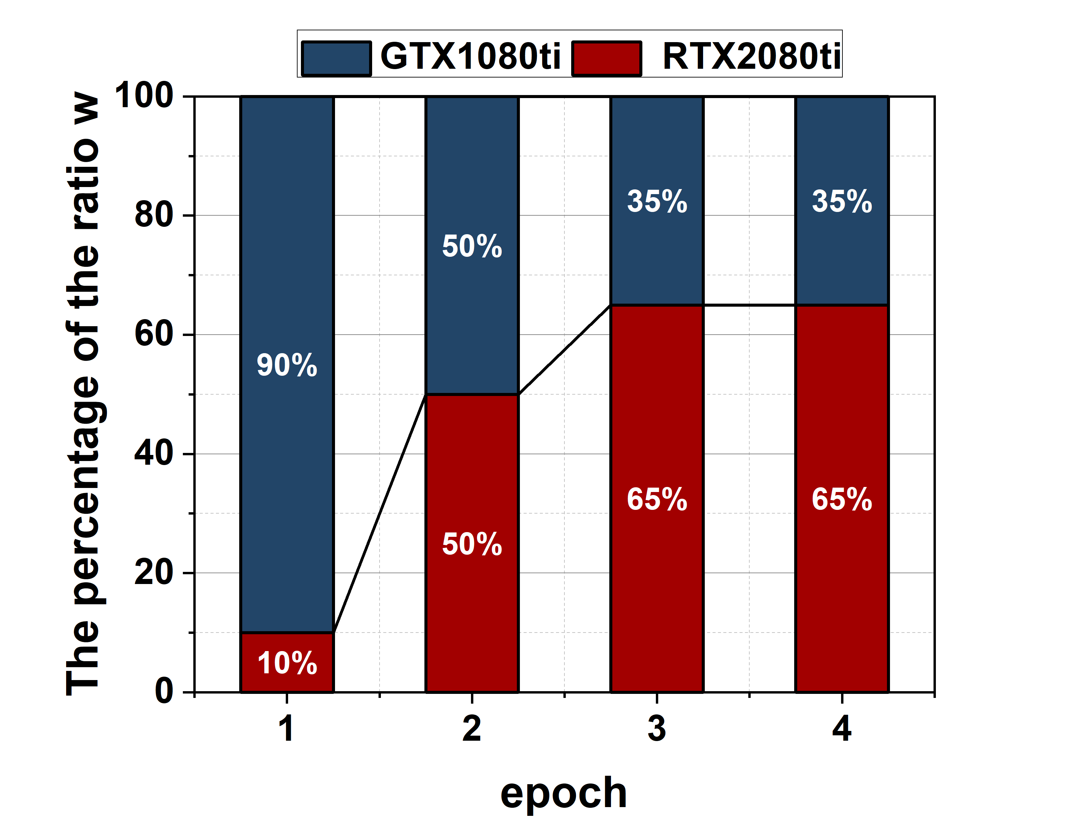
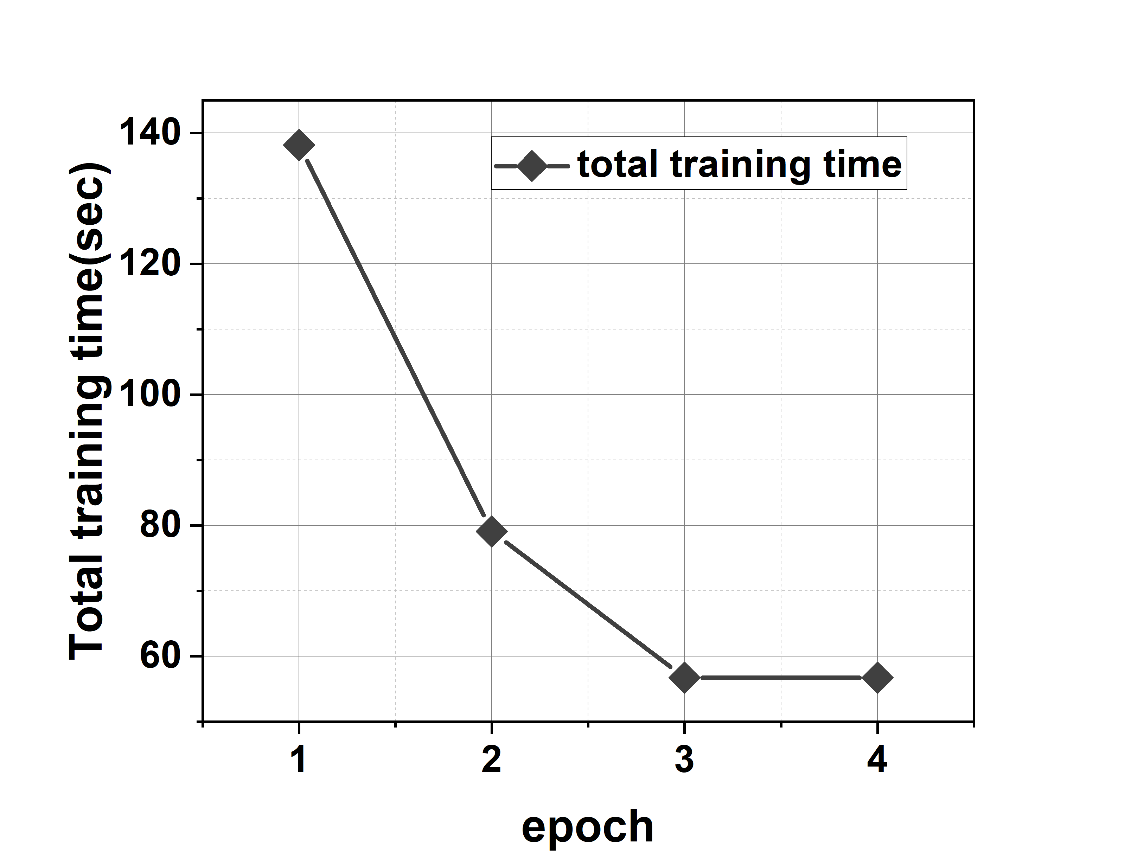
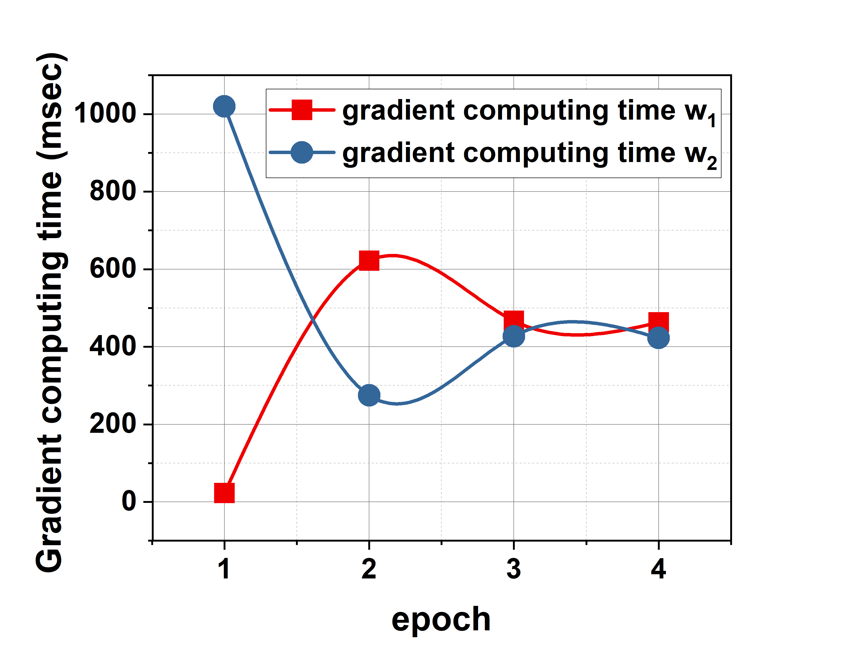
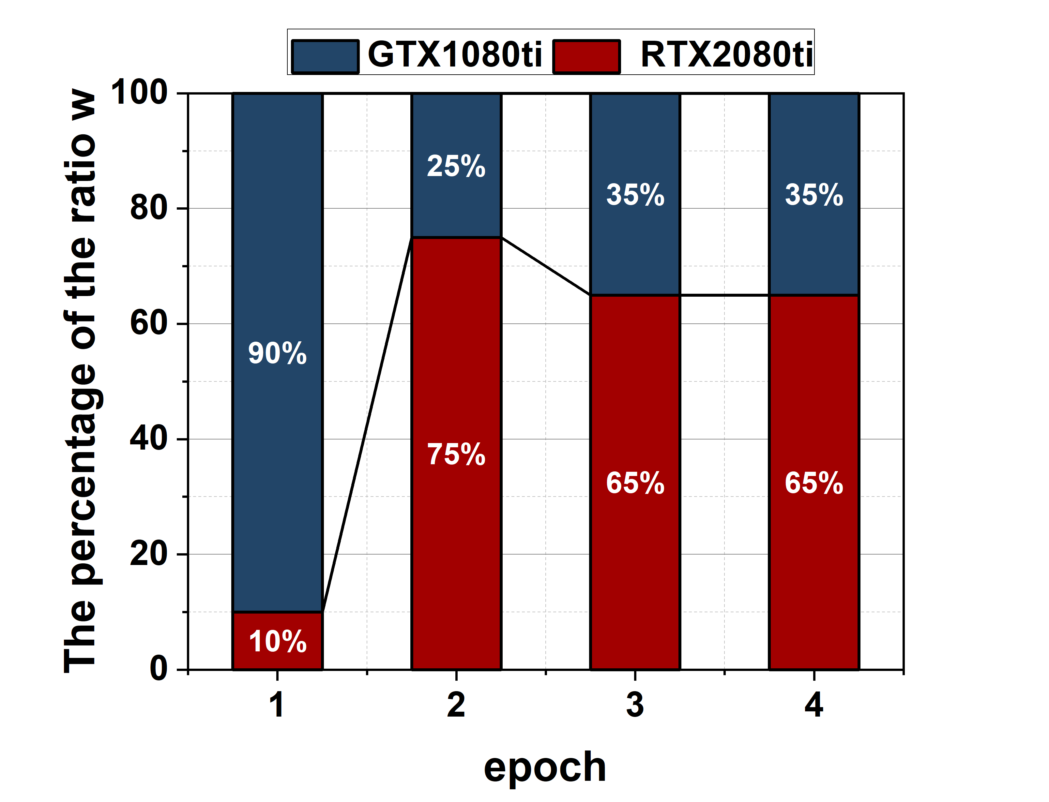
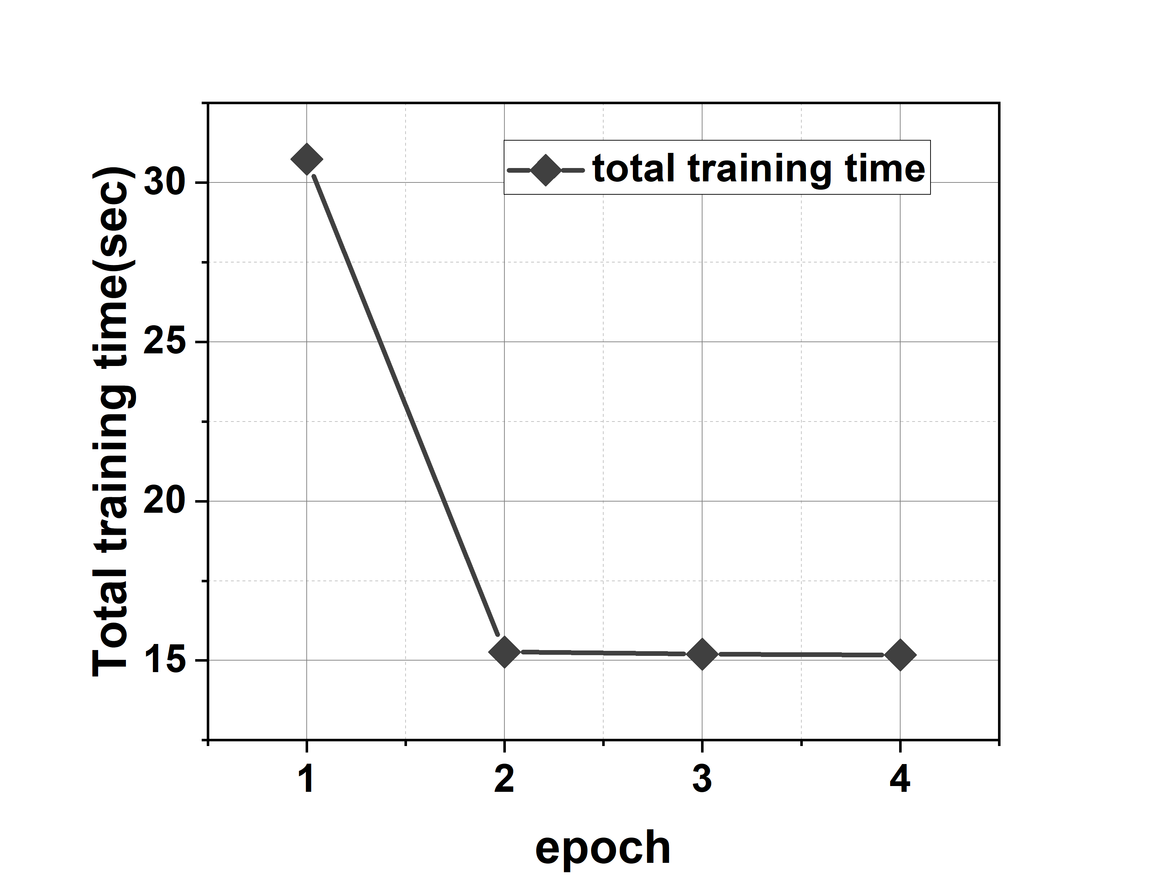
Experiment
Institute of Automation, Chinese Academy of Sciences
4.1.acceleration by SATA algorithm in heterogeneous environments
2 nodes
ResNet
VGG

Slide 11
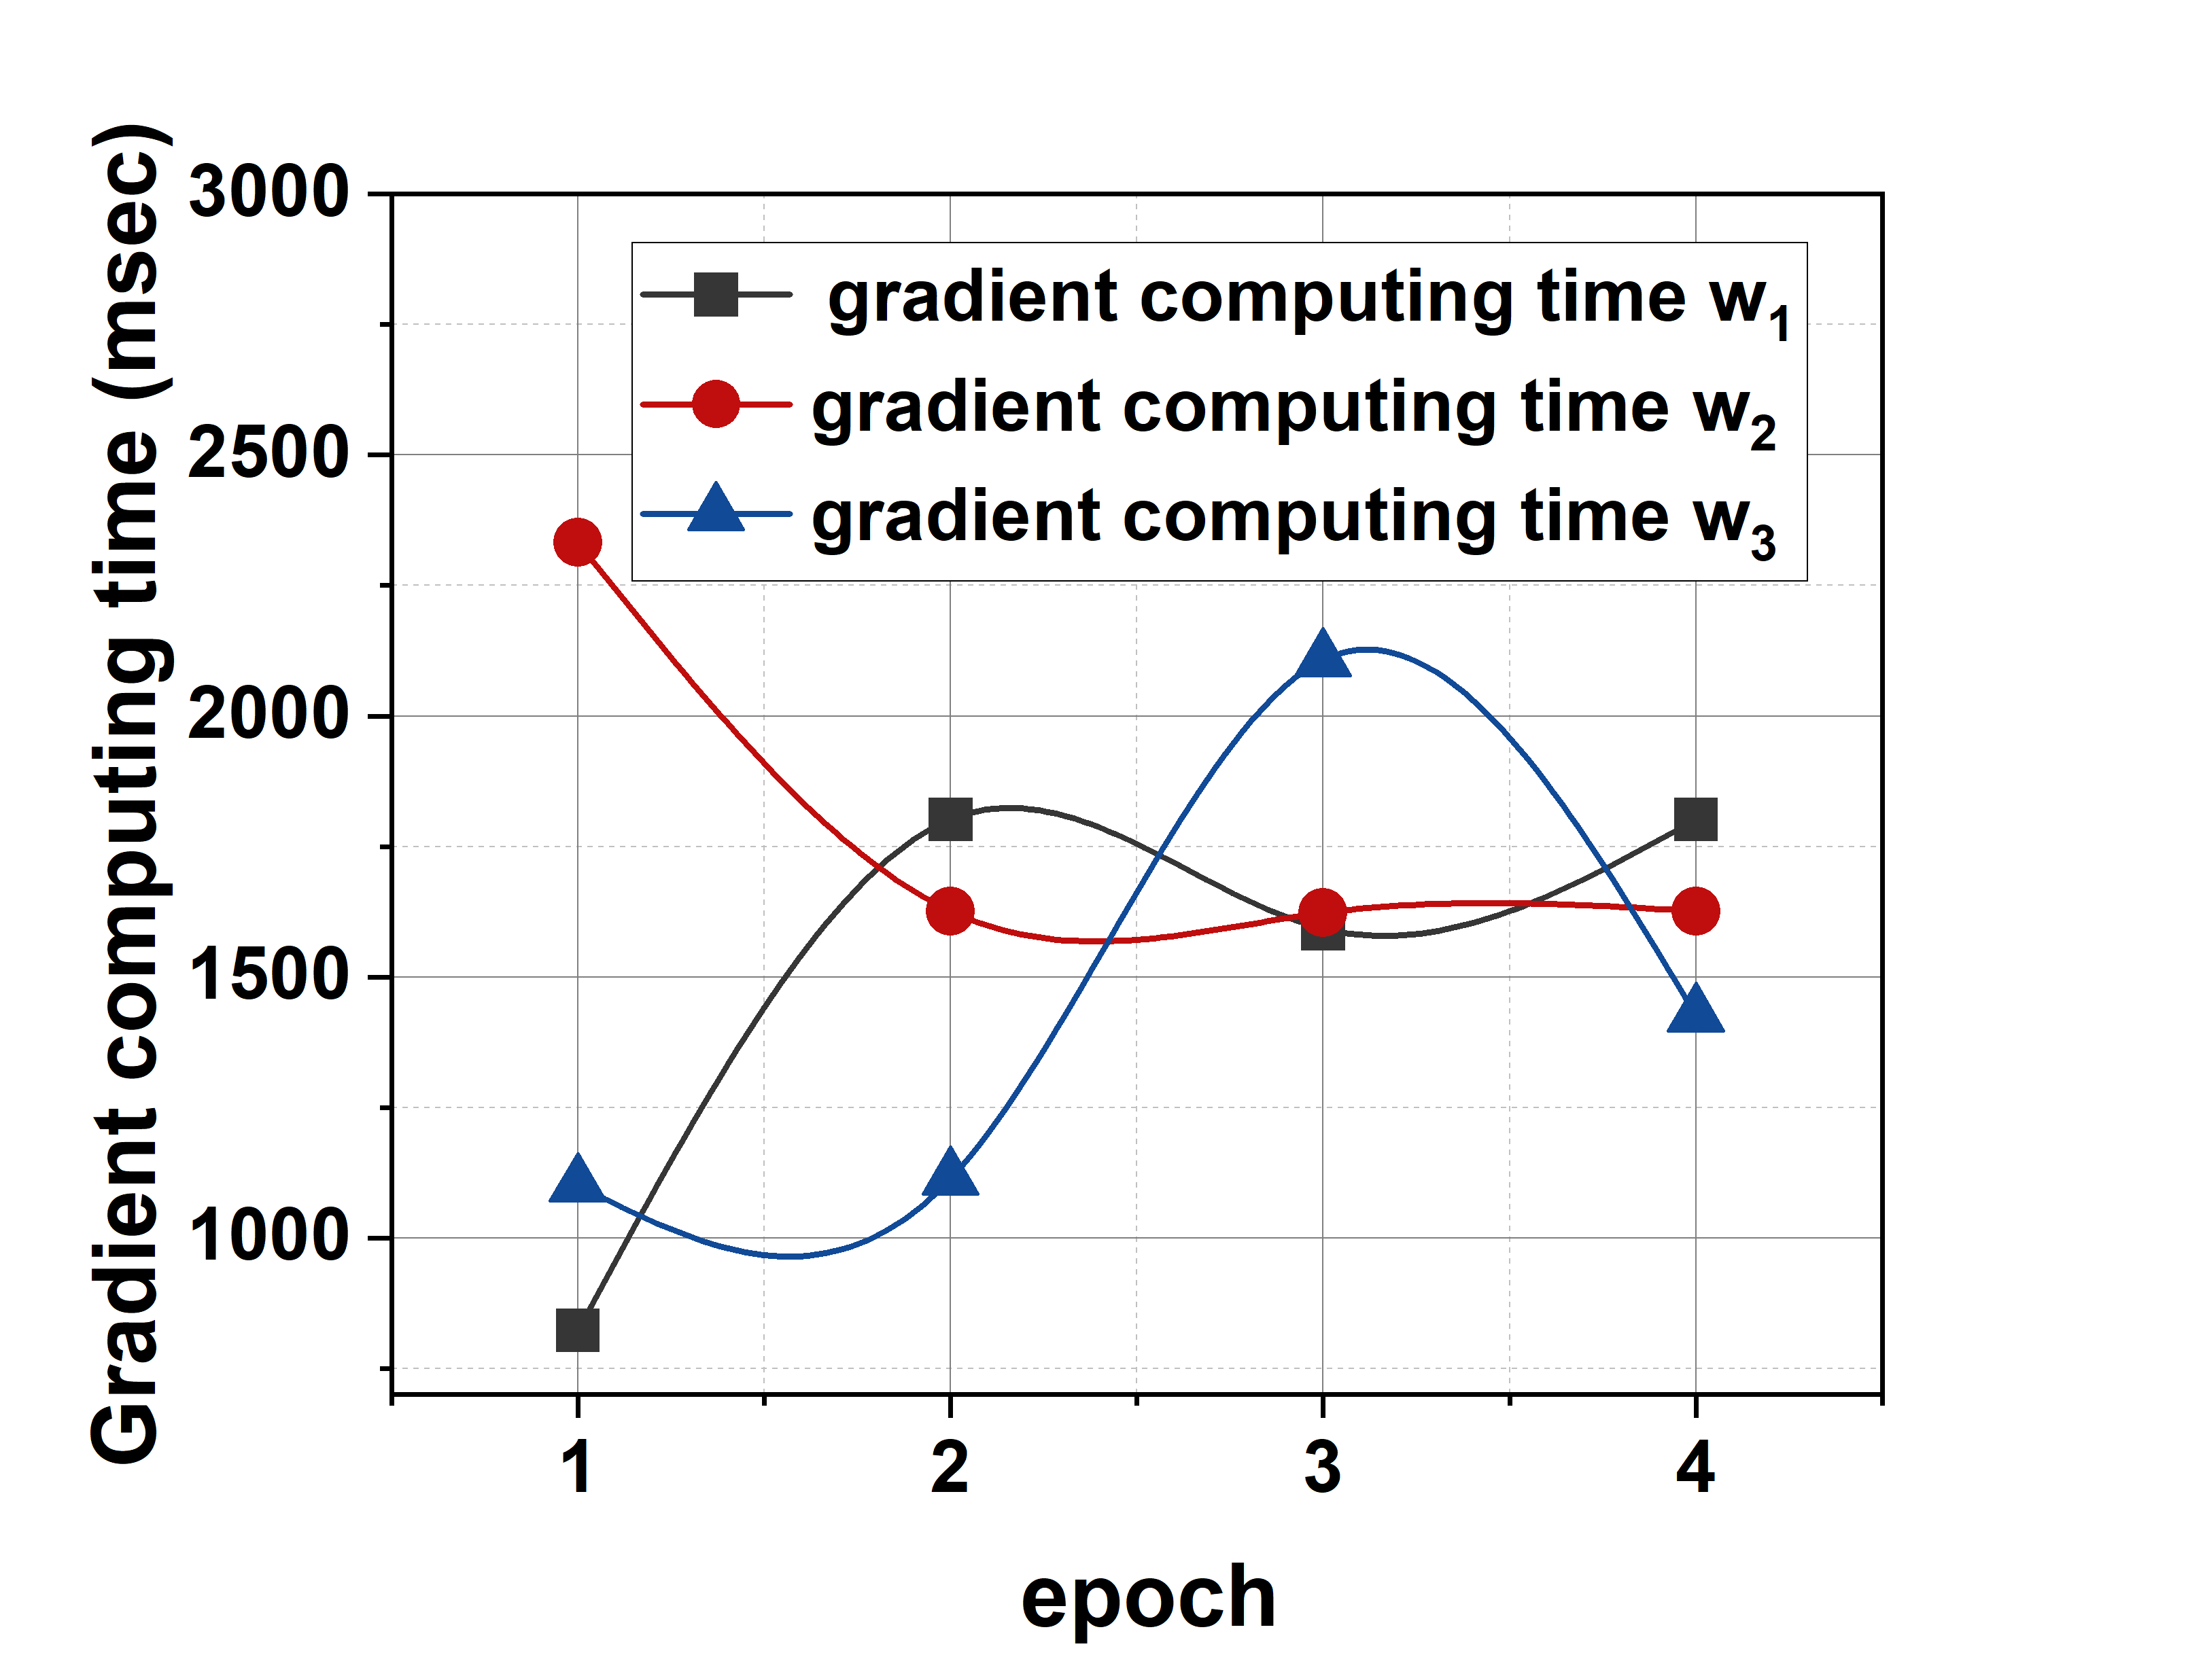
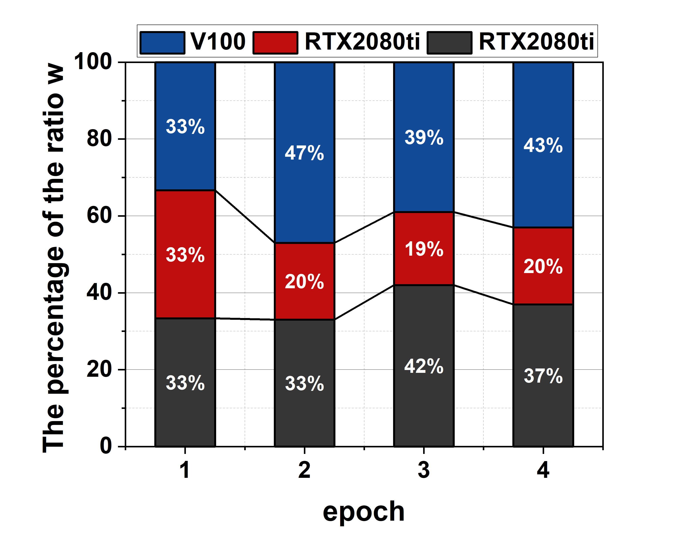
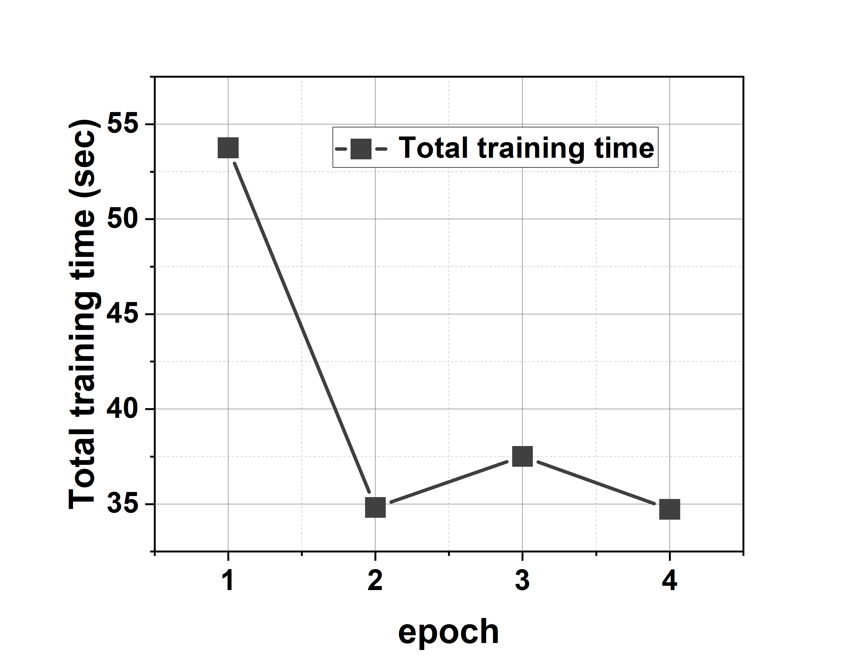
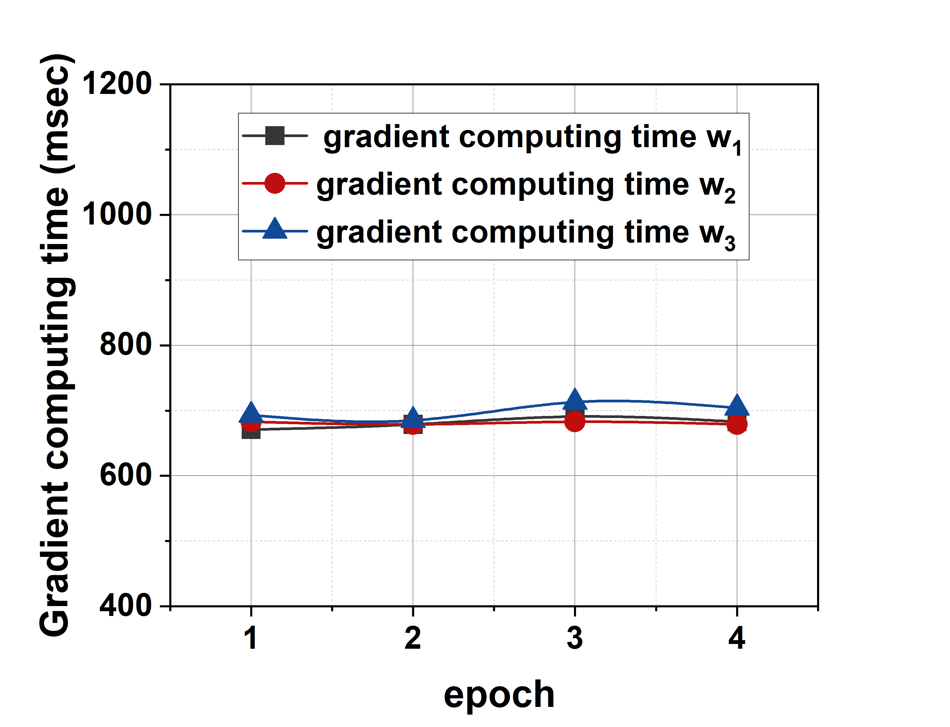
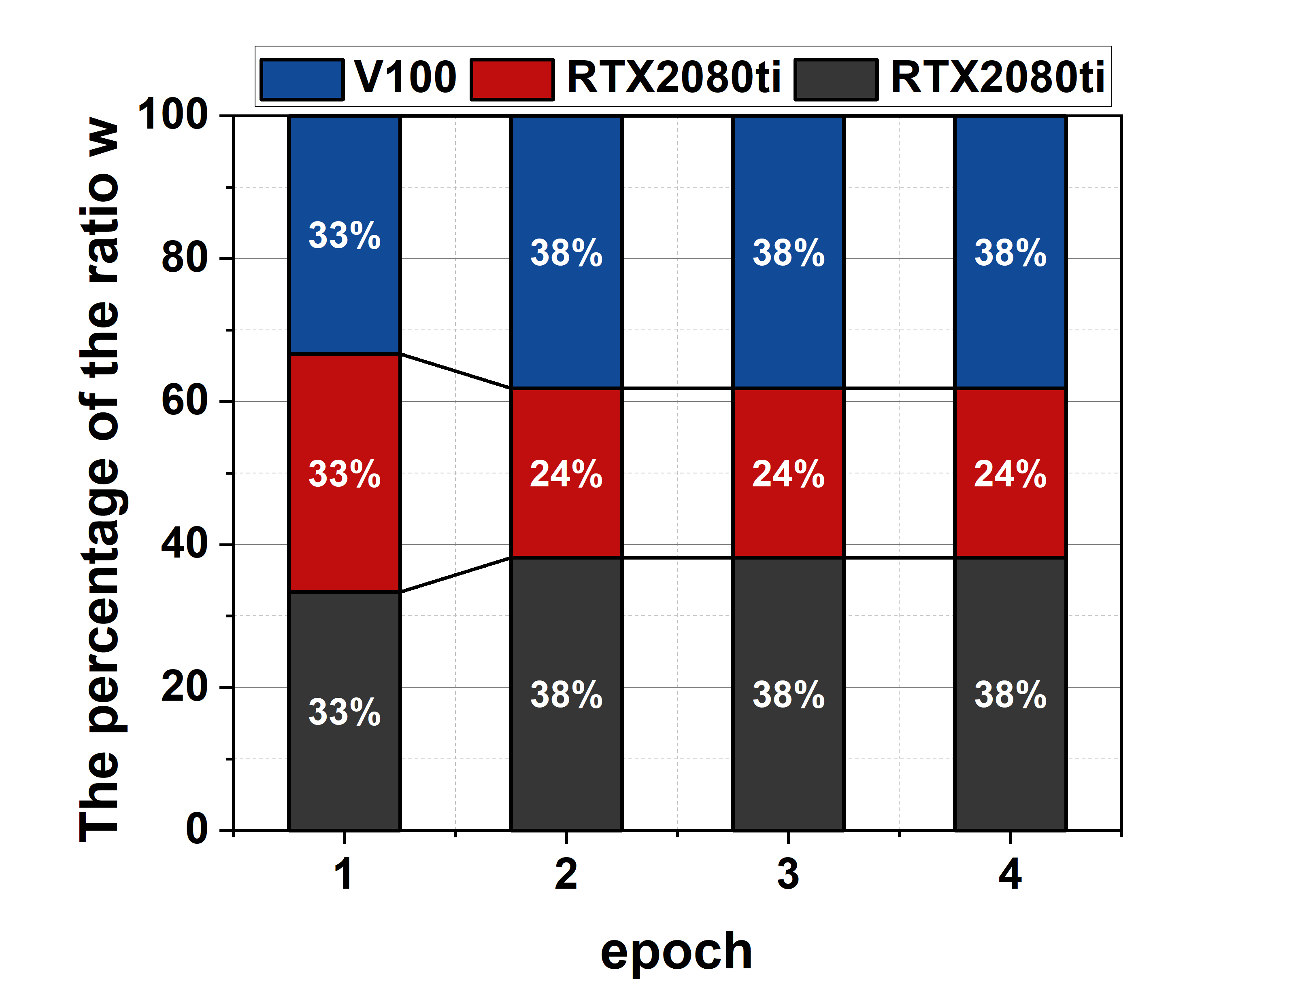
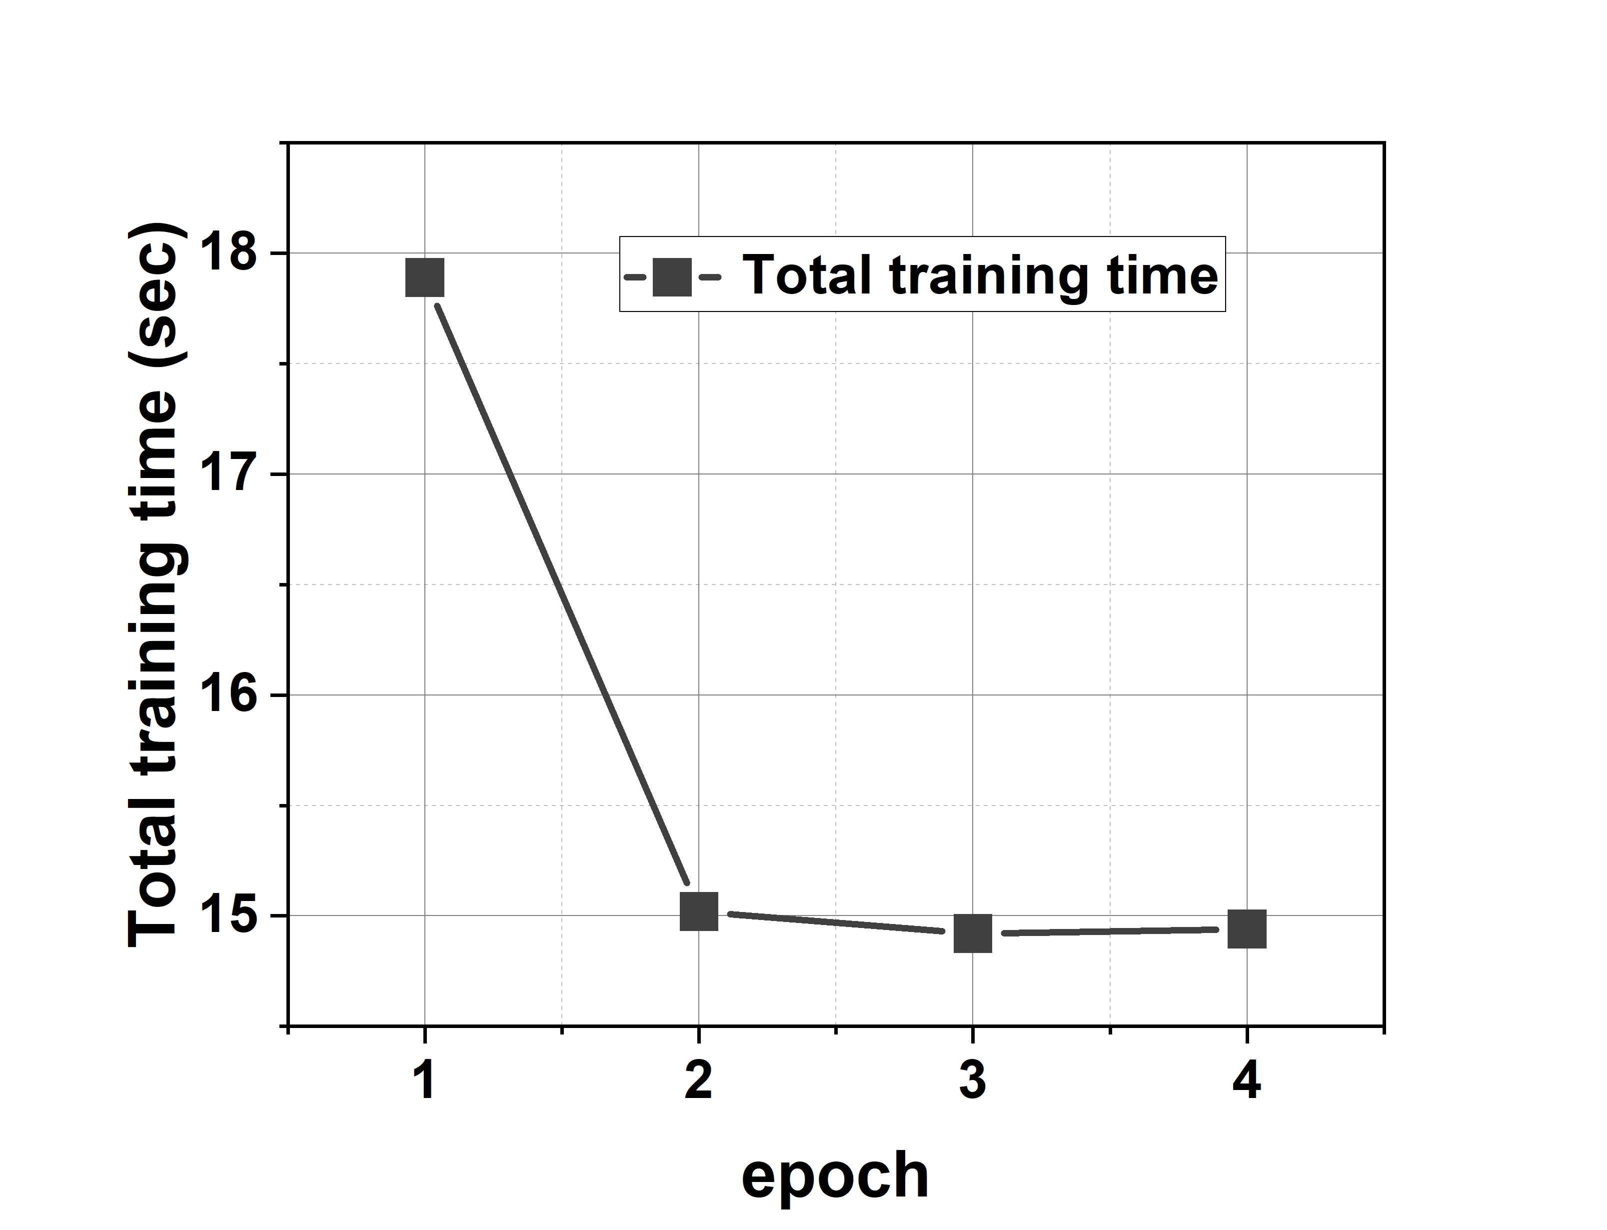
Experiment
Institute of Automation, Chinese Academy of Sciences
4.1.acceleration by SATA algorithm in heterogeneous environments
3 nodes
ResNet
VGG

Slide 12
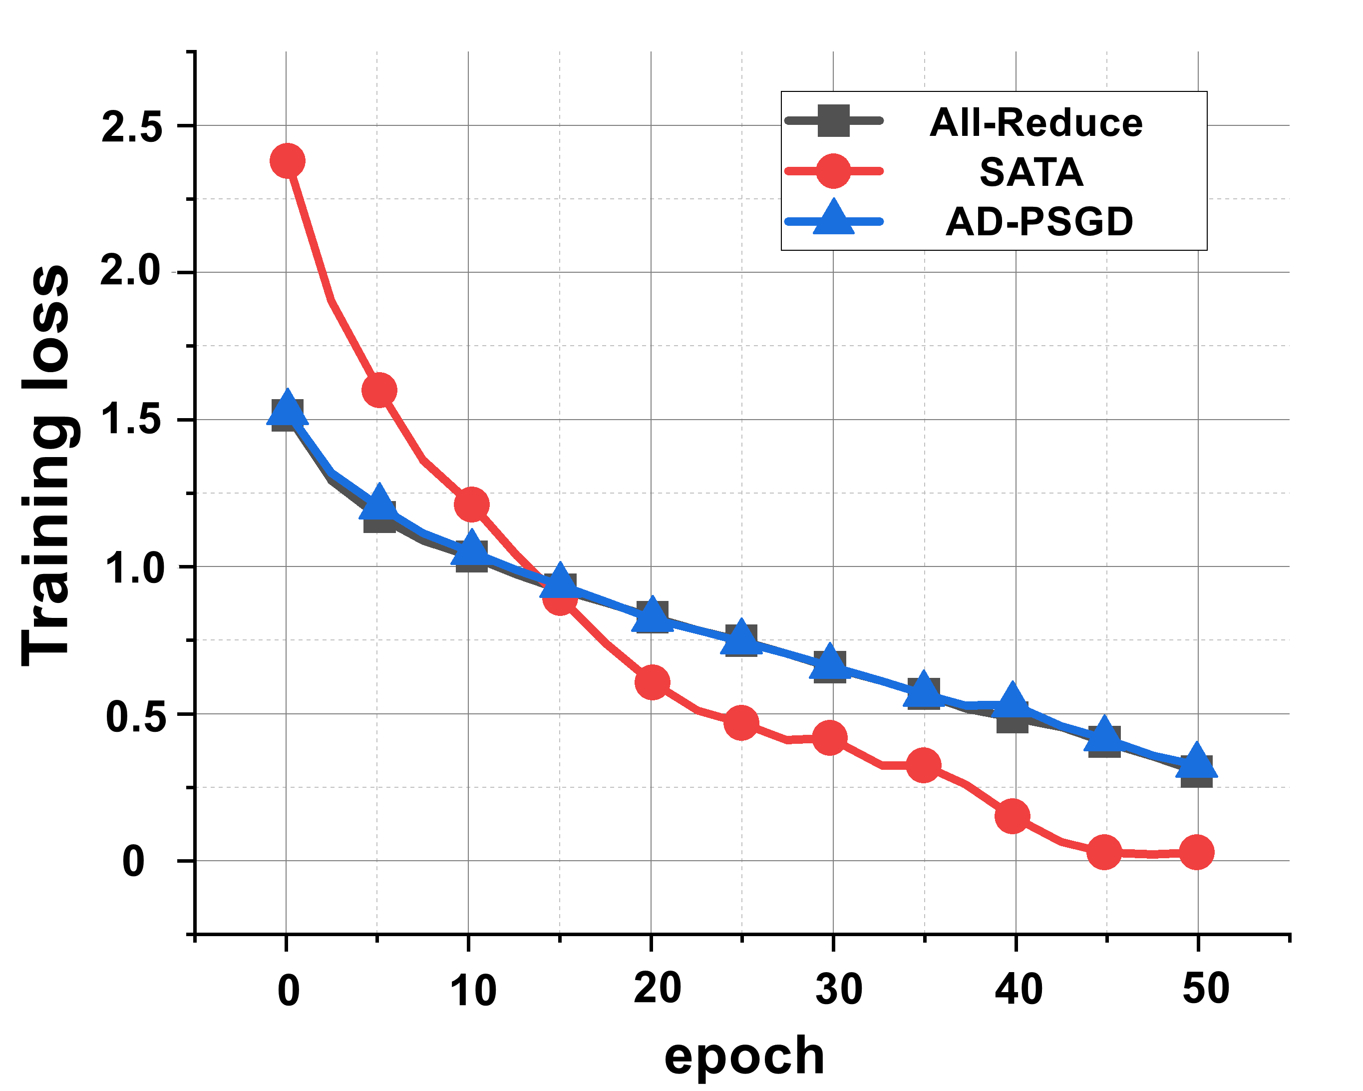
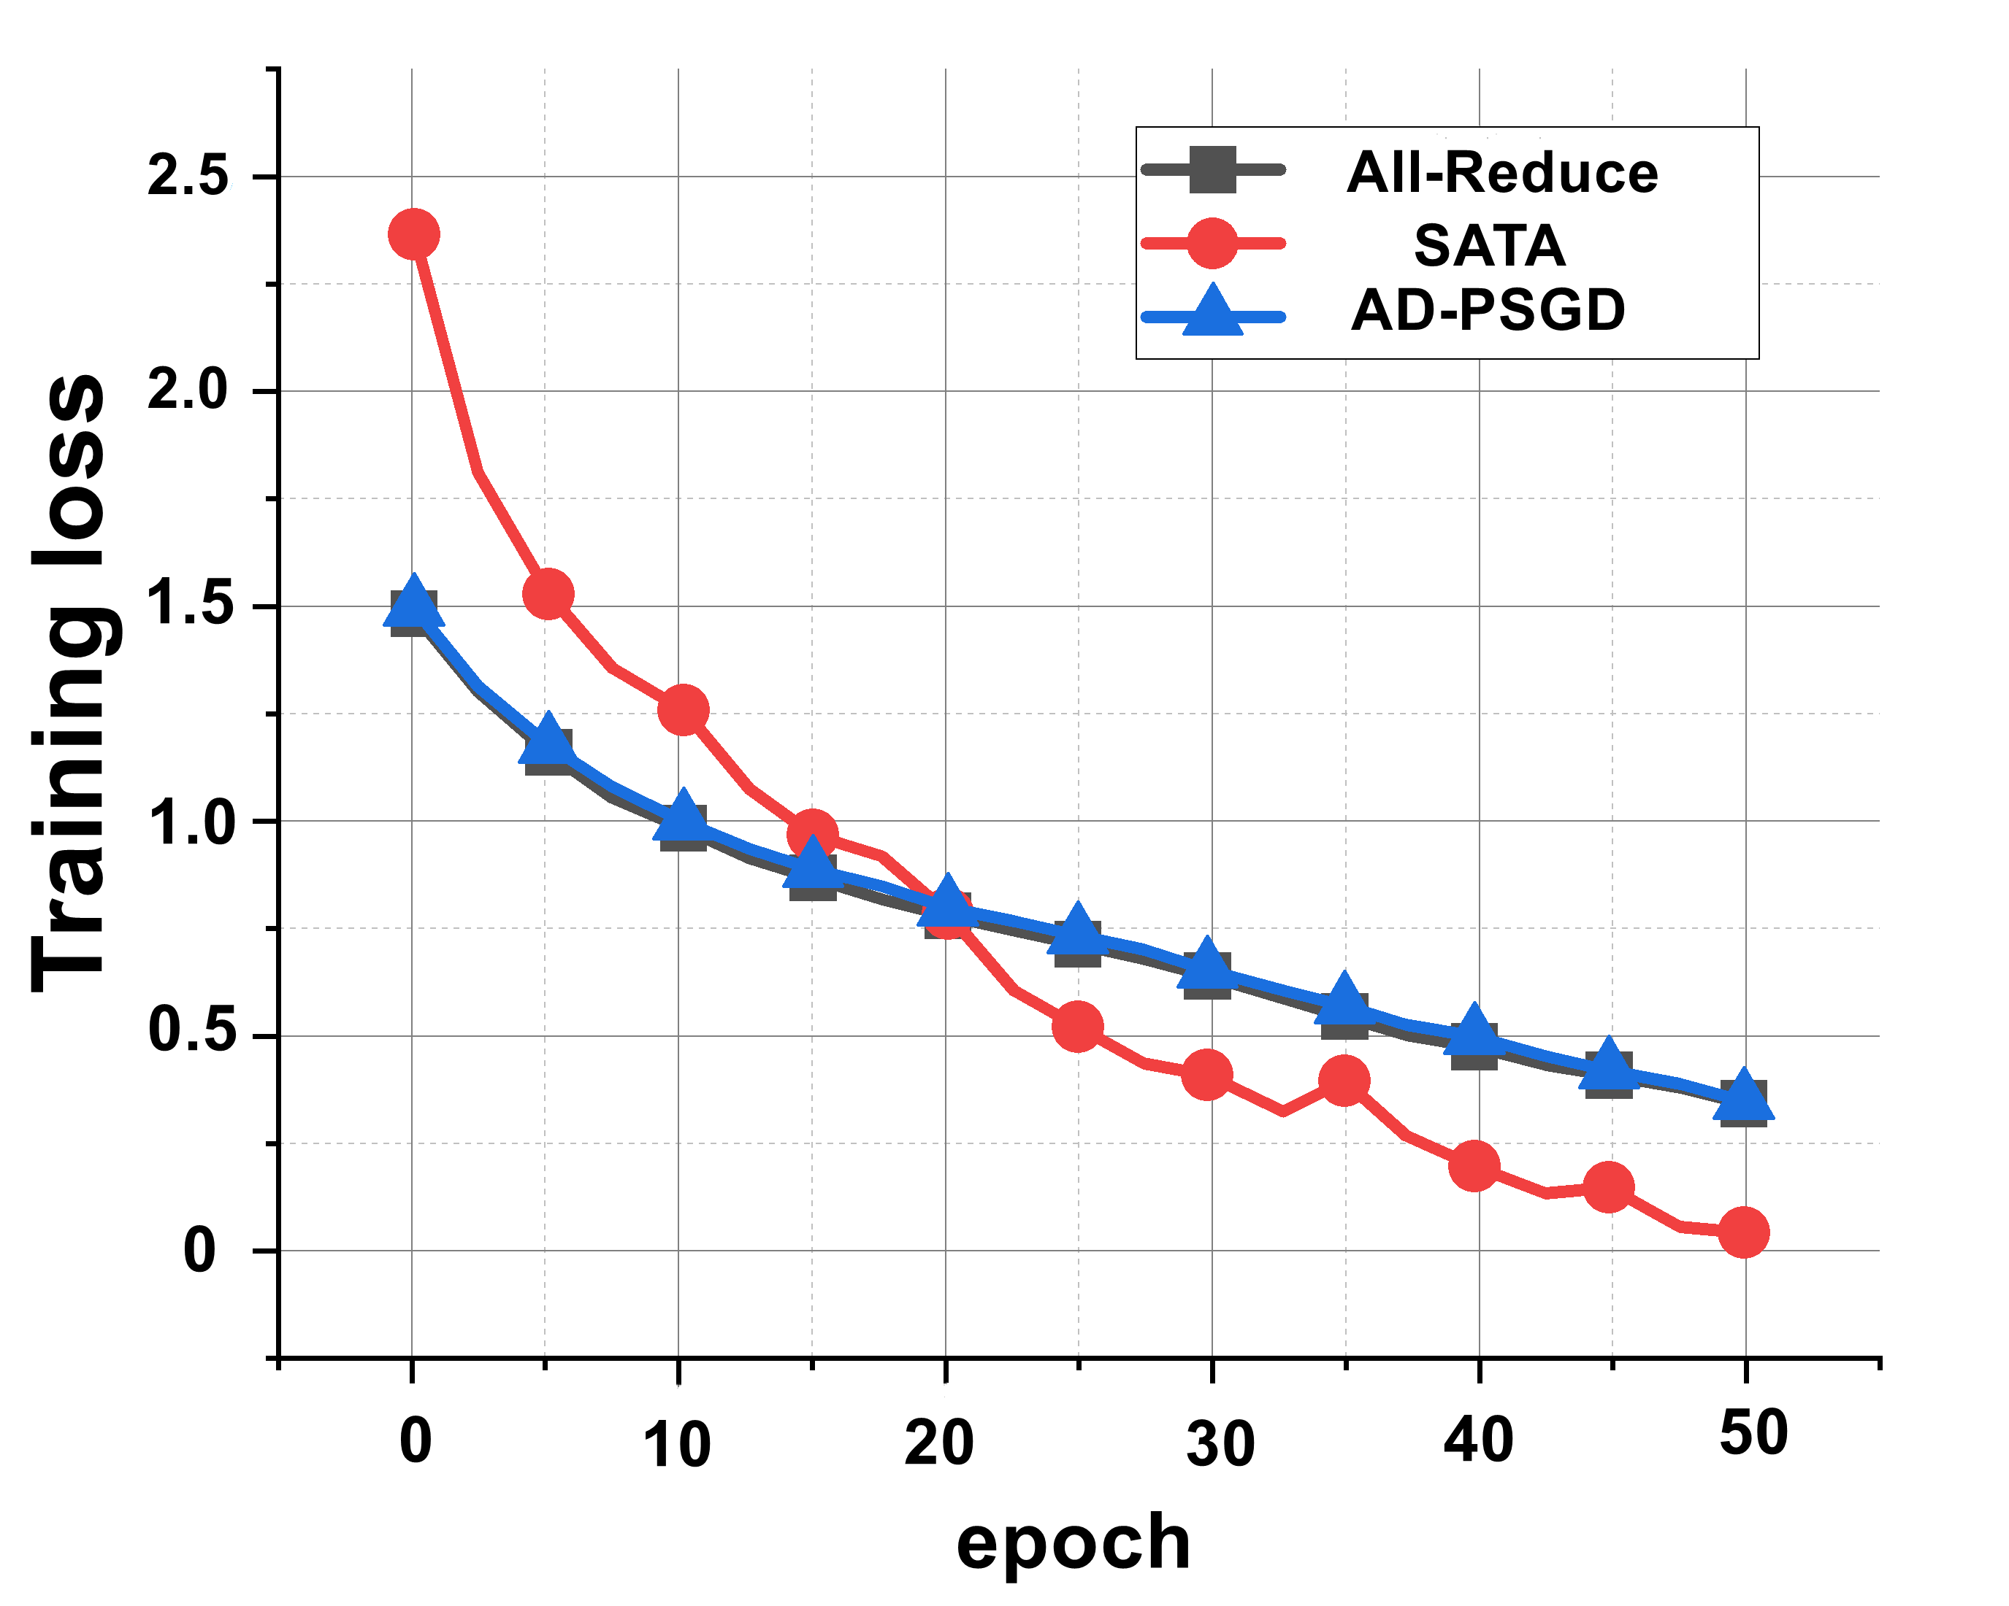
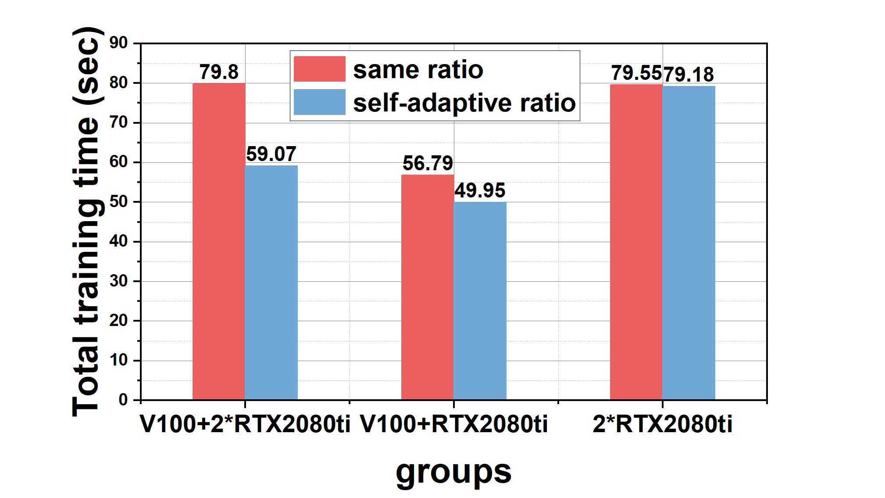
Experiment
Institute of Automation, Chinese Academy of Sciences
4.2.compared to other algorithms for straggler problems
① We set a straggler with 2X, 5X and 10X slowdown and set the speedup ratio of PS as 1 as done in Prague.
② SATA can reach about 3.3X that of All-Reduce given 2X/5X slowdown, 3.8X that of AD-PSGD under 2X slowdown and 1.9X under 5X slowdown

Slide 13
Thanks for listening

