Slide 1
An efficient discrimination discovery method for fairness testing
○ Shinya Sano (Keio University)
Takashi Kitamura (National Institute of Advanced Industrial Science and Technology)
Shingo Takada (Keio University)
SEKE2022

Slide 2
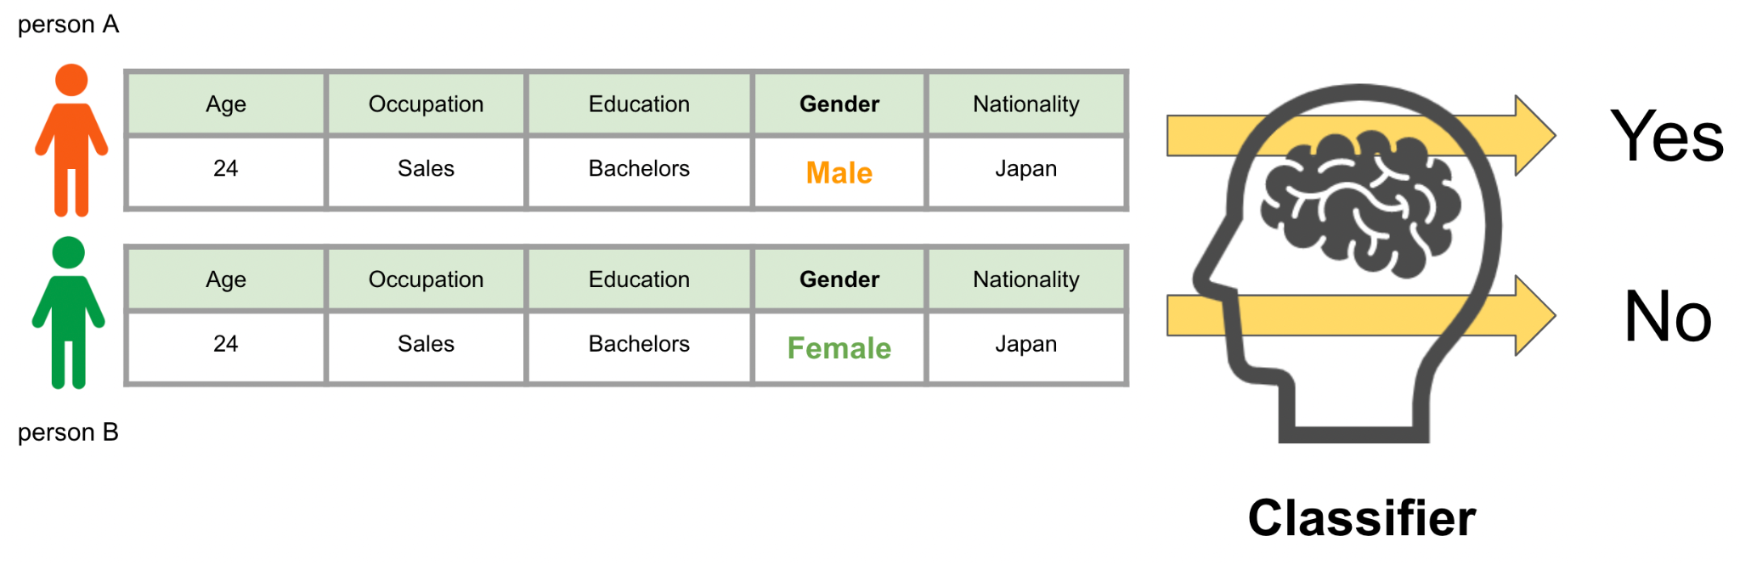
Background
Machine learning software that makes decisions is rapidly becoming popular
  Medical diagnosis, Loan, Sentencing (Court)
Individual discrimination
Only the values of a protected attribute (Gender) are different
Discrimination!!!
Data

Slide 3

Related Work: AEQUITAS
【Hypothesis①】
Search the same way for
any A obtained in the global search
↓
Inefficient if there are no discriminatory data in the neighborhood
Global search: random search yields discriminatory data ( ).
Local Search: Neighborhood ( ) of are searched, and discriminatory data ( ) are obtained.

Slide 4
How we use data
1: Engineer
2: Marketing
…
15: Sales
0: Male
1: Female
Age | Occupation | Education | Gender | Nationality
24 | Sales | Bachelors | Male | Japan
0: Doctors
1: Masters
2: Bachelors
0: US
1: UK
…
22: Japan
Convert to number if needed
Age | Occupation | Education | Gender | Nationality
24 | 15 | 2 | 0 | 22

Slide 5
Mechanism of Aequitas’s local search
↓ Unprotected attribute
↓ Protected attribute
Age | Occupation | Education | Gender | Nationality
24 | 15 | 2 | 0 | 22
←discriminatory data
24 | 16 | 2 | 0 | 22
24 | 16 | 1 | 0 | 22
【Hypothesis②】
These are the same data
→ Unnecessary
Choose “Occupation” and Change by “1”
25 | 16 | 1 | 0 | 22
Choose “Education” and Change by “-1”
24 | 16 | 1 | 0 | 22
Choose “Age” attribute and Change by “1”
24 | 16 | 1 | 0 | 23
Choose “Age” attribute and Change by “-1”
Choose “Nationality” and Change by “1”

Slide 6
Proposal: Keeper Of Systematic Equality Investigation (KOSEI)
↓ Unprotected attribute
↓ Protected attribute
Age | Occupation | Education | Gender | Nationality
24 | 15 | 2 | 0 | 22
←discriminatory data
23 | 15 | 2 | 0 | 22
25 | 15 | 2 | 0 | 22
Change 1st attribute (“Age”) by “-1”
24 | 14 | 2 | 0 | 22
Change 1st attribute (“Age”) by “1”
24 | 16 | 2 | 0 | 22
Change 2nd attribute (“Occupation”) by “-1”
・
・
・
Change 2nd attribute (“Occupation”) by “1”
Change 5th attribute (“Nationality”) by “1”
24 | 15 | 2 | 0 | 23

Slide 7
Our improvements
Ordered search
Implementation without Basin-hopping
Dynamic update
Please read our paper for details

Slide 8
Evaluation
RQs
  RQ1: Does KOSEI find more discriminatory data than AEQUITAS, at a reasonable execution cost?
  RQ2: Does KOSEI generate test cases (data) likely to be discriminatory and avoid duplicated data, better than AEQUITAS?
Experiment setup
  Dataset: Adult, Statlog, Bank Marketing
  ML Classifier: Decision Tree, MLPC, Random Forest
We performed evaluations ten times for each combination of a dataset and a ML classifier.

Slide 9
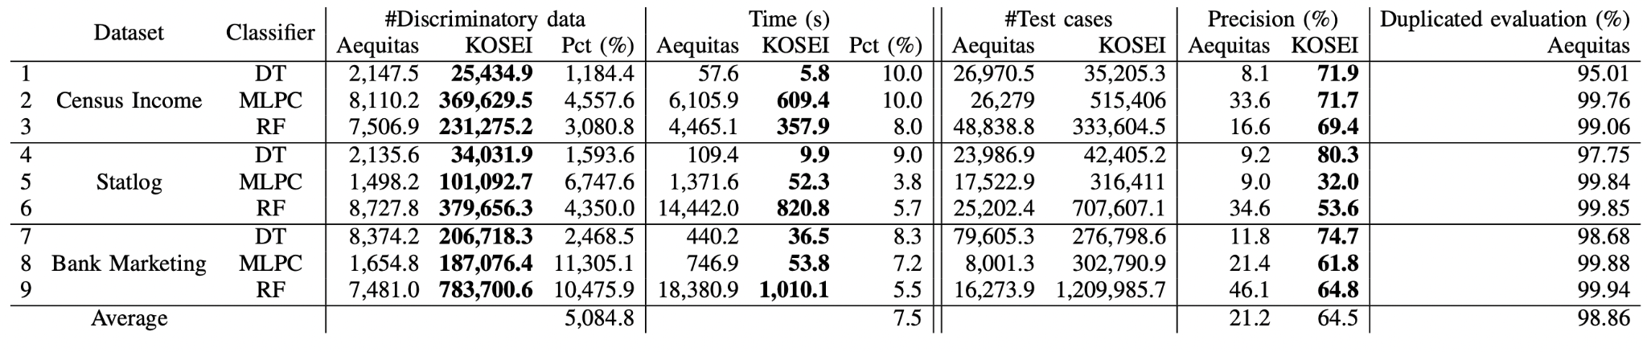
Experimental result (RQ1)
<Answer for RQ1>
KOSEI found 50 times more discriminatory data
KOSEI took only 7.5% of execution time, meaning that it ran 13.3 times faster

Slide 10
Experimental result (RQ2)
<Answer for RQ2>
KOSEI had a much higher precision compared to Aequitas,
  i.e., it can better generate discriminatory test cases (data)
Aequitas had 99% redundancy, while KOSEI avoids them

Slide 11
Conclusion and Future works
We proposed a fairness testing technique, KOSEI
  Method of generating neighboring data
  Elimination of duplicate evaluations
  Dynamic update of discriminatory data
Our evaluation showed significant improvement in the efficiency of KOSEI
Future works
  Extend experiments with more datasets, classifiers, and protected attributes for further generalization.
  Evaluate KOSEI, comparing it with techniques other than AEQUITAS
  Combine KOSEI with other techniques such as CGFT

