Slide 1
Exploring MMSE Score Prediction Model Based on Spontaneous Speech
Li Sun, Jieyuan Zheng, Jiyun Li, Chen Qian
SEKE 2022
KSIR Virtual Conference Center, Pittsburgh, USA
July 1 - July 10, 2022

Slide 2
Background
Alzheimer's disease(AD) is a neurodegenerative and irreversible disease. Currently, there is no cure for it. Only early screening can achieve the purpose of early prevention.
As a scale that is often used in clinical practice, Mini Mental State Examination(MMSE) requires a special score by doctors, which will undoubtedly bring psychological pressure to the subjects, and the scale is not very friendly to people with low education levels.
There is evidence that automated methods can predict MMSE scores from open communication. An easily accessible automated assessment mechanism could enable more frequent and regular assessments of individuals, helping to diagnose early dementia more quickly.

Slide 3
Dataset
AD Non-AD
Age M F MMSE M F MMSE
[50,55) 1 0 30.0 1 0 29.0
[55,60) 5 4 16.3 5 4 29.0
[60,65) 3 6 18.3 3 6 29.3
[65,70) 6 10 16.9 6 10 29.1
[70,75) 6 8 15.8 6 8 29.1
[75,80) 3 2 17.2 3 2 28.8
Total 24 30 17.0 24 30 29.1
As shown in the table on the right, the dataset is divided into training set and test set, provided by the ADReSS 2020 challenge, in which there are 108 subjects in the training set and 48 subjects in the test set, all of which provide the corresponding MMSE scores.
AD Non-AD
Age M F MMSE M F MMSE
[50,55) 1 0 23.0 1 0 28.0
[55,60) 2 2 18.7 2 2 28.5
[60,65) 1 3 14.7 1 3 28.7
[65,70) 3 4 23.2 3 4 29.4
[70,75) 3 3 17.3 3 3 28.0
[75,80) 1 1 21.5 1 1 30.0
Total 11 13 19.5 11 13 28.8

Slide 4
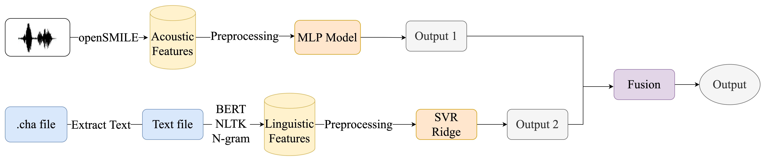
Overall Work Content
1
3
2

Slide 5
Features Extraction
Acoustic Features:We use openSMILE to extract four types of acoustic features, namely ComParE16, emobase, eGeMAPS, and Is09-13
Linguistic Features:For linguistic features, we extract the words spoken by the subjects according to the .cha files provided in the dataset, and put them into the corresponding text files to form transcripts. Linguistic features are divided into two types. One uses the pre-training model BERT to extract sentence vectors; the other is lexical features combined with sentiment scores. First, N-gram is used to extract lexical features, and then Natural Language Toolkit (NLTK) is used to obtain sentiment scores.

Slide 6
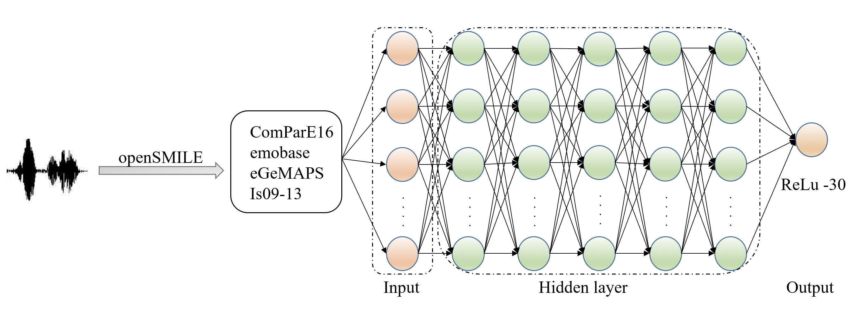
Model Building-Acoustic Model
The extracted acoustic features are preprocessed, then put into MLP, the activation function ReLu is added at the end of the model, and max_value=30 is set.

Slide 7
Acoustic Model Experiment Results
Features Model RMSE on train set RMSE on test set
baseline - 7.28 6.14
ComParE16 MLP 5.46 5.49
emobase MLP 4.73 5.82
eGeMAPS MLP 5.06 5.96
Is09-13 MLP 5.08 6.28
It can be seen from the table that the feature set ComParE16 performs the best on test, with an Root Mean Square Error (RMSE) of 5.49, which is 10.6% lower than the acoustic baseline.

Slide 8
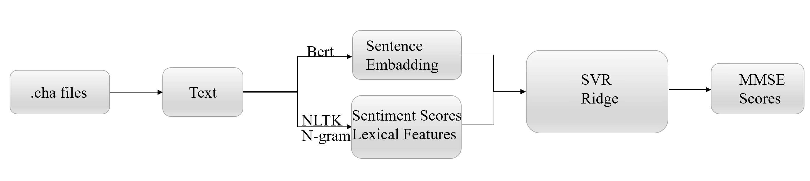
Model Building-Linguistic Model
The extracted linguistic features are preprocessed and put into the machine learning model for regression analysis.

Slide 9
Linguistic Model Experiment Results
Features Model RMSE on train set RMSE on test set
baseline - 4.38 5.21
Bert embedding Ridge 4.86 5.37
Lexical+sentiment SVR 4.01 4.51
Using the machine learning model to analyze the linguistic features, it can be seen that the lexical features and sentiment scores are the best, with an RMSE of 4.51, which is 13.4% lower than the linguistic baseline.

Slide 10
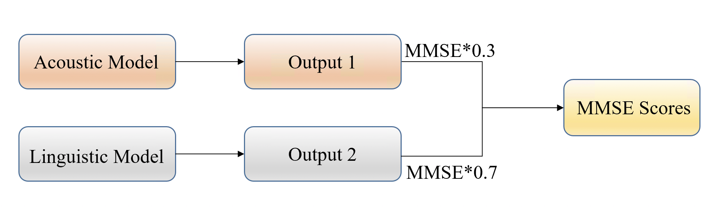
Model Building-Model Fusion
Synthesize acoustic and linguistic models, combining the results from both. After many experiments, it is found that when the result obtained by the linguistic model is given a weight of 0.7, and the result obtained by the acoustic model is given a weight of 0.3, the optimal result can be obtained.

Slide 11
Model Fusion Experiment Results
Features Model RMSE on test set
ComParE16+ Lexical+sentiment MLP+SVR 4.18
ComParE16+Bert embedding MLP+ridge 4.91
eGeMAPS+ Lexical+sentiment MLP+SVR 4.20
eGeMAPS +Bert embedding MLP+ridge 4.93
emobase+ Lexical+sentiment MLP+SVR 4.40
emobase+Bert embedding MLP+ridge 4.87
Is09-13+ Lexical+sentiment MLP+SVR 4.32
Is09-13+Bert embedding MLP+ridge 4.93
Combining the results obtained from the acoustic and linguistic models, it is found that the combination of the acoustic feature ComParE16 and the linguistic feature Lexical+sentiment can get the best results. The RMSE is 4.18, which is 31.9% lower than the acoustic baseline and 19.8% lower than the linguistic baseline.

Slide 12
Conclusion
This paper predicts subjects' MMSE scores from three perspectives: acoustic model, linguistic model, and fusion of the two models. It is found that the results obtained by the model fusion are better than those obtained by a single model.

Slide 13
Prospect
In subsequent work, we can combine convolutional neural networks with spectrogram (Spec), mel spectrogram (Melspec), and mel frequency cepstral coefficients (MFCC). For speech that cannot be transcribed, wav2vec2.0 can be used to learn speech structure from raw audio and apply it to downstream tasks.

Slide 14
Thanks！

