Slide 1
SEKE 2022
Dual Contrastive Learning for Unsupervised Knowledge Selection
Authors: Xiang Cao, Lei Wang, Yujiu Yang
Reporter: Xiang Cao

Slide 2
SEKE 2022
Introduction
A dialogue system aims to produce an appropriate response given a post as its input.
Existing works have shown that leveraging external knowledge is helpful for dialogue systems to improve informativeness and diversity of generated responses.
For unsupervised knowledge selection, a tricky challenge is the lack of supervisory signals.
In this paper, inspired by previous works on contrastive, we propose a dual contrastive method for unsupervised knowledge selection.

Slide 3
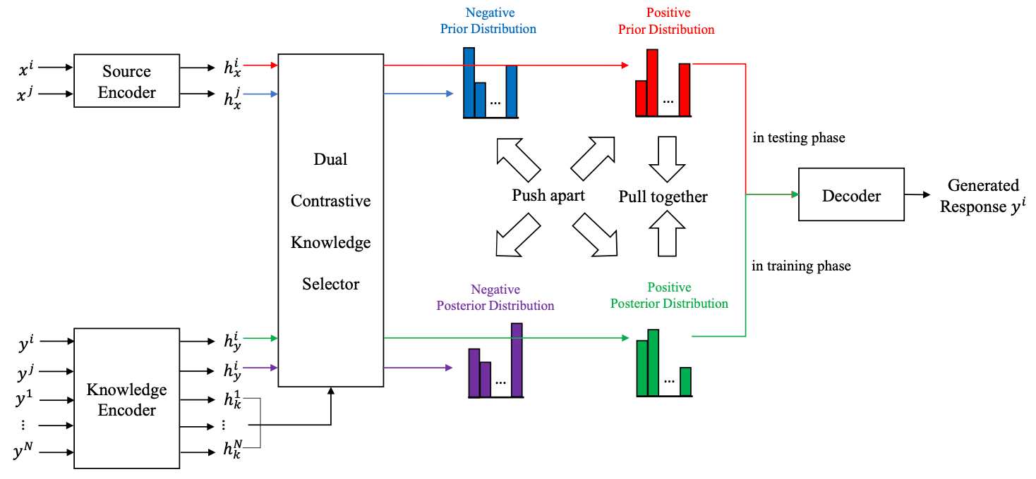
SEKE 2022
Methods
Overview

Slide 4



SEKE 2022
Methods
Base Architecture
  Encoder
  Knowledge selector

Slide 5

SEKE 2022
Methods
Base Architecture
  Decoder

Slide 6


SEKE 2022
Methods
Base architecture
  Loss function

Slide 7
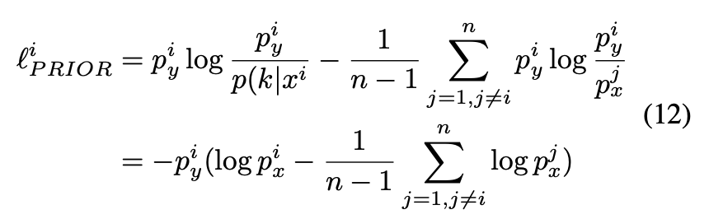
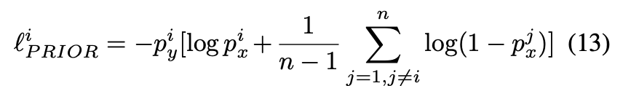
SEKE 2022
Methods
Dual contrastive knowledge selector
  For the prior side

Slide 8
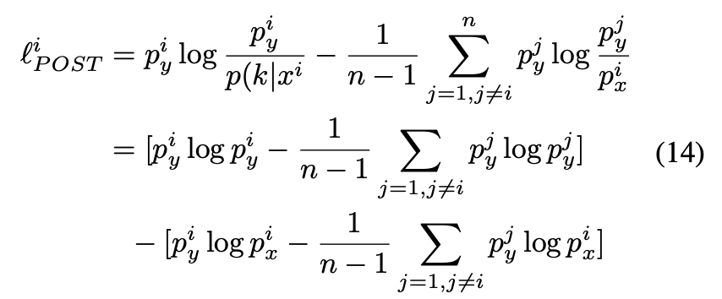
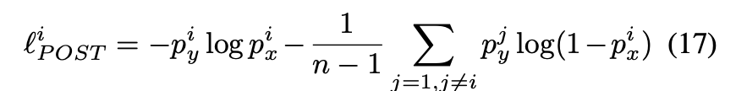
SEKE 2022
Methods
Dual contrastive knowledge selector
  For the posterior side

Slide 9
SEKE 2022
Methods
Dual contrastive knowledge selector
  Total loss

Slide 10
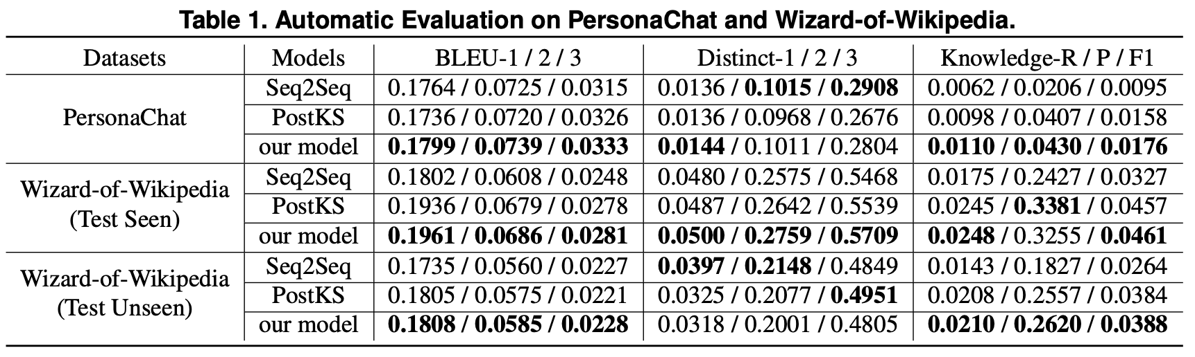
SEKE 2022
Experiments
Automatic evaluation results

Slide 11
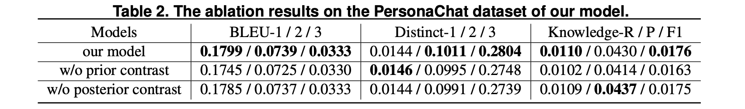
SEKE 2022
Experiments
Ablation results

Slide 12
SEKE 2022
Conclusion
This paper proposes a dual contrastive method for unsupervised knowledge selection in dialogue systems, which is the first work that introduces contrastive learning into knowledge selection in dialogue systems.
Experiment results show that our model has improved on diversity and knowledge incorporation of generated responses.
As for future work, we plan to extend our contrastive method to Transformer-based architecture.

Slide 13
Thank you for listening!

