Slide 1

Increasing Representative Ability for Topic Representation
Rong Yan^{1,2,3,*}, Ailing Tang^{1,2,3}, Ziyi Zhang^{1,2,3}
1.College of Computer Science, Inner Mongolia University, Hohhot, China
2. Inner Mongolia Key Laboratory of Mongolian Information Processing Technology , Hohhot, China
3. National Local Joint Engineering Research Center of Intelligent Information Processing Technology for Mongolian , Hohhot, China

Slide 2
01
02
Methodology
Motivation
OUTLINE
03
04
Conclusion
Experiments

Slide 3
1.Motivation
Standard probabilistic topic model (PTM) family is really difficult to improve or keep ‘topic independence’ assumption, because word frequency and word inherent diversity characteristic.
  INCOHERENCE
  BIAS
In this work, we try to answer the following questions and focus on enhancing the representative ability of the topic to support fine grained topic representation:
  Q1: Is the same word that in different topics represent the same semantic meaning?
  Q2: Is it correct that each latent topic with single semantic?

Slide 4
2. Methodology
WTW (Word Topic Ware)
Aim:
  to re-rank the word set in order to obtain a better topic representation.
  to identify the meaningful representative word set for increasing representative ability to a specific topic.
Diversification:
  to identify and refine the quantification the meaningful representative words for topic representation from the diversification point view
  to avoid semantic loss of the topic description.

Slide 5
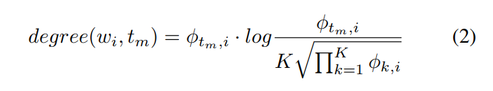
2. Our Model
Equation (1) is used to compute new semantic contribution degree of each word
λ denotes the interpolation parameter which controls the tradeoff between the relevance and the diversity.
Equation (2) is used to compute the representative degree value of the word.

Slide 6
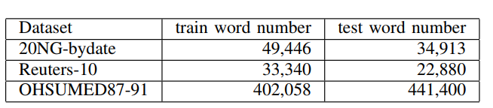
3. Experiments
Datasets

Slide 7
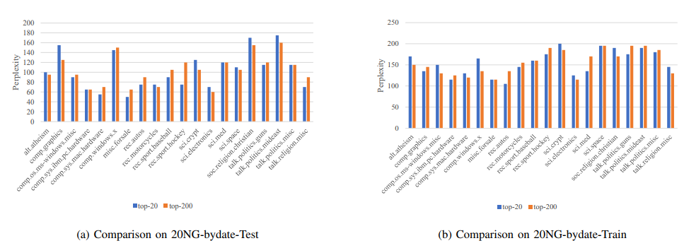
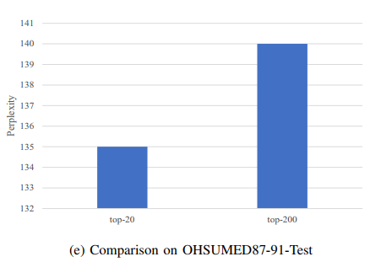
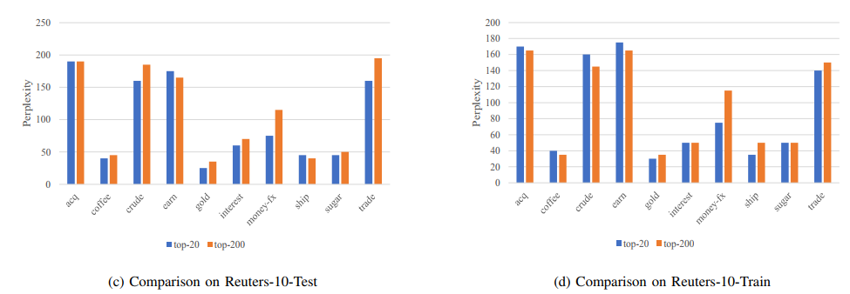
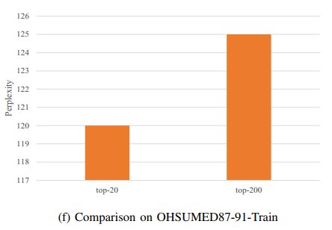
3. Experiments

Slide 8
4. Conclusion
In this paper, we focus on screening out the more representative words for topic representation. We investigate a reranking method WTW to evaluate the representative ability of words over different topics.
This work will enhance the ability to support fine grained topics representation for text content mining tasks.

Slide 9
THANKS
csyanr@imu.edu.cn

