Slide 1
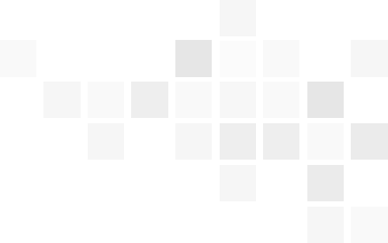
Embedding Knowledge Graphs with Semantic-Guided Walk
Hao Tang,Donghong Liu,Xinhai Xu and Feng Zhang
SEKE2022

Slide 2
Outline
  一、Background
  二、Our Approach
  三、Experimental Evaluation
  四、Conclusion

Slide 3


一、Background
（一）knowledge graph
( h
r
t )
Entity/Concept
relationship
Entity/Concept
Data World
July
Likes
orange
Likes
Real World

Slide 4
一、Background
（二）Our main task
Knowledge graph completion
  Knowledge graphs usually suffer from incompleteness. And Knowledge graph completion(KGC) aims to predict the missing triples in a knowledge graph. In this work, we particularly target link prediction task for KGC, whose goal is to predict the missing head(tail) given the relation and tail (head) in a triple.
Formal definition
head prediction: (?, r, t)
tail prediction: (h, r, ?)

Slide 5
Outline
  一、Background
  二、Our Approach
  三、Experimental Evaluation
  四、Conclusion

Slide 6
二、Our Approach
（一）Motivation
AttWALK(our method) is inspired by a point of view in social reference theory that an individual’s social role is influenced by his or her personal relational network instead of only direct neighbors, moreover, those entities in this network contribute differently to his or her social role. In this work, both structural and semantic path features are exploited in the embedding.

Slide 7
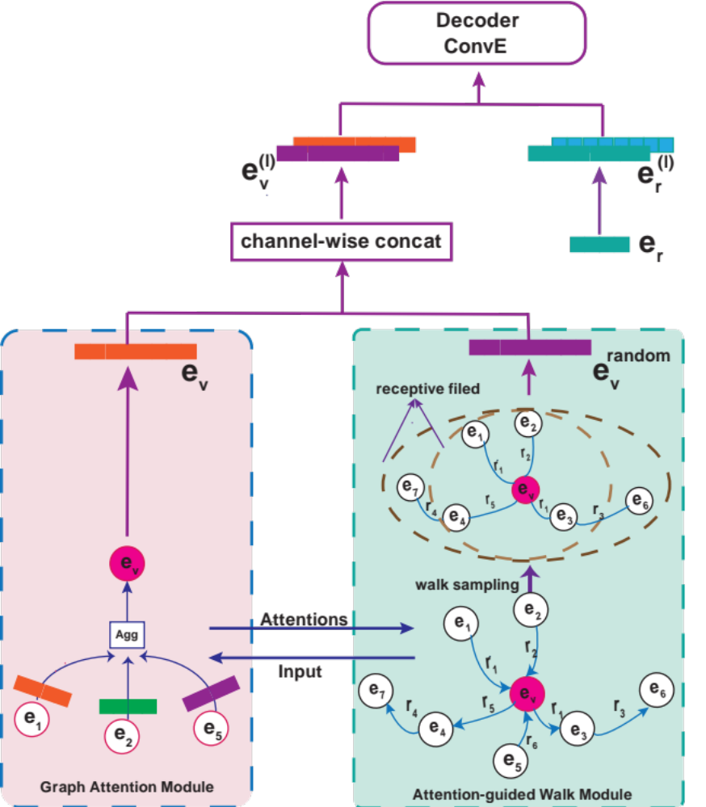
二、Our Approach
（二）AttWALK Work Flow
Graph Attention Network
for each node n, AttWalk first evaluates the importance of its neighbors. In this step, we try to exploit structural features.
Attention-guided Walk
based on the previous step’s attention and n-order Markov， we obtain new attention scores affected by the node’s relational network. In this step, we try to exploit path semantic features.

Slide 8
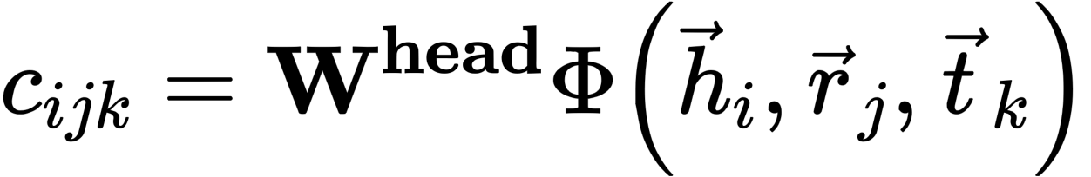
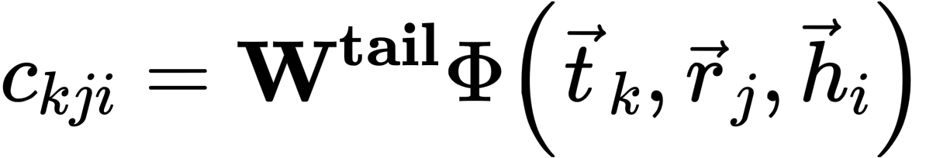
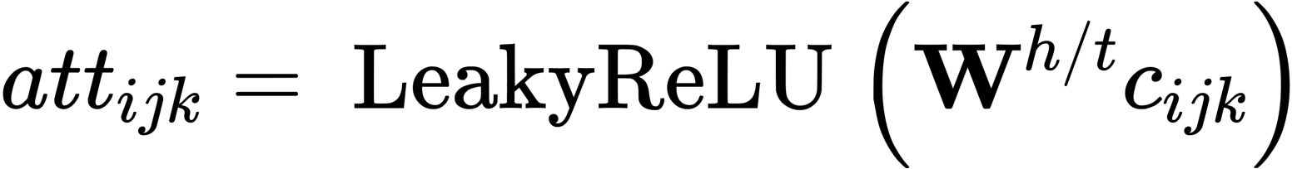
二、Our Approach
（三）Graph Attention Network
Considering the role (head/tail) the node plays in triples. In other words, the in- and out-flowing features of a node’s neighbors are modeled.

Slide 9
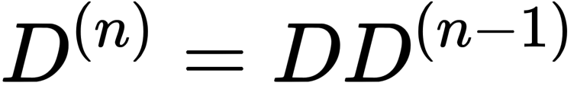
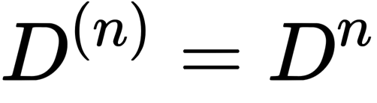
二、Our Approach
（四）Attention-guided Walk
According to our motivation, the attention score between nodes is affected by the relational network, that is not only related to triples. Here, we use simple but effective method, n-order Markov theory。
B
a5
a4
C
D
a2
a1
a3
A

Slide 10
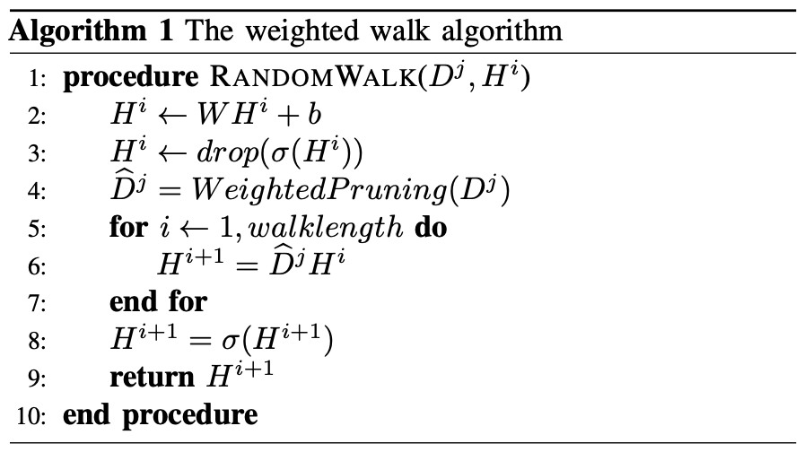
二、Our Approach
（四）Attention-guided Walk
Attention matrix from GAT
Entity embedding
Subgraph sampling
exploit path features

Slide 11
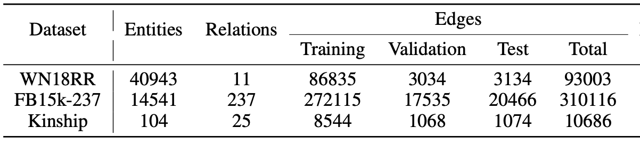
三、Experiments
（一）Datasets

Slide 12
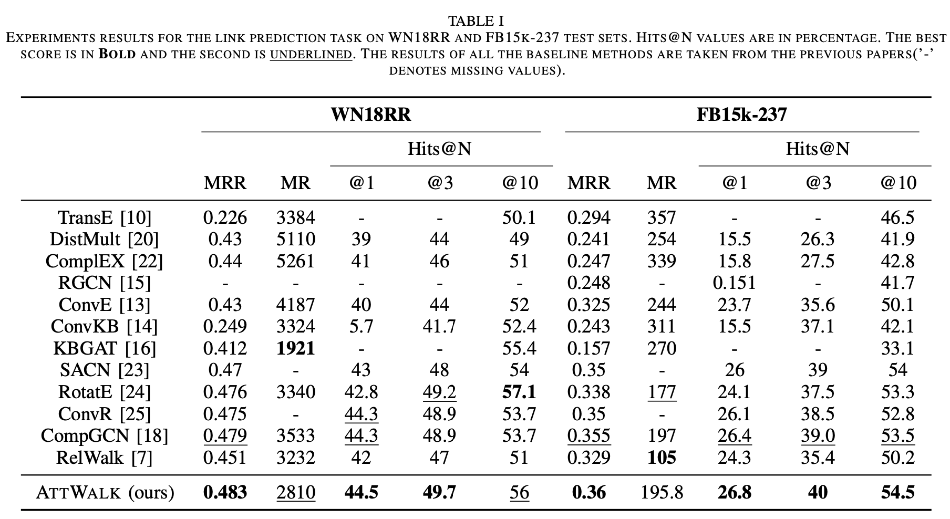
三、Experiments
（二）Results

Slide 13
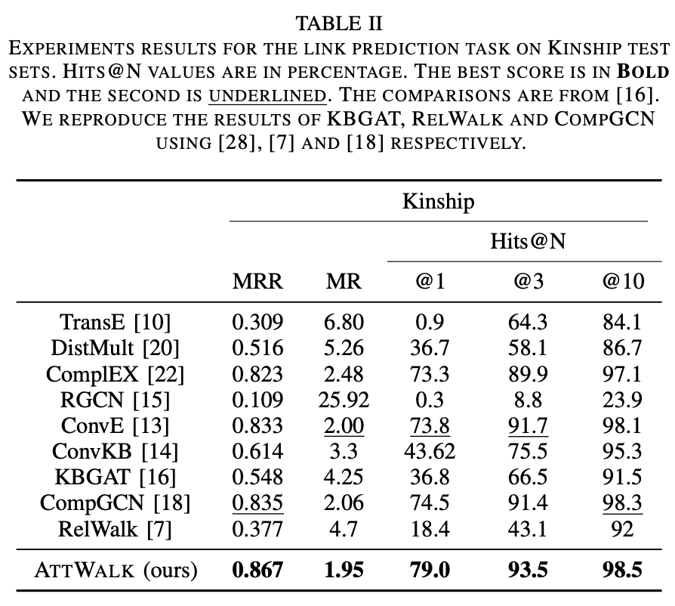
三、Experiments
（二）Results

Slide 14
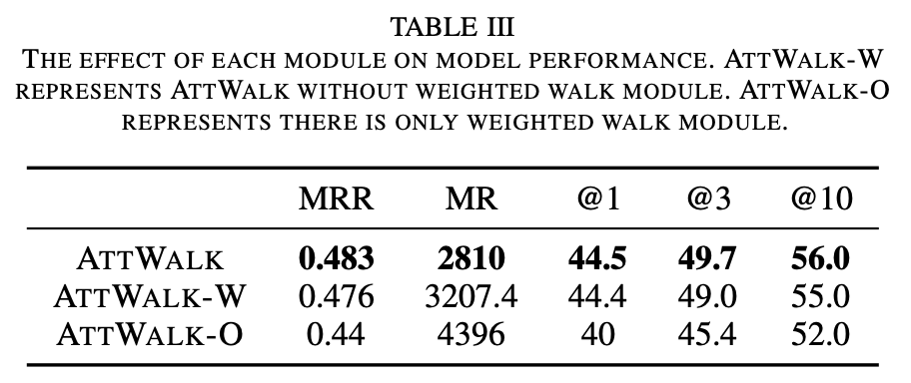
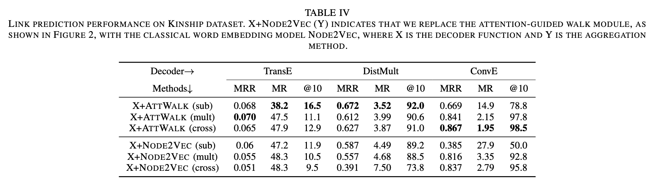
三、Experiments
（三）Ablation Study

Slide 15
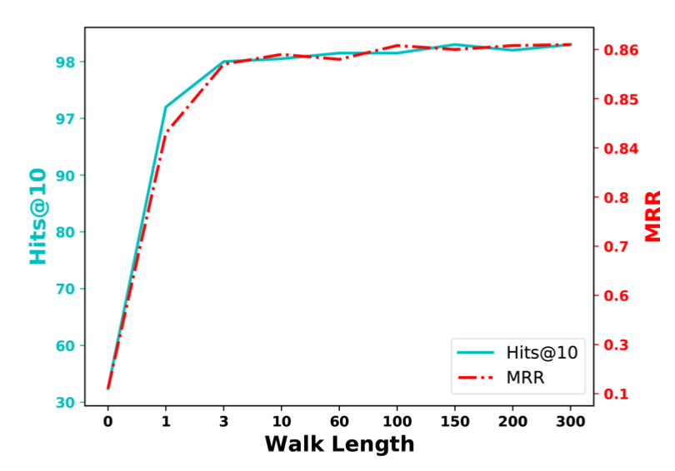
三、Experiments
（三）Ablation Study

Slide 16
四、Conclusion
In this paper, we propose a new perspective combining graph structures and semantic information in a KG completion task. The idea is simple but effective and can be combined with many existing KGE approaches. Experiments indicate the effectiveness and provide additional that the expressiveness of weighted-guided random walks can improve the performance of KGE.

Slide 17
Thanks for listening!

