Slide 1
Ethereum Smart Contract Representation Learning
for Robust Bytecode-Level Similarity Detection
Yaqian Huang
Xi’an University of Posts and Telecommunications

Slide 2




Contents
INTRODUCTION
METHODOLOGY
EVALUATION
CONCLUSION

Slide 3
INTRODUCTION
Smart contracts
  Smart contracts are Turing-complete programs that run on a blockchain
  Smart contracts have the unique characteristics of openness, transparency non tamperability, and independence from third parties
  Smart contracts are usually written in Solidity

Slide 4
INTRODUCTION
various defects have been found in the deployed smart contracts
code reuse
programming languages are young and evolving

Slide 5
INTRODUCTION
Research implications
  Detecting the similarity of smart contracts may allow developers to avoid using the compromised ones;by comparing contracts with known vulnerabilities, it helps to identify threats and improve Ethereum security.
Research goal
  To automatically identify the similarities over the Ethereum smart contract bytecodes

Slide 6
INTRODUCTION
Bytecode-Level
Many smart contract defects occur after being compiled as bytecodes
Smart contract source codes are not always accessible to avoid attacks,bytecodes are deployed to run on EVM
单击此处添加文本具体内容
1
2

Slide 7
INTRODUCTION
Challenge
A
B
Developers may compile smart contracts using different compilers or the same compiler with different optimization options enabled
  Cross-compiler and cross-optimization-level compilations will impose discrepancies on opcode distributions of the resulting bytecodes, even when their source codes are exactly the same

Slide 8
INTRODUCTION
The work of the paper
  Investigate smart contract similarity detection on the bytecode level.
  Supervise representation learning and similarity measurement via SNN, and use the trained networks to infer the similarities of smart contract pairs.
  Formulate our positive and negative sample pairs from smart contract collection using Etherscan, and conduct extensive experimental evaluations on them.

Slide 9
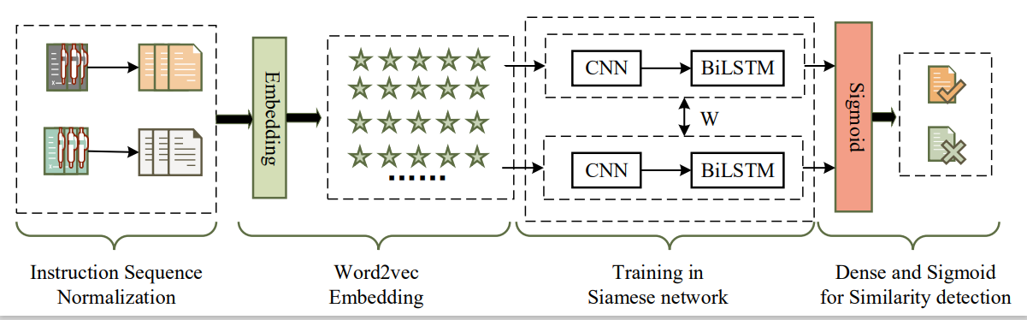
METHODOLOGY
The overview of SmartSD

Slide 10
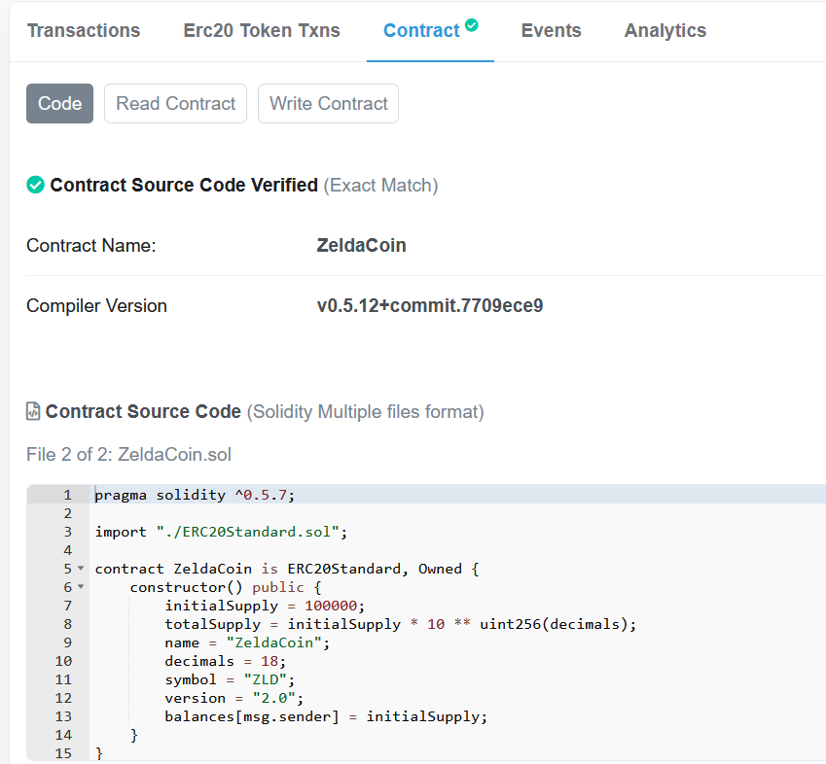
METHODOLOGY
Data Preprocessing
Source codes
EVM instructions
EtherScan

Slide 11
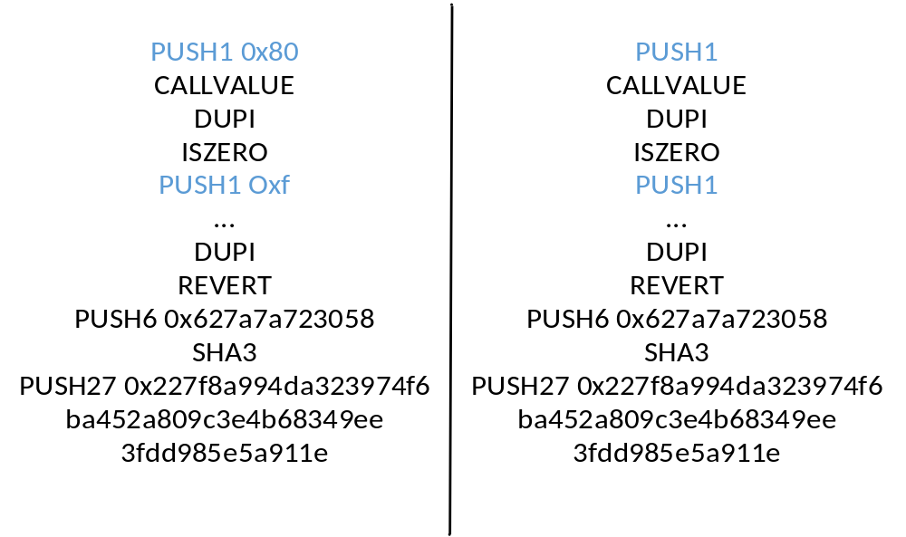
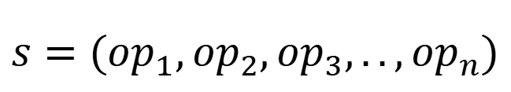
METHODOLOGY
Representation Learning
EVM instructions
opcodes
$$s=({op}_{1},{op}_{2},{op}_{3},..,{op}_{n})$$
  Instruction Abstraction

Slide 12
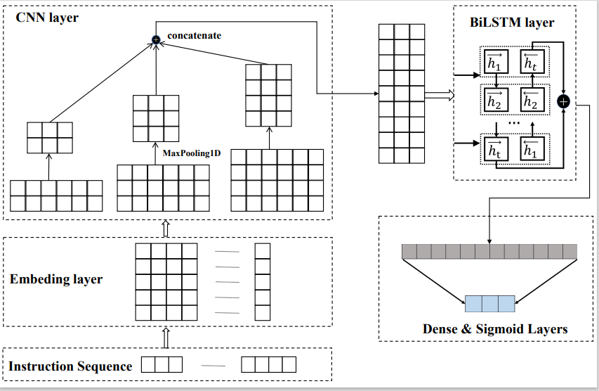
METHODOLOGY
Representation Learning for Opcode Sequences

Slide 13
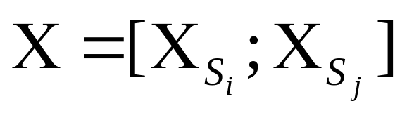
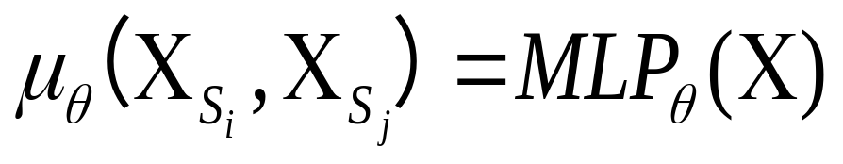
METHODOLOGY
Supervised Learning using Siamese Neural Networks

Slide 14
EVALUATION
Dataset Preparation and Experimental Settings
SmartEmbed:identify similar and dissimilar smart contracts
>0.95
小于0.35
<0.35
CP
CN
candidates of positive samples
candidates of negative samples

Slide 15
EVALUATION
Dataset Preparation and Experimental Settings
BigQuery
42,082 pairs of positive samples
30,530 pairs of negative samples
CP,CN
compiling a smart contract’s source code with varying compiler settings
相似标签 1
相似标签 0

Slide 16
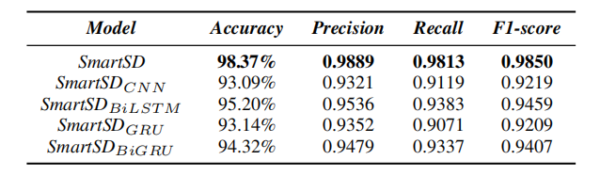
EVALUATION
Evaluation Results
Performance comparison with varying neural network structures in SmartSD

Slide 17
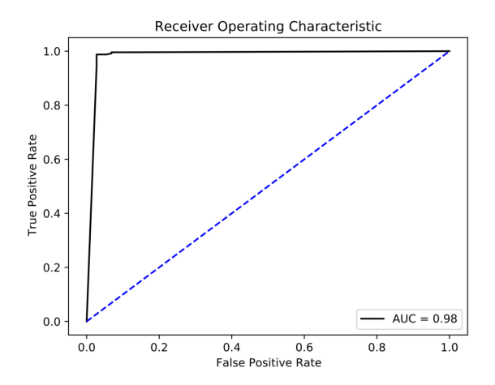
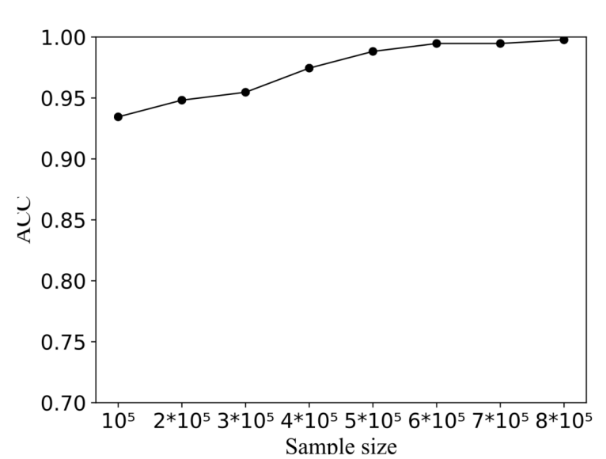
EVALUATION
Evaluation Results

Slide 18
CONCLUSION
We propose to detect the similarity of Ethereum smart contracts and build up a bytecode-level model SmartSD using deep siamese neural network to supervise the representation learning and the similarity measurement process.
CONCLUSION
The experimental results show that SmartSD achieves 98.37% high detection accuracy and 0.9850 F1-score.
SmartSD also significantly outperforms the baseline models, and is computationally tractable and effectively mitigates the interference caused by compilers

Slide 19
Thanks for Listening

