Slide 1
Two-Stage AST Encoding for Software Defect Prediction
Yanwu Zhou, Lu Lu, Quanyi Zou, Cuixu Li
School of Computer Science and Engineering, South China University of Technology, Guangzhou, China
School of Software Engineering, South China University of Technology, Guangzhou, China
cGuangdong Meiweixian Flavoring Foods Co.,Ltd., Zhongshan, China
Corresponding author email: lul@scut.edu.cn

Slide 2

Background
Traditional Methods
Deep Learning Methods
Advantages:
Low computational cost and time cost
Disadvantages:
Fail to capture the semantics of code
Only focus on the statistics of code
Handcraft features are hard to collected
Advantages:
Exploit raw materials (code files)
Extract code features automatically
Stronger code representation ability
Disadvantages:
Long time for training
Lack of interpretability of code feature

Slide 3




Background
Drawbacks of existing ast based methods:
Pre-order traversal loses tree structural infomation
Not all the ast nodes are at the same level
AST Based Methods
defective
or not
code
files
abstract syntax
tree (AST)
token
vectors
neural
network
code
representation

Slide 4
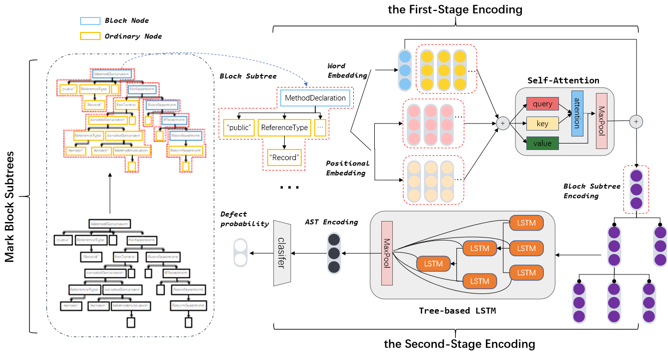
Framework
Parse code files into ASTs and then marked and converted into vectors.
Feed the block node encodings into a Tree-based LSTM and produce the AST’s final encoding by max pooling in the second stage.
Aggregate the word embeddings and positional encodings of ordinary nodes to construct the block node encodings in the first stage.

Slide 5
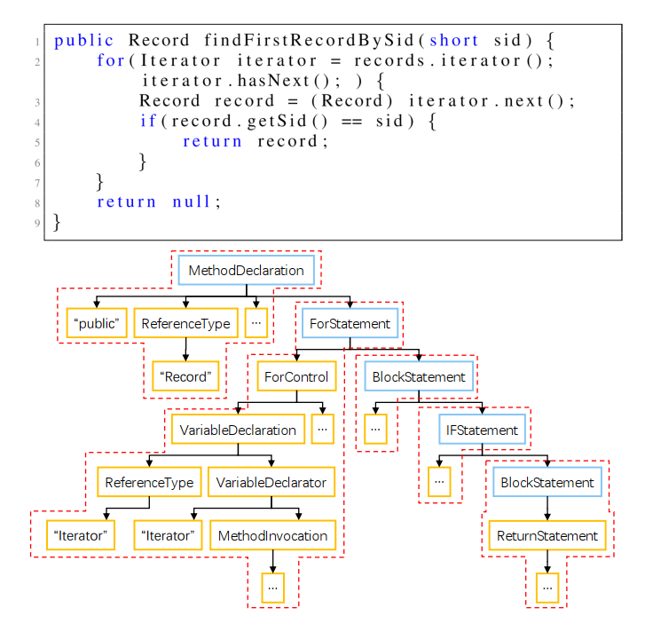
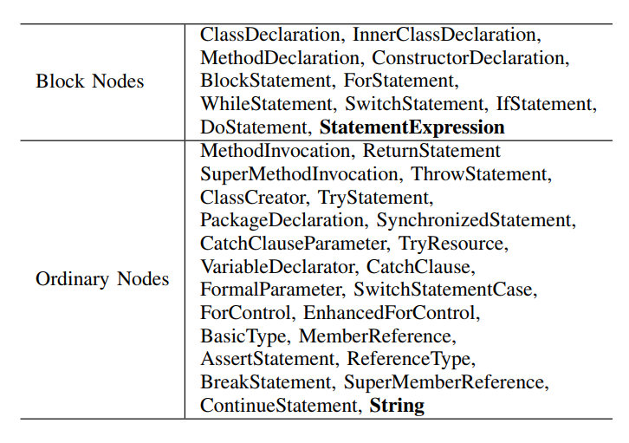
Method
Mark AST nodes
The block nodes chosen create a local scope with specific context.
The meaning of ast nodes beneath the specific block node may differ in other statement blocks.
block tree
block node
ordinary node

Slide 6
Method
Two-Stage Encoding
MethodDeclaration
“public”
ReferenceType
…
word encoding
Self-Attention
Block Subtree
Encoding
…
“Record”
AST Encoding
query
LSTM
Defect Probability
attention
+
+
key
MaxPool
clasifer
…
LSTM
LSTM
positional encoding
MaxPool
value
LSTM
LSTM
level-order traversal
LSTM
…
Tree-based LSTM
block tree
block node
ordinary node
The self-attention mechanism can 1. flexibly assign the attention weights of thesame nodes in different contexts and 2. mask the difference in the number of nodes in a subtree.
The Positional encoding represent the depth of the node in the block subtree and the sequence number of the node at that depth.
Tree-based LSTM is adopted as the final encoder, preserving more information about the AST’s tree structure.
Since all ordinary nodes have been processed in the first stage, the scale of the AST has been considerably reduced.

Slide 7
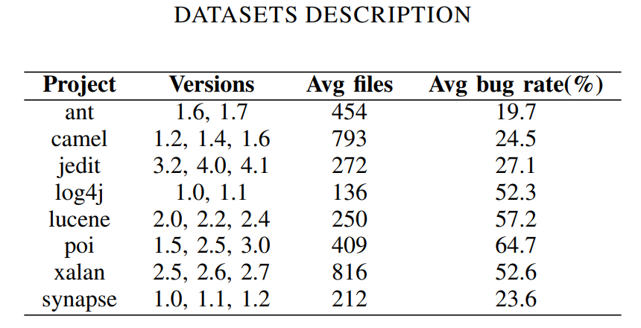
Dataset
14 prediction tasks from 8 open-source Java projects are utilized for method evaluation

Slide 8
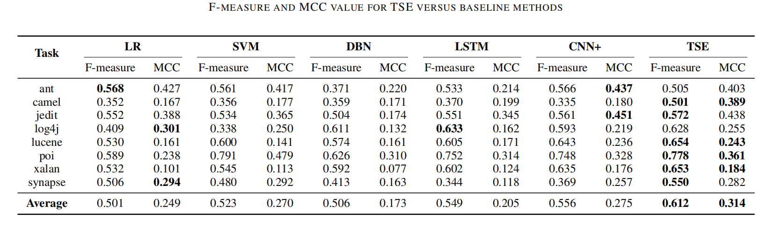
Experimental Result
Our proposed TSE achieves F-measure as 0.612 and MCC as 0.314 on average value and obtains the best average value on the two indicators.
Compared to the traditional machine learning methods, i.e., LR and SVM, has an average improvement of 24.9% and 16.5% on the two indicators.
Compared to the deep learning methods, i.e., DBN, LSTM and CNN+, our TSE method has an average improvement of 13.4% and 48.6% on the two indicators.

Slide 9
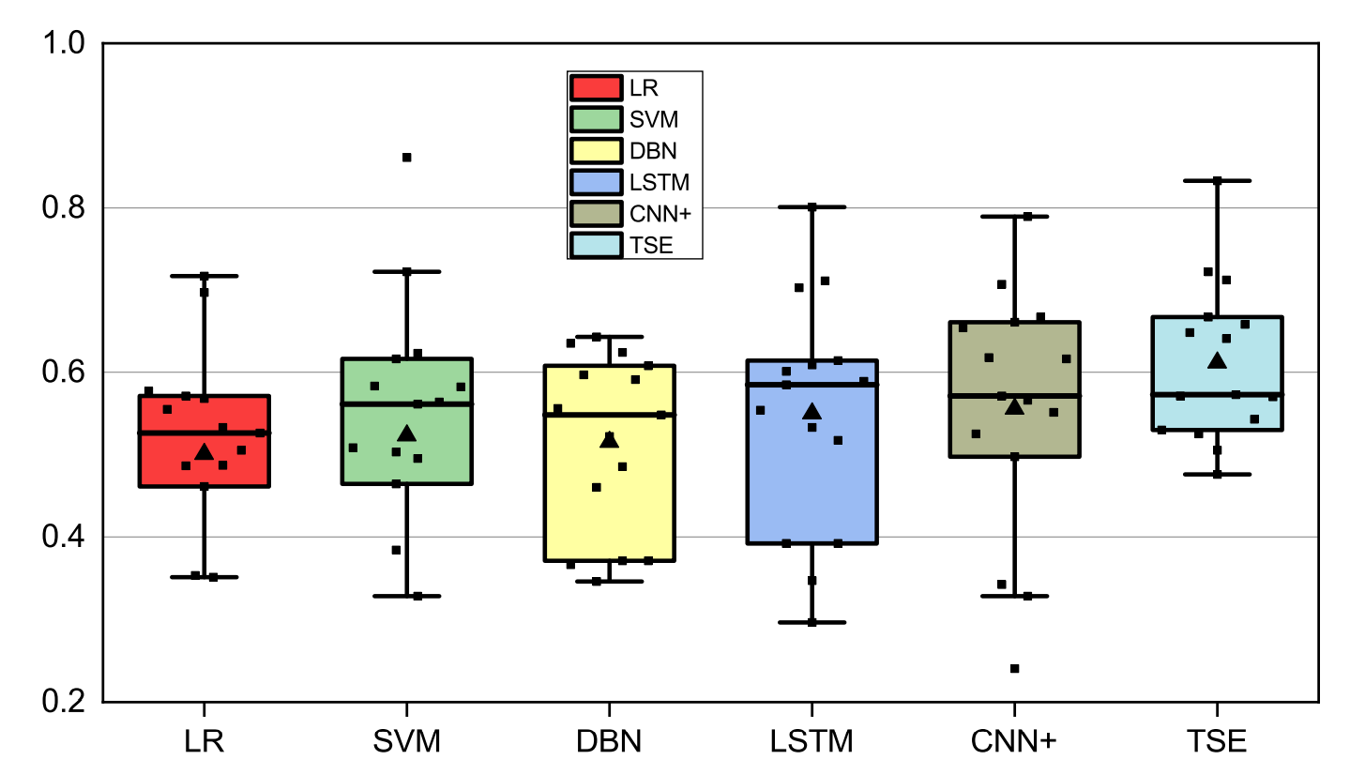
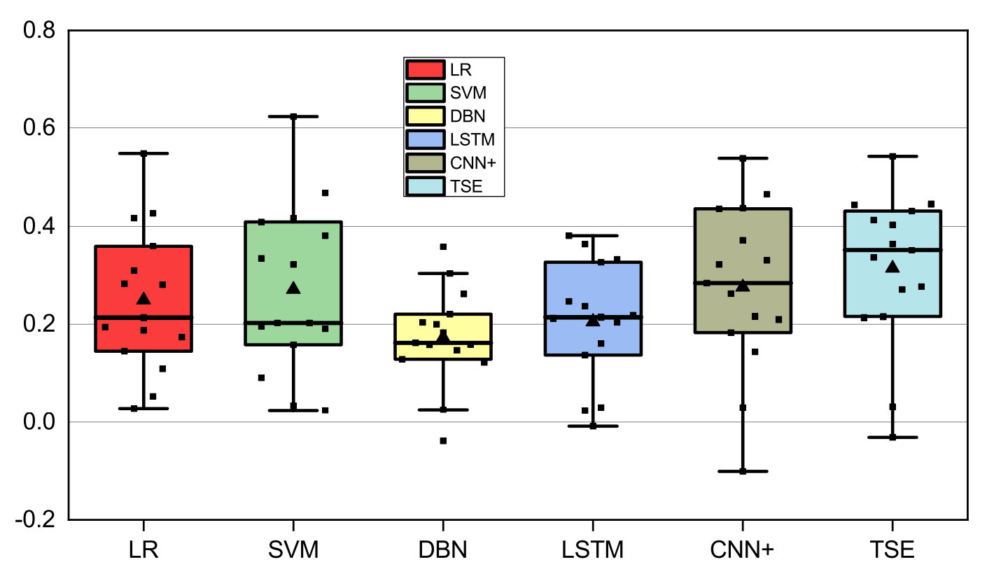
Experimental Result
As box-plots depicted, the 25th, median, and 75th F-measure and MCC by TSE are higher than most baseline methods.
The distribution of F-measure and MCC values by TSE is concentrated ina relatively higher and narrower region than baseline methods, demonstrating the stability of TSE.

Slide 10
Conclusion
In this paper, a two-stage AST encoding method is proposed, which employs a bottom-up encoding to learn the semantic information for software defect prediction.
The main advantages of TSE are : 1. executing the encoding following the natural hierarchy of AST nodes. 2. combining the tree positional encoding to augment the structural information of the AST.
The performance of TSE is evaluated by comparing it with traditional methods and state of-the-art deep learning methods in terms of F-measure and MCC. Experimental results show that TSE achieves better performance versus all baseline methods.

