Slide 1


Exp-SoftLexicon Lattice Model Integrating Radical-
Level Features for Chinese NER
Harbin Engineering University, Georgia State University
Lijie Li, Shuangyang Hu, Junhao Chen, Ye Wang, and Zuobin Xiong
{lilijie, sunyonge, junhaochen, wangye2020}@hrbeu.edu.cn, zxiong2@student.gsu.edu
DOI reference number: 10.18293/SEKE2022-037.

Slide 2

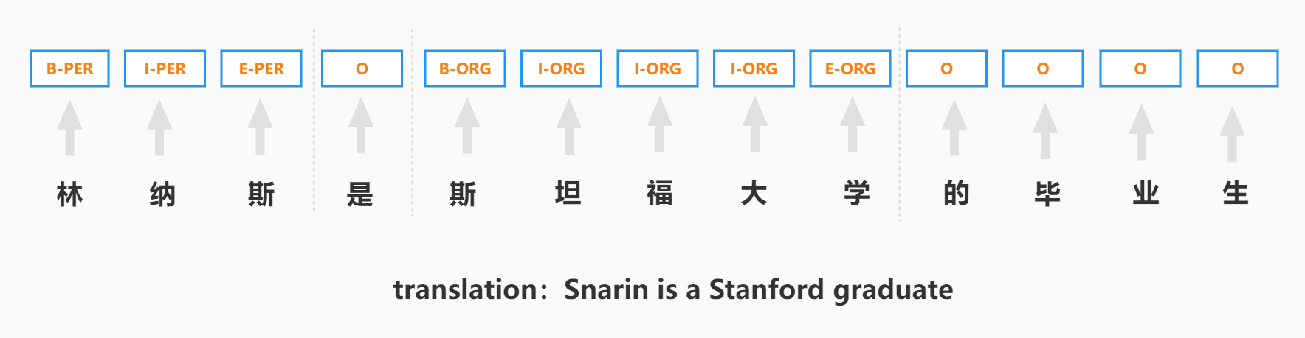
Background: Chinese NER
Given a Chinese sentence , then identify entities from S and tagging them with types, such as person, location, organization, etc.
an example of Chinese NER

Slide 3
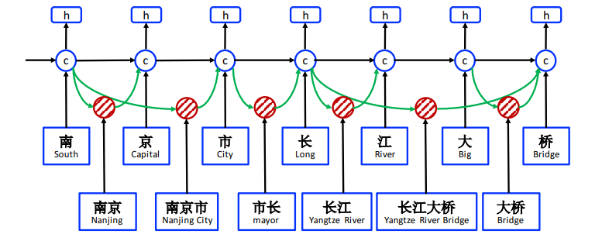
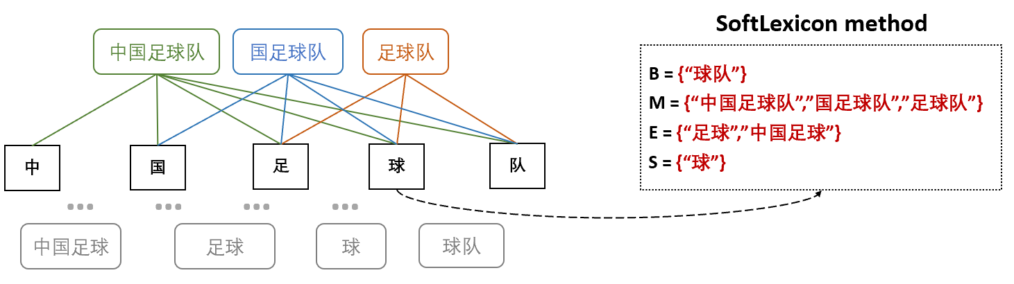
Simplified Lattice LSTM
Lattice LSTM and Simplified Lattice LSTM are the representatives of integrating words information
into character-based model.
ISSUES:
1.failed to explore the intrinsic information.
2.loss the position information for long words.

Slide 4
Key Ideas of SLRL
Key Ideas: 1. elaborate a text CNN to extract radical-level information of characters.
2. expand the original Soft-Lexicon module to enrich the char relative
position information
3. use BERT-wwm-exp instead of original BERT to get better word representations.
Exp-SoftLexicon Lattice Model Integrating Radical-
Level Features for Chinese NER

Slide 5
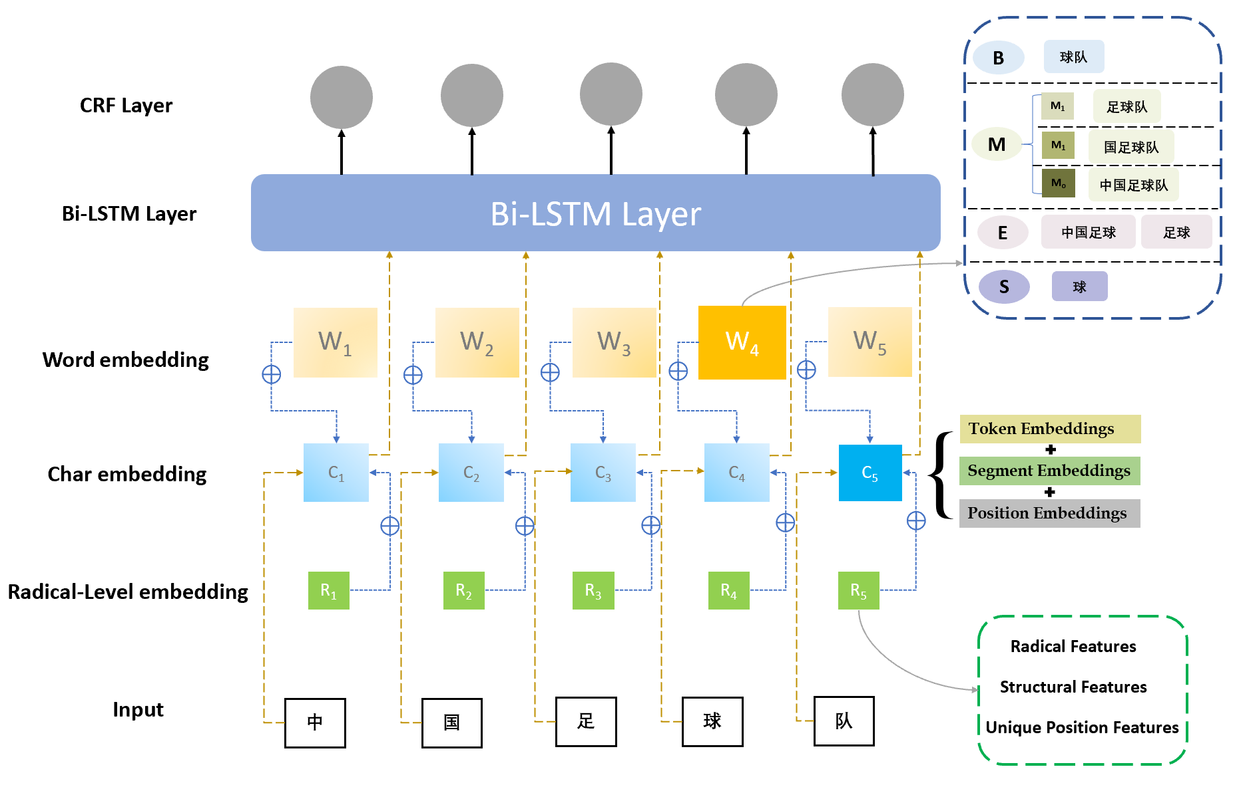
Architecture of SLRL

Slide 6
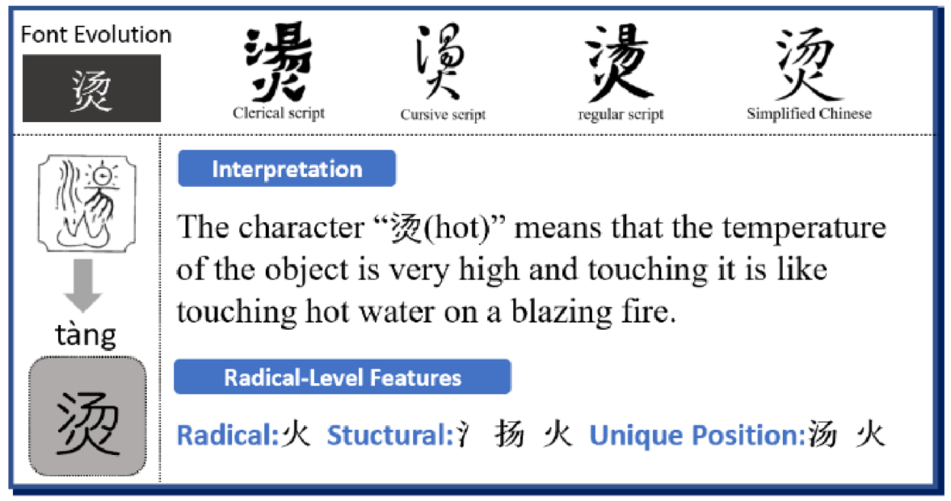
Radical Level Embedding
The radical-level features of “烫(hot)”include:
(1) Radical Feature
(2) Structural Features
(3) Unique position

Slide 7
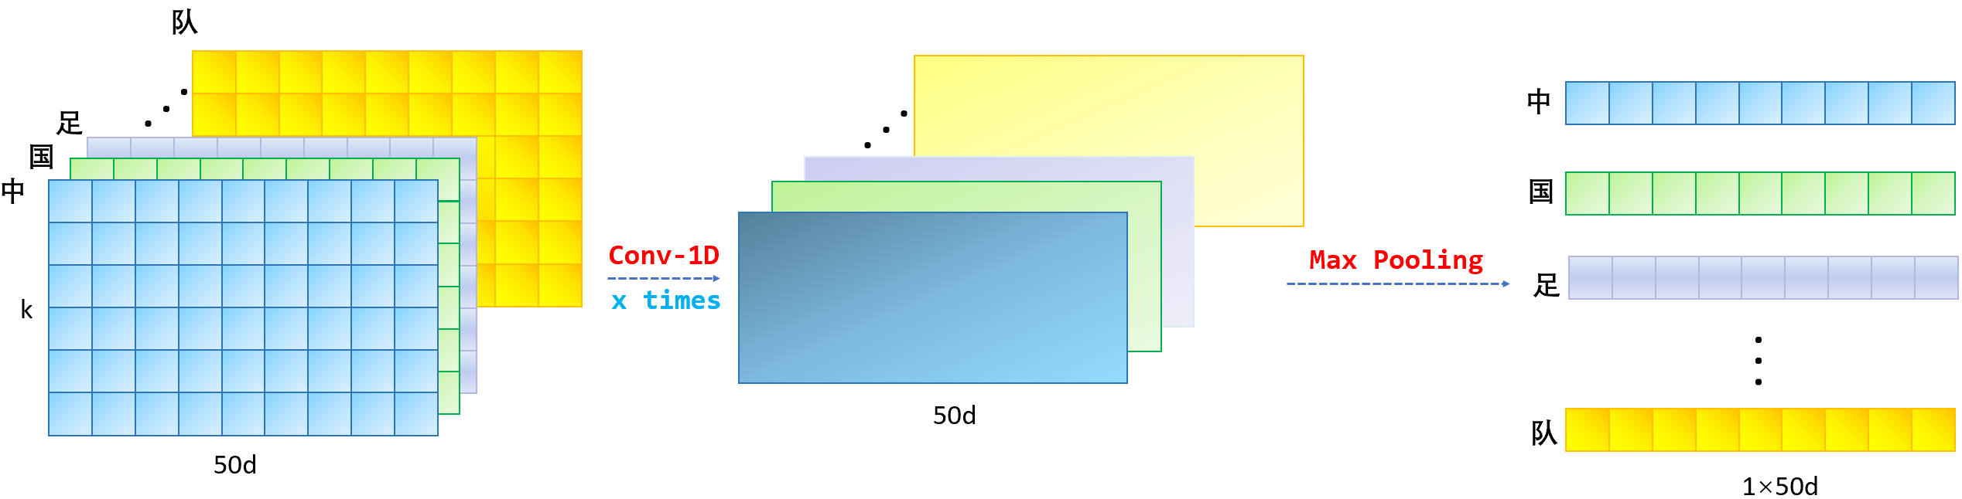
Radical Level Embedding

Slide 8
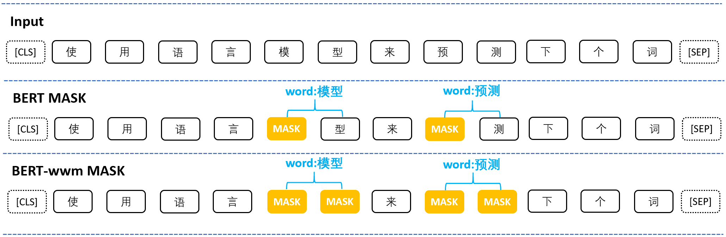
BERT-wwm-ext
BERT-wwm-ext masks all the consecutive Chinese characters that composed the words, so that the embeddings of characters have the semantic information of the words.

Slide 9
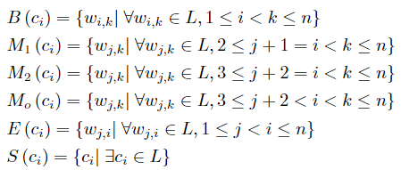
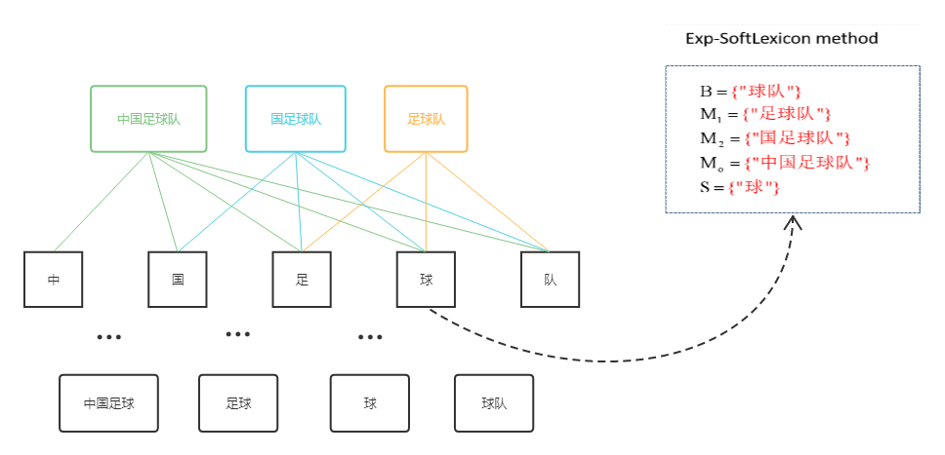
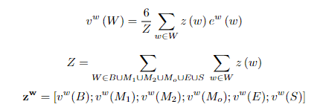
Word Representation
1.build an exp-SoftLexicon set for each char
2.obtain word-level feature by weighted strategy

Slide 10

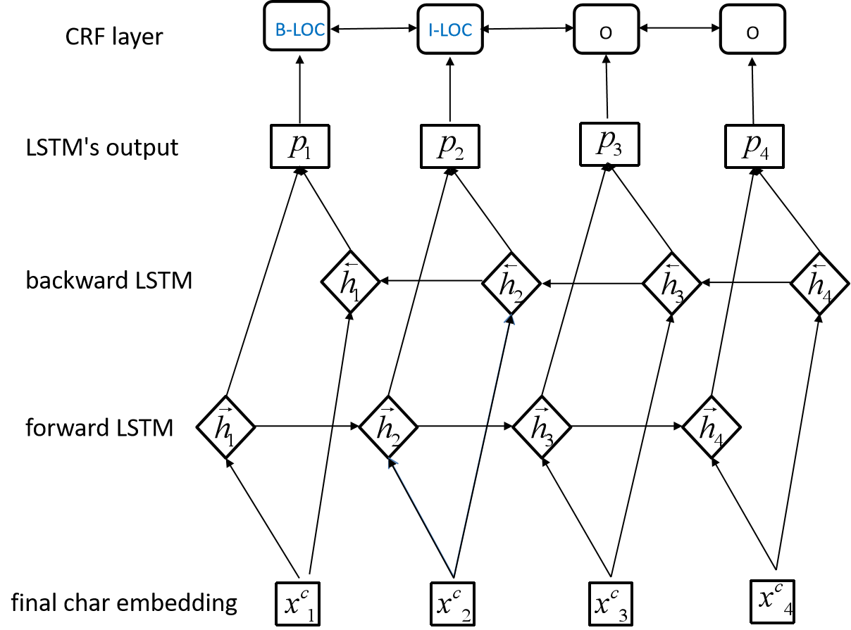
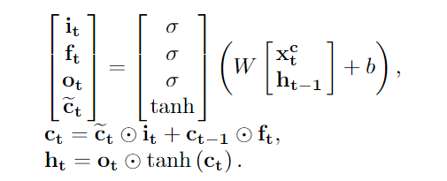


Bi-LSTM and CRF
1.concatenate the three embeddings
2.feed the final char representation into BiLSTM layer
3.perform sequence tagging by CRF layer

Slide 11
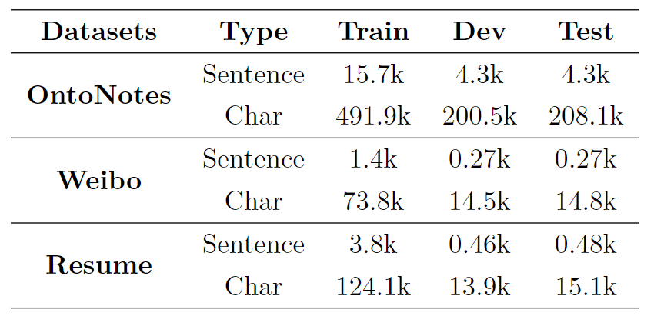
Datasets
We conducted experiments on three commonly used Chinese NER datasets.

Slide 12
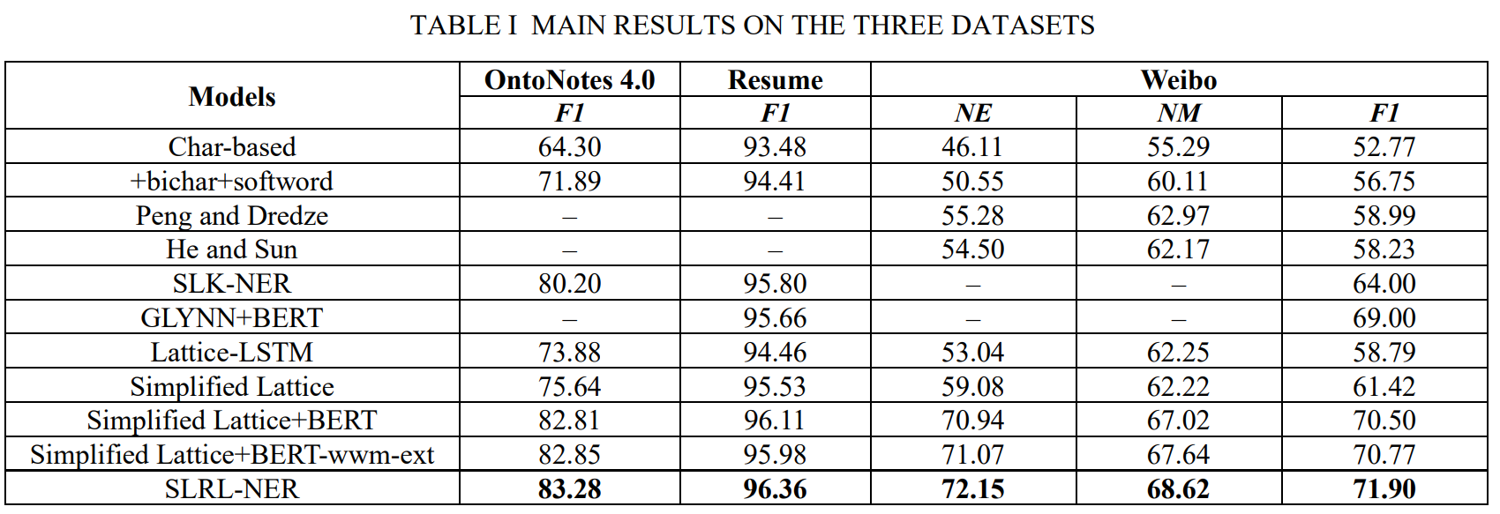
Results on Three Datasets
1. Word information is critical to Chinese NER.
2. BERT can significantly improve the performance of Chinese NER.
3. SLRL achieve the SOTA performance.

Slide 13
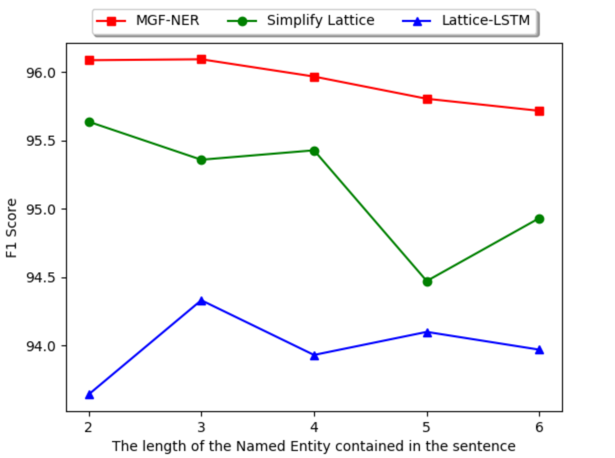
Robustness Research
As the entity length increases, our model is more robust than other models.

Slide 14
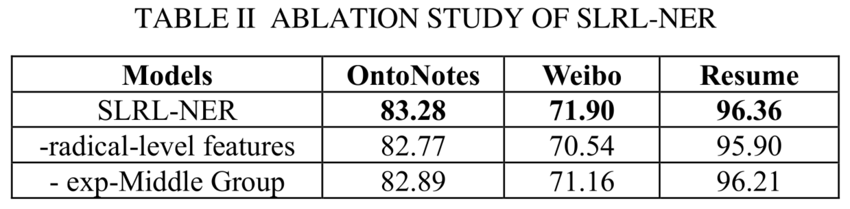
Ablation Study
Both the radical-level feature and the exp-SoftLexicon component in our model are indispensable.

Slide 15
Conclusion
The radical-level features extracted by text CNN can improve the performance of Chinese NER.
Expand word sets can accurately capture the relative position information of Chinese characters.
By fusing radical, character and word level features, the performance of Chinese NER can be further improved.

Slide 16
Q&A
Thank You for Your Attention

