Slide 1



34th International Conference on Software Engineering and Knowledge Engineering, July 1 to July 10, 2022
KEMA: Knowledge-Graph Embedding Using
Modular Arithmetic
Hussein Baalbaki, Hussein Hazimeh, Hassan Harb, Rafael Angarita
Institut supérieur d’électronique de Paris, Paris, France
Computer Science Department, Lebanese University, Beirut, Lebanon

Slide 2


Outline
Knowledge Graph: Introduction
Link Prediction
Knowledge Graph Embedding
Study of Recent Advances in Knowledge Graph Embedding
Our proposed mechanism
Simulation results
Conclusions and perspectives
Hussein BAALBAKI - 2022
2

Slide 3
Knowledge Graph: Introduction
  Knowledge Graph (KG):
  Built of nodes representing real world entities
  Nodes are connected by edges representing the
  Represented by set of triplets having the form (h, r, t)
  A triplet (h, r, t) is a relation r between 2 entities h and t
  One major challenge
  Completeness problem: KG is incomplete
Hussein BAALBAKI - 2022
3

Slide 4
Link Prediction
  Link Prediction is used to:
    Predict the existence of a relation between two entities
    Predict specific type of this relation
Hussein BAALBAKI - 2022
4

Slide 5
Knowledge Graph Embedding
  KGE embeds a KG into a continuous vector space:
    replaces entities and relations with vectors of continuous numbers called “embedding vectors”
  State Of The Art:
    Translation-based models
    Tensor factorization-based models
    Neural network-based models
Hussein BAALBAKI - 2022
5

Slide 6
Modular Arithmetic
  Modular arithmetic replaces any number by the remainder of its division by a fixed number “modulus”
  Two numbers are Congruent:
    have the equal remainders of division by same modulus
  Example: 12-hour clock
    Modulus value = 12
    Hours 3 and 16 are congruent
11
12
1
10
2
9
Mod 12
3
3
16
8
4
7
5
6
Hussein BAALBAKI - 2022
6

Slide 7
Our Contribution: KEMA
  KEMA represent the relation between two entities (h, r, t) by modular arithmetic operation
      function F: t = h mod (r)
      First, KEMA assigns random vectors for every entity and relation in KG
      Then, KEMA tunes these vectors to satisfy F
Hussein BAALBAKI - 2022
7

Slide 8
Example
  Example: for a KG of two triplet:
  “ Bob Parent-Of Alice”, and “Marie Sister-Of Alice”
      KEMA assign random vectors for Bob, Alice, Marie, Parent-Of, Sister-Of
      KEMA tune vectors to satisfy both:
          Alice = Bob mod( Parent-Of )
          Alice = Marie mod( Sister-Of )
Hussein BAALBAKI - 2022
8

Slide 9
Example
    Alice = Bob mod( Parent-Of ) , Alice = Marie mod( Sister-Of )
  KEMA returns: Marie =[27], Bob=[15], Alice=[3]
  Parent-Of = [12], Sister-Of = [24]
??
Bob Parent-Of Marie
12
24
12
3
M
A
Mod 12
Parent-Of
Mod 24
Sister-Of
Mod 12
Parent-Of
9
3
18
6
9
3
A
B
B
M
6
12
6
Hussein BAALBAKI - 2022
9

Slide 10
KEMA
  KEMA can represent :
    Simple relation:
      Symmetry ; composition ; inversion
    Complex relation:
      1-to-N, N-to-1, N-to-N
Hussein BAALBAKI - 2022
7

Slide 11
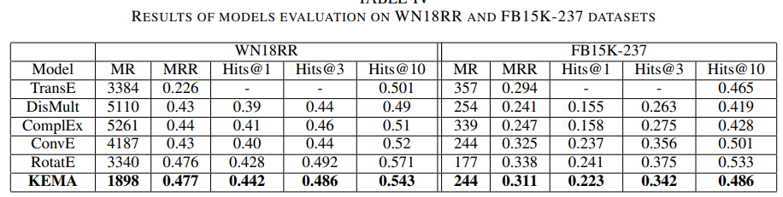
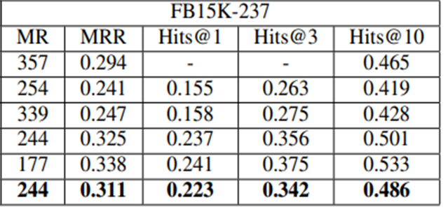
Simulation results:
Hussein BAALBAKI - 2022
8

Slide 12
Conclusion and future work:
  We plan to build a complete KEMA framework containing:
    A loss function
    A suitable negative sampling method
Hussein BAALBAKI - 2022
9

Slide 13

Thank You
Any questions? Any comments?

