Slide 1


Efficient LTL Model Checking of
Deep Reinforcement Learning Systems
using Policy Extraction
Authors: Peng Jin, Yang Wang, Min Zhang
Institution: Shanghai Key Laboratory for Trustworthy Computing
E-mail: 51194501007@stu.ecnu.edu.cn, {ywang, zhangmin}@sei.ecnu.edu.cn
Notes:
Hello, everyone. My name is Jin. I will give the oral presentation about the paper named ‘Efficient LTL Model Checking of Deep Reinforcement Learning Systems using Policy Extraction.’

Slide 2
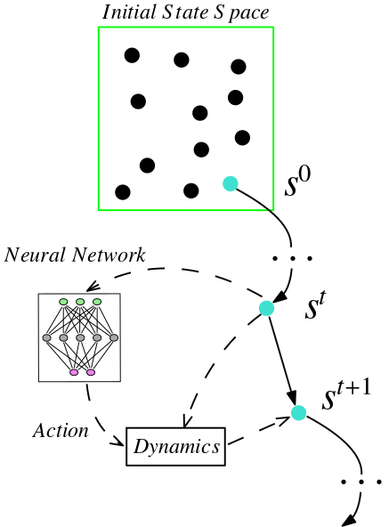
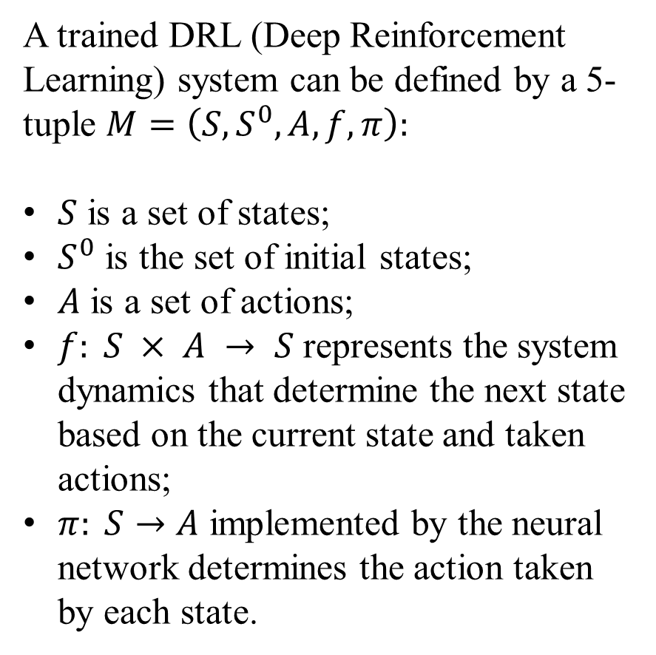
Problem Formulation
A trained DRL (Deep Reinforcement Learning) system can be defined by a 5-tuple $M=\left(S, S^{0}, A, f, π\right):$
$S$ is a set of states;
$S^{0}$ is the set of initial states;
$A$ is a set of actions;
$f: S × A → S$ represents the system dynamics that determine the next state based on the current state and taken actions;
$π: S→A$ implemented by the neural network determines the action taken by each state.
Notes:
I start by stating the problem our paper is trying to solve, namely how to verify a trained DRL system.
The system considered in our work can be defined by a five-tuple, where S is a set of states. S superscript zero is the set of initial states,
A is a set of actions. The function f represents the system dynamics that determine the next state based on the current state and actions.
The function pi implemented by the neural network outputs the action taken by each state.
The left figure shows the state transition process.
The s in it is lowercase.
Start with a concrete state in the initial state space.
In each transition from s superscript t to s superscript (t+1), the concrete state is first fed into the neural network to determine the action.
Then, we can calculate the next concrete state based on the current state, actions, and dynamics.

Slide 3
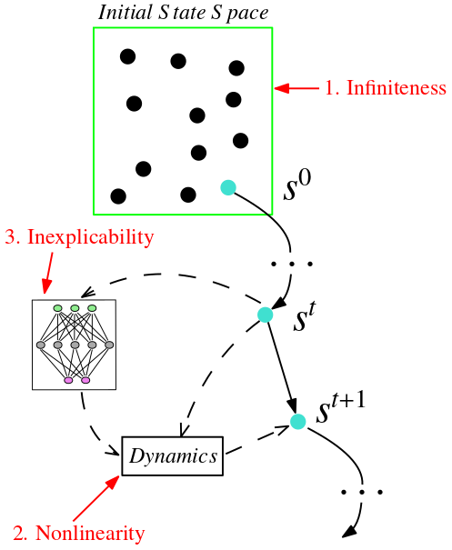
Difficulties
Infiniteness: the state space of such control systems is usually infinite and continuous;
Nonlinearity: the system dynamics are generally nonlinear;
Inexplicability: the neural networks embedded in the systems are inexplicable.
Notes:
However, there are many difficulties in verifying such systems. First, the state space of such control systems is usually infinite and continuous, but most of the model checking-based approaches can only handle finite-state models. Second, the system dynamics are generally nonlinear, which increases the complexity of formal verification. Lastly, the neural networks embedded in systems are uninterpretable, restricting the scalability of verification methods. Among them, we think that the black-box nature of neural networks is the crux in defining faithful models for target systems.

Slide 4
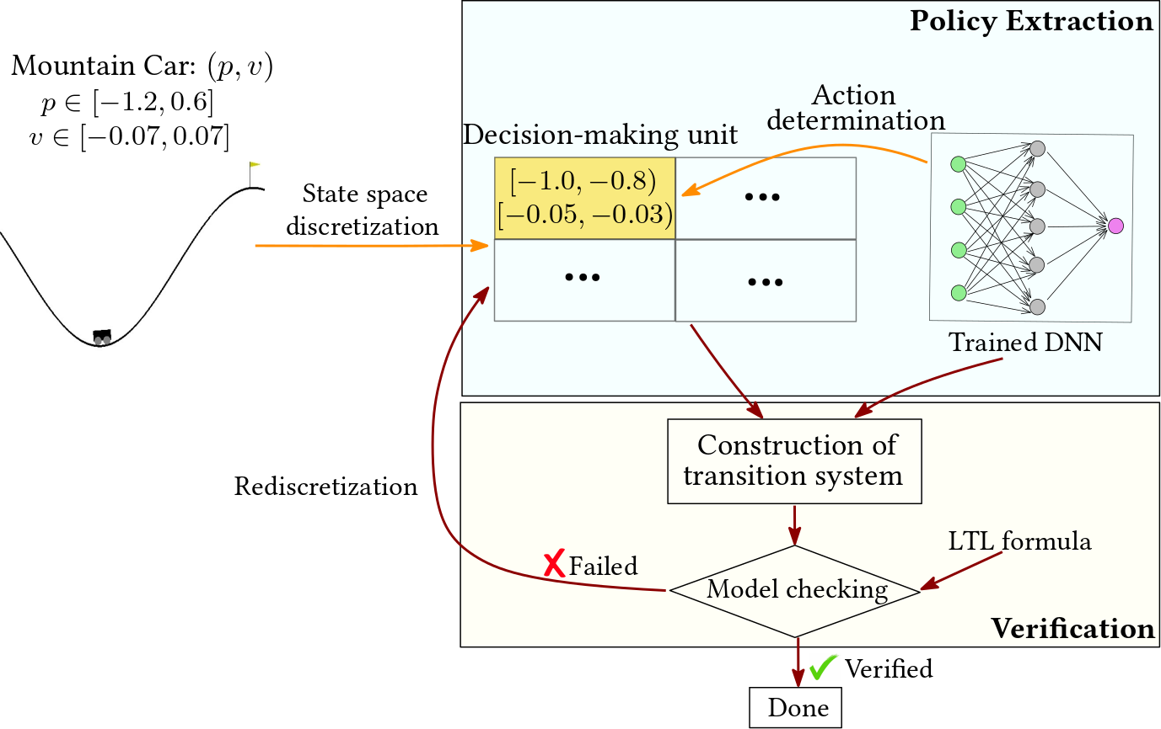
Framework
Notes:
We propose a novel framework to overcome these difficulties. We bypass the crux by extracting interpretable policies from trained neural networks. We first discretize the state space of systems into finite interval boxes. Each interval box is a decision-making unit of the policy. Then, we determine the action adopted by each decision-making unit to generate the final policy. These interval boxes are disjoint, indicating that concrete states within the decision-making unit take the same action. More importantly, since the decision-making units are finite, we can transform the system driven by the extracted policy into a classic transition system that can be model-checked with existing tools.

Slide 5
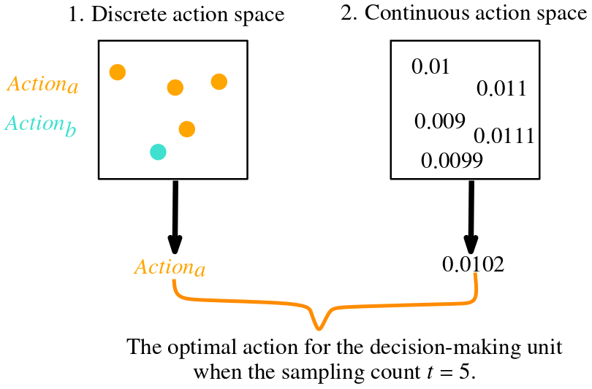
Action Determination
Notes:
The action determination process is based on the DNNs trained by traditional DRL algorithms. For the given decision-making unit, we aim to select the most frequently adopted action by concrete states in it as its optimal action. However, there are infinite concrete states in the decision-making unit, so it is infeasible to calculate precisely the action taken by most concrete states. Inspired by related work, we uses Monte Carlo algorithm to solve this problem. Simply put, we sample t concrete states and feed them to the neural network to obtain the corresponding t actions. Let Action a and Action B be the first two actions with the highest occurrences. If Act a appears much more often than other actions, it will be the optimal action for the corresponding decision-making unit, as shown on the left. Otherwise, we repeat the sampling process.
When the action space of systems is continuous, we directly calculate the average of t actions as the final action of the decision-making unit.
Although the above idea is very intuitive, related experimental results show its effectiveness.

Slide 6
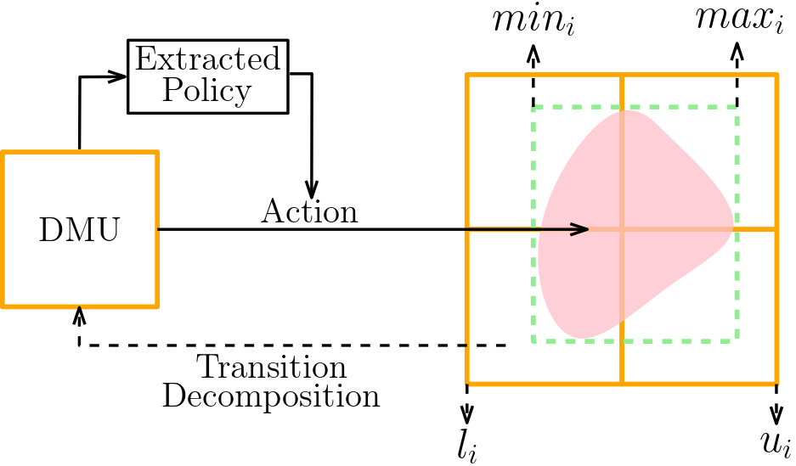
Abstraction-Based Construction of Transition Relations
Computing direct successors of the DMU in a 2-dimensional control system.
Notes:
The decision-making units are finite, and their union covers the entire state space. We can treat them as states of the transition system. Therefore, the system driven by the extracted policy can be transformed into a transition system to be verified. Accordingly, we introduce the abstract and refinement techniques to solve the problems encountered in constructing transition systems. First, l introduce the abstract operation used in building transition relations.As demonstrated in the figure, the concrete states contained in the decision-making unit take the same action. So we can treat them as a whole to carry out a state transition based on the system dynamics. However, the generated area (the pink part) may be irregular.Therefore, we try to abstract it into the form we can represent. In practice, we properly expand it to fit multiple decision-making units exactly. In the figure, the given decision-making unit has four successor states.

Slide 7
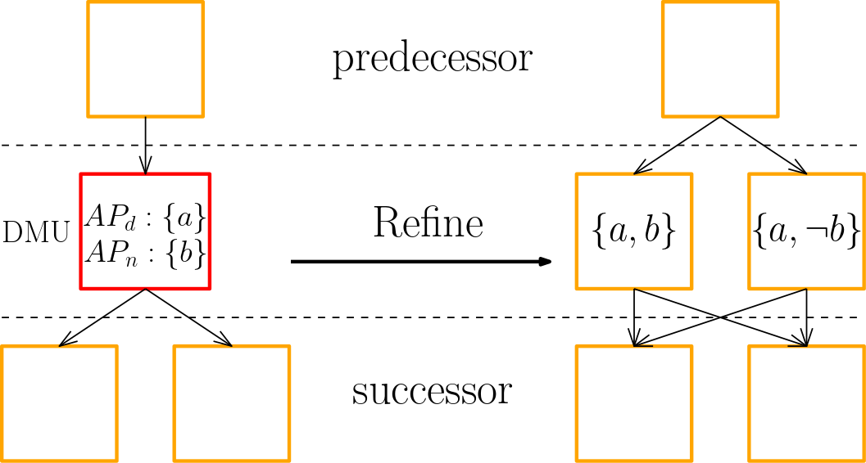
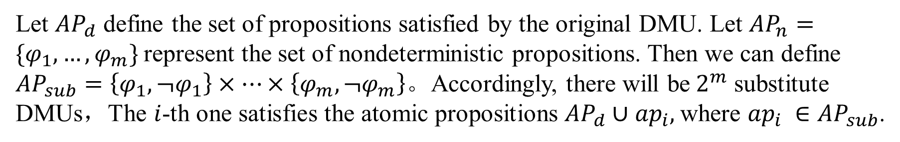
Property-Based Refinement of DMUs
Let ${AP}_{d}$ define the set of propositions satisfied by the original DMU. Let ${AP}_{n}=\{φ_{1},…,φ_{m}\}$represent the set of nondeterministic propositions. Then we can define ${AP}_{sub}=\left\{φ_{1},¬φ_{1}\right\}×…×\left\{φ_{m},¬φ_{m}\right\}$。Accordingly, there will be$2^{m}$ substitute DMUs，The $i$-th one satisfies the atomic propositions ${AP}_{d}∪{ap}_{i},$where ${ap}_{i} ∈{AP}_{sub}$.
Notes:
Then, l introduce the refinement operation.
The linear temporal logic property consists of atomic propositions. Therefore, it is necessary to determine the atomic propositions each state satisfies in the transition system. However, treating decision-making units as states in the transition system may lead to ambiguity. For example, partial concrete states satisfy the atomic proposition b, and the others satisfy not b.
We refine such nondeterministic decision-making units to eliminate ambiguity.
Let AP subscript d define the set of propositions satisfied by the original decision-making unit. Let AP subscript n represent the set of nondeterministic propositions. Then, there will be two super m substitute decision-making units.
The 𝑖-th one satisfies the union of AP subscript d and ap subscript i.

Slide 8
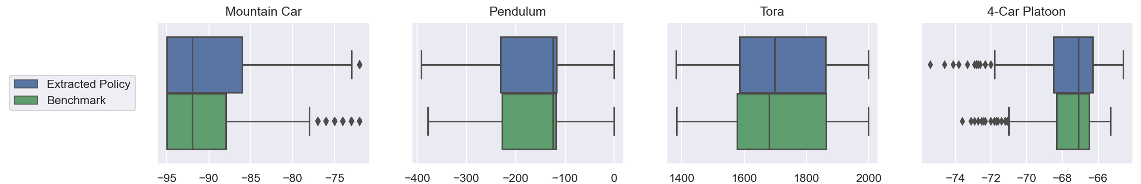
Experiment—Performance Comparison
Performance comparison between the extracted policies and the DNNs (horizontal axis: the episode reward).
We utilize the framework (TF2RL) to train benchmark neural networks.
We use boxplots to depict the distribution of test results, where the black dots are outliers.
The metrics describing the distribution of episodic rewards, such as minimum and median, are close.
Notes:
Here we intend to demonstrate two aspects of our approach through experiments. The first is the performance comparison with the benchmark DNN.
We utilize a framework to train benchmark neural networks. We utilize the framework TF2RL to train benchmark neural networks.
We use the default settings in the framework for most training hyperparameters.
We compare the performance of extracted policies and original DNNs via the episode reward value. We test 500 episodes for both policies.
As shown in the figure, we use boxplots to depict the distribution of test results, where the black dots are outliers.
We can see that the metrics describing the distribution of episodic rewards, such as minimum and median, are close.

Slide 9
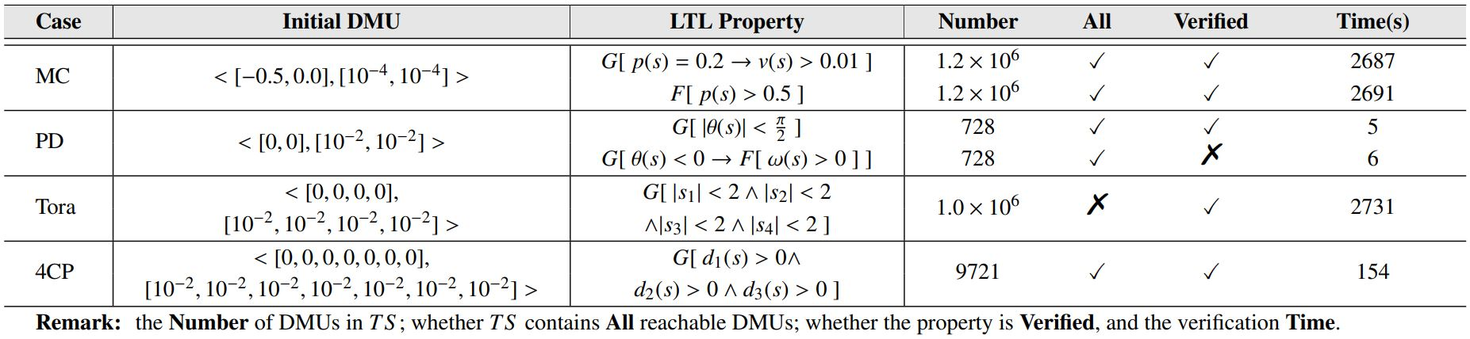
Experiment— LTL Verification Analysis
LTL verification results of four systems driven by extracted policies.
Remark: the Number of DMUs in the transition system; whether the transition system contains All reachable DMUs; whether the property is Verified, and the verification Time.
Notes:
The second experiment is the LTL verification of four benchmark systems. The results are listed in the table, where the meaning of each column is marked below the table. We verify the LTL properties related to the system setting.
Here we focus on the last column, the verification time. The verification time is proportional to the number of traversed DMUs. However, compared with the state space, reachable DMUs are limited. Therefore, the combination of policy extraction and T S construction can ensure efficient verification of systems with limited reachable ranges.

Slide 10
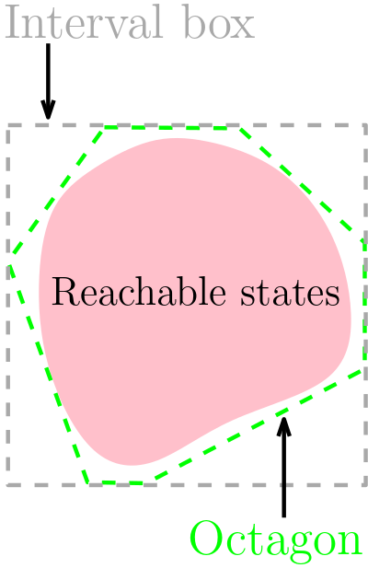
Conclusion and Future Work
A more precise over-approximation can reduce the number of decision-making units involved in the transition system, which can improve verification efficiency. For example, Octagon can be used to replace the interval box to over-approximate the reachable range and then calculate the decision-making units that intersect it.
Notes:
Finally, I will discuss the future work of our approach. As the figure shows, a more precise over-approximation can reduce the number of decision-making units involved in the transition system, which can improve verification efficiency. For example, Octagon can be used to replace the interval box to over-approximate the reachable range.

