Slide 1
Formal Verification of the Lim-Jeong-Park-Lee Autonomous Vehicle Control Protocol using the OTS/CafeOBJ Method
Tatsuya Igarashi Masaki Nakamura Kazutoshi Sakakibara
Toyama Prefectural University, Japan

Slide 2

Background and Motivation
Autonomous vehicle (AV) technology has been developed rapidly
For a near future with lots of AVs may be used densely,
not only a control of a single AV
but also a group control of AVs is important
We investigate a way to verify a group control system for AVs using CafeOBJ, an algebraic specification language/system
https://cafeobj.org
Notes:
〜必要となります．本研究では，衝突回避性について検証する手法として，形式手法を用います．

Slide 3
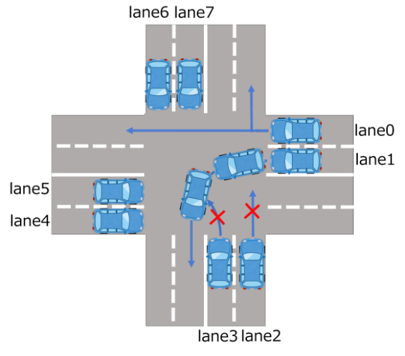
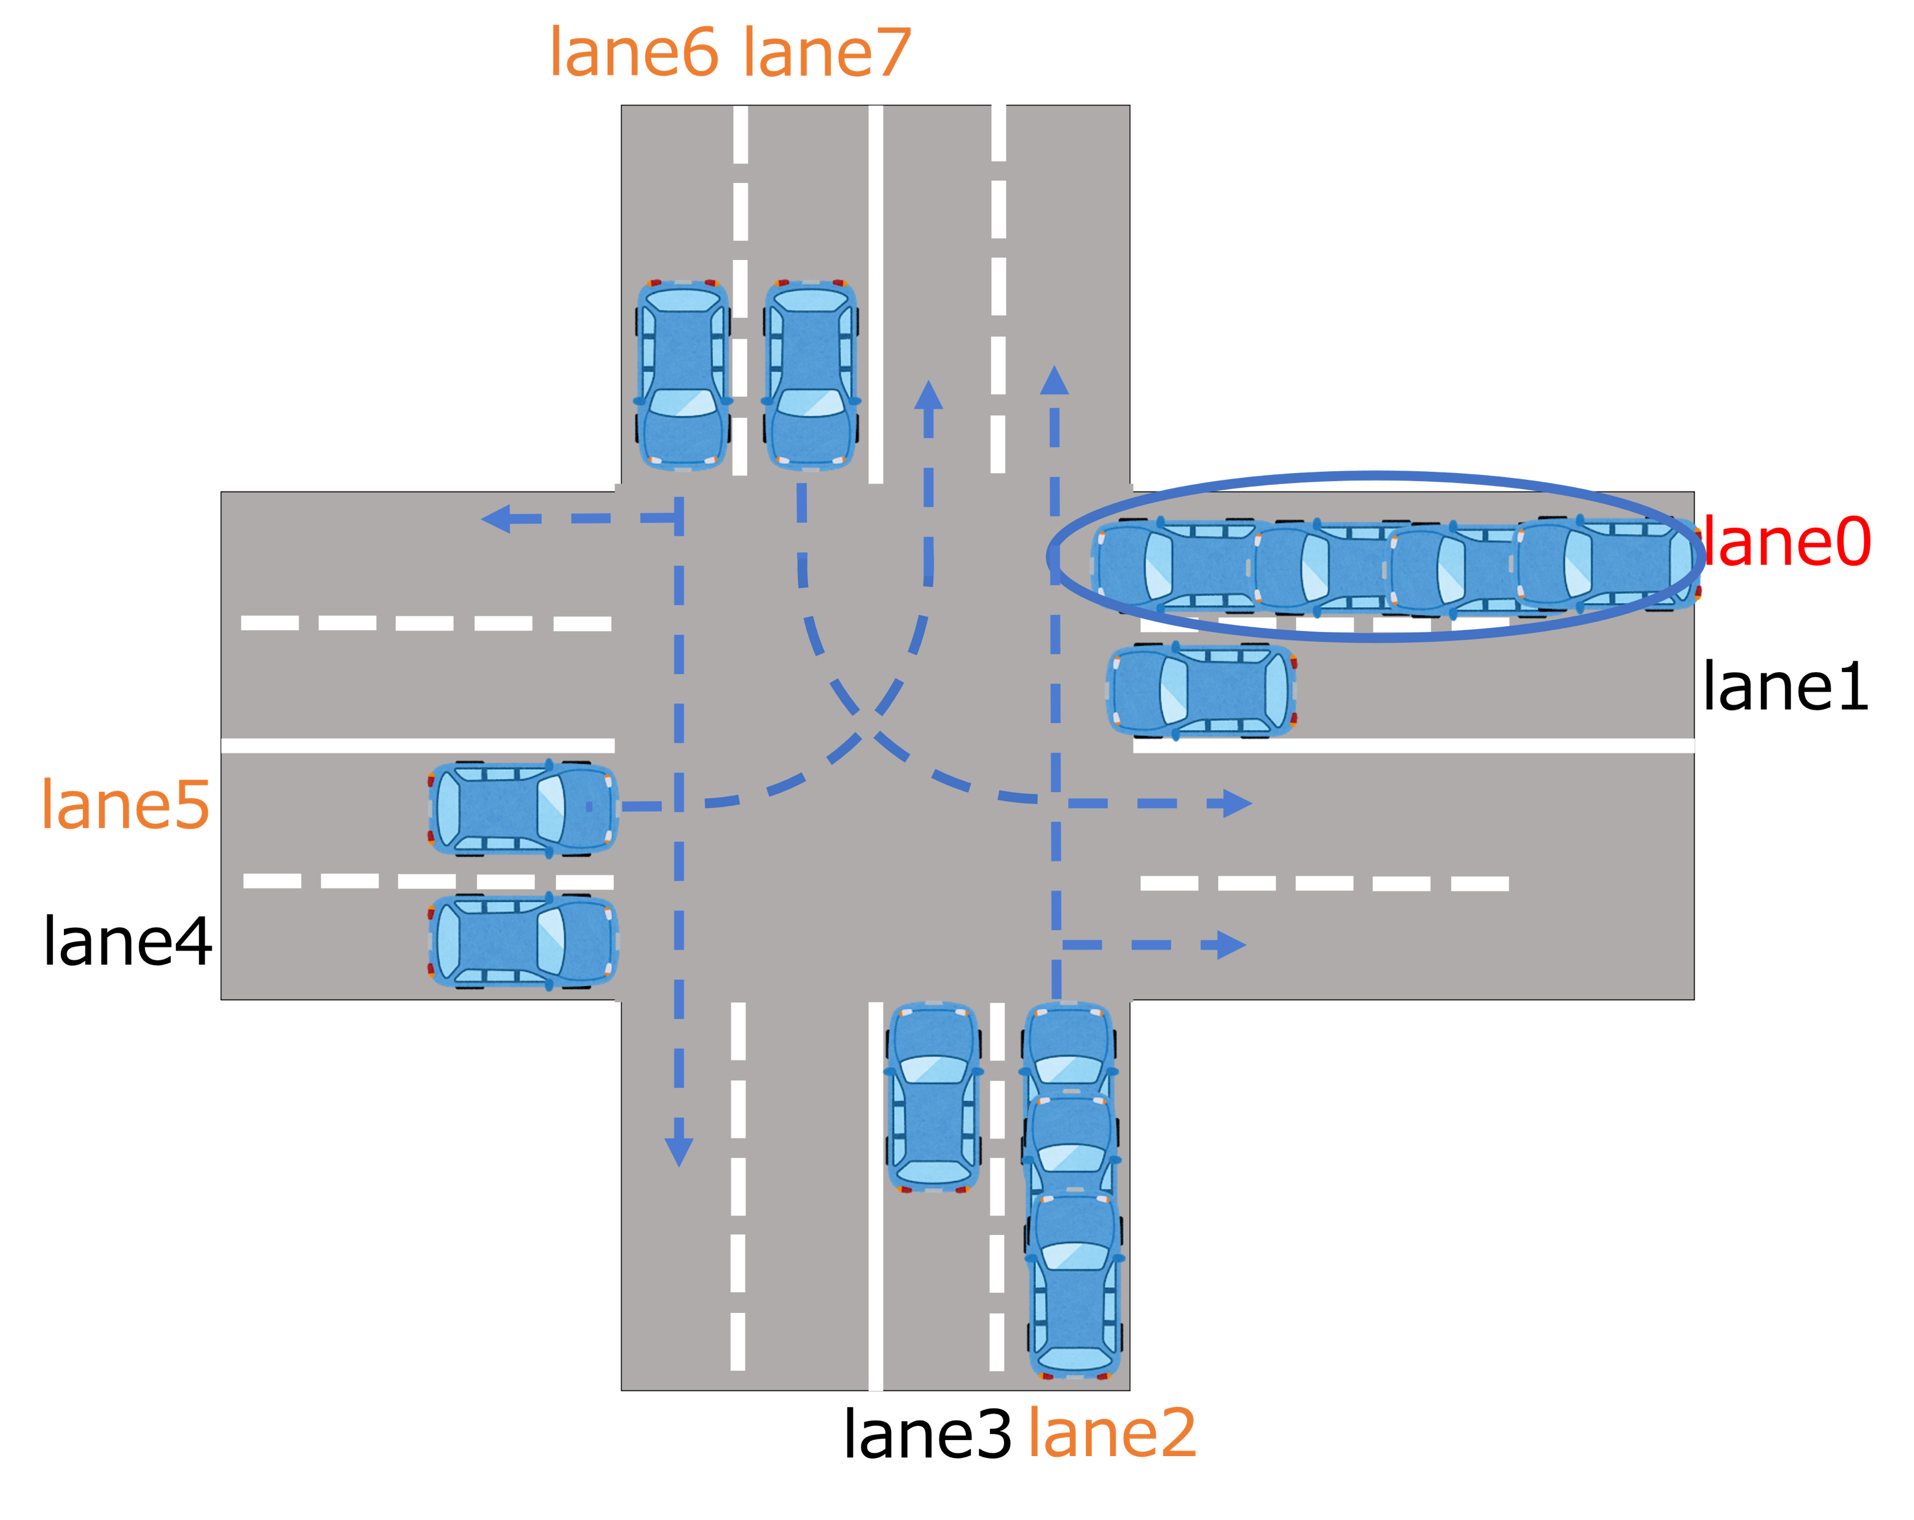
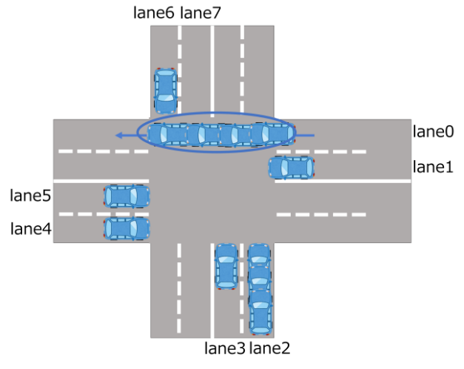
Related work : our target protocol
In [LJPL18], an efficient distributed mutual exclusion algorithm for intersection traffic control, called the Lim-Jeong-Park-Lee protocol (LJPL protocol), has been proposed
AVs can enter if they are not in conflict lanes
All AVs waiting in a queue have a same time stamp of the arrival time of the head of the queue
AVs with earlier time stamps than other conflict lanes
can enter
[LJPL18] J. Lim, Y. Jeong, D. Park, and H. Lee, An efficient distributed mutual exclusion algorithm for intersection traffic control, The Journal of Supercomputing, vol.74, pp.1090-1107, 2018.
Notes:
〜必要となります．本研究では，衝突回避性について検証する手法として，形式手法を用います．

Slide 4
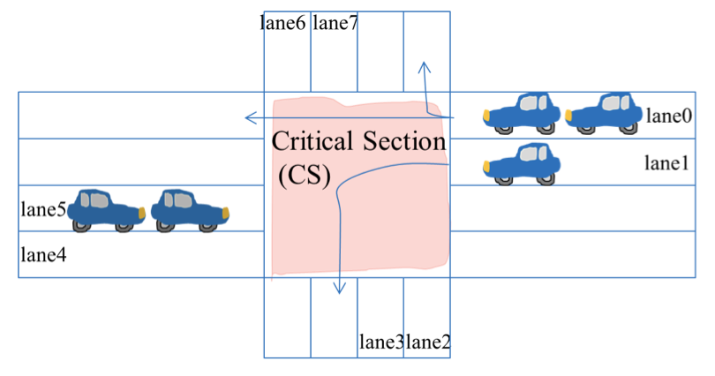
Related work : verification of LJPL
In [Nandi19], the LJPL protocol has been formally specified and
the safety property is verified by Maude tool, which supports fully automated exhaustive searching by model checker
There is a limitation of the size of
a state space, such that
only five vehicles can be treated,
mentioned in [Nandi19]
Our purpose is to verify it
without any limitation
[MYK19]
[Nandi19] Moe Nandi Aung, Yati Phyo, Kazuhiro Ogata, Formal Specification and Model Checking of the Lim-Jeong-Park-Lee Autonomous Vehicle Intersection Control Protocol，SEKE 2019，pp.159-208，2019.
Notes:
〜必要となります．本研究では，衝突回避性について検証する手法として，形式手法を用います．

Slide 5
Approach : The OTS model
We model the LJPL protocol as an observational transition system (OTS) [Ogata03]
A state of the system is not represented explicitly
but can be identified through a given set of observation functions
We can model a system independent from the structure of states
Our model does not fix the number of vehicles participating the protocol
[Ogata03] K. Ogata, and K. Futatsugi, Proof scores in the OTS/CafeOBJ method, FMOODS 2003, LNCS 2884, pp.170-184. Springer, 2003.

Slide 6
Approach : The OTS/CafeOBJ method
An OTS can be specified in CafeOBJ language, which supports not only specification description but also specification execution for semi-automated verification
For the OTS/CafeOBJ specification of the LJPL protocol, we verify
the safety property such that vehicles of different conflict lanes cannot enter at same time by the proof score method based on the specification execution
[Ogata03] K. Ogata, and K. Futatsugi, Proof scores in the OTS/CafeOBJ method, FMOODS 2003, LNCS 2884, pp.170-184. Springer, 2003.

Slide 7
Data modules
An OTS/CafeOBJ specification consists of data modules and a system module
There are two kinds of module declarations in CafeOBJ
mod! LID{ [Lid]
ops lane0 lane1 lane2 lane3 lane4
lane5 lane6 lane7 lane999 : -> Lid
op _=_ : Lid Lid -> Bool {comm}
op _<_ : Lid Lid -> Bool
eq (L:Lid = L) = true .
eq (lane0 = lane1) = false . ...
eq (L:Lid < L) = false .
eq (lane0 < lane1) = true . ...
eq (lane5 < lane3) = false . ... }
mod* VID{
[Vid < Vid+]
op dummy : -> Vid+
op _=_ : Vid+ Vid+ -> Bool {comm}
eq (I:Vid = dummy) = false .
eq (V:Vid+ = V) = true . }
Loose denotation : an arbitrary model of vehicles is denoted, e.g.,
five vehicles, a hundred vehicles, infinitely many vehicles
Tight denotation : a model of 8+1 lanes

Slide 8
System module: observers
After defining data modules, we give a system module of the LJPL protocol
First, we give observers of our system module
There are six observers for observing lane IDs, vehicles states, time stamps, and so on
mod* OTS{
pr(LID + VSTAT + QUEUE + TIMEVAL)
*[Sys]*
bop lid : Sys Vid+ -> Lid
bop vstat : Sys Vid+ -> VStat
bop t : Sys Vid+ -> Rat
bop lt : Sys Vid+ -> Rat+
bop q : Sys Lid -> Queue
bop now : Sys -> Rat

Slide 9
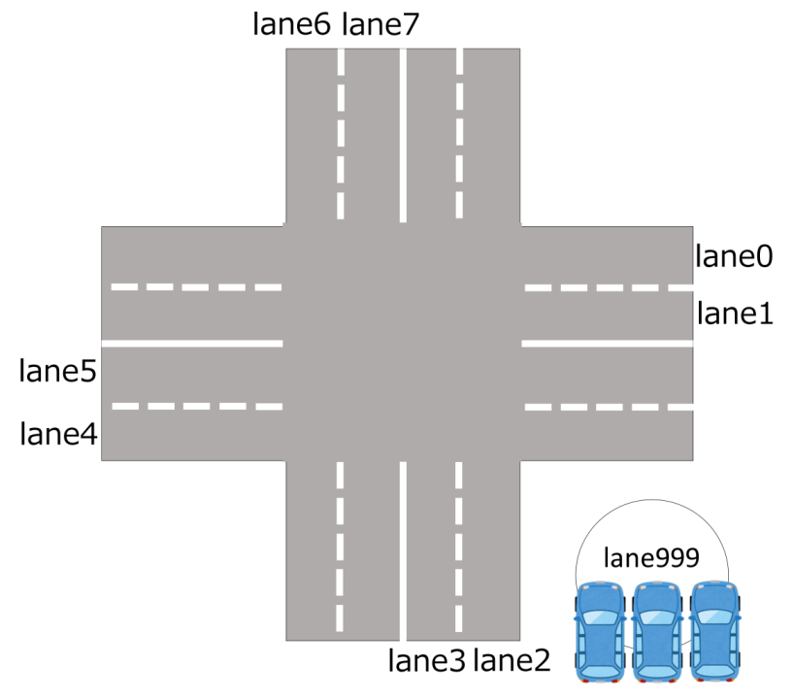

System module: an initial state
The initial state is defined through six observers
op init : -> Sys
eq lid(init,I:Vid) = lane999 .
eq vstat(init,I:Vid) = running .
eq t(init,I:Vid) = oo .
eq lt(init,I:Vid) = oo .
eq q(init,L:Lid) = empty .
eq now(init) = 0 .
0
The initial lanes of all vehicles are lane999, that stands for outside of the intersection
The initial time is zero, and so on

Slide 10
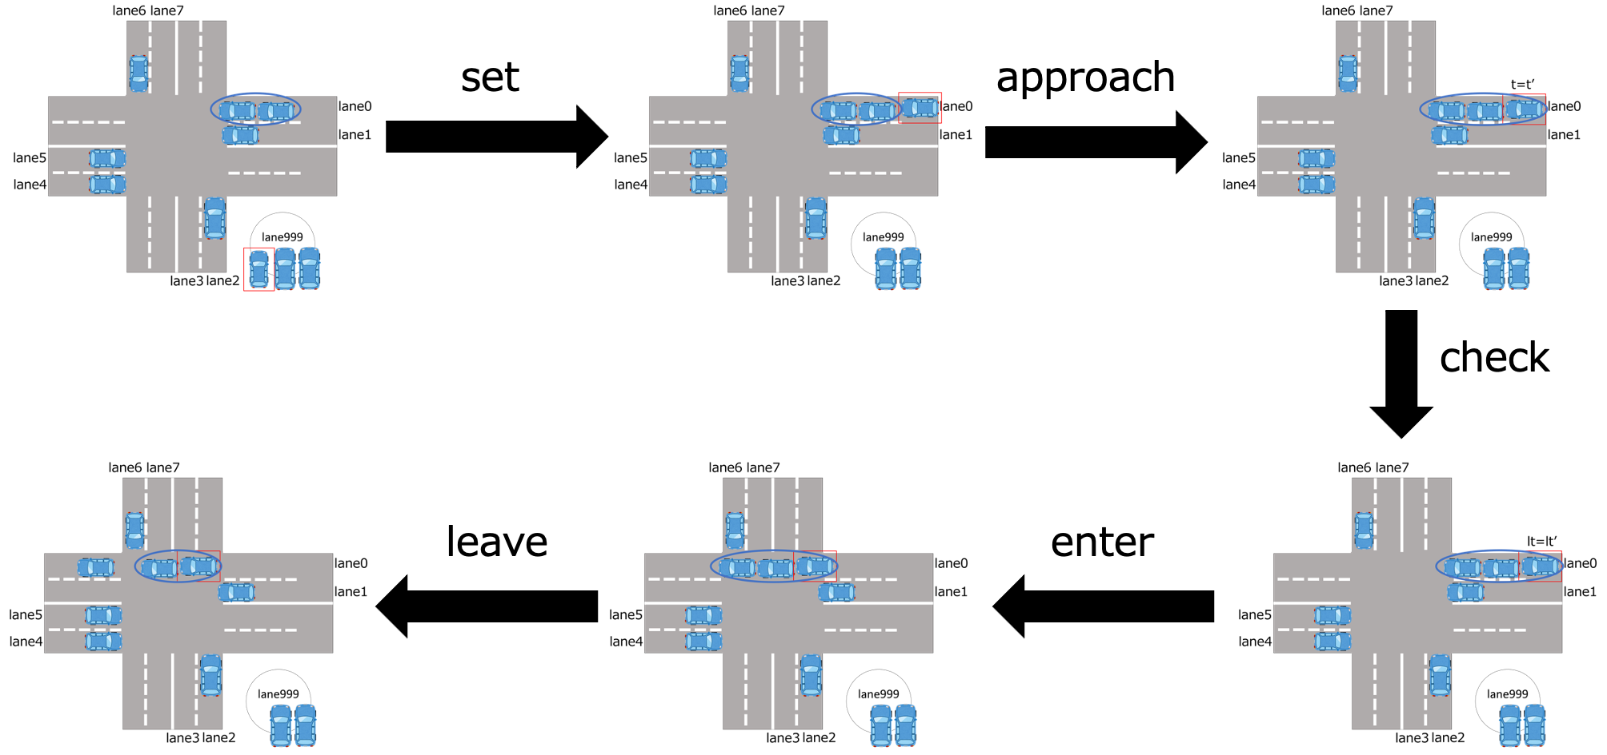
Transitions for LJPL protocol
There are five transitions during an AV has crossed the intersection
approach to the queue
set to a lane
check time of the head AV and set it
leave the intersection
enter the intersection
when the time is earlier than the other conflict queues

Slide 11
System module: transitions
We declare six transitions and define them by equations
The following is the set of all equations defining set
bop set : Sys Vid Lid -> Sys bop approach : Sys Vid -> Sys
bop check : Sys Vid -> Sys bop enter : Sys Vid -> Sys
bop leave : Sys Vid -> Sys bop tick : Sys Rat -> Sys
ceq lid(set(S,I,L),J) = (if I = J then L else lid(S,J) fi) if c-set(S,I) .
ceq vstat(set(S,I,L),J) = vstat(S,J) if c-set(S,I) .
ceq t(set(S,I,L),J) = t(S,J) if c-set(S,I) .
ceq lt(set(S,I,L),J) = lt(S,J) if c-set(S,I) .
ceq q(set(S,I,L),L') = q(S,L') if c-set(S,I) .
ceq now(set(S,I,L)) = now(S) if c-set(S,I) .
Similarly, we define six observed values after applying each of six transitions, that is, 36 equations like the above.

Slide 12
Specification execution
CafeOBJ supports a reduction command based on term rewriting theory
The reduction command takes a term and returns a term by applying equations
eq s1 = approach(set(set(init,a,lane2),b,lane0),a) .
s1 represents the state by applying set for a and b and approach for a to the initial state
%OTS5> red lid(s1,a) .
(lane2):Lid
%OTS5> vstat(s1,a) .
(approaching):VStat
By the reduction command we can obtain
  The lane ID of a at s1 (lane2)
  The state of a at s1 (approaching)

Slide 13
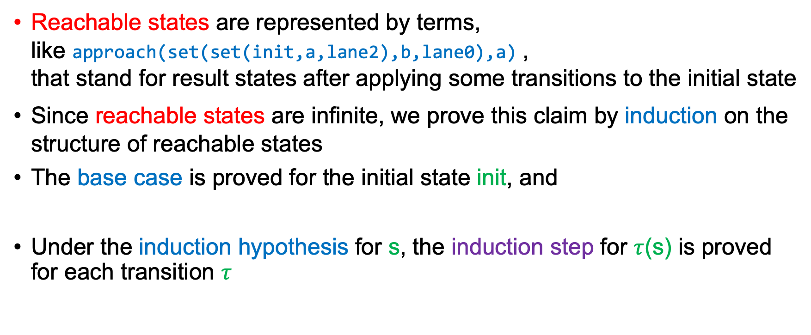
Structural induction
Reachable states are represented by terms,
like approach(set(set(init,a,lane2),b,lane0),a) ,
that stand for result states after applying some transitions to the initial state
Since reachable states are infinite, we prove this claim by induction on the structure of reachable states
The base case is proved for the initial state init, and
Under the induction hypothesis for s, the induction step for $τ$(s) is proved for each transition $τ$
red inv1(init,i,j) .
eq s’ = set(s,k,l) .
red inv1(s,i,j) implies inv1(s’,i.j) .

Slide 14
Invariant property of safety
We formalize a safety predicate inv1 for states as follows:
eq inv1(S,I,J) =
(not(I = J) && vstat(S,I) = crossing && vstat(S,J) = crossing)
implies concur(lid(S,I),lid(S,J)) .
The invariant property inv1 is a state predicate, meaning that different vehicles can cross the intersection at concurrent lanes only
We prove inv1(s) is true for all reachable states from the initial state
BASE CASE: The following base case of the induction returns true
red inv1(init,i,j) .

Slide 15
Structural induction: induction step
The following proof passage represents an induction step for set
open INV .
ops i j : -> Vid .
eq s' = set(s,k,l) .
red inv1(s,i,j) implies inv1(s’,i.j) .
close .
Unfortunately, the above reduction does not return true nor false
We divide the proof passage into two cases manually until they return true or false
eq c-set(s,k) = true .
eq s' = set(s,k,l) .
red inv1(s,i,j) implies inv1(s’,i.j) .
eq c-set(s,k) = false .
eq s' = set(s,k,l) .
red inv1(s,i,j) implies inv1(s’,i.j) .

Slide 16
Structural induction: complete a proof
We do case-splitting until the reduction commands return true or false
When it is false, we need find an appropriate lemma to deny it and
need prove the added lemma as well as the first invariant property inv1
Finally, we obtain a complete proof score for inv1 with 609 proof passages which all return true, where twenty lemmas are introduced
Since the data module VID of vehicles denotes the loose denotation,
the system specification OTS denotes all systems following the LJPL protocol with arbitrary number of vehicles
Our result guarantees that the LJPL protocol is safe for any set of AVs

Slide 17
Conclusion
We described an OTS model of the LJPL protocol in CafeOBJ language and verified a safety property by the proof score method.
The main contribution of our study is to give a formal verification of the safety property of the LJPL protocol for arbitrary number of vehicles
In [Nandi19], not only the safety property we deal with in this study, but other important properties of intersection control protocols have also been verified, e.g., the deadlock-freedom and the starvation-freedom properties
To specify and verify such properties in our OTS/CafeOBJ specification is one of our future work

Slide 19
Data modules
Since the LJPL protocol manages a queue of vehicles,
we specify a data module QUEUE of queues as follows:
mod! QUEUE{
pr(VID) [Queue]
op empty : -> Queue
op _,_ : Vid Queue -> Queue
op put : Queue Vid -> Queue
op remove : Queue -> Queue
op top : Queue -> Vid+ ...
...
eq put(empty,I:Vid) = I,empty .
eq put((J:Vid,Q:Queue),I:Vid) = J,put(Q,I) .
...
}
put((a,b,empty),c)
= a,put((b,empty),c)
= a,b,put(empty,c)
= a,b,c,empty
One of the strong points of algebraic specifications is that we can describe specifications of user-defined abstract data types intuitively

Slide 20
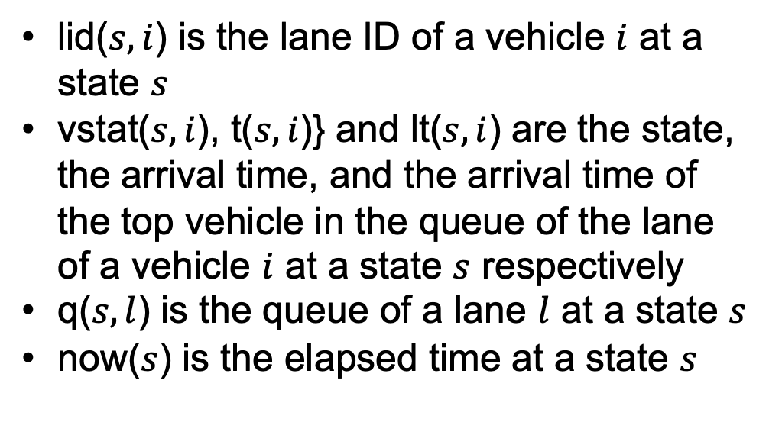
System module: observers
We give a system module of the LJPL protocol.
First, we give observers of our system module
lid($s,i$) is the lane ID of a vehicle $i$ at a state $s$
vstat($s,i$), t($s,i$)} and lt($s,i$) are the state, the arrival time, and the arrival time of the top vehicle in the queue of the lane of a vehicle $i$ at a state $s$ respectively
q($s,l$) is the queue of a lane $l$ at a state $s$
now($s$) is the elapsed time at a state $s$
mod* OTS{
pr(LID + VSTAT + QUEUE + TIMEVAL)
*[Sys]*
bop lid : Sys Vid+ -> Lid
bop vstat : Sys Vid+ -> VStat
bop t : Sys Vid+ -> Rat
bop lt : Sys Vid+ -> Rat+
bop q : Sys Lid -> Queue
bop now : Sys -> Rat

Slide 21
System module: transitions (1/2)
State transitions are declared as follows:
bop set : Sys Vid Lid -> Sys
bop approach : Sys Vid -> Sys
bop check : Sys Vid -> Sys
bop enter : Sys Vid -> Sys
bop leave : Sys Vid -> Sys
bop tick : Sys Rat -> Sys
Term set(s,i,l) is the result state after applying the transition set for a vehicle i and a lane l at the state s
Similarly, other transitions are declared as operators which take a current state and return the result state with some parameters.
Transition tick(s,x) is a special transition which advances elapsed time by x
A transition has its effective condition under which it can be executed
op c-set : Sys Vid -> Bool
eq c-set(S:Sys,I) =
(vstat(S,I) = running
&& lid(S,I) = lane999) .

Slide 22
System module: transitions (2/2)
The following is the set of all equations defining set when it is effective.
ceq lid(set(S,I,L),J) = (if I = J then L else lid(S,J) fi) if c-set(S,I) .
ceq vstat(set(S,I,L),J) = vstat(S,J) if c-set(S,I) .
ceq t(set(S,I,L),J) = t(S,J) if c-set(S,I) .
ceq lt(set(S,I,L),J) = lt(S,J) if c-set(S,I) .
ceq q(set(S,I,L),L') = q(S,L') if c-set(S,I) .
ceq now(set(S,I,L)) = now(S) if c-set(S,I) .
For example, the first equation specifies that
the lane ID (lid) of a vehicle J after set(S,I,L) is defined as
L if I = J when set is effective, and it is unchanged if I and J are different
Similarly, we define six observed values after applying each of six transitions, that is, 36 equations like the above.

Slide 23
Invariant property of safety
We verify the safety property of the LJPL protocol, that is, no vehicles enter the intersection if they belong to conflict lanes in all reachable states
First, we formalize a safe state by operators and equations.
eq concur(L,L') = ((L = L') || (L = lane0 && (L' = lane1 || L' = lane3
|| L' = lane4) || ... ) .
eq inv1(S,I,J) =
(not(I = J) && vstat(S,I) = crossing && vstat(S,J) = crossing)
implies concur(lid(S,I),lid(S,J)) . }
The first equation specifies a predicate concur such that concur(L,L') is true if lanes L does not conflict with L’
The invariant property inv1 is a state predicate, meaning that different vehicles can cross the intersection at concurrent lanes only

Slide 24
Structural induction: base step
The following is a fragment of a proof score, called a proof passage, for the base step
open INV .
ops i j : -> Vid .
red inv1(init,i,j) .
close .
Constants i and j are declared as arbitrary vehicles
CafeOBJ returns true as the result of the above reduction,
that guarantees that the base step is proved successfully.

Slide 25
Specification execution
The CafeOBJ reduction command reduces a term to a term equivalent to the input term based on term rewriting theory
open OTS .
ops a b : -> Vid . eq (a = b) = false .
op s1 : -> Sys . eq s1 = approach(set(set(init,a,lane2),b,lane0),a) .
red lid(s1,a) .
red vstat(s1,a) .
red vstat(s1,b) .
close .
In the left , the state s1 is obtained by applying
set lane2 and lane0 for AVs a and b resp.
to the initial state and then applying approach for a
The lane ID and states of the AVs can be obtained by the CafeOBJ reduction command
All reachable states are represented by terms constructed by init and transitions
%OTS5> -- reduce in %OTS5 : (lid(s1,a)):Lid
(lane2):Lid
%OTS5> -- reduce in %OTS5 : (vstat(s1,a)):VStat
(approaching):VStat
%OTS5> -- reduce in %OTS5 : (vstat(s1,b)):VStat
(running):VStat

Slide 26
Specification execution
open OTS . ...
eq s1 = set(set(set(set(init,a,lane0),b,lane3),b2,lane3),c,lane4) .
eq s2 = approach(approach(approach(s1,a),b),c) .
eq s3 = approach(tick(s2,1),b2) .
eq s4 = check(check(check(check(s3,a),b),c),b2).
eq s5 = enter(enter(enter(s4,c),b),a) .
red vstat(s5,a) . red vstat(s5,b) .
red vstat(s5,b2) . red vstat(s5,c) .
close .
By the last four reduction commands, we check states of all vehicles
CafeOBJ returns crossing for a in lane0, crossing for b and b2 in lane3, and stopped for c in lane4
Vehicles a and b, b2 are crossing since they do not conflict with each other
Vehicle c failed to enter (from stopped to crossing) since b in a conflict lane has already entered
Although b2’s arrival time is later than c’s arrival time, b2 entered since it belongs to the same queue with b.

Slide 27
Structural induction: Unreachable states
If a proof passage returns false, there are two possibilities, the invariant property is not true or the considered state is unreachable from the initial state
open ISTEP .
ops i j k : -> Vid .
eq vstat(s,k) = stopped . eq top(q(s,lid(s,k))) = k . eq lid(s,k) = lane0 . eq top(q(s,lane0)) = k . eq vstat(s,top(q(s,lane2))) = stopped . ...
eq s' = enter(s,k) . eq i = k . eq (j = k) = false . eq lid(s,j) = lane2 .
eq (lid(s,j)= lane0) = false . eq vstat(s,j) = crossing .
red inv1(s,i,j) implies inv1(s’,i.j) .
close .

Slide 28
Structural induction: Lemma discovery
To solve this proof passage, we introduce a lemma extracted from the unreachable state
The following is a lemma we introduce.
eq pred1(S,empty) = true .
eq pred1(S,(I,Q)) = (if vstat(S,I) = crossing then false else pred1(S,Q) fi) .
eq pred2(S,empty) = true .
eq pred2(S,(I,Q)) = (if vstat(S,I) = stopped then pred1(S,Q) else pred2(S,Q) fi) .
eq inv2(S,I) = pred2(S,q(S,lid(S,I))) .
red inv2(s,j) implies inv1(s,i,j) implies inv1(s’,i.j) .
Then, the reduction does not return false, and
We proceed case splitting and lemma discovery repeatedly and
all proof passages (cases) for inv1 become true after introducing two more lemmas inv3 and inv4

