Slide 1
Exploring Relevance and Coherence for Automated Text Scoring using Multi-task Learning
Presenter：Yupin Yang
SEKE 2022
KSIR Virtual Conference Center, Pittsburgh, USA
July 1 - July 10, 2022
Notes:
Good morning ladies and gentlemen. I am honored to speak at this conference. I am yupin yang, a master student from Chongqing university. Today my topic is Exploring Relevance and Coherence for Automated Text Scoring using Multi-task Learning.

Slide 2
Outline
Introduction
Our method
The experiment
Conclusion
Notes:
The content of this presentation is divided into 4 parts: In section 1. I will introduce automated text scoring. In section 2, I will introduce the method we proposed . The experiment will be showd in section 3. Finally I will make a conclusion.

Slide 3

Introduction
Automated text scoring (ATS) is the use of specialized computer programs to assign scores to texts. It is an application of natural language processing.
  Information management
  Recommendation systems
  Knowledge charging
Feature extraction
Text
Regression
Score
Notes:
Automated text scoring (ATS) is the use of specialized computer programs to assign scores to texts. It is an application of natural language processing.
Such systems can also be used for information management, recommendation systems, and knowledge charging. Usually we extract features from the text and use regression to get the score.

Slide 4
Outline
Introduction
Our method
The experiment
Conclusion
Notes:
Then I will introduce our method.

Slide 5
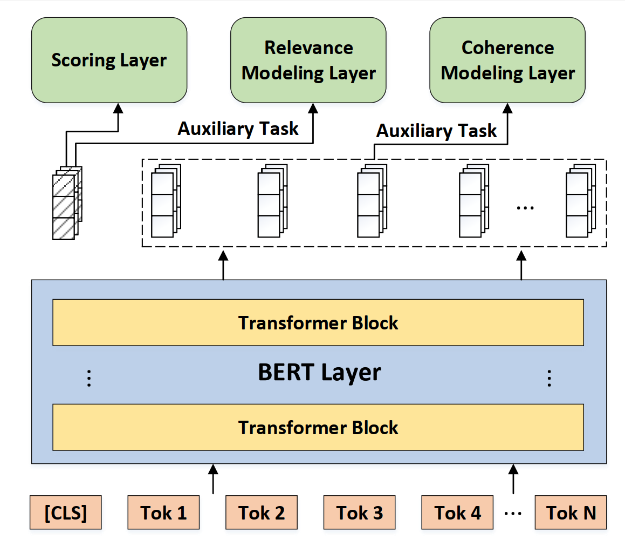
AES-SE
In this section, we describe the proposed hierarchical structured model, which contains three parts:
The encoder Bert layer.
The scoring task layer.
The auxiliary task layer.
The overview of our method
Notes:
In this section, we describe the proposed hierarchical structured model, which contains three parts:
The encoder Bert layer.
The scoring task layer.
The auxiliary task layer.

Slide 6
The BERT layer
Send the words to the encoder to get the vector representation of words.
Notes:
First we send the words into the encoder. Here, we use BERT as the encoder. Because it can better capture the semantics of the given text.

Slide 7
The Relevance modeling layer
Mix up the top 40% essays of all prompts, and their labels are
the prompt they belong to.
Notes:
The next is the auxiliary task. For relevance modeling, we mix up the top 40% essays of all prompts, and their labels are
the prompt they belong to.

Slide 8
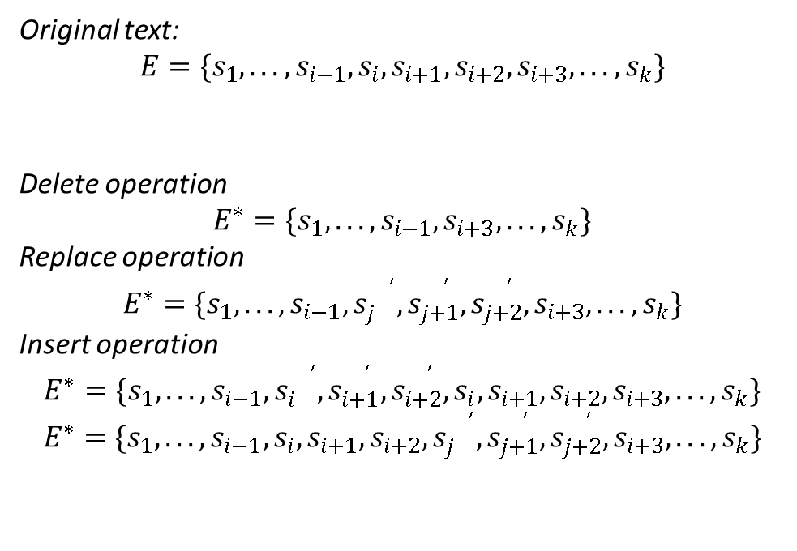
The Coherence modeling layer
Original text:
$$E=\{s_{1},...,s_{i−1},s_{i},s_{i+1},s_{i+2},s_{i+3},...,s_{k}\}$$
Delete operation
$$E^{∗}=\{s_{1},...,s_{i−1},s_{i+3},...,s_{k}\}$$
Replace operation
$$E^{∗}=\{s_{1},...,s_{i−1},s_{j}^{{}^{′}},s_{j+1}^{{}^{′}},s_{j+2}^{{}^{′}},s_{i+3},...,s_{k}\}$$
Insert operation
$$E^{∗}=\{s_{1},...,s_{i−1},s_{i}^{{}^{′}},s_{i+1}^{{}^{′}},s_{i+2}^{{}^{′}},s_{i},s_{i+1},s_{i+2},s_{i+3},...,s_{k}\}$$
$$E^{∗}=\{s_{1},...,s_{i−1},s_{i},s_{i+1},s_{i+2},s_{j}^{{}^{′}},s_{j+1}^{{}^{′}},s_{j+2}^{{}^{′}},s_{i+3},...,s_{k}\}$$
Notes:
The next is the auxiliary task. For coherence modeling, we construct negative samples. The original text is the true sample and the negative one is generated by three operations. Delete operation , Replace operation and Insert operation .

Slide 9
Outline
Introduction
Our method
The experiment
Conclusion
Notes:
The following is the experiment

Slide 10
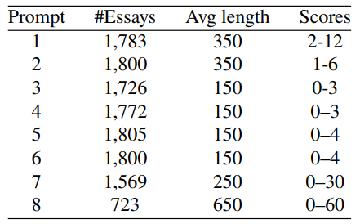
Dataset
ASAP (Automated Student Assessment Prize)¹
Statistics of the ASAP dataset
¹https://www.kaggle.com/c/asap-aes/data
Notes:
We use the ASAP dataset as it has been widely used to evaluate the performance of ATS systems. There are 13 thousand essays written by students with 8 prompts of different topics.

Slide 11
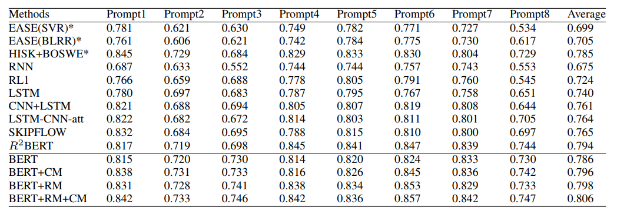
Evaluation
Quadratic Weighted Kappa (QWK) is the official evaluation metric in the ASAP competition, which measures the agreement between ratings assigned by humans and ratings predicted by AES systems.
Comparison with recent methods on the ASAP dataset
¹https://www.kaggle.com/c/asap-aes/data
Notes:
As for evaluation, Quadratic Weighted Kappa (QWK) is the official evaluation metric in the ASAP competition, which measures the agreement between ratings assigned by humans and ratings predicted by ATS systems. From the results in the table, we can see that our model outperforms previous methods.

Slide 12
Outline
Introduction
Our method
The experiment
Conclusion
Notes:
Now I will make a conclusion

Slide 13
Conclusion
In this work, we introduce an approach based on two auxiliary tasks to assess the quality of texts. We integrate the auxiliary tasks into a multi-task learning framework to benefit the scoring task. To verify the effectiveness of our proposed method, we compare our model with several methods on the ASAP dataset. Experimental results show that our model outperforms previous methods. Our work also shows that auxiliary tasks can enhance the performance of the BERT model for downstream tasks. For future work, we plan to explore more dimensions for the automated text scoring task.

Slide 14

Thank you!
SEKE 2022
KSIR Virtual Conference Center, Pittsburgh, USA
July 1 - July 10, 2022
Notes:
That’s all thank you

