Slide 1


An Explainable Knowledge-based AI Framework for Mobility as a Service
Enayat Rajabi^{1,2}, Sławomir Nowaczyk¹, Sepideh Pashami¹, and Magnus Bergquist¹
¹ Center for Applied Intelligent Systems Research, Halmstad University, Halmstad, Sweden
² Cape Breton University, Sydney, NS, Canada
The 34th International Conference on Software Engineering & Knowledge Engineering
July 5th, 2022

Slide 2
Mobility as a Service
Mobility as a Service (MaaS) combines various modes of transportation and different kinds of data to present personalized services to travellers based on transport needs.
The main goal of MaaS is:
  to make commuting convenient for travellers.
  to offer travellers flexible, price-worthy, reliable, and sustainable mobility services for goods shipping and delivery.
  to provide an integrating various services and systems such as electronic ticketing, booking, route planning, and payment services across different modes of transportation.

Slide 3
AI in MaaS
Artificial Intelligence (AI) is increasingly used these days in MaaS to develop advanced mobility services.
A knowledge-based AI system can be used to:
  interpret huge amount of data collected from several sources
  provide the right information to the right user with understandable explanations
  collect facts, designing rules, concepts, procedures, heuristics formulas, relationships, ontologies, statistics, or other helpful information.

Slide 4
Knowledge-based AI Framework for MaaS
There are different sources of mobility knowledge, including contextual data (weather, traffic, disruptions), operational (routes, schedules, business rules, and deliveries), personal (passengers, travellers, and drivers) and transactional (booking, tickets, and payments).
We propose a knowledge-based AI framework that provides customized, explainable, and enriched services based on various types of mobility data.
The framework intends to integrate different mobility data types processes, analyze them, and recommend a real-time personalized service with customized explanations based on mobility users' needs.

Slide 5
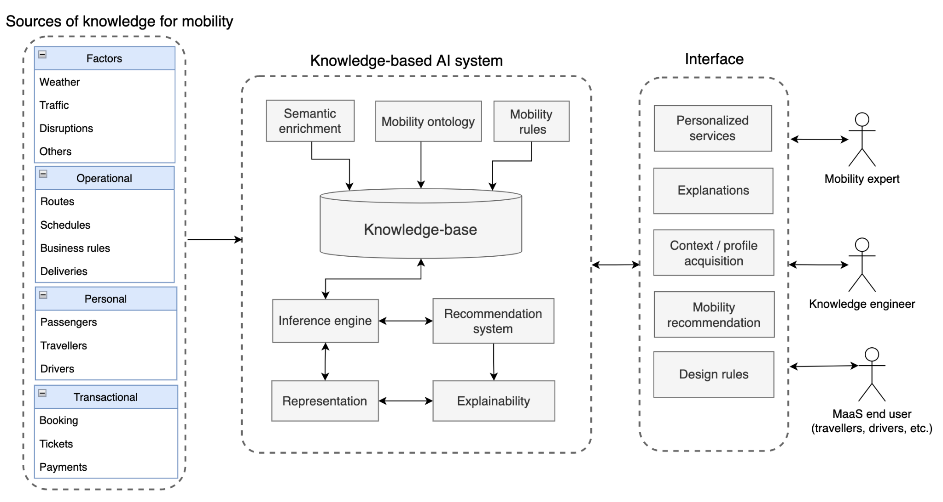
Proposed Framework

Slide 6
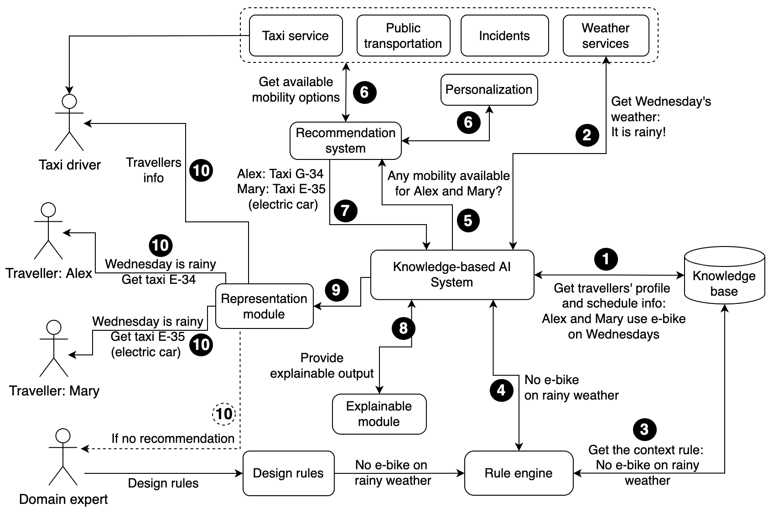
A Scenario based on the Proposed Framework

Slide 7
Conclusions and Future Works
A knowledge base that can capture travellers’ profiles can be combined with AI to create personalized and explainable mobility services.
As a proof of concept, we designed a scenario to illustrate an example of functionality of the proposed framework, although there are some challenges such as data integration.
As a future work, we are going to simulate a couple of mobility scenarios based on the presented framework using sumo simulation software (https://www.eclipse.org/sumo/) .

Slide 8
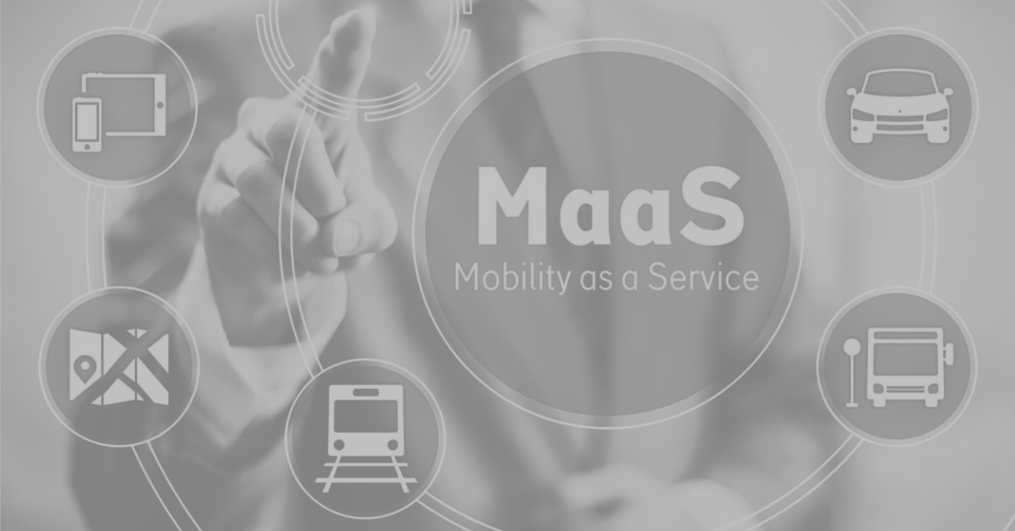
Thank you!

